Slide 1
Here goes your presentation title.
And here your subtitle.

Slide 2

Hello! I’m...
Here is where you introduce yourself.
You can add your name, title and a little background. Right click the image and replace it with your own.

Slide 3
Introduction.
1
This is title number One.
This is title number Two.
This is title number Three.
This is title number Four.
This is title number Five.
6
This is title number Six.
This is title number Seven.
This is title number Eight.
This is title number Nine.
This is title number Ten.
2
7
3
8
4
9
5
10

Slide 4
This is title number One
1
And this is subtitle number One

Slide 5
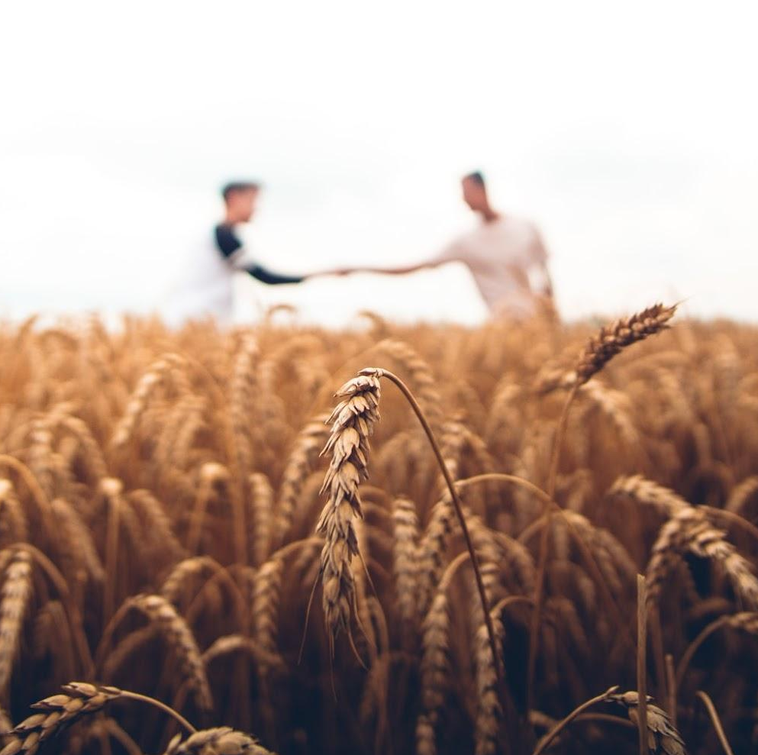
This is title number One.
1
2
3
4
5
6
7
8
9
10
This is subtitle number One.
Did you know that elephants can sense storms?
Elephants may be able to detect a thunderstorm from hundreds of miles away, and will head towards it, looking for water.

Slide 6
This is title number Two
2
And this is subtitle number Two

Slide 7
This is title number Two.
1
2
3
4
5
6
7
8
9
10
A man's best friend...
Mmm, can I fit in?...
Did you know that dogs can smell your feelings?
Dogs can pick up on subtle changes in your scent, which can help him figure out how you are feeling, such as by smelling your perspiration when you become nervous or fearful.
Did you know that a cat uses its whiskers as feelers to determine if a space is too small to squeeze through?
Also, cats love to sleep. A fifteen-year-old cat has probably spent ten years of its life sleeping.

Slide 8
This is title number Three
3
And this is subtitle number Three

Slide 9
Clearly, animals know more than we think, and think a great deal more than we know.
1
2
3
4
5
6
7
8
9
10
― Irene M. Pepperberg

Slide 10
This is title number Four
4
And this is subtitle number Four

Slide 11
This is title number Four.
1
2
3
4
5
6
7
8
9
10
Pandas don’t hibernate.
There are more kangaroos than humans in Australia.
Koalas are even more lazy than cats.
When winter approaches, they head lower down their mountain homes to warmer temperatures, where they continue to chomp away on bamboo!
It is estimated that more than 50 million kangaroos live there. They are Australia’s national symbol and appear on postage stamps, coins, and airplanes.
Koalas don’t have much energy and, when not feasting on leaves, they spend their time dozing in the branches. Believe it or not, they can sleep for up to 18 hours a day!

Slide 12
This is title number Five
5
And this is subtitle number Five

Slide 13
This is title number Five.
1
2
3
4
5
6
7
8
9
10
Elephants
Pandas
Cats
Elephants can sense storms.
Pandas don’t hibernate.
Cats use their whiskers as feelers to determine if a space is too small to squeeze through.
Dogs
Kangaroos
Koalas
Dogs can smell your feelings.
There are more kangaroos than humans in Australia.
Koalas are even more lazy than cats.

Slide 14
This is title number Six
6
And this is subtitle number Six

Slide 15

This is title number Six.
1
2
3
4
5
6
7
8
9
10
This is subtitle number Six.
Did you know that elephants can sense storms?
Elephants may be able to detect a thunderstorm from hundreds of miles away, and will head towards it, looking for water.

Slide 16
This is title number Seven
7
And this is subtitle number Seven

Slide 17
This is title number Seven.
1
2
3
4
5
6
7
8
9
10
A man's best friend...
Mmm, can I fit in?...
Did you know that dogs can smell your feelings?
Dogs can pick up on subtle changes in your scent, which can help him figure out how you are feeling, such as by smelling your perspiration when you become nervous or fearful.
Did you know that a cat uses its whiskers as feelers to determine if a space is too small to squeeze through?
Also, cats love to sleep. A fifteen-year-old cat has probably spent ten years of its life sleeping.

Slide 18
This is title number Eight
8
And this is subtitle number Eight

Slide 19
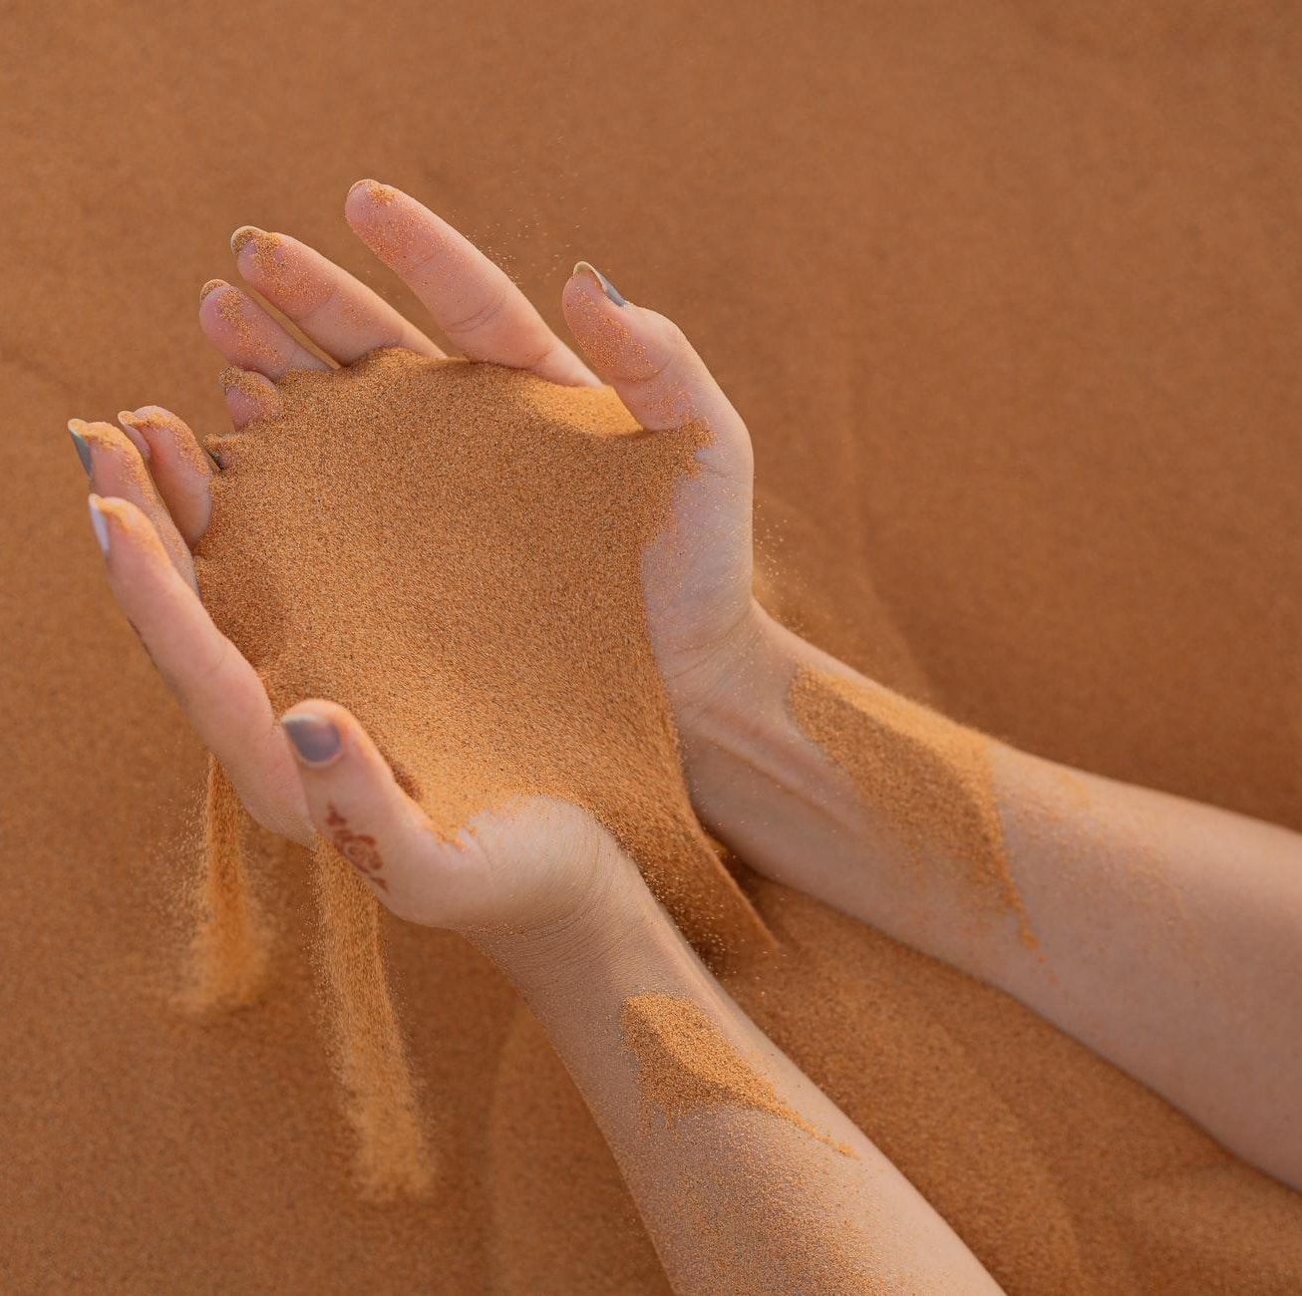
This is title number Eight.
1
2
3
4
5
6
7
8
9
10
This is subtitle number One.
Did you know that elephants can sense storms?
Elephants may be able to detect a thunderstorm from hundreds of miles away, and will head towards it, looking for water.

Slide 20
This is title number Nine
9
And this is subtitle number Nine

Slide 21
This is title number Nine.
1
2
3
4
5
6
7
8
9
10
A man's best friend...
Mmm, can I fit in?...
Did you know that dogs can smell your feelings?
Dogs can pick up on subtle changes in your scent, which can help him figure out how you are feeling, such as by smelling your perspiration when you become nervous or fearful.
Did you know that a cat uses its whiskers as feelers to determine if a space is too small to squeeze through?
Also, cats love to sleep. A fifteen-year-old cat has probably spent ten years of its life sleeping.

Slide 22
This is title number Ten
10
And this is subtitle number Ten

Slide 23
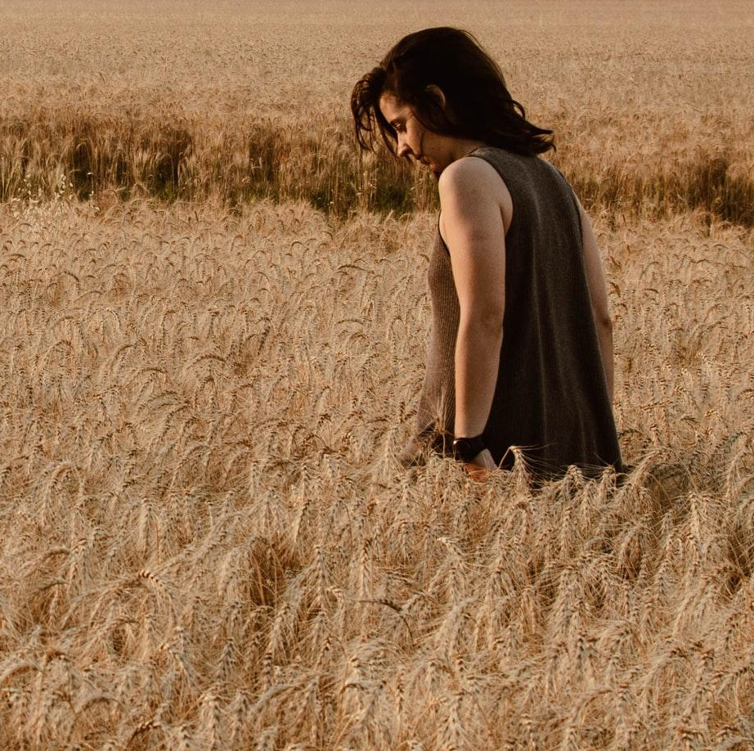
This is title number Ten.
1
2
3
4
5
6
7
8
9
10
This is subtitle number Ten.
Did you know that elephants can sense storms?
Elephants may be able to detect a thunderstorm from hundreds of miles away, and will head towards it, looking for water.

Slide 24
Thank you
Do you have any questions?
hello@mail.com
555-111-222
mydomain.com

Slide 25
Credits.
Presentation Template: SlidesMania
Images: Unsplash
Fonts used in this presentation: Barlow Semi Condensed, Cormorant Upright and Home Made Apple

Slide 26
Editable Icons

