Slide 1
ART GALLERY
You can add a subtitle here.

Slide 2

ROOMS C & D
ROOM
A
ROOM
B

Slide 3
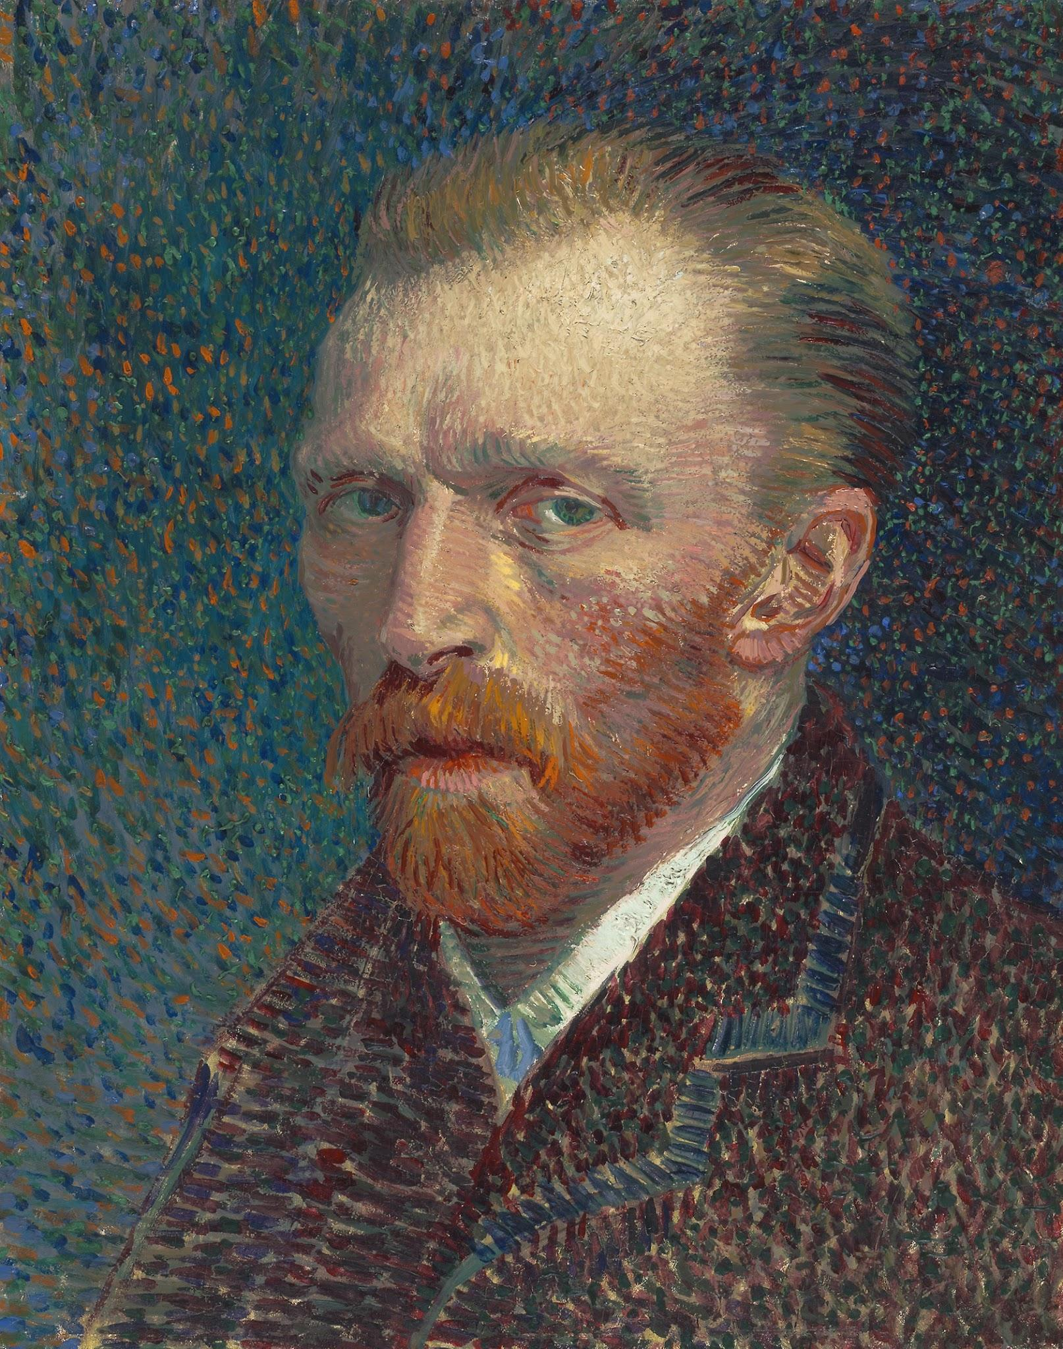
ROOM
A

Slide 4
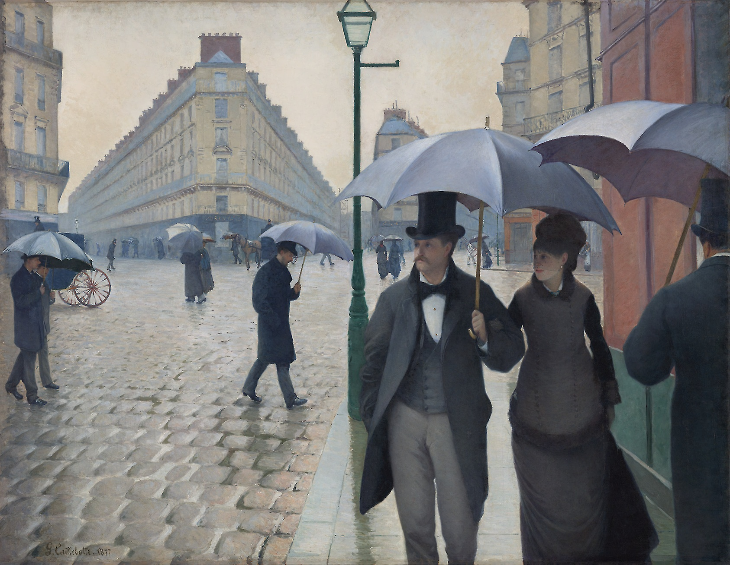
ROOM
B

Slide 5
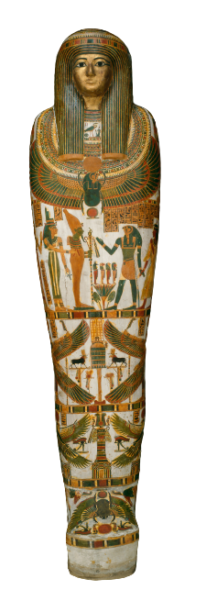
ROOMS E & F
ROOM
C
ROOM
D

Slide 6
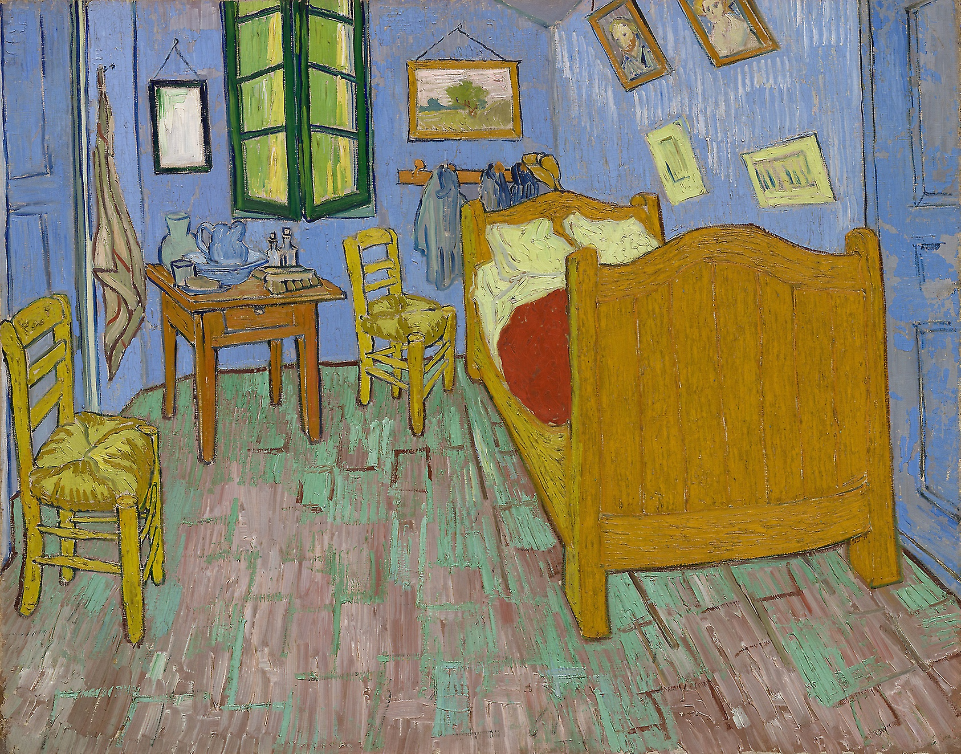
ROOM
C

Slide 7
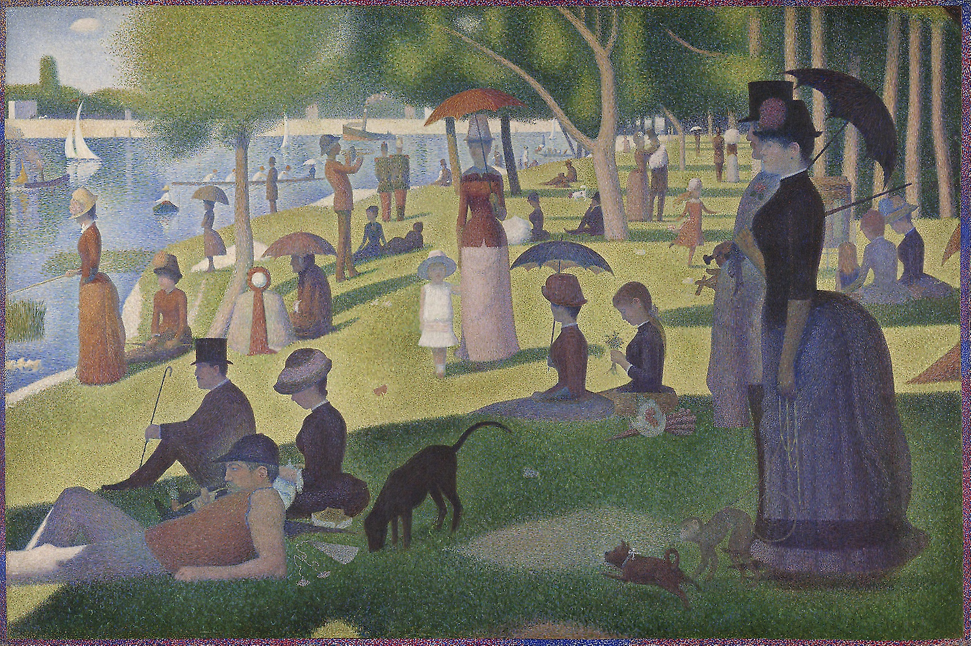
ROOM
D

Slide 8
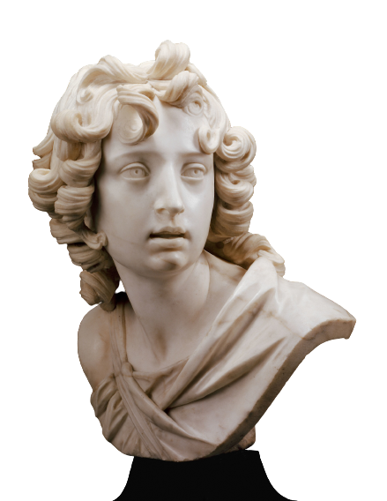
ROOMS G & H
ROOM
E
ROOM
F

Slide 9

ROOM
E

Slide 10
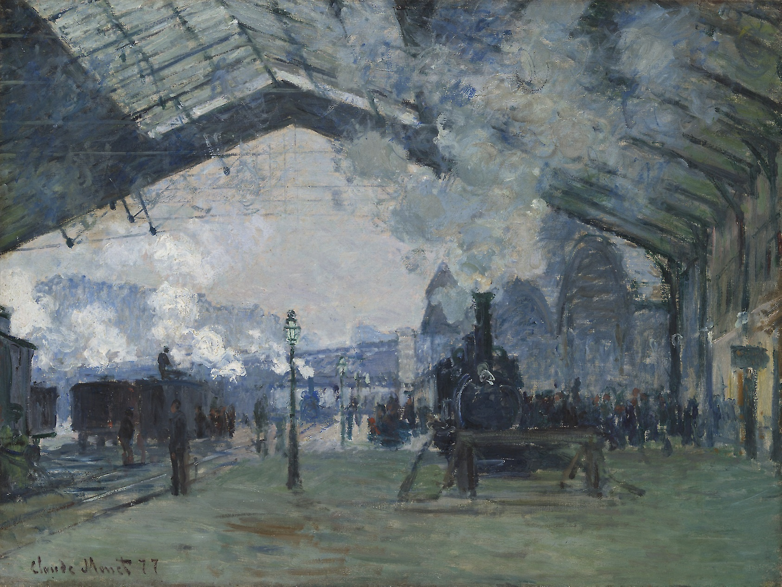
ROOM
F

Slide 11
ROOMS I & J
ROOM
G
ROOM
H

Slide 12
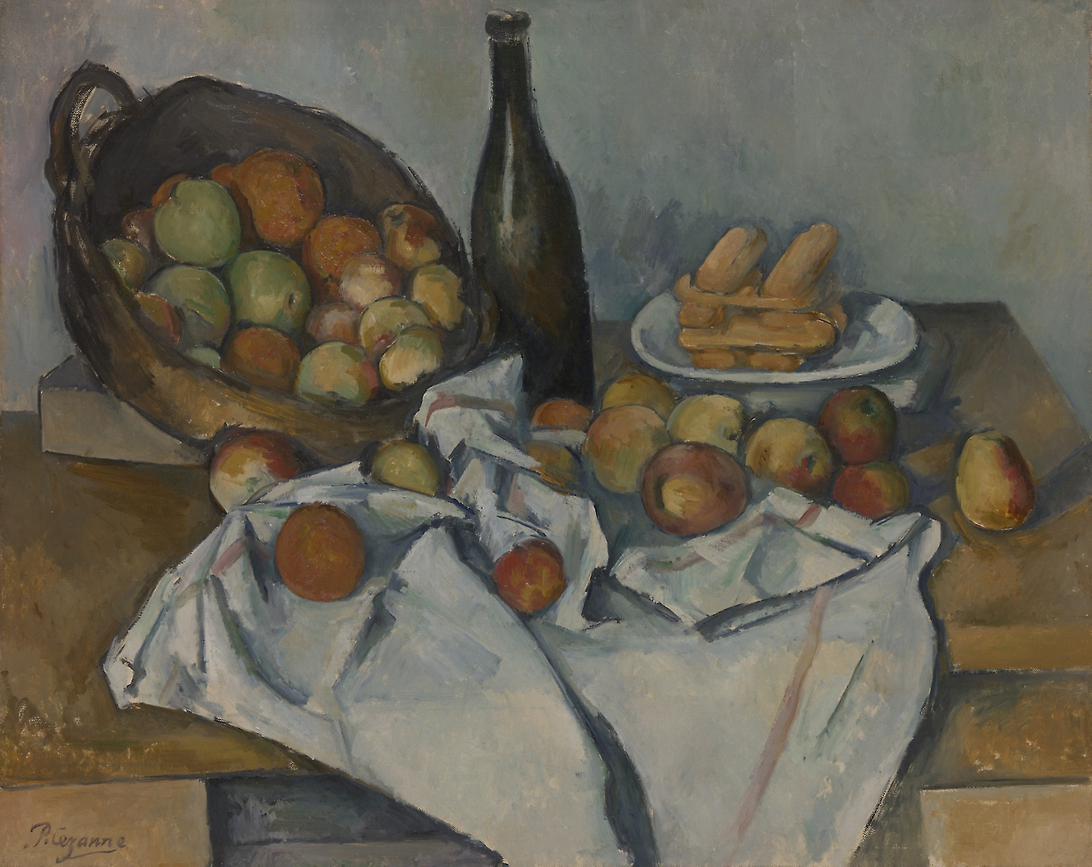
ROOM
G

Slide 13

ROOM
H

Slide 14
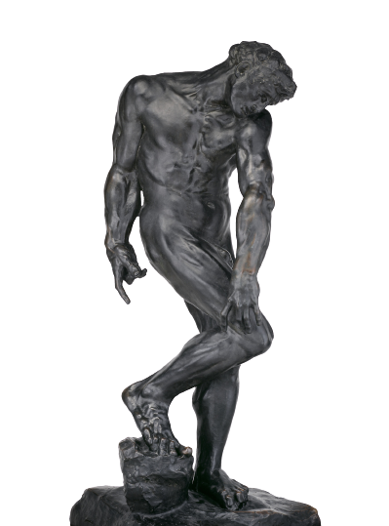
ROOMS K & L
ROOM
I
ROOM
J

Slide 15
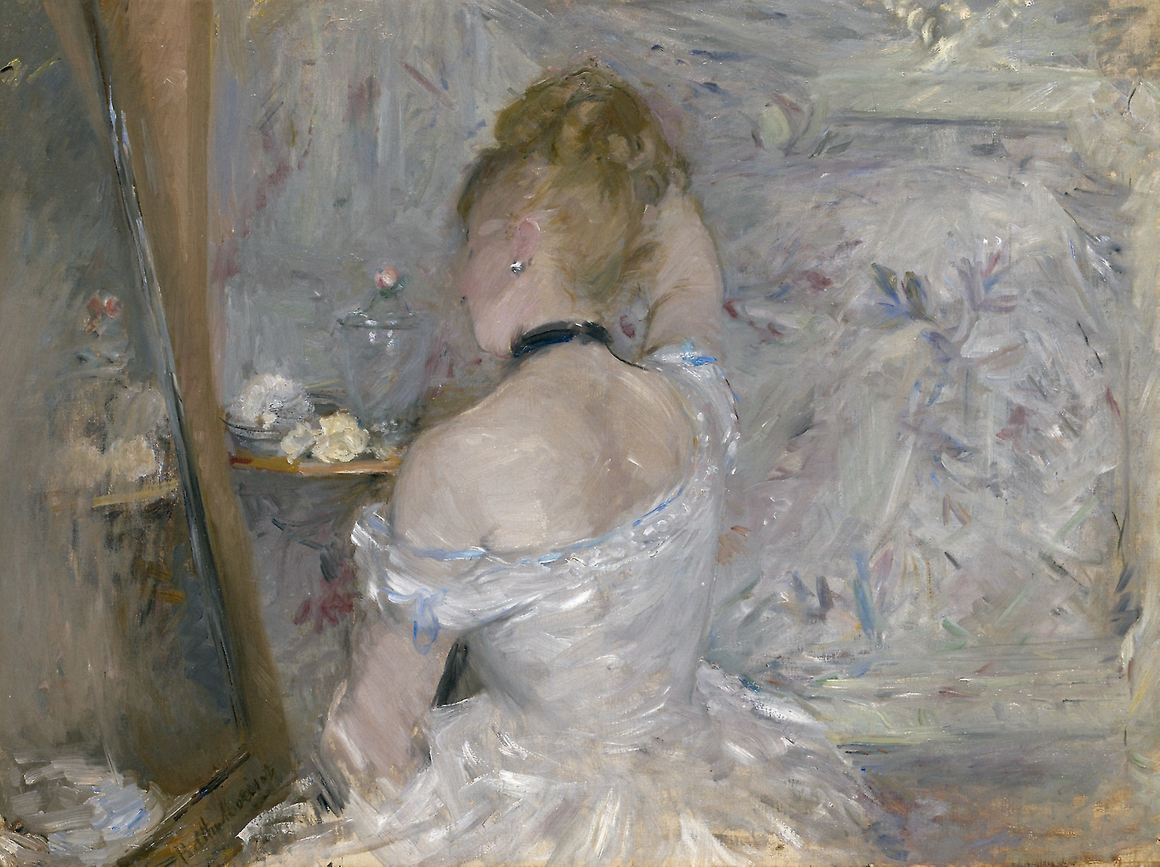
ROOM
I

Slide 16
ROOM
J

Slide 17
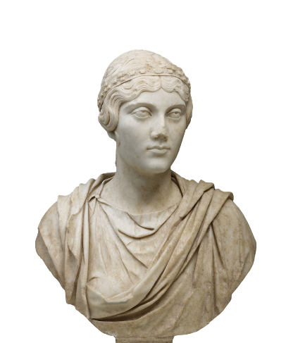
ROOMS M & N
ROOM
K
ROOM
L

Slide 18
ROOM
K

Slide 19
ROOM
L

Slide 20
ROOMS O & P
ROOM
M
ROOM
N

Slide 21
ROOM
M

Slide 22
ROOM
N

Slide 23
ROOMS Q & R
ROOM
O
ROOM
P

Slide 24
ROOM
O

Slide 25
ROOM
P

Slide 26
ROOMS S & T
ROOM
Q
ROOM
R

Slide 27
ROOM
Q

Slide 28
ROOM
R

Slide 29
ROOMS U & V
ROOM
S
ROOM
T

Slide 30
ROOM
S

Slide 31
ROOM
T

Slide 32
ROOMS W & X
ROOM
U
ROOM
V

Slide 33
ROOM
U

Slide 34
ROOM
V

Slide 35
ROOMS Y & Z
ROOM
W
ROOM
X

Slide 36
ROOM
W

Slide 37
ROOM
X

Slide 38
EXIT
ROOM
Y
ROOM
Z

Slide 39
ROOM
Y

Slide 40
ROOM
Z

Slide 41
Credits:
Presentation template: SlidesMania
Art images: Art Institute of Chicago

