Slide 1
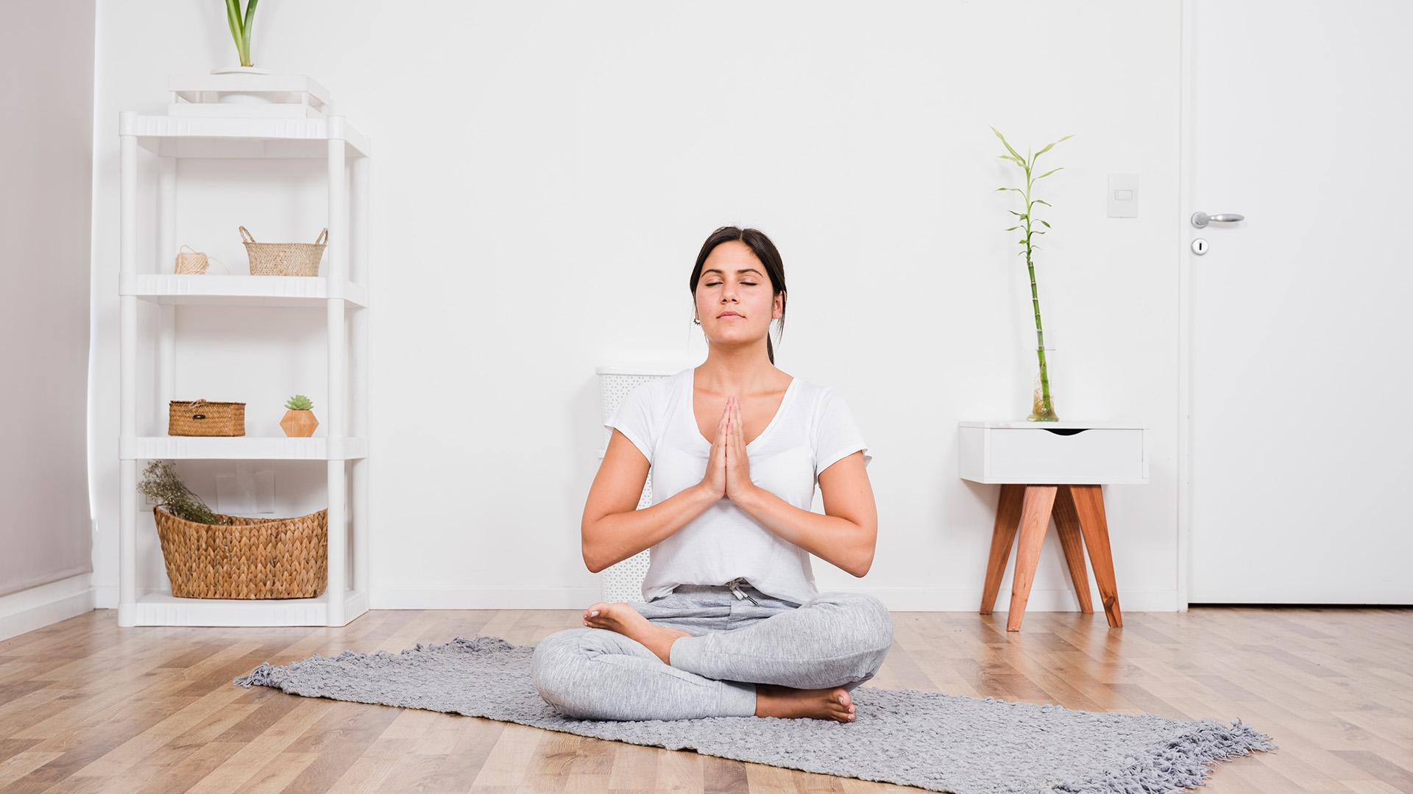
Meditation & Yoga
at Home Lesson
Connect with your mind & your body

Slide 2
Contents of This Template
Here’s what you’ll find in this Slidesgo template:
A slide structure based on a lesson, which you can easily adapt to your needs. For more info on how to edit the template, please visit Slidesgo School or read our FAQs.
An assortment of pictures and illustrations that are suitable for use in the presentation can be found in the alternative resources slide.
A thanks slide, which you must keep so that proper credits for our design are given.
A resources slide, where you’ll find links to all the elements used in the template.
Instructions for use.
Final slides with:
The fonts and colors used in the template.
More infographic resources, whose size and color can be edited.
Sets of customizable icons of the following themes: general, business, avatar, creative process, education, help & support, medical, nature, performing arts, SEO & marketing, and teamwork.
You can delete this slide when you’re done editing the presentation.

Slide 3
01
Be a Yogi
02
Ready?
Table of Contents
03
Breathing
04
Exercises
Find out what is yoga and why practice it
Choose your type of yoga and grab your gear
Some breathwork to relax mind and body
Practice some of the most common poses

Slide 4

What Is This Topic About?
With this presentation, you can learn about this wonderful practice which will help you relax, exercise and improve your health without having to go out!

Slide 5
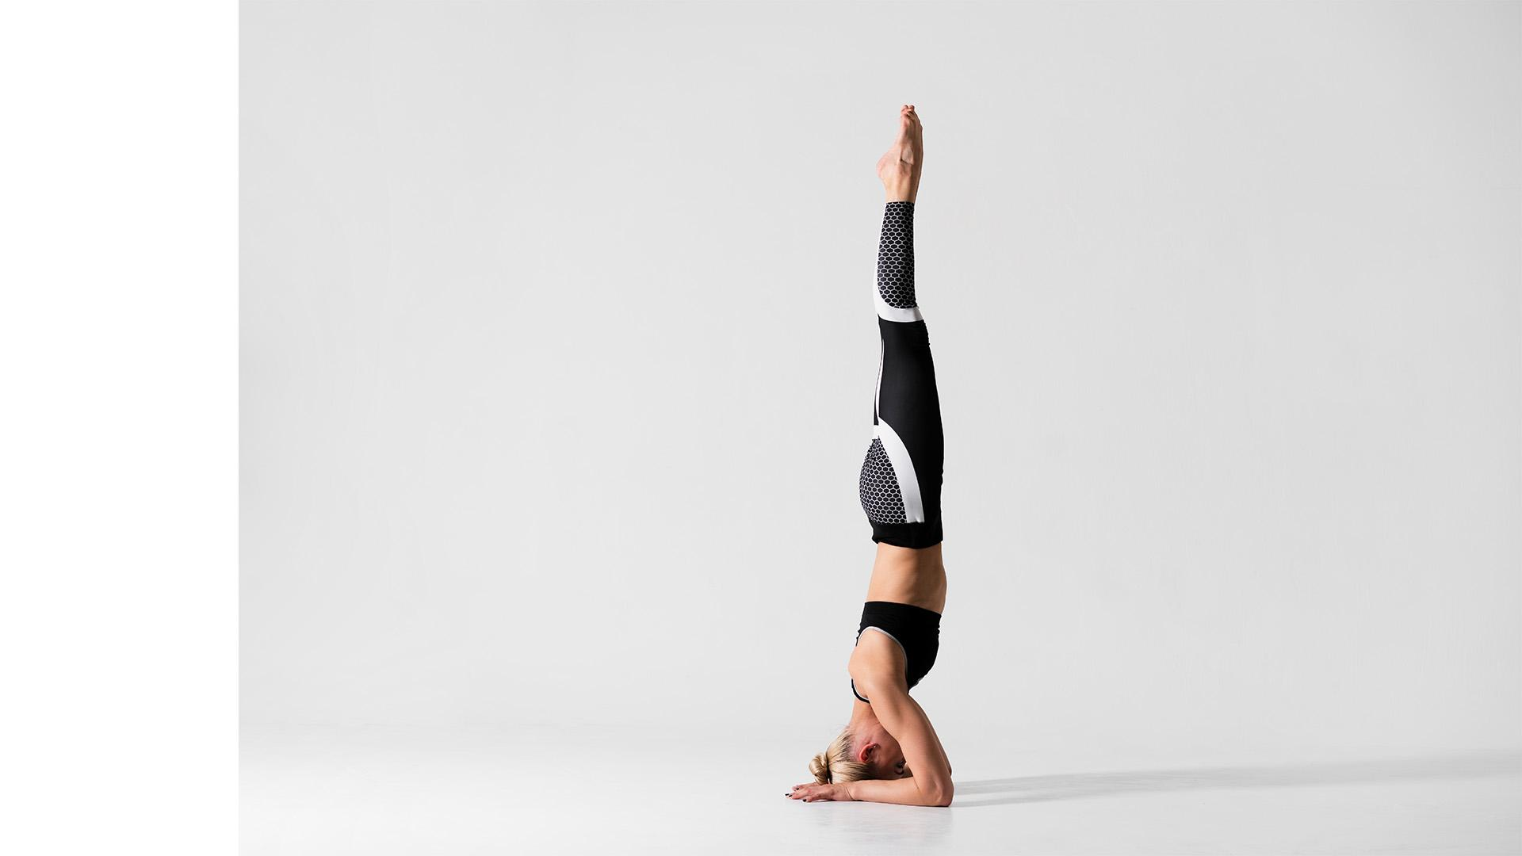
Be a Yogi
Yoga is an ancient discipline that connects the body with the mind by means of poses, exercises, breathwork and meditation to improve one’s health and welfare

Slide 6
The Origin
Yoga originated in ancient India, and it took hundreds of years for it to be known in Europe

Slide 7
500M
yoga practitioners of all levels all around the world

Slide 8



20%
75%
50%
Have a positive opinion about their physical and mental health
Practice other additional physical activities or sports
Dedicate free time to the community/voluntary work

Slide 9
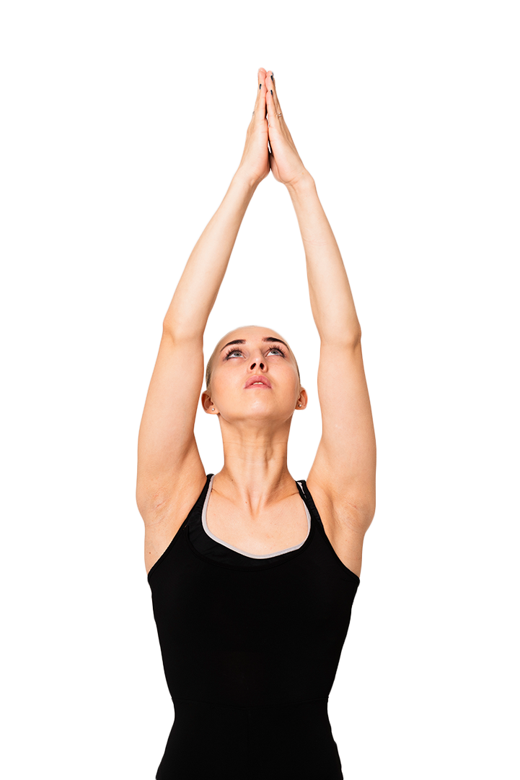
Problem?
Solution!
You want to live a healthy life, but you don’t have much time for gym...
With streaming lessons, you can do yoga at home according to your level

Slide 10
Mind & Body

Slide 11
Why Practice It?
+ Memory
- Stress
+ Energy
- Insomnia
Improves your memory, emotional stability and concentration
Eases the effects of depression or anxiety and stimulates your mind
Reinvigorates, gives you energy and reduces risks of a heart attack
Helps alleviate sleeping issues thanks to its relaxing nature

Slide 12
Choose Your Type of Yoga
Hatha | Physical yoga, the classic one, focused on energy balance
Rāja | Mental yoga, focused on learning about your inner self
Jñāna | Path-of-knowledge yoga, focused on self-realization
Mantra | Concentration yoga, focused on awakening your dormant energy
Bhakti | Devotional yoga, focused on finding a personal god through emotions
Tantra | Sexual yoga, focused on channeling energy to discover your own body
Karma | Focused on doing the right thing in order to purify your mind
Kundalini | Focused on meditation that awakens energy through your backbone

Slide 13
Someone Famous
Yoga not only changes our point of view about life, but also transforms you as a person

Slide 14
What Will You Need?
Room
Mat
Jumpsuit
Cushion
Music
Lighting
A quiet place with no external noises
For doing exercise and poses on the floor
Or a comfortable tracksuit for freedom of movement
For exercises related to breathwork
Relaxing and concentrating can be easier with music
You can pair it with scented candles or incense

Slide 15
Are You Ready?
Routine
Practice
1
2
3
4
Materials
Warm-up
Choose the type and the exercise routine
Enjoy the practice and its benefits
Set up the room and the equipment
To reduce any risk of injuries

Slide 16
Relax and Breathe
Collarbone
Chest
Abdomen
This is done with the topmost part of the lungs
Breathe expanding and contracting your chest
A deep breath that reaches your abdomen

Slide 17
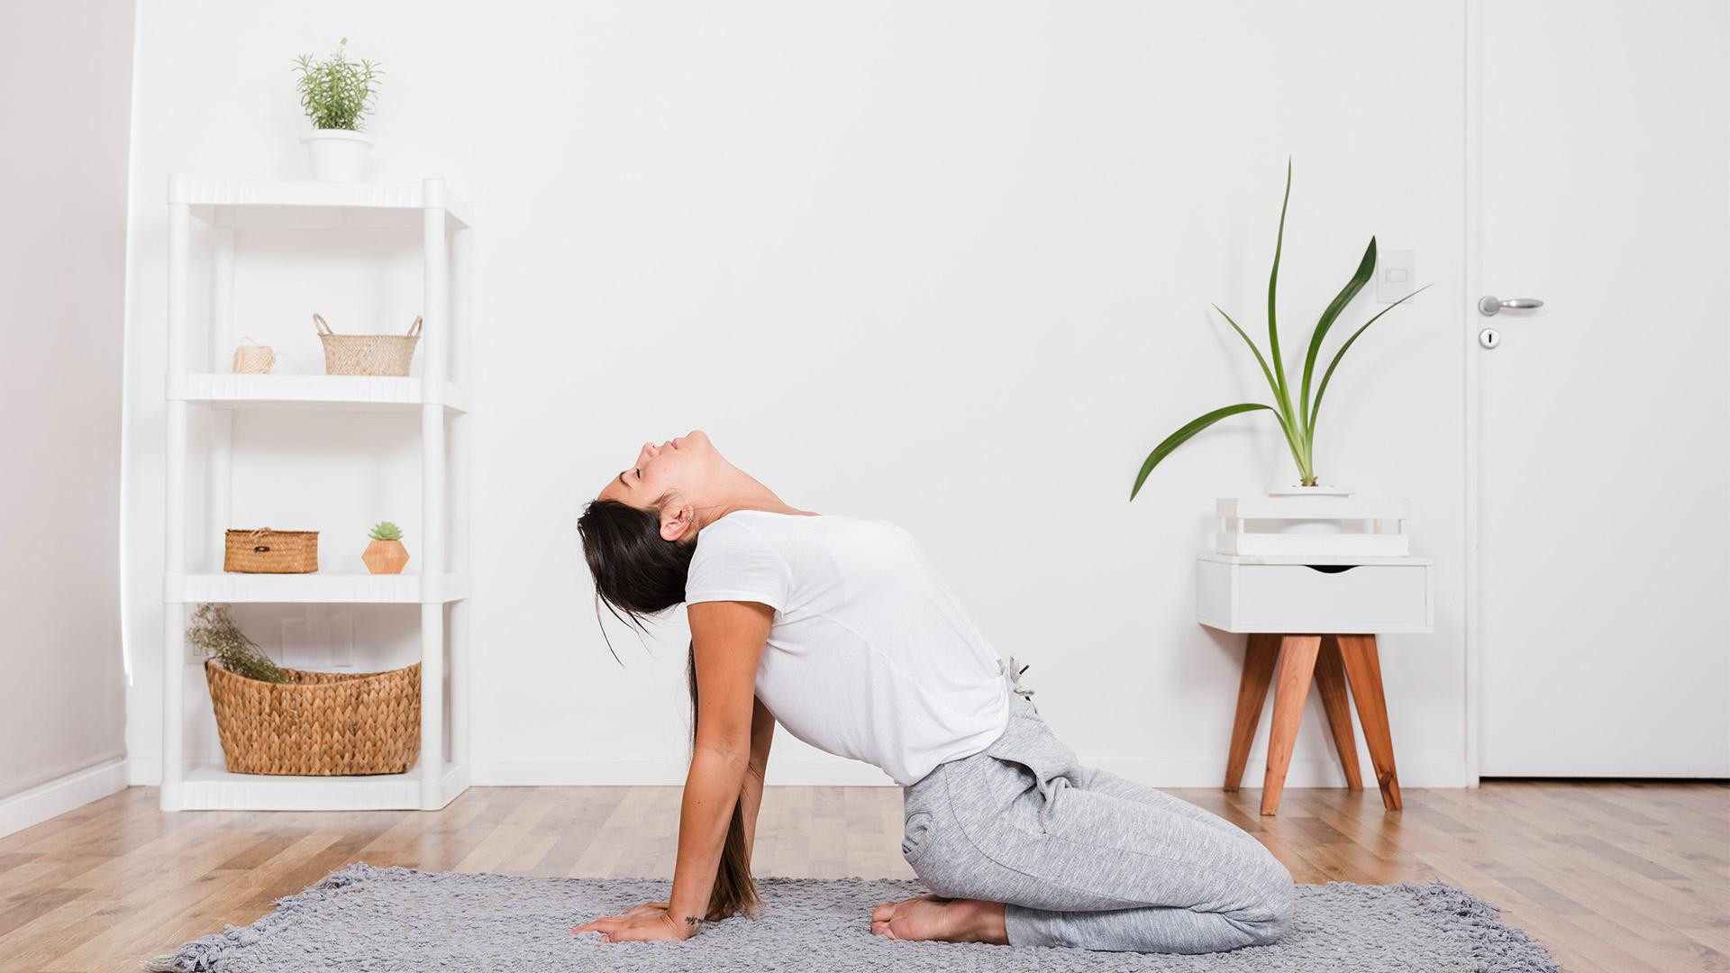
A Picture Is Worth a Thousand Words

Slide 18
04
Exercises
Let’s try some yoga poses!

Slide 19
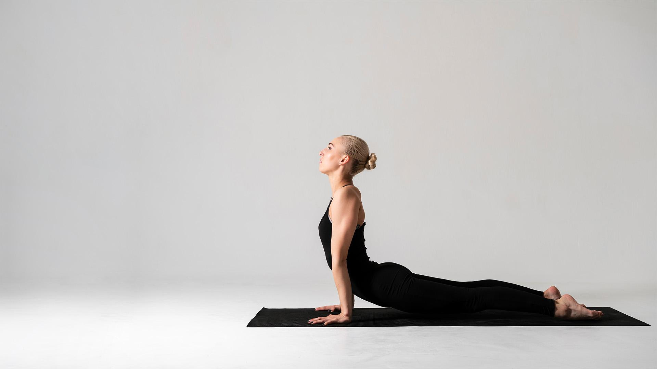
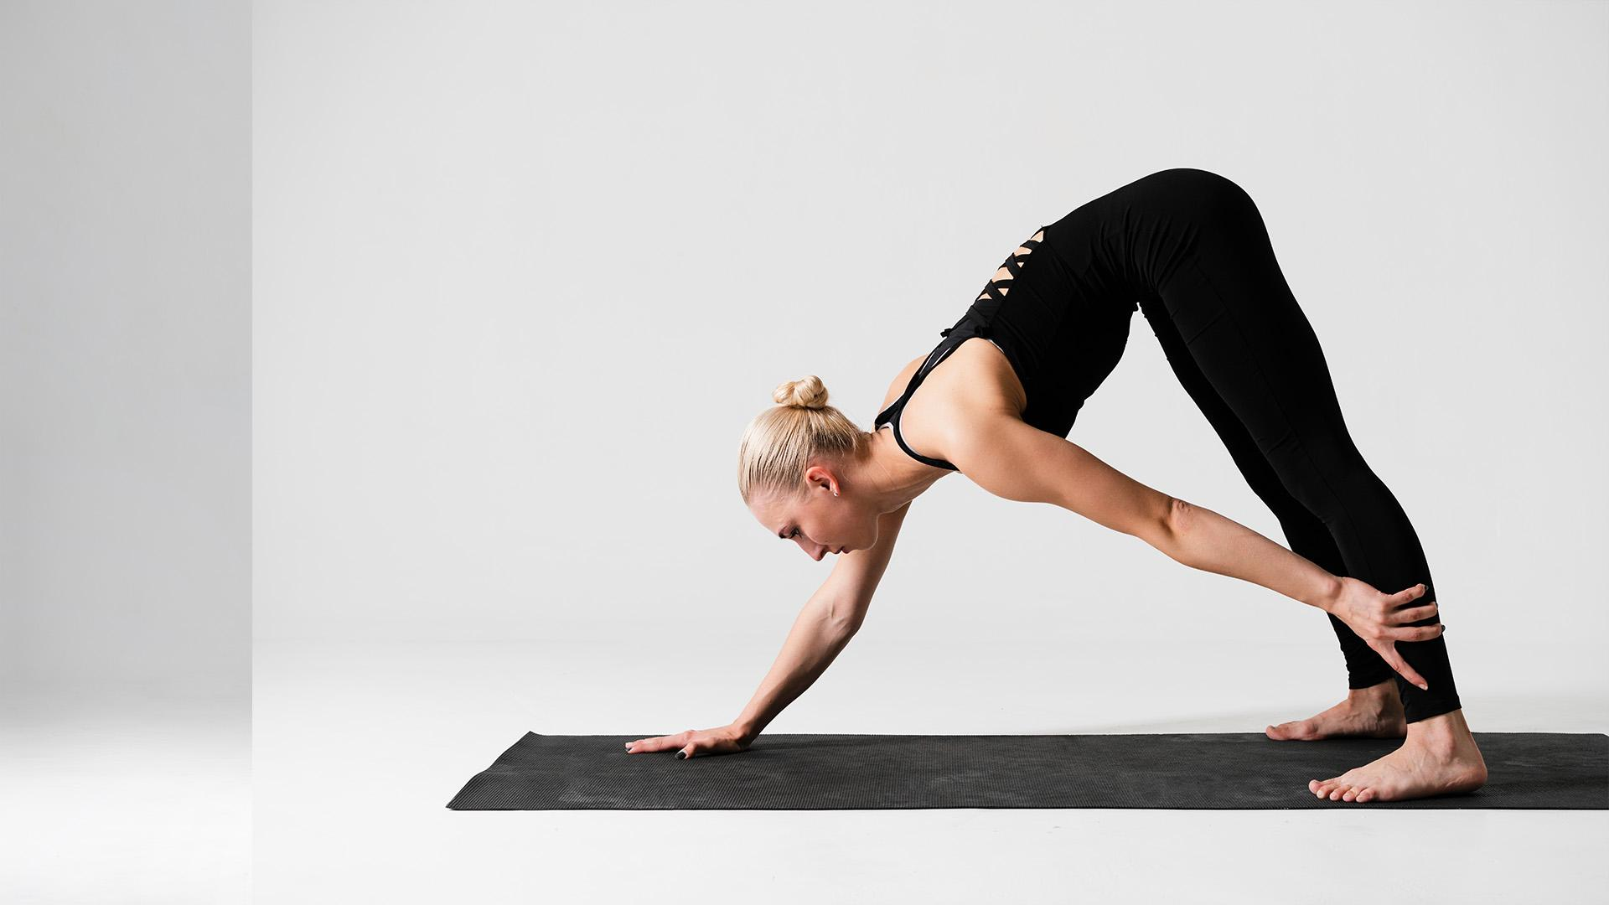
Exercises Part 1
Cobra
Downward Dog
Lie face down and, using your hands, bend your back upward
Adopt an inverted V pose and try to keep your head under your body

Slide 20
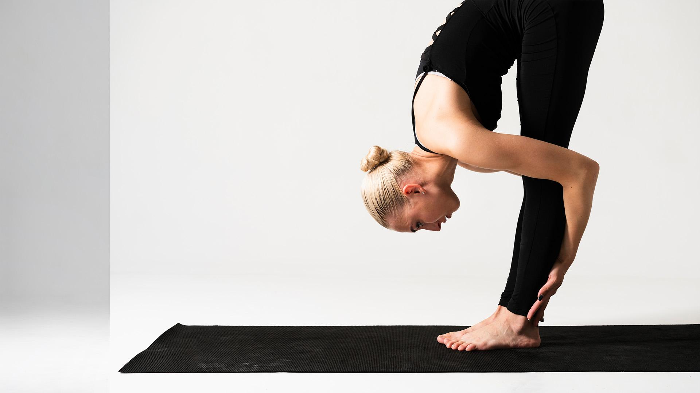
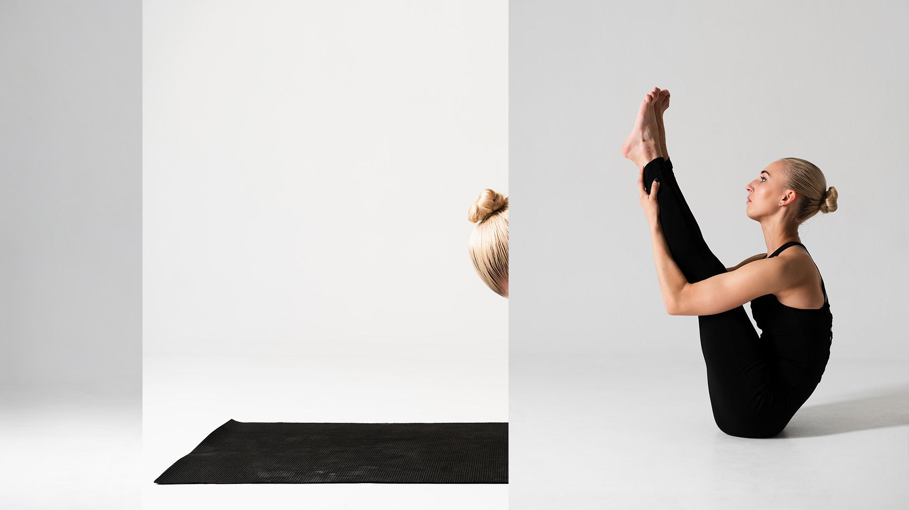
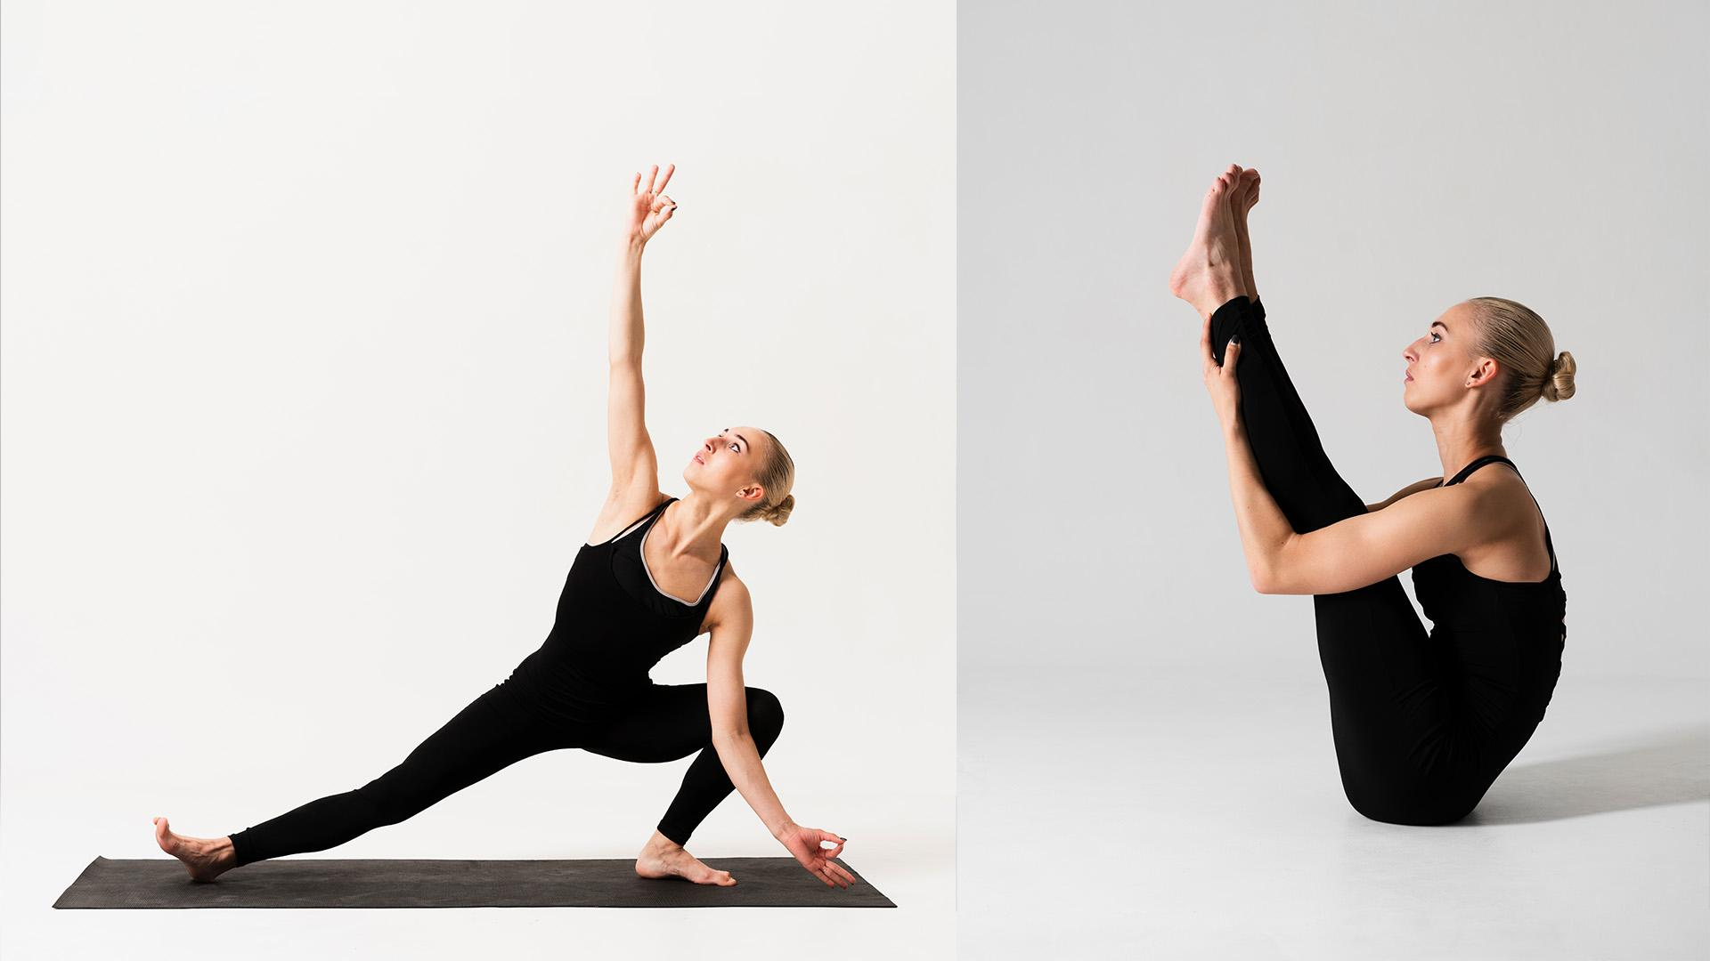
Exercises Part 2
Uttanasana
Boat
Triangle
Stand straight and then bend your upper half downward
Sit down and try to bring your legs closer to your body
Try to keep your hands and legs as separated as possible

Slide 21
Did You Know This?
Yoga is also considered a philosophy of life
June 21 is the official International Day of Yoga
It leads to integrity and personal welfare
Yoga comes from the Sanskrit root yuj (to join)
70 percent of yoga practitioners are women

Slide 22
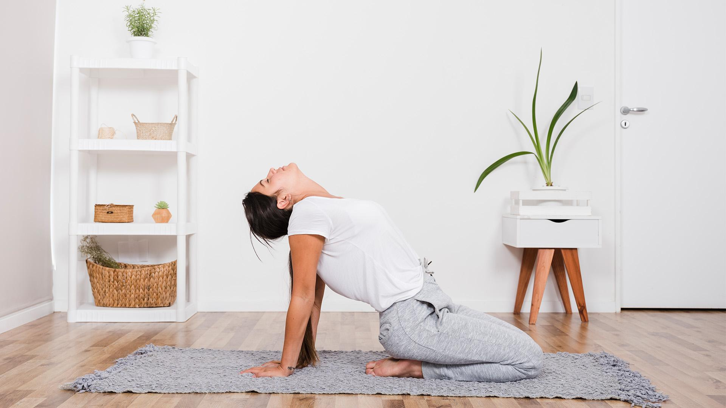
Streaming Lessons
You can find lots of online videos and lessons to follow for reference

Slide 23
The Assignment
Now, try these poses on your own. Remember that yoga is for everyone!
Try these keywords when looking on the Internet for some useful videos on how to practice yoga at home:
Yoga for Beginners
Yoga for Back Pain
Yoga for Weight Loss
Yoga Intermediate Level

Slide 24
Overview Diagram
Breathing
Why Practice It?
Be a Yogi
Choose Your Type
Yoga at Home
Data
Ready?
Equipment
Exercises

Slide 25
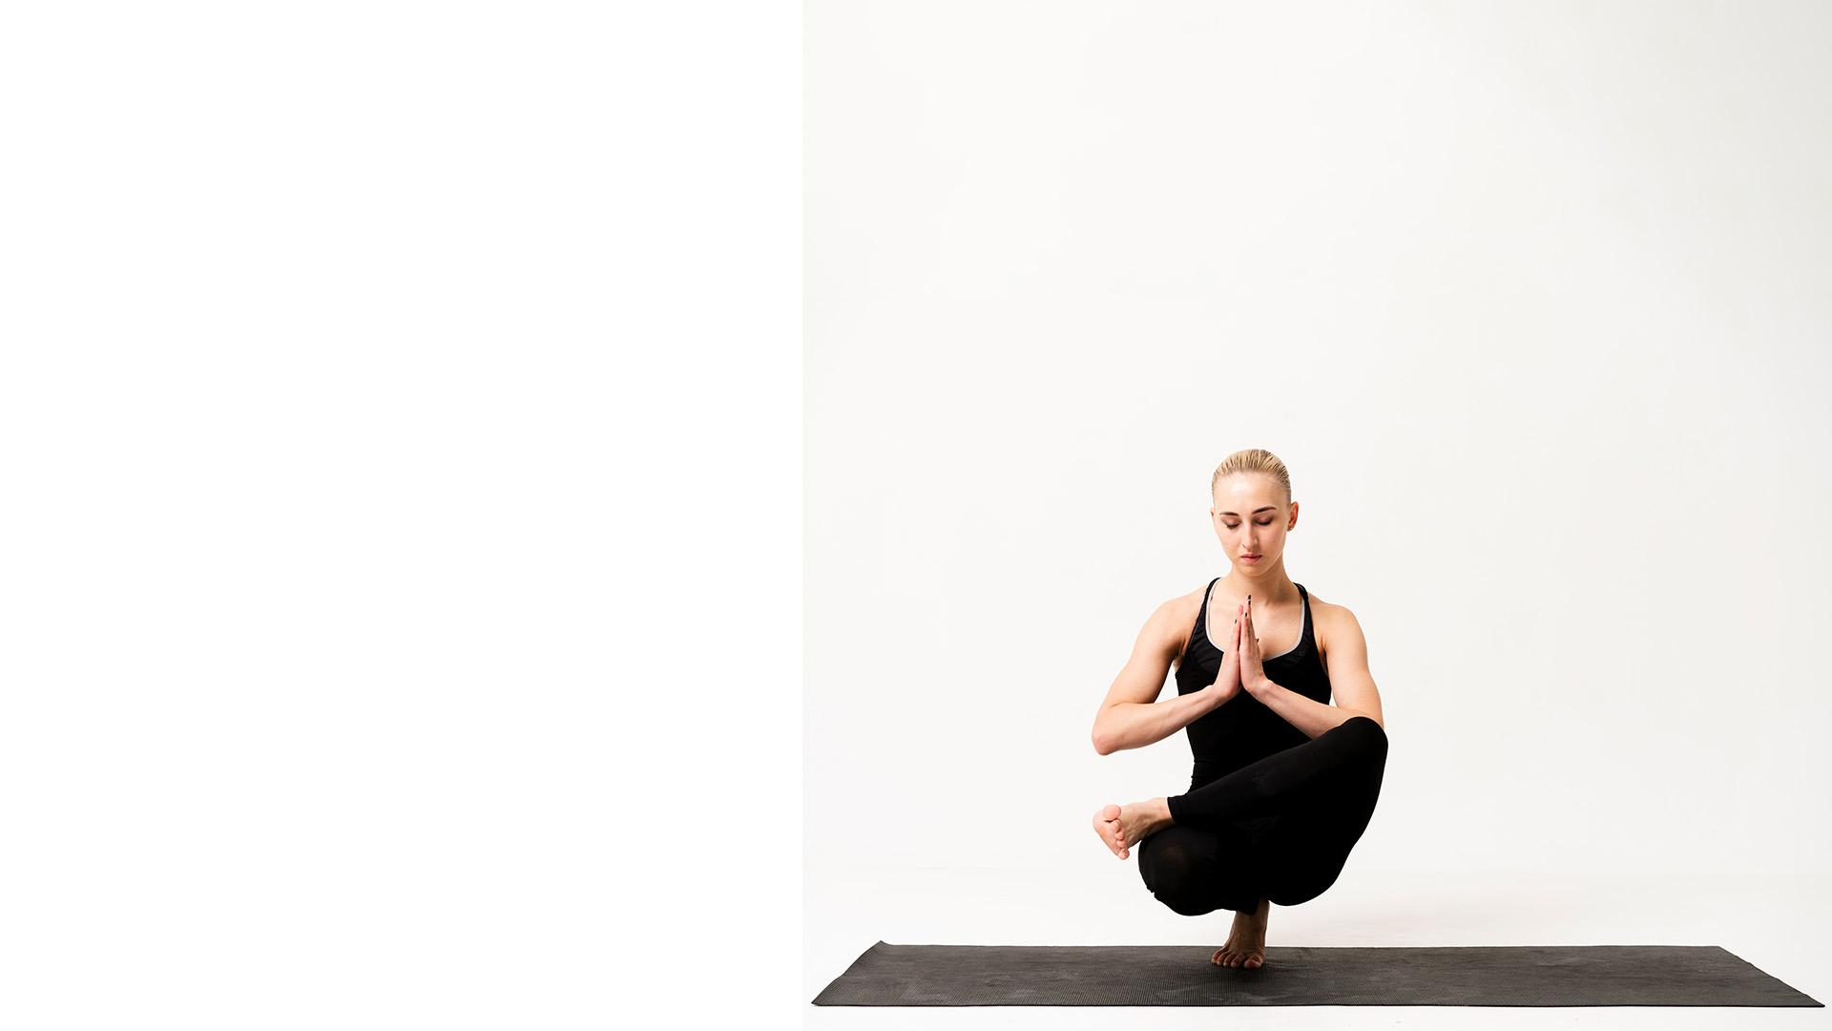
Thank You!
Do you have any questions?
youremail@freepik.com
+91 620 421 838
yourcompany.com
Please keep this slide for attribution.

Slide 26
Alternative Resources
PHOTOS:
Woman doing yoga at home
Woman doing yoga at home
Full shot woman with one leg up
Portrait young female with hands united in air
Woman doing yoga at home
Bridge position execution by young woman
Young woman standing in hands at yoga class
Yoga class with beautiful woman
Beautiful pose at yoga class indoor
Beautiful woman elegant position at yoga class
Portrait woman with hands united at chest
VECTORS:
Purple silhouettes yoga poses pack
Minimalistic business card

Slide 27
Resources
Did you like the resources on this template? Get them for free at our other websites:
PHOTOS:
Woman doing yoga at home
Woman doing yoga at home
Full shot fit woman standing on arms
Young female with hands united in air
Woman doing yoga at home
Side view woman in black clothes with yoga mat
Side view woman exercising on mat
Full shot blonde woman complex position
Medium shot woman standing on yoga mat
Elegant position at yoga class indoor
Inner balance while standing on one leg
VECTORS:
Minimal business card template
Yoga silhouettes pack

Slide 28
Instructions for use
In order to use this template, you must credit Slidesgo by keeping the Thanks slide.
You are allowed to:
- Modify this template.
- Use it for both personal and commercial projects.
You are not allowed to:
- Sublicense, sell or rent any of Slidesgo Content (or a modified version of Slidesgo Content).
- Distribute Slidesgo Content unless it has been expressly authorized by Slidesgo.
- Include Slidesgo Content in an online or offline database or file.
- Offer Slidesgo templates (or modified versions of Slidesgo templates) for download.
- Acquire the copyright of Slidesgo Content.
For more information about editing slides, please read our FAQs or visit Slidesgo School:
https://slidesgo.com/faqs and https://slidesgo.com/slidesgo-school

Slide 29
Fonts & colors used
This presentation has been made using the following fonts:
Poppins Bold
(https://fonts.google.com/specimen/Poppins)
Lato Regular
(https://fonts.google.com/specimen/Lato)
#434343
#f2938f
#f5cdca
##ffffffff

Slide 30
Use our editable graphic resources...
You can easily resize these resources without losing quality. To change the color, just ungroup the resource and click on the object you want to change. Then, click on the paint bucket and select the color you want. Group the resource again when you’re done.

Slide 33
JANUARY
FEBRUARY
MARCH
APRIL
MAY
JUNE
PHASE 1
Task 1
Task 2
PHASE 2
Task 1
Task 2
JANUARY
FEBRUARY
MARCH
APRIL
PHASE 1
Task 1
Task 2

Slide 36
Medical Infographics

Slide 39
...and our sets of editable icons
You can resize these icons without losing quality.
You can change the stroke and fill color; just select the icon and click on the paint bucket/pen.
In Google Slides, you can also use Flaticon’s extension, allowing you to customize and add even more icons.

Slide 40
Educational Icons
Medical Icons

Slide 41
Business Icons
Teamwork Icons

Slide 42
Help & Support Icons
Avatar Icons

Slide 43
Creative Process Icons
Performing Arts Icons

Slide 44
Nature Icons

Slide 45
SEO & Marketing Icons

Slide 46


