Slide 1
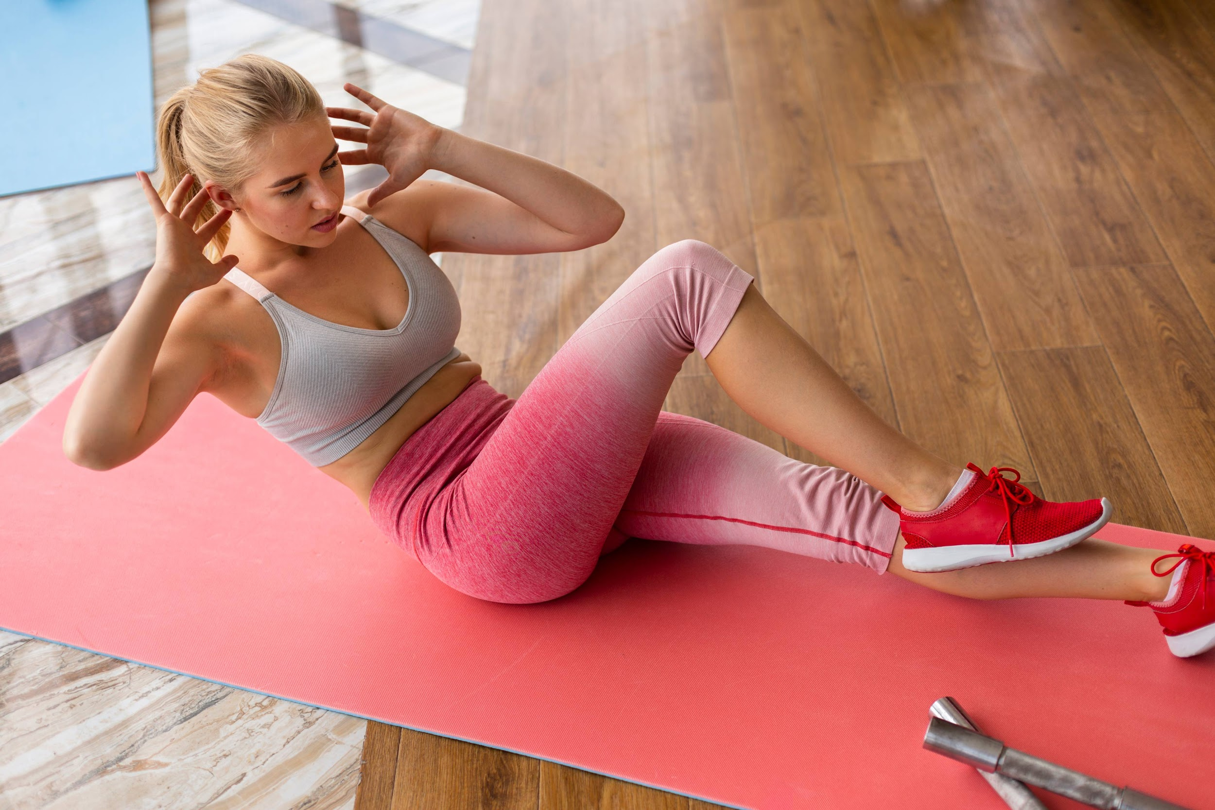
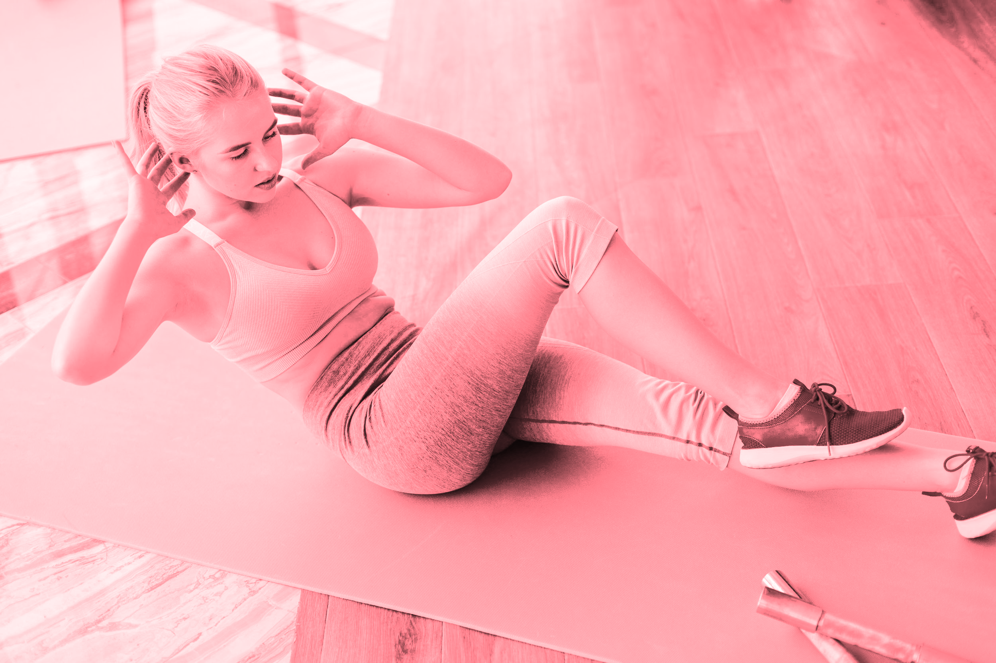
WORKOUT AT HOME APP
Now is the perfect time to get in shape!

Slide 2
CONTENTS OF THIS TEMPLATE
Here’s what you’ll find in this Slidesgo template:
A slide structure based on a pitch deck, which you can easily adapt to your needs. For more info on how to edit the template, please visit Slidesgo School or read our FAQs.
An assortment of illustrations that are suitable for use in the presentation can be found in the alternative resources slide.
A thanks slide, which you must keep so that proper credits for our design are given.
A resources slide, where you’ll find links to all the elements used in the template.
Instructions for use.
Final slides with:
The fonts and colors used in the template.
More infographic resources, whose size and color can be edited.
Sets of customizable icons of the following themes: general, business, avatar, creative process, education, help & support, medical, nature, performing arts, SEO & marketing, and teamwork.
You can delete this slide when you’re done editing the presentation.

Slide 3
TABLE OF CONTENTS
PROBLEM VS. SOLUTION
01
OUR APP
02
OUR DATA
03
Here you could describe the topic of the section
Here you could describe the topic of the section
Here you could describe the topic of the section

Slide 4
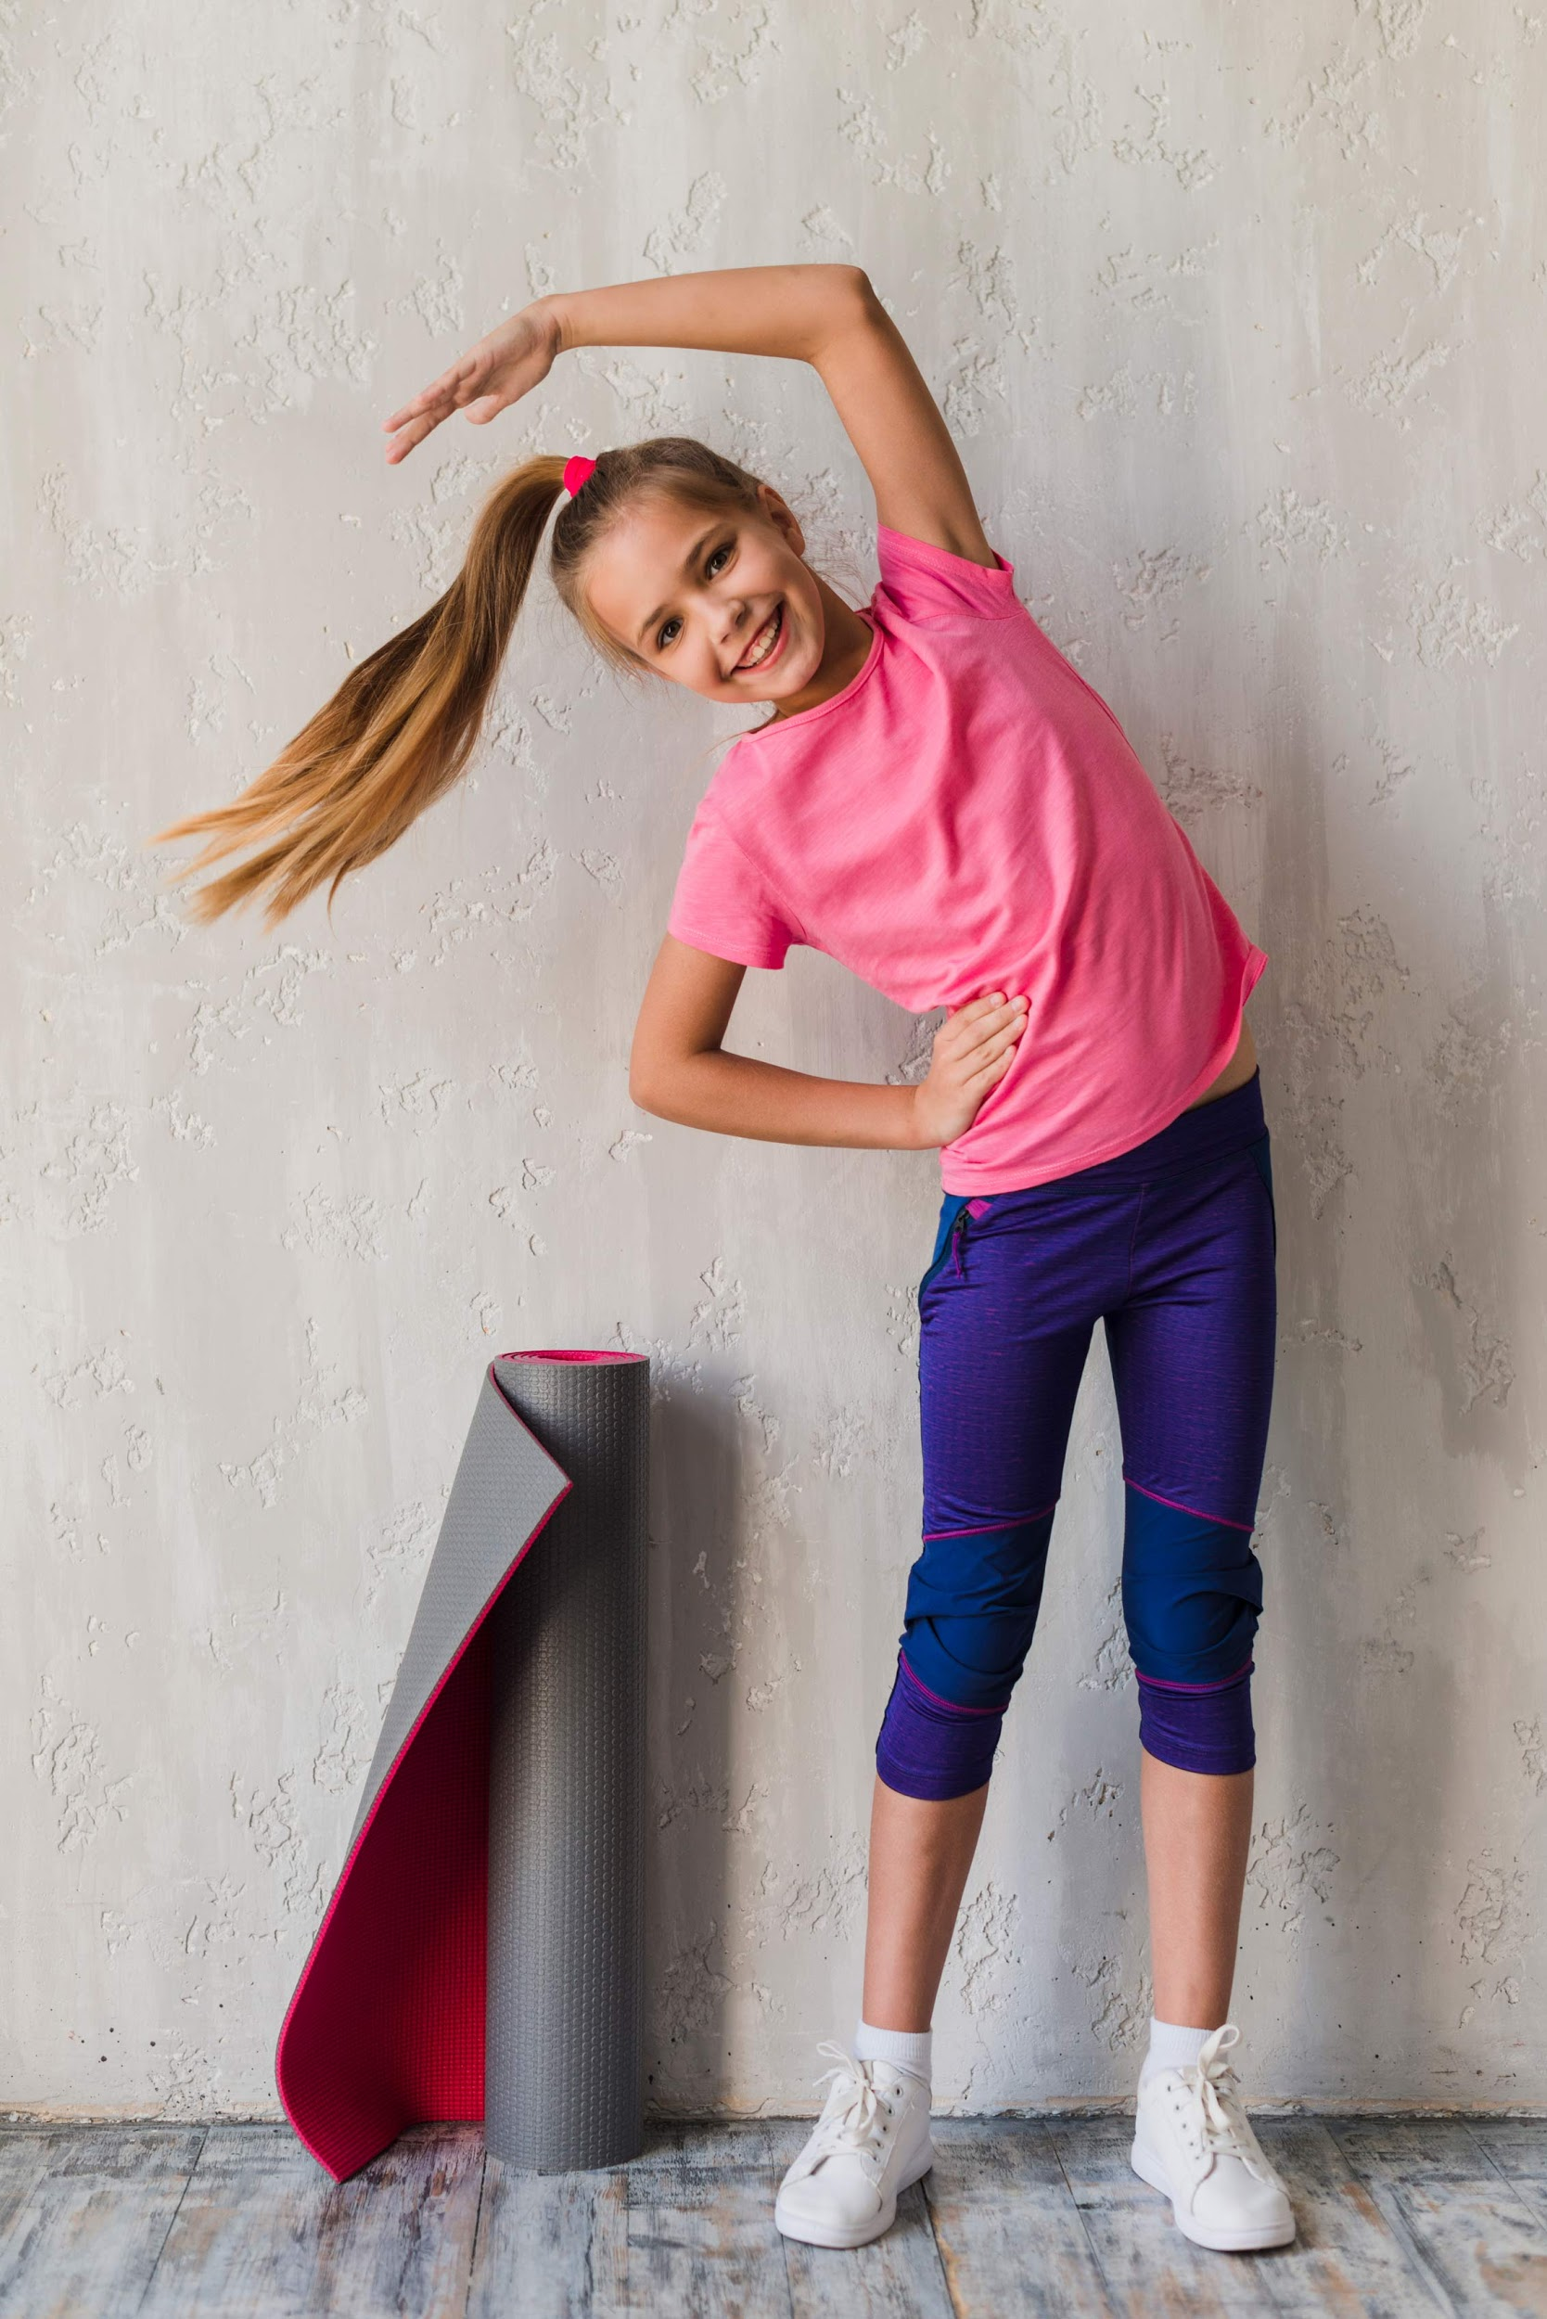
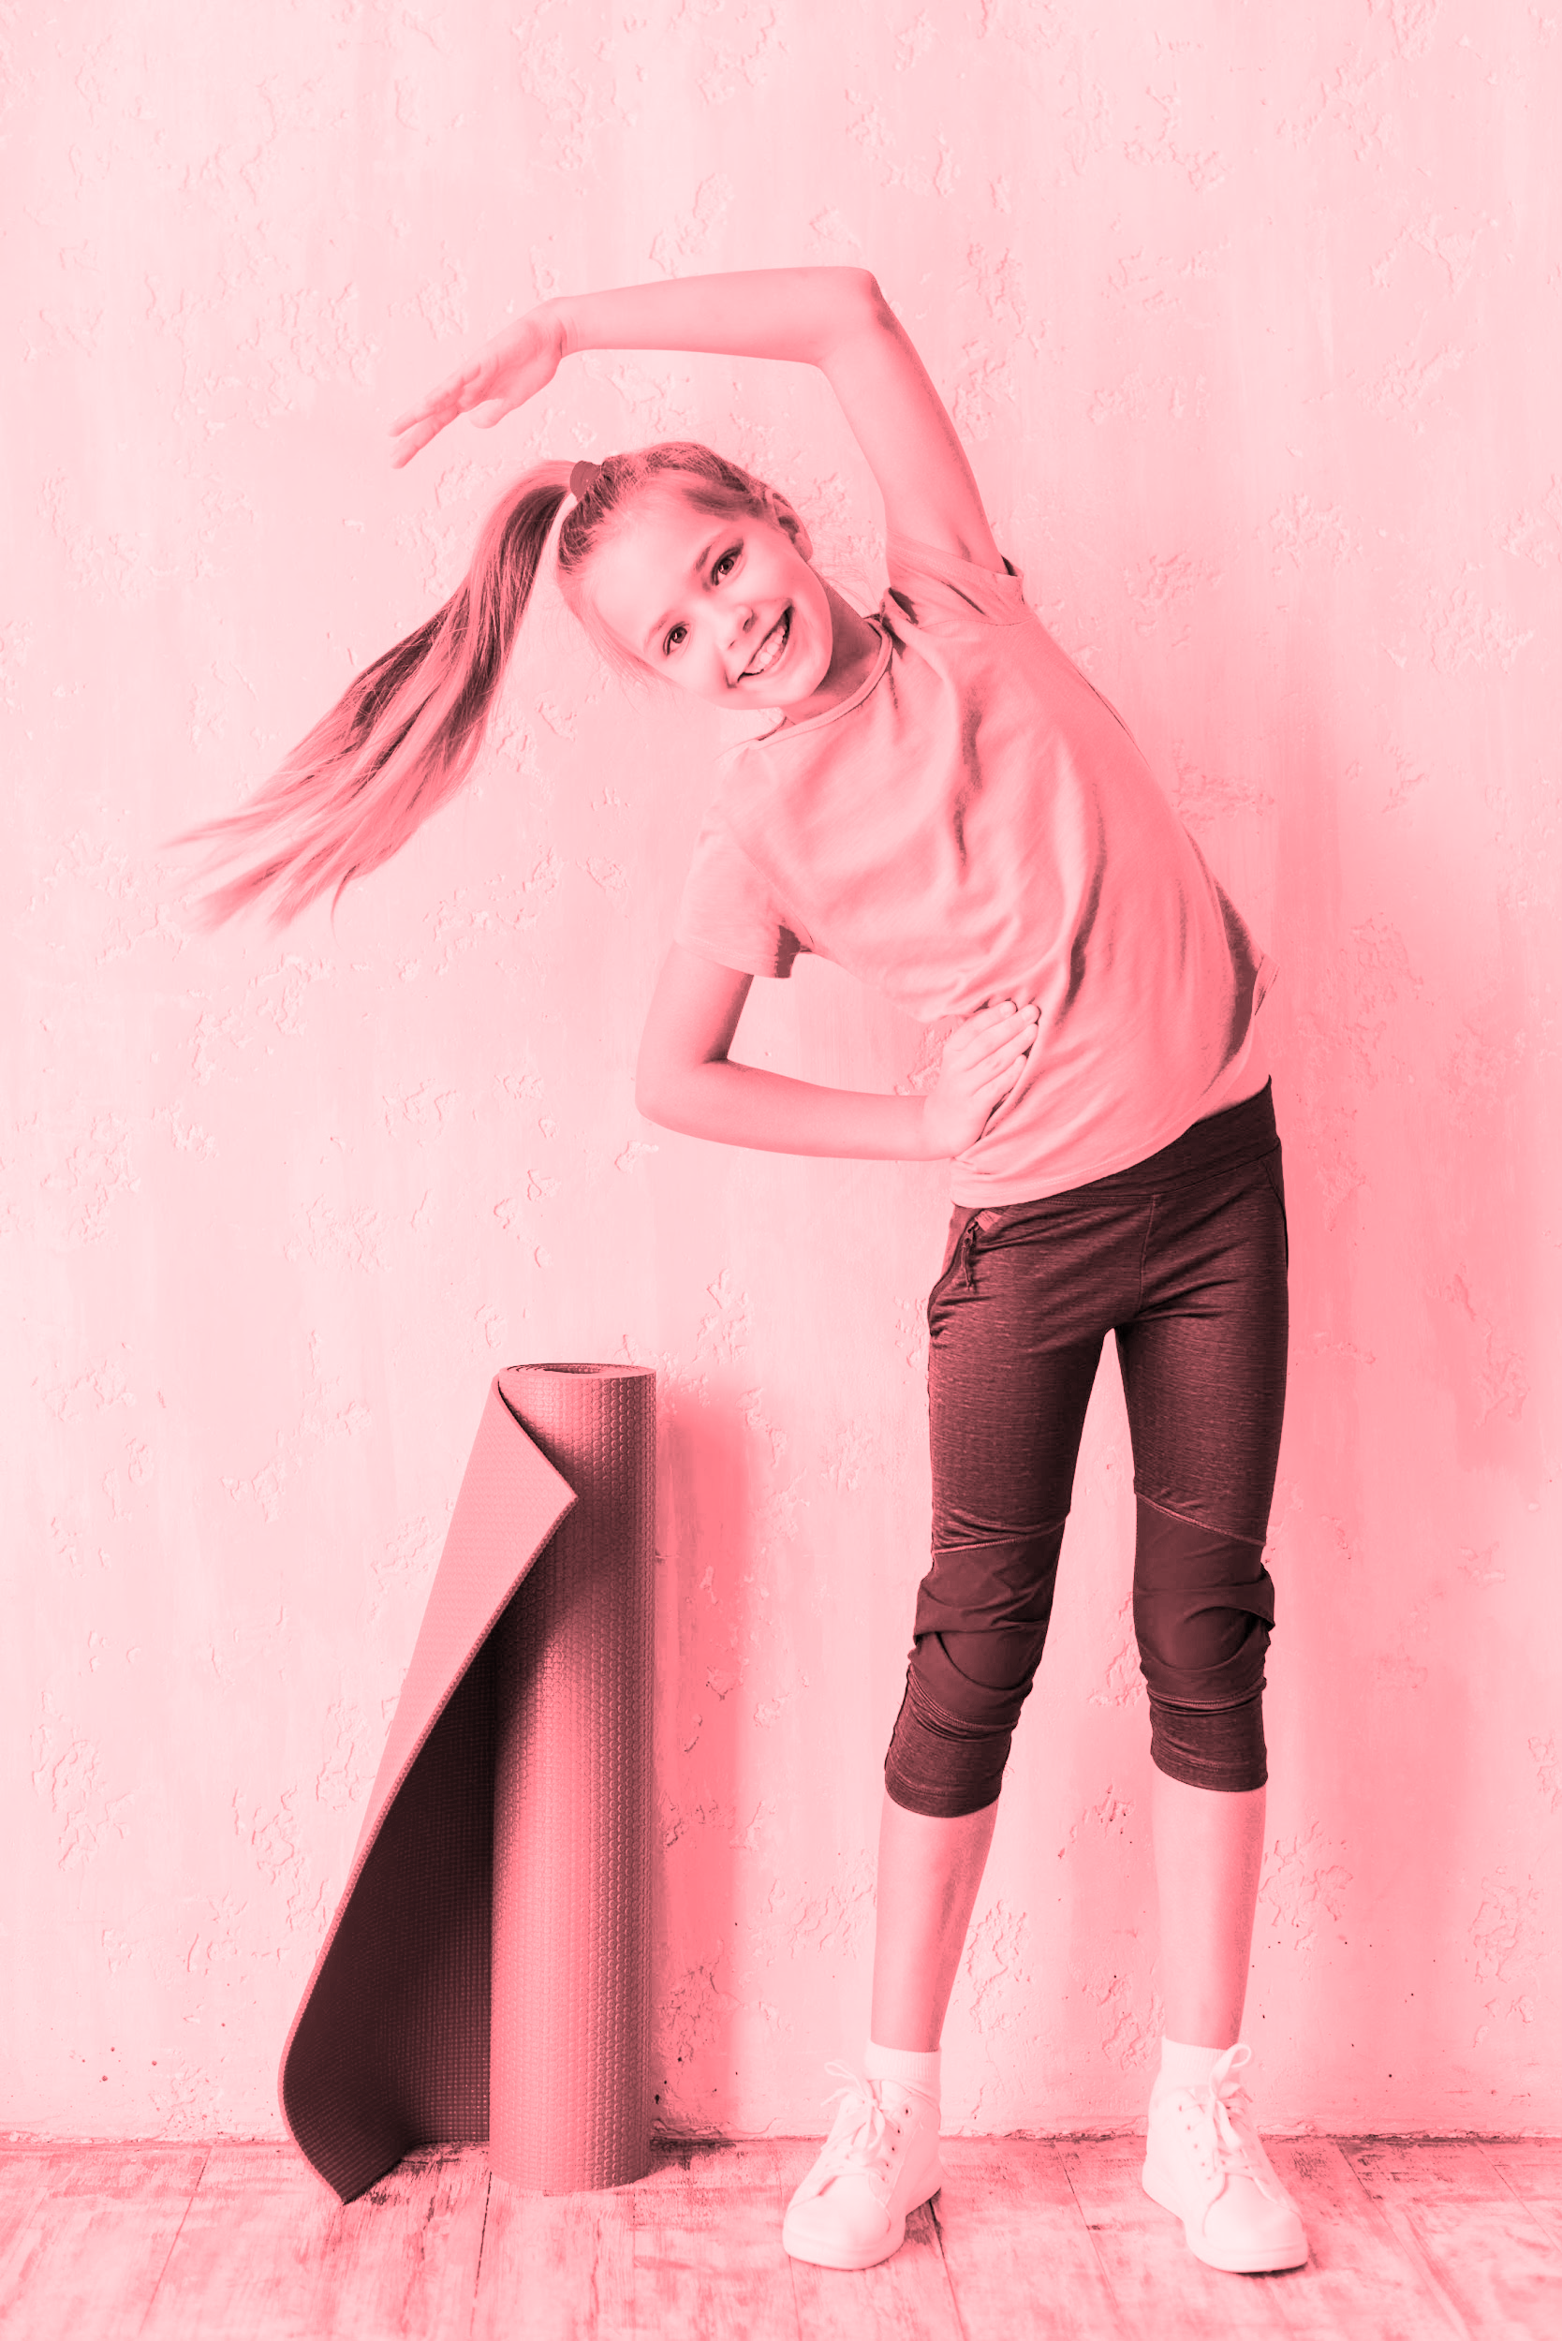
INTRODUCTION
Exercise is good for both our mental and physical health. With this app we’ll help you get in shape in no time. Are you ready to sweat?

Slide 5
WHAT WE DO
EASY EXERCISES
IT’S FREE TO USE!
NO NEED FOR EQUIPEMENT
01
02
03
You don’t have to be a pro to get fit with these!
Download the app and run it to get started!
Use your body or things you already have!

Slide 6
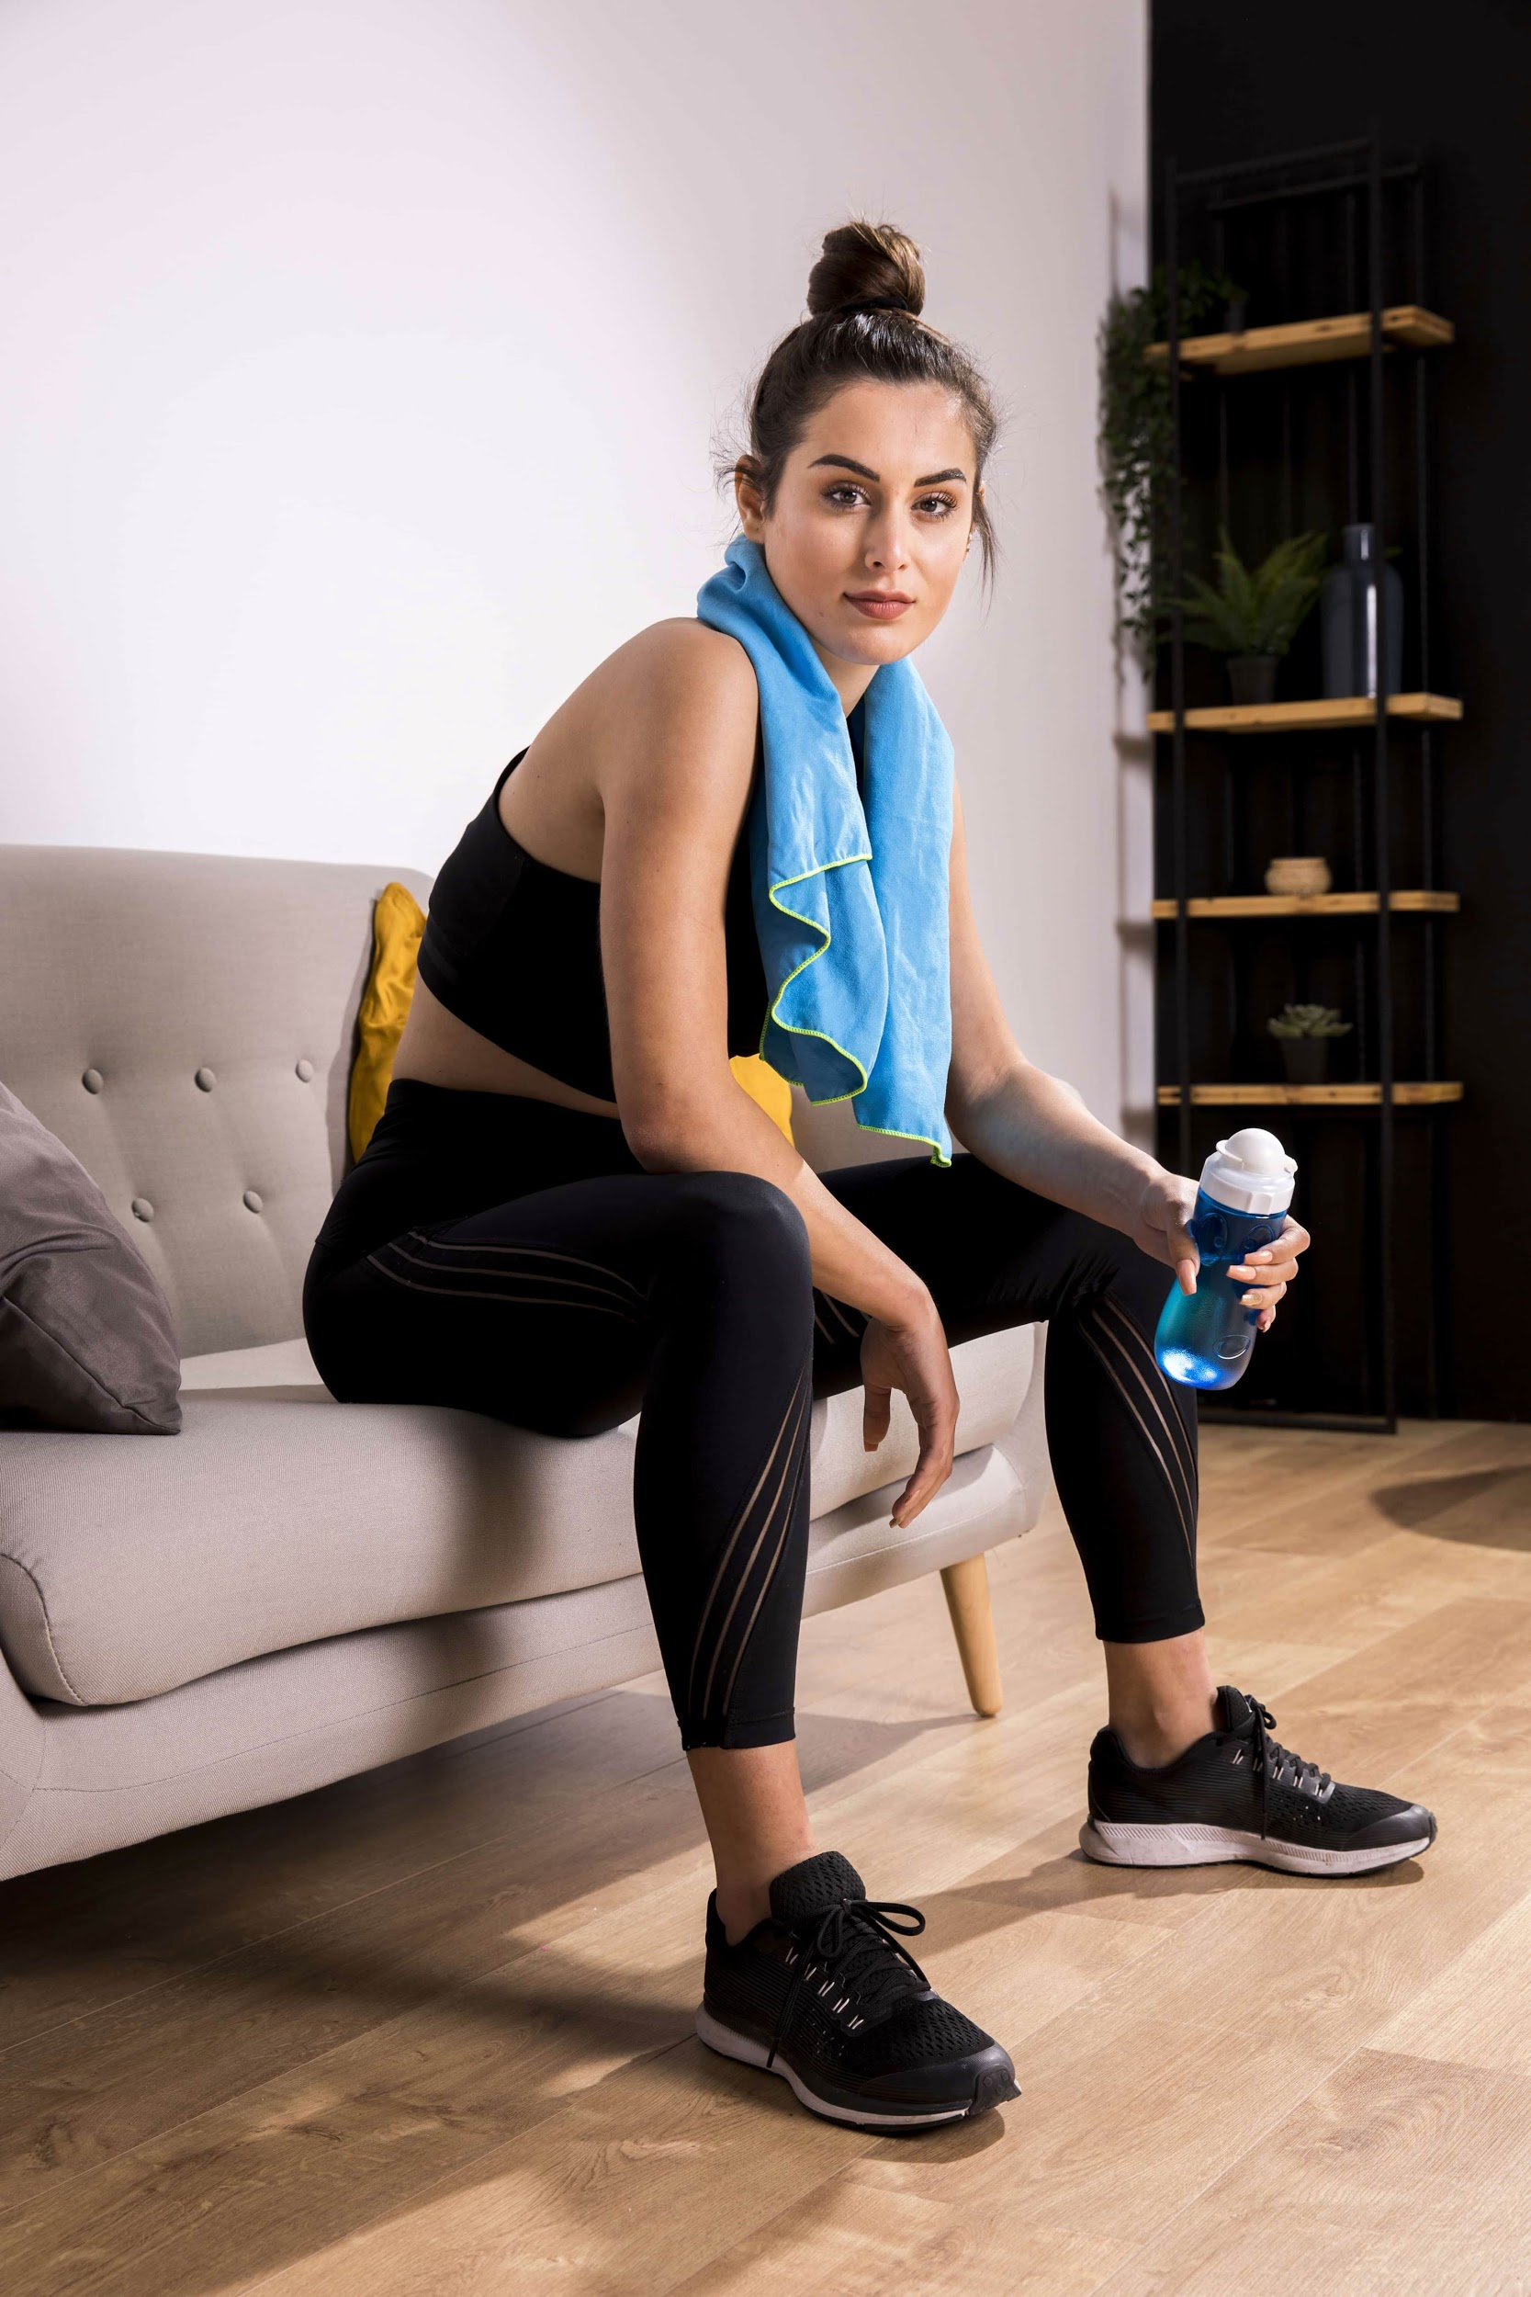
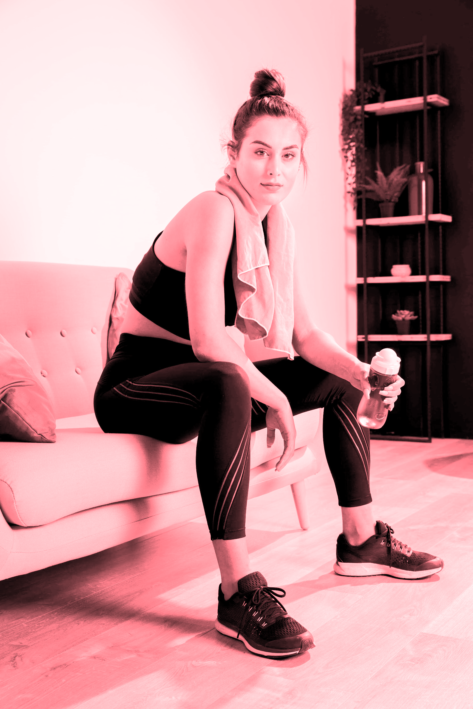
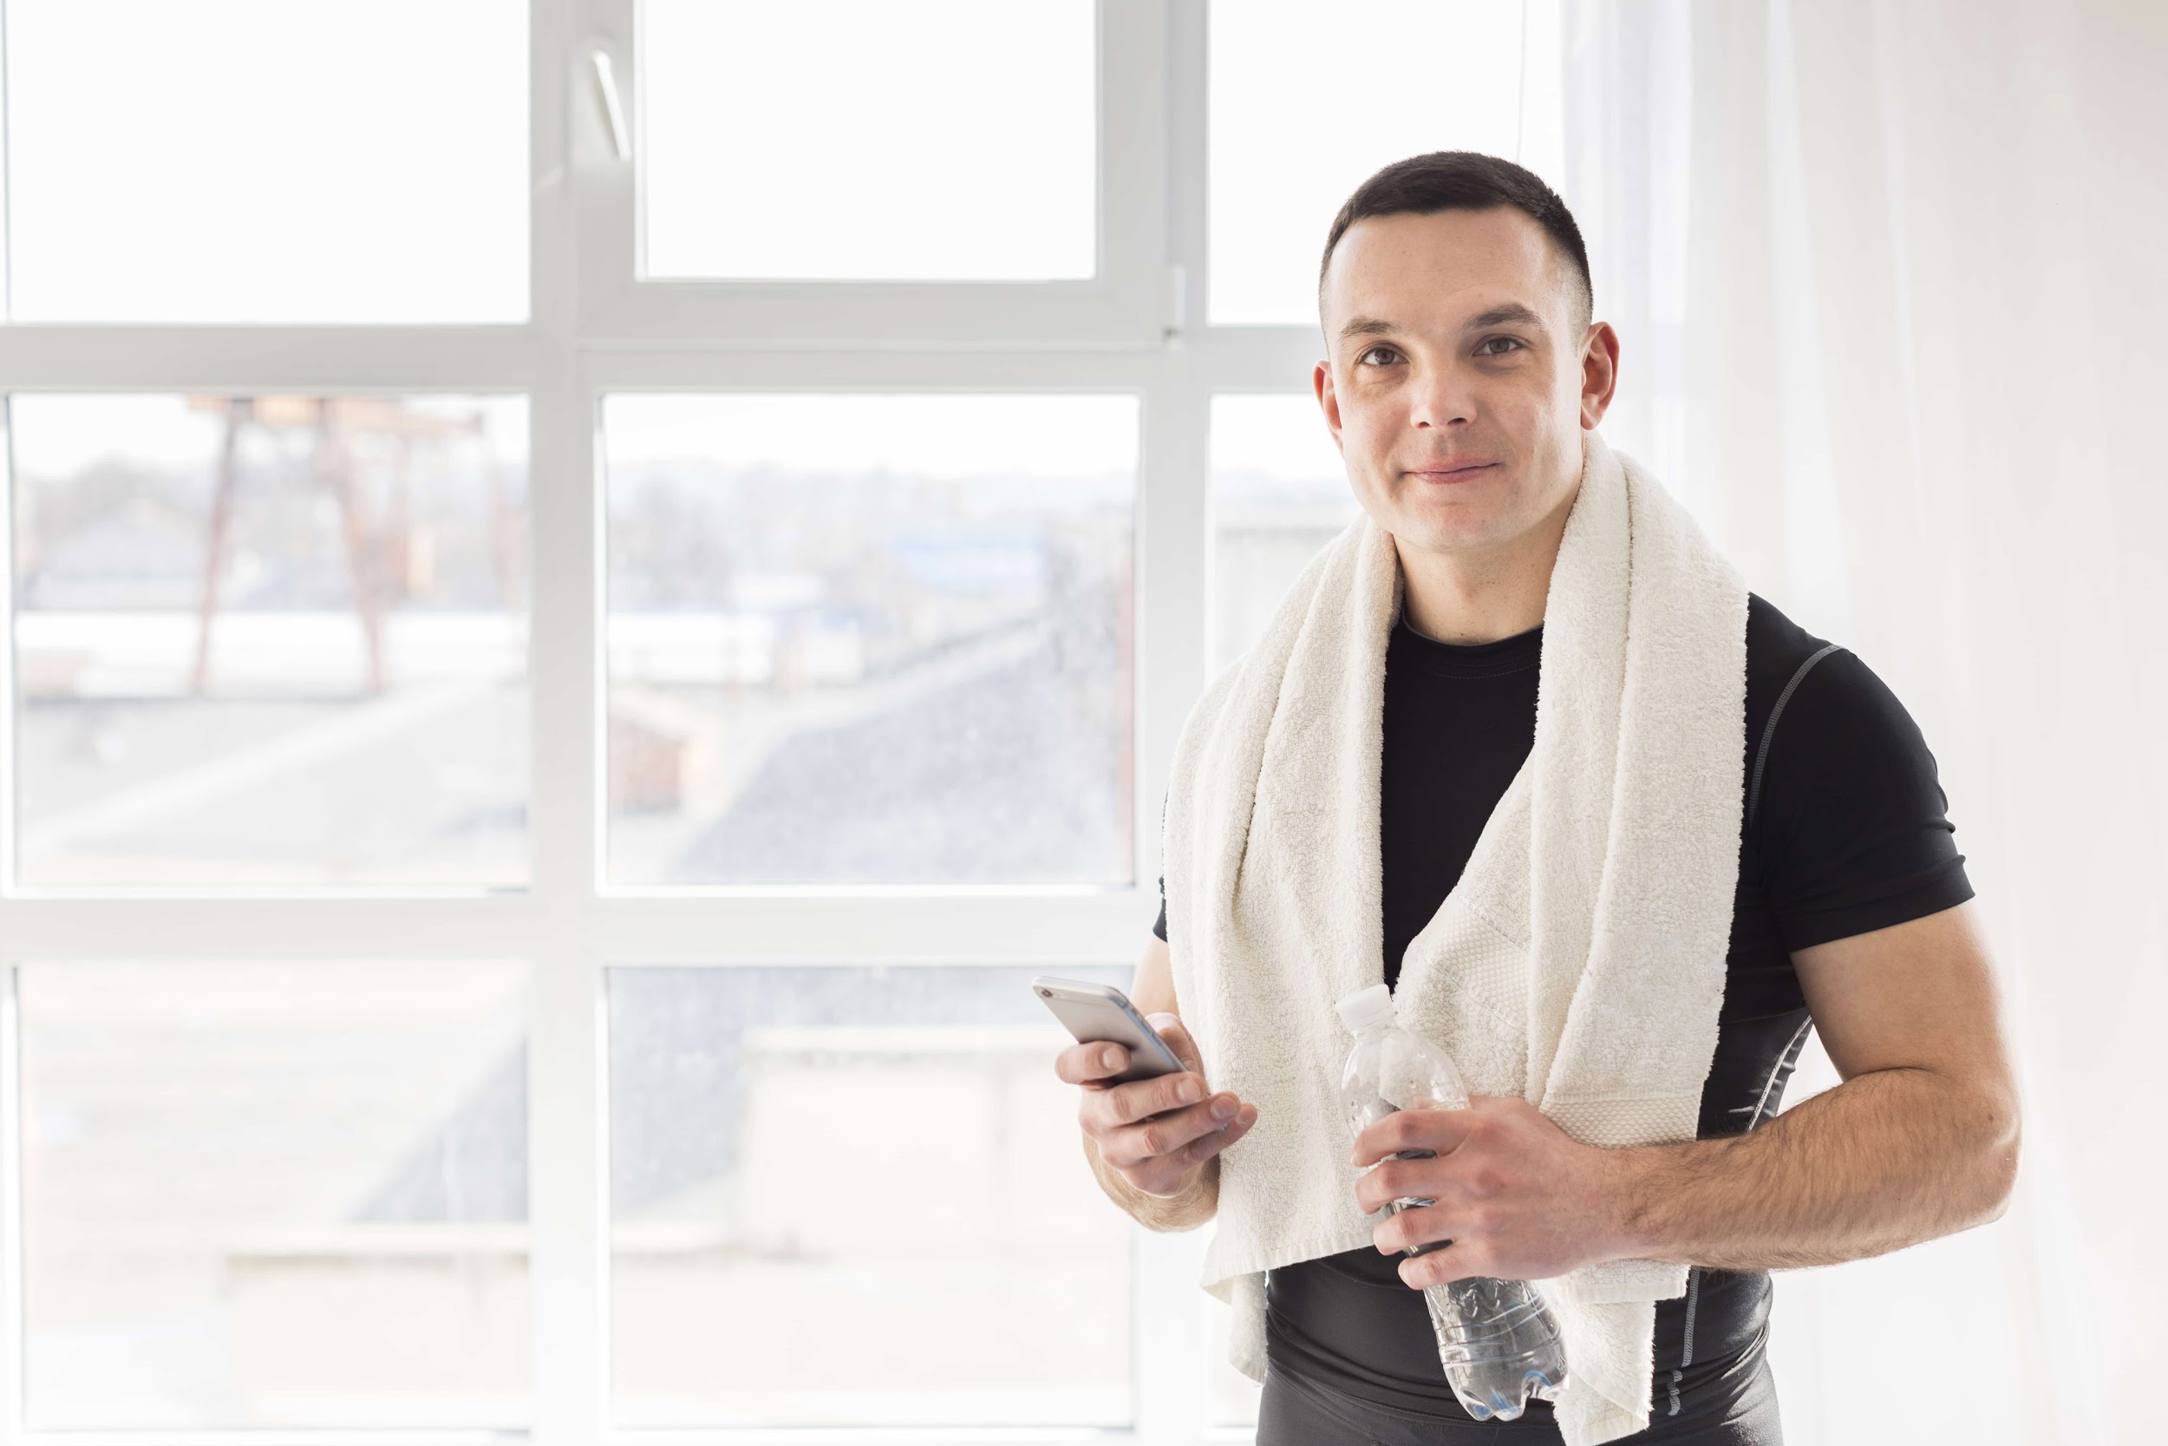

OUR TEAM
MOLLY NICHOLS
JACOB DUNCAN
You can replace the image on the screen with your own
You can replace the image on the screen with your own

Slide 7
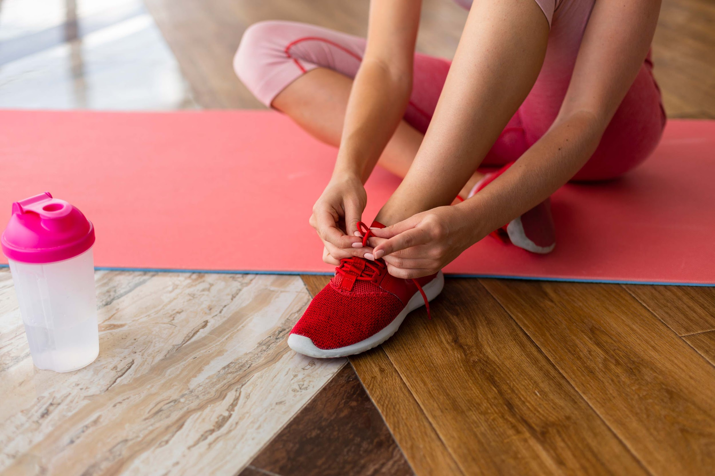
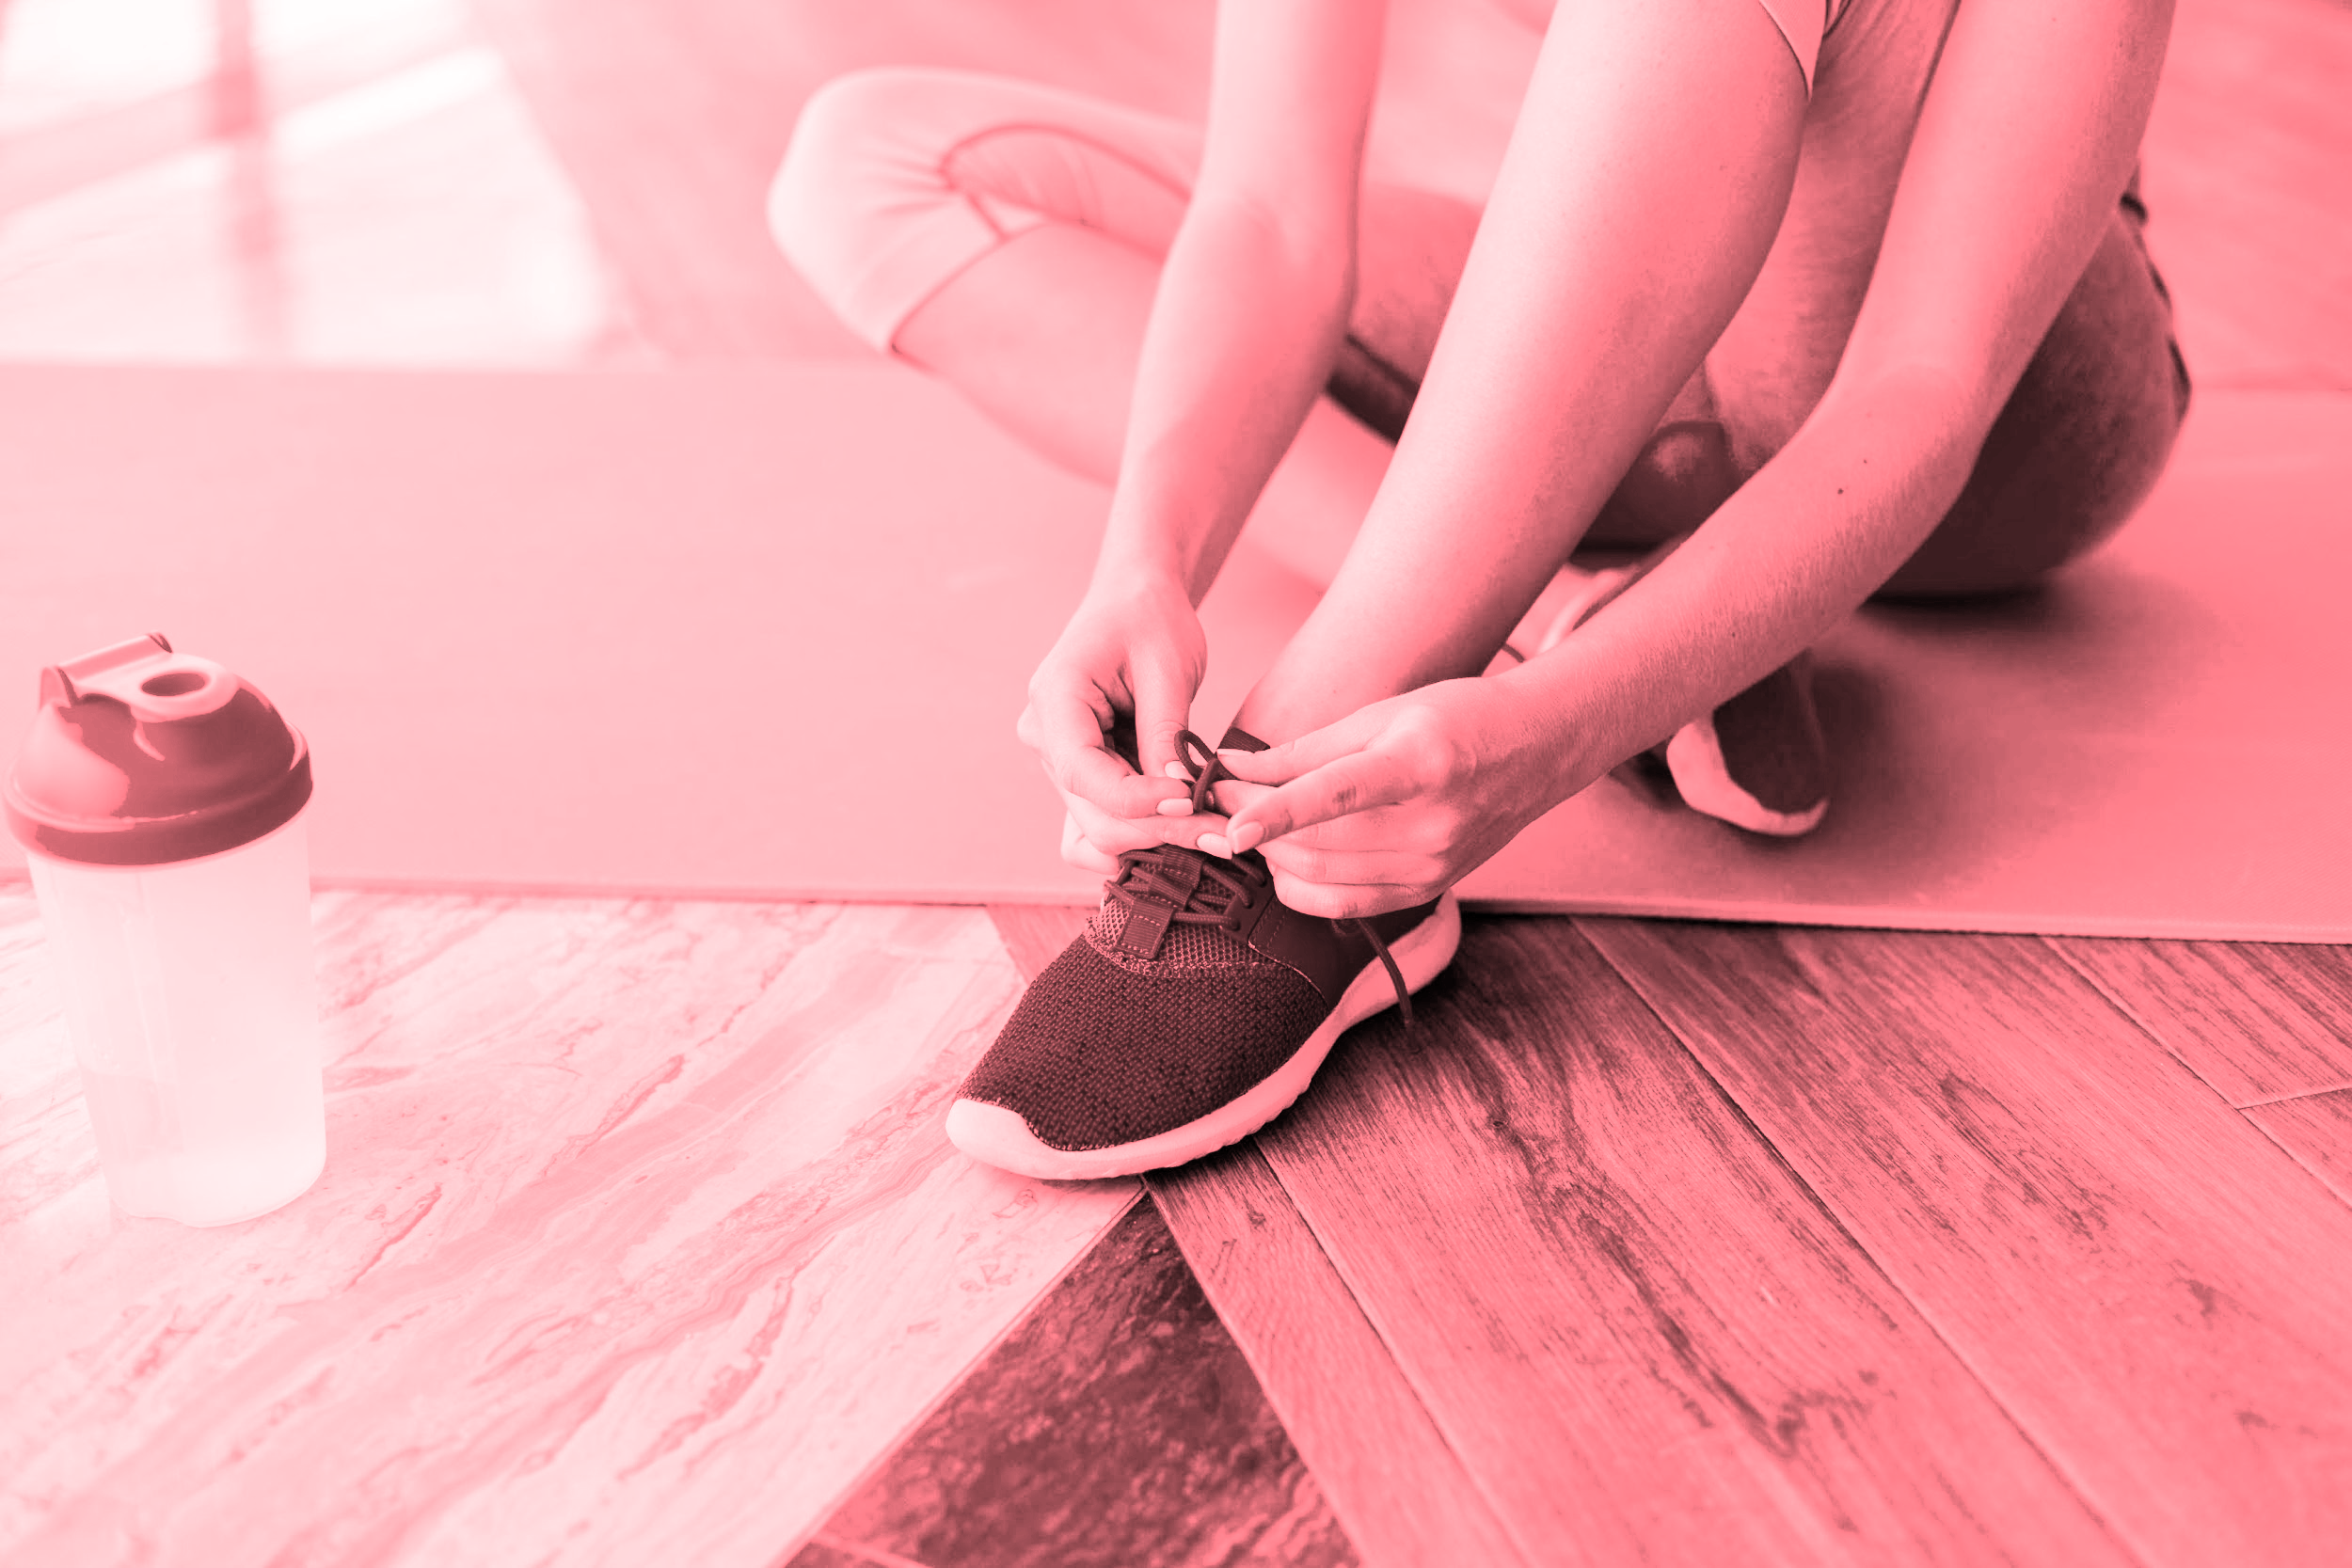
PROBLEM
With the situation going on in the world right now, we’re can’t go to the gym or do some jogging for a bit to clear our heads. That doesn’t mean we can’t do anything to fix this particular problem, though!

Slide 8
THEM
US
Other apps either make you buy expensive equipment or require a paid subscription
We try to focus on making it easy and accessible for the whole family, and it’s free!

Slide 9


OUR SOLUTIONS
We try to offer a wide variety of solutions that will work for you and your loved ones:
It’s very easy to workout using only your body! You can do cardio, yoga or even dance!
We offer video classes, which are easy to follow and perfect for first timers
Exercise model for one person or an entire family, we adapt to your situation

Slide 10
THE APP
01
Let’s check out what we offer

Slide 11

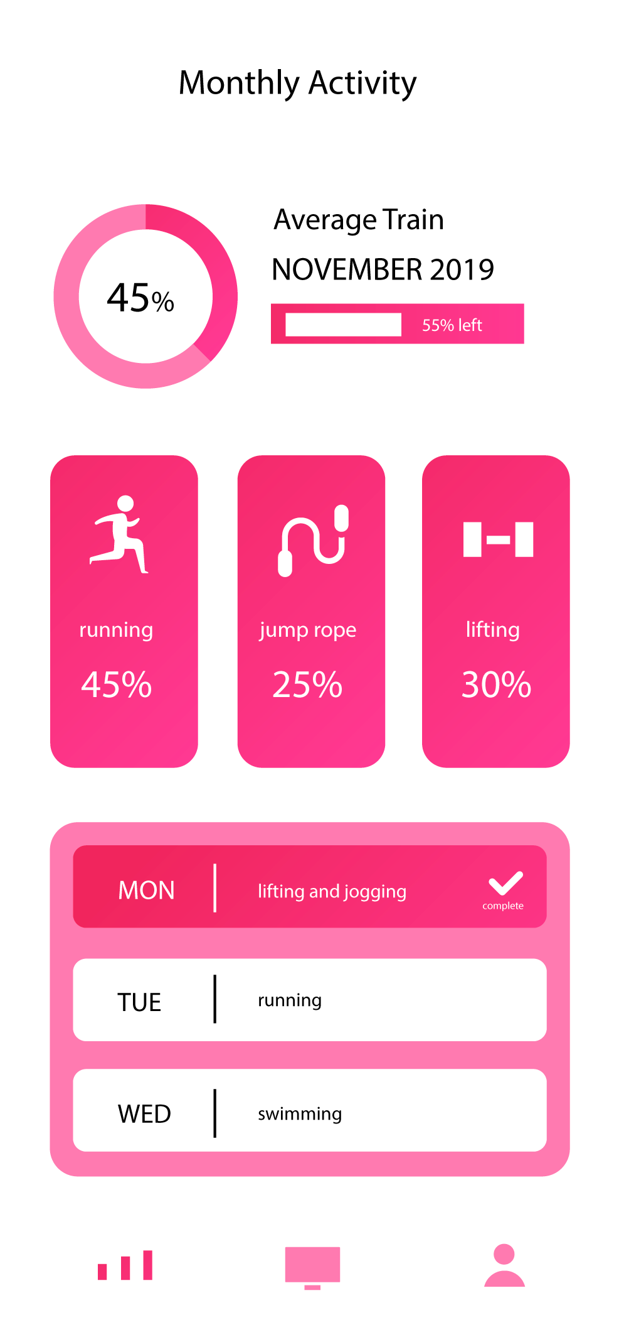
PRODUCT OVERVIEW
INFORMATION
EXERCISES
SCHEDULES
Being able to see how much you progress is very useful
You can choose the ones you feel like doing in the moment
Perhaps you prefer some nice pre-made workout tables?

Slide 12
EXERCISE EXAMPLES
01
02
03
THE ROLL OVER
01
02
03
TEASER
Control the movement with your abdominal muscles
This exercise lets you work your abs in a symmetrical way

Slide 13
EXERCISE EXAMPLES
01
02
03
LEG STRETCH
ROCKING
01
02
03
Keep your shoulders lifted off the mat and the arms level
This helps you strengthen your back and contributes to having a good posture

Slide 14
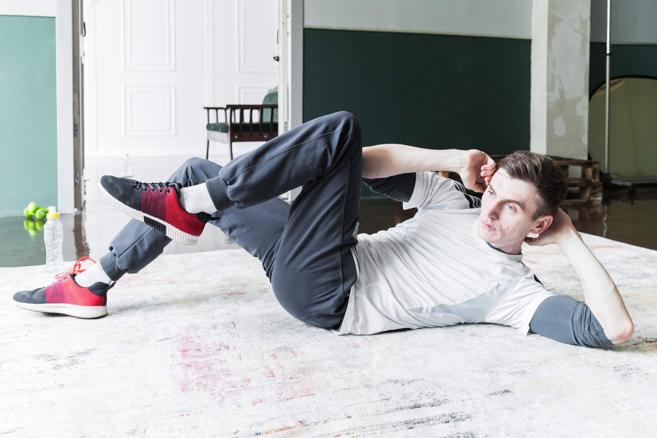
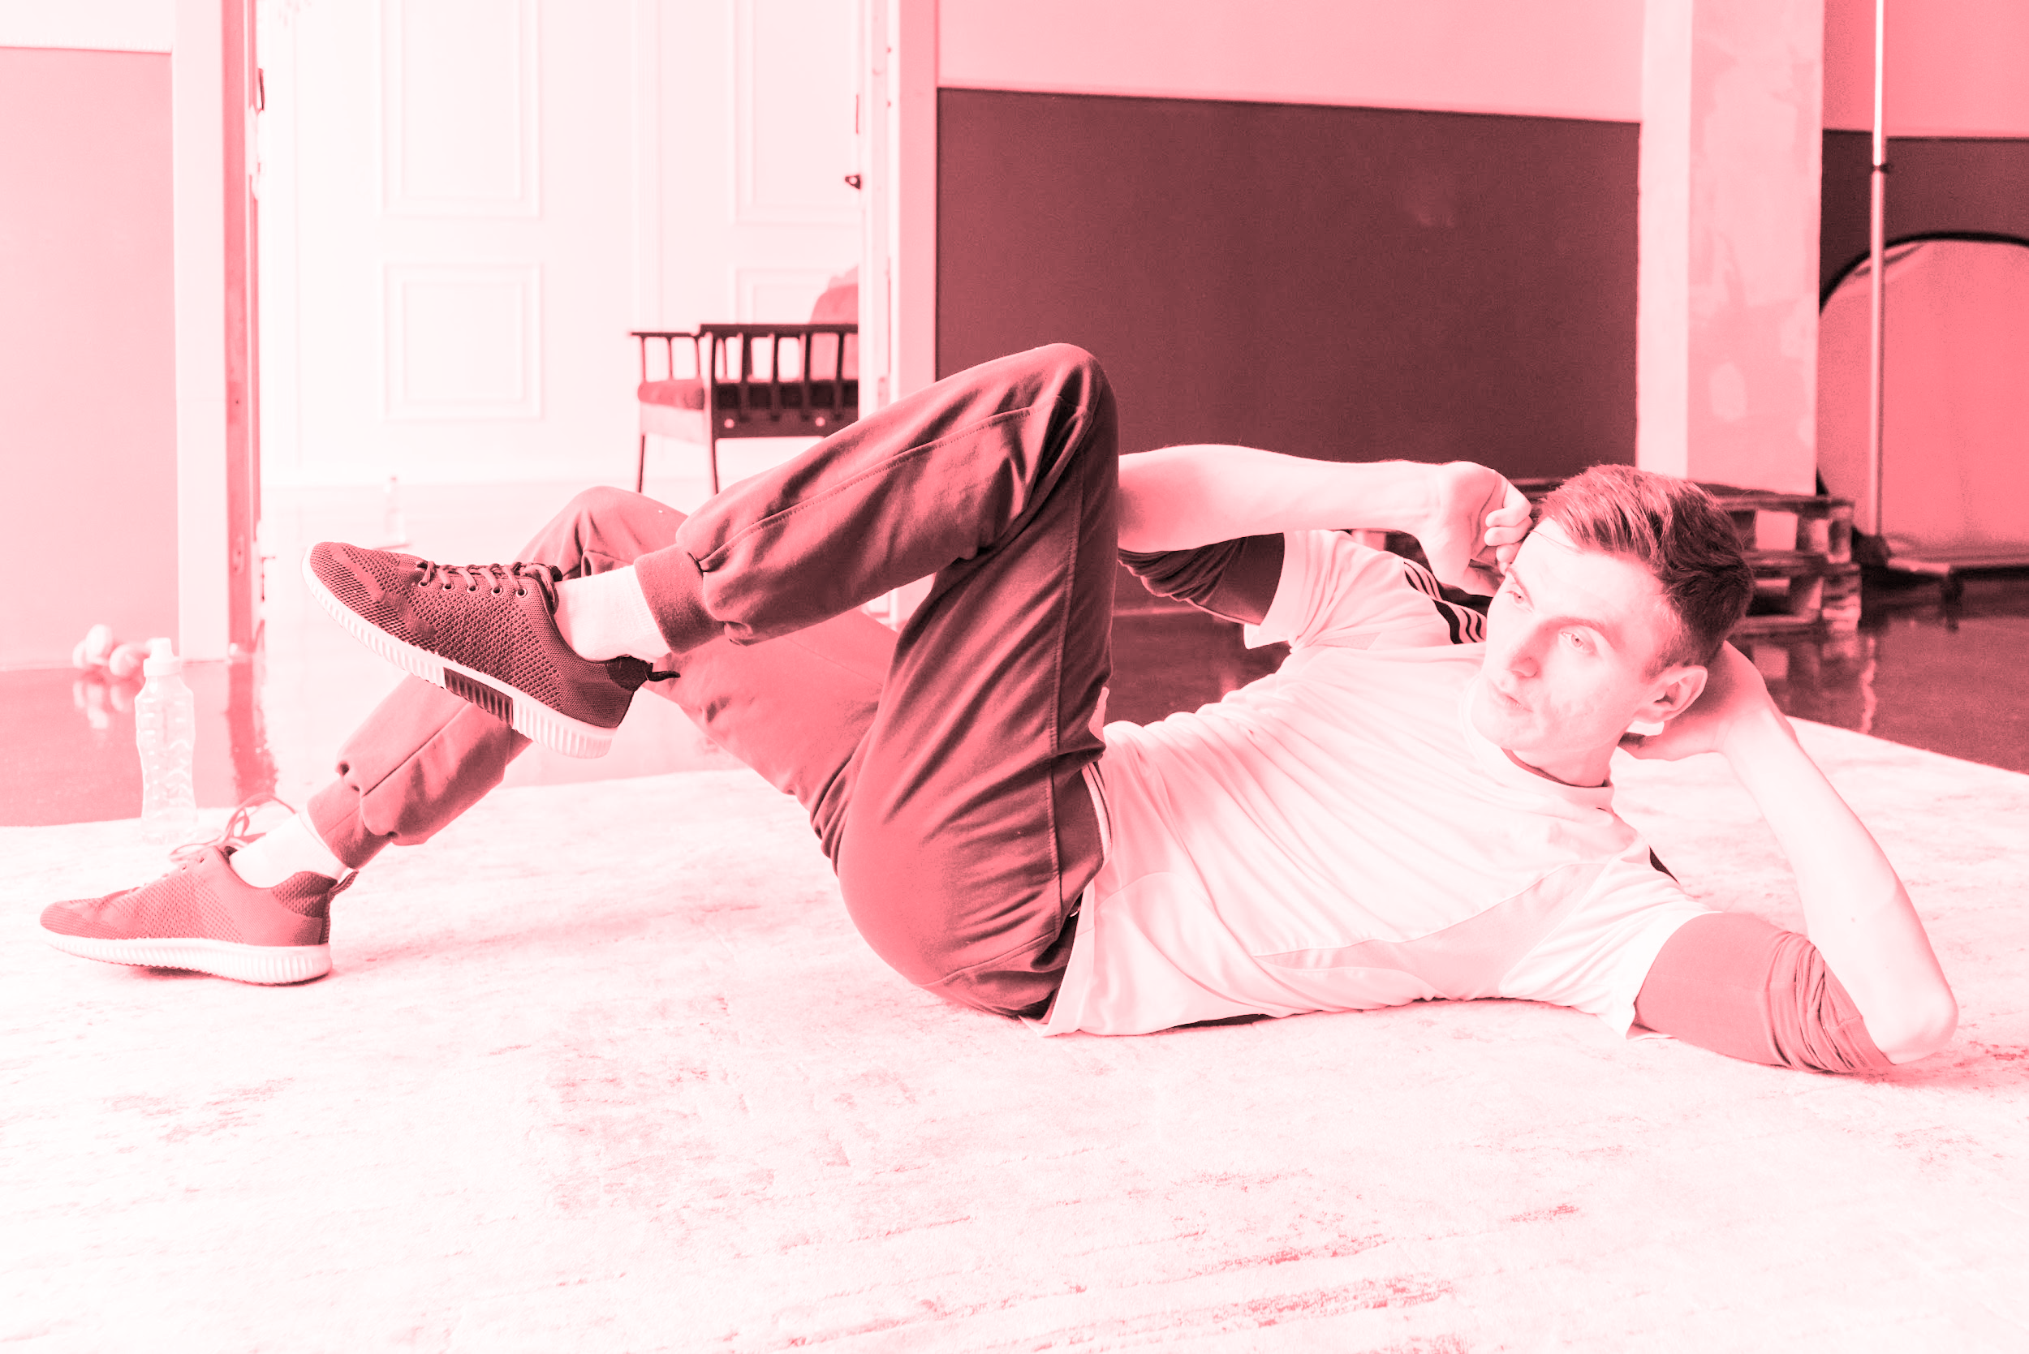
HOW TO DO BICYCLE CRUNCHES
Lie on the floor with your lower back pressed to the ground
Put your hands behind your head and bring your knees towards your chest
Straighten your right leg out to a 45° angle to the ground while turning your upper body to the left, bringing your right elbow towards the left knee
Now switch sides and do the same motion to complete one rep

Slide 15
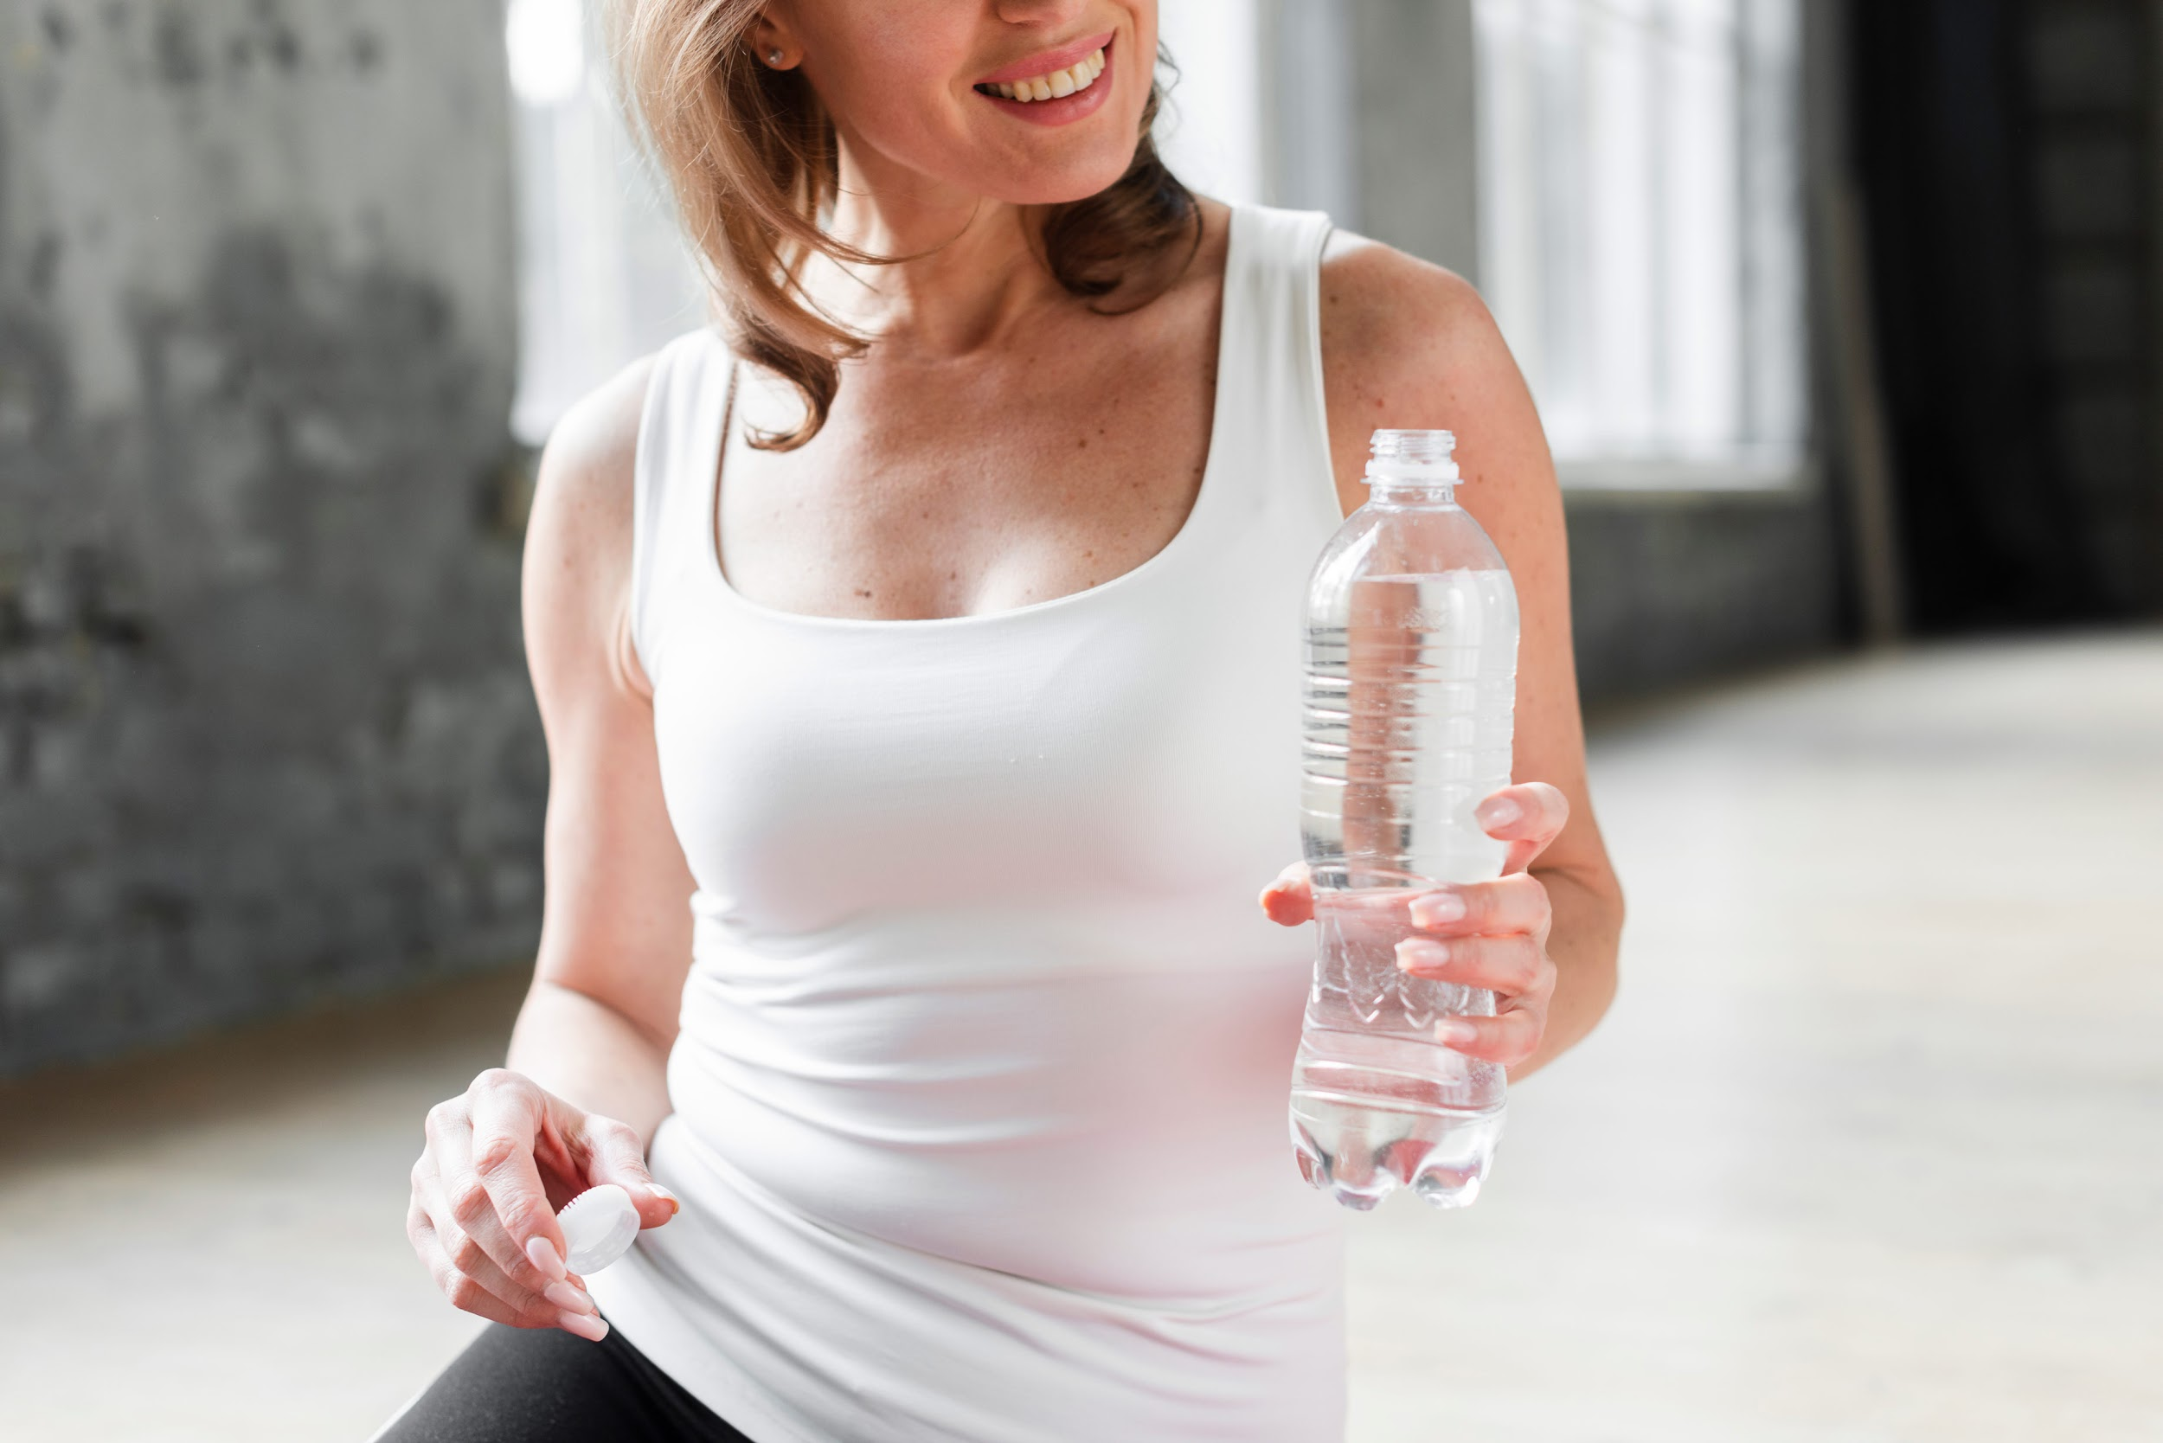

USEFUL TIPS
GOOD FORM
UPCYCLE
HIDRATATE
STAY SAFE
Take care of your posture when you’re exercising
For example, use a filled water bottle as a dumbbell
Drink plenty of water before and after exercising
Move furniture away so you don’t hit anything

Slide 16
WORKOUT TABLE
MON-TUE | WED-THU | FRI | SAT-SUN
30 minutes: yoga | 15 minutes: stretching | 20 minutes: dance cardio | 40 minutes: cardio
20 push-ups 30 jumping jacks (3 times) | 15-second plank 20 walking lunges (4 times) | 30-second skipping 10 push-ups (6 times) | 30-second plank 10 walking lunges (3 times)
Cardio routine | Pilates routine | Kickboxing routine | HIIT routine

Slide 17
TIMING
SET UP THE ROOM
CARDIO
YOGA
01
03
05
02
04
STRETCH
WORKOUT

Slide 18
OUR DATA
02
Here’s how we do it

Slide 19
SWOT ANALYSIS
STRENGTHS
WEAKNESSES
S
W
OPPORTUNITIES
THREATS
O
T
Very easy to use, free, lots of different exercises
Made for use at home, doesn’t replace a gym
In constant expansion, growing user base
Low opportunity to expand within target audience

Slide 20
AWESOME WORDS

Slide 21
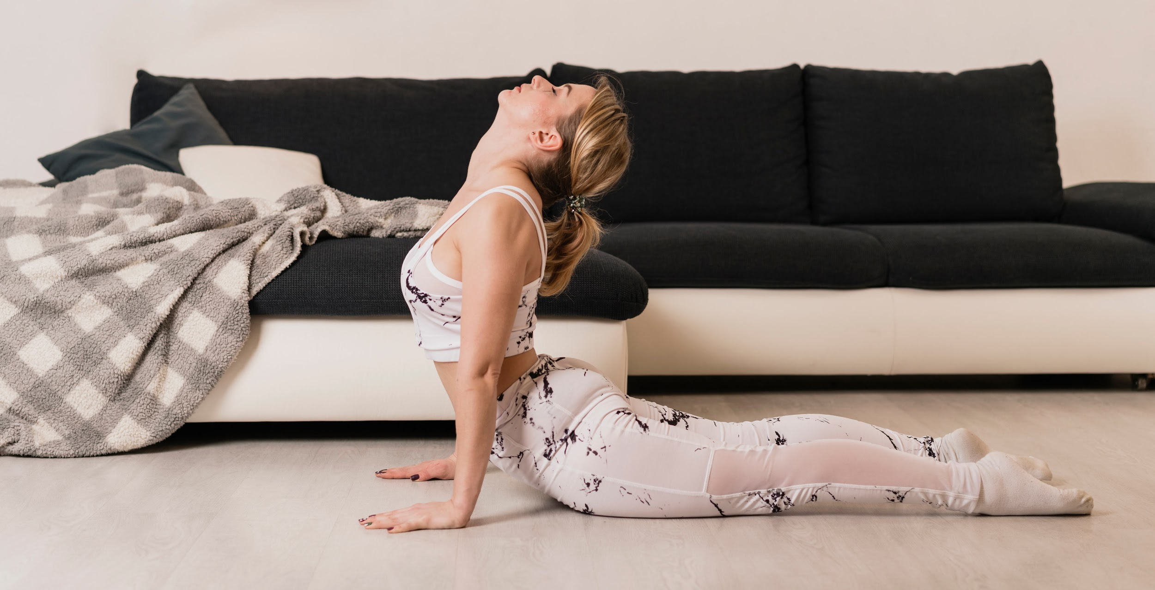
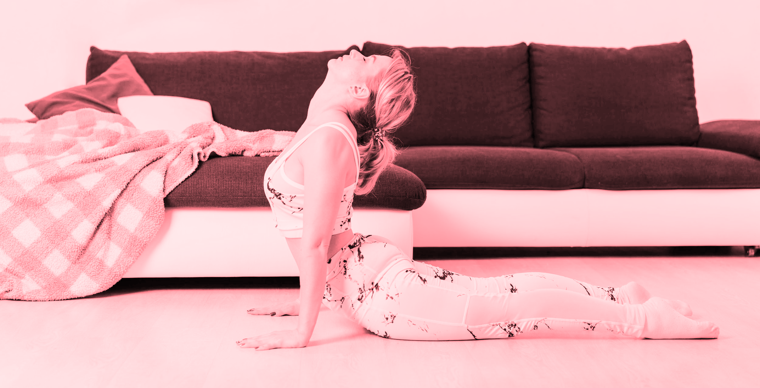
OUR PLANS
CASUAL
WORKOUT PRO
FOR FAMILIES
For people that don’t exercise regularly
For avid gym-goers looking to continue exercising
For families that want to get fit together

Slide 22
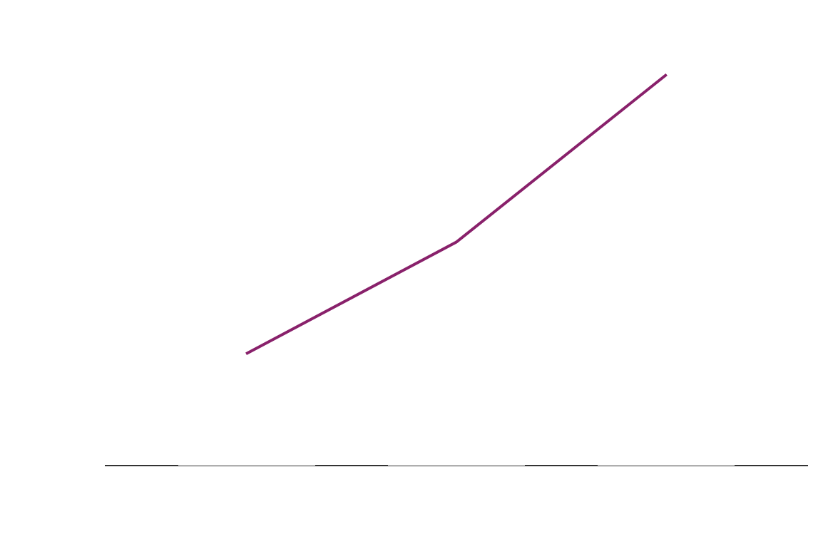
TRACTION
Revenue
Users
140,000
New users per week
$200,000
Gross revenue
9.7/10
Average rating
To modify this graph, click on it, follow the link, change the data and paste the resulting graph here

Slide 23
1,000,000
Total downloads since January

Slide 24
REVIEWS
—MOLLY LANE
—LILLY BENNETT
—HARVEY DOYLE
“The diversity of workouts as well as an user-friendly interface makes it a great app”
“I love this! Variety, different levels, and lots of fun. Makes staying home easier”
“There’s something for each member of the family. It’s fantastic even for kids”

Slide 25
CASE STUDY
CHALLENGE 01
RESULTS 01
SOLUTION 01
CHALLENGE 02
RESULTS 02
SOLUTION 02
People can’t go outside to exercise
People want to exercise at home with no equipment
Workouts that use your own body and little space
The need of one-on-one classes, like at the gym
People want someone to help them exercise
Videos that show exercises step by step

Slide 26
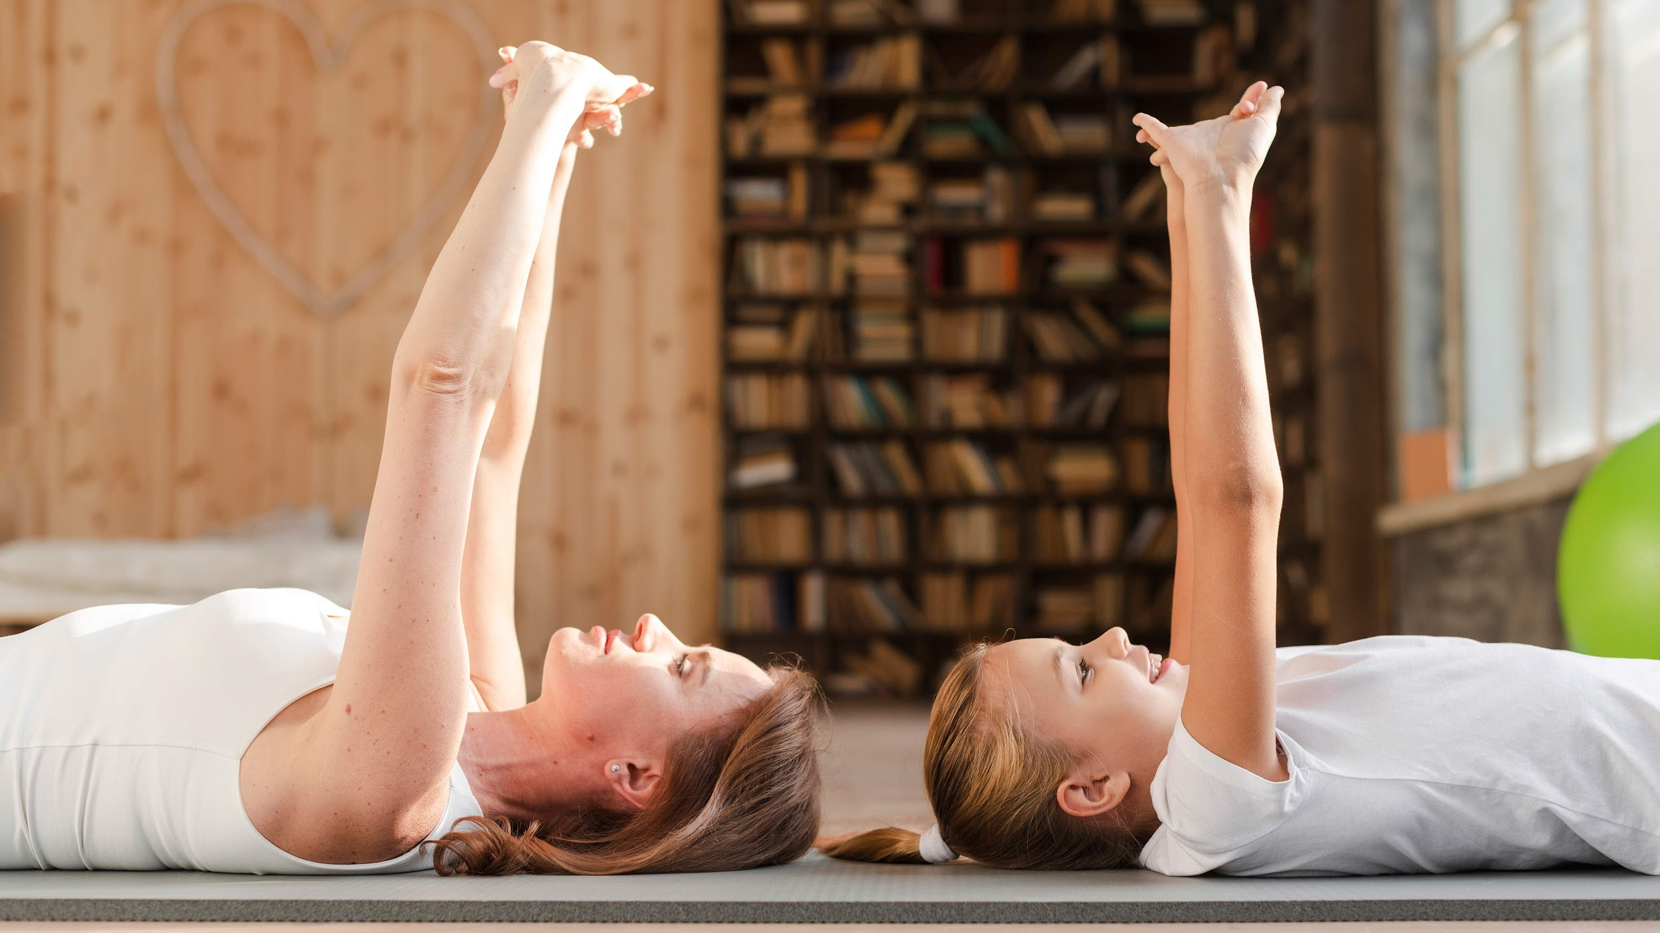
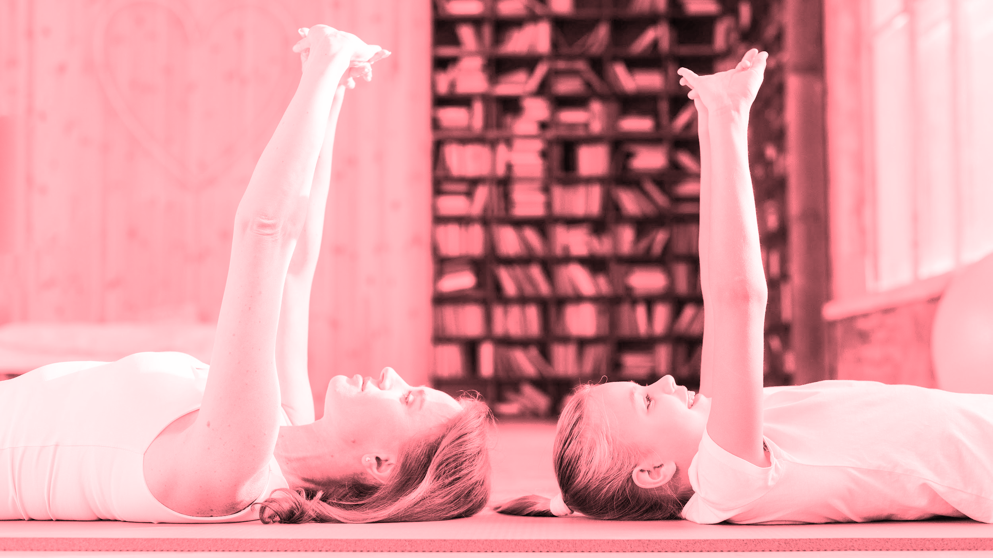
A PICTURE IS WORTH A THOUSAND WORDS

Slide 27
MARKET SIZE
50%
30%
20%
JUPITER
MARS
MERCURY

Slide 28
TARGET
15 h
GENDER
AVG. WEEKLY WORKOUT TIME
60%
40%
AGE
PREFERENCES
9-20
21-40
Stretch
Yoga
Strength

Slide 29
BUSINESS MODEL
FREE APP
ADS
PLATFORMS
SOCIAL
Downloading and using the app has absolutely no cost
Source of Income to keep the app alive and for free
Developed for all available mobile operating systems
Friend list and connectivity with social media

Slide 30
PREDICTED GROW
Users
Revenue
50%
70%
75%
90%
APRIL
MAY
JUNE
JULY

Slide 31

INVESTMENT
CODING
60%
GRAPHICS
20%
MARKETING
20%
A stable, crash-free app for all mobile OS
A user-friendly and appealing interface
We aim to be the number one choice
To modify this graph, click on it, follow the link, change the data and paste the resulting graph here

Slide 32
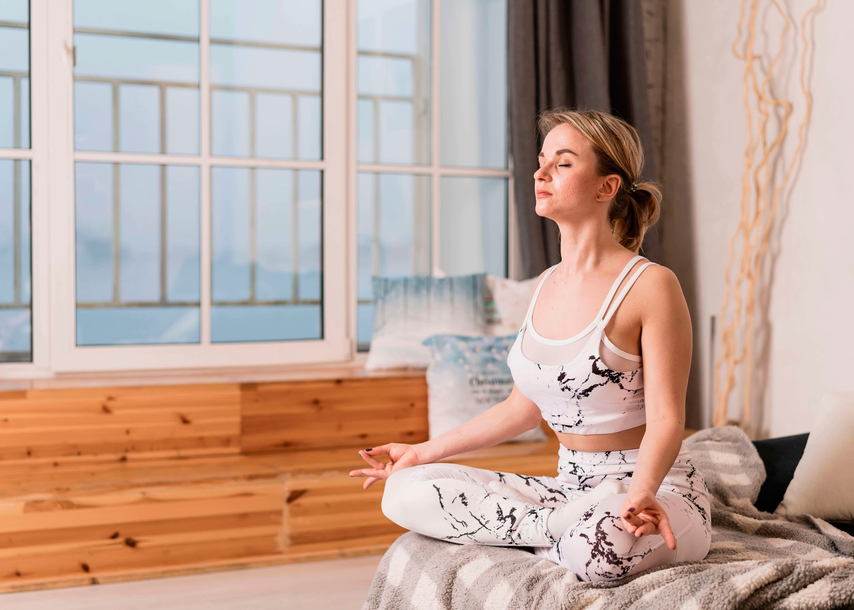

THANKS
Do you have any questions?
youremail@freepik.com
+91 620 421 838
yourcompany.com
Please keep this slide for attribution

Slide 33
PILATES ICONS

Slide 34
ALTERNATIVE RESOURCES
Here’s an assortment of alternative pictures within the same style of this template.
Fitness woman doing exercise at home
Fitness man
Male stretching legs on exercise mat
Young woman working out at home
Flexible blonde young woman stretching her legs at home
Full shot mother and daughter stretching
Athletic woman stretching resistance band with copy space
Rear view of a woman stretching her hands standing in front of weathered wall
Fitness woman using mobile phone
Pretty sporty young woman stretching clasped hands

Slide 35
RESOURCES
Did you like the resources on this template? Get them for free at our other websites.
PHOTOS
Woman with pink leggings doing crunches
Smiling portrait of a girl doing stretching exercise in front of concrete wall
Fitness woman doing exercise at home
Fitness man
Close-up of woman tying her shoelaces
Daughter kissing mother taking selfie
Man doing crunches on exercise mat
Woman holding water bottle
High angle woman in flexible position
Mother and daughter stretching on yoga mat
High angle woman doing yoga
VECTORS
Get fit gym promotion landing page
ICONS
Pilates 6

Slide 36
Instructions for use
In order to use this template, you must credit Slidesgo by keeping the Thanks slide.
You are allowed to:
- Modify this template.
- Use it for both personal and commercial projects.
You are not allowed to:
- Sublicense, sell or rent any of Slidesgo Content (or a modified version of Slidesgo Content).
- Distribute Slidesgo Content unless it has been expressly authorized by Slidesgo.
- Include Slidesgo Content in an online or offline database or file.
- Offer Slidesgo templates (or modified versions of Slidesgo templates) for download.
- Acquire the copyright of Slidesgo Content.
For more information about editing slides, please read our FAQs or visit Slidesgo School:
https://slidesgo.com/faqs and https://slidesgo.com/slidesgo-school

Slide 37
Fonts & colors used
This presentation has been made using the following fonts:
Maven Pro
(https://fonts.google.com/specimen/Maven+Pro)
Overpass
(https://fonts.google.com/specimen/Overpass)
#89216b
#ff3f52
#f400ad
#ffffff

Slide 38
Use our editable graphic resources...
You can easily resize these resources without losing quality. To change the color, just ungroup the resource and click on the object you want to change. Then, click on the paint bucket and select the color you want. Group the resource again when you’re done.

Slide 41
JANUARY
FEBRUARY
MARCH
APRIL
MAY
JUNE
PHASE 1
Task 1
Task 2
PHASE 2
Task 1
Task 2
JANUARY
FEBRUARY
MARCH
APRIL
PHASE 1
Task 1
Task 2

Slide 44
...and our sets of editable icons
You can resize these icons without losing quality.
You can change the stroke and fill color; just select the icon and click on the paint bucket/pen.
In Google Slides, you can also use Flaticon’s extension, allowing you to customize and add even more icons.

Slide 45
Educational Icons
Medical Icons

Slide 46
Business Icons
Teamwork Icons

Slide 47
Help & Support Icons
Avatar Icons

Slide 48
Creative Process Icons
Performing Arts Icons

Slide 49
Nature Icons

Slide 50
SEO & Marketing Icons

Slide 51


