Slide 1
OS Weekly Planner for Teachers
Start now!

Slide 2
Contents of This Template
Slidesgo
School
Resources
Instructions
Final Slides
FAQ
Here’s what you’ll find in this Slidesgo template:
A slide structure based on a multi-purpose presentation, which you can easily adapt to your needs. For more info on how to edit the template, please visit Slidesgo School or read our FAQs.
An assortment of illustrations that are suitable for use in the presentation can be found in the alternative resources slide.
A thanks slide, which you must keep so that proper credits for our design are given.
A resources slide, where you’ll find links to all the elements used in the template.
Instructions for use.
Final slides with:
The fonts and colors used in the template.
More infographic resources, whose size and color can be edited.
Sets of customizable icons of the following themes: general, business, avatar, creative process, education, help & support, medical, nature, performing arts, SEO & marketing, and teamwork.
You can delete this slide when you’re done editing the presentation.

Slide 3
Contact Me
Our Week
Here you could describe the topic of the section
Here you could describe the topic of the section
Homework
Upload
Here you could describe the topic of the section
Here you could describe the topic of the section

Slide 4
How to Contact Me
Monday
Tuesday
Wednesday
Thursday
Friday
Homework
658-956-87
youremail@freepik.com

Slide 5
—Someone Famous
Monday
Tuesday
Wednesday
Thursday
Friday
Homework
“This is a quote, words full of wisdom that someone important said and can make the reader get inspired.”

Slide 6
Our Week
Monday
Tuesday
Wednesday
Thursday
Friday
Homework
Contact
Video Conference
Monday
Tuesday
Mercury is the closest planet to the Sun and the smallest one in the Solar System—it’s only a bit larger than the Moon
Wednesday
Thursday
Friday
Homework

Slide 7
Videoconference Hours
Monday
Tuesday
Wednesday
Thursday
Friday
Homework
Monday | Tuesday | Wednesday | Thursday | Friday
10:45 - 11:45 | 10:45 - 11:45 | 10:45 - 11:45 | 10:45 - 11:45 | 10:45 - 11:45

Slide 8
01.
Our Week
Monday
Tuesday
Wednesday
Thursday
Friday
Homework
You could enter a subtitle here if you need it

Slide 9
Monday
Monday
Tuesday
Wednesday
Thursday
Friday
Homework
01.
02.
Mercury is the closest planet to the Sun and also the smallest one in the Solar System
Jupiter is the biggest planet in the Solar System and the fourth-brightest object in the sky

Slide 10
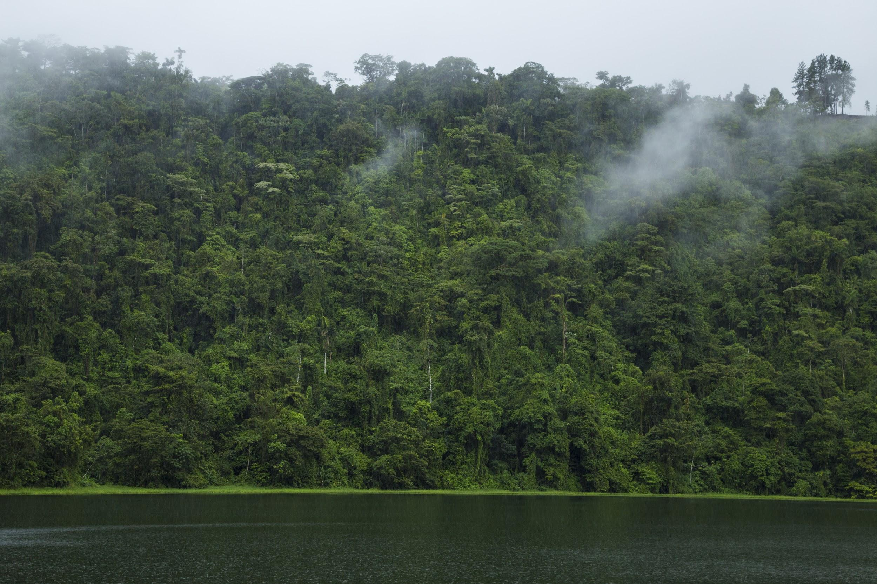
Natural Science
Monday
Tuesday
Wednesday
Thursday
Friday
Homework
Jupiter is a gas giant and the biggest planet in the Solar System
Saturn is composed mostly of hydrogen and helium
a.
b.
Neptune is the fourth-largest planet in the Solar System
Venus has a beautiful name and is the second planet from the Sun
c.
d.

Slide 11
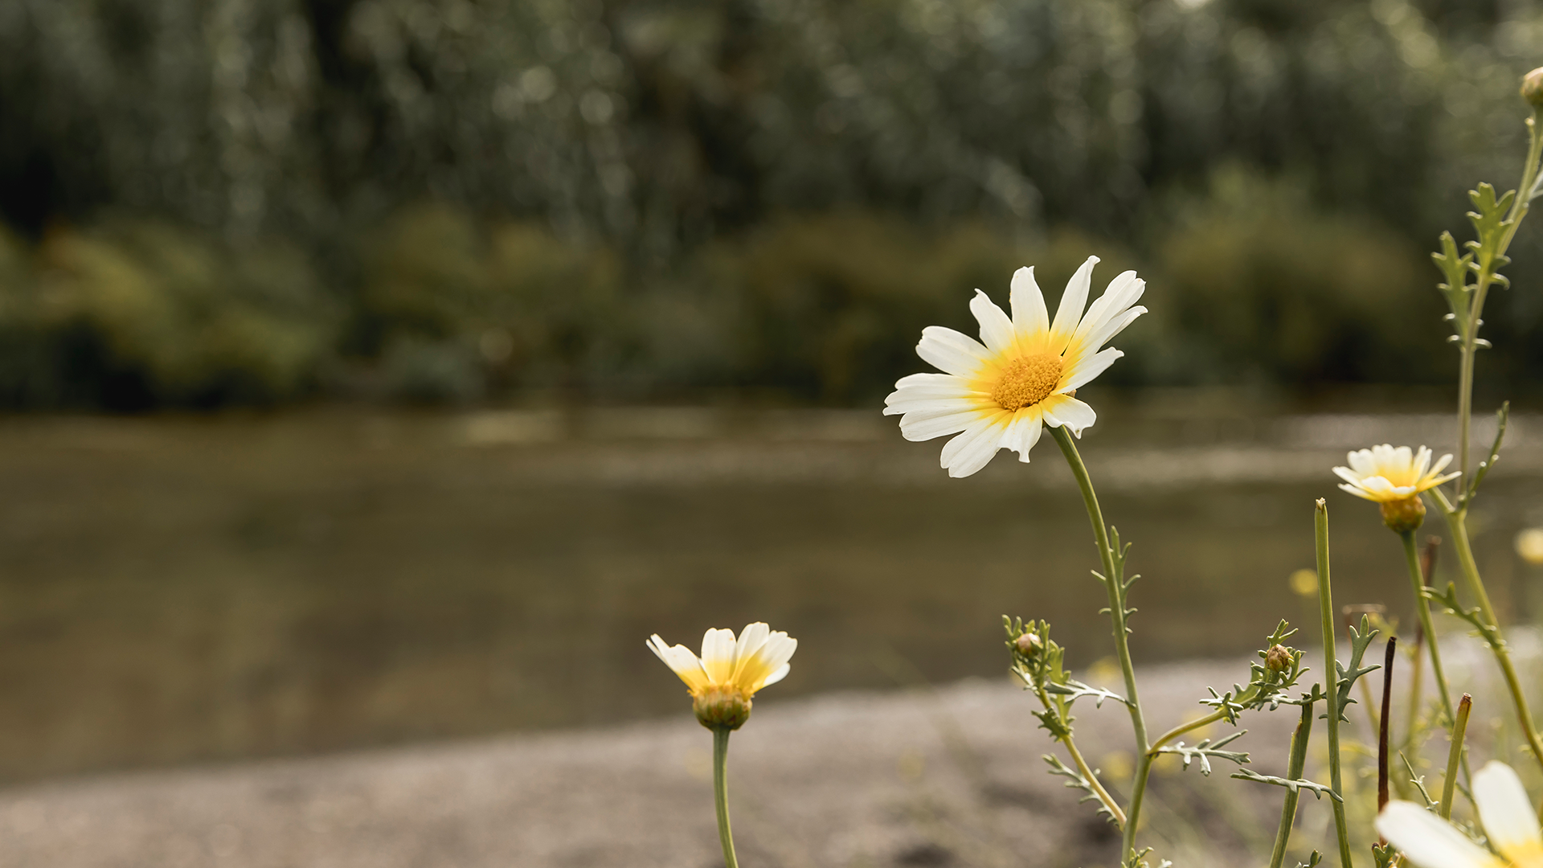
A Picture Is Worth a Thousand Words
Monday
Tuesday
Wednesday
Thursday
Friday
Homework

Slide 12
Tuesday
Monday
Tuesday
Wednesday
Thursday
Friday
Homework
01.
02.
03.
Neptune is the fourth-largest planet in the Solar System
Jupiter is a gas giant and the biggest planet in the Solar System
Venus has a beautiful name and is the second planet from the Sun

Slide 13
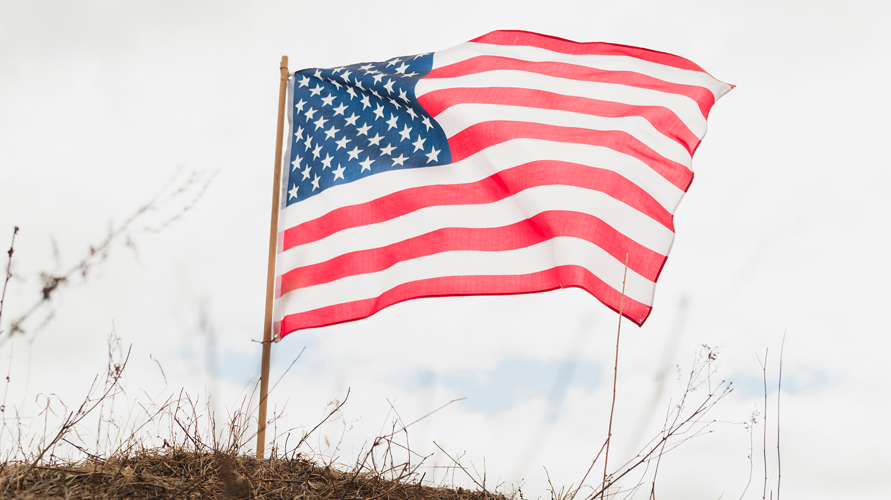
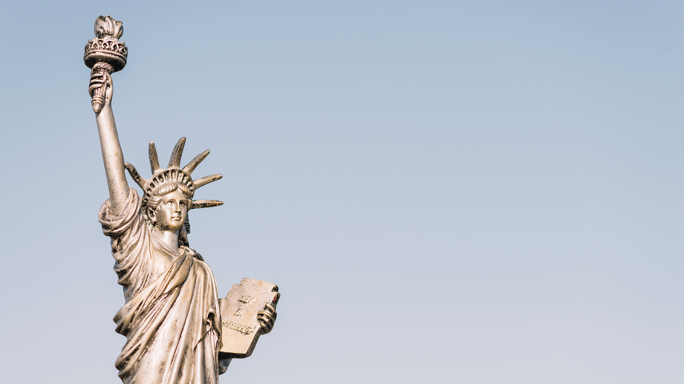
Historia
Monday
Tuesday
Wednesday
Thursday
Friday
Homework
Photo 01.
Venus has a beautiful name and is the second planet from the Sun. It’s terribly hot—even hotter than Mercury
Photo 01
Photo 02.
Mercury is the closest planet to the Sun and the smallest one in the Solar System—it’s only a bit larger than the Moon
Photo 02

Slide 14
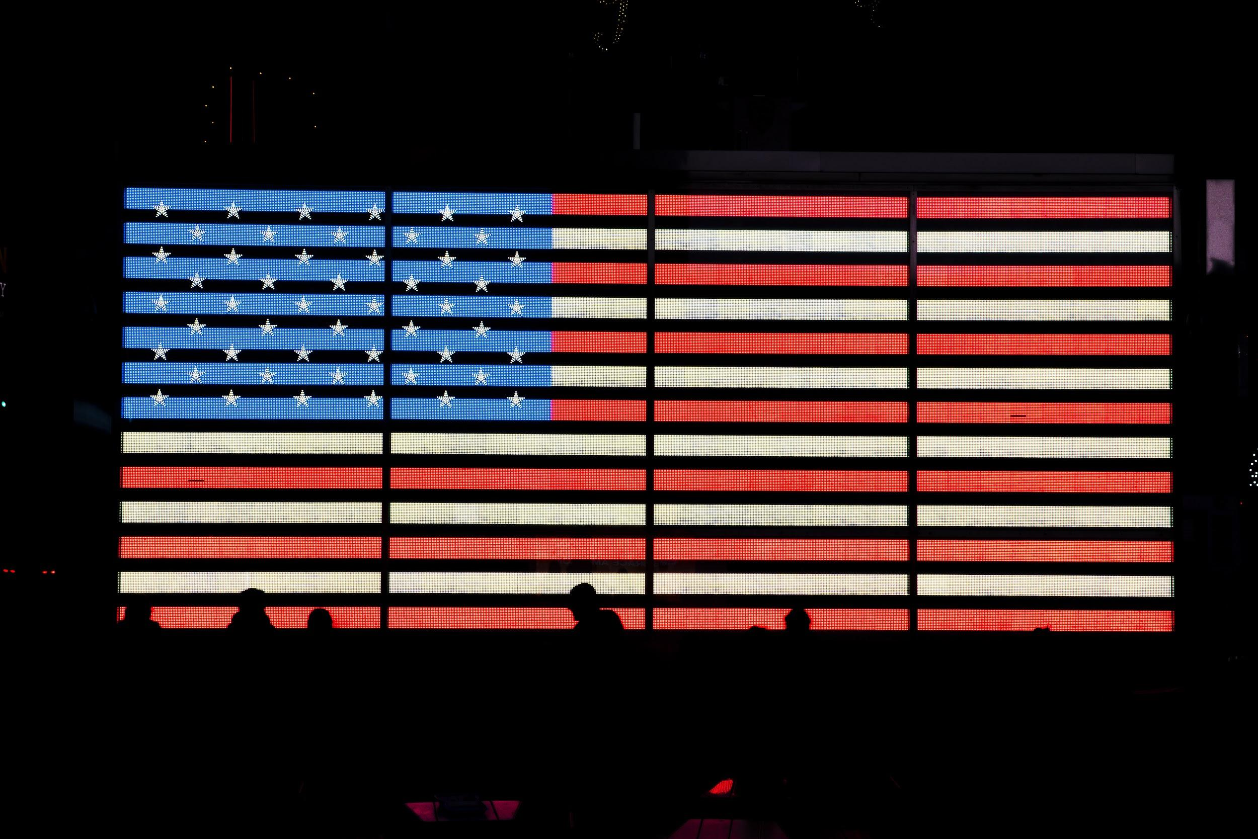
History
Monday
Tuesday
Wednesday
Thursday
Friday
Homework

Slide 15
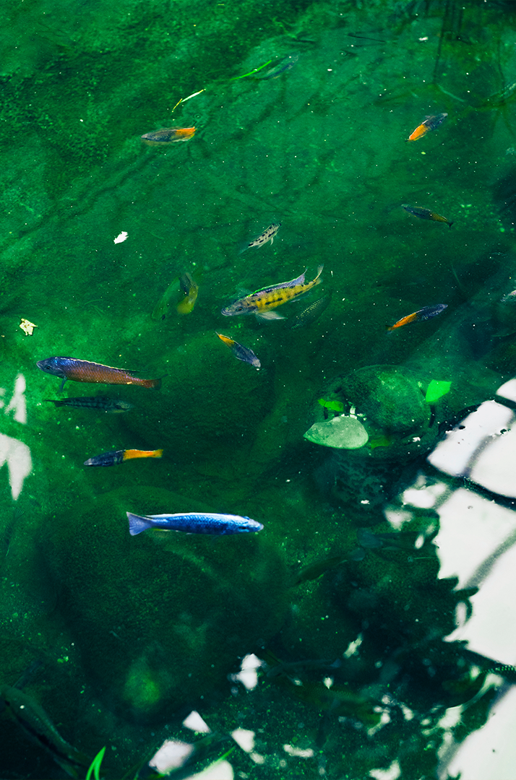
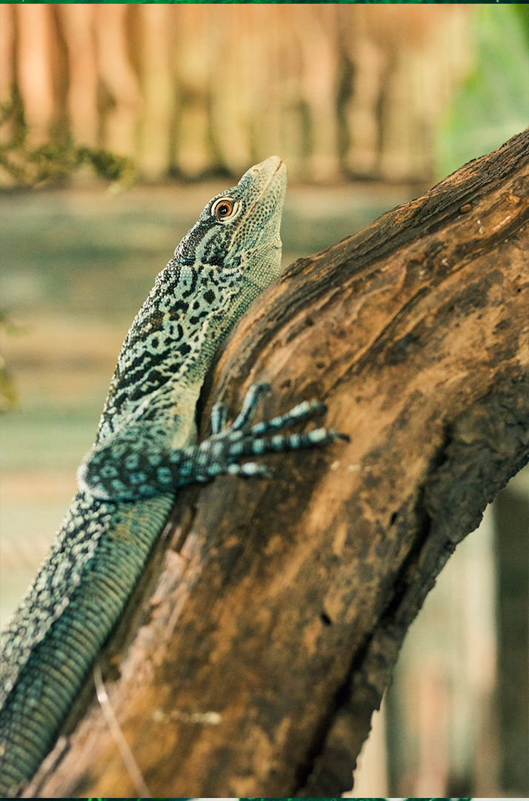
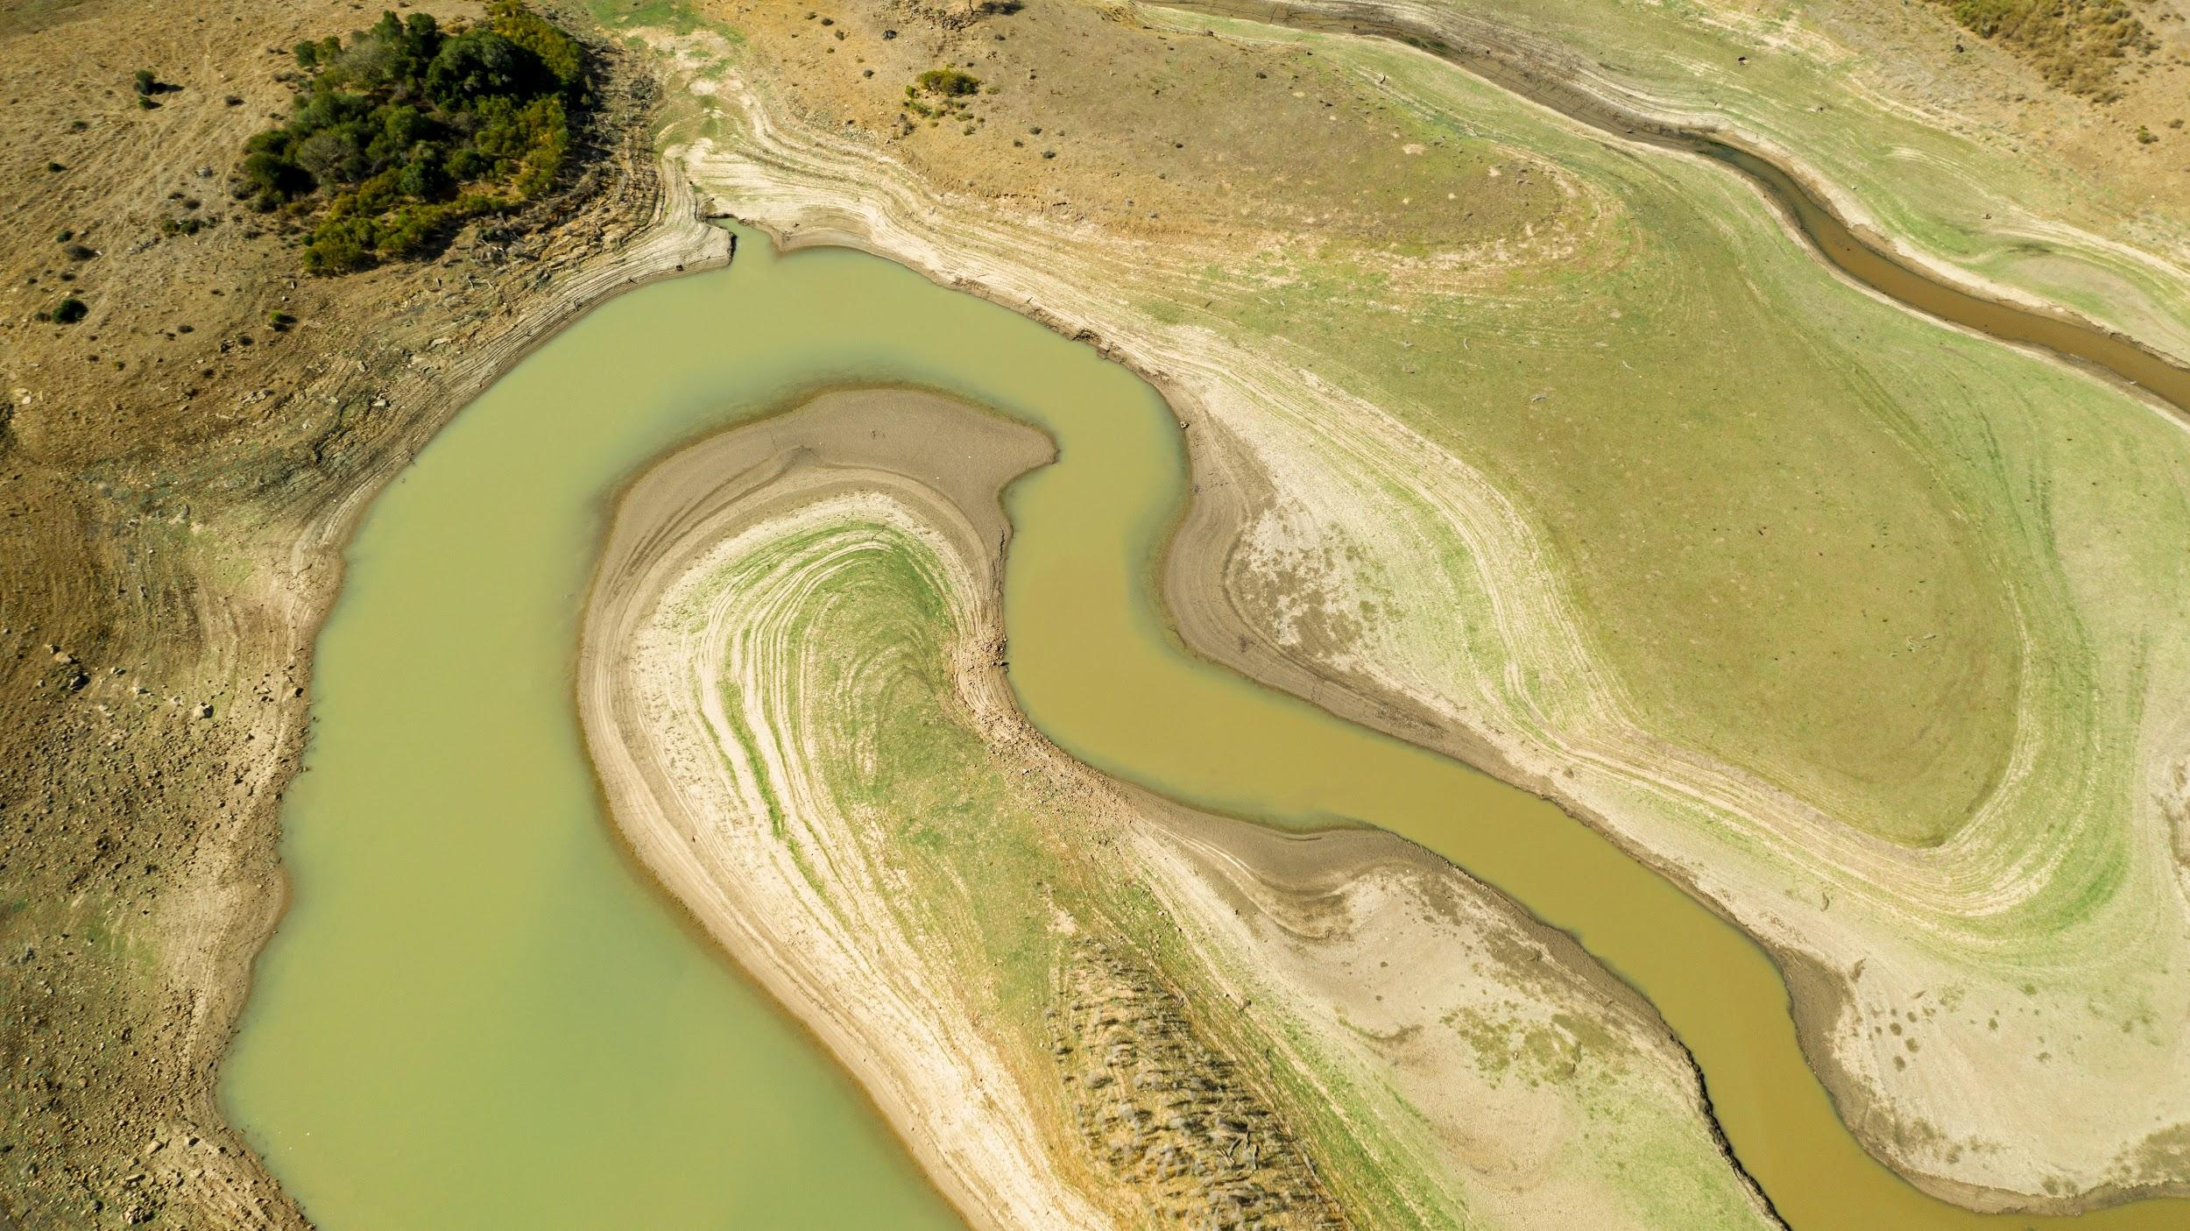
Monday
Tuesday
Wednesday
Thursday
Friday
Homework
Photo 01
Photo 02

Slide 16
Wednesday
Monday
Tuesday
Wednesday
Thursday
Friday
Homework
Despite being red, Mars is actually a cold place
Mercury is the smallest planet in the Solar System
Venus has a beautiful name, but it’s very hot
Neptune is the farthest planet from the Sun

Slide 17
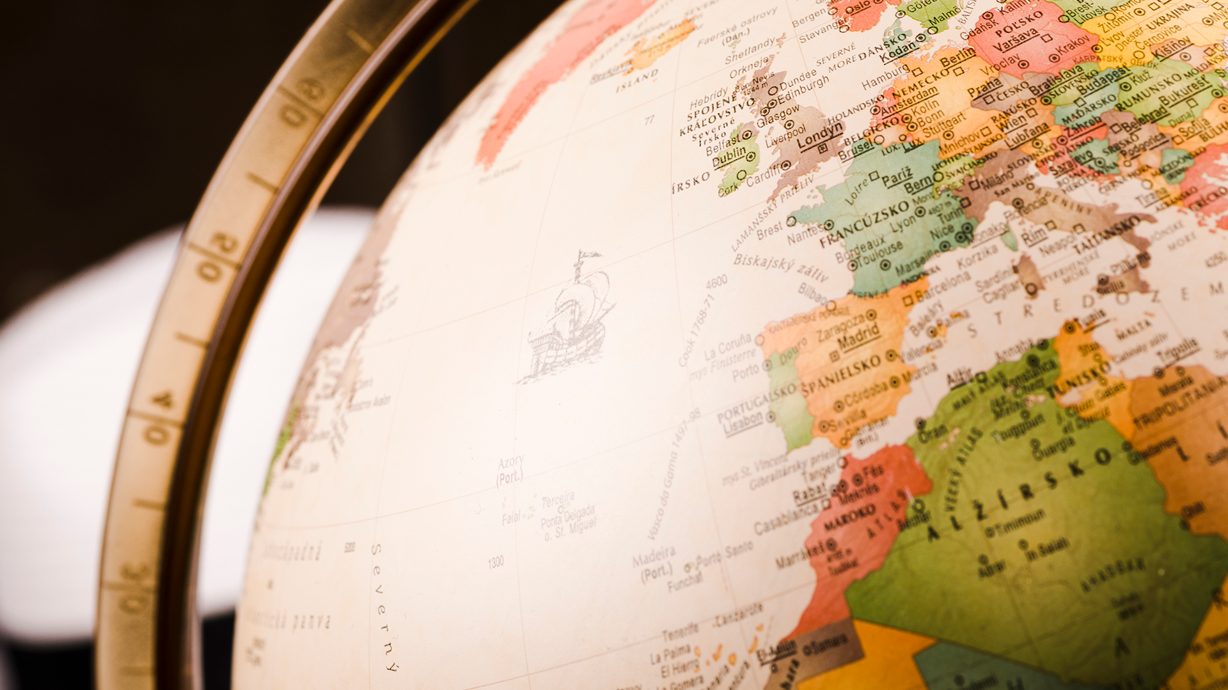
Geography
Monday
Tuesday
Wednesday
Thursday
Friday
Homework
Venus has a beautiful name
Despite being yellow, Mars is actually a cold place
Mercury was named after a Roman god
Saturn is composed mostly of hydrogen and helium
Neptune is the farthest planet from the Sun
Jupiter is a gas giant and the smallest planet

Slide 18
Geography
Monday
Tuesday
Wednesday
Thursday
Friday
Homework
Neptune is the farthest planet from the Sun:
3.
1.
6.
4.
2.
1.
2.
3.
4.
5.
5.
7.
6.
7.

Slide 19
Name 5 countries
Monday
Tuesday
Wednesday
Thursday
Friday
Homework

Slide 20
It’s a gas giant and the biggest planet in the Solar System, which planet is it?
It’s also a gas giant, the sixth planet from the Sun and has rings around it, what’s its name?
Monday
Tuesday
Wednesday
Thursday
Friday
Homework

Slide 21
Thursday
Monday
Tuesday
Wednesday
Thursday
Friday
Homework
Exercises
Theorems
Mercury is the closest planet to the Sun and also the smallest one in the Solar System
Venus has a beautiful name and is the second planet from the Sun. It’s terribly hot

Slide 22
Maths
Monday
Tuesday
Wednesday
Thursday
Friday
Homework
01. _________ is the fourth-largest planet in the Solar System
02. _________ is the biggest planet in the Solar System
03. _________ is the farthest planet from the Sun

Slide 23
a²=b²+c²
Monday
Tuesday
Wednesday
Thursday
Friday
Homework
Mercury is the closest planet to the Sun

Slide 24
Friday
Monday
Tuesday
Wednesday
Thursday
Friday
Homework
Despite being red, Mars is actually a cold place
Mercury is the smallest planet in the Solar System
Saturn is composed of hydrogen and helium
Venus has a beautiful name, but it’s very hot
Neptune is the farthest planet from the Sun
Jupiter is the biggest planet in the Solar System

Slide 25
Biology
Monday
Tuesday
Wednesday
Thursday
Friday
Homework
a.
d.
b.
e.
c.
f.

Slide 26
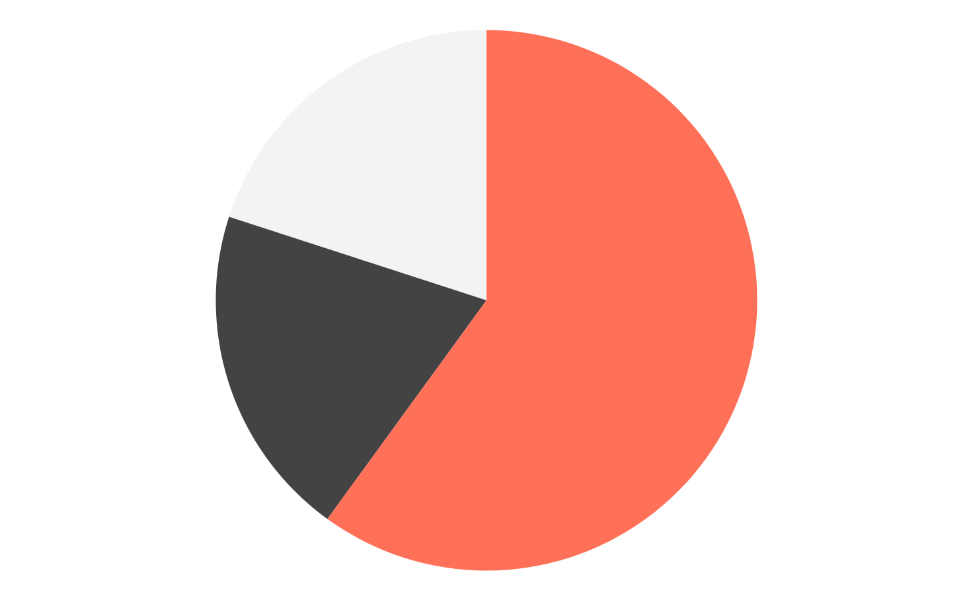
Maths
Monday
Tuesday
Wednesday
Thursday
Friday
Homework
Is Jupiter a gas giant and the biggest planet in the Solar System?
a.
x
Despite being red, is Mars actually a cold place full of iron oxide dust?
b.
20
60
To modify this graph, click on it, follow the link, change the data and paste the resulting graph here
c.

Slide 27
Maths
25,120,356 cm²
62,152 cm
872,532 cm
580,346 cm²
Monday
Tuesday
Wednesday
Thursday
Friday
Homework
Insert the solution here
Insert the solution here
Insert the solution here
Insert the solution here

Slide 28
Maths
½ + ½ = ?
¼ + ¼ = ?
½ - ¼ = ?
Monday
Tuesday
Wednesday
Thursday
Friday
Homework
Insert the solution here
Insert the solution here
Insert the solution here

Slide 29
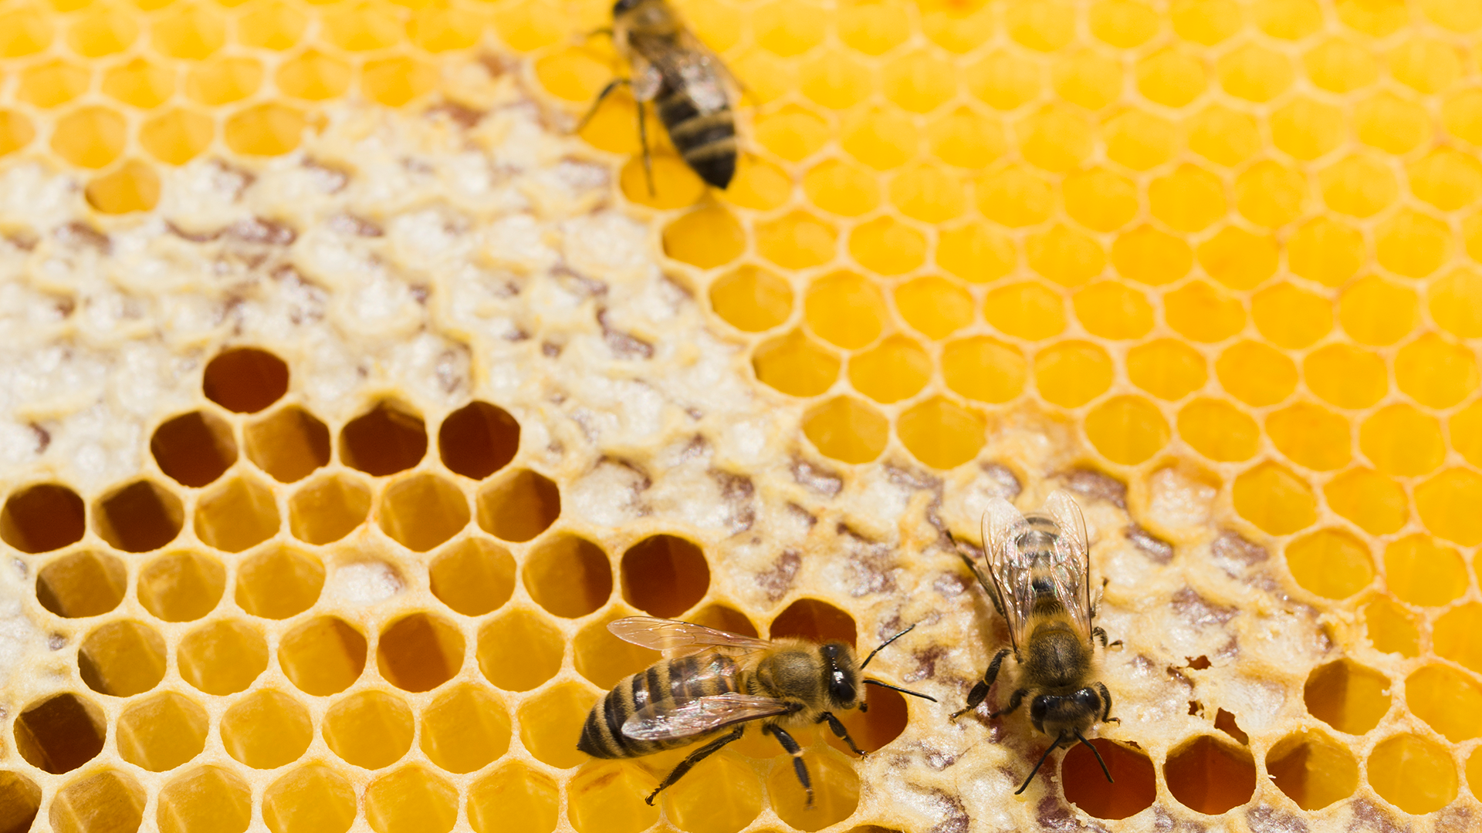
Monday
Tuesday
Wednesday
Thursday
Friday
Homework
Natural Science
Venus has a beautiful name
Despite being yellow, Mars is actually a cold place
Mercury was named after a Roman god
Saturn is composed mostly of hydrogen and helium
Neptune is the farthest planet from the Sun
Jupiter is a gas giant and the smallest planet

Slide 30
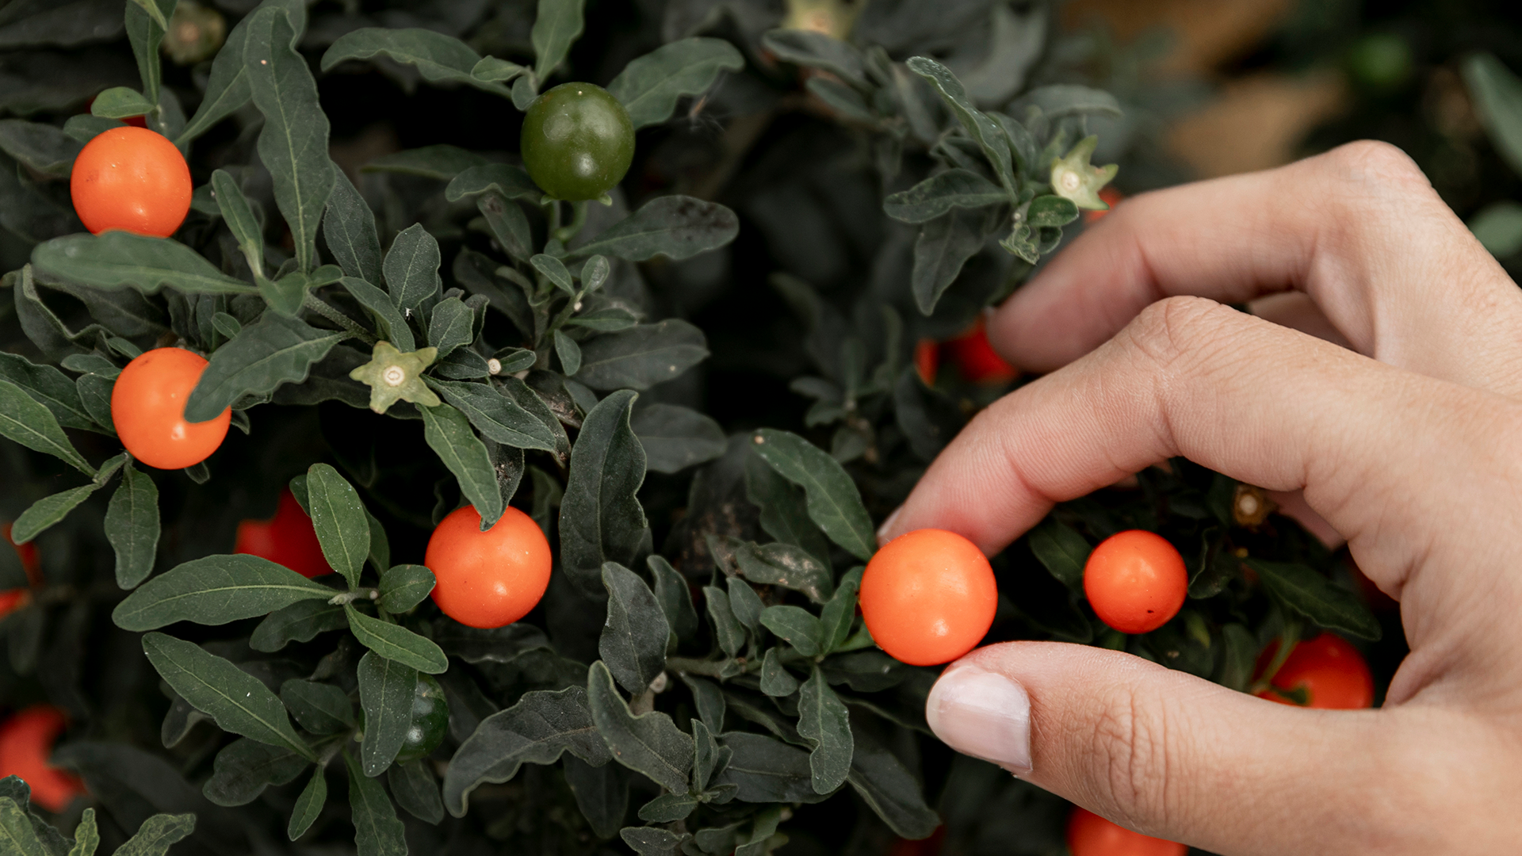
Natural Science
Monday
Tuesday
Wednesday
Thursday
Friday
Homework

Slide 31
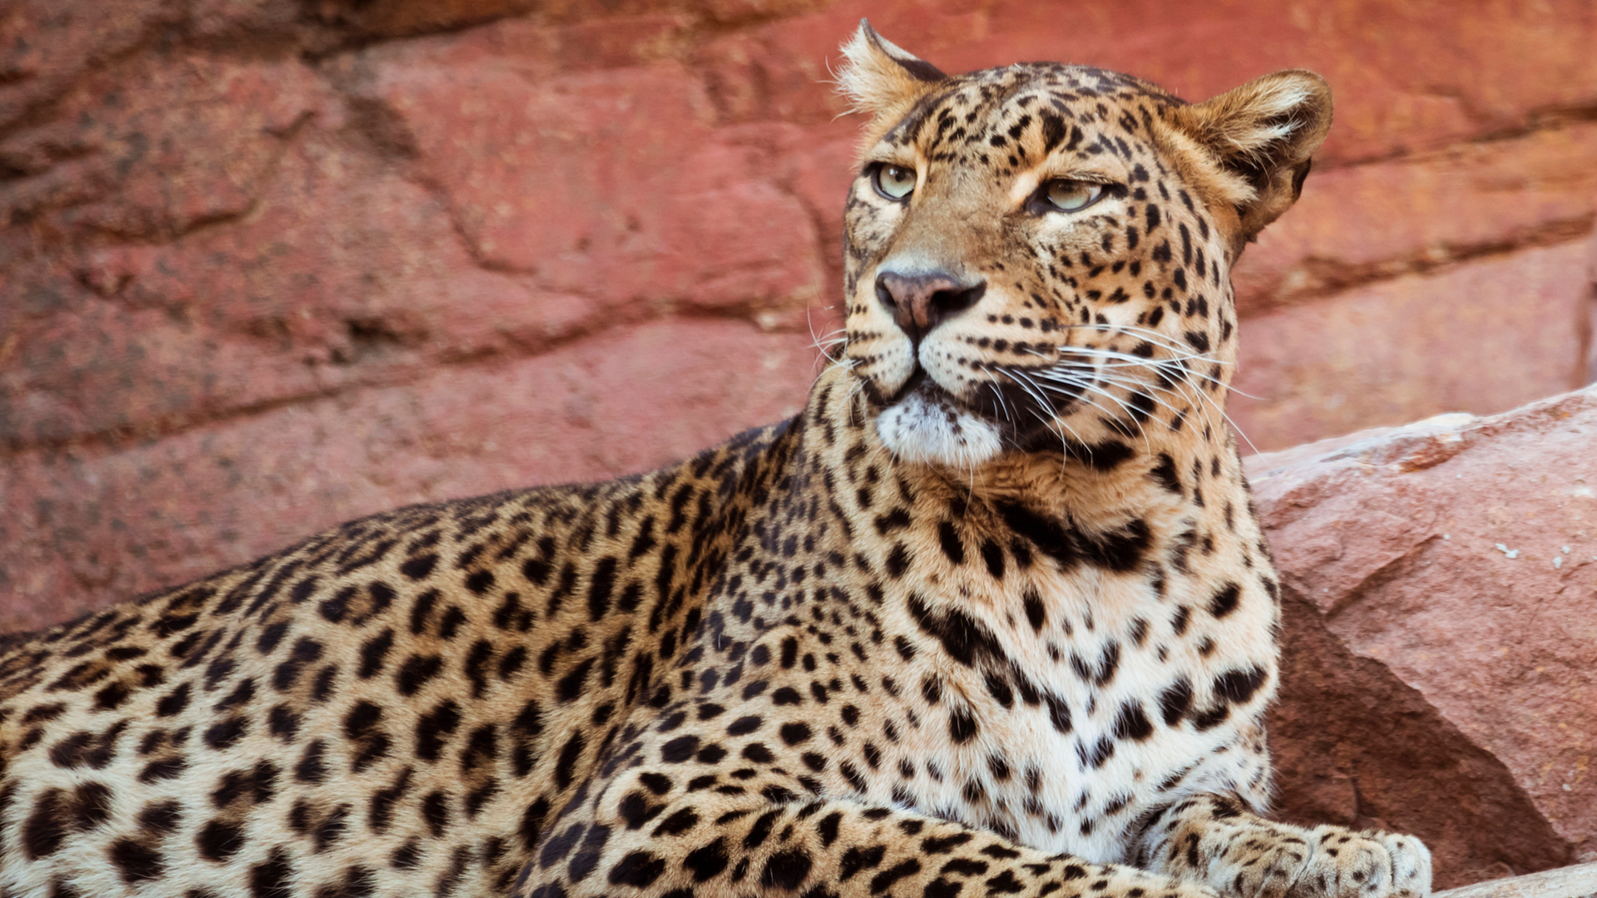
Monday
Tuesday
Wednesday
Thursday
Friday
Homework
Watch this documentary and write an essay on it

Slide 32
Homework Upload
Monday
Tuesday
Wednesday
Thursday
Friday
Homework
Monday
Tuesday
Jupiter is the biggest planet in the Solar System
1
Wednesday
Thursday
Despite being red, Mars is actually a cold place
2
Friday
Mercury is the smallest planet in the Solar System
3
Homework

Slide 33
Subject - A
Monday
Tuesday
Wednesday
Thursday
Friday
Homework
45%
15%
80%
Completed chapters
Homework
Average grade

Slide 34
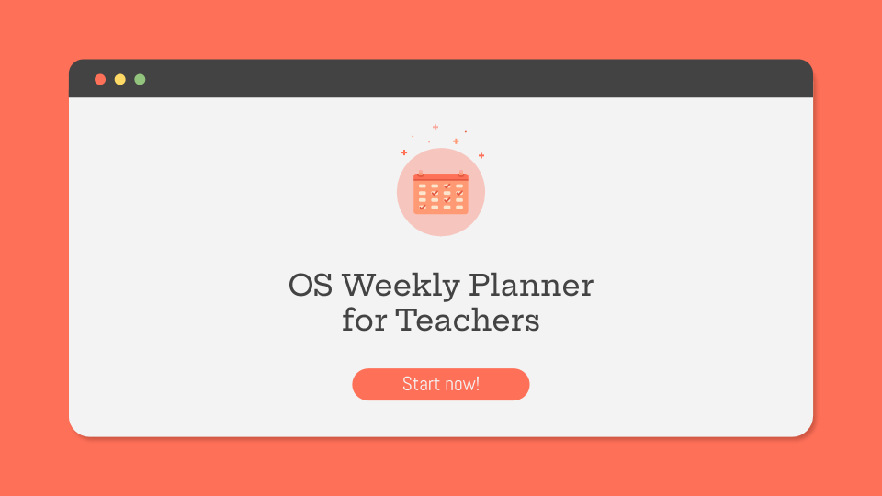
Desktop Software
Monday
Tuesday
Wednesday
Thursday
Friday
Homework
You can change the image on the screen with your own work. Just delete this one, add yours and send it to the back

Slide 35
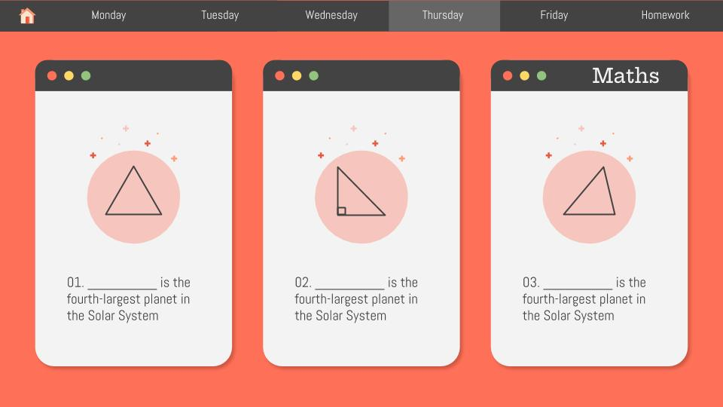
Mobile Web
Monday
Tuesday
Wednesday
Thursday
Friday
Homework
You can change the image on the screen with your own work. Just delete this one, add yours and send it to the back

Slide 36
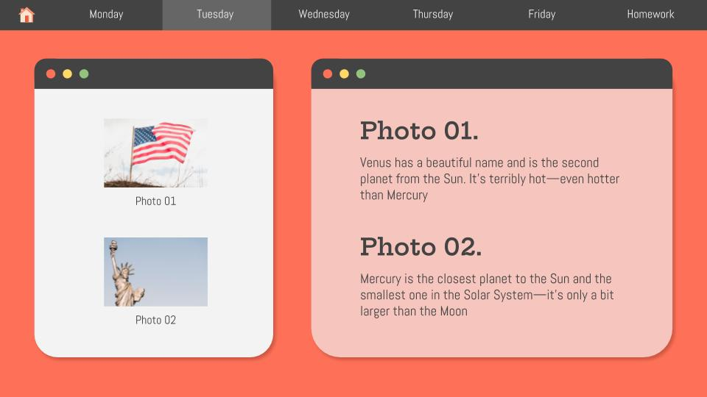
Tablet App
Monday
Tuesday
Wednesday
Thursday
Friday
Homework
You can change the image on the screen with your own work. Just delete this one, add yours and send it to the back

Slide 37
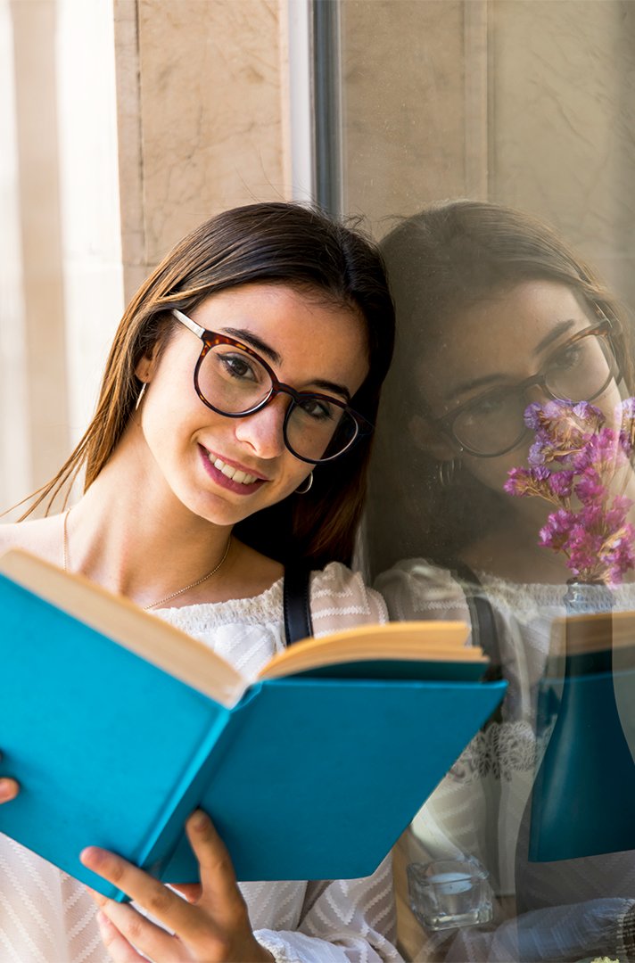
Your Teacher
Monday
Tuesday
Wednesday
Thursday
Friday
Homework
Jenna Doe
Mercury is the closest planet to the Sun and the smallest one in the Solar System

Slide 38
Thanks!
Do you have any questions?
youremail@freepik.com
+91 620 421 838
yourcompany.com
Please keep this slide for attribution

Slide 39
Alternative Resources
Photos
Close-up of a vintage old globe
Usa flag on dark marble
Hanging bridge in rainforest at costa rica
Daisy flowers near the river
Teen schoolgirl in glasses reading book
Statue of liberty
Gorilla
Meerkat
Animal habitat
Flamingos
Green plant with orange berries
Top view arrangement with red and yellow flowers

Slide 40
Alternative Resources
Photos
Close-up of a vintage old globe
Usa flag on dark marble
Hanging bridge in rainforest at costa rica
Daisy flowers near the river
Teen schoolgirl in glasses reading book
Statue of liberty
Gorilla
Meerkat
Animal habitat
Flamingos
Green plant with orange berries
Top view arrangement with red and yellow flowers

Slide 41
Resources
Photos
Idyllic river near costa rican rainforest
Daisy flowers near the river
Glowing usa flag
Lizard
Fishes in a pond
American flag on hill
Statue of liberty
Detail of a vintage globe
Honeycomb with bees
Green plant with orange berries
Leopard
Lady looking at camera and holding book near window
Vector
Nice infographic of the human body in flat design

Slide 42
Instructions for use
In order to use this template, you must credit Slidesgo by keeping the Thanks slide.
You are allowed to:
- Modify this template.
- Use it for both personal and commercial projects.
You are not allowed to:
- Sublicense, sell or rent any of Slidesgo Content (or a modified version of Slidesgo Content).
- Distribute Slidesgo Content unless it has been expressly authorized by Slidesgo.
- Include Slidesgo Content in an online or offline database or file.
- Offer Slidesgo templates (or modified versions of Slidesgo templates) for download.
- Acquire the copyright of Slidesgo Content.
For more information about editing slides, please read our FAQs or visit Slidesgo School:
https://slidesgo.com/faqs and https://slidesgo.com/slidesgo-school

Slide 43
Fonts & colors used
This presentation has been made using the following fonts:
Hepta Slab
(https://fonts.google.com/specimen/Hepta+Slab)
Abel
(https://fonts.google.com/specimen/Abel)
#963a2a
#e55a43
#ff7058
#ff9a75
#f9aba0
#f6c5be
#fce5cd
#666666
#434343

Slide 44
Use our editable graphic resources...
You can easily resize these resources without losing quality. To change the color, just ungroup the resource and click on the object you want to change. Then, click on the paint bucket and select the color you want. Group the resource again when you’re done.

Slide 47
JANUARY
FEBRUARY
MARCH
APRIL
MAY
JUNE
PHASE 1
Task 1
Task 2
PHASE 2
Task 1
Task 2
JANUARY
FEBRUARY
MARCH
APRIL
PHASE 1
Task 1
Task 2

Slide 50
...and our sets of editable icons
You can resize these icons without losing quality.
You can change the stroke and fill color; just select the icon and click on the paint bucket/pen.
In Google Slides, you can also use Flaticon’s extension, allowing you to customize and add even more icons.

Slide 51
Educational Icons
Medical Icons

Slide 52
Business Icons
Teamwork Icons

Slide 53
Help & Support Icons
Avatar Icons

Slide 54
Creative Process Icons
Performing Arts Icons

Slide 55
Nature Icons

Slide 56
SEO & Marketing Icons

Slide 57
