Slide 1
Corona Virus
SYMPTOMS | DIAGNOSIS | PRECAUTIONS | PREVENTION
Editable PowerPoint Template For Offices, Schools & Universities

Slide 2
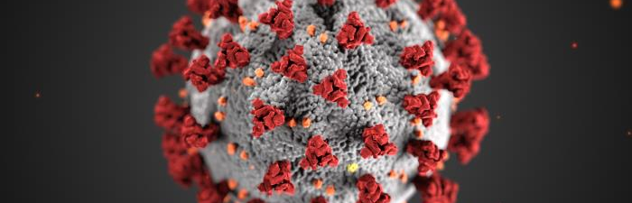
WHAT IS CORONA VIRUS
Coronavirus disease (COVID-19) is a new strain that was discovered in 2019 and has not been previously identified in humans. Coronaviruses are zoonotic, meaning they are transmitted between animals and people. Detailed investigations found that SARS-CoV was transmitted from civet cats to humans and MERS-CoV from dromedary camels to humans. Several known coronaviruses are circulating in animals that have not yet infected humans.
(WHO, 16.3.2020)

Slide 3

COMMON SIGNS OF INFECTION
You can use this page as your about us slide
Common signs of infection include respiratory symptoms, fever, cough, shortness of breath and breathing difficulties. In more severe cases, infection can cause pneumonia, severe acute respiratory syndrome, kidney failure and even death.
(WHO, 16.03.2020)

Slide 4
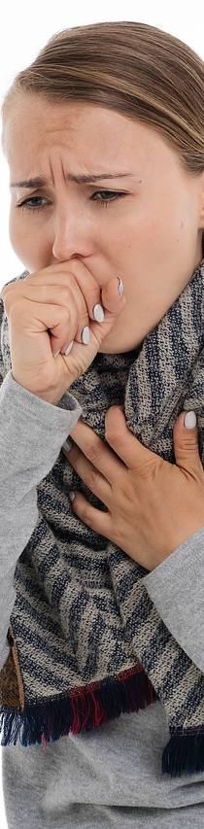


SYMPTOMS
Watch for symptoms
Reported illnesses have ranged from mild symptoms to severe illness and death for confirmed coronavirus disease 2019 (COVID-19) cases.
The following symptoms may appear 2-14 days after exposure.*
Fever
Cough
Shortness of breath
Shortness of breath
Cough
Fever
(CENTERS OF DISEASE CONTROL & PREVENTION , 19-03-2020)

Slide 5

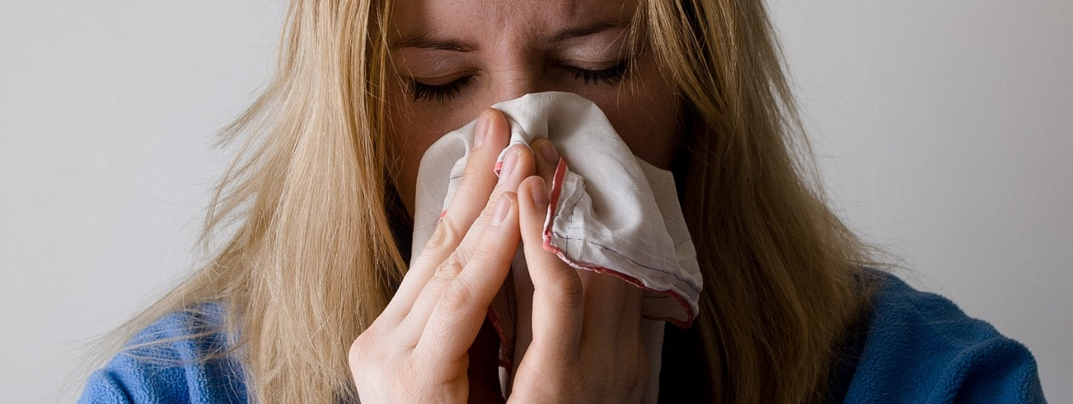

KNOW HOW IT SPREADS
Slidehood.com
  Between people who are in close contact with one another (within about 6 feet).
  Through respiratory droplets produced when an infected person coughs or sneezes.
These droplets can land in the mouths or noses of people who are nearby or possibly be inhaled into the lungs.
There is currently no vaccine to prevent coronavirus disease 2019 (COVID-19).
The best way to prevent illness is to avoid being exposed to this virus.
The virus is thought to spread mainly from person-to-person.
(CENTERS OF DISEASE CONTROL & PREVENTION , 19-03-2020)

Slide 6


TAKE STEPS TO PROTECT YOURSELF
Slidehood.com
Clean your hands often
Avoid close contact
Wash your hands often with soap and water for at least 20 seconds especially after you have been in a public place, or after blowing your nose, coughing, or sneezing.
If soap and water are not readily available, use a hand sanitizer that contains at least 60% alcohol. Cover all surfaces of your hands and rub them together until they feel dry.
Avoid touching your eyes, nose, and mouth with unwashed hands.
Avoid close contact with people who are sick
Put distance between yourself and other people if COVID-19 is spreading in your community. This is especially important for people who are at higher risk of getting very sick.
(CENTERS OF DISEASE CONTROL & PREVENTION , 19-03-2020)

Slide 7
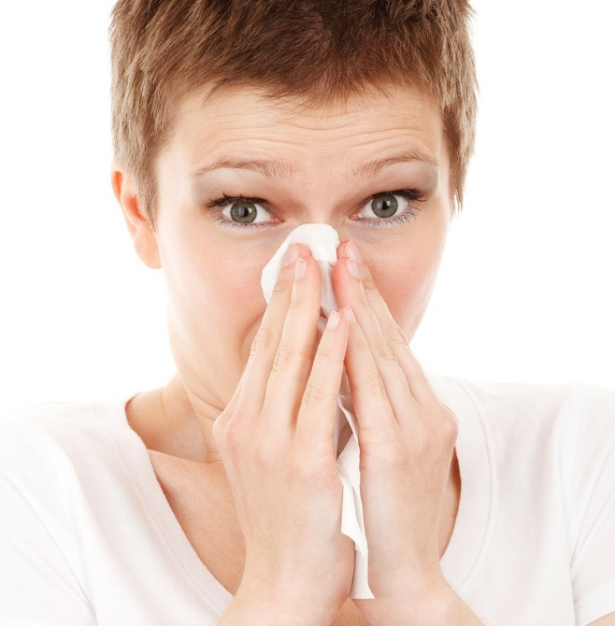


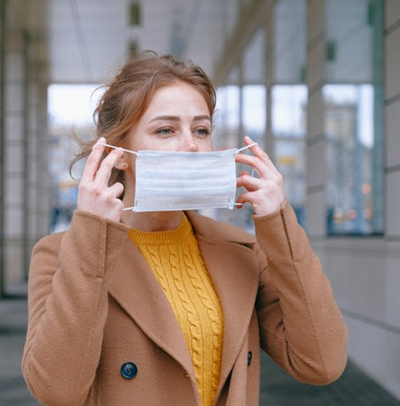
TAKE STEPS TO PROTECT OTHERS
COVER COUGHS AND SNEEZES
Cover your mouth and nose with a tissue when you cough or sneeze or use the inside of your elbow.
Throw used tissues in the trash.
STAY HOME IF YOU’RE SICK
Stay home if you are sick, except to get medical care.
CLEAN AND DISINFECT
Clean AND disinfect frequently touched surfaces daily. This includes tables, doorknobs, light switches, countertops, handles, desks, phones, keyboards, toilets, faucets, and sinks.
If surfaces are dirty, clean them: Use detergent or soap and water prior to disinfection.
WEAR A FACEMASK IF YOU ARE SICK
You should wear a facemask when you are around other people (e.g., sharing a room or vehicle) and before you enter a healthcare provider’s office.
(CENTERS OF DISEASE CONTROL & PREVENTION , 19-03-2020)

Slide 8
CORONA VIRUS CASES
Slidehood.com
Source: (WORLDOMETERS, 17.3.2020)

Slide 9
CORONA VIRUS DETAILED STATISTICS
Slidehood.com
COUNTRY | TOTAL CASES | NEW CASES | TOTAL DEATHS | NEW DEATHS | RECOVERED | CRITICAL
China | 80,881 | 21 | 3,226 | 13 | 68,690 | 3,226
Italy | 27,980 | - | 2,158 | - | 2,749 | 1,851
Iran | 14,991 | - | 853 | - | 4,996
Spain | 9,942 | - | 342 | - | 530 | 272
S. Korea | 8,320 | 84 | 81 | 6 | 1,401 | 59
Germany | 7,272 | - | 17 | - | 67 | 2
France | 6,633 | - | 148 | - | 12 | 400
USA | 4,727 | 64 | 93 | 7 | 74 | 12
Switzerland | 2,353 | - | 19 | - | 4
UK | 1,543 | - | 55 | - | 52 | 20
Netherlands | 1,413 | - | 24 | - | 2 | 45
Source: (WORLDOMETERS, 17.3.2020)

Slide 10
USE MAPS
Slidehood.com
27,980
441
9,942
80,881
4,727
14,991
Source: (WORLDOMETERS, 17.3.2020)

Slide 11
COVID-19
TIMELINE INFOGRAPHIC
Slidehood.com
December 31
China alerted WHO to several cases of unusual pneumonia in Wuhan
January 11
China announces first death
January 30
WHO declares outbreak a global health emergency
February 7
Chinese doctor & whistleblower Li Wenliang dies
February 14
Egypt confirms Africa’s first case
2019
2020
January 7
France confirms Europe's first case
January 13
WHO reports case in Thailand, the first case outside of China
February 2
First death outside China recorded in the Philippines
February 11
WHO names
Virus COVID-19
Source: Aljazeera

Slide 12
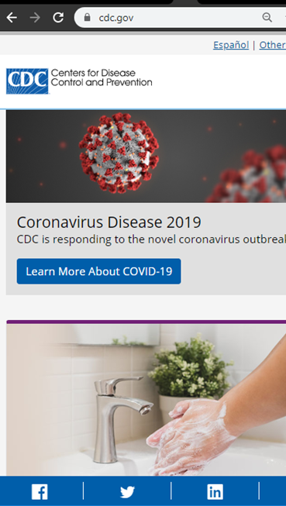
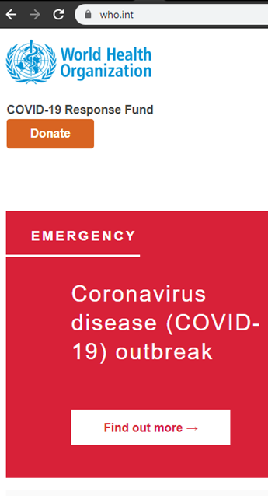
Slidehood.com
STAY UPDATED (Important Websites)
Stay updated with current news related to Corona Virus
WHO (World Health Organization)
CDC (Centers of Disease Control and Prevention)
Worldometers

Slide 13
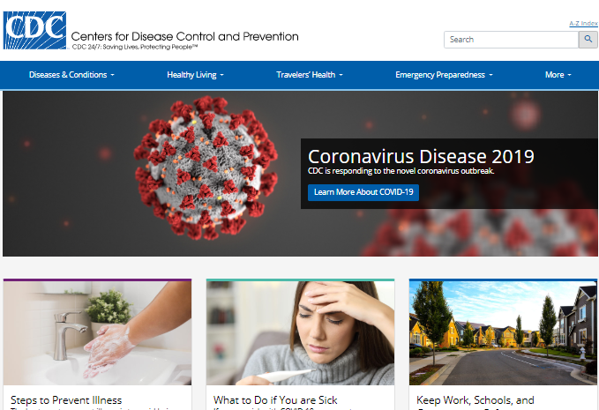
STAY UPDATED (Important Websites)
Stay updated with current news related to Corona Virus
WHO (World Health Organization)
CDC (Centers of Disease Control and Prevention)
Worldometers

Slide 14
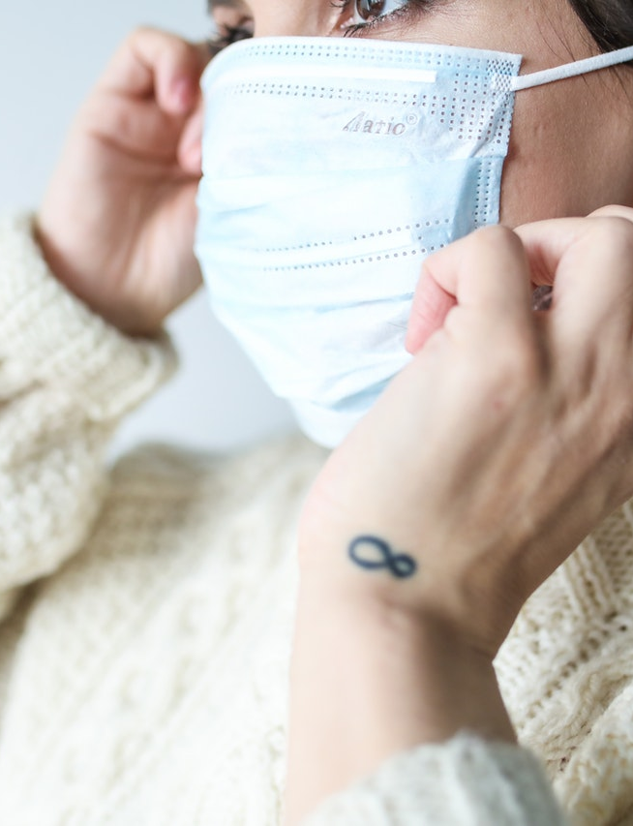
INSTRUCTIONS FOR USE
DOWNLOAD AS POWERPOINT TEMPLATE
Click on the button under the presentation preview that says "Download as Power Point template". You will get a .pptx file that you can edit in PowerPoint. Remember to download and install the fonts used in this presentation.
USE AS GOOGLE SLIDES THEME
Click on the button that says "Use as Google Slides Theme". You will get a copy of this document on your Google Drive and will be able to edit, add or delete slides. Remember you must be signed in to your Google account.
FONT: Raleway & Roboto (Free Google Fonts)
This template is free to use under Creative Commons Attribution license. Please mention Slidehood.com and other resources used in a slide footer.
Courtesy: All the content is taken from WHO , Centers of Disease Control & Prevention , Worldometers & Aljazeera

Slide 15
BREAK SLIDE
Slidehood.com
First things first let’s start with the first set of slides

Slide 16
Slidehood.com
REFERENCES
All the content has been taken from the following websites (no changes has been to the content to keep the information precise)
WHO (World Health Organization) , CDC (Centers of Disease Control and Prevention), Worldometers & Aljazeera
Special thanks and credit for images and icons to: Unsplash.com | Pixabay.com | Pexels.com | Slidescarnival.com

