Slide 1
FRUIT PATTERN
Here is where your presentation begins

Slide 2
CONTENTS OF THIS TEMPLATE
Here’s what you’ll find in this Slidesgo template:
A slide structure based on a multi-purpose presentation, which you can easily adapt to your needs. For more info on how to edit the template, please visit Slidesgo School or read our FAQs.
An assortment of illustrations that are suitable for use in the presentation can be found in the alternative resources slide.
A thanks slide, which you must keep so that proper credits for our design are given.
A resources slide, where you’ll find links to all the elements used in the template.
Instructions for use.
Final slides with:
The fonts and colors used in the template.
More infographic resources, whose size and color can be edited.
Sets of customizable icons of the following themes: general, business, avatar, creative process, education, help & support, medical, nature, performing arts, SEO & marketing, and teamwork.
You can delete this slide when you’re done editing the presentation.

Slide 3
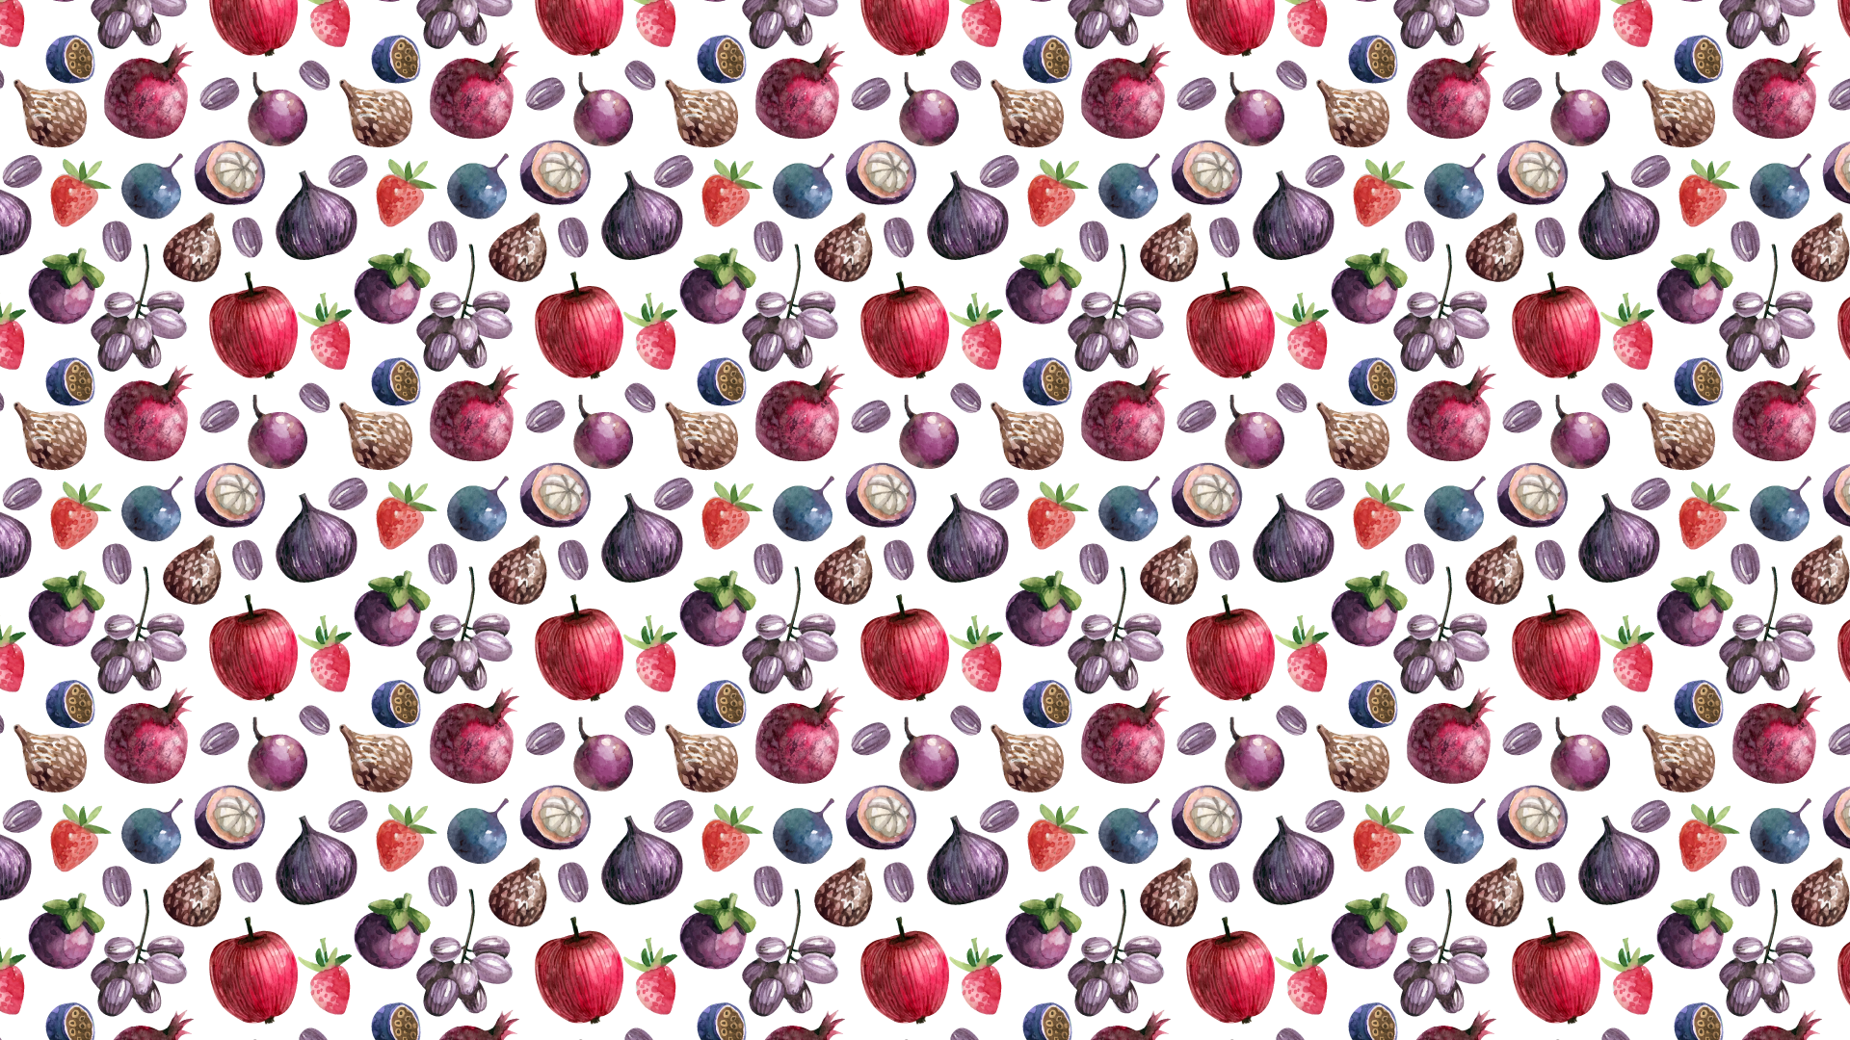
WHOA!
This could be the part of the presentation where you can introduce yourself, write your email…

Slide 4
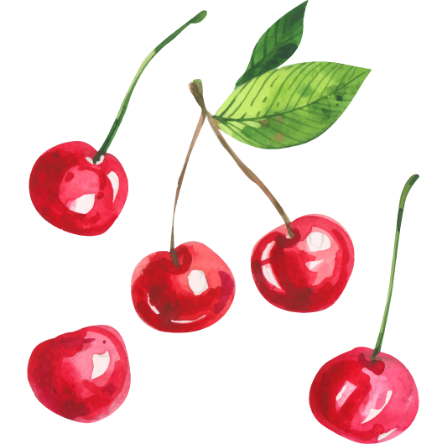
—SOMEONE FAMOUS
“This is a quote. Words full of wisdom that someone important said and can make the reader get inspired.”

Slide 5
TABLE OF CONTENTS
01
02
03
Here you could describe the topic of the first section
Here you could describe the topic of the second section
Here you could describe the topic of the third section
FIRST SECTION
SECOND SECTION
THIRD SECTION

Slide 6
01
FIRST SECTION
You could enter a subtitle here if you need it

Slide 7
THE SLIDE TITLE GOES HERE!
Do you know what helps you make your point clear? Lists like this one:
They’re simple
You can organize your ideas clearly
You’ll never forget to buy milk!
And the most important thing: the audience won’t miss the point of your presentation

Slide 8
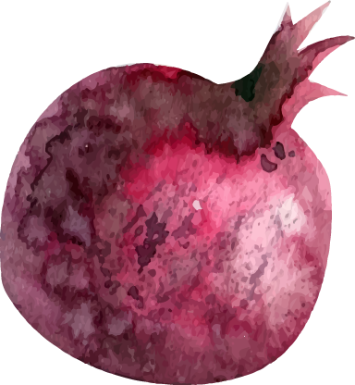
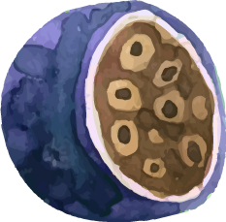
HERE YOU HAVE TWO COLUMNS
MERCURY
VENUS
Mercury is the closest planet to the Sun and the smallest one in the Solar System—it’s only a bit larger than the Moon
Venus has a beautiful name and is the second planet from the Sun. It’s terribly hot, even hotter than Mercury

Slide 9
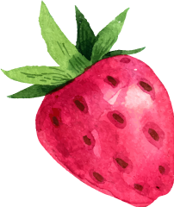
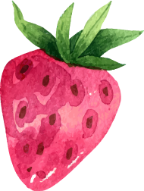
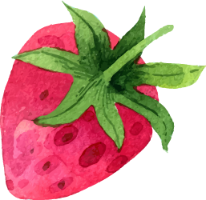
HOW ABOUT THREE COLUMNS?
VENUS
SATURN
MARS
Neptune is the fourth-largest planet in the Solar System
Saturn is a gas giant, composed mostly of hydrogen and helium
Despite being red, Mars is a cold place full of iron oxide dust

Slide 10
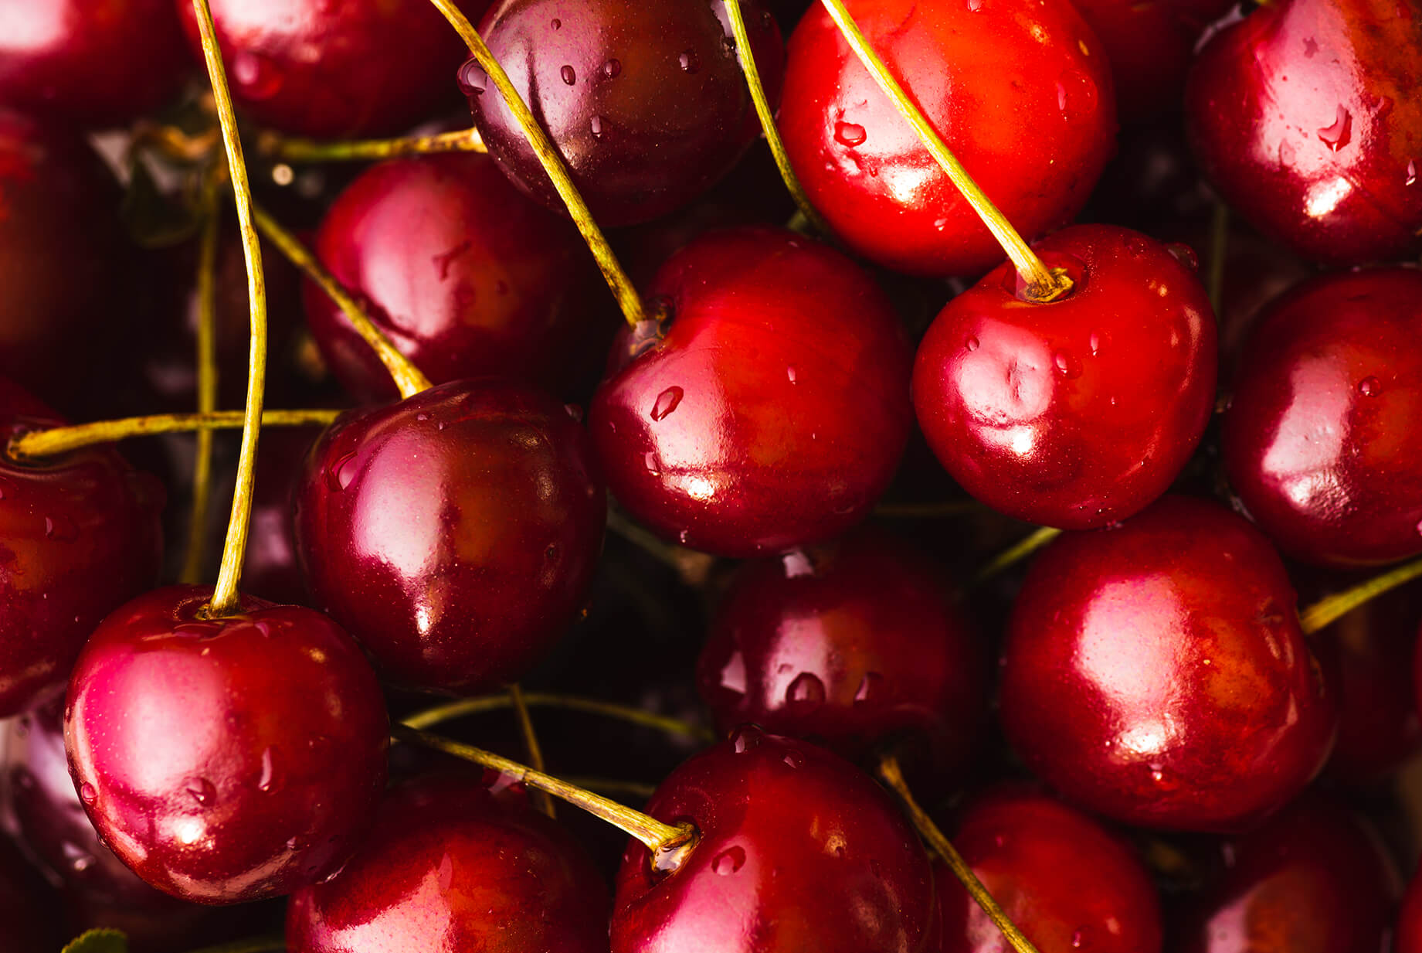
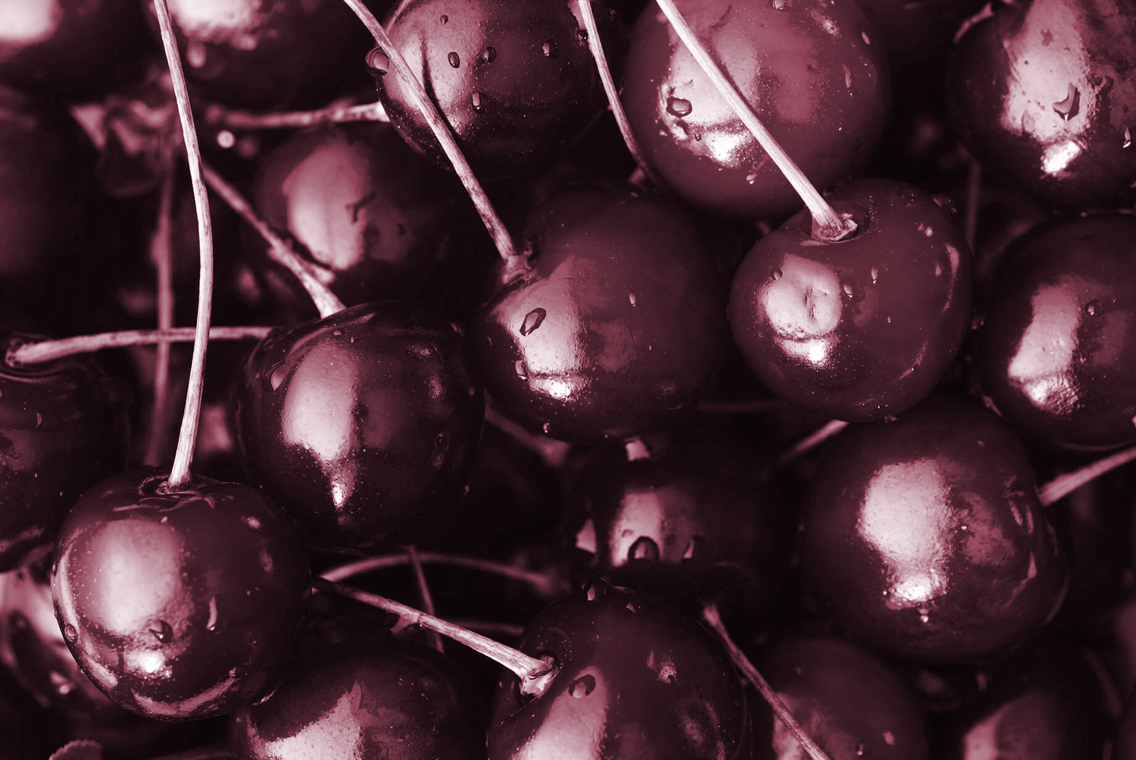
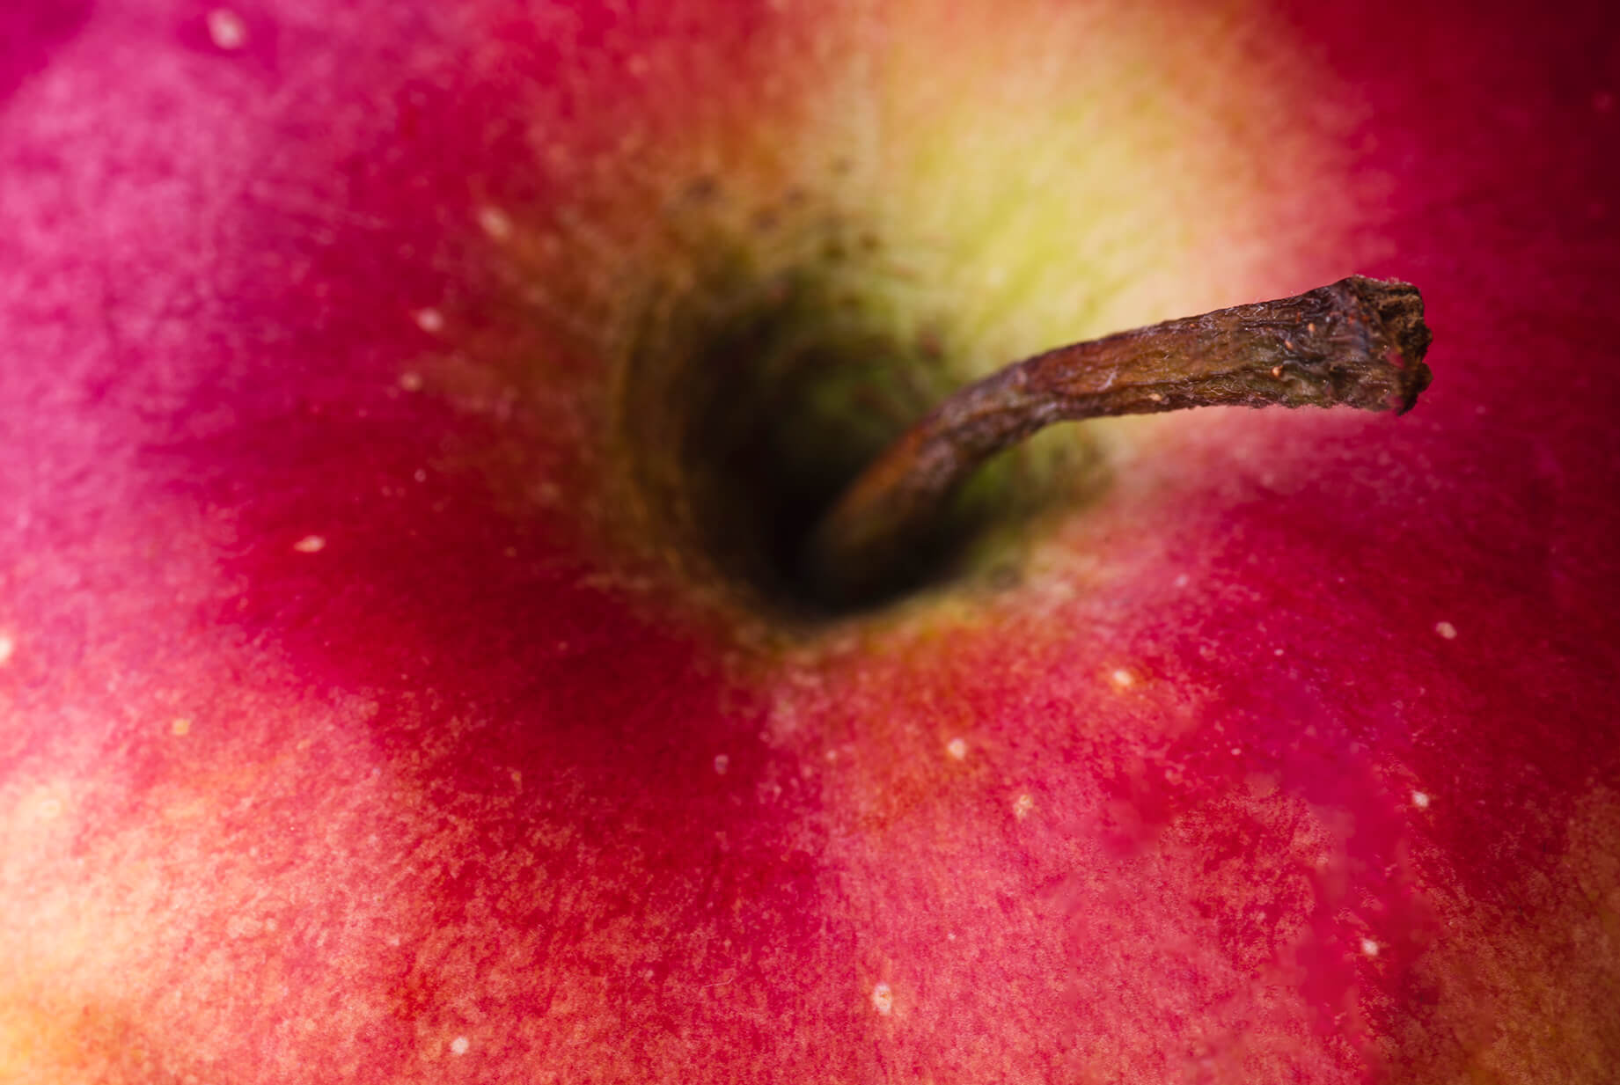
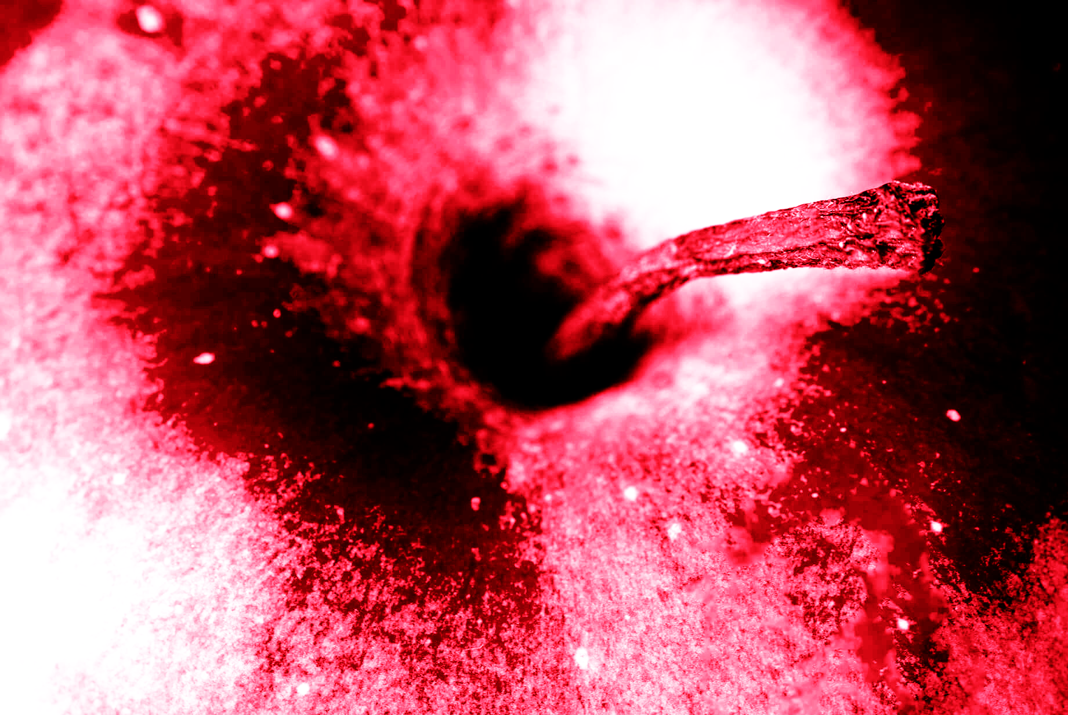
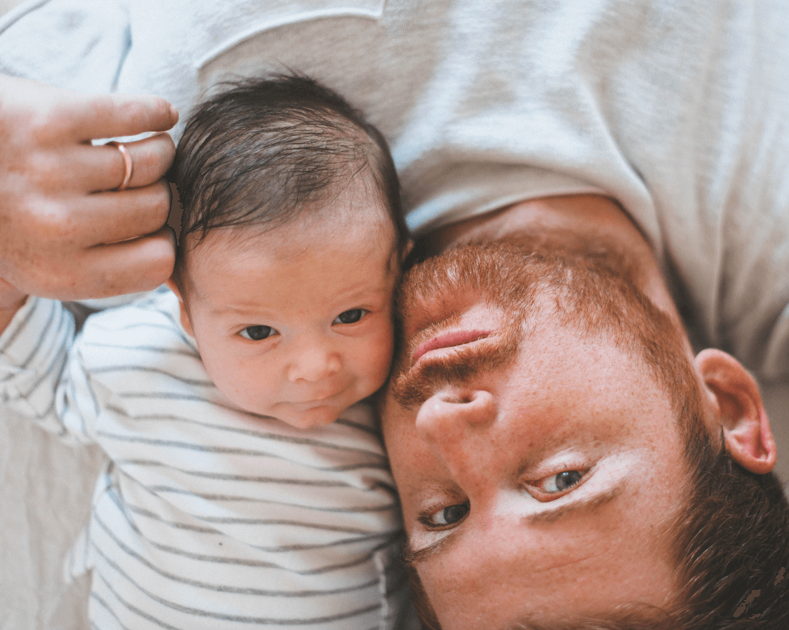
A Picture Always Reinforces the Concept
Images reveal large amounts of data, so remember: use an image instead of long texts

Slide 11



TRY USING INFOGRAPHICS!
MERCURY
MARS
SATURN
Mercury is the closest planet to the Sun
Despite being red, Mars is a cold place
Saturn is a gas giant and has several rings

Slide 12
THIS IS A TABLE
 | Mass (Earths) | Diameter (Earths) | Gravity (Earths)
MARS | 100 | 355 | 370
MERCURY | 490 | 150 | 890
VENUS | 1,000 | 260 | 245

Slide 13
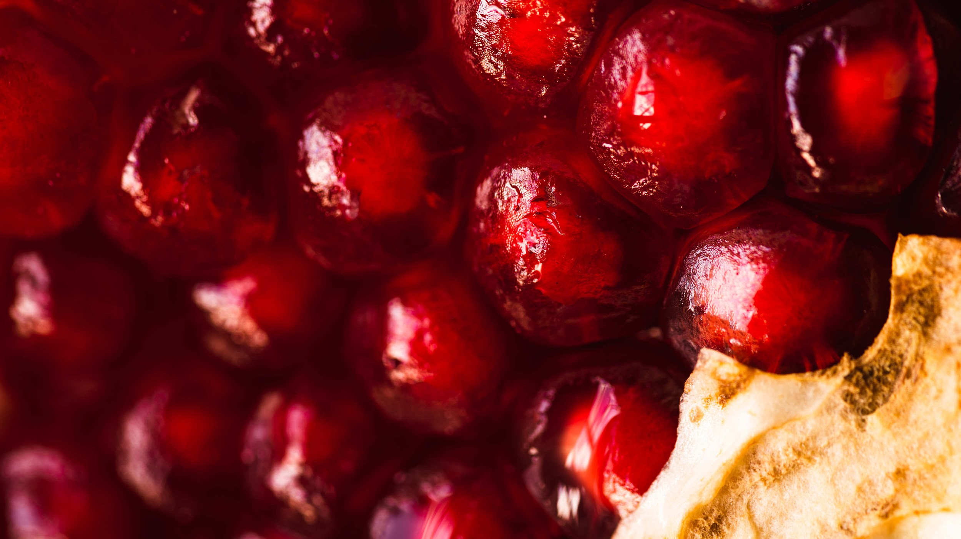
A Picture Is Worth a Thousand Words

Slide 14
REVIEWING CONCEPTS IS A GOOD IDEA
JUPITER
VENUS
MERCURY
NEPTUNE
SATURN
MARS
It’s the biggest planet in the Solar System
Venus is the second planet from the Sun
Mercury is the closest planet to the Sun
Neptune is the farthest planet from the Sun
Saturn is a gas giant and has several rings
Despite being red, Mars is a cold place

Slide 15
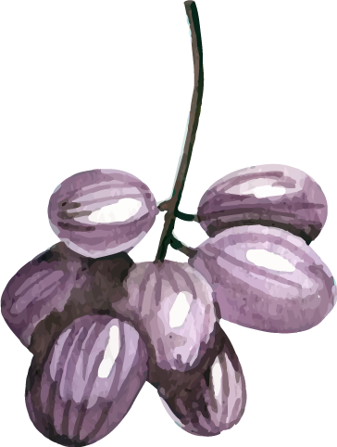
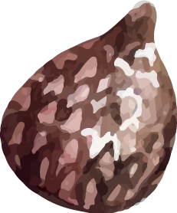
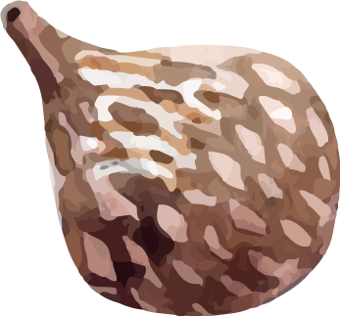
THESE ARE FOUR COLUMNS
SATURN
NEPTUNE
MARS
VENUS
Saturn is a gas giant composed mostly of hydrogen and helium
Neptune is the fourth-largest planet in the Solar System
Despite being red, Mars is actually a cold place full of iron oxide dust
Venus has a beautiful name and is the second planet from the Sun

Slide 16
A TIMELINE ALWAYS WORKS WELL
It’s the biggest planet in the Solar System
It’s composed mostly of hydrogen and helium
DAY 1
DAY 3
JUPITER
SATURN
NEPTUNE
MARS
Neptune is the farthest planet from the Sun
Despite being red, Mars is actually a cold place
DAY 2
DAY 4

Slide 17
02
SECOND SECTION
You could enter a subtitle here if you need it

Slide 18



DO YOU NEED SOME PERCENTAGES?
40%
NEPTUNE
SATURN
20%
30%
JUPITER
MARS
10%
Did you know that you can manually edit this graph?
You will see two little orange diamonds
Select one of the colored portions of the graph
Just click and drag one of them to resize that portion

Slide 19
THIS IS A LIST
You can describe an item from the list here
You can describe an item from the list here
You can describe an item from the list here
You can describe an item from the list here
You can describe an item from the list here
You can describe an item from the list here
You can describe an item from the list here
You can describe an item from the list here

Slide 20



DO YOU NEED MORE INFOGRAPHICS?
01
02
01
NEPTUNE
SATURN
04
02
03
04
JUPITER
MARS
03
Neptune is the farthest planet from the Sun
Saturn is composed mostly of hydrogen and helium
It’s the biggest planet in the entire Solar System
Despite being red, Mars is actually a cold place

Slide 21
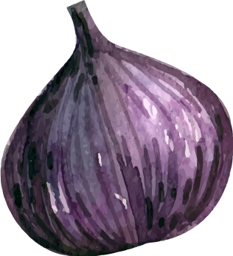
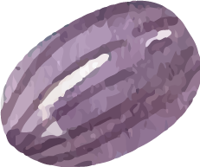
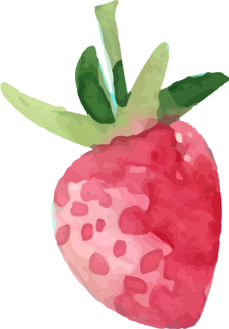
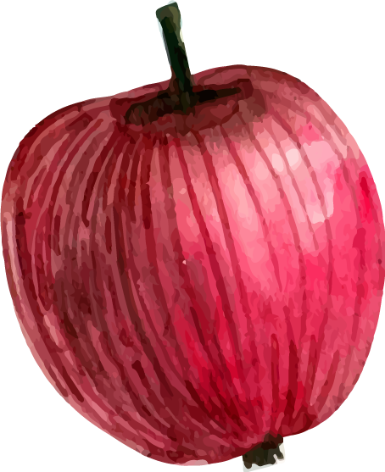
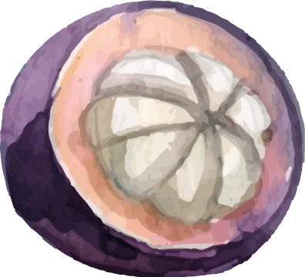
AWESOME WORDS

Slide 22



THIS IS A MAP
Try editing this map according to your own needs

Slide 23
HOW ABOUT A TEXT?
Mercury is the closest planet to the Sun and the smallest one in the Solar System—it’s only a bit larger than the Moon. The planet’s name has nothing to do with the liquid metal, since Mercury was named after the Roman messenger god

Slide 24



A SECOND TIMELINE COULD WORK TOO
JUPITER
MARS
It’s the biggest planet in the Solar System
Despite being red, Mars is actually a cold place
01
03
02
04
NEPTUNE
SATURN
Neptune is the farthest planet from the Sun
It’s composed of hydrogen and helium

Slide 25
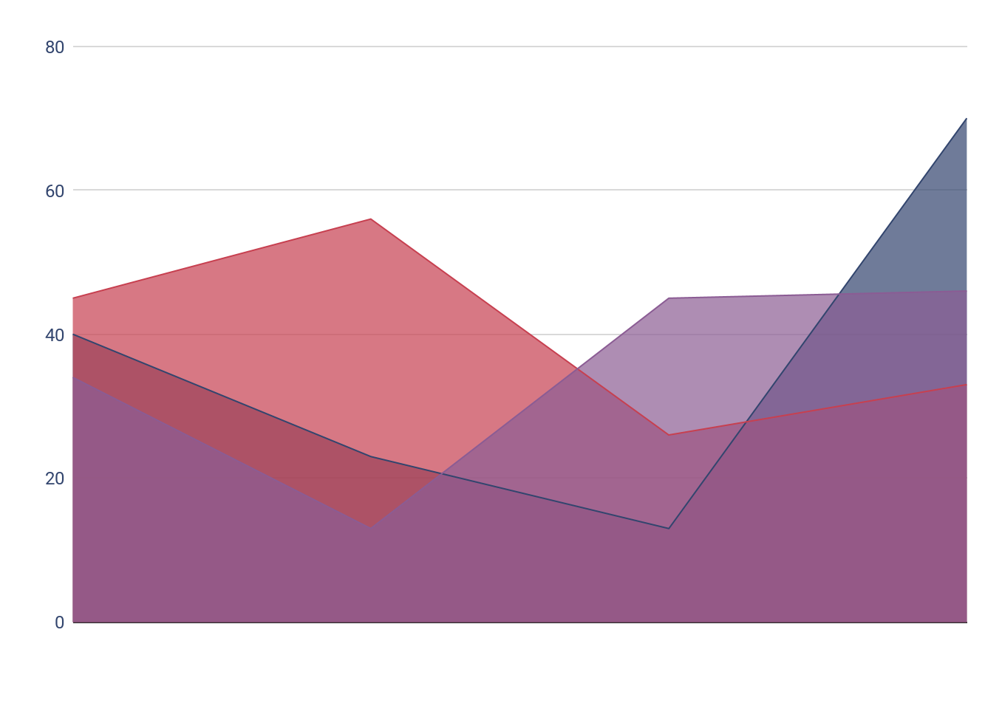
USE A GRAPH TO SHOW YOUR DATA
MERCURY
SATURN
VENUS
Mercury is the closest planet to the Sun
Saturn is a gas giant and has several rings
Venus is the second planet from the Sun
To modify this graph, click on it, follow the link, change the data and paste the new graph here

Slide 26
58,300,000
Big numbers catch your audience’s attention

Slide 27
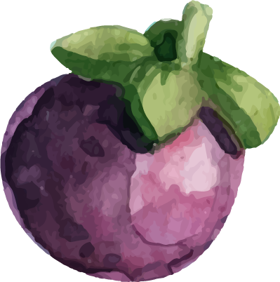
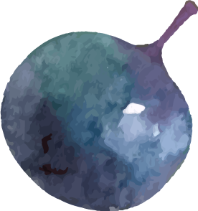
24h 37m
343 m/s
is Jupiter’s rotation period
is the speed of sound in air at 20ºC

Slide 28
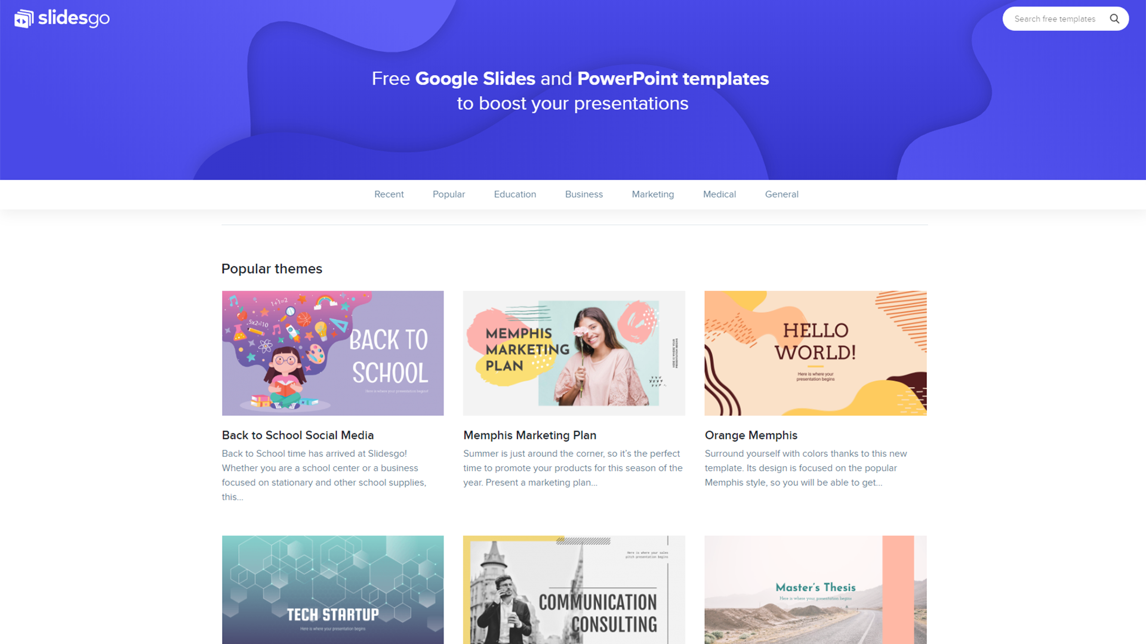
DESKTOP SOFTWARE
You can replace the image on the screen with your own work. Just delete this one and add yours

Slide 29
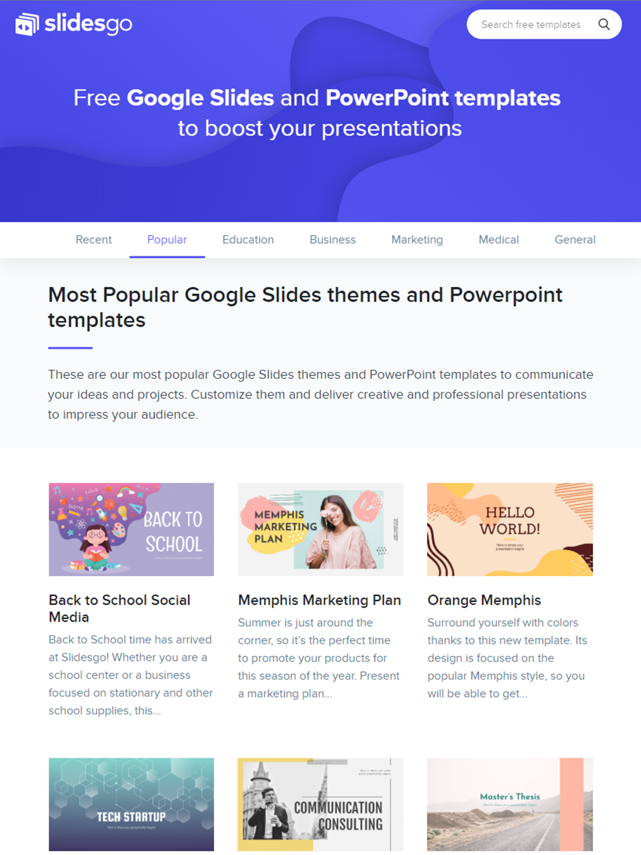
TABLET APP
You can replace the image on the screen with your own work. Just delete this one and add yours

Slide 30
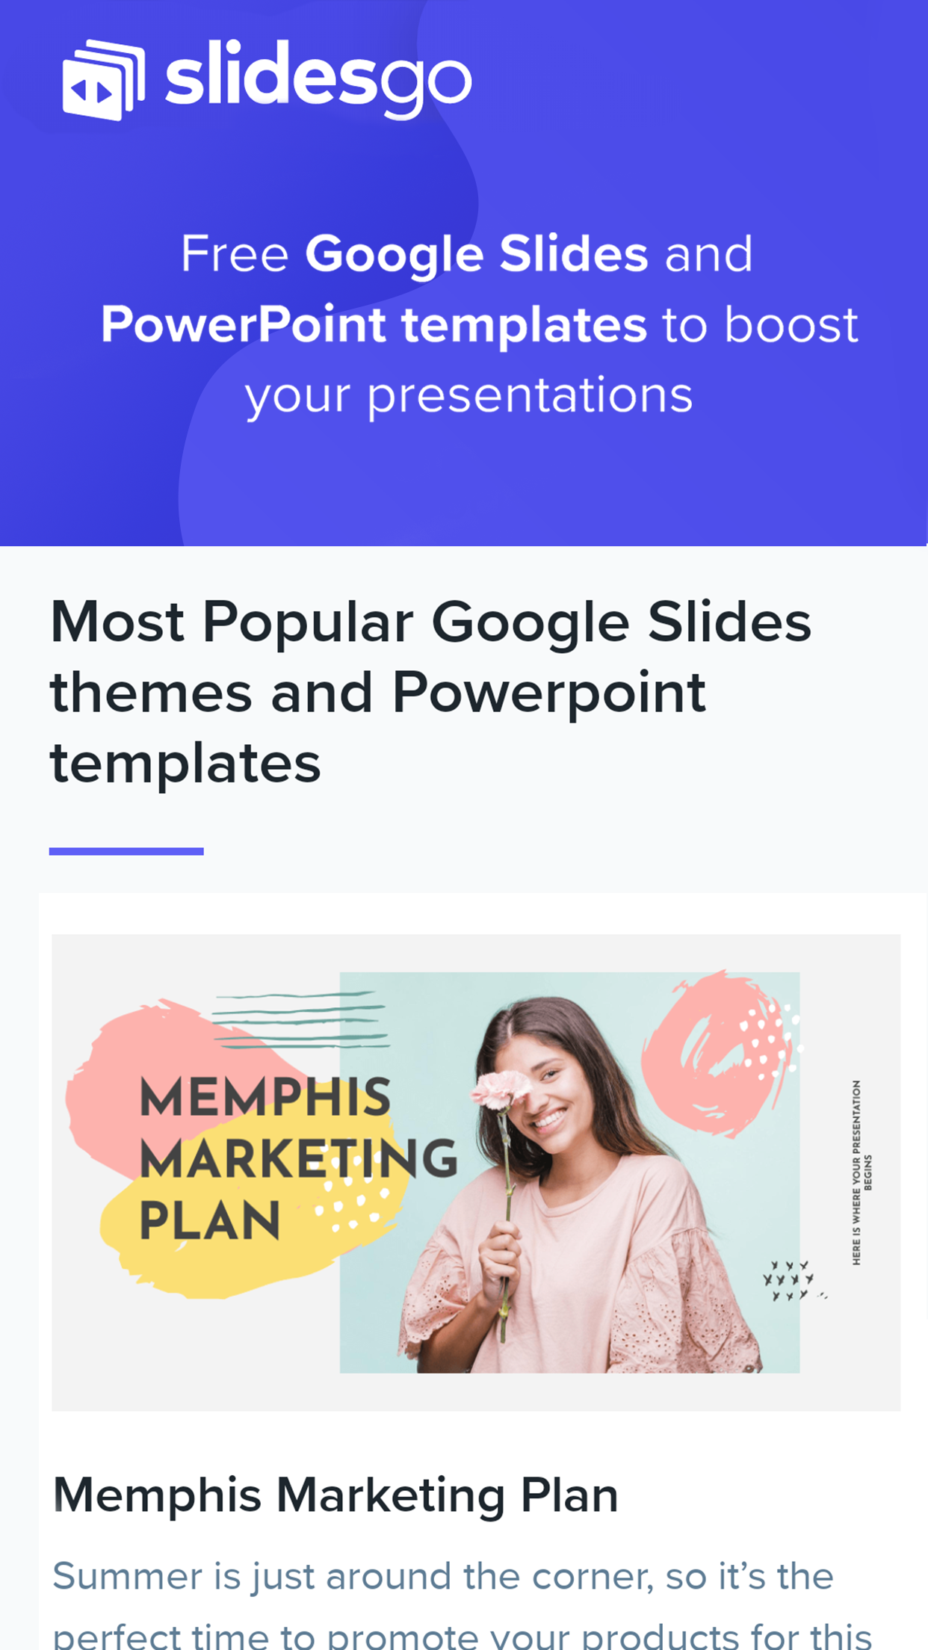
MOBILE WEB
You can replace the image on the screen with your own work. Just delete this one and add yours

Slide 31

OUR TEAM
DELILAH ROJAS
DAMIEN ALFORD
You can replace the image on the screen with your own one
You can replace the image on the screen with your own one

Slide 32



THANKS!
Do you have any questions?
youremail@freepik.com
+91 620 421 838
yourcompany.com
CREDITS: This presentation template was created by Slidesgo, including icons by Flaticon, and infographics & images by Freepik
Please keep this slide for attribution.

Slide 33
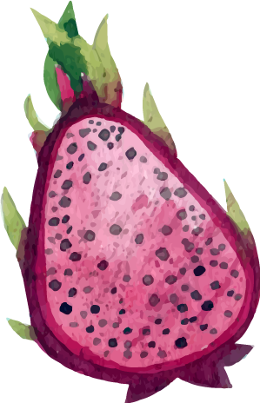
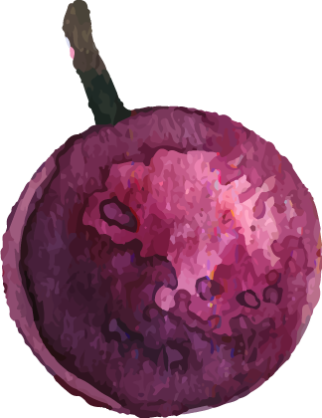
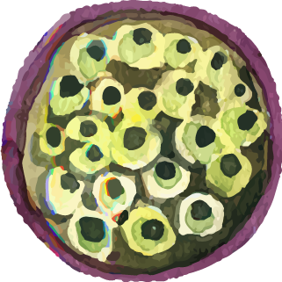
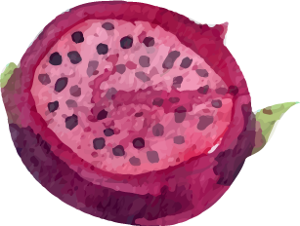
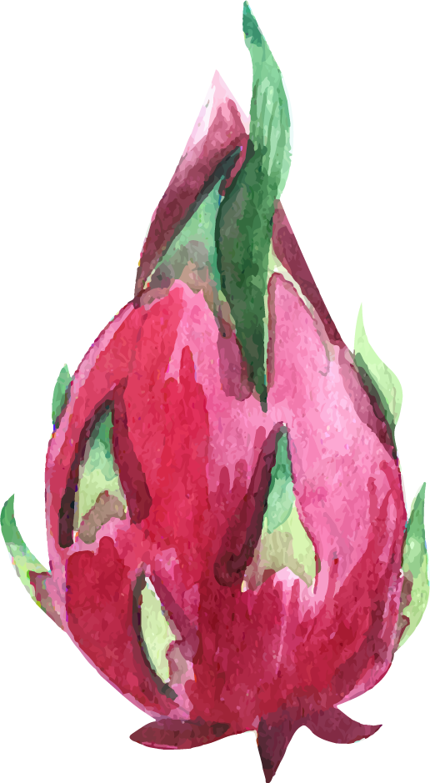
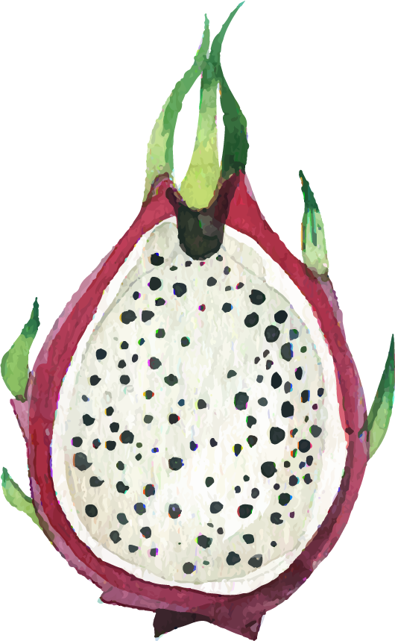
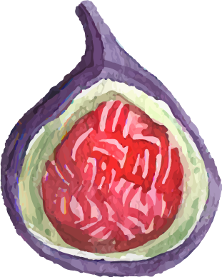
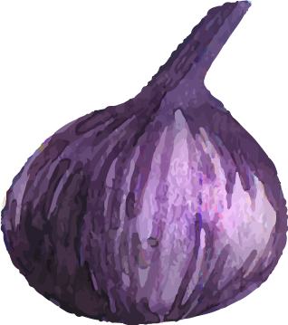
ALTERNATIVE RESOURCES

Slide 34
RESOURCES
Did you like the resources on this template? Get them for free at our other websites.
VECTORS
Watercolor patterns with variety of pieces of fruit
Fruit background with watercolor cherry
Fruit background with watercolor strawberry
Watercolor arrow scribbles
Watercolor pointers set with hand-drawn icons
Watercolor fruit set
Variety of pieces of fruit in watercolor style
PHOTOS
Close-up delicious pomegranate fruit
Fresh background of delicious cherries
Close-up delicious red apple

Slide 35
Instructions for use
In order to use this template, you must credit Slidesgo by keeping the Thanks slide.
You are allowed to:
- Modify this template.
- Use it for both personal and commercial projects.
You are not allowed to:
- Sublicense, sell or rent any of Slidesgo Content (or a modified version of Slidesgo Content).
- Distribute Slidesgo Content unless it has been expressly authorized by Slidesgo.
- Include Slidesgo Content in an online or offline database or file.
- Offer Slidesgo templates (or modified versions of Slidesgo templates) for download.
- Acquire the copyright of Slidesgo Content.
For more information about editing slides, please read our FAQs or visit Slidesgo School:
https://slidesgo.com/faqs and https://slidesgo.com/slidesgo-school

Slide 36
Fonts & colors used
This presentation has been made using the following fonts:
Hind Vadodara
(https://fonts.google.com/specimen/Hind+Vadodara)
Chivo
(https://fonts.google.com/specimen/Chivo)
#c74050
#32456e
#8b5c94
#763b4c

Slide 37
Use our editable graphic resources...
You can easily resize these resources without losing quality. To change the color, just ungroup the resource and click on the object you want to change. Then, click on the paint bucket and select the color you want. Group the resource again when you’re done.

Slide 40
JANUARY
FEBRUARY
MARCH
APRIL
MAY
JUNE
PHASE 1
Task 1
Task 2
PHASE 2
Task 1
Task 2
JANUARY
FEBRUARY
MARCH
APRIL
PHASE 1
Task 1
Task 2

Slide 43
...and our sets of editable icons
You can resize these icons without losing quality.
You can change the stroke and fill color; just select the icon and click on the paint bucket/pen.
In Google Slides, you can also use Flaticon’s extension, allowing you to customize and add even more icons.

Slide 44
Educational Icons
Medical Icons

Slide 45
Business Icons
Teamwork Icons

Slide 46
Help & Support Icons
Avatar Icons

Slide 47
Creative Process Icons
Performing Arts Icons

Slide 48
Nature Icons

Slide 49
SEO & Marketing Icons

Slide 50


