Slide 1
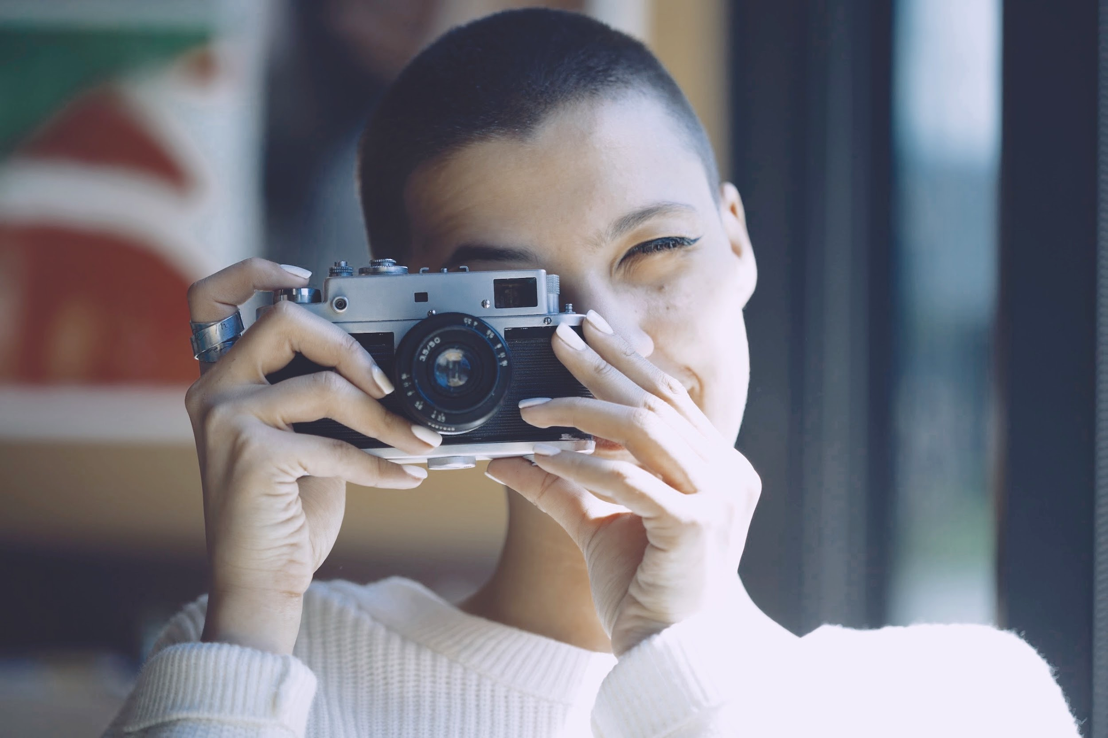
EDITORIAL
PORTFOLIO.
Jenna Doe // portfolio 19
Here is where your presentation begins!

Slide 2
CONTENTS OF THIS TEMPLATE
Here’s what you’ll find in this Slidesgo template:
A slide structure based on a portfolio presentation, which you can easily adapt to your needs. For more info on how to edit the template, please visit Slidesgo School or read our FAQs.
An assortment of pictures that are suitable for use in the presentation can be found in the alternative resources slide.
A thanks slide, which you must keep so that proper credits for our design are given.
A resources slide, where you’ll find links to all the elements used in the template.
Instructions for use and final slides with:
The fonts and colors used in the template.
A selection of illustrations. You can also customize and animate them as you wish with the online editor. Visit Stories by Freepik to find more.
More infographic resources, whose size and color can be edited.
Sets of customizable icons of various themes.
You can delete this slide when you’re done editing the presentation.

Slide 3
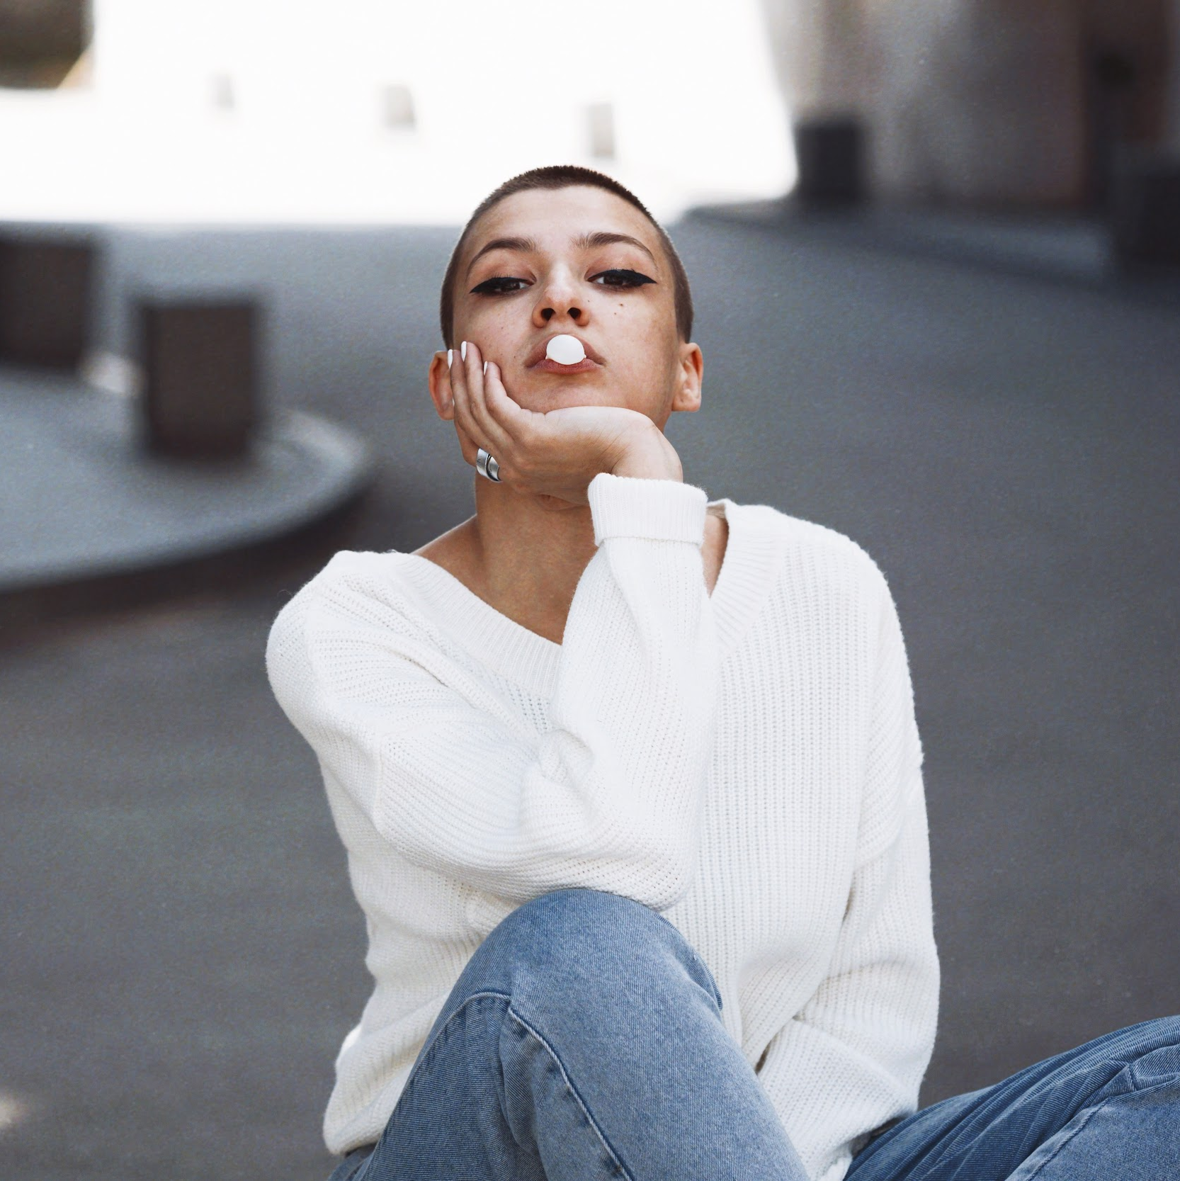
01.
ABOUT ME
Mercury is the closest planet to the Sun and the smallest one in the entire Solar System

Slide 4
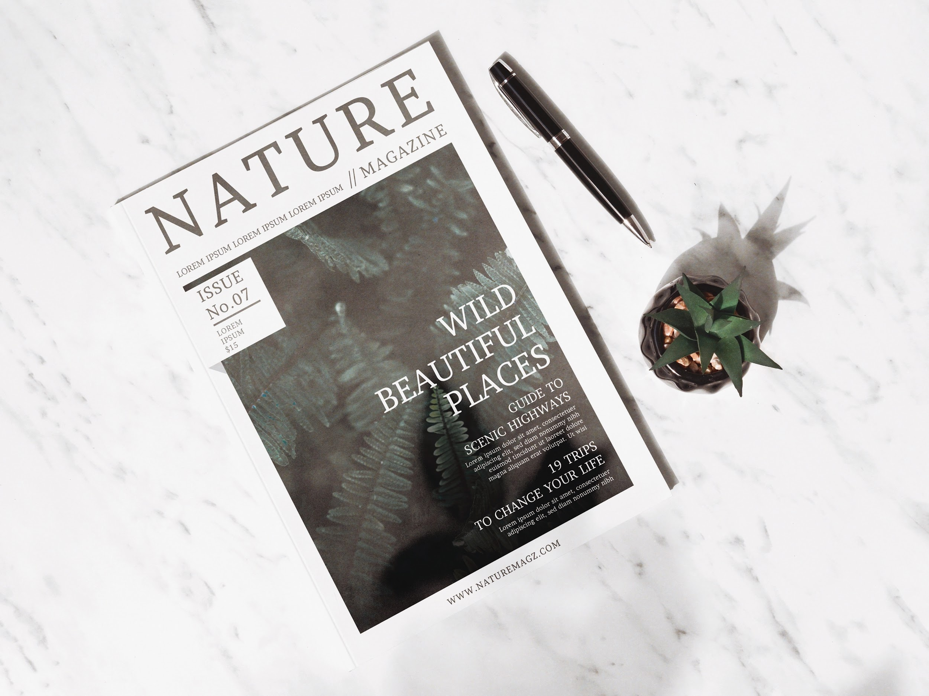
VALUES
A
C
Despite being red, Mars is actually a cold place
Saturn is composed mostly of hydrogen and helium
B
D
Venus has a beautiful name, but it’s terribly hot
Mercury is the closest planet to the Sun

Slide 5
”
—SOMEONE FAMOUS
“This is a quote, words full of wisdom that someone important said and can make the reader get inspired.”

Slide 6
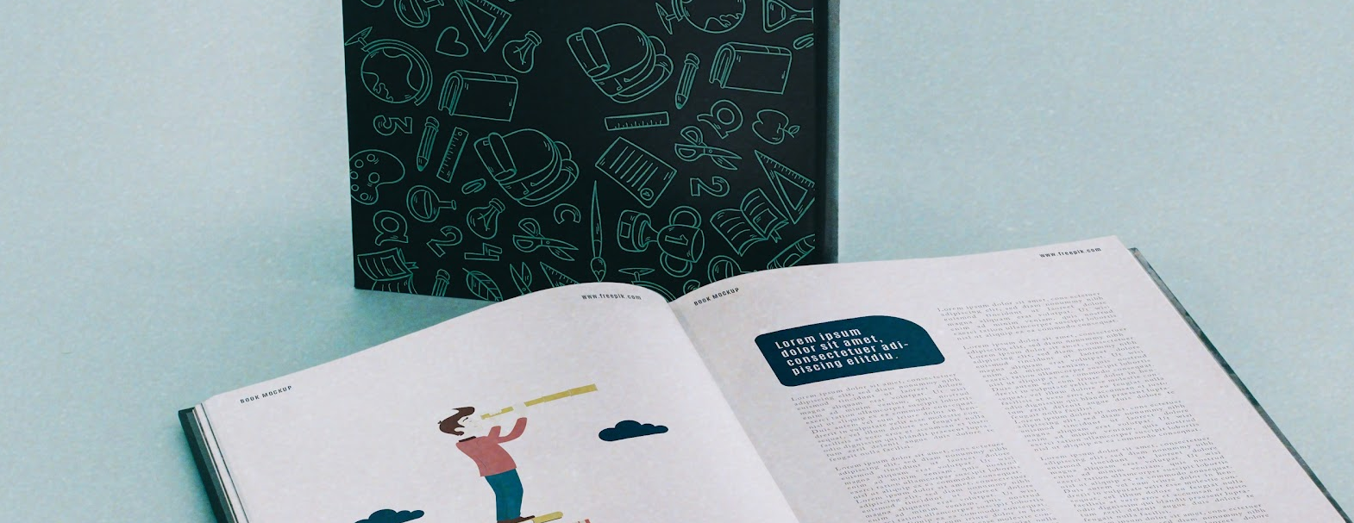
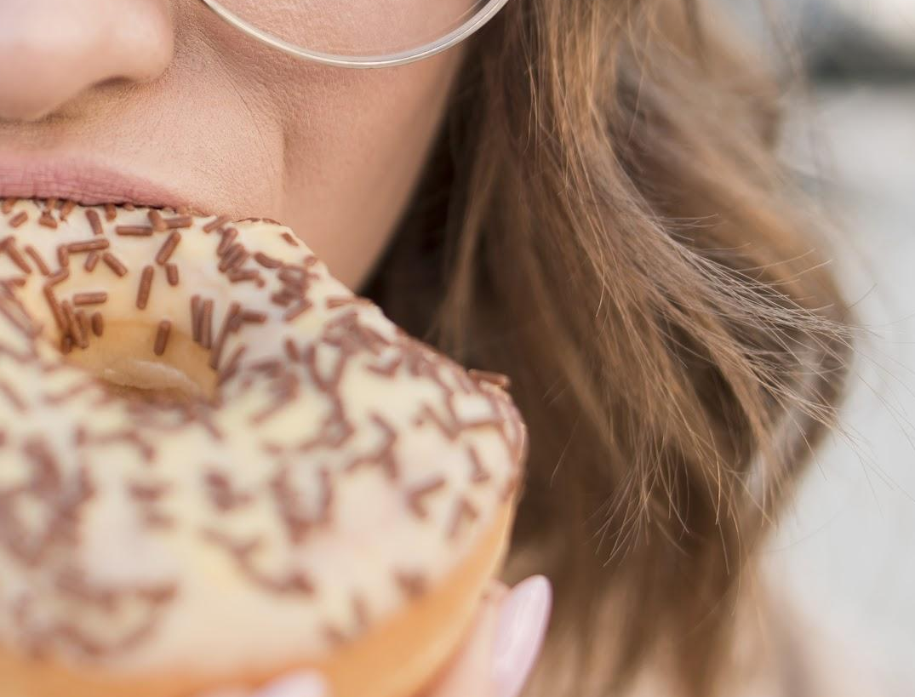
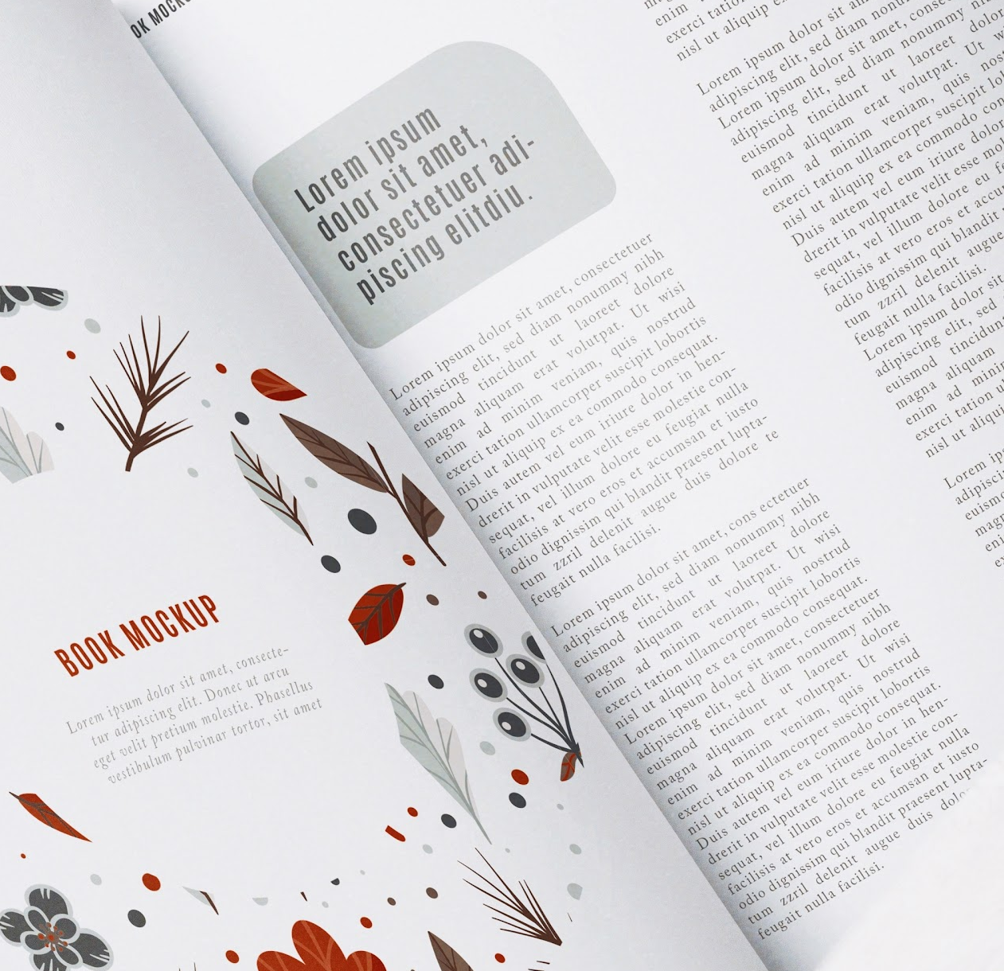
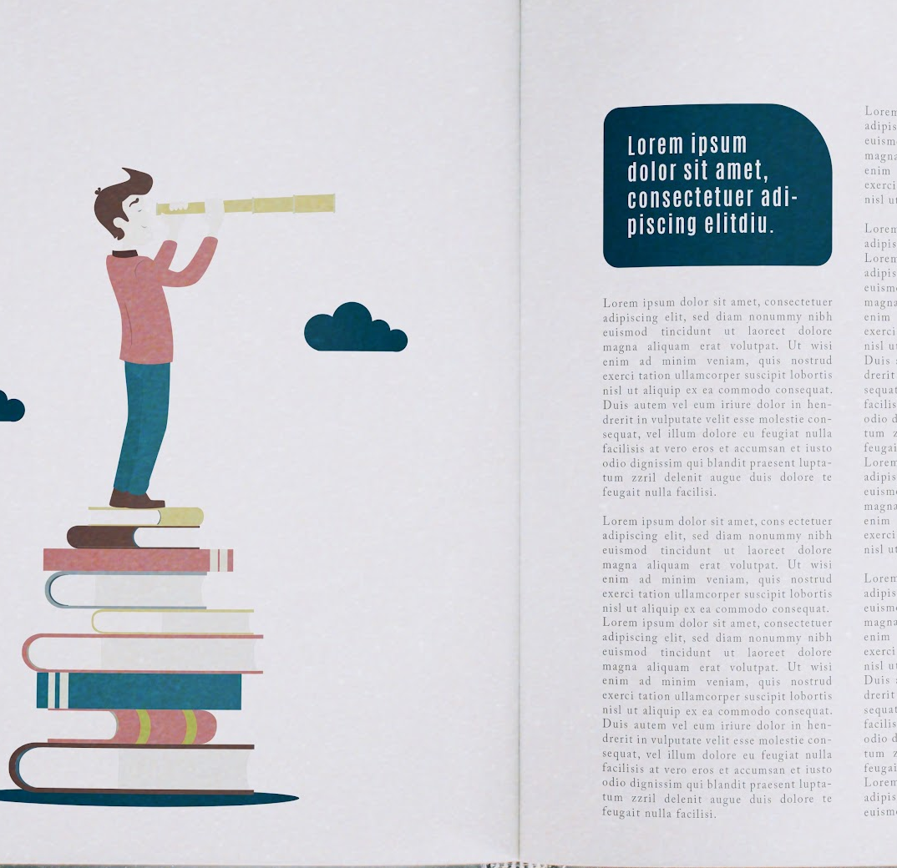
02.
WHAT I DO
Jupiter is the biggest planet in the Solar System and the fourth-brightest object in the night sky

Slide 7
MY EDUCATION
2000/03
2003/09
COMPANY NAME
COMPANY NAME
Jupiter is a gas giant and the biggest planet in the Solar System
Saturn, the ringed planet, is composed mostly of hydrogen and helium

Slide 8
MY EXPERIENCE
COMPANY NAME
COMPANY NAME
COMPANY NAME
2005/2009
2009/2015
2015/2020
Despite being red, Mars is actually a cold place
Jupiter is biggest planet in the Solar System
Venus is the second planet from the Sun

Slide 9
MY OBJECTIVES
01
02
03
Despite being red, Mars is actually a cold place
Neptune is the farthest planet from the Sun
Venus has a beautiful name, but it’s terribly hot
04
05
06
Jupiter is a gas giant and the biggest planet
Saturn is composed mostly of hydrogen and helium
Mercury is the smallest planet in the Solar System

Slide 10
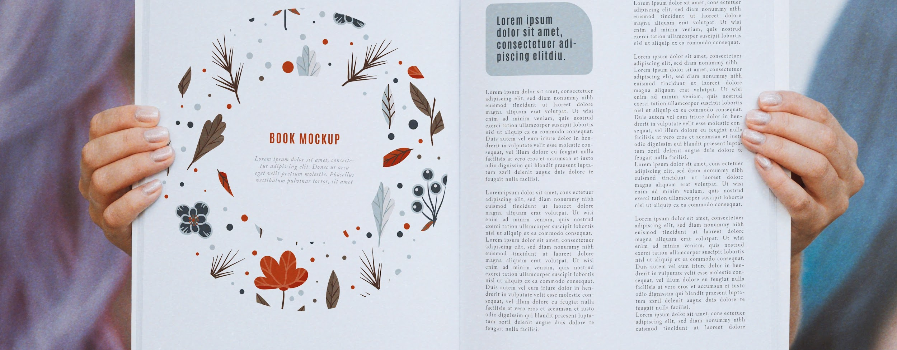
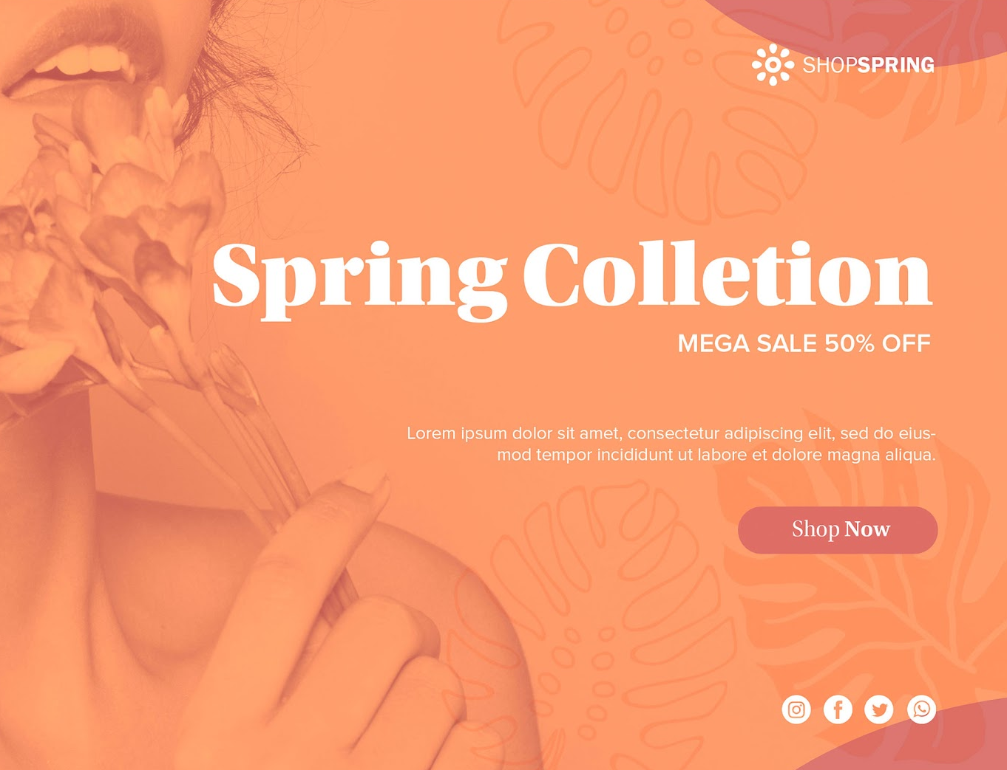
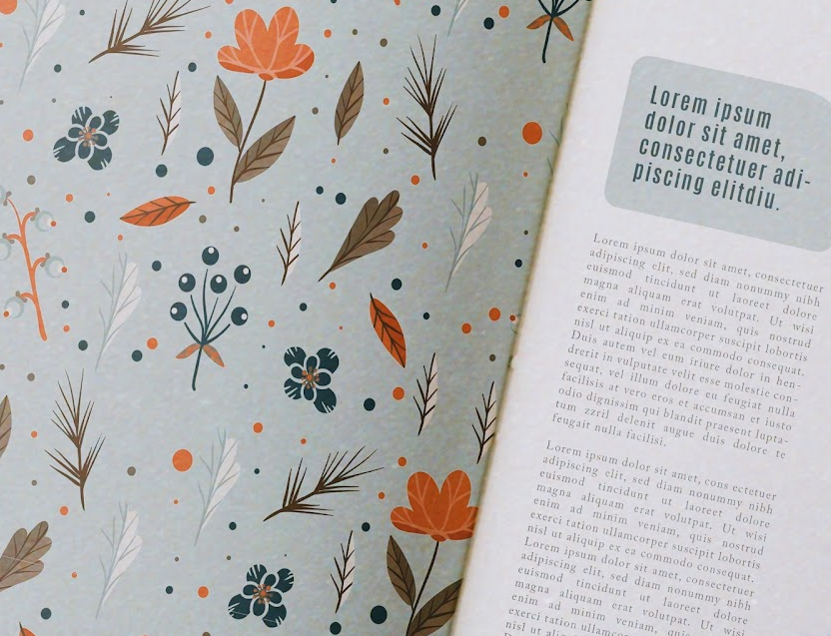
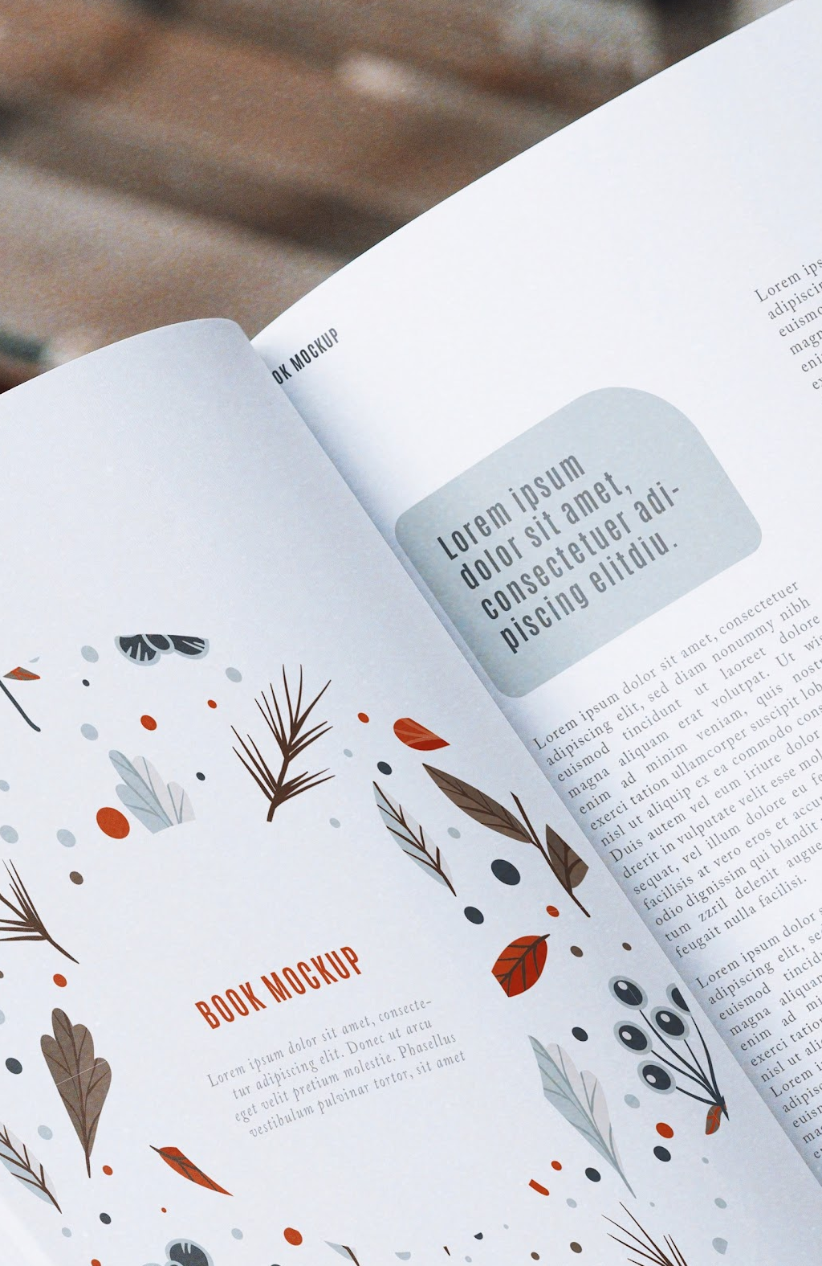
03.
MY WORK
Neptune is the fourth-largest planet by diameter in the Solar System

Slide 11
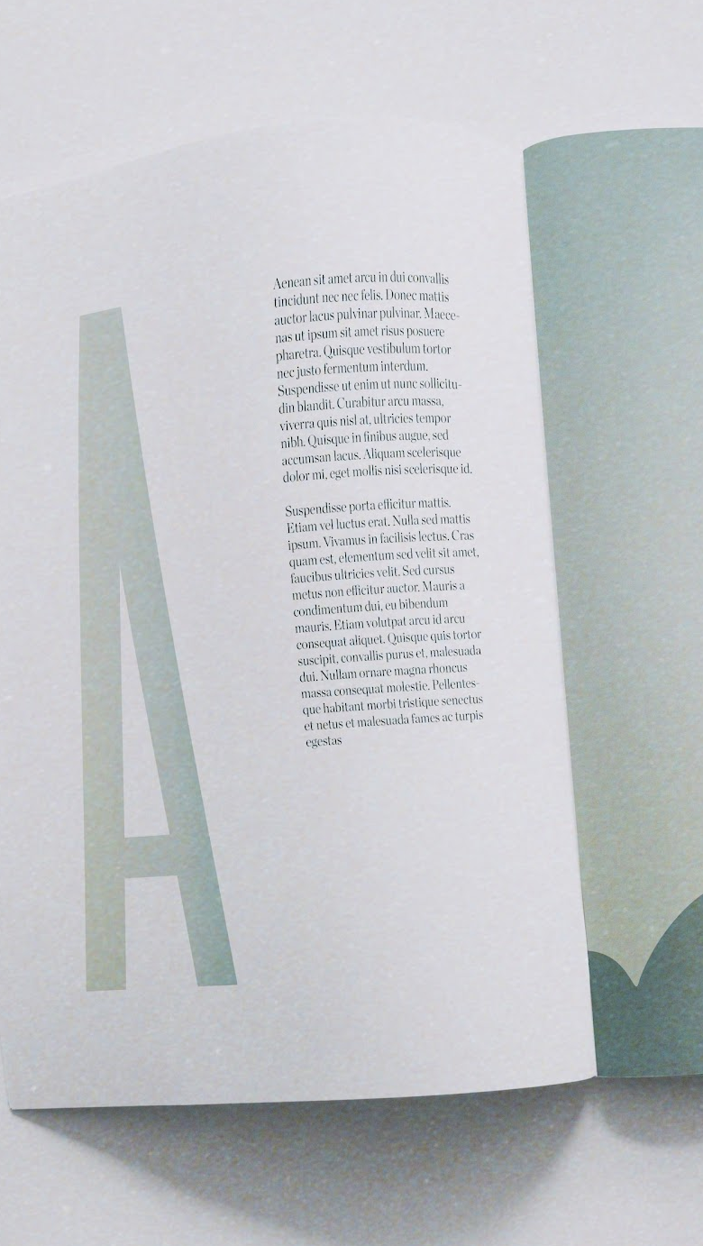
04.
Jenna Doe // portfolio 19
PROJECT NAME HERE
You could enter a subtitle here if you need it

Slide 12
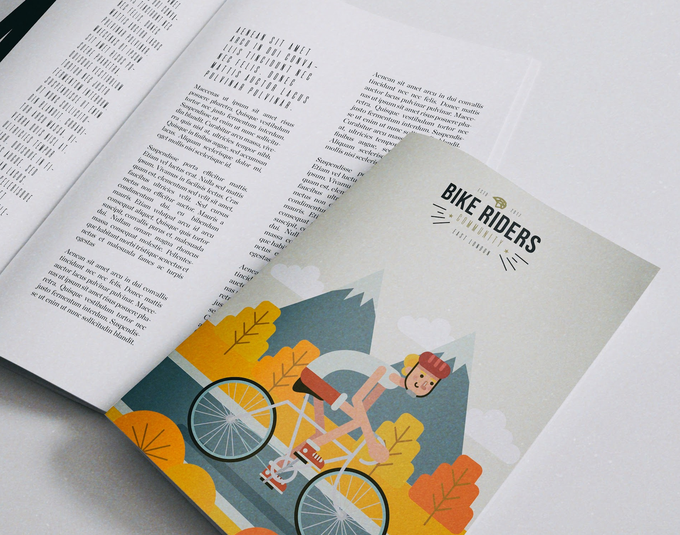
THIS IS THE PATH TO UNDERSTANDING
Mercury is the closest planet to the Sun and the smallest one in the Solar System—it’s only a bit larger than the Moon. The planet’s name has nothing to do with the liquid metal
2012 — Place of exhibition

Slide 13
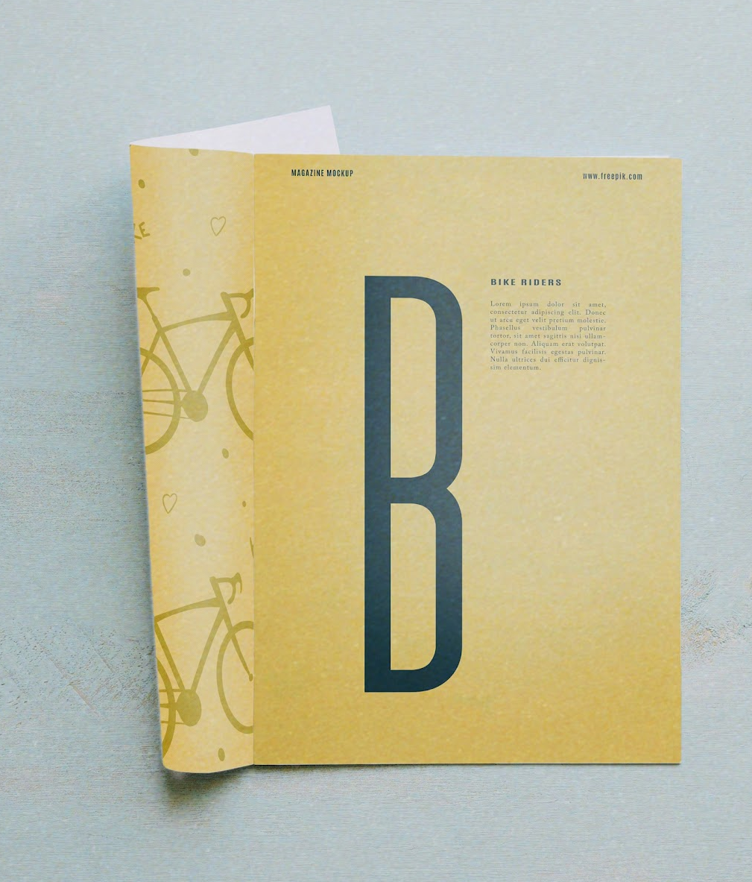
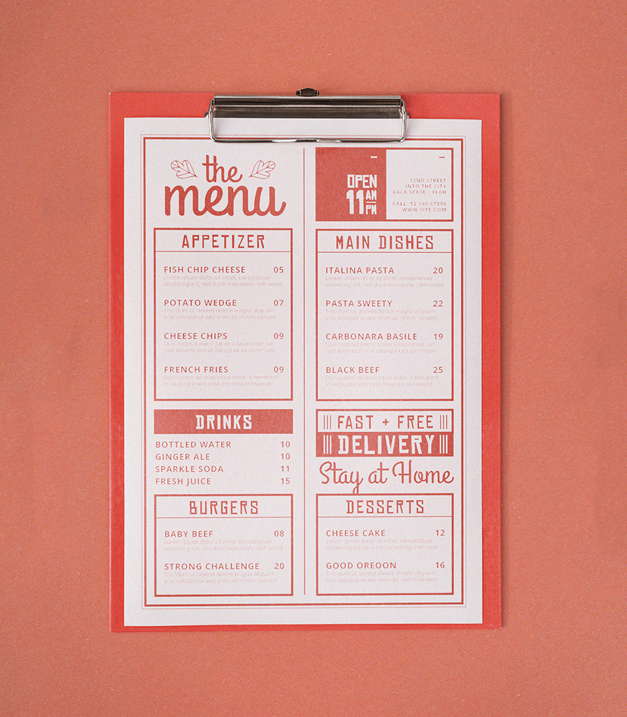
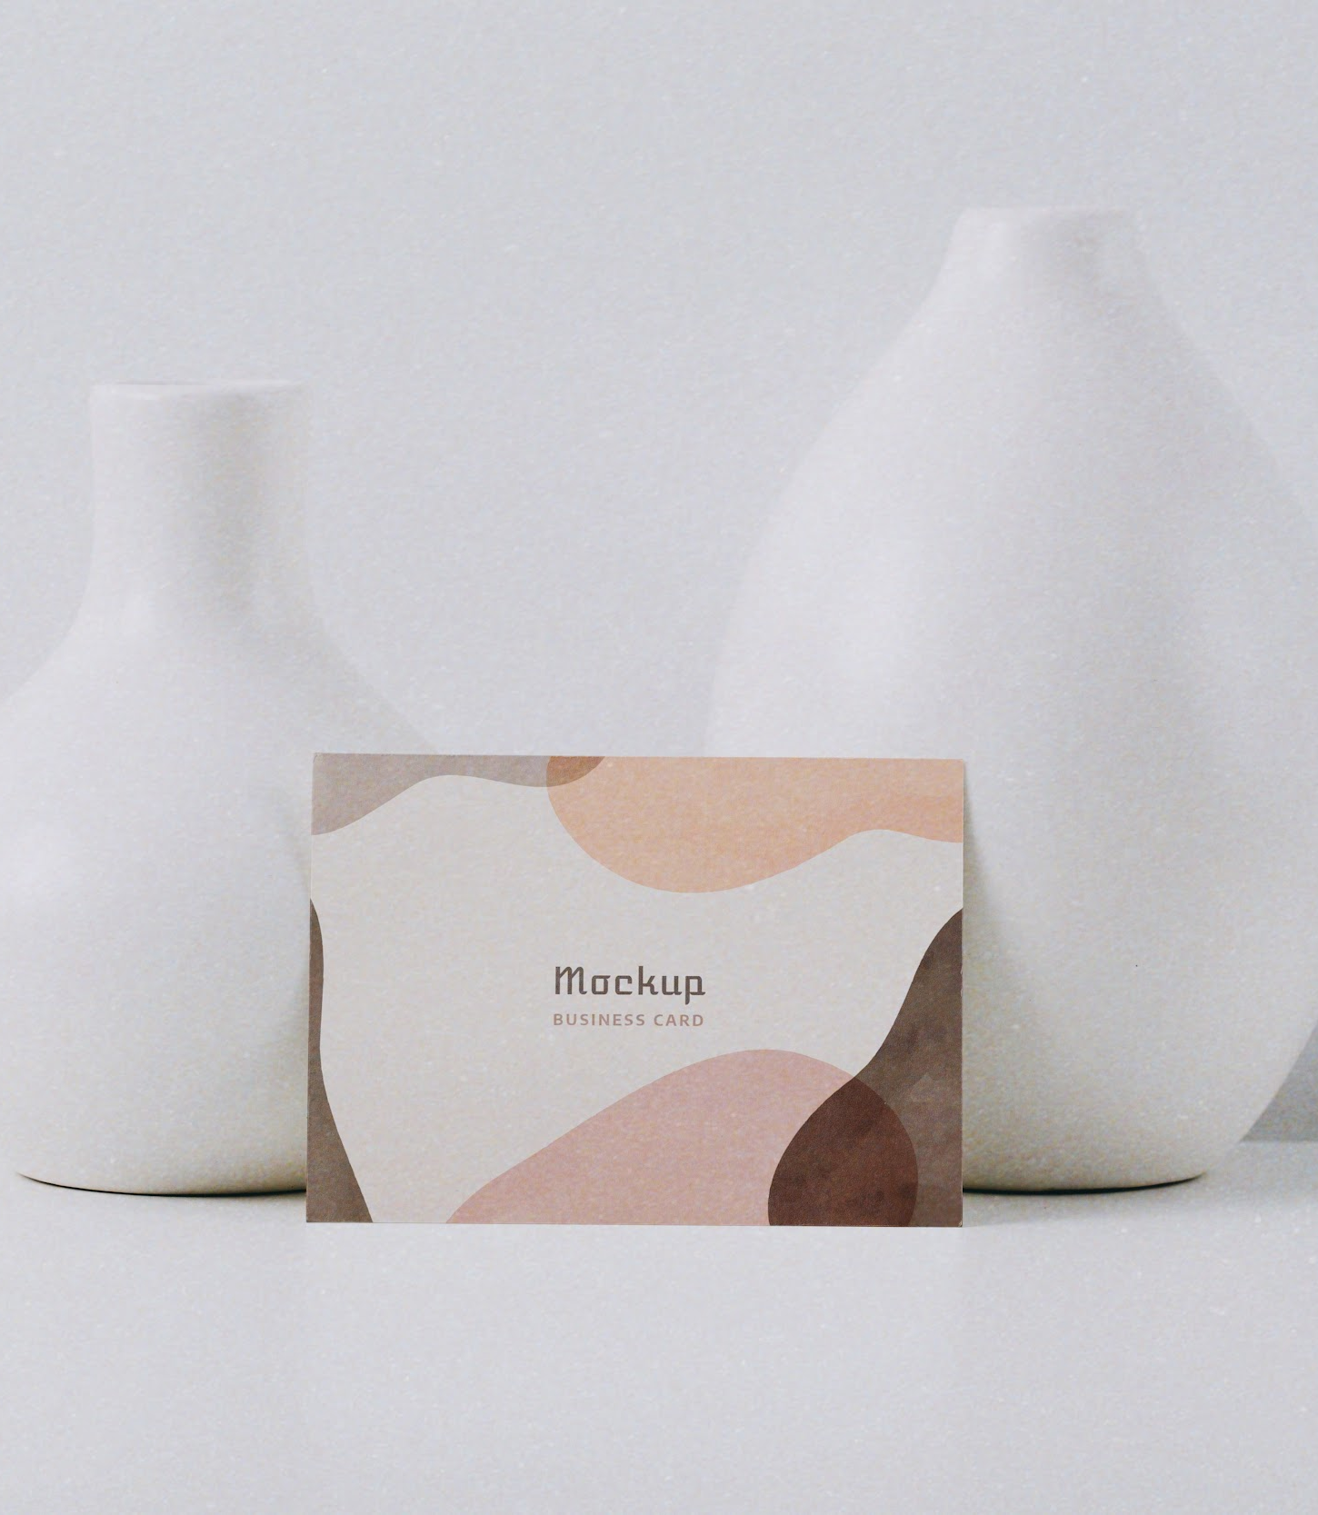
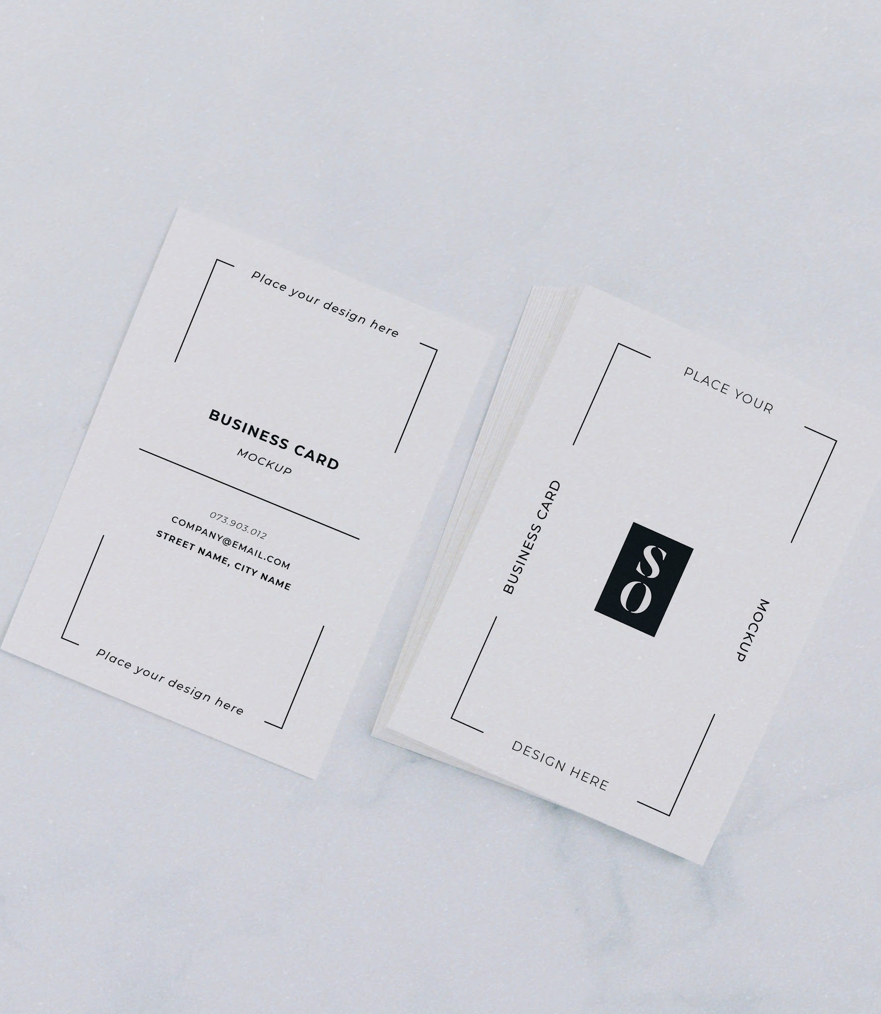
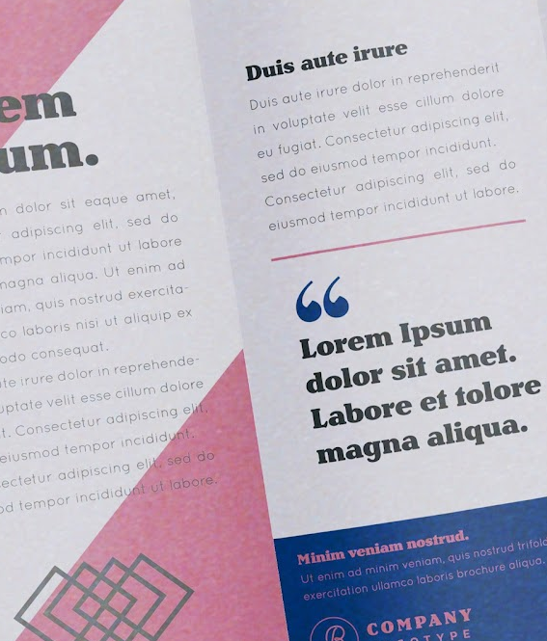
Saturn is composed mostly of hydrogen and helium

Slide 14
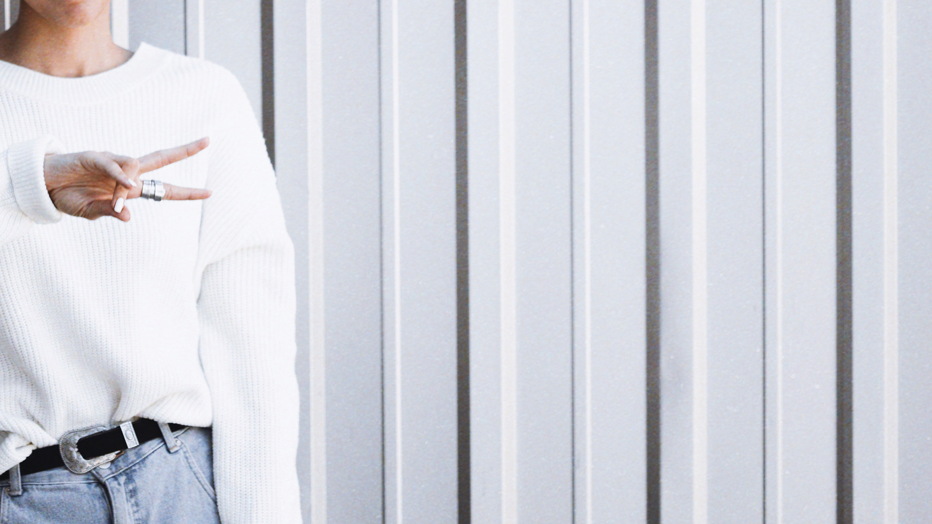
300,000
HOURS
Neptune is the farthest planet from the Sun

Slide 15
THIS IS AN INFOGRAPHIC
A.
B.
C.
Jupiter is a gas giant and the biggest planet
Despite being red, Mars is a cold place
Venus is the second planet from the Sun

Slide 16
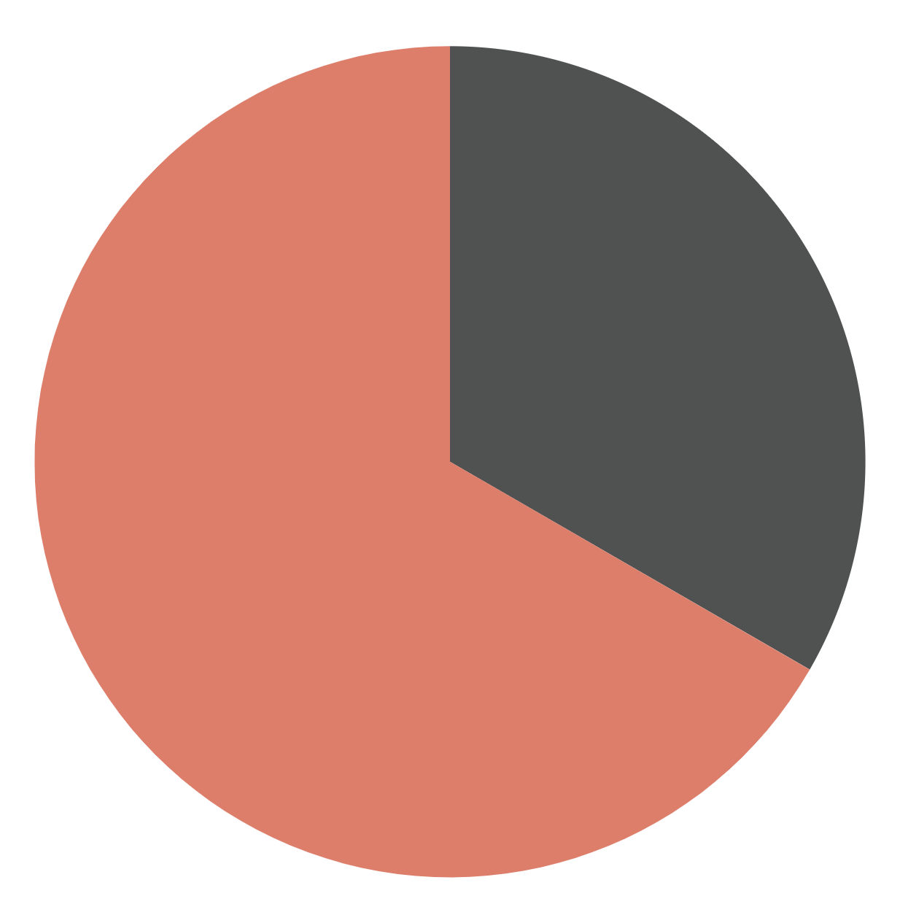
THIS IS A GRAPH
%
60.6
%
39.4
Jupiter is the biggest planet of them all
To modify this graph, click on it, follow the link, change the data and paste the new graph here
Saturn is composed of hydrogen and helium

Slide 17
THIS IS A MAP
Mercury is the closest planet to the Sun and the smallest one in the Solar System

Slide 18
THIS IS A TABLE
01
02
03
Saturn is composed of hydrogen and helium | Neptune is the farthest planet from the Sun | Venus is the second planet from the Sun. It’s extremely hot
Despite being red, Mars is a cold place | Jupiter is the biggest planet | Mercury is the smallest planet

Slide 19

SNEAK PEEK
Mercury was named after the Roman messenger god
Despite being red, Mars is a cold place
Venus is the second planet from the Sun

Slide 20
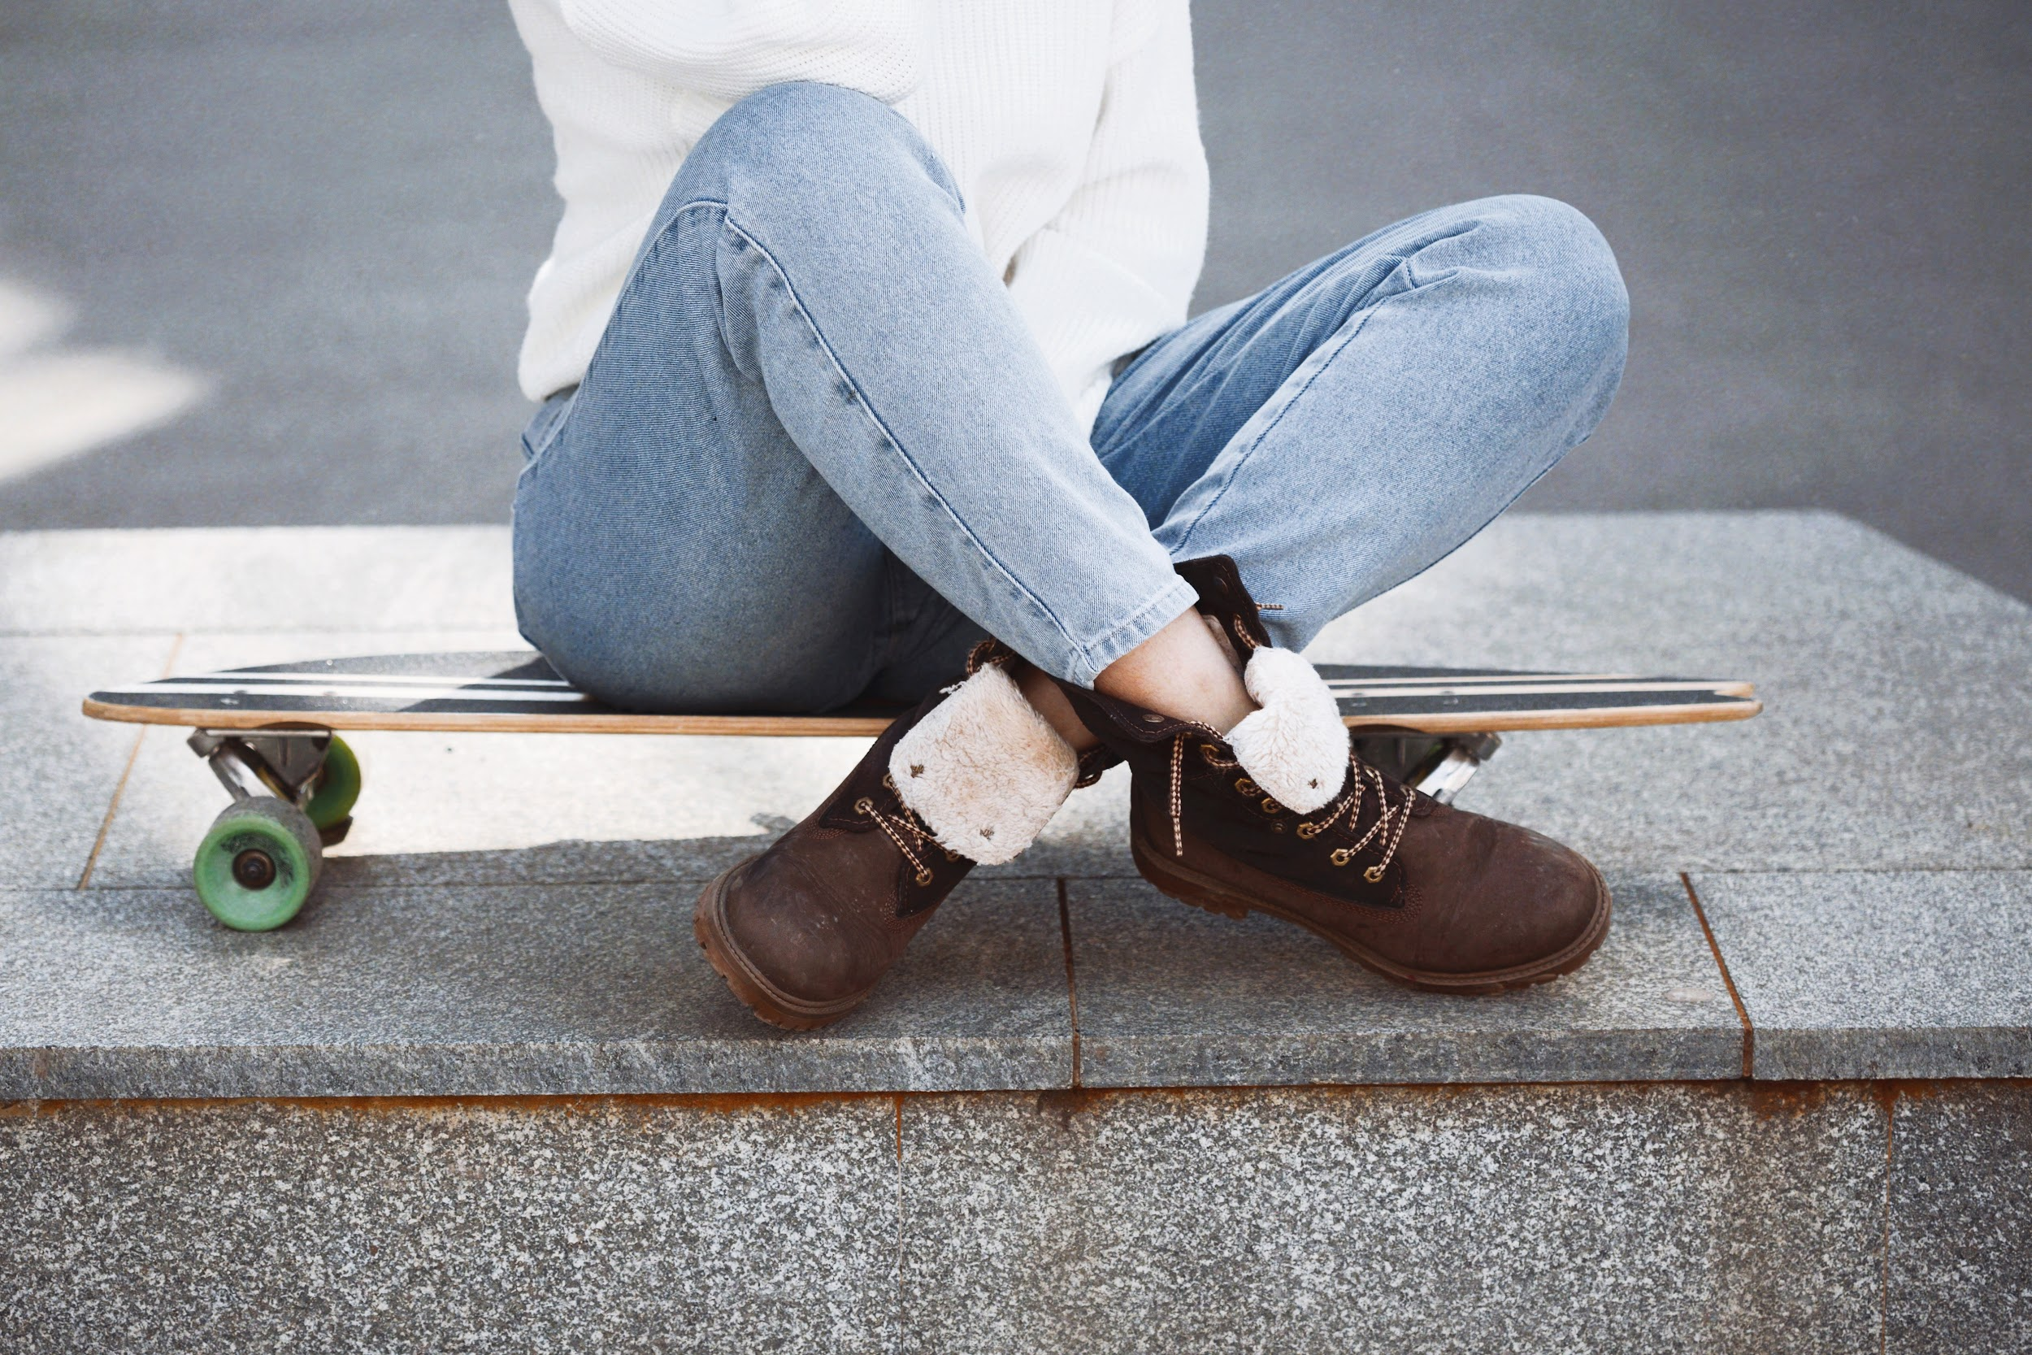
MANY
THANKS!
Do you have any questions?
youremail@freepik.com
+91 620 421 838
yourwebsite.com
Please keep this slide for attribution

Slide 21
ALTERNATIVE RESOURCES
Beautiful woman reading magazine
Smile woman drinking coffee
Close-up woman reading magazine
Young female reading magazine
Close-up woman reading mockup magazine
Close-up woman holding mockup magazine
Woman hands holding magazine
Natural book mockup
Hands holding magazine with coffee

Slide 22
RESOURCES
Woman sitting on longboard with legs crossed
Young short haired woman blowing gum
Smiling young woman with headphones and bob hairstyle gesturing peace sign
Woman in jeans sitting on longboard
Minimalist business card mockup
Open magazine mockup and petals
Magazine mockup with floral decoration
Top view of menu with fork and knife
Top view business card mockup
Spring concept mockup with open book and flowers
Stationery mockup with open bool
Open book mockup

Slide 23
Instructions for use
In order to use this template, you must credit Slidesgo by keeping the Thanks slide.
You are allowed to:
- Modify this template.
- Use it for both personal and commercial projects.
You are not allowed to:
- Sublicense, sell or rent any of Slidesgo Content (or a modified version of Slidesgo Content).
- Distribute Slidesgo Content unless it has been expressly authorized by Slidesgo.
- Include Slidesgo Content in an online or offline database or file.
- Offer Slidesgo templates (or modified versions of Slidesgo templates) for download.
- Acquire the copyright of Slidesgo Content.
For more information about editing slides, please read our FAQs or visit Slidesgo School:
https://slidesgo.com/faqs and https://slidesgo.com/slidesgo-school

Slide 24
Fonts & colors used
This presentation has been made using the following fonts:
Anton
(https://fonts.google.com/specimen/Anton)
Courier Prime
(https://fonts.google.com/specimen/Courier+Prime)
#434343
#efefef
#ffffff
#dd7e6b

Slide 25

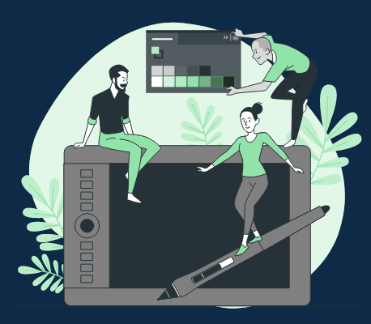


Stories by Freepik
Create your Story with our illustrated concepts. Choose the style you like the most, edit its colors, pick the background and layers you want to show and bring them to life with the animator panel! It will boost your presentation. Check out how it works.
Pana
Amico
Bro
Rafiki

Slide 26
Use our editable graphic resources...
You can easily resize these resources without losing quality. To change the color, just ungroup the resource and click on the object you want to change. Then, click on the paint bucket and select the color you want. Group the resource again when you’re done.

Slide 29
JANUARY
FEBRUARY
MARCH
APRIL
MAY
JUNE
PHASE 1
Task 1
Task 2
PHASE 2
Task 1
Task 2
JANUARY
FEBRUARY
MARCH
APRIL
PHASE 1
Task 1
Task 2

Slide 32
...and our sets of editable icons
You can resize these icons without losing quality.
You can change the stroke and fill color; just select the icon and click on the paint bucket/pen.
In Google Slides, you can also use Flaticon’s extension, allowing you to customize and add even more icons.

Slide 33
Educational Icons
Medical Icons

Slide 34
Business Icons
Teamwork Icons

Slide 35
Help & Support Icons
Avatar Icons

Slide 36
Creative Process Icons
Performing Arts Icons

Slide 37
Nature Icons

Slide 38
SEO & Marketing Icons

Slide 39


