Slide 1



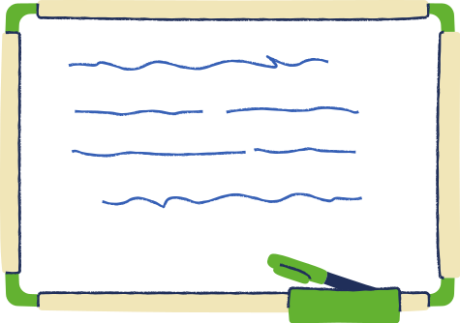
Educational
Presentation
Infographic Template

Slide 2




How to Use This Presentation
Canva
PowerPoint
Google Slides
Click on the "Canva" button under this presentation preview. Start editing your presentation. You need to sign in to your Canva account.
Export this design from Canva as a PowerPoint template. Open the design in Canva. This will provide you with all the fonts used and elements used in this presentation as listed on page 21. Learn more on slide 4.
Export this design from Canva as a GoogleSlide template. This will provide you with all the fonts used and elements used in this presentation as listed on page 21. Learn more on slide 5.

Slide 3



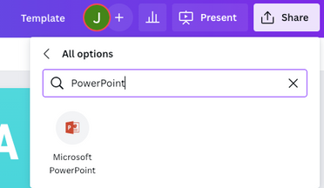

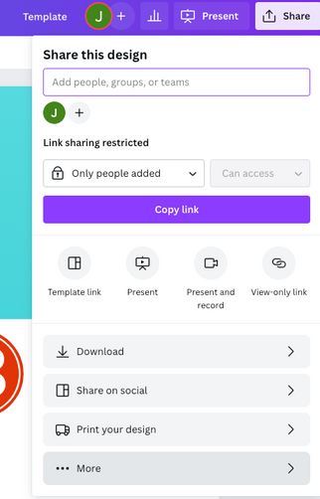
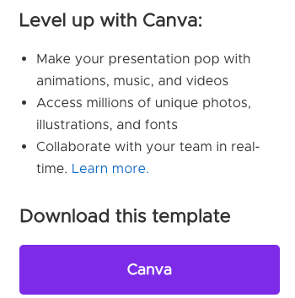


Download This Presentation As A Powerpoint Template In 3 Steps
1.
2.
3.
  Click on the "Canva" button next to this presentation. Start editing your presentation. You may need to sign in to your Canva account.
  Click on the "Share" button on the top right corner in Canva and click on "More" at the bottom of the menu.
  Enter "PowerPoint" in the search bar and click on the PowerPoint icon to download.

Slide 4




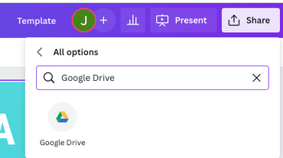


Download This Presentation As A Google Slide Template In 3 Steps
1.
2.
3.
  Click on the "Canva" button next to this presentation. Start editing your presentation. You may need to sign in to your Canva account.
  Click on the "Share" button on the top right corner in Canva and click on "More" at the bottom of the menu.
  Enter "Google Drive" in the search bar and click on the Google Drive icon to add this design as a Google slide in your G Drive. It will ask you to link your Google account to Canva the first time.

Slide 5





Write your
title here
Elaborate here

Slide 6



Important notes
Point 1
Point 2
Presentations are communication tools that can be used as demonstrations, lectures, speeches, reports, and more.
  Presentations are communication tools that can be used as demonstrations, lectures, speeches, reports, and more.
Point 3
Point 4
  Presentations are communication tools that can be used as demonstrations, lectures, speeches, reports, and more.
  Presentations are communication tools that can be used as demonstrations, lectures, speeches, reports, and more.

Slide 7




Important notes
Point 1
Point 2
  Presentations are communication tools that can be used as demonstrations, lectures, speeches, reports, and more.
  Presentations are communication tools that can be used as demonstrations, lectures, speeches, reports, and more.
Point 3
Point 4
  Presentations are communication tools that can be used as demonstrations, lectures, speeches, reports, and more.
  Presentations are communication tools that can be used as demonstrations, lectures, speeches, reports, and more.

Slide 8


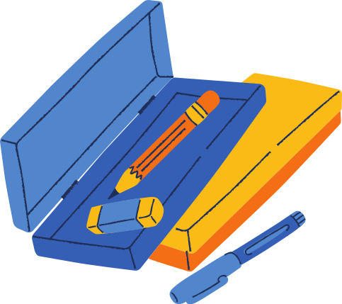
Important notes
Point 1
Point 2
  Presentations are communication tools that can be used as demonstrations, lectures, speeches, reports, and more.
  Presentations are communication tools that can be used as demonstrations, lectures, speeches, reports, and more.
Point 3
Point 4
  Presentations are communication tools that can be used as demonstrations, lectures, speeches, reports, and more.
  Presentations are communication tools that can be used as demonstrations, lectures, speeches, reports, and more.

Slide 9


Infographic Slide Report
Item 5
18.2%
Point 1
Item 1
36.4%
  Presentations are communication tools that can be used as demonstrations, lectures, speeches, reports, and more.
Item 4
9.1%
Point 2
  Presentations are communication tools that can be used as demonstrations, lectures, speeches, reports, and more.
Item 3
18.2%
Point 3
Item 2
18.2%
  Presentations are communication tools that can be used as demonstrations, lectures, speeches, reports, and more.

Slide 10



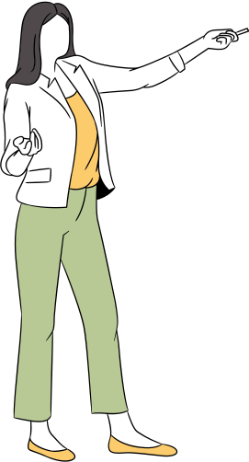

Let's Take A Look At Some Statistics

Slide 11


Infographic Slide Report
Presentations are communication tools.
2011
2019
2022
Series 1
Series 2
Series 3
Series 1
Series 2
Series 3
Series 1
Series 2
Series 3

Slide 12

Infographic Slide Report
50
40
Point 1
  Presentations are communication tools that can be used as demonstrations, lectures, speeches, reports, and more.
30
Point 2
  Presentations are communication tools that can be used as demonstrations, lectures, speeches, reports, and more.
20
10
Point 3
  Presentations are communication tools that can be used as demonstrations, lectures, speeches, reports, and more.
0
Item 1
Item 2
Item 3
Item 4
Item 5

Slide 13


Infographic Slide Report
25
Presentations are communication tools that can be used as demonstrations, lectures, speeches, reports, and more. It is mostly presented before an audience.
20
15
10
5
0
Item 1
Item 2
Item 3
Item 4
Item 5

Slide 14

Infographic Slide Report
Presentations are communication tools.
67%
40%
87%
  Presentations are communication tools that can be used as demonstrations
  Presentations are communication tools that can be used as demonstrations
  Presentations are communication tools that can be used as demonstrations

Slide 15


Infographic Slide Report
Presentations are communication tools.
2011
2022
Series 2
Series 3
Series 2
Series 3

Slide 16


Infographic Slide Report
125
100
Point 1
  Presentations are communication tools that can be used as demonstrations, lectures, speeches, reports, and more.
75
Point 2
  Presentations are communication tools that can be used as demonstrations, lectures, speeches, reports, and more.
50
25
Point 3
  Presentations are communication tools that can be used as demonstrations, lectures, speeches, reports, and more.
0
Item 1
Item 2
Item 3
Item 4
Item 5

Slide 17


Credits
This presentation template
is for everyone to use thanks
to the following:
Canva Original Stickers for the images
Sketchify for the images
HAPPY DESIGNING!

Slide 18

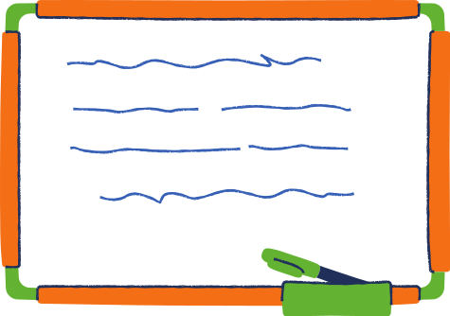

This presentation template uses the following fonts:
Nunito Sans Black
Secular One
Questrial
You can find these fonts online too.

Slide 19







Image Resource Page
Use these design resources in your Canva Presentation.
Don't forget to delete this page before presenting.

Slide 20




Thanks For
Watching
  Presentations are communication tools that can be used as demonstrations, lectures, speeches, reports, and more. It is mostly presented before an audience.

