Slide 1
US National Dollar Day Infographics
Here is where this template begins

Slide 2
About these infographics
This template contains an assortment of complementary infographic resources for the US National Dollar Day Minitheme presentation
These infographics are adapted to the style of the aforementioned presentation, so you can insert them easily and have them completely integrated at once. You just need to do the following:
  Select the element that you want to copy
  Right-click and choose “Copy”
  Go to the slide where you want the element to appear
  Right-click and choose “Paste”

Slide 3
US National Dollar Day infographics
Mercury
Mars
Mercury is the smallest planet in the Solar System
Despite being red, Mars is actually a cold place
Venus
Jupiter
Venus is the second planet from the Sun
Jupiter is the biggest planet in the Solar System

Slide 4
US National Dollar Day infographics
75%
25%
50%
Jupiter
Neptune
Mercury
Jupiter is an enormous planet
Neptune is far away from Earth
Mercury is quite a small planet

Slide 5
US National Dollar Day infographics
Mercury
Mars
Jupiter
Mercury is the smallest planet in the Solar System
Despite being red, Mars is actually a cold place
Jupiter is the biggest planet in the Solar System
Venus
Saturn
Venus is the second planet from the Sun
Saturn is a gas giant and has several rings

Slide 6
US National Dollar Day infographics
2XXX
2XXX
Mercury is small
Earth has life
2XXX
2XXX
Venus is very hot
Jupiter is big

Slide 7
US National Dollar Day infographics
2XXX
Saturn has rings
2XXX
2XXX
Mars is very cold
The Sun is a star

Slide 8
US National Dollar Day infographics
Do you need a table?
 | Mercury is the closest planet to the Sun and the smallest one in the Solar System
 | Venus has a beautiful name and is the second planet from the Sun. It’s terribly hot
 | Earth is the third planet from the Sun and the only one that harbors life in the Solar System
 | Despite being red, Mars is actually a cold place. It's full of iron oxide dust, which gives the planet its reddish cast

Slide 9
US National Dollar Day infographics
Mercury
Mercury is the smallest planet in the Solar System
Mars
Despite being red, Mars is actually a cold place
Venus
Venus is the second planet from the Sun
Jupiter
Jupiter is the biggest planet in the Solar System

Slide 10
US National Dollar Day infographics
+
+
+
01
02
03
04
Venus
Mercury
Mars
Jupiter
Venus is the second planet from the Sun
Mercury is the smallest planet in the Solar System
Despite being red, Mars is actually a cold place
Jupiter is the biggest planet in the Solar System

Slide 11
US National Dollar Day infographics
30%
Mercury
60%
Venus
10%
Earth
40%
Mars

Slide 12
US National Dollar Day infographics
Mercury
Jupiter
Mercury is quite a small planet
Jupiter doesn’t have a solid surface
60%
50%
Neptune
Mars
Neptune is far away from Earth
Despite being red, Mars is a cold place
30%
90%

Slide 13
US National Dollar Day infographics
Mercury
Mercury is quite a small planet
Neptune
Neptune is far away from Earth
Jupiter
Jupiter doesn’t have a solid surface

Slide 14
US National Dollar Day infographics
25%
50%
75%
Venus
Mercury
Mars
Venus is the second planet from the Sun
Mercury is the smallest planet in the Solar System
Despite being red, Mars is actually a cold place

Slide 15
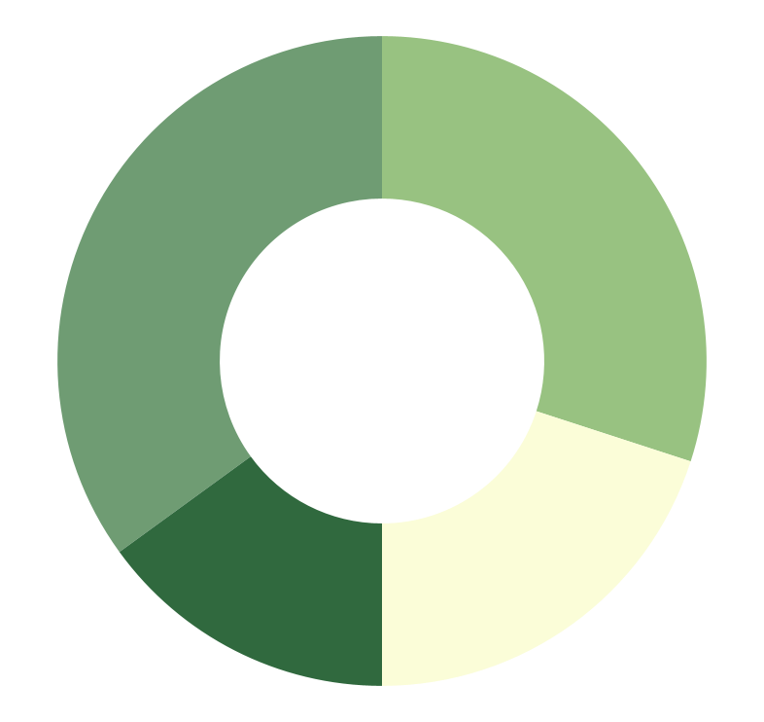
US National Dollar Day infographics
35%
30%
Mercury
Jupiter
Mercury is quite a small planet
Jupiter doesn’t have a solid surface
15%
20%
Neptune
Mars
Neptune is far away from Earth
Despite being red, Mars is a cold place
Follow the link in the graph to modify its data and then paste the new one here. For more info, click here

Slide 16
US National Dollar Day infographics
01 | 02 | 03 | 04
Venus | Mercury | Mars | Jupiter
Venus is the second planet from the Sun | Mercury is the smallest planet in the Solar System | Despite being red, Mars is actually a cold place | Jupiter is the biggest planet in the Solar System

Slide 17
US National Dollar Day infographics
 | Mon | Tue | Wed | Thu | Fri
Mars
Venus
Mercury
Jupiter
Saturn

Slide 18
US National Dollar Day infographics
 | Year 1 | Year 2 | Year 3 | Year 4
Mars is actually a very cold place
Venus is the second planet from the Sun
Neptune is very far away from Earth
Mercury is the closest planet to the Sun
Saturn is a gas giant with several rings
Jupiter is the biggest planet of them all

Slide 19
US National Dollar Day infographics
August
 | 01 | 02 | 03 | 04 | 05 | 06
07 | 08 | 09 | 10 | 11 | 12 | 13
14 | 15 | 16 | 17 | 18 | 19 | 20
21 | 22 | 23 | 24 | 25 | 26 | 27
28 | 29 | 30 | 31
US National Dollar Day
Mercury is quite a small planet

Slide 20
US National Dollar Day infographics
01
01 | Mercury is the smallest planet in the Solar System
02 | Venus has a beautiful name, but also high temperatures
03 | Despite being red, Mars is actually a very cold place
04 | Jupiter is the biggest planet in the Solar System
02
03
04

Slide 21
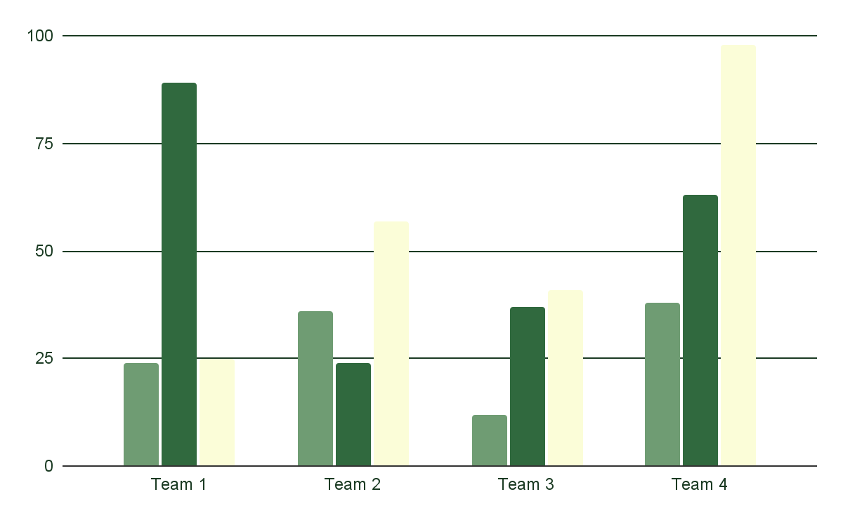
US National Dollar Day infographics
Mercury
Mercury is quite a small planet
Neptune
Neptune is far away from Earth
Jupiter
Jupiter doesn’t have a solid surface
Follow the link in the graph to modify its data and then paste the new one here. For more info, click here

Slide 22
US National Dollar Day infographics
Mercury
Jupiter
Mars
Mercury is the smallest planet in the Solar System
Despite being red, Mars is actually a cold place
Venus

Slide 23
US National Dollar Day infographics
Mercury
Venus
Mercury is the closest planet to the Sun
Venus is the second planet from the Sun
Neptune
Mars
Neptune is far away from Earth
Despite being red, Mars is a cold place
Jupiter
Saturn
Jupiter doesn’t have a solid surface
Saturn is composed of hydrogen and helium

Slide 24
US National Dollar Day infographics
Jupiter
Jupiter is the biggest planet in the Solar System
Venus
Venus is the second planet from the Sun
Saturn
Mercury
Saturn is composed of hydrogen and helium
Mercury is the closest planet to the Sun
Mars
Neptune
Despite being red, Mars is actually a cold place
Neptune is very far away from the Sun

Slide 25
US National Dollar Day infographics
Jupiter
Jupiter is the biggest planet of them all
80%
Venus
Venus is the second planet from the Sun
60%
Mars
Despite being red, Mars is a cold place
20%
Mercury
Mercury is the closest planet to the Sun
70%

Slide 26
US National Dollar Day infographics
Venus | Earth
Venus has a beautiful name and is the second planet from the Sun | Earth is the third planet from the Sun and the only one that harbors life
Mercury | Jupiter
Mercury is the closest planet to the Sun and the smallest of them all | Jupiter is a gas giant and the biggest planet in the Solar System

Slide 27
US National Dollar Day infographics
Mercury
Venus
Mercury is the closest planet to the Sun
Venus is the second planet from the Sun
25%
75%
Neptune
Mars
Neptune is far away from Earth
Despite being red, Mars is a cold place
50%
100%

Slide 28
US National Dollar Day infographics
07
08
09
Mon
Tue
Wed
Mercury is the smallest planet in the Solar System
Venus is the second planet from the Sun
Despite being red, Mars is actually a cold place

Slide 29
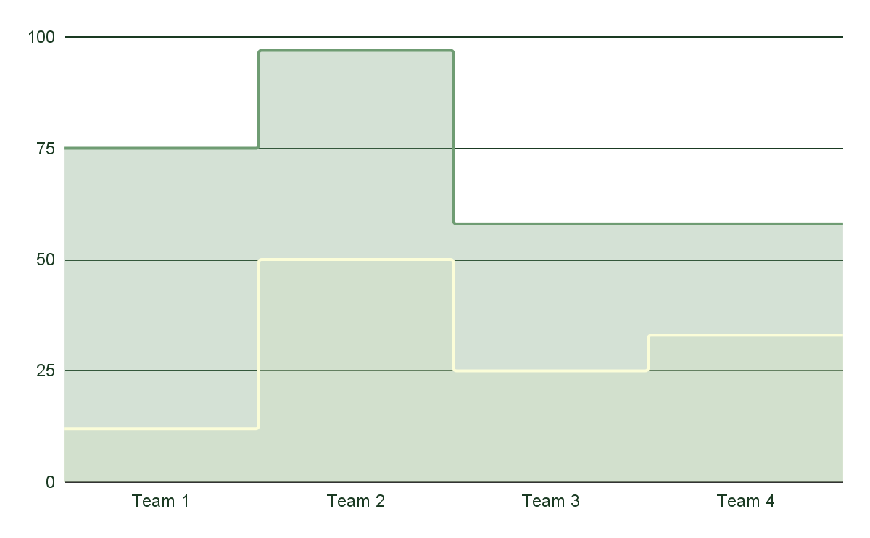
US National Dollar Day infographics
Mars
Mars is cold
Mars is a red planet
Mars is made of basalt
Saturn
Saturn is a gas giant
Saturn has rings
Saturn is quite big
Follow the link in the graph to modify its data and then paste the new one here. For more info, click here

Slide 30
US National Dollar Day infographics
Mercury
Mercury is the closest planet to the Sun and the smallest of them all
Venus
Venus has a beautiful name and is the second planet from the Sun
Neptune
Neptune is the fourth-largest planet in the Solar System

Slide 31
US National Dollar Day infographics
Mercury
Mars
Mercury is the smallest planet in the Solar System
Despite being red, Mars is actually a cold place
Venus
Jupiter
Venus is the second planet from the Sun
Jupiter is the biggest planet in the Solar System

Slide 32
US National Dollar Day infographics
Mercury
Mercury is the closest planet to the Sun
Neptune
Neptune is far away from Earth
Venus
Venus is the second planet from the Sun
Mars
Despite being red, Mars is a cold place

Slide 33
Instructions for use
If you have a free account, in order to use this template, you must credit Slidesgo in your final presentation. Please refer to the next slide to read the instructions for premium users.
As a Free user, you are allowed to:
- Modify this template.
- Use it for both personal and commercial projects.
You are not allowed to:
- Sublicense, sell or rent any of Slidesgo Content (or a modified version of Slidesgo Content).
- Distribute Slidesgo Content unless it has been expressly authorized by Slidesgo.
- Include Slidesgo Content in an online or offline database or file.
- Offer Slidesgo templates (or modified versions of Slidesgo templates) for download.
- Acquire the copyright of Slidesgo Content.
For more information about editing slides, please read our FAQs or visit our blog:
https://slidesgo.com/faqs and https://slidesgo.com/slidesgo-school

Slide 34
Instructions for use (premium users)
As a Premium user, you can use this template without attributing Slidesgo.
You are allowed to:
Modify this template.
Use it for both personal and commercial purposes.
Hide or delete the “Thanks” slide and the mention to Slidesgo in the credits.
Share this template in an editable format with people who are not part of your team.
You are not allowed to:
Sublicense, sell or rent this Slidesgo Template (or a modified version of this Slidesgo Template).
Distribute this Slidesgo Template (or a modified version of this Slidesgo Template) or include it in a database or in any other product or service that offers downloadable images, icons or presentations that may be subject to distribution or resale.
Use any of the elements that are part of this Slidesgo Template in an isolated and separated way from this Template.
Register any of the elements that are part of this template as a trademark or logo, or register it as a work in an intellectual property registry or similar.
For more information about editing slides, please read our FAQs or visit our blog:
https://slidesgo.com/faqs and https://slidesgo.com/slidesgo-school

Slide 35
Infographics
You can add and edit some infographics to your presentation to present your data in a visual way.
Choose your favourite infographic and insert it in your presentation using Ctrl C + Ctrl V or Cmd C + Cmd V in Mac.
Select one of the parts and ungroup it by right-clicking and choosing “Ungroup”.
Change the color by clicking on the paint bucket.
Then resize the element by clicking and dragging one of the square-shaped points of its bounding box (the cursor should look like a double-headed arrow). Remember to hold Shift while dragging to keep the proportions.
Group the elements again by selecting them, right-clicking and choosing “Group”.
Repeat the steps above with the other parts and when you’re done editing, copy the end result and paste it into your presentation.
Remember to choose the “Keep source formatting” option so that it keeps the design. For more info, please visit our blog.

