Slide 1


Colorful & inspirational
+20 Background Slides
by Slidecore

Slide 2

Friends bring happiness into your life.
“
“
Best friends bring coffee.

Slide 3

“
In a gentle way, you can shake the world.
Mahatma Gandhi

Slide 4

MAHATMA GANDHI
Learn as if you
will live forever.
Live like you
will die tomorrow.

Slide 5

“
“
People trample over flowers,
yet only to embrace a cactus.
JAMES JOYCE

Slide 6

FRIDA KAHLO
Passion is the bridge that takes
you from pain to change.

Slide 7

“
“
If your ship
doesn't come in
Swim out
and meet it.
Jonathan Winters

Slide 8

“
“
If a flower can flourish in the desert,
you can flourish anywhere.
MATSHONA DHLIWAYO

Slide 9

Opportunities don't happen, you create them.
—
CHRIS GROSSER
“

Slide 10

“
“
If it’s the right chair,
it doesn’t take too long to get comfortable in it.
~ Robert De Niro

Slide 11

The creative adult is the child who survived.
-- URSULA LEGUIN

Slide 12

“
“
Better three hours too soon
than a minute too late.
– William Shakespeare –

Slide 13

“
“
Progress lies not in enhancing what is, but in advancing towards what will be.
KHALIL GIBRAN

Slide 14

“
What you do today can
improve all your tomorrows.
Ralph Marston

Slide 15

“
“
What divides us pales in
comparison to what unites us.
~ Edward Kennedy ~

Slide 16
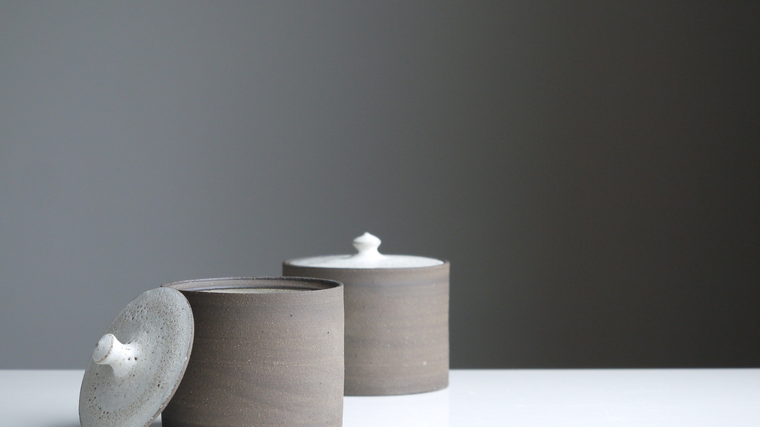
Less is more
- Mies Van Der Roh -

Slide 17

“
Pleasure in the job puts perfection in the work.
– Aristotle

Slide 18

“
The bad news is time flies.
The good news is you're the pilot.
— Michael Altshuler —

Slide 19

— Walt Whitman —
Keep your face always toward the sunshine,
and shadows will fall behind you.

Slide 20

“
“
Nothing is impossible.
The word itself says 'I'm possible!'
— Audrey Hepburn —

Slide 21
  Editable Icon Set
Things you can do:
Resize the icon
Change fill color and opacity
Add stroke
Add dash lines

Slide 22

This template was made specially for you by
Big shout-out to the great people that provided us with the free resources of this presentation:
STOCK IMAGES
unsplash.com
pixabay.com
pexels.com
ICONS
Thick Icons
Nice and Serious
Visit slidecoretemplates.com to get more presentations for free

