Slide 1
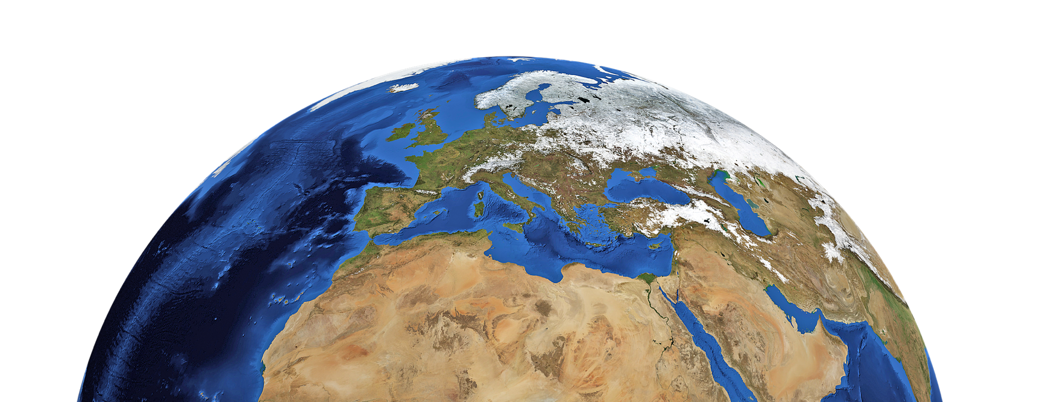
A PRESENTATION BY SLIDECORE
MAKE EARTH GREAT AGAIN

Slide 2
INSTRUCTIONS FOR USE
Just being extra careful, you don’t really need them ;)
EDIT AS GOOGLE SLIDES
Make sure to be logged in your Google account.
Click the “Edit in Google Slides “ button below the template preview.
Get the editable template in your drive and start editing as Frank Sinatra or Fleetwood Mac would: in your own way.
EDIT AS A POWER POINT
Click the “Edit in Power Point” button below the template preview.
A .pptx file will be downloaded in your computer.
Open it as a Power Point and start rocking your presentation.
You are free to use this presentation under Creative Commons Attribution License. But please, either keep the Credits Slide or mention Slidecore and other used sources in the slide footer. Help to keep the free resources environment a better place :)

Slide 3


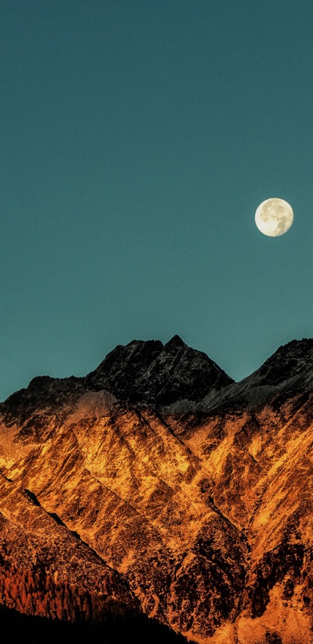

01
02
03
04
INTRODUCTION
FACTS TO KNOW
SOLUTIONS
CONCLUSION

Slide 4
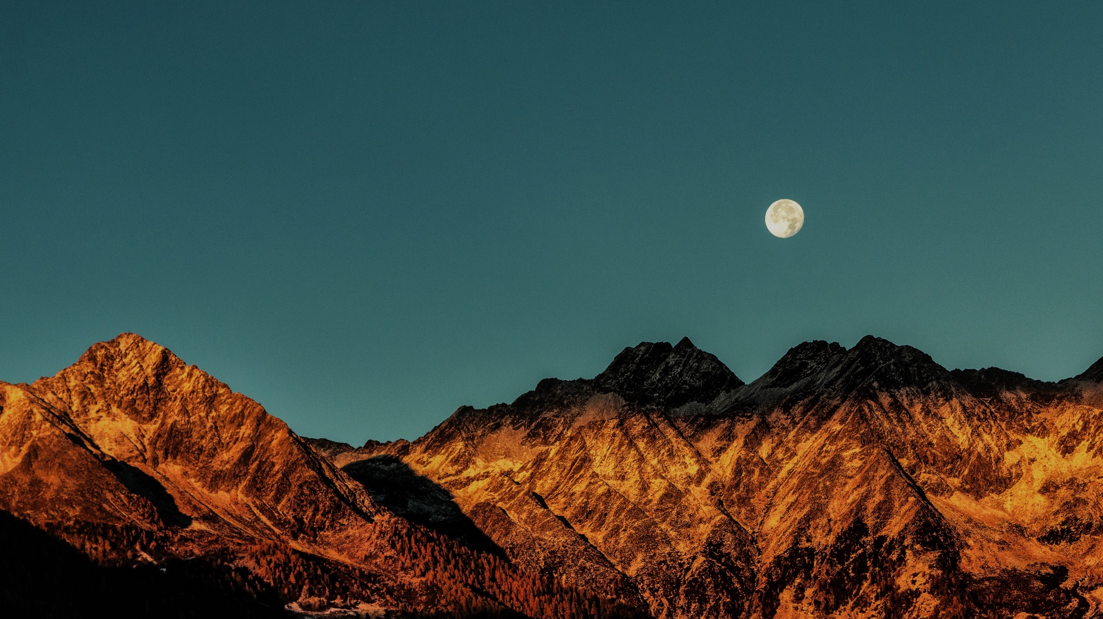
01
INTRODUCTION

Slide 5

GLOBAL WARMING PROBLEM
Global warming is the long-term rise in the average temperature of the Earth's climate system.
The Intergovernmental Panel on Climate Change (IPCC) Fifth Assessment Report concluded, "It is extremely likely that human influence has been the dominant cause of the observed warming since the mid-20th century".

Slide 6
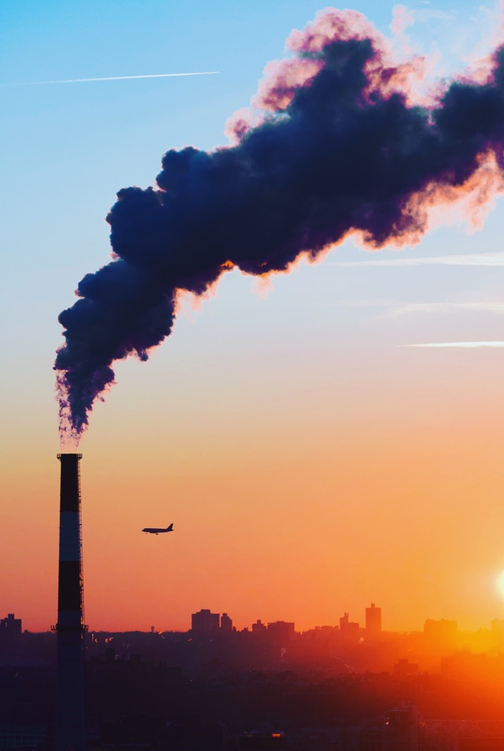
413
1.9
Parts per million
ºF since 1880
CARBON DIOXIDE
GLOBAL TEMPLERATURE
12.85
3.3
Percent per decade
Milimeters per year
ARTIC ICE MINIMUM
SEA LEVEL

Slide 7
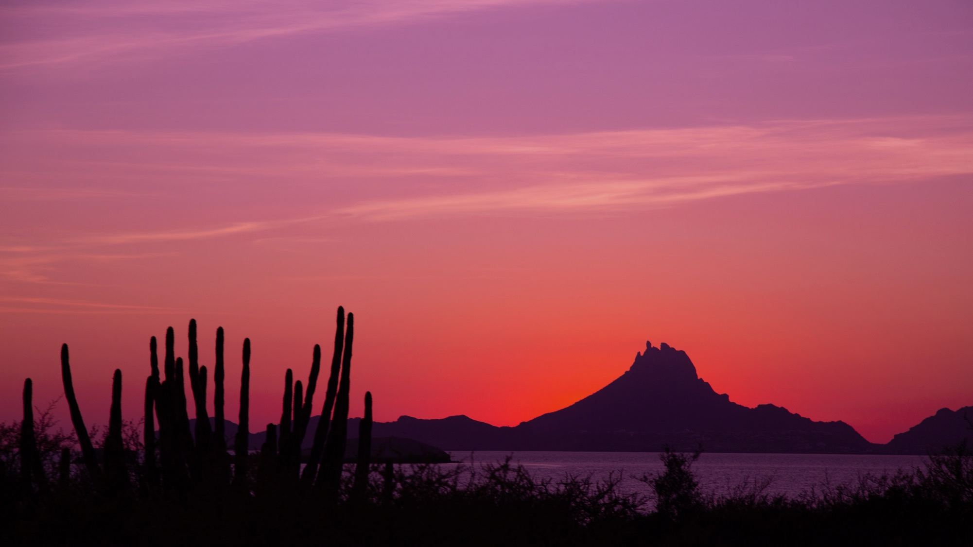
02
FACTS TO KNOW

Slide 8
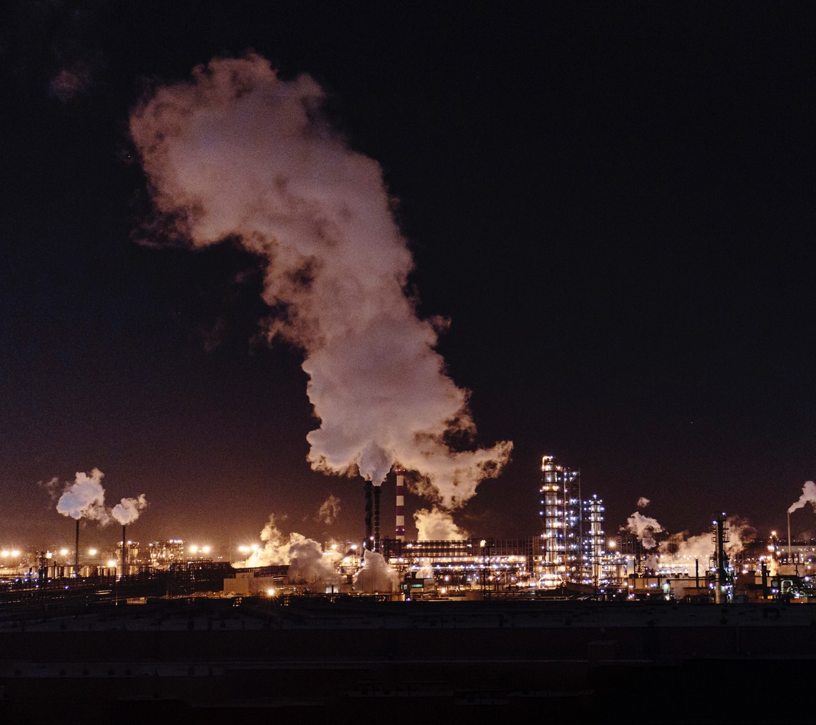
FACTS TO KNOW
408 PART​S PER MILLION
The concentration of carbon dioxide (CO2)​​​​​​​ in our atmosphere, as of 2018, is the highest it has been in 3 million years.

Slide 9
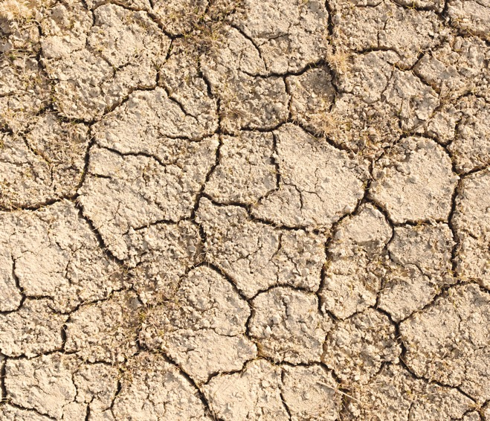
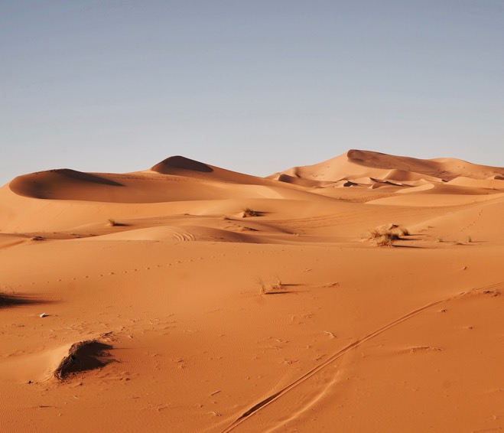
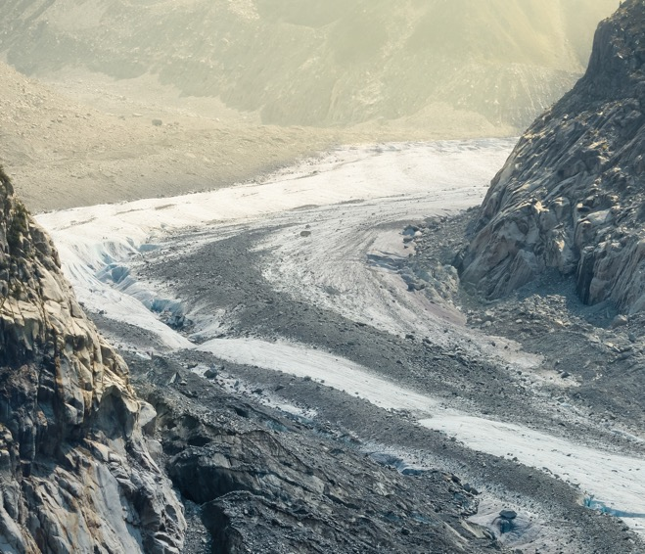
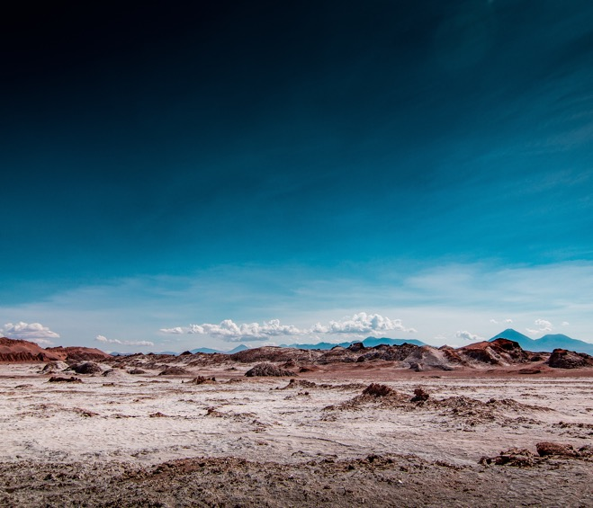
FACTS TO KNOW
2016 ​WAS THE WARMEST YEAR ON RECORD
NASA and NOAA data show that global averages in 2016 were 1.78 degrees F (0.99 degrees C) warmer than the mid-20th century average. Seventeen of the 18 warmest years have occurred since 2000.

Slide 10
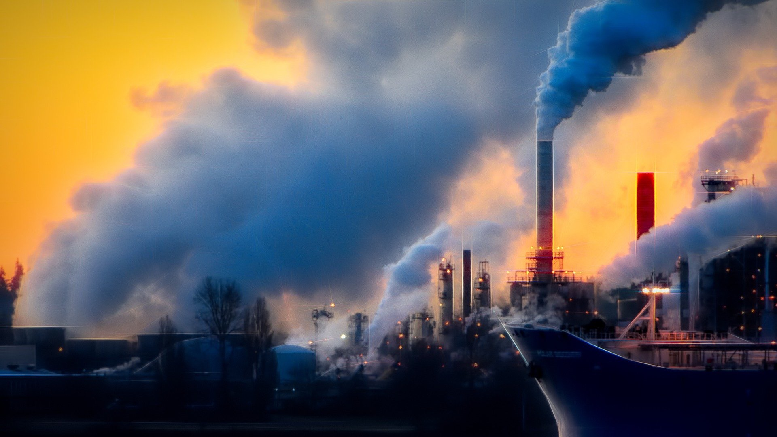
FACTS TO KNOW
11% OF EMISSIONS.
Eleven percent of all global greenhouse gas emissions caused by humans are caused by deforestation — comparable to the emissions from all of the cars and trucks on the planet.

Slide 11

FACTS TO KNOW
THE AMAZON IS A CARBON-STORING POWERHOUSE
In the Amazon, 1% of tree species sequester 50% of the region’s carbon.

Slide 12

FACTS TO KNOW
800 MILLION PEOPLE
Eleven percent of the world’s population is currently vulnerable to climate change impacts such as droughts, floods, heat waves, extreme weather events and sea-level rise.

Slide 13


FACTS TO KNOW
SAVE NATURE.
IT’S CHEAPER
Conserving ecosystems is ​often more cost-effective than human-made interventions. In the Maldives, building a sea wall for coastal protection cost about US$ 2.2 billion. Even after 10 years of maintenance costs, it is still four times cheaper to preserve the natural reef.

Slide 14
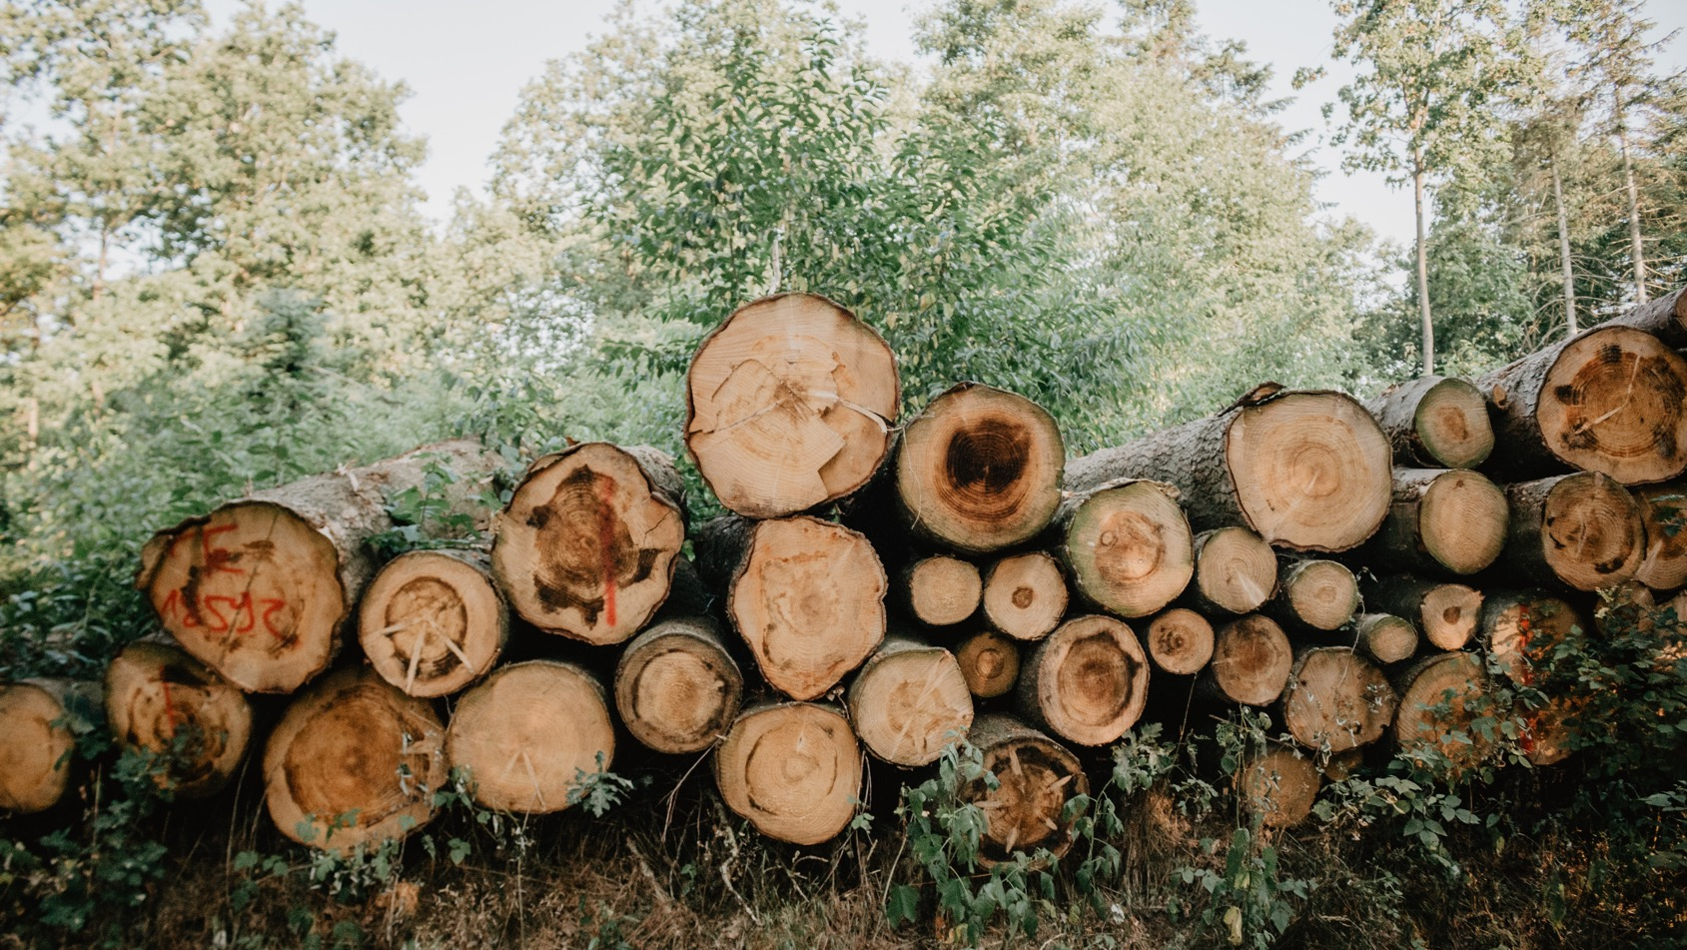
FACTS TO KNOW
NEARLY 1 MILLION HECTARES LOST
An area of coastal ecosystems larger than New York City is destroyed every year, removing an important buffer from extreme weather for coastal communities and releasing carbon dioxide into the atmosphere.

Slide 15

03
SOLUTIONS

Slide 16
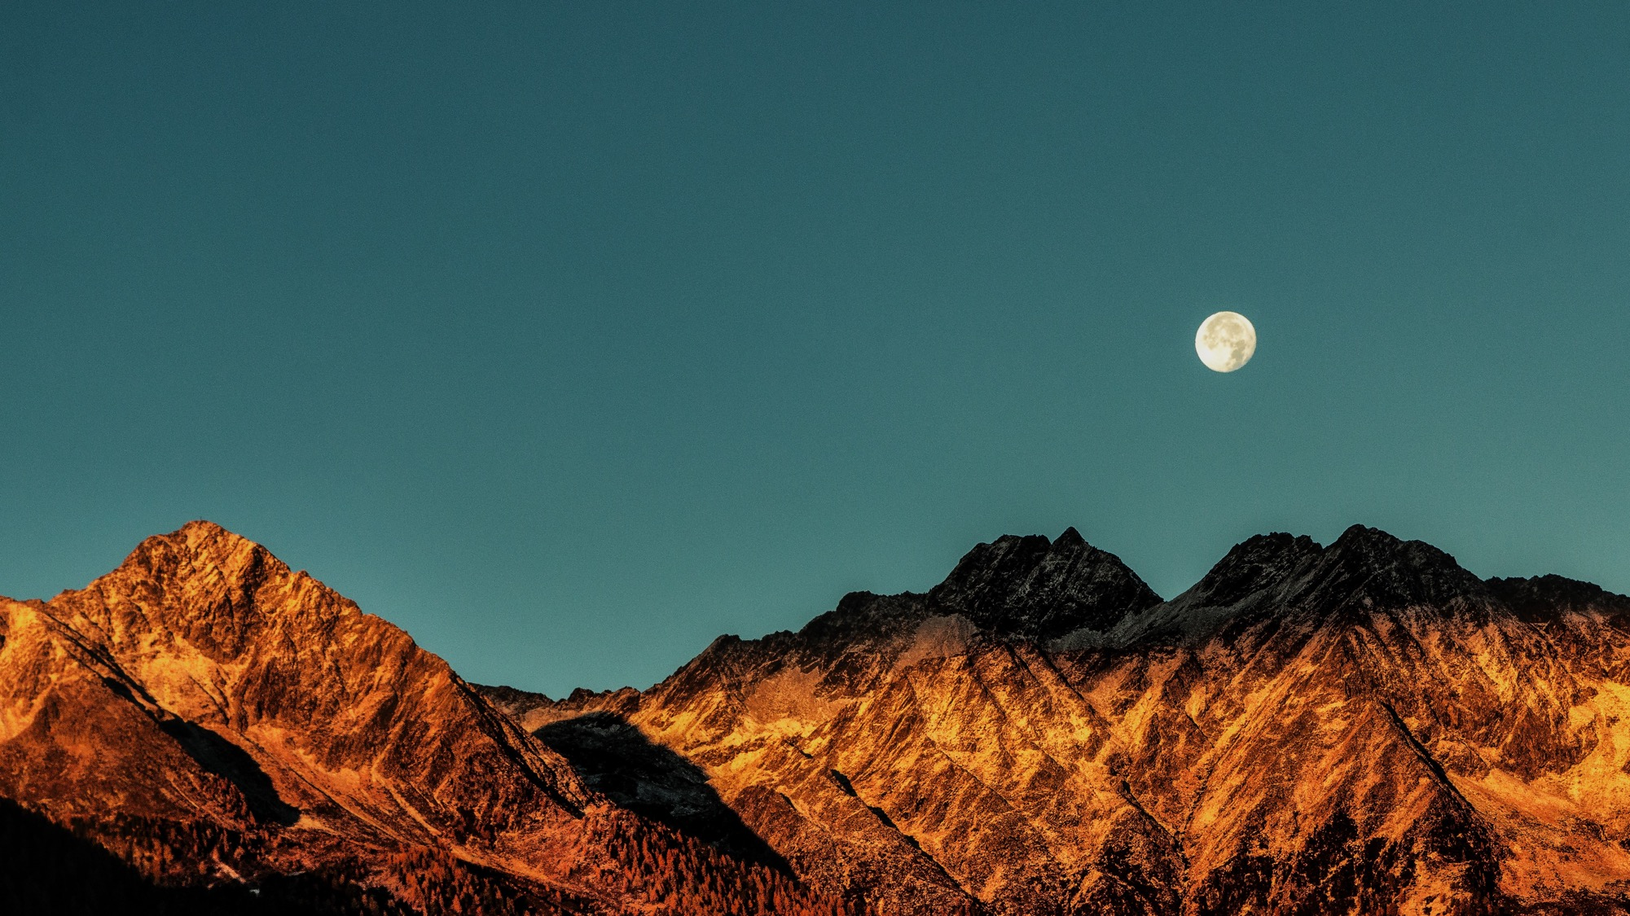
“
“We can't save the world by playing by the rules, because the rules have to be changed. Everything needs to change - and it has to start today.
GRETA THUMBERG

Slide 17





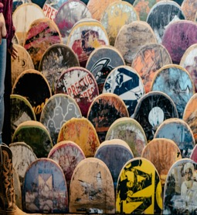
REDUCE
REUSE
RECYCLE
Cut down on what you throw away. Follow the three "R's" to conserve natural resources and landfill space

Slide 18
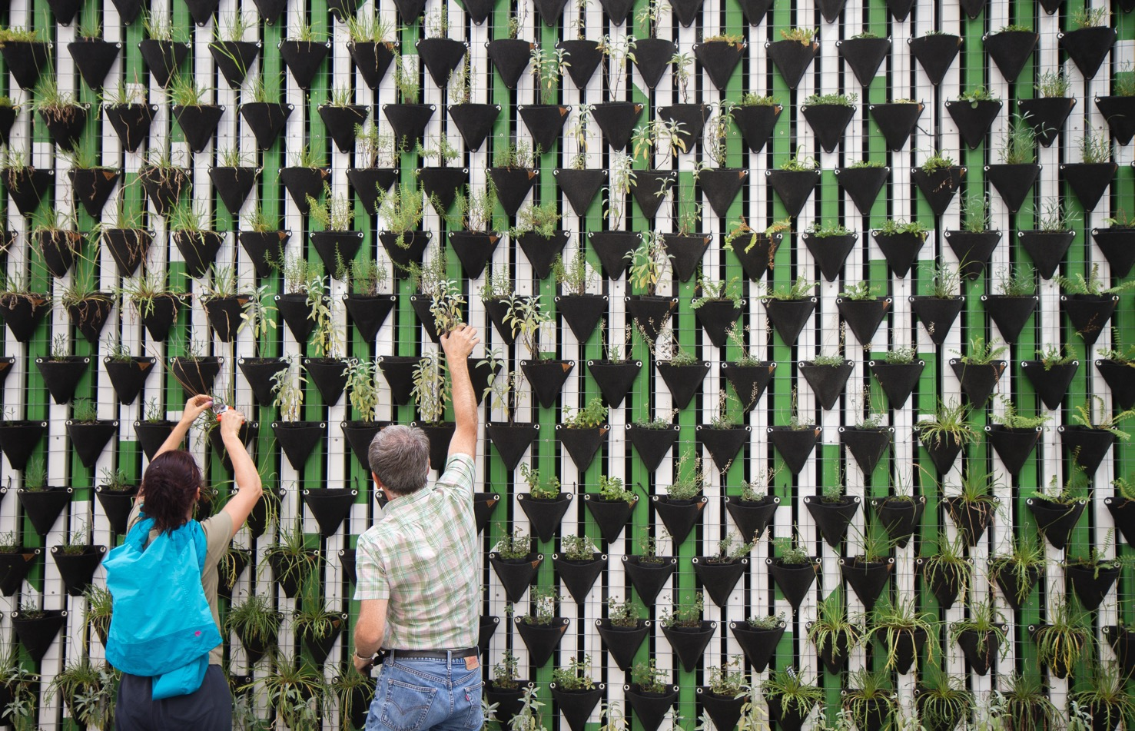
SOLUTIONS
VOLUNTEER
Volunteer for cleanups in your community. You can get involved in protecting your watershed, too.

Slide 19

SOLUTIONS
EDUCATE
When you further your own education, you can help others understand the importance and value of our natural resources.

Slide 20
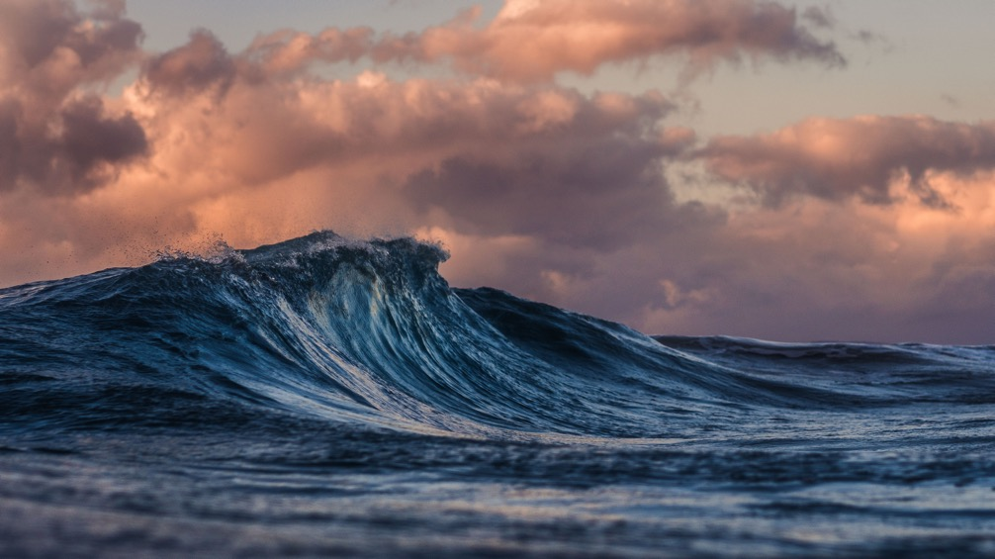
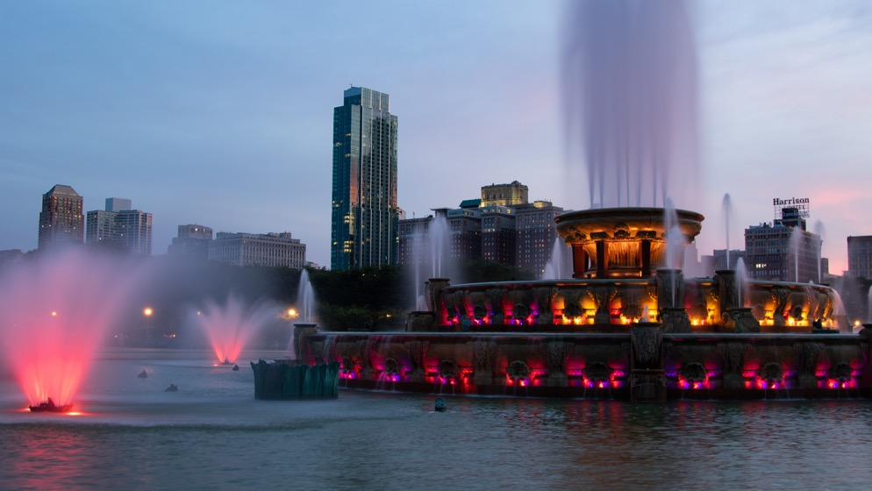
The less water you use, the less runoff and wastewater that eventually end up in the ocean.
SOLUTIONS
CONSERVE WATER

Slide 21

04
CONCLUSION

Slide 22

CONCLUSION
PROTECTING THE PLANET STARTS WITH YOU
Global warming is the major challenge for our global society. There is very little doubt that global warming will change our climate in the next century.

Slide 23
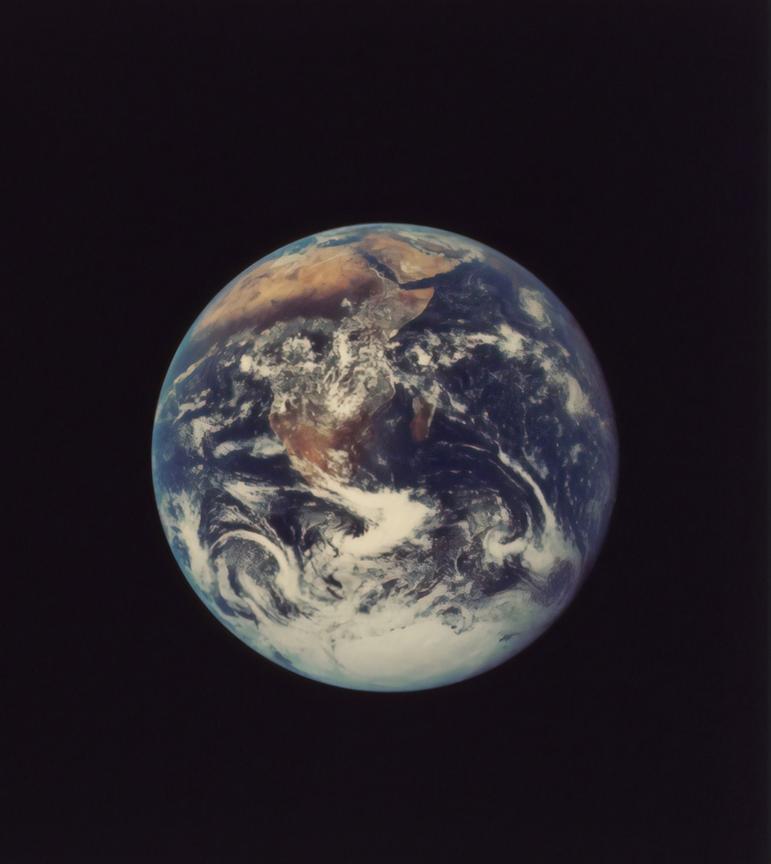
CONCLUSION
PROTECTING THE PLANET STARTS WITH YOU
There must be an international political solution.
Funding for developing cheap and clean energy production must be increased
We must not pin all our hopes on global politics and clean energy technology, so we must prepare for the worst and adapt

Slide 24
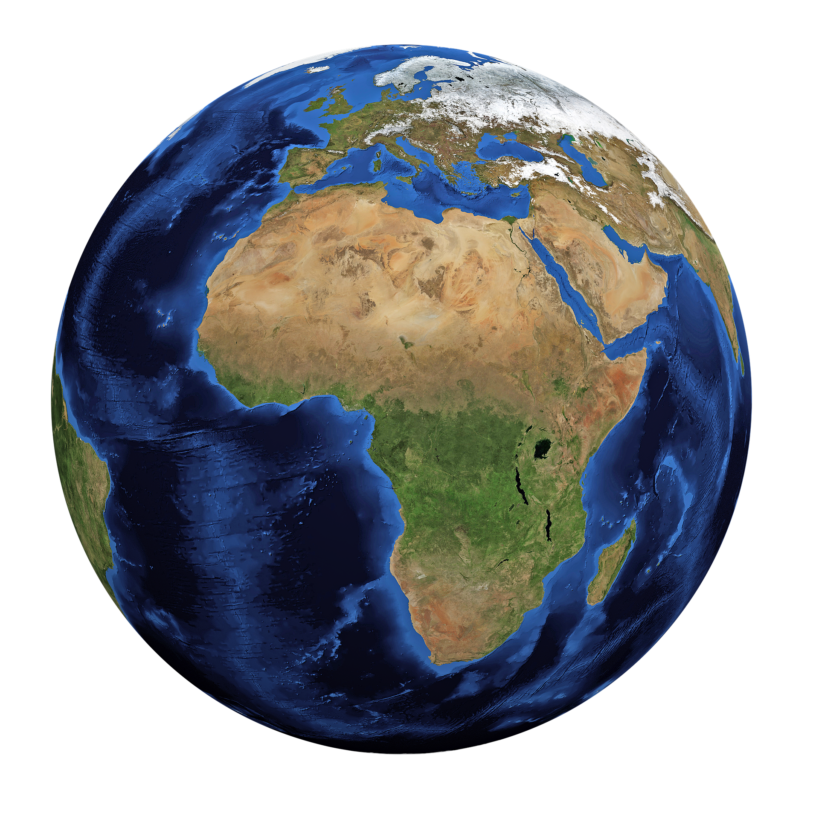
COVER PAGE 2
THERE IS NO PLANET B

Slide 25















Ecology Editable Icon Set
Icons by Peecheey

Slide 26
Editable Icon Set
Things you can do:
Resize the icon
Change fill color and opacity
Add stroke
Add dash lines

Slide 27

This template was made specially for you by
Big shout-out to the great people that provided us with the free resources of this presentation:
STOCK IMAGES
unsplash.com
pixabay.com
INFO SOURCES
Wikipedia.org
oceanservice.noaa.gov
conservation.org
ICONS
Ecology Editable Icon Set
Peecheey
Thick Icons
Nice and Serious
Visit slidecoretemplates.com to get more editable premium presentations for free

