Slide 1
Instructions for use
Just being extra careful, you don’t really need them ;)
EDIT AS GOOGLE SLIDES
Make sure to be logged in your Google account.
Click the “Edit in Google Slides “ button below the template preview.
Get the editable template in your drive and start editing as Frank Sinatra or Fleetwood Mac would: in your own way.
EDIT AS A POWER POINT
Click the “Edit in Power Point” button below the template preview.
A .pptx file will be downloaded in your computer.
Open it as a Power Point and start rocking your presentation.
You are free to use this presentation under Creative Commons Attribution License. But please, either keep the Credits Slide or mention Slidecore and other used sources in the slide footer. Help to keep the free resources environment a better place :)

Slide 2

Editable Poster template
Mininal and simple style to wow your audience
A free resource by Slidecore

Slide 3

MUSIC POSTER
TEMPLATE
BY SLIDECORE
BY SLIDECORE
NEW ALBUM RELEASE
OUT NOW

Slide 4
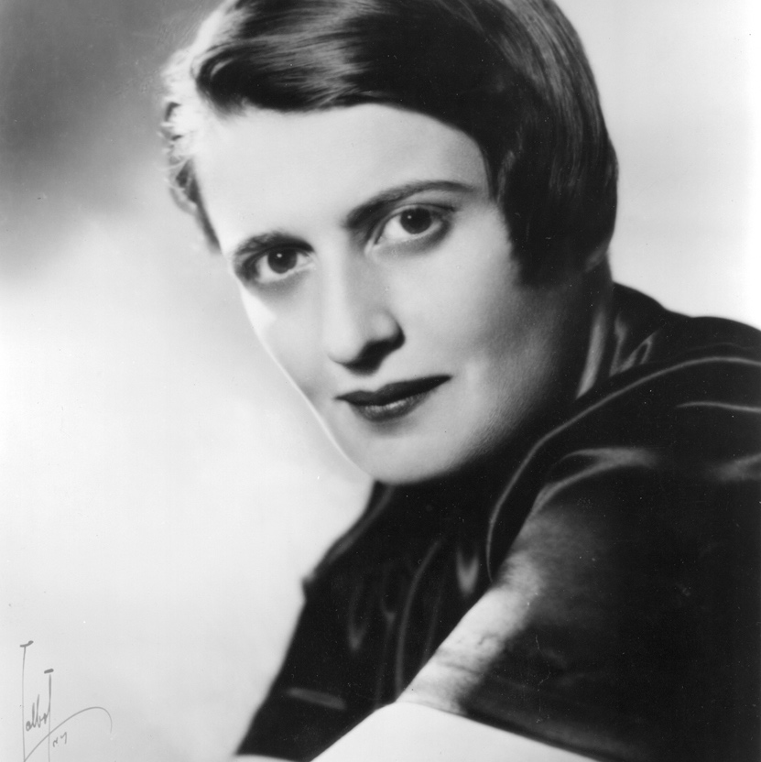
“
MOTIVATIONAL QUOTE
#1
The question isn’t who is going to let me; it’s who is going to stop me.
“
Ayn Rand
Writer and philosopher

Slide 5
Back to
School
Open date: 22 SEPT
Join us and meet the teachers!

Slide 6

Flower
Poster Template
Fresh and colorful
flower &plants inspired design
_ 10-13 NOV_

Slide 7

50%
SALE • SALE • SALE • SALE
LIMITED TIME ONLY
70%
UP TO
OFF
SATURDAY JUNE 12

Slide 8

Congratulations
Name here!
8
Party
invitation
When: 1st of September
Where: My house

Slide 9

#1
ART_
_FESTIVAL
_ 24-30 NOV
THE SCHOOL OF FINE ARTS THESIS EXHIBITION

Slide 10



NATURAL BEAUTY PRODUCTS
New Arrivals
20% OFF
In your first order

Slide 11

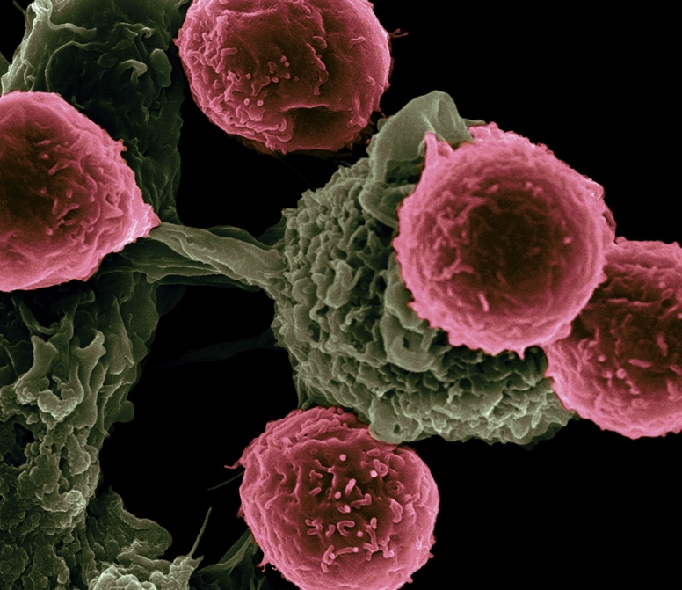


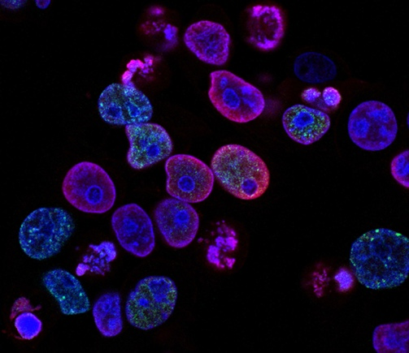
Scientific Conference
_ 10-13 NOV_
GENERAL AUDITORIUM
15:00 CEST

Slide 12

This template was made specially for you by
Visit slidecoretemplates.com to get more editable premium presentations for free
Big shout-out to the great people that provided us with the free resources of this presentation:
STOCK IMAGES
unsplash.com
pixabay.com
ICONS
Thick Icons
Nice and Serious

