Slide 1
DAILY
Planner
You can add your name here.

Slide 2
Notes.
I’ll be updating this template monthly (as I do with all my templates with calendars on them), so you will always have 12 months of planning ready to go. Remember to check slidesmania.com regularly to get your updated copy. Once you have it, you’ll only need to copy the new months and paste them onto your original copy of the planner.

Slide 3
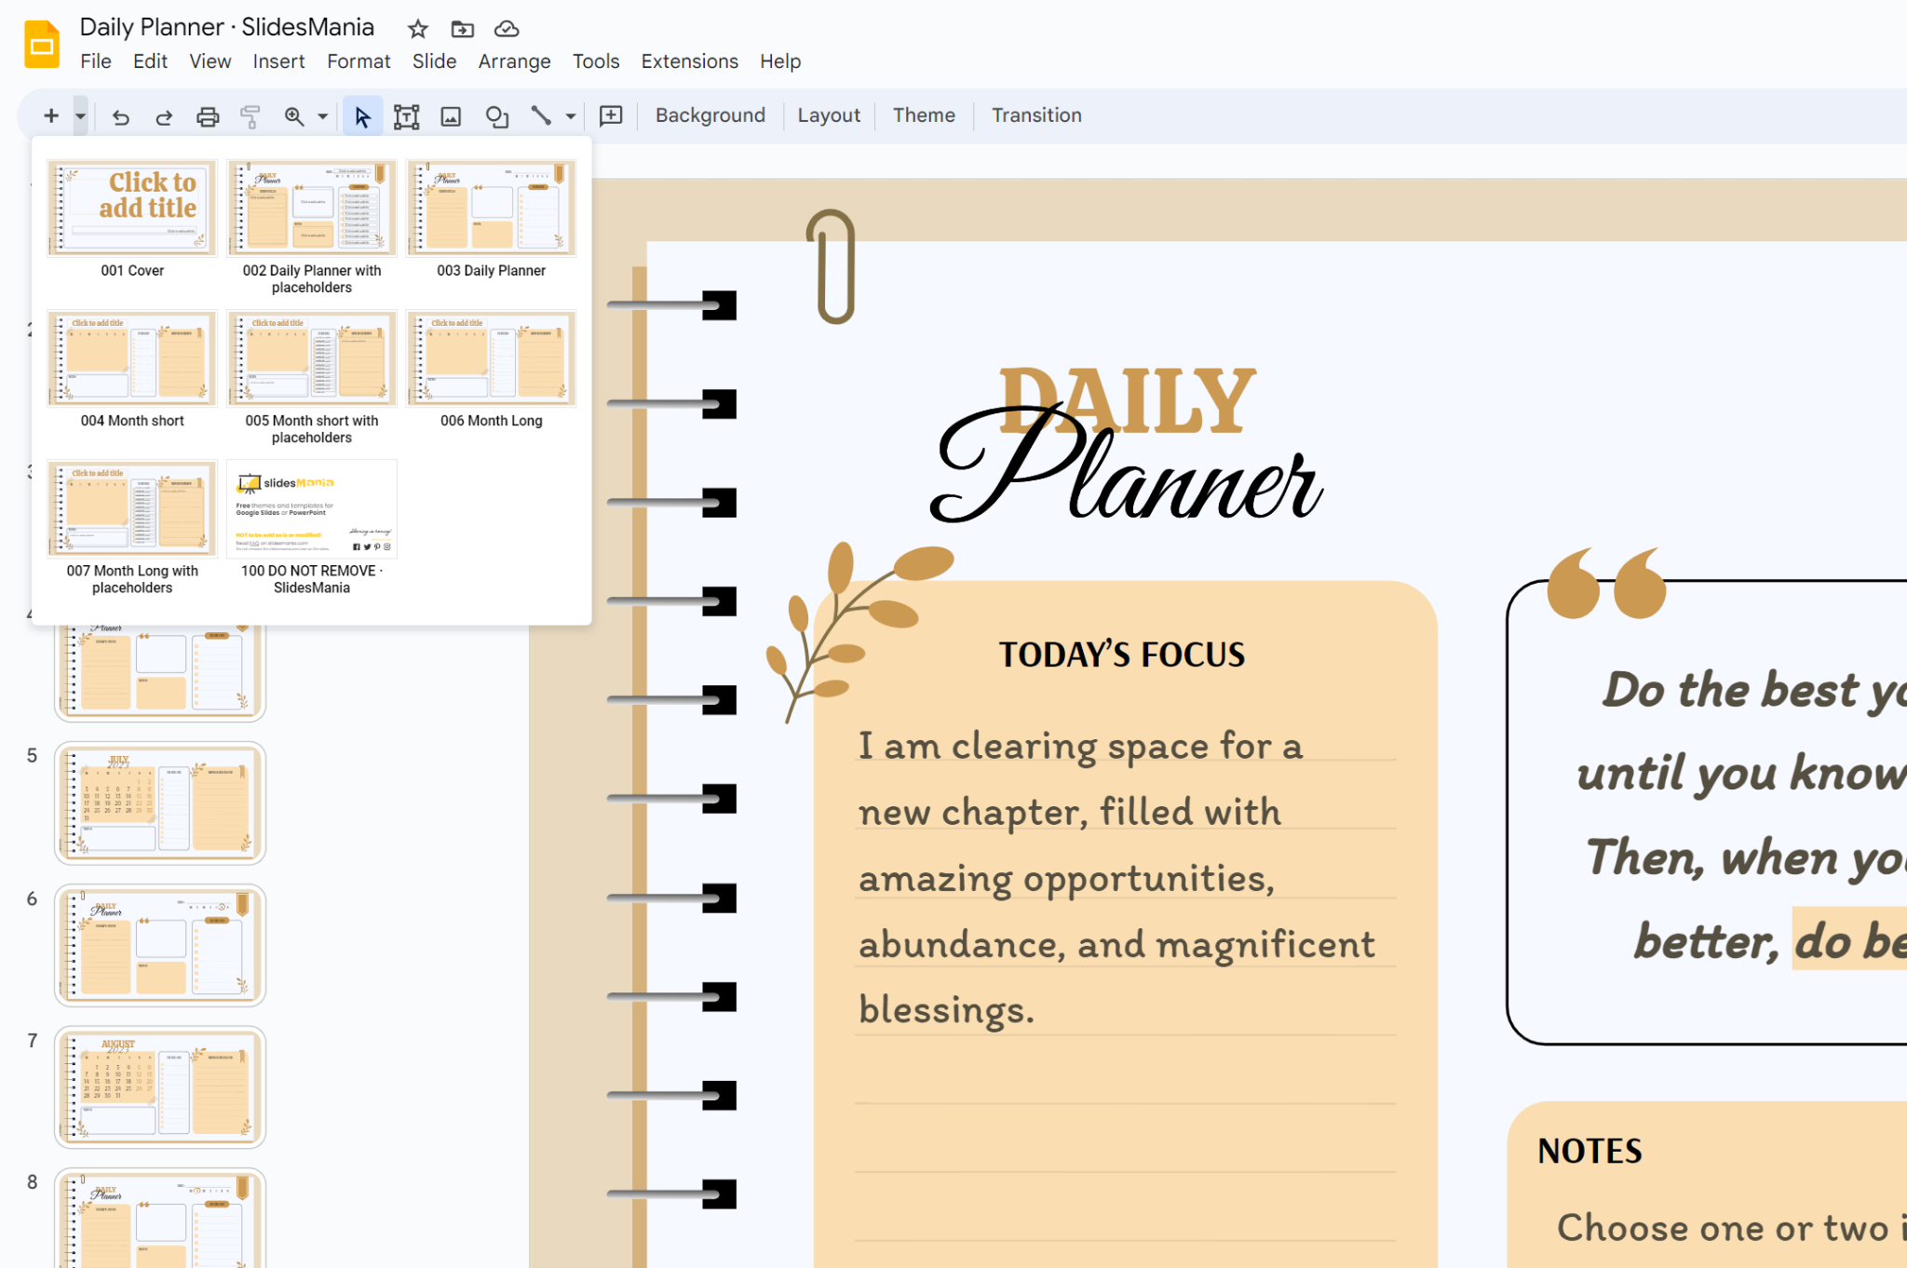
Instructions.
Duplicate an existing daily planner layout or click on + to add more daily planner slides to start planning your days.

Slide 4
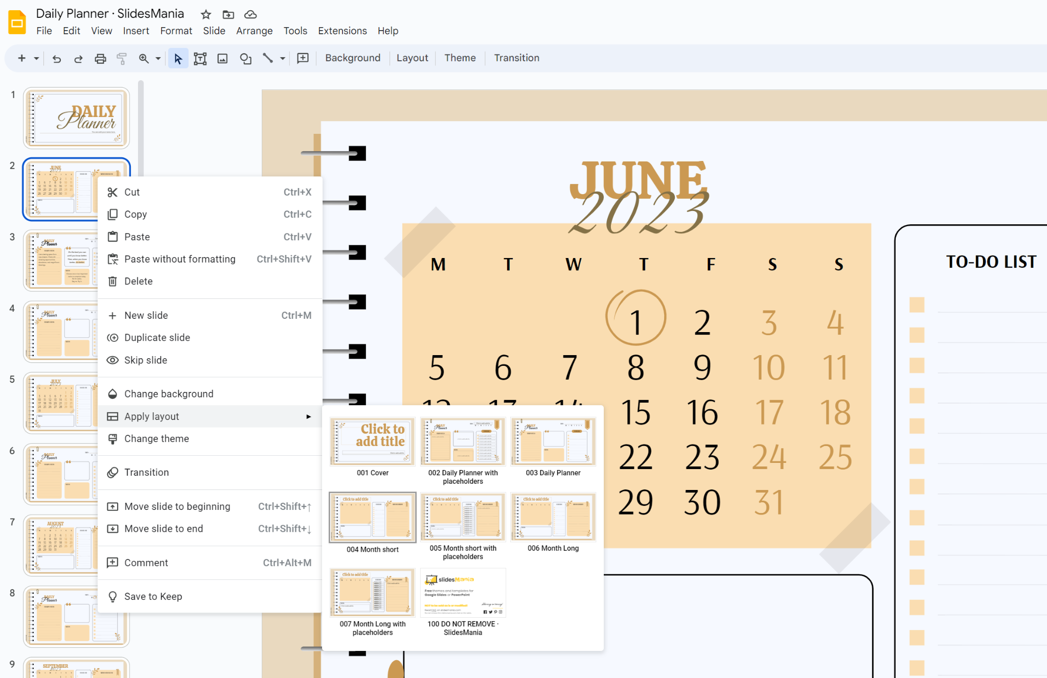
Instructions.
I’ve included layouts with and without placeholders for the month and daily views. If you want to choose one or the other, right click on the slide, select “Apply layout” and select the layout you want.

Slide 5
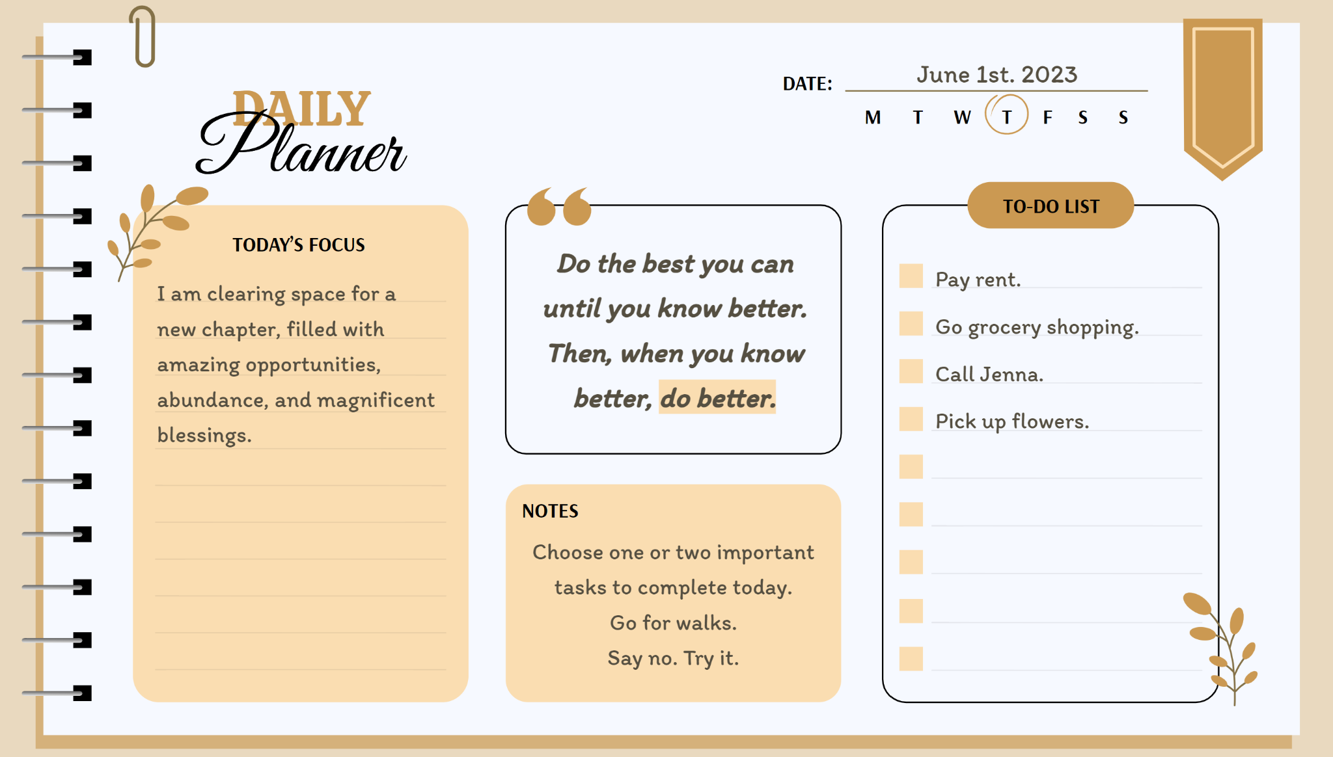

Instructions.
The little circle scribble is for you to copy / paste / move and mark the day of the week. Please note that if you click on + instead of duplicating slides, you’ll need to copy and paste it from an existing slide.

Slide 6
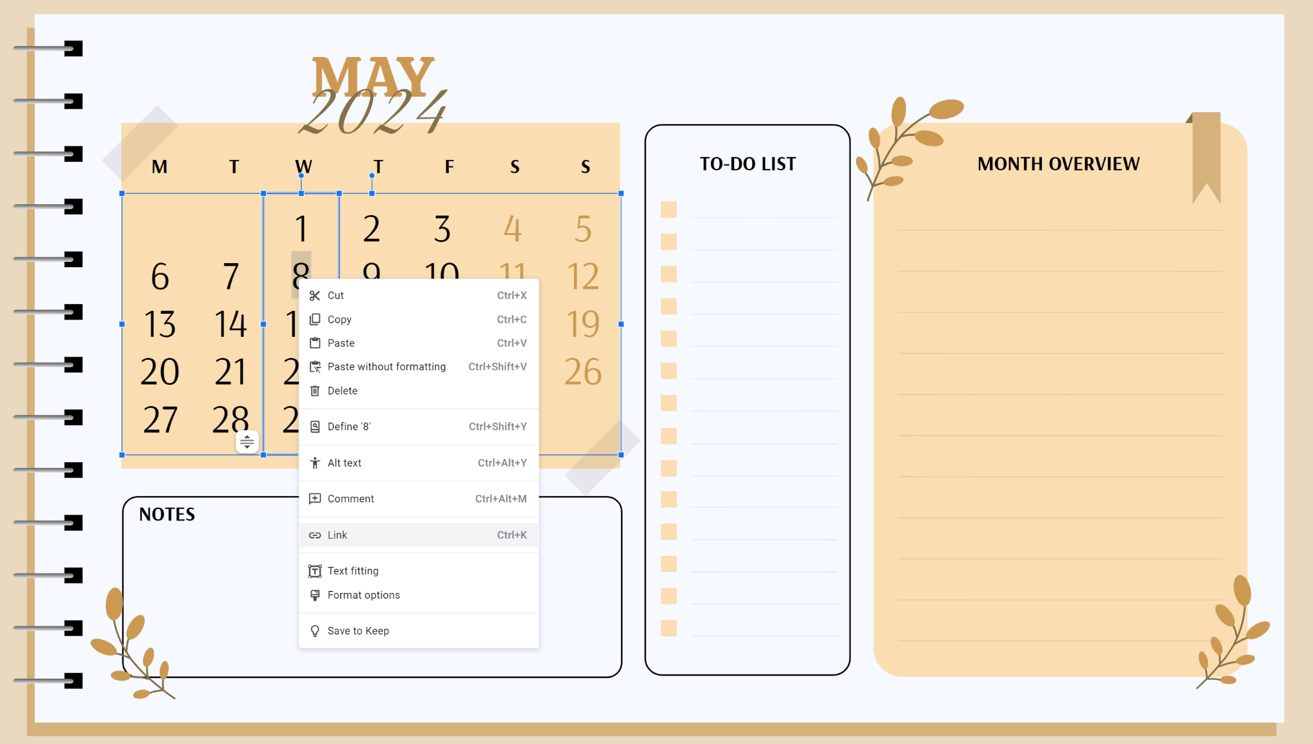
Extra tip.
You can link your slides by selecting the day of the month (double click it), once selected, right click it and select Link, then choose the slide you want to link the day to.

Slide 7
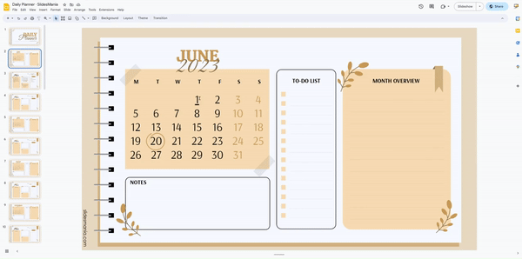
Linked slide.

Slide 8
JUNE
2023
5
12
19
26
6
13
20
27
7
14
21
28
1
8
15
22
29
2
9
16
23
30
3
10
17
24
31
4
11
18
25
Schedule meeting.
Go for a walk daily.
(5) Call John Smith.
(22) Julie’s B-day.
This is an example of the month layout with placeholders.

Slide 9
June 1st. 2023
Planner
Do the best you can until you know better. Then, when you know better, do better.
This is an example of the daily layout with placeholders.
I am clearing space for a new chapter, filled with amazing opportunities, abundance, and magnificent blessings.
Pay rent.
Go grocery shopping.
Call Jenna.
Pick up flowers.
Choose one or two important tasks to complete today.
Go for walks.
Say no. Try it.

Slide 10
JUNE
2023
5
12
19
26
6
13
20
27
7
14
21
28
1
8
15
22
29
2
9
16
23
30
3
10
17
24
31
4
11
18
25

Slide 12
JULY
2023
3
10
17
24
31
4
11
18
25
5
12
19
26
6
13
20
27
7
14
21
28
1
8
15
22
29
2
9
16
23
30

Slide 14
AUGUST
2023
7
14
21
28
1
8
15
22
29
2
9
16
23
30
3
10
17
24
31
4
11
18
25
5
12
19
26
6
13
20
27

Slide 16
SEPTEMBER
2023
4
11
18
25
5
12
19
26
6
13
20
27
7
14
21
28
1
8
15
22
29
2
9
16
23
30
3
10
17
24

Slide 17
Planner

Slide 18
OCTOBER
2023
2
9
16
23
30
3
10
17
24
31
4
11
18
25
5
12
19
26
6
13
20
27
7
14
21
28
1
8
15
22
29

Slide 19
Planner

Slide 20
NOVEMBER
2023
6
13
20
27
7
14
21
28
1
8
15
22
29
2
9
16
23
30
3
10
17
24
4
11
18
25
5
12
19
26

Slide 21
Planner

Slide 22
DECEMBER
2023
4
11
18
25
5
12
19
26
6
13
20
27
7
14
21
28
1
8
15
22
29
2
9
16
23
30
3
10
17
24
31

Slide 23
Planner

Slide 24
JANUARY
2024
1
8
15
22
29
2
9
16
23
30
3
10
17
24
31
4
11
18
25
5
12
19
26
6
13
20
27
7
14
21
28

Slide 25
Planner

Slide 26
FEBRUARY
2024
5
12
19
26
6
13
20
27
7
14
21
28
1
8
15
22
29
2
9
16
23
3
10
17
24
4
11
18
25

Slide 27
Planner

Slide 28
MARCH
2024
4
11
18
25
5
12
19
26
6
13
20
27
7
14
21
28
1
8
15
22
29
2
9
16
23
30
3
10
17
24
31

Slide 29
Planner

Slide 30
APRIL
2024
1
8
15
22
29
2
9
16
23
30
3
10
17
24
4
11
18
25
5
12
19
26
6
13
20
27
7
14
21
28

Slide 31
Planner

Slide 32
MAY
2024
6
13
20
27
7
14
21
28
1
8
15
22
29
2
9
16
23
30
3
10
17
24
31
4
11
18
25
5
12
19
26

Slide 33
Planner

Slide 34
Credits.
Daily Planner Template made with love by SlidesMania
Fonts used in this planner: Calistoga, Itim and Great Vibes.
I’ve used theme colors, so if you wish to change them, click on Slide > Edit theme, click on Colors, and change the Theme Colors.

