Slide 1


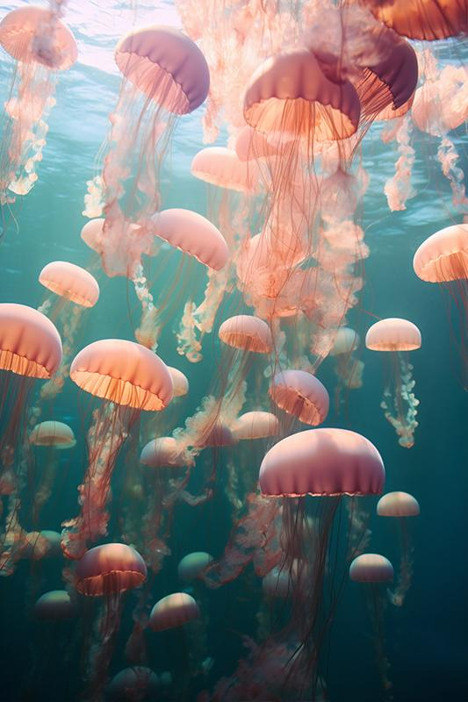

Submerged Sea Aesthetics Portfolio
Here is where your presentation begins

Slide 2
Contents of this template
You can delete this slide when you’re done editing the presentation
Fonts | To view this template correctly in PowerPoint, download and install the fonts we used
Used and alternative resources | An assortment of graphic resources that are suitable for use in this presentation
Thanks slide | You must keep it so that proper credits for our design are given
Colors | All the colors used in this presentation
Icons and infographic resources | These can be used in the template, and their size and color can be edited
Editable presentation theme | You can edit the master slides easily. For more info, click here
For more info:
Slidesgo | Blog | FAQs
You can visit our sister projects:
Freepik | Flaticon | Storyset | Wepik | Videvo

Slide 3
Table of contents
01
02
03
04
05
06
Introduction
Resume
Cover letter
My work
Previous projects
Other

Slide 4
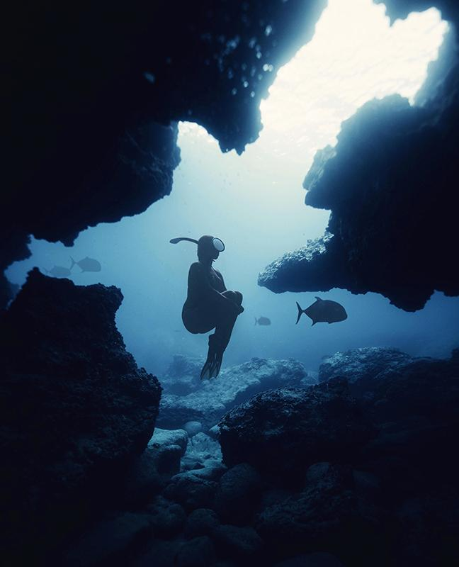

Contents of a portfolio
A portfolio is composed of three main elements:
Content: this includes the actual work you want to showcase and can be anything from writing samples to photographs or videos
Design: the design should reflect your personality and style while remaining professional. It should also make it easy to navigate the portfolio
Summary: a brief summary at the beginning of the portfolio will help provide an introduction to your work and give visitors a better understanding of yourself and what you have created

Slide 5


Things to include in your portfolio
Work samples
Work samples can be anything from graphics to writing, videos or websites that showcase your design, development or the writing skills you have
Skills
Skills and qualifications are the credentials you have that show employers your experience and abilities in various areas that are related to your field
Professional narrative
An overview of past project successes or other accomplishments as well as a summary of relevant knowledge and skills gained over the course of your career

Slide 6
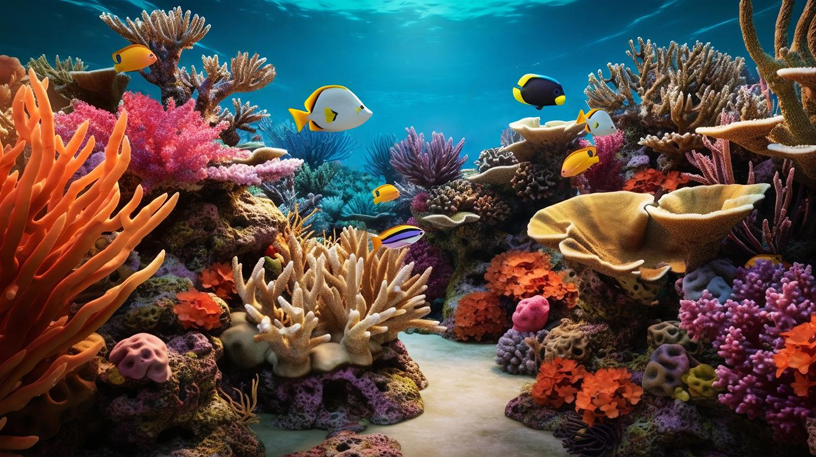
02
Resume

Slide 7

Jane Doe
“I always strive for excellence. I believe in the power of collaboration, and I love to build meaningful relationships with clients throughout the creative process”
+34 654 321 432 | jane@freepik.com
Experience
Education
Now-20xx
Marketing technician
Marketing agency
20xx- 20xx
Marketing degree
Communication
Writing
Leadership
Tracking and analyzing data to optimize campaigns
Coordinating promotional activities
20xx-20xx
Content creator
Creation studio
20xx- 20xx
Master’s in Graphic Design
Graphic Design
Creativity
Curiosity
Creating videos, podcasts, graphics and infographics
Developing unique and engaging content
20xx-20xx
Team leader
Creation studio
20xx- 20xx
Master’s in Content Creation
Creativity
Adaptability
Management
Motivating and leading team members in tasks
Setting clear objectives and goals for the team

Slide 8
Previous projects
Marketing
Content creation projects
“I was responsible for managing campaigns across all major social media platforms; creating, curating and optimizing content for maximum engagement; analyzing data to gain insights into customer behavior and maintaining a strong relationship with customers”
“I have participated throughout my career in crafting SEO-friendly copy, creating promotional videos, designing newsletters and brochures and more. My work has been well received with several pieces being featured in prominent and important publications”

Slide 9
Cover letter
Slidesgo
+91 651 736 904
company@slidesgo.com
Welcome to my portfolio!
I'm [name], a highly creative and motivated individual, with a passion for [field of expertise]. My portfolio is filled with unique and inspiring content, which showcases my skills in the field
Here you will find everything ranging from writing samples, photographs, videos and more. I strive for excellence in all that I do, and this portfolio serves as a testament to my capabilities and accomplishments
Have a look around, get to know me better, and don't hesitate to reach out if you have any questions or would like to collaborate with me!
Sincerely,
Jane Doe
+91 620 421 838 | jane@freepik.com

Slide 10
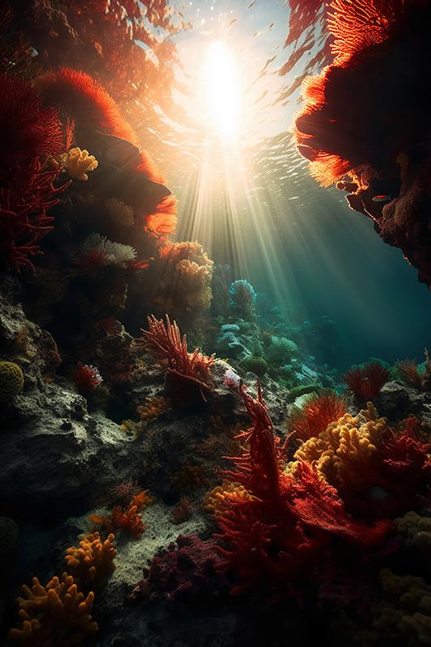
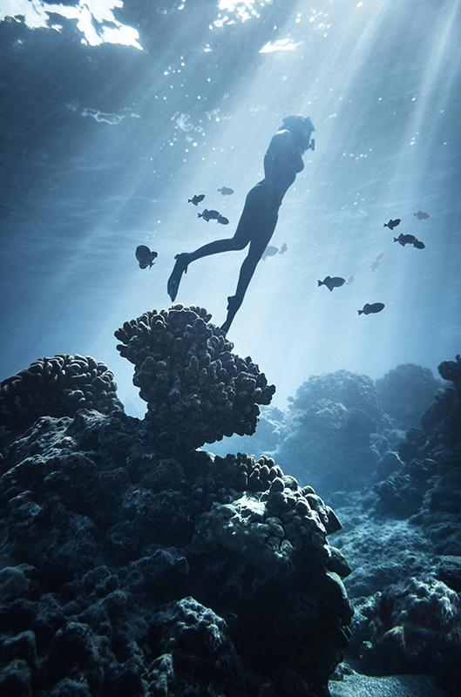
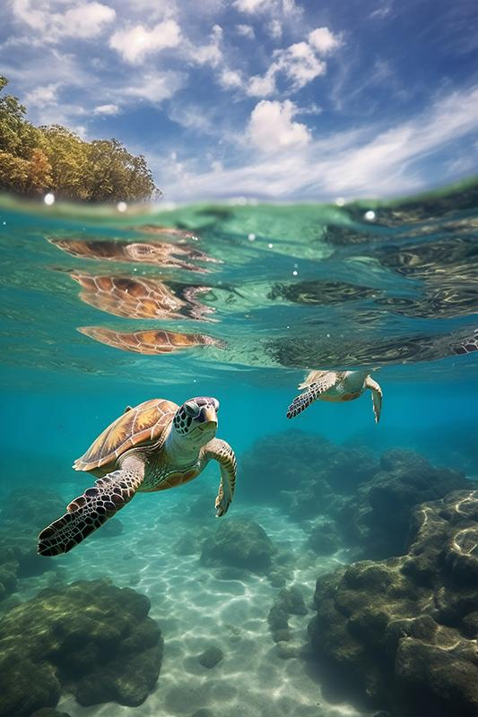
Photo showcase
This photo showcase is a collection of stunning images, each capturing a unique moment in time. Let them inspire you!

Slide 11
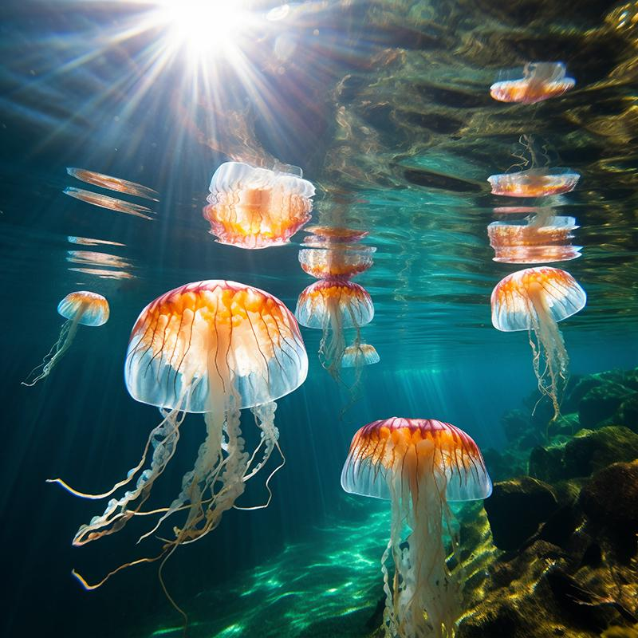
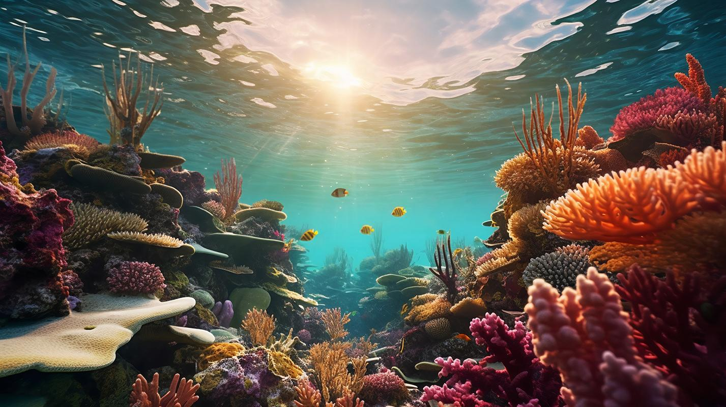
My best work
“As an artist, it's my job to capture the beauty, joy and emotion of the world around me. I strive to create something unique in each piece, combining technique and detail”

Slide 12

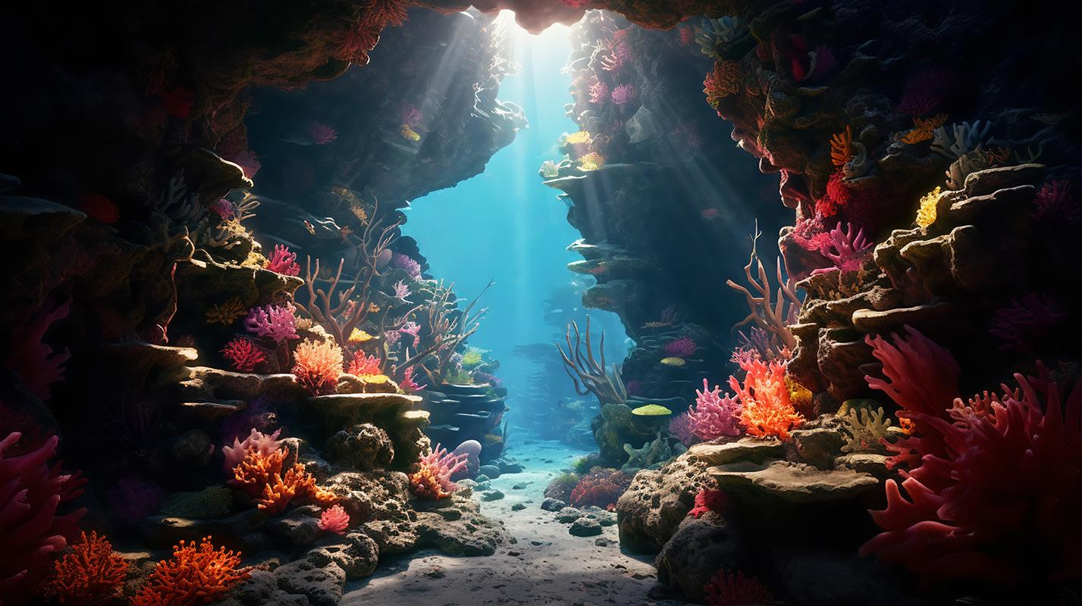
"Creativity is the key to unlocking your true potential"

Slide 13
What people say about me
Employer 1
Employer 2
“I have been impressed by the quality, attention to detail and creative approach brought to every project made”
“Projects and campaigns are always taken to another level with ideas that come from this person. Digital marketing and content creation experience is quite evident”
Employer 3
Employer 4
“This person has a strong technical understanding in order to develop successful strategies. Highly recommended for any kind of project or task”
“Content creation is top-notch, with engaging yet professional writing style tailored to different audiences while keeping a steady brand message”

Slide 14
My skills and qualifications
Leadership
Problem-solving
Communications
“I possess leadership abilities that have been sharpened through past roles where I was responsible for the teams”
“My problem-solving capabilities have enabled me to solve difficult issues in the past, using creative and innovative solutions”
“With excellent verbal and written skills, I can effectively convey complex messages to a variety of diverse audiences"
Organization
Technical skill
Interpersonal skill
“My proactivity allows me to plan ahead and prioritize tasks according to objectives and different deadlines"
“I am knowledgeable in several technical areas such as programming languages that support my ambition in my field"
“Teamwork is one of the essential part of my daily job, and I have acquired a high sensitivity towards different cultures"

Slide 15


200
The number of projects I have worked on so far

Slide 16
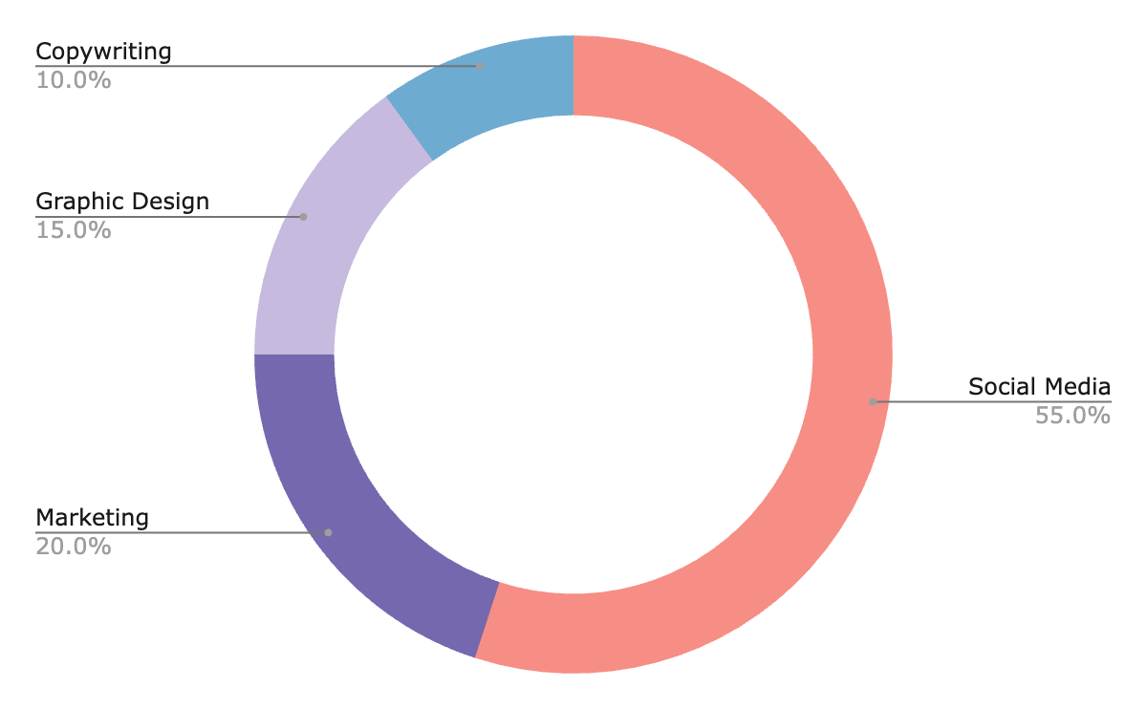
A chart of the areas I work in
Social media
Instagram, Twitter
Marketing
Promotion
Graphic design
Illustrations, vectors
Copywriting
SEO copywriting
Follow the link in the graph to modify its data and then paste the new one here. For more info, click here

Slide 17
Table
Project title | Skills | Date | Ref | Category
Project 1 | Graphic design | Jan 20XX | [Link or reference] | Print
Project 2 | Copywriting | Feb 20XX | [Link or reference] | Content
Project 3 | Video production | Mar 20XX | [Link or reference] | Motion
Project 4 | 3D modeling | Apr 20XX | [Link or reference] | 3D
Project 5 | UI/UX design | May 20XX | [Link or reference] | Web
Project 6 | HTML/CSS | Jun 20XX | [Link or reference] | Web

Slide 18
How did I achieve success?
Step 1
Step 2
Step 3
Step 4
Identifying objectives
Research and preparation
Developing strategies
Plans of action
Step 5
Step 6
Step 7
Step 8
Measuring progress
Continuous improvement
Analyzing outcomes
Focusing on the future

Slide 19
Roadmap of my future projects
Initiative | Objective | Jan | Feb | Mar | Apr | May | Jun | Jul | Aug | Sep | Oct | Nov | Dec
Developing a digital marketing strategy | Reach potential customers through well-crafted campaigns
Creating engaging content | Craft content that engages and inspires the target audience
Optimizing search rankings | Optimize for better and more visibility with SEO
Leveraging social media platforms | Connect with customers and boost brand awareness
Analyzing user habits | Gather user data to optimize design for more engagement
Executing email campaigns | Send emails to subscribers to convert leads into sales

Slide 20
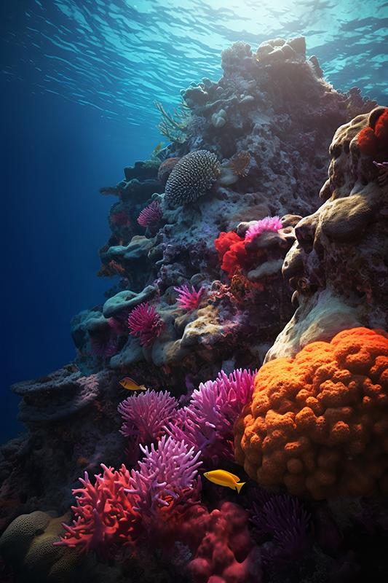
Thanks!
Do you have any questions?
youremail@freepik.com
+34 654 321 432
yourwebsite.com
Please keep this slide for attribution

Slide 21
Icon pack

Slide 22
Alternative resources
Here’s an assortment of alternative resources whose style fits that of this template:
Photos
Underwater landscape I
Underwater landscape II
Scuba diving I
Scuba diving II
Scuba diving III
Water picture
Water picture II
Woman freediving with flippers underwater I
Woman freediving with flippers underwater II
Woman freediving with flippers underwater III
Woman freediving with flippers underwater IV
Woman freediving with flippers underwater V
Woman freediving with flippers underwater VI
Women freediving with flippers underwater VII
View of fish swimming underwater

Slide 23
Resources
Did you like the resources in this template? Get them on these websites:
Photos
Underwater landscape I
Underwater landscape II
Underwater landscape III
Underwater landscape IV
Underwater landscape V
Woman posing underwater
Scuba diving
Swarm of jellyfish in the ocean
View of majestic jellyfish swarm in the ocean
Turtles swimming in ocean
Full shot swimming with fish
Full shot swimmer with rocks
Icons
Ocean Icon Pack | Lineal color
Vectors
Water splash collection in realistic style without background
Gradient grainy shapes collection
Monochrome realistic liquid effect background
Abstract colorful background with shapes

Slide 24
Instructions for use
If you have a free account, in order to use this template, you must credit Slidesgo by keeping the Thanks slide. Please refer to the next slide to read the instructions for premium users.
As a Free user, you are allowed to:
Modify this template.
Use it for both personal and commercial projects.
You are not allowed to:
Sublicense, sell or rent any of Slidesgo Content (or a modified version of Slidesgo Content).
Distribute Slidesgo Content unless it has been expressly authorized by Slidesgo.
Include Slidesgo Content in an online or offline database or file.
Offer Slidesgo templates (or modified versions of Slidesgo templates) for download.
Acquire the copyright of Slidesgo Content.
For more information about editing slides, please read our FAQs or visit our blog:
https://slidesgo.com/faqs and https://slidesgo.com/slidesgo-school

Slide 25
Instructions for use (premium users)
As a Premium user, you can use this template without attributing Slidesgo or keeping the Thanks slide.
You are allowed to:
Modify this template.
Use it for both personal and commercial purposes.
Hide or delete the “Thanks” slide and the mention to Slidesgo in the credits.
Share this template in an editable format with people who are not part of your team.
You are not allowed to:
Sublicense, sell or rent this Slidesgo Template (or a modified version of this Slidesgo Template).
Distribute this Slidesgo Template (or a modified version of this Slidesgo Template) or include it in a database or in any other product or service that offers downloadable images, icons or presentations that may be subject to distribution or resale.
Use any of the elements that are part of this Slidesgo Template in an isolated and separated way from this Template.
Register any of the elements that are part of this template as a trademark or logo, or register it as a work in an intellectual property registry or similar.
For more information about editing slides, please read our FAQs or visit our blog:
https://slidesgo.com/faqs and https://slidesgo.com/slidesgo-school

Slide 26
Fonts & colors used
This presentation has been made using the following fonts:
Gilda Display
(https://fonts.google.com/specimen/Gilda+Display)
Didact Gothic
(https://fonts.google.com/specimen/Didact+Gothic)
#191919
#f3eeea
#4295a3
#6dabd1
#a8cfd4
#7568ae
#d66226
#f68e85
#f9b866
#c6bade

Slide 27





Storyset
Create your Story with our illustrated concepts. Choose the style you like the most, edit its colors, pick the background and layers you want to show and bring them to life with the animator panel! It will boost your presentation. Check out how it works.
Pana
Amico
Bro
Rafiki
Cuate

Slide 28
Use our editable graphic resources...
You can easily resize these resources without losing quality. To change the color, just ungroup the resource and click on the object you want to change. Then, click on the paint bucket and select the color you want. Group the resource again when you’re done. You can also look for more infographics on Slidesgo.

Slide 31
JANUARY
FEBRUARY
MARCH
APRIL
MAY
JUNE
PHASE 1
Task 1
Task 2
PHASE 2
Task 1
Task 2
JANUARY
FEBRUARY
MARCH
APRIL
PHASE 1
Task 1
Task 2

Slide 34
...and our sets of editable icons
You can resize these icons without losing quality.
You can change the stroke and fill color; just select the icon and click on the paint bucket/pen.
In Google Slides, you can also use Flaticon’s extension, allowing you to customize and add even more icons.

Slide 35
Educational Icons
Medical Icons

Slide 36
Business Icons
Teamwork Icons

Slide 37
Help & Support Icons
Avatar Icons

Slide 38
Creative Process Icons
Performing Arts Icons

Slide 39
Nature Icons

Slide 40
SEO & Marketing Icons

Slide 41


