Slide 1








WRITE A SUBTITLE
Trick or Treat!

Slide 2


How to Use This Presentation
GOOGLE SLIDES
POWERPOINT
CANVA
Click on the "Google Slides" button below this presentation preview. Make sure to sign in to your Google account. Click on "Make a copy." Start editing your presentation.
Alternative: Click on the "Share" button on the top right corner in Canva and click on "More" at the bottom of the menu. Enter "Google Drive" in the search bar and click on the GDrive icon to add this design as a Google slide in your GDrive.
Click on the "PowerPoint" button below this presentation preview. Start editing your presentation.
Alternative: From Canva template file, Click on the "Share" button on the top right corner in Canva and click on "More" at the bottom of the menu. Enter "PowerPoint" in the search bar and click on the PowerPoint icon to download.
Click on the "Canva" button under this presentation preview. Start editing your presentation. You need to sign in to your Canva account.

Slide 3







Table of Contents
01
02
INTRODUCTION
OUR PROJECTS
Write a description
Write a description
03
04
STRATEGIES
BUDGET
Write a description
Write a description

Slide 4







Introduction
01
Elaborate on what you want to discuss.

Slide 5





Welcome To Presentation
  I'm Rain, and I'll be sharing with you my beautiful ideas. Follow me at @reallygreatsite to learn more.

Slide 6







Write your topic or idea
ADD A MAIN POINT
ADD A MAIN POINT
ADD A MAIN POINT
Elaborate on what
you want to discuss.
Elaborate on what
you want to discuss.
Elaborate on what
you want to discuss.

Slide 7






Write your topic or idea
01
02
03
Elaborate on what you want to discuss
Elaborate on what you want to discuss
Elaborate on what you want to discuss

Slide 8






Our Projects
02
Elaborate on what you want to discuss.

Slide 9




Recent Trends
01
WRITE ABOUT TOPIC ONE
Elaborate on what you want to discuss.
02
WRITE ABOUT TOPIC TWO
Elaborate on what you want to discuss.
03
WRITE ABOUT TOPIC THREE
Elaborate on what you want to discuss.

Slide 10







Gallery Image
What can you say about your projects? Share it here!

Slide 11









Marketing Strategy
Elaborate on what you want to discuss.
Elaborate on what
you want to discuss.
SOCIAL MEDIA
MARKETING
VIDEO
MARKETING
WEBSITE
MARKETING
CONTENT
MARKETING
Elaborate on what you want to discuss.
Elaborate on what you want to discuss.

Slide 12







Timeline Page
ADD A MAIN POINT
Elaborate on what you want to discuss.
2020
2021
ADD A MAIN POINT
Elaborate on what you want to discuss.

Slide 13









ADD A MAIN POINT
Elaborate on what you want to discuss.
2022
2023
ADD A MAIN POINT
Elaborate on what
you want to discuss.

Slide 14






CLAIRE
Title or Position
SALLY
Title or Position
New Team Members
JOHN
Title or Position

Slide 15









A picture is worth
a thousand words

Slide 16







Strategies
03
Elaborate on what you want to discuss.

Slide 17


Competitor analysis
Criteria | Criteria | Criteria | Criteria | Criteria | Criteria | Criteria
 | REVENUE | PROFIT | MARKET SHARE | MAIN ACTIVITY | PRODUCT QUALITY | PRICE
Competitor 1
Competitor 2
Competitor 3
Competitor 4

Slide 18


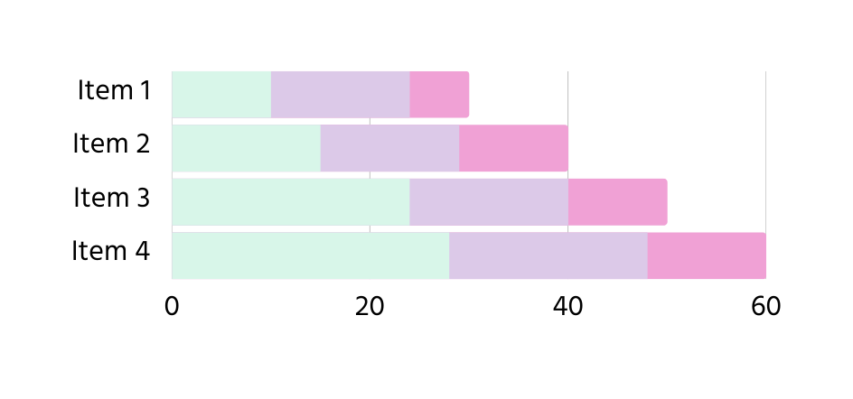


Market Research
90%
Elaborate on the featured statistic.
3.5+
Elaborate on the featured statistic.
Elaborate on the featured statistic.

Slide 19








Market Research
EXAMPLE
Presentations are communication tools
EXAMPLE
Presentations are communication tools
EXAMPLE
Presentations are communication tools
EXAMPLE
Presentations are communication tools

Slide 20








123,456,789
Elaborate on the featured statistic.

Slide 21








Contact Us
hello@reallygreatsite.com
@reallygreatsite
reallygreatsite.com
123 Anywhere St., Any City

Slide 22






Thank you
Write a closing statement or call-to-action here.

Slide 23































Resource
Page
USE THESE DESIGN RESOURCES IN YOUR CANVA PRESENTATION.
This presentation template
uses the following free fonts:
Titles:Stella
Headers: Hind Guntur
Body Copy: Hind Guntur
You can find these fonts
online too. Happy designing!
Don't forget to delete this
page before presenting.

Slide 24















































Slide 25




Credits
THIS PRESENTATION TEMPLATE IS FREE FOR EVERYONE TO USE THANKS TO THE FOLLOWING:
Happy designing!
SLIDESCARNIVAL
for the presentation template
PEXELS
for the photos

