Slide 1
WARNING
YELLOW TAPE
CRIME SCENE INVESTIGATION FOR COLLEGE
INFOGRAPHICS
Here is where your presentation begins

Slide 2
Warning Yellow Tape Infographics
This template contains an assortment of complementary infographic resources for the Warning Yellow Tape Crime Scene Investigation for College by Slidesgo
These infographics are adapted to the style of the aforementioned presentation, so you can insert them easily and have them completely integrated at once. You just need to do the following:
  Select the element that you want to copy
  Right-click and choose “Copy”
  Go to the slide where you want the element to appear
  Right-click and choose “Paste”

Slide 3
Warning Yellow Tape Infographics
1 | Mercury | Mercury is the closest planet to the Sun and the smallest one in the Solar System
2 | Venus | Venus has a beautiful name and is the second planet from the Sun. It’s terribly hot
3 | Earth | Earth is the third planet from the Sun and the only one that harbors life in the Solar System
4 | Mars | Despite being red, Mars is actually a cold place. It’s full of iron oxide dust, which gives the planet its reddish cast
5 | Jupiter | Jupiter is a gas giant and the biggest planet in the Solar System. It’s the fourth-brightest object in the night sky

Slide 4
Warning Yellow Tape Infographics
Mercury
Mars
Mercury is the closest planet to the Sun
Mars is actually a very cold place
Four points cycle
Jupiter
Neptune
Jupiter is the biggest planet of them all
Neptune is far away from the Sun

Slide 5
Warning Yellow Tape Infographics
25 K
+325
150,000
375 km
Mercury is the closest planet to the Sun
Venus is the second planet from the Sun
Jupiter is the biggest planet of them all
Saturn is composed of hydrogen and helium
7 / 10
Neptune is the farthest planet from the Sun. It’s also the fourth-largest planet by diameter in the Solar System

Slide 6
Warning Yellow Tape Infographics
1
2
3
4
5
Mercury
Venus
Mars
Jupiter
Saturn
Mercury is the closest planet to the Sun
Venus is the second planet from the Sun
Despite being red, Mars is a cold place
Jupiter is the biggest planet of them all
Neptune is a planet far away from Earth

Slide 7
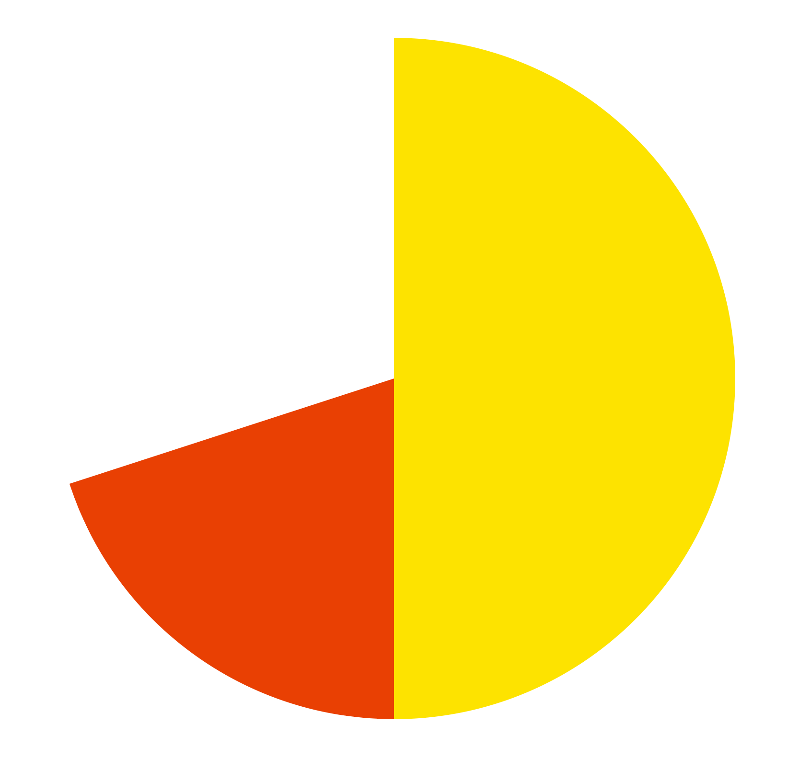
Warning Yellow Tape Infographics
50%
Mercury
Mercury is a small planet
20%
Venus
Venus has a beautiful name
30%
Jupiter
Jupiter is a very big planet
Follow the link in the graph to modify its data and then paste the new one here. For more info, click here

Slide 8
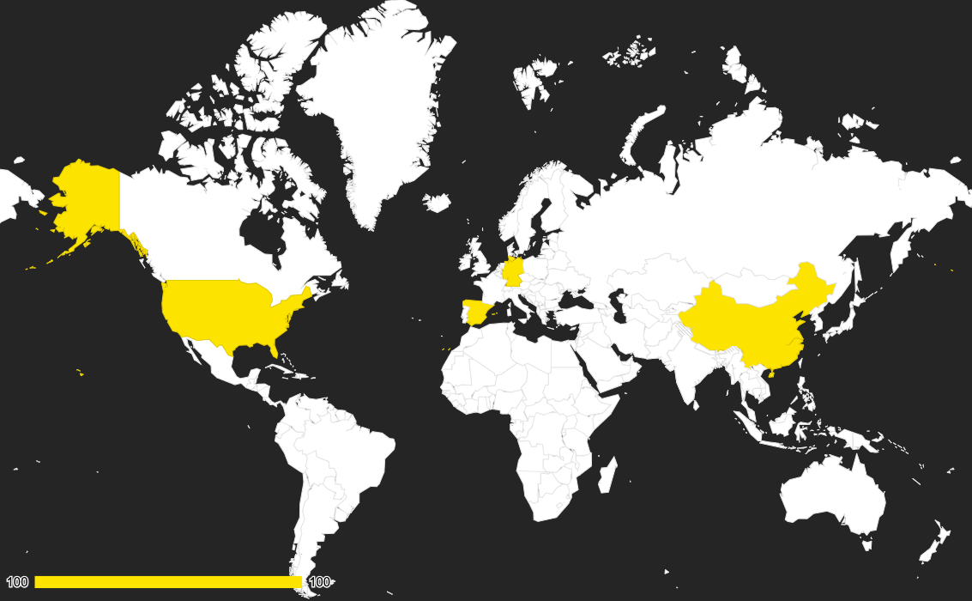
Warning Yellow Tape Infographics
Usa
Spain
Mercury is a very small planet
Venus has a beautiful name
Germany
China
Jupiter is a very big planet
Saturn is a gas giant with rings
Follow the link in the graph to modify its data and then paste the new one here. For more info, click here

Slide 9
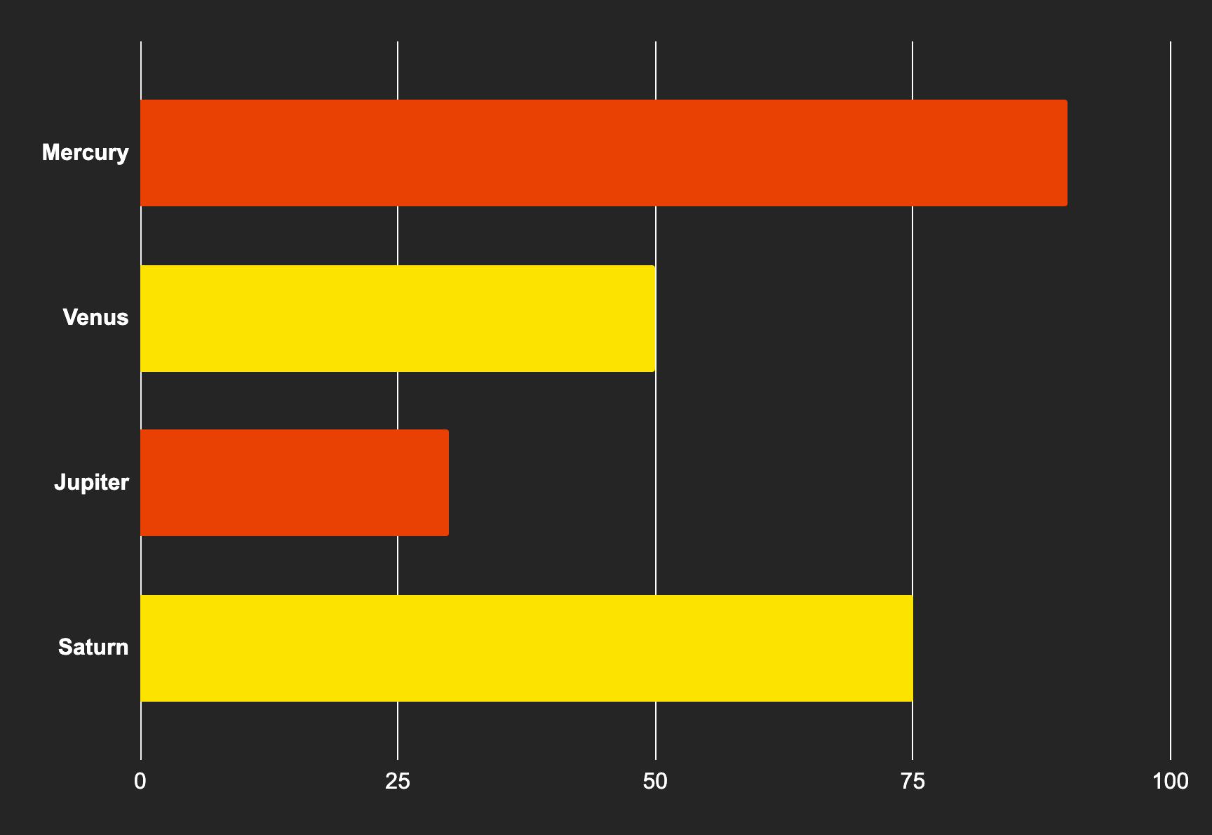
Warning Yellow Tape Infographics
90%
50%
Mercury
Venus
Mercury is a small planet
Venus is a beautiful planet
30%
75%
Jupiter
Saturn
Jupiter is a very big planet
Saturn is a gas giant with rings
Follow the link in the graph to modify its data and then paste the new one here. For more info, click here

Slide 10
Warning Yellow Tape Infographics
1
Mercury
Mercury is a very small planet
2
2
Venus
Venus is a beautiful planet
Jupiter
1
3
Jupiter is a very big planet
4
4
Saturn
3
Saturn is a gas giant with rings

Slide 11
Warning Yellow Tape Infographics
Three important topics
Mercury
Venus
Mars
Mercury is the closest planet to the Sun and the smallest one in the Solar System. It was named after the Roman god
Venus has a beautiful name and is the second planet from the Sun. It’s terribly hot, even hotter than Mercury
Despite being red, Mars is actually a cold place. It’s full of iron oxide dust, which gives the planet its reddish cast

Slide 12
Warning Yellow Tape Infographics
1
Mercury
Mercury is the closest planet to the Sun
2
Venus
Venus is the second planet from the Sun
3
Mars
4
Mars is actually a very cold place
2
4
Jupiter
3
Jupiter is the biggest planet of them all
1

Slide 13
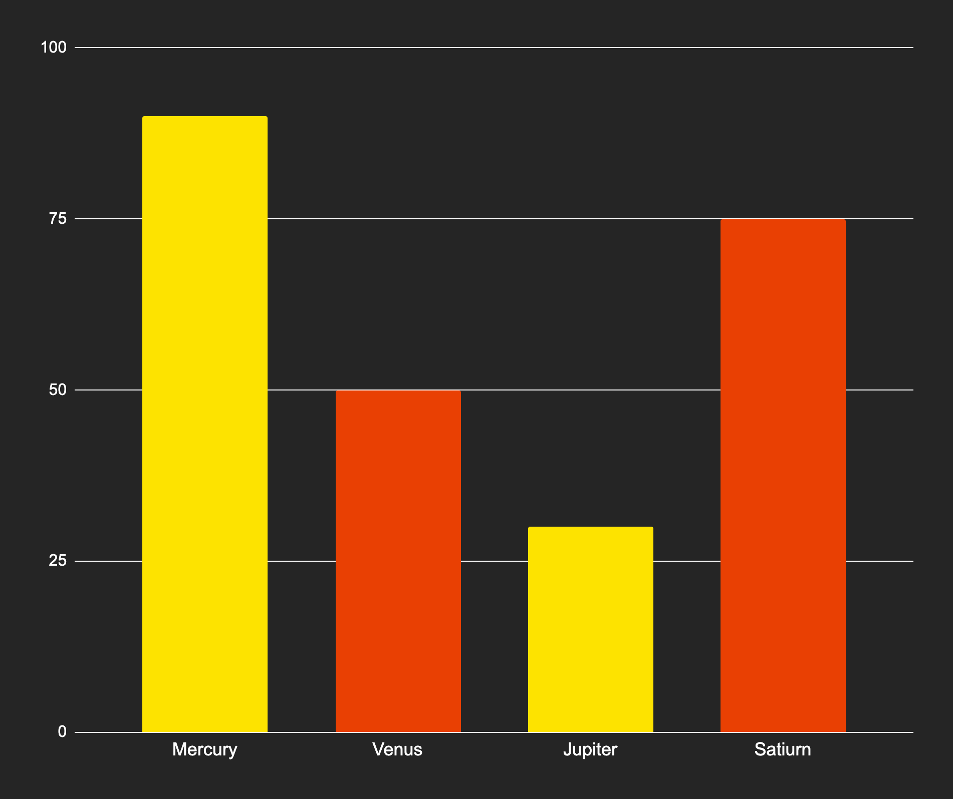
Warning Yellow Tape Infographics
90%
50%
Mercury
Venus
Mercury is a small planet
Venus has a beautiful name
30%
75%
Jupiter
Saturn
Jupiter is a very big planet
Saturn is a gas giant with rings
Follow the link in the graph to modify its data and then paste the new one here. For more info, click here

Slide 14
Warning Yellow Tape Infographics
Mercury
Mars
Mercury is the closest planet to the Sun
Mars is actually a very cold place
Venus
Venus is the second planet from the Sun
Jupiter
Neptune
Jupiter is the biggest planet of them all
Neptune is far away from Earth

Slide 15
Warning Yellow Tape Infographics
Four sections table
Topic 1 | Topic 2 | Topic 3 | Topic 4
Venus is the second planet from the Sun | Despite being red, Mars is a cold place | Jupiter is the biggest planet of them all | Saturn is a gas giant and has several rings

Slide 16
Warning Yellow Tape Infographics
Mercury
Venus
Mercury is the closest planet to the Sun
Venus is the second planet from the Sun
Jupiter
Saturn
Jupiter is the biggest planet of them all
Saturn is composed of hydrogen and helium

Slide 17
Warning Yellow Tape Infographics
2xxx
2xxx
2xxx
Mercury is the closest planet to the Sun
Venus is the second planet from the Sun
Mars is actually a very cold place
2xxx
2xxx
2xxx
Jupiter is the biggest planet of them all
Saturn is composed of hydrogen and helium
Neptune is far away from Earth

Slide 18
Warning Yellow Tape Infographics
Any question about Mercury?
Mercury is the closest planet to the Sun and the smallest one in the Solar System
Any question about Venus?
Venus has a beautiful name and is the second planet from the Sun. It’s terribly hot
Any question about Earth?
Earth is the third planet from the Sun and the only one that harbors life in the Solar System
Any question about Mars?
Despite being red, Mars is actually a cold place. It’s full of iron oxide dust

Slide 19
Warning Yellow Tape Infographics
Mercury is the closest planet to the Sun
Venus is the second planet from the Sun
Mars is actually a very cold place
Mercury
Venus
Mars
Yellow tape cycle
Jupiter
Saturn
Jupiter is the biggest planet of them all
Saturn is composed of hydrogen and helium

Slide 20
Warning Yellow Tape Infographics
Right
Mercury is the closest planet to the Sun Mercury is the smallest one of them all Its name has nothing to do with the liquid metal Mercury was named after the Roman messenger god Mercury is non-habitable for humans
Wrong
Despite being red, Mars is actually a cold place Mars’ surface is quite similar to that of Earth’s Moon Mars has a lot of craters and plains Mercury takes a little more than 58 days to complete its rotation

Slide 21
Warning Yellow Tape Infographics
Mercury
Jupiter
Mercury is the closest planet to the Sun
Jupiter is the biggest planet of them all
Six topics diagram
Venus
Saturn
Venus is the second planet from the Sun
Saturn is composed of hydrogen and helium
Mars
Neptune
Mars is actually a very cold place
Neptune is a planet far away from Earth

Slide 22
Warning Yellow Tape Infographics
 | Mon | Tue | Wed | Thu | Fri
8:00 |  | Meeting |  |  | Holidays
9:00 |  |  | Crime scene |  | Holidays
10:00 | Call Saul |  |  |  | Holidays
11:00 |  |  |  | Meeting | Holidays
12:00 |  |  |  |  | Holidays
13:00 |  |  | Office lunch |  | Holidays
14:00 |  | Sign documents |  |  | Holidays

Slide 23
Warning Yellow Tape Infographics
Warning scenes
Scene 1
Scene 2
Scene 3
Scene 4
Scene 5
Mercury is the closest planet to the Sun
Venus is the second planet from the Sun
Being red, Mars is actually a very cold place
Jupiter is the biggest planet of them all
Neptune is a planet located so far away

Slide 24
Warning Yellow Tape Infographics
Task list
A | Write a task to do here
B
C
D
E
F

Slide 25
Warning Yellow Tape Infographics
Top secrets
Secret 1
Write the secret here
Secret 2
Write the secret here
Secret 3
Write the secret here
Secret 4
Write the secret here
Secret 5
Write the secret here
Secret 6
Write the secret here

Slide 26
Warning Yellow Tape Infographics
1
2xxx
Mercury
Mercury is the closest planet to the Sun
2
2xxx
Venus
Venus is the second planet from the Sun
3
2xxx
Mars
Mars is actually a very cold place
4
2xxx
Jupiter
Jupiter is the biggest planet of them all

Slide 27
Warning Yellow Tape Infographics
Evidences
1 | Mercury is the closest planet to the Sun
2 | Mercury is a very small planet
3 | Venus has a beautiful name
4 | Venus is hotter than Mercury
5 | Earth is the third planet from the Sun
6 | Earth is where we all live on
7 | Being red, Mars is actually a cold place
8 | Mars is full of iron oxide dust
9 | Jupiter is a gas giant
10 | Saturn has several rings
11 | Neptune is very far away from the Sun
12 | Pluto is now considered a dwarf planet

Slide 28
Warning Yellow Tape Infographics
Testifications
“Mercury is the closest planet to the Sun and the smallest one in the Solar System. This planet’s name has nothing to do with the liquid metal, since Mercury was named after the Roman messenger god”
By Jenna Doe
“Venus has a beautiful name and is the second planet from the Sun. It’s terribly hot, even hotter than Mercury, and its atmosphere is extremely poisonous. It’s the second-brightest object”
By Sarah Brunel
“Jupiter is a gas giant and the biggest planet in the Solar System. Jupiter is also the fourth-brightest object in the night sky. Jupiter was named after the Roman god of the skies and lightning”
By John Smith

Slide 29
Warning Yellow Tape Infographics
Clues of the crime
Clue 1
Clue 2
Mercury is the closest planet to the Sun and the smallest one in the entire Solar System. This planet’s name has nothing to do with the liquid metal, since Mercury was named after the Roman messenger god
Mercury takes a little more than 58 days to complete its rotation, so try to imagine how long days must be there! Since the temperatures are so extreme, albeit not as extreme as on Venus

Slide 30
Warning Yellow Tape Infographics
Checklist
Mercury is the closest planet to the Sun and the smallest one in the Solar System | ✓
Venus has a beautiful name and is the second planet from the Sun | ✘
Earth is the third planet from the Sun and the only one that harbors life | ✓
Despite being red, Mars is actually a cold place. It’s full of iron oxide dust | ✘
Jupiter is a gas giant and the biggest planet in the Solar System
Saturn is a gas giant and has several rings | ✓

Slide 31
Warning Yellow Tape Infographics
1
Mercury
Mercury is the closest planet to the Sun
Four sections diagram
2
Venus
Venus is the second planet from the Sun
3
Mars
Mars is actually a very cold place
4
Jupiter
Jupiter is the biggest planet of them all

Slide 32
Instructions for use (premium users)
As a Premium user, you can use this template without attributing Slidesgo.
You are allowed to:
Modify this template.
Use it for both personal and commercial purposes.
Share this template in an editable format with people who are not part of your team.
You are not allowed to:
Sublicense, sell or rent this Slidesgo Template (or a modified version of this Slidesgo Template).
Distribute this Slidesgo Template (or a modified version of this Slidesgo Template) or include it in a database or in any other product or service that offers downloadable images, icons or presentations that may be subject to distribution or resale.
Use any of the elements that are part of this Slidesgo Template in an isolated and separated way from this Template.
Register any of the elements that are part of this template as a trademark or logo, or register it as a work in an intellectual property registry or similar.
For more information about editing slides, please read our FAQs or visit our blog:
https://slidesgo.com/faqs and https://slidesgo.com/slidesgo-school

Slide 33
Infographics
You can add and edit some infographics to your presentation to present your data in a visual way.
Choose your favourite infographic and insert it in your presentation using Ctrl C + Ctrl V or Cmd C + Cmd V in Mac.
Select one of the parts and ungroup it by right-clicking and choosing “Ungroup”.
Change the color by clicking on the paint bucket.
Then resize the element by clicking and dragging one of the square-shaped points of its bounding box (the cursor should look like a double-headed arrow). Remember to hold Shift while dragging to keep the proportions.
Group the elements again by selecting them, right-clicking and choosing “Group”.
Repeat the steps above with the other parts and when you’re done editing, copy the end result and paste it into your presentation.
Remember to choose the “Keep source formatting” option so that it keeps the design. For more info, please visit our blog.

