Slide 1

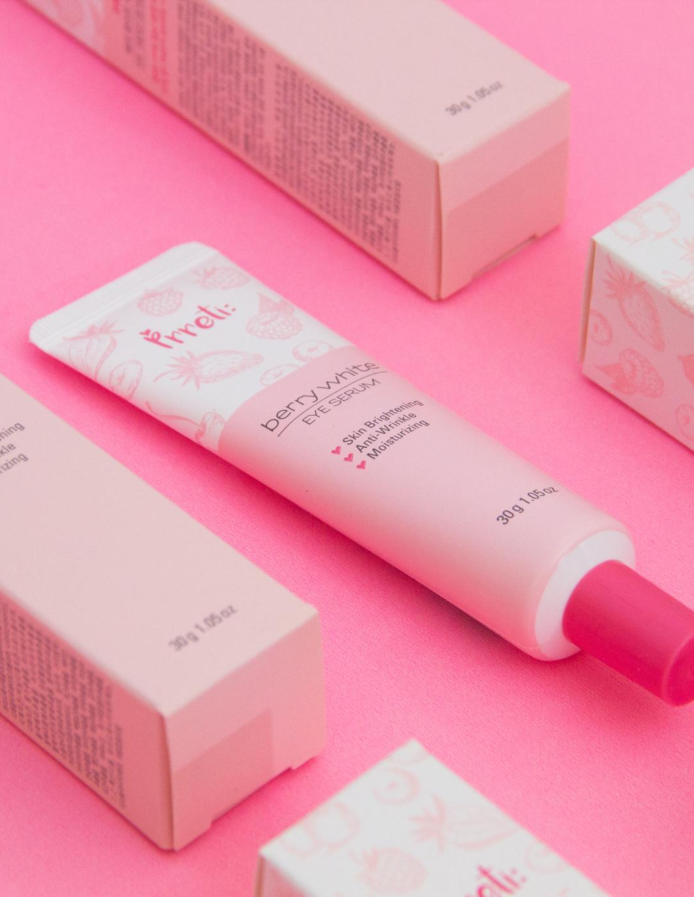
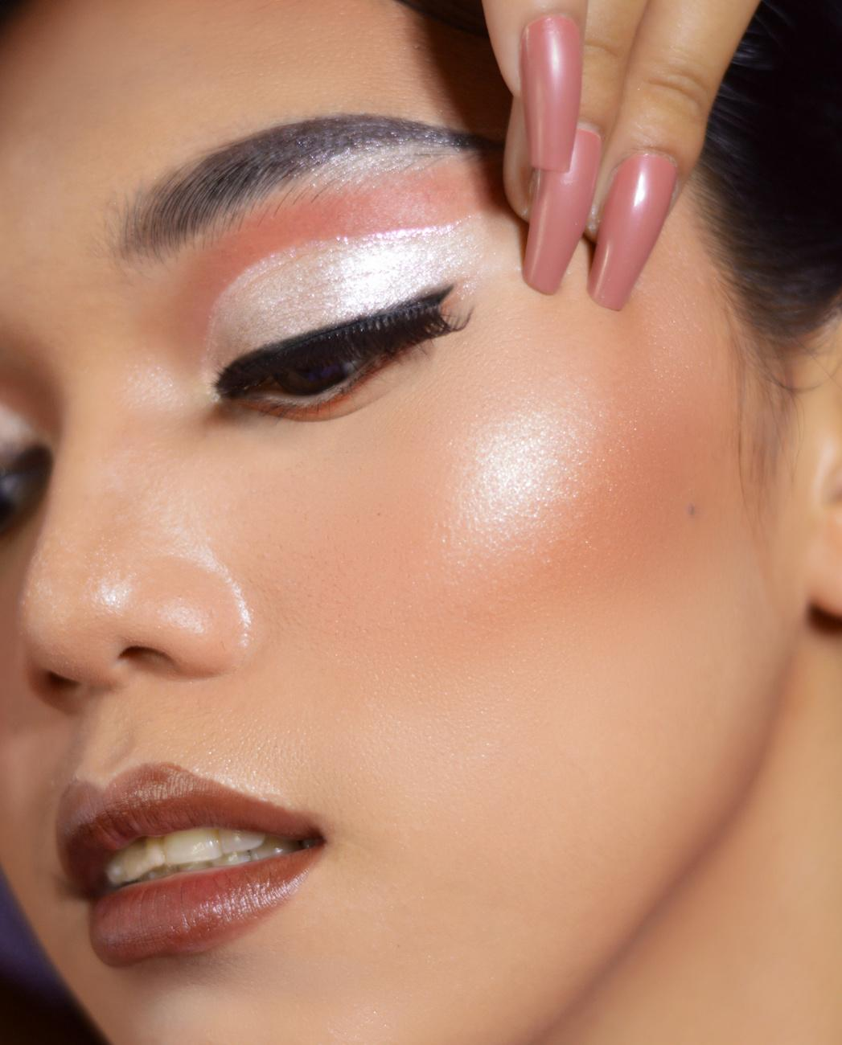

CV
beauty vlogger

Slide 2

how to use this presentation.
Google Slides
PowerPoint
Canva
Click on the "Google Slides" button below this presentation preview. Make sure to sign in to your Google account. Click on "Make a copy." Start editing your presentation.
Alternative: Click on the "Share" button on the top right corner in Canva and click on "More" at the bottom of the menu. Enter "Google Drive" in the search bar and click on the GDrive icon to add this design as a Google slide in your GDrive.
Click on the "PowerPoint" button below this presentation preview. Start editing your presentation.
Alternative: From Canva template file, Click on the "Share" button on the top right corner in Canva and click on "More" at the bottom of the menu. Enter "PowerPoint" in the search bar and click on the PowerPoint icon to download.
Click on the "Canva" button under this presentation preview. Start editing your presentation. You need to sign in to your Canva account.

Slide 3
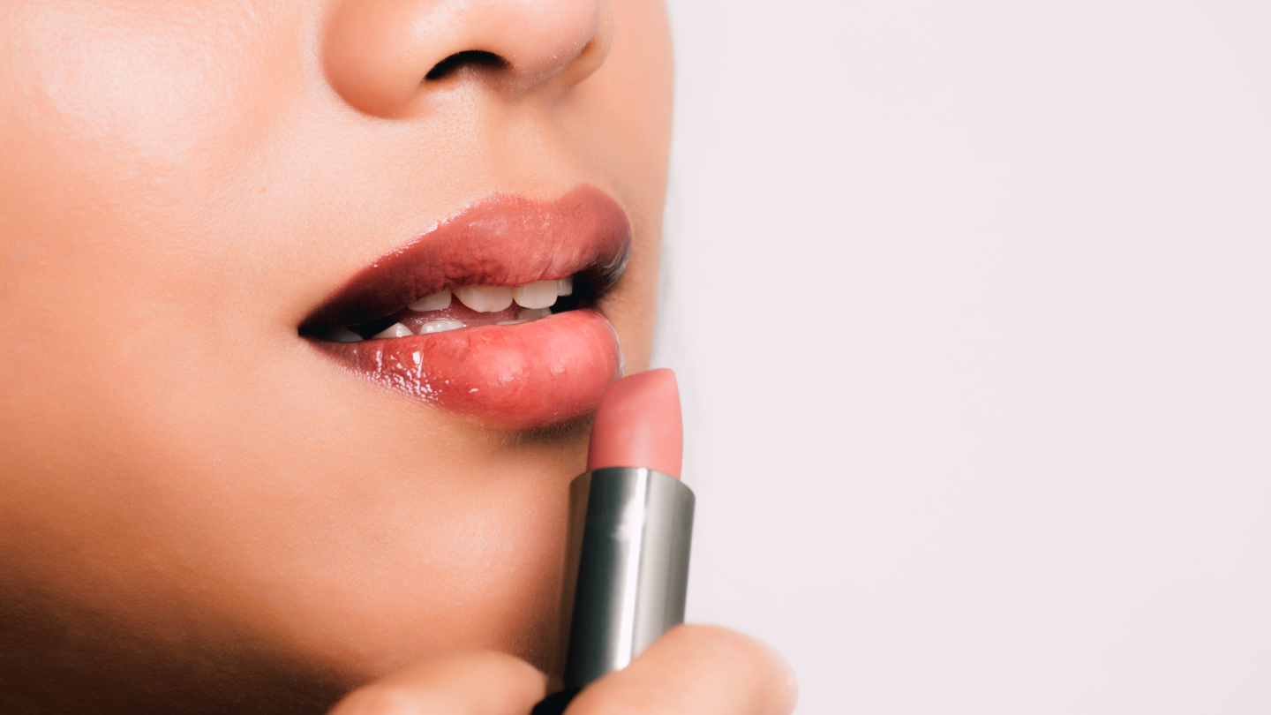

table of contents.
Introduction
Elaborate on what you want to discuss.
About Us
Elaborate on what you want to discuss.
Our Projects
Elaborate on what you want to discuss.

Slide 4
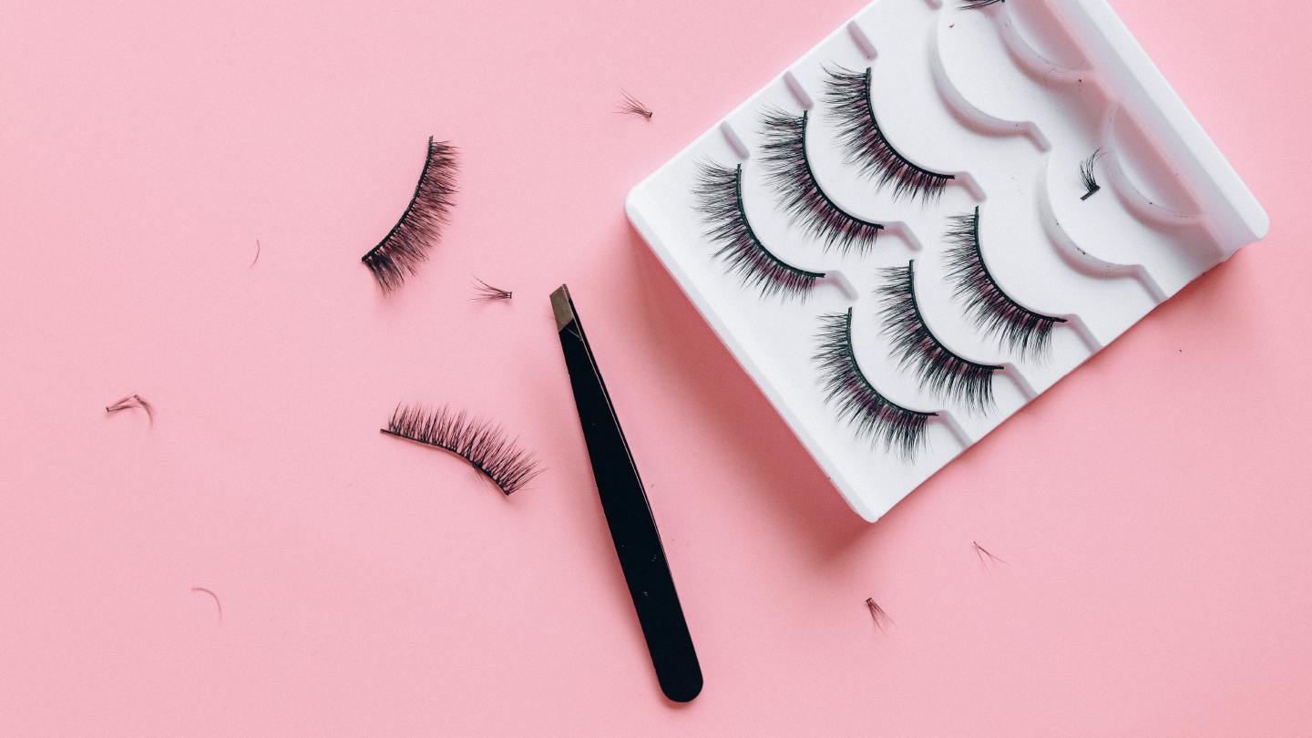
01.
introduction.
Elaborate on what you want to discuss.

Slide 5
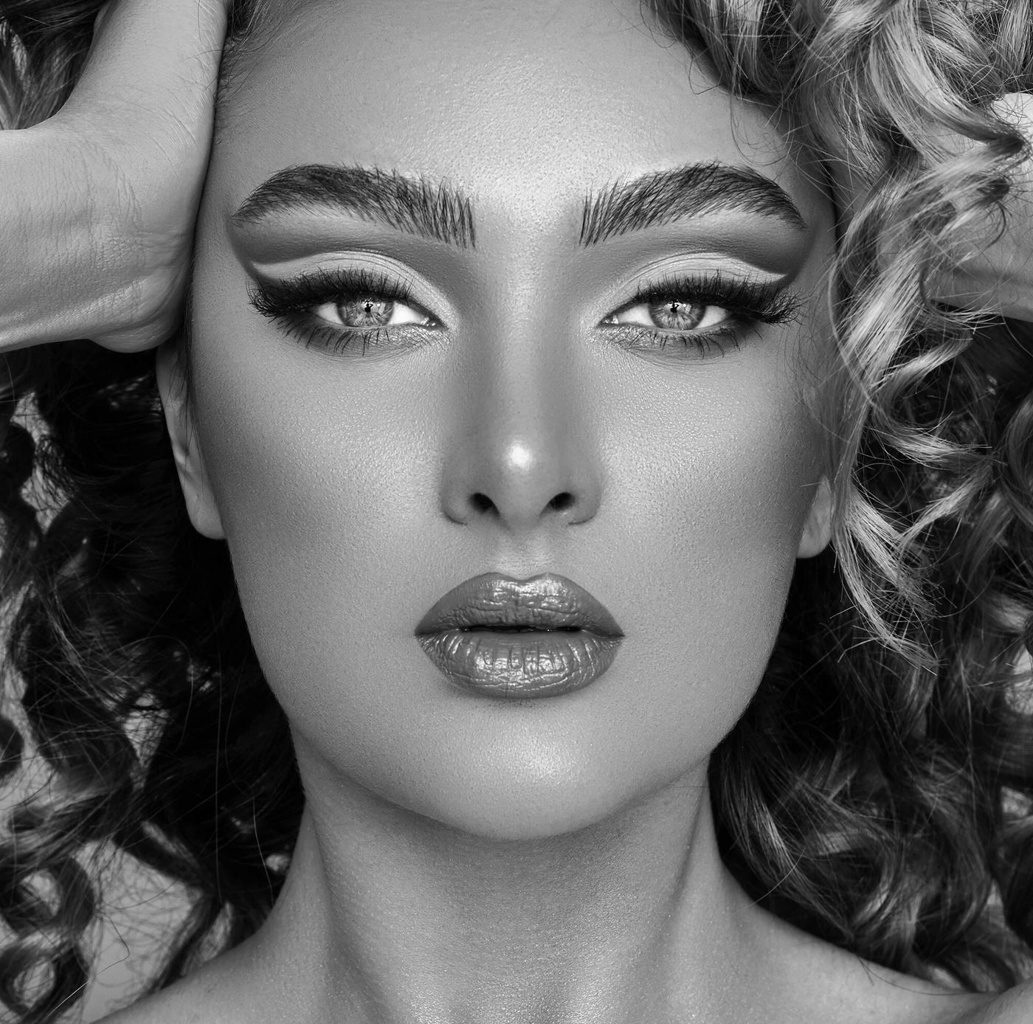
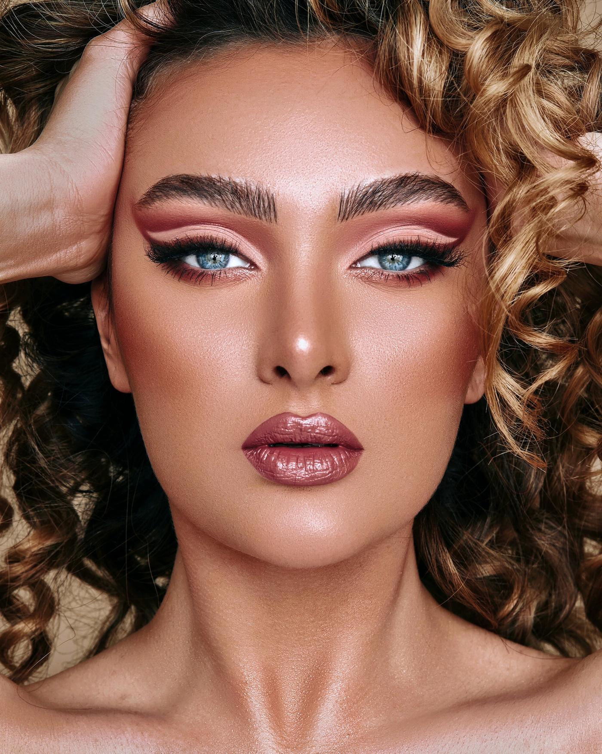
my beauty journey.
Hi there!
My name is Sarah Shah and I'm a beauty vlogger based in Any City. I love all things beauty and I'm excited to share my tips and tricks with you!

Slide 6
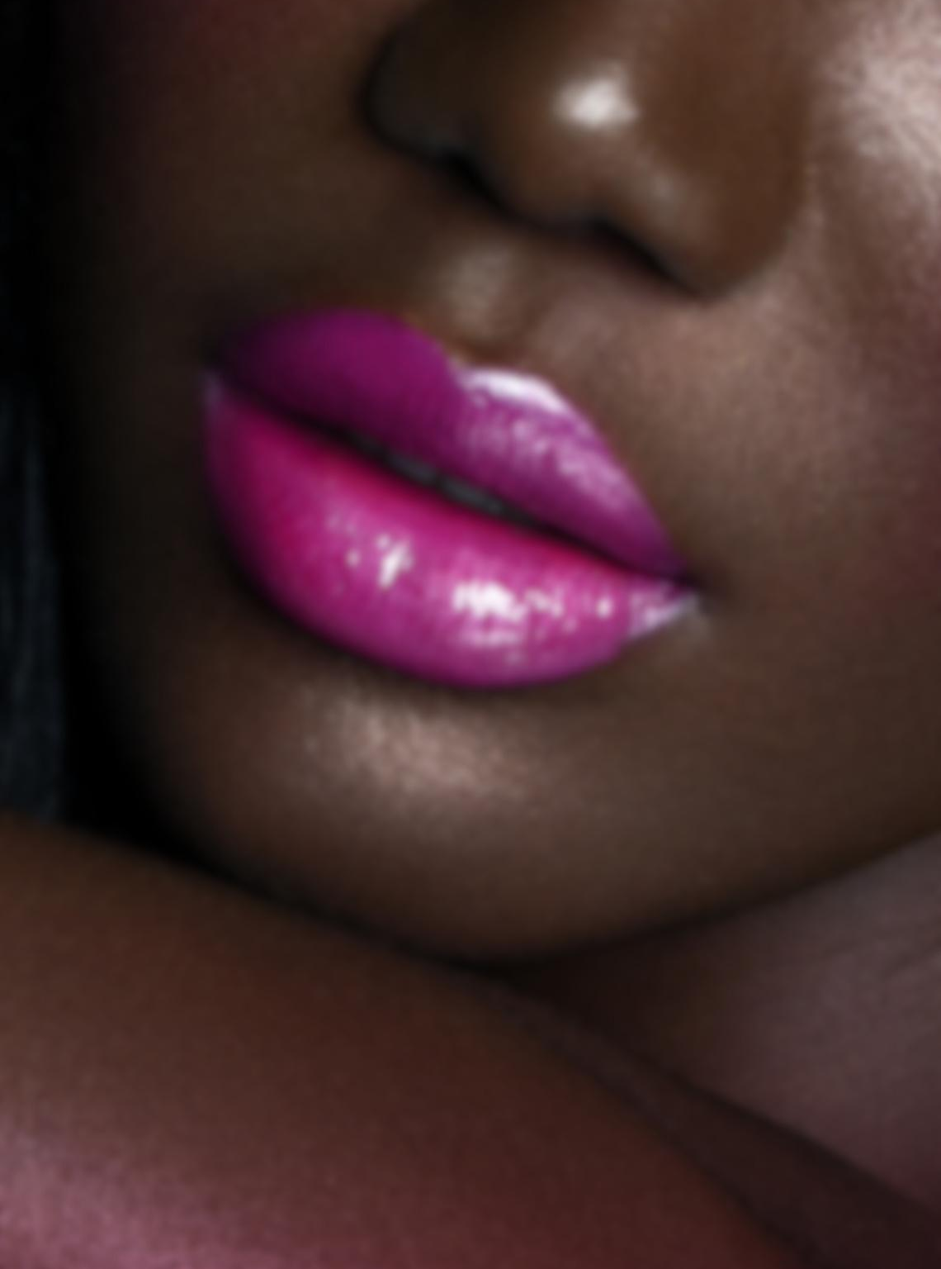
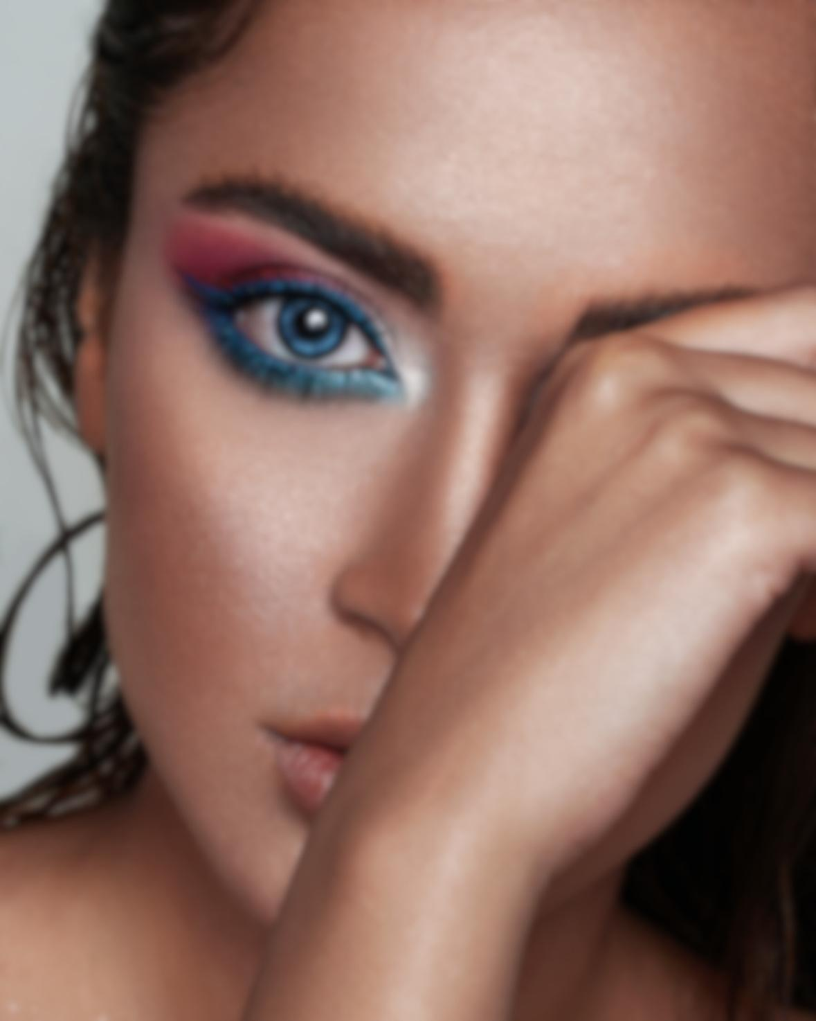
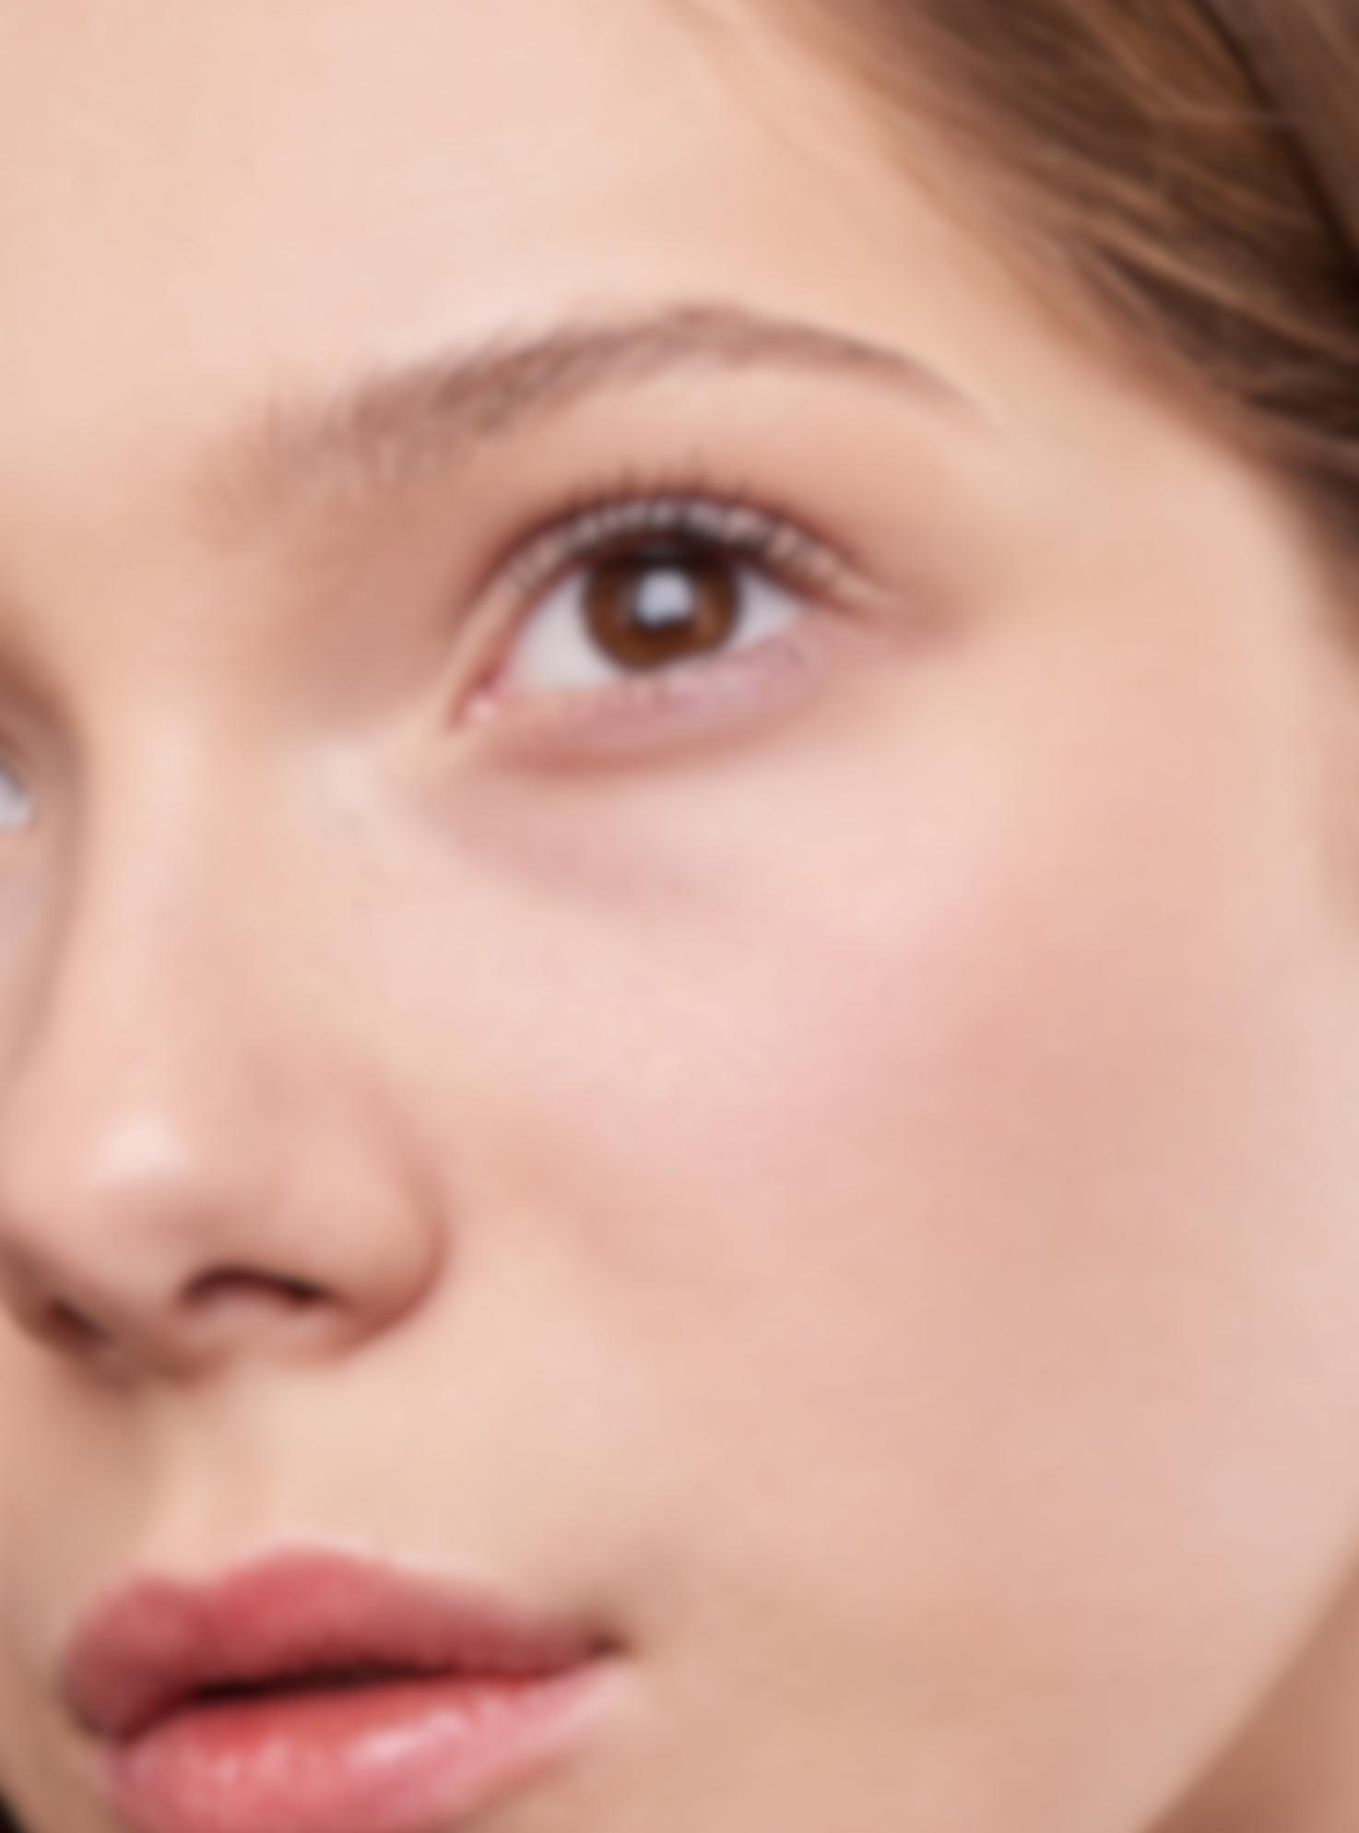
current trends.
Neon Lips
Glitter Everywhere
Au Naturale
Neon lips are taking over for 2030! This trend is all about bright, bold colors that pop. Whether you prefer hot pinks or electric oranges, there's a neon shade for everyone.
Glitter is no longer just for special occasions – it's for every day! From glittery eyeshadow to sparkly highlighter, this trend is all about adding some sparkle to your look. Don't be afraid to shine!
The 'no-makeup' makeup trend is here to stay for 2030! This trend is all about enhancing your natural beauty with a few subtle touches. Think sheer lip tints, light coverage foundation, and a touch of bronzer for a sun-kissed glow.

Slide 7
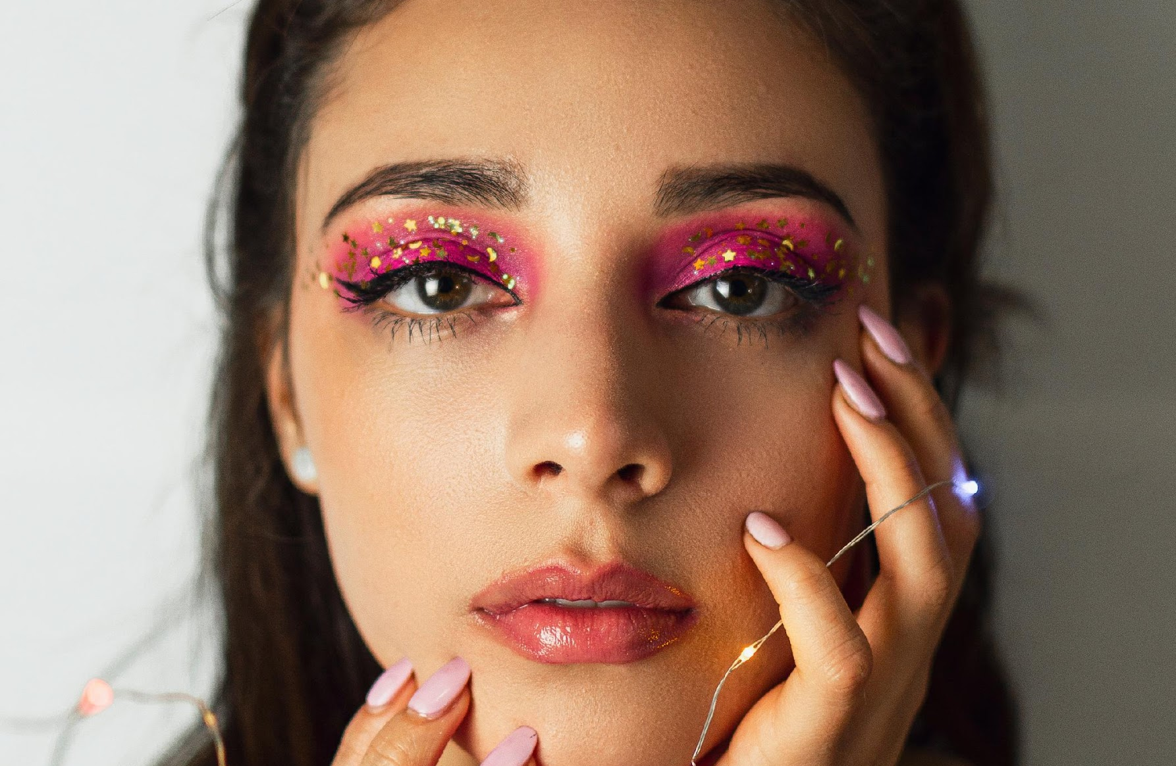
about me.
I am a beauty enthusiast who loves to share my knowledge and experience with others. Join me on my journey to discover the latest beauty trends and tips!

Slide 8
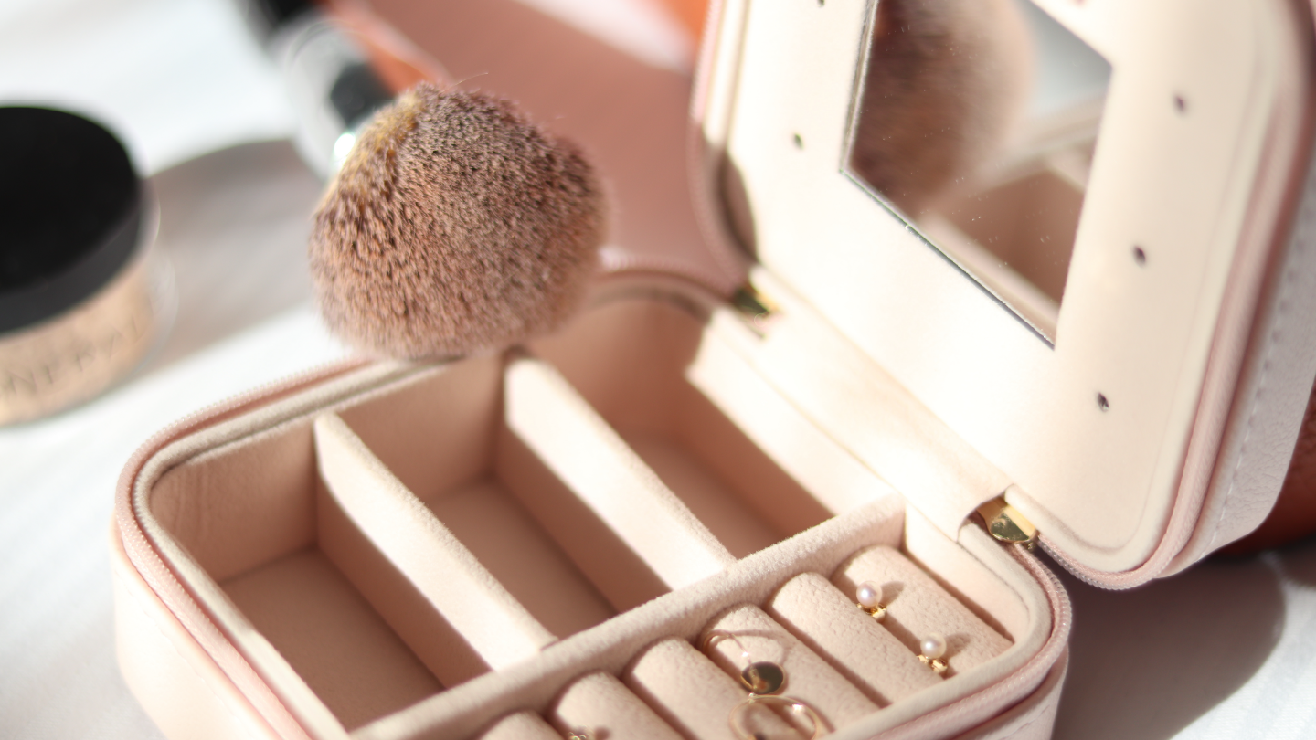
02.
about us.
Elaborate on what you want to discuss.

Slide 9

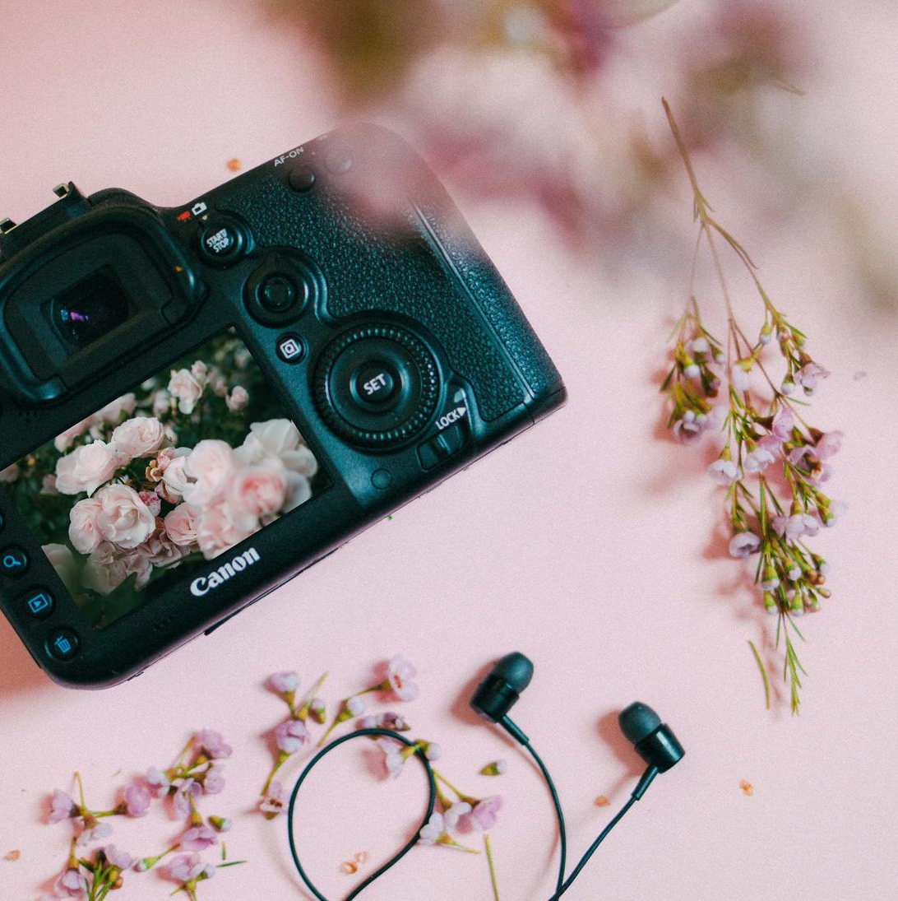
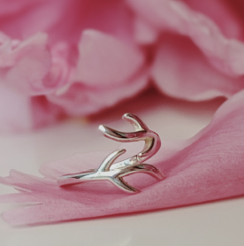
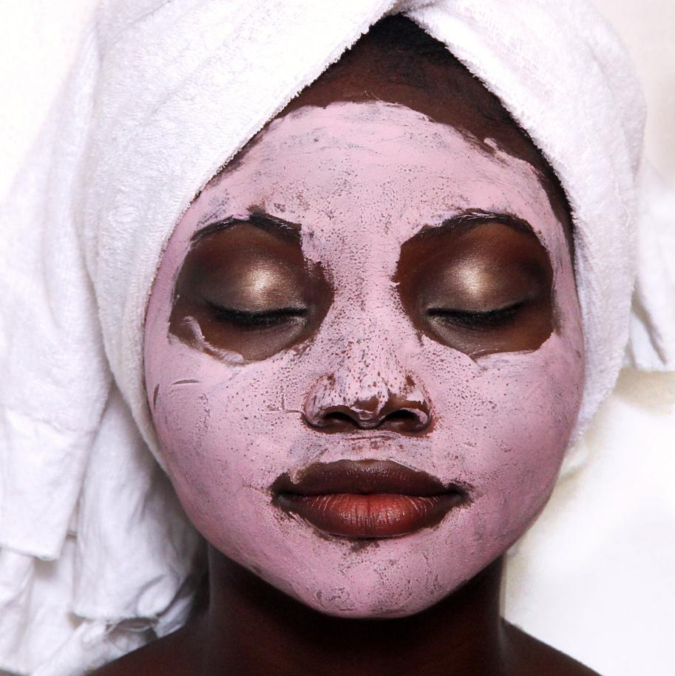
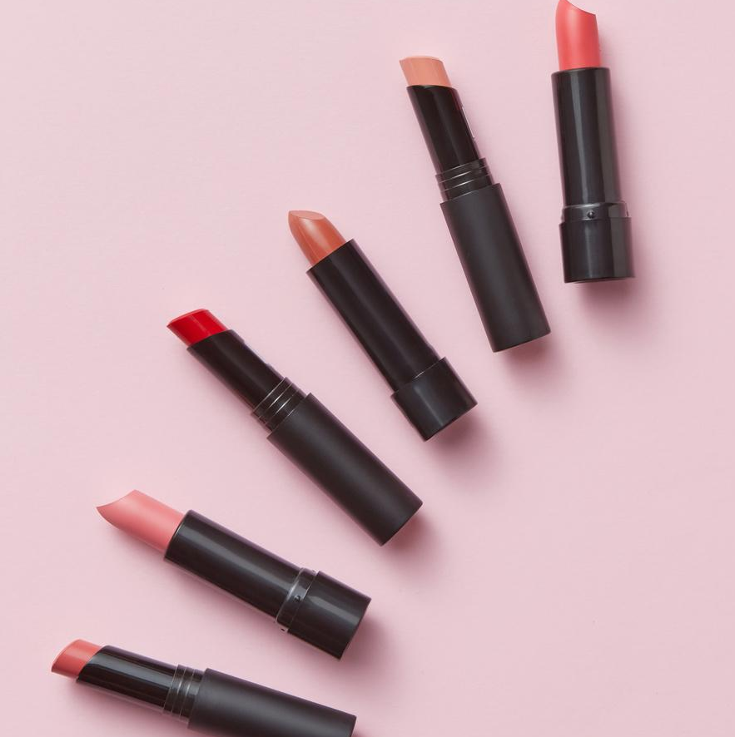
skills.
01.
02.
Photography
Content Creation
Elaborate on what you want to discuss.
Elaborate on what you want to discuss.
03.
04.
Skincare
SMM
Elaborate on what you want to discuss.
Elaborate on what you want to discuss.

Slide 10
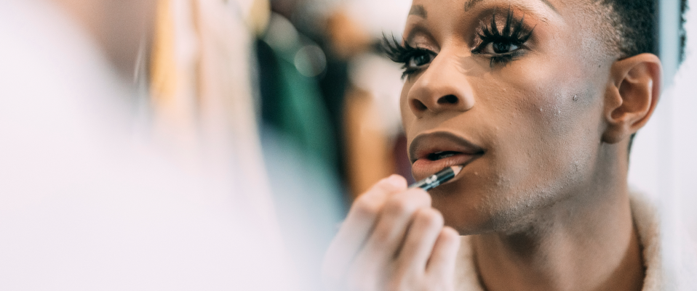
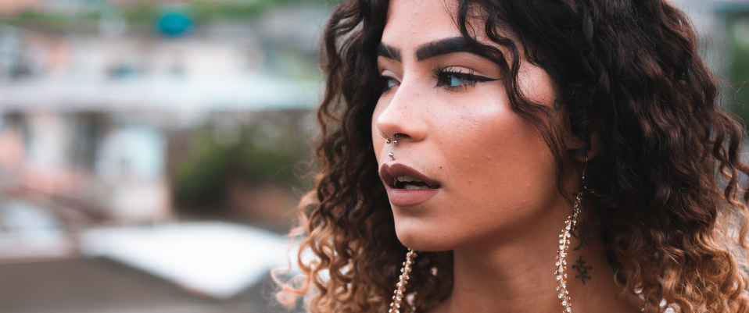

Name - Title or Position
my team.
At our core, we are a team of individuals who are passionate about beauty and sharing our knowledge with others.
Name - Title or Position

Slide 11
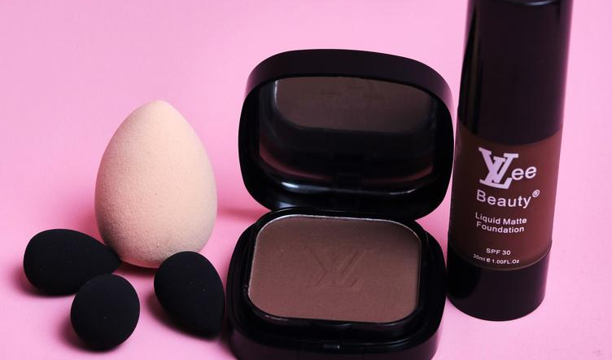
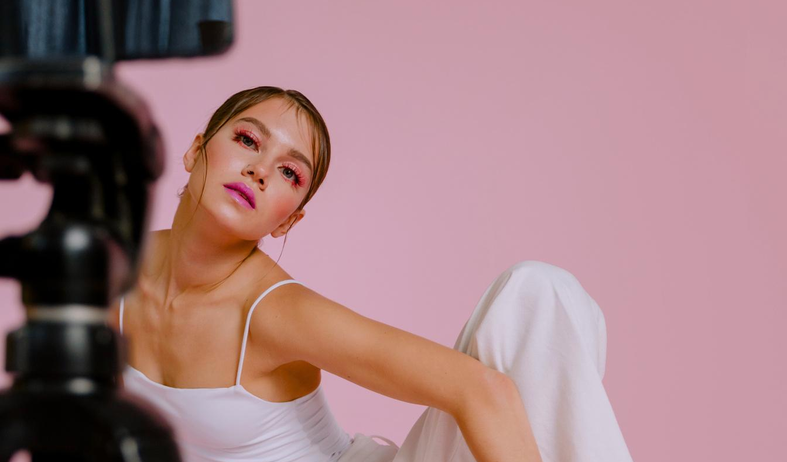
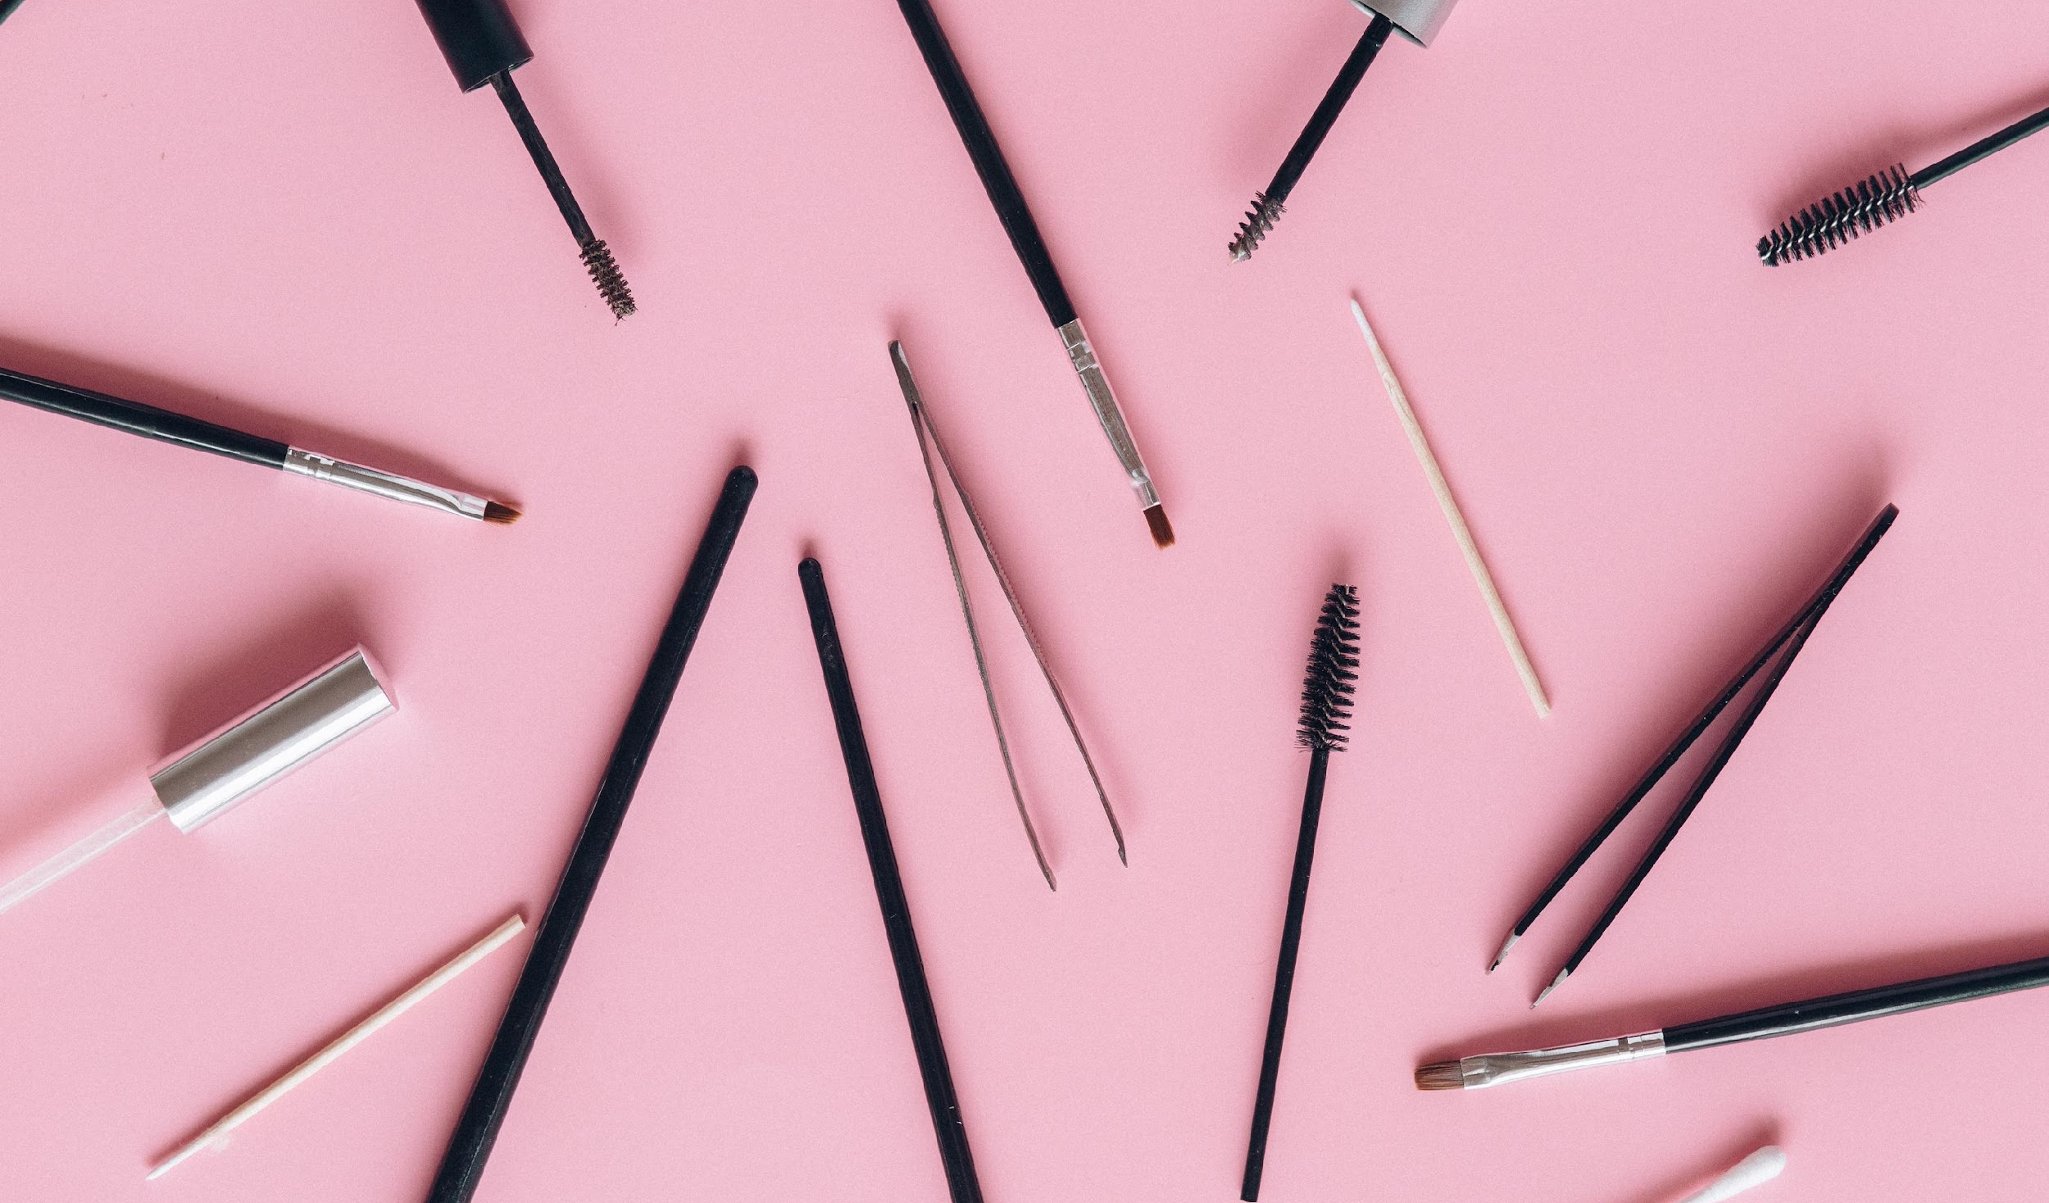
experience.
2027-2028
Giggling Platypus Co., Brand Ambassador
2025-2027
2028-present
Borcelle,
Social Media Manager
Thynk Unlimited,
Beauty Vlogger

Slide 12
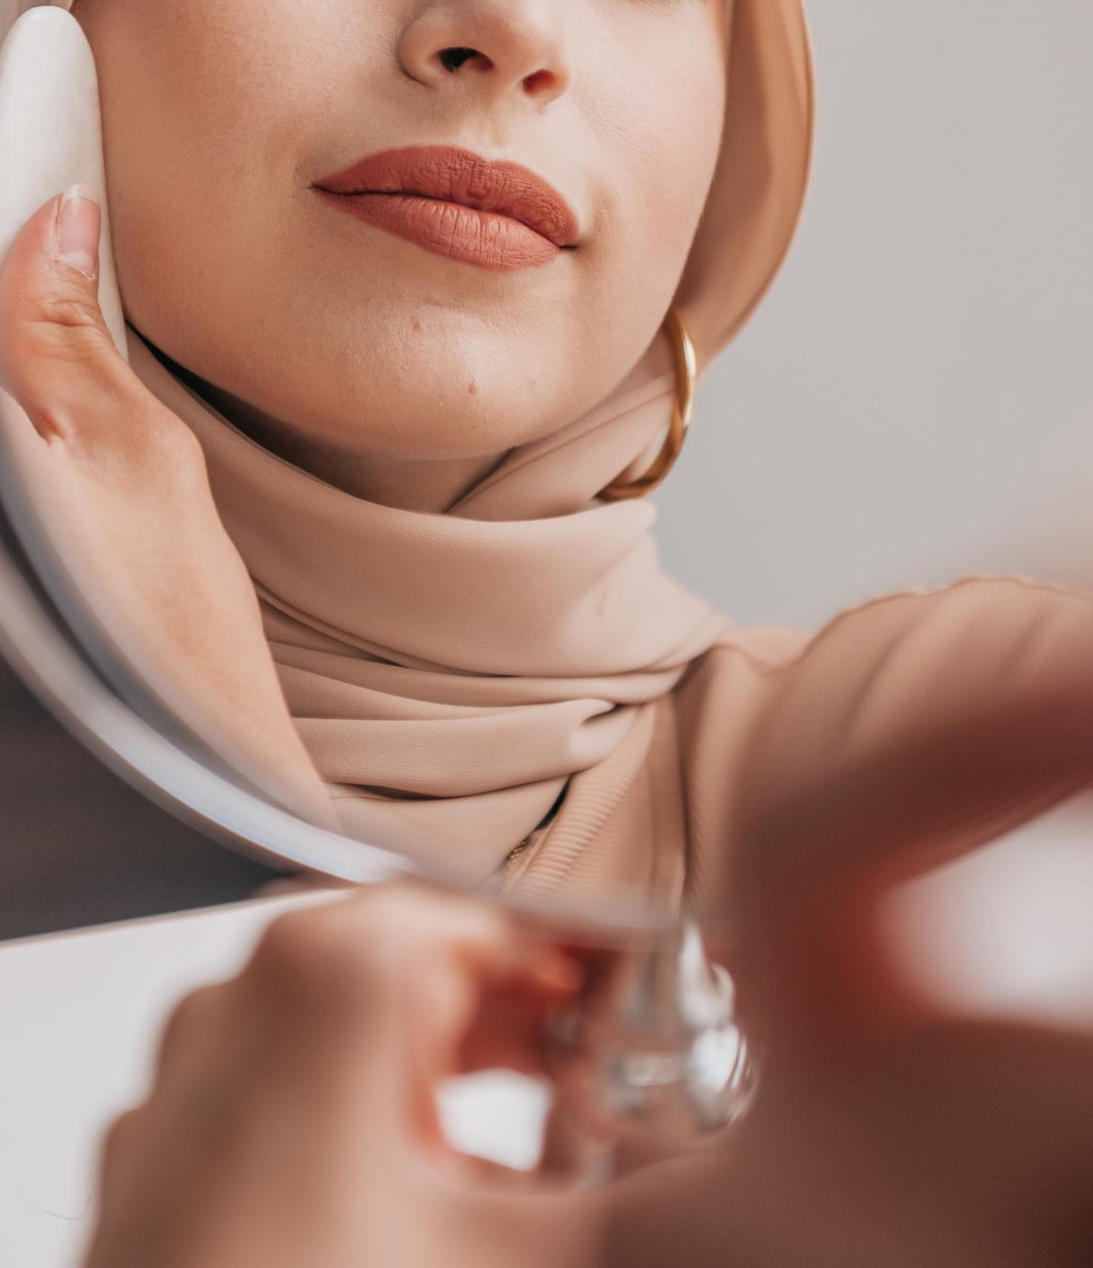
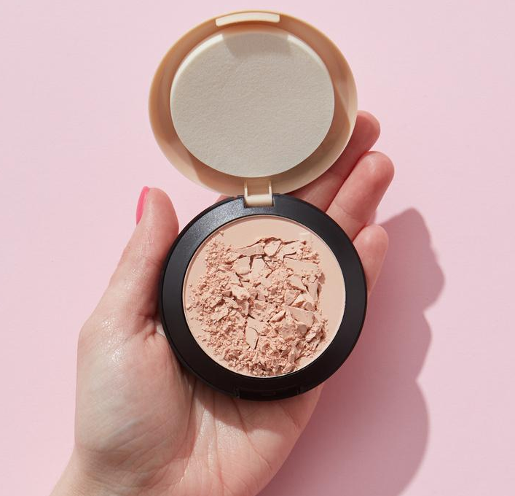
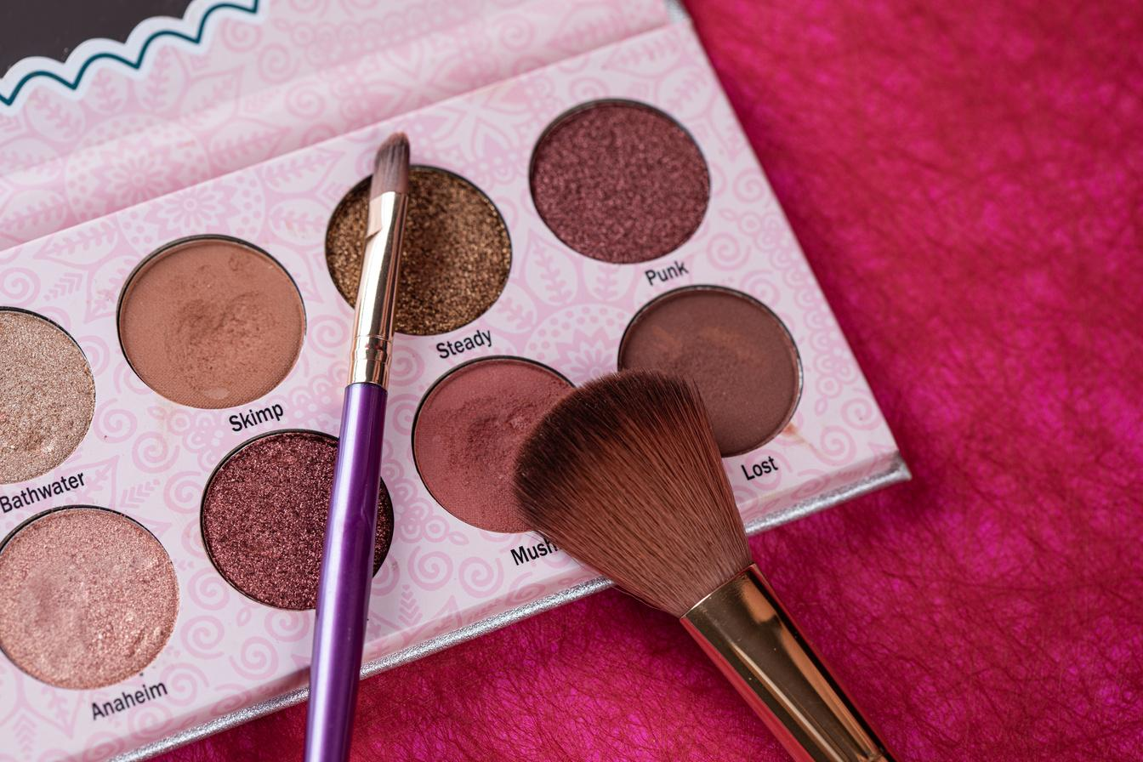
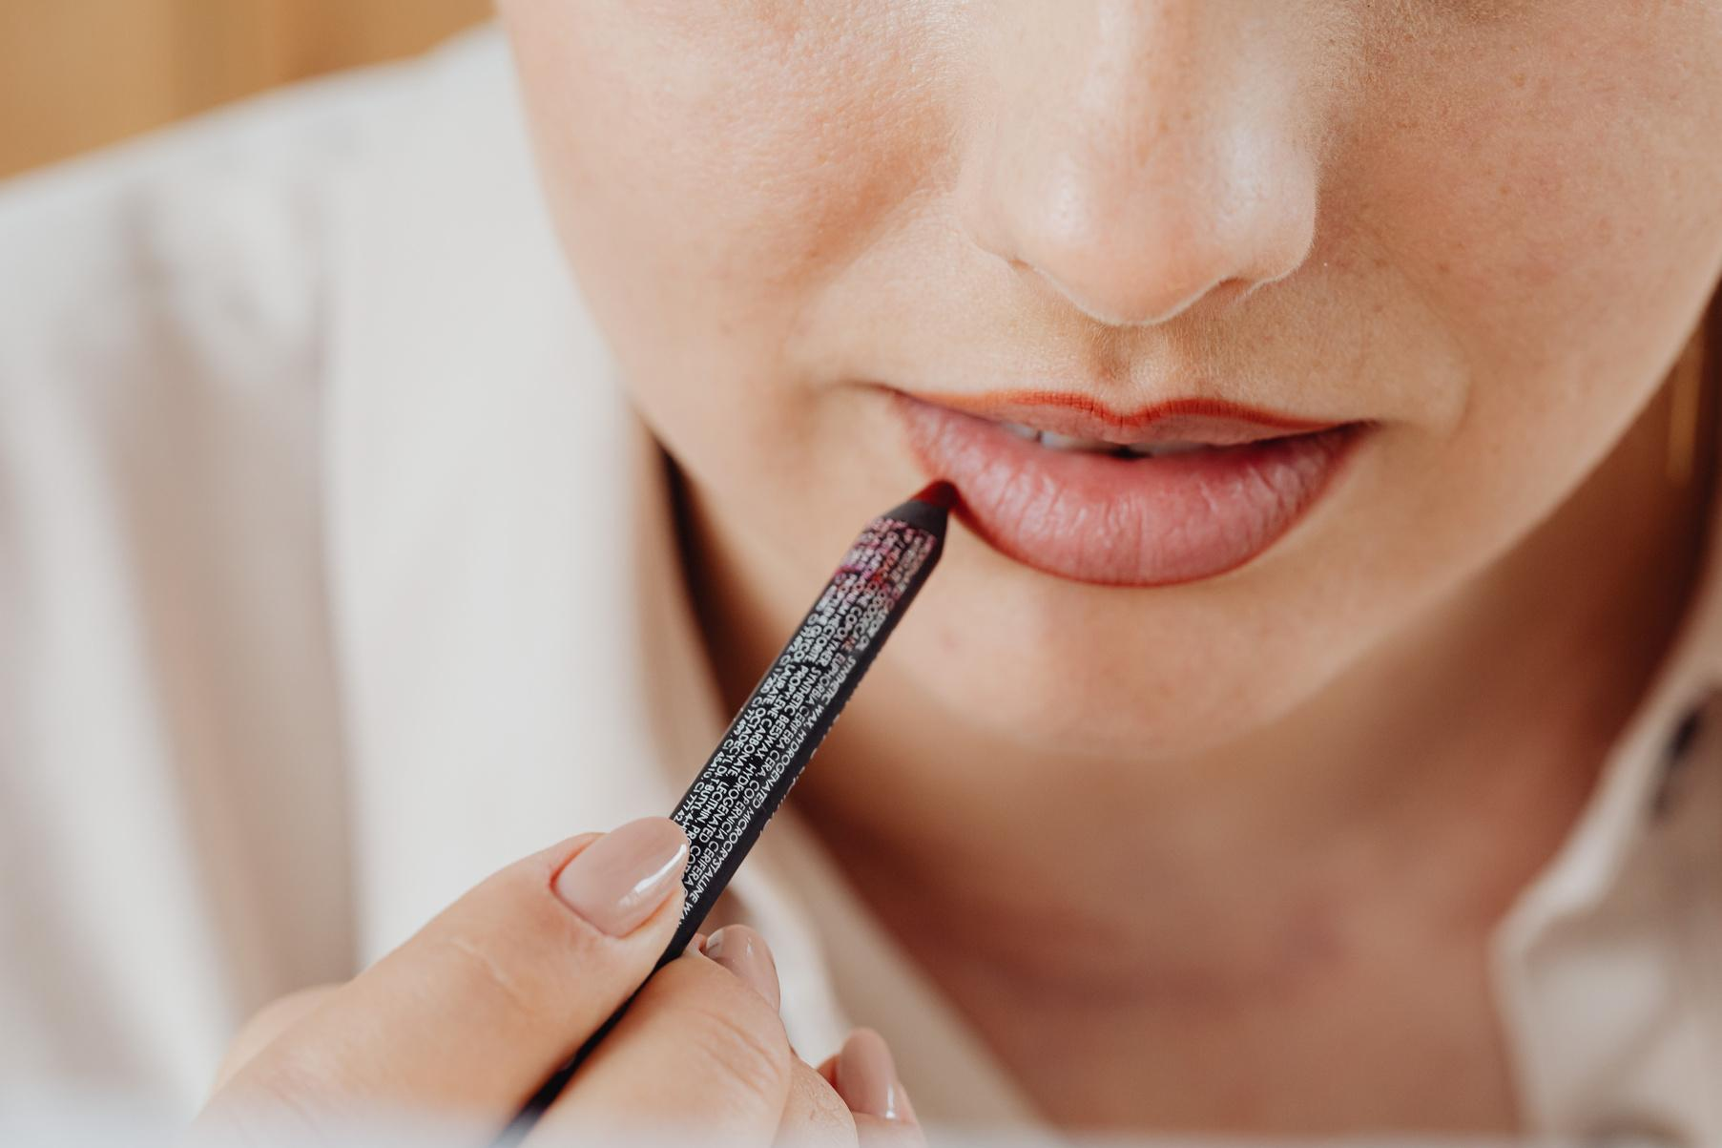
gallery image.
What can you say about your projects? Share it here!

Slide 13
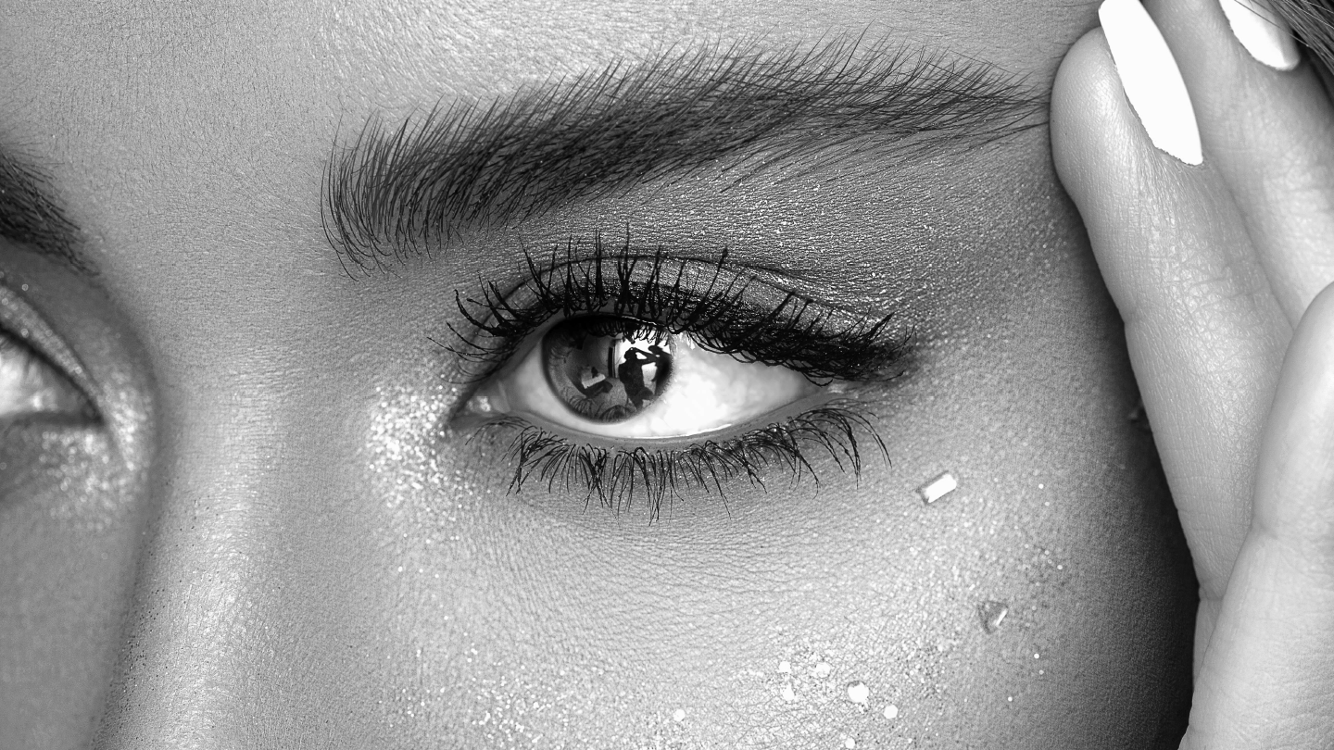
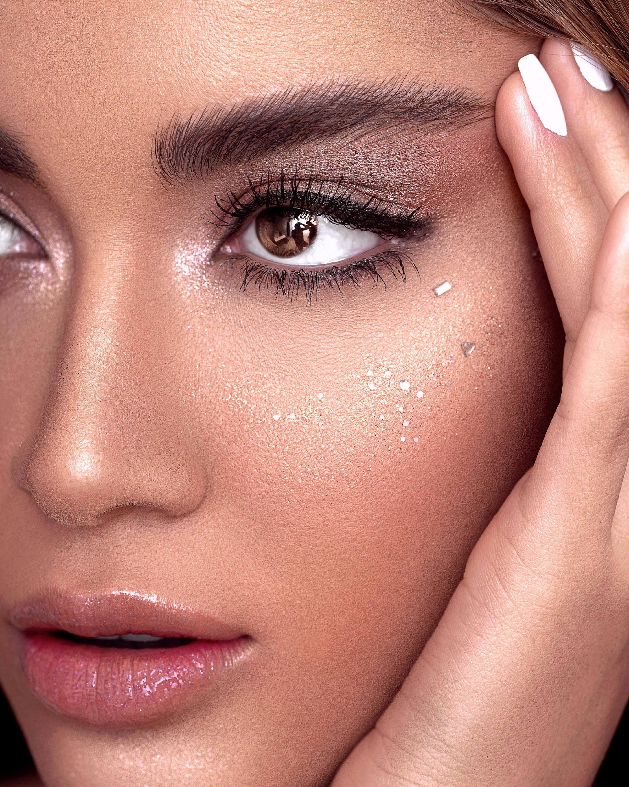
stay beautiful.

Slide 14
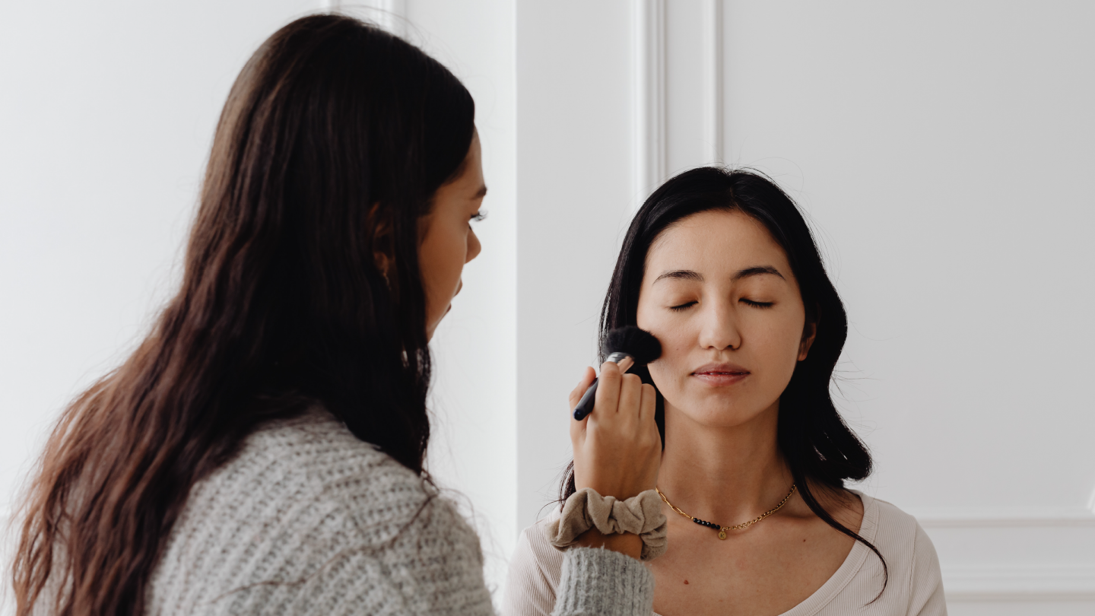
03.
our projects.
Elaborate on what you want to discuss.

Slide 15
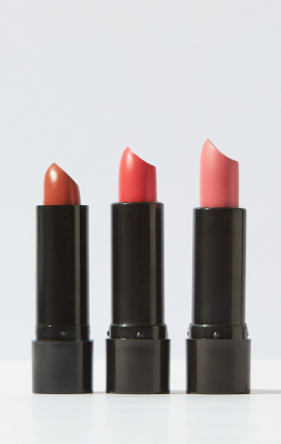
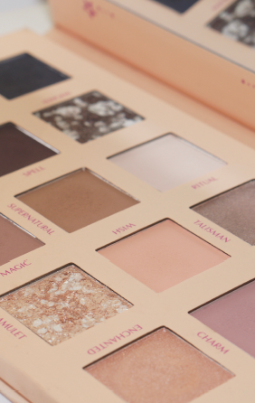
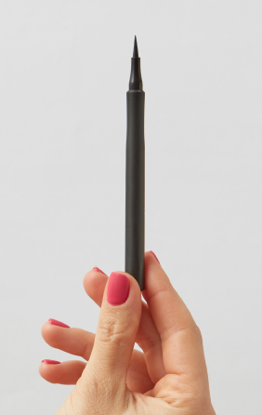
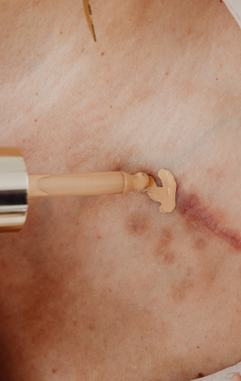
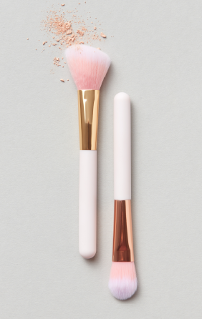
1.
2.
3.
4.
5.
top 5 beauty products of 2030.
Long lasting lipsticks
Glitter Eyeshadow
Waterproof Eyeliner
Mega Coverage Concealer
Natural Brushes

Slide 16
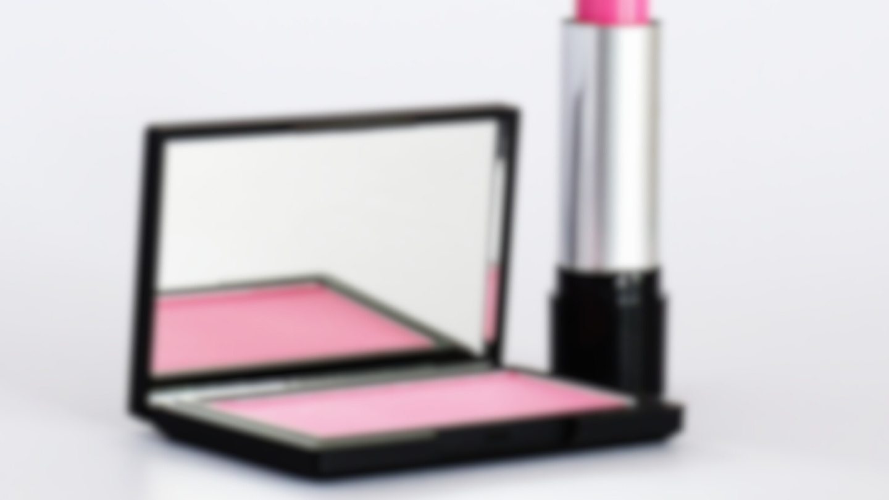
achievements.
20k
x5
50k
Subscribers on YouTube
Featured in beauty magazines
Followers on Social Media Platforms
I'm proud to have reached 123456 subscribers on my channel and to have been featured in [Publication]. I've also won awards for my content and collaborations with brands.

Slide 17
audience engagement.
Elaborate on what you want to discuss.
Q1
Q2
How do you engage with your audience (e.g. responding to comments, hosting Q&A sessions, etc.)?
Have you ever received negative feedback from your audience? If so, how did you respond to it?

Slide 18
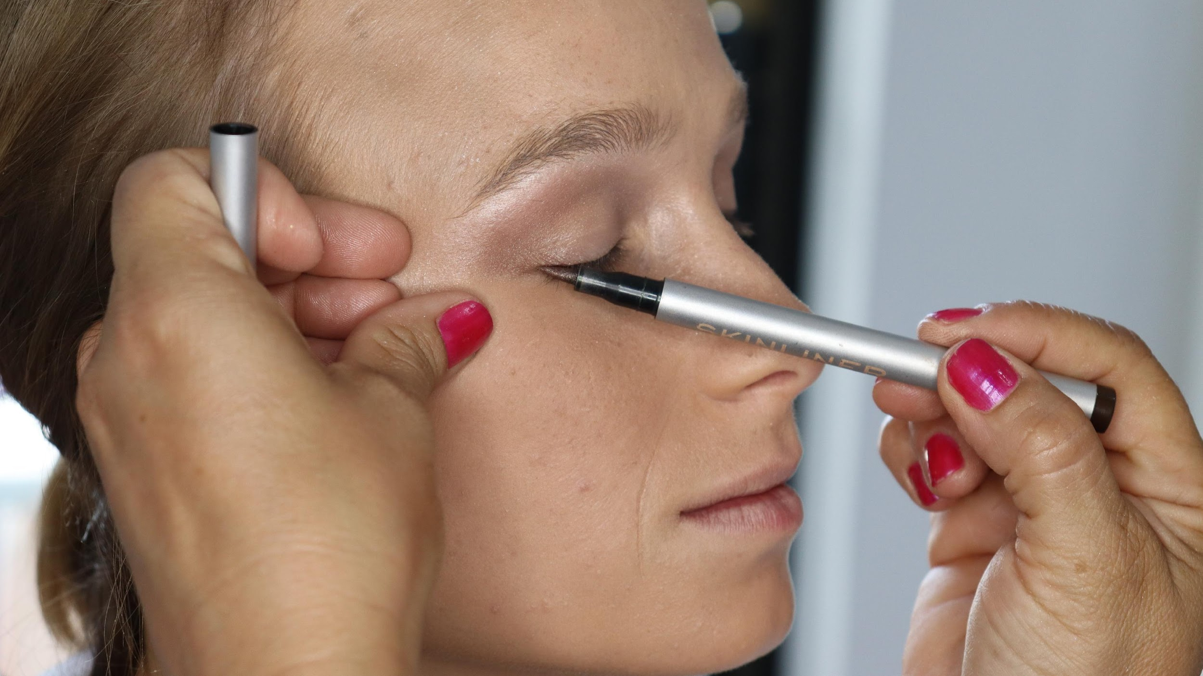
123,456,789
Elaborate on the featured statistic.

Slide 19
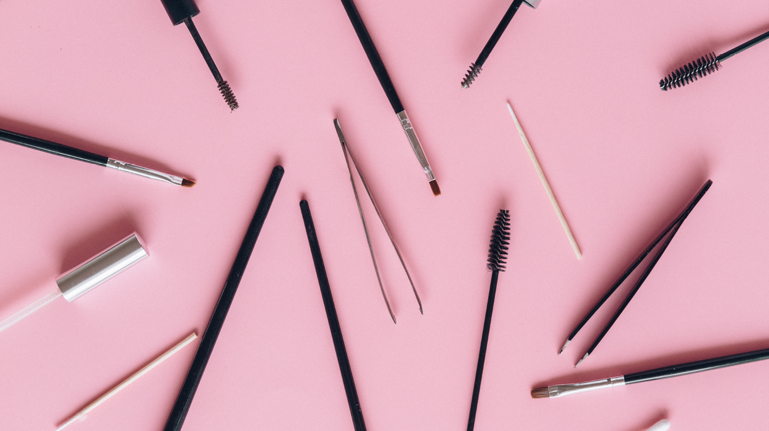
Our clients love us for our attention to detail and personalized approach to beauty.
— Include a credit, citation, or supporting message

Slide 20
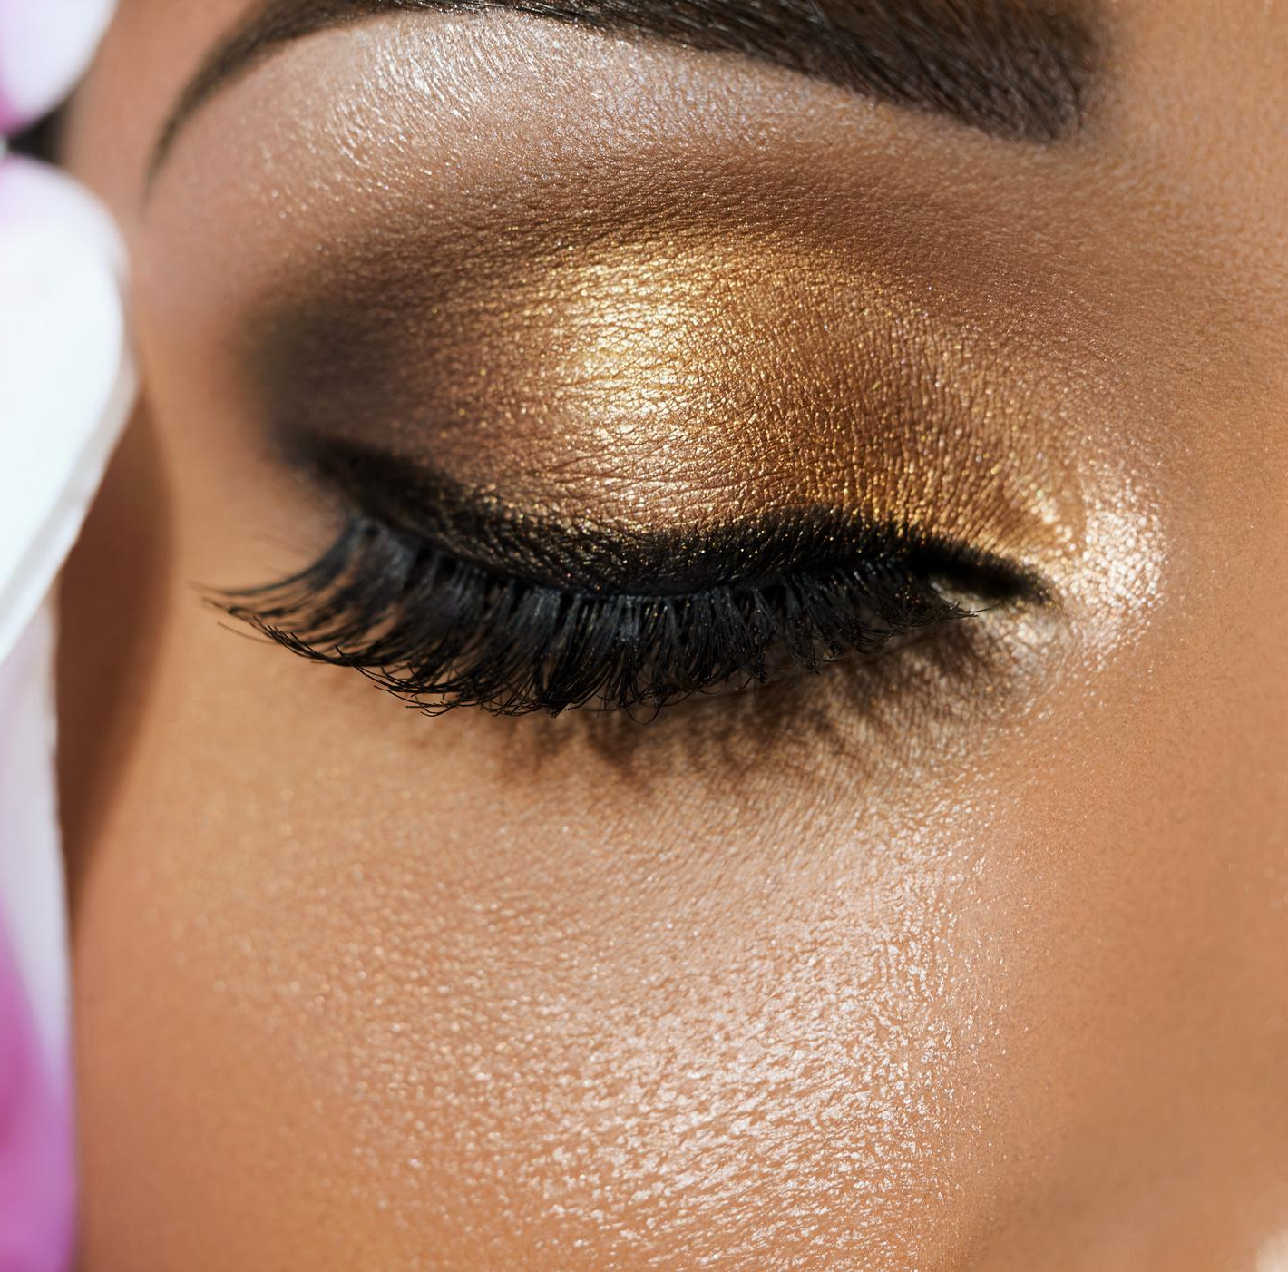



contact us.
For business inquiries, please contact me at samira@reallygreatsite.com.
You can also follow me on Instagram at @reallygreatsite for daily beauty content and updates.
123 Anywhere St., Any City,ST 12345
123-456-7890
hello@reallygreatsite.com

Slide 21
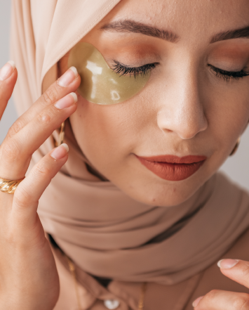
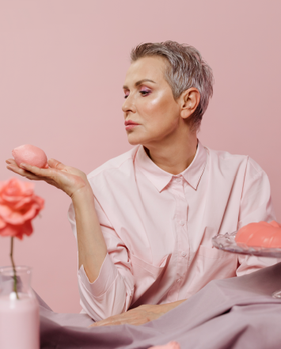
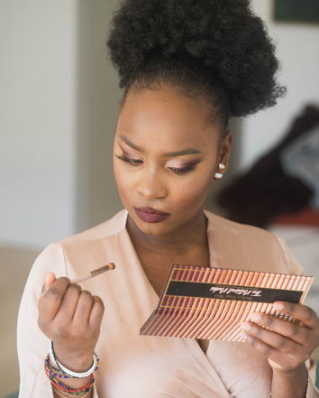
thank you
Write a closing statement or call-to-action here.

Slide 22


resource page.
Use these design resources in your Canva Presentation.
You can find these fonts online too. Happy designing!
Don't forget to delete this page before presenting.
This presentation template uses the following free fonts:
  Titles: League Spartan
  Headers: ABeeZee Bold
  Body Copy: ABeeZee

Slide 23
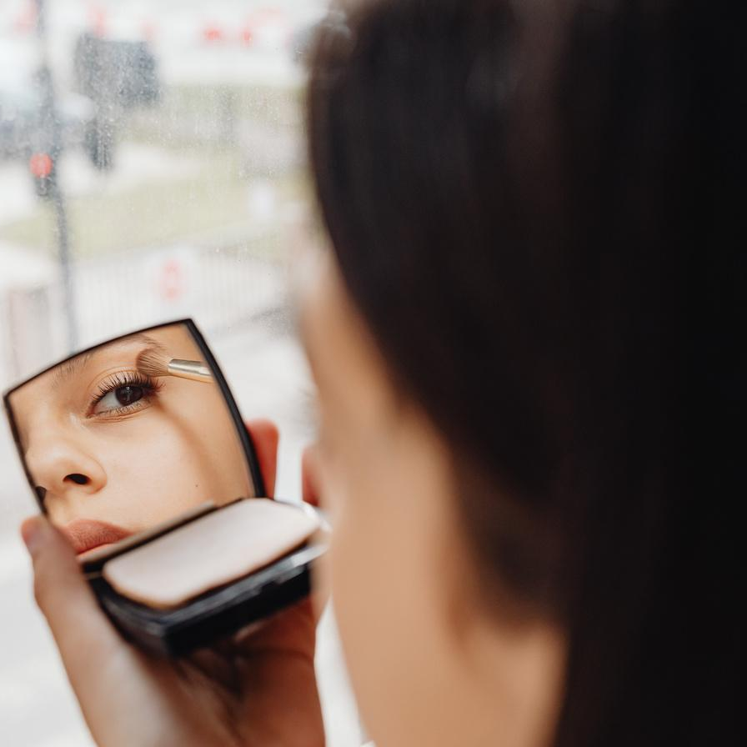
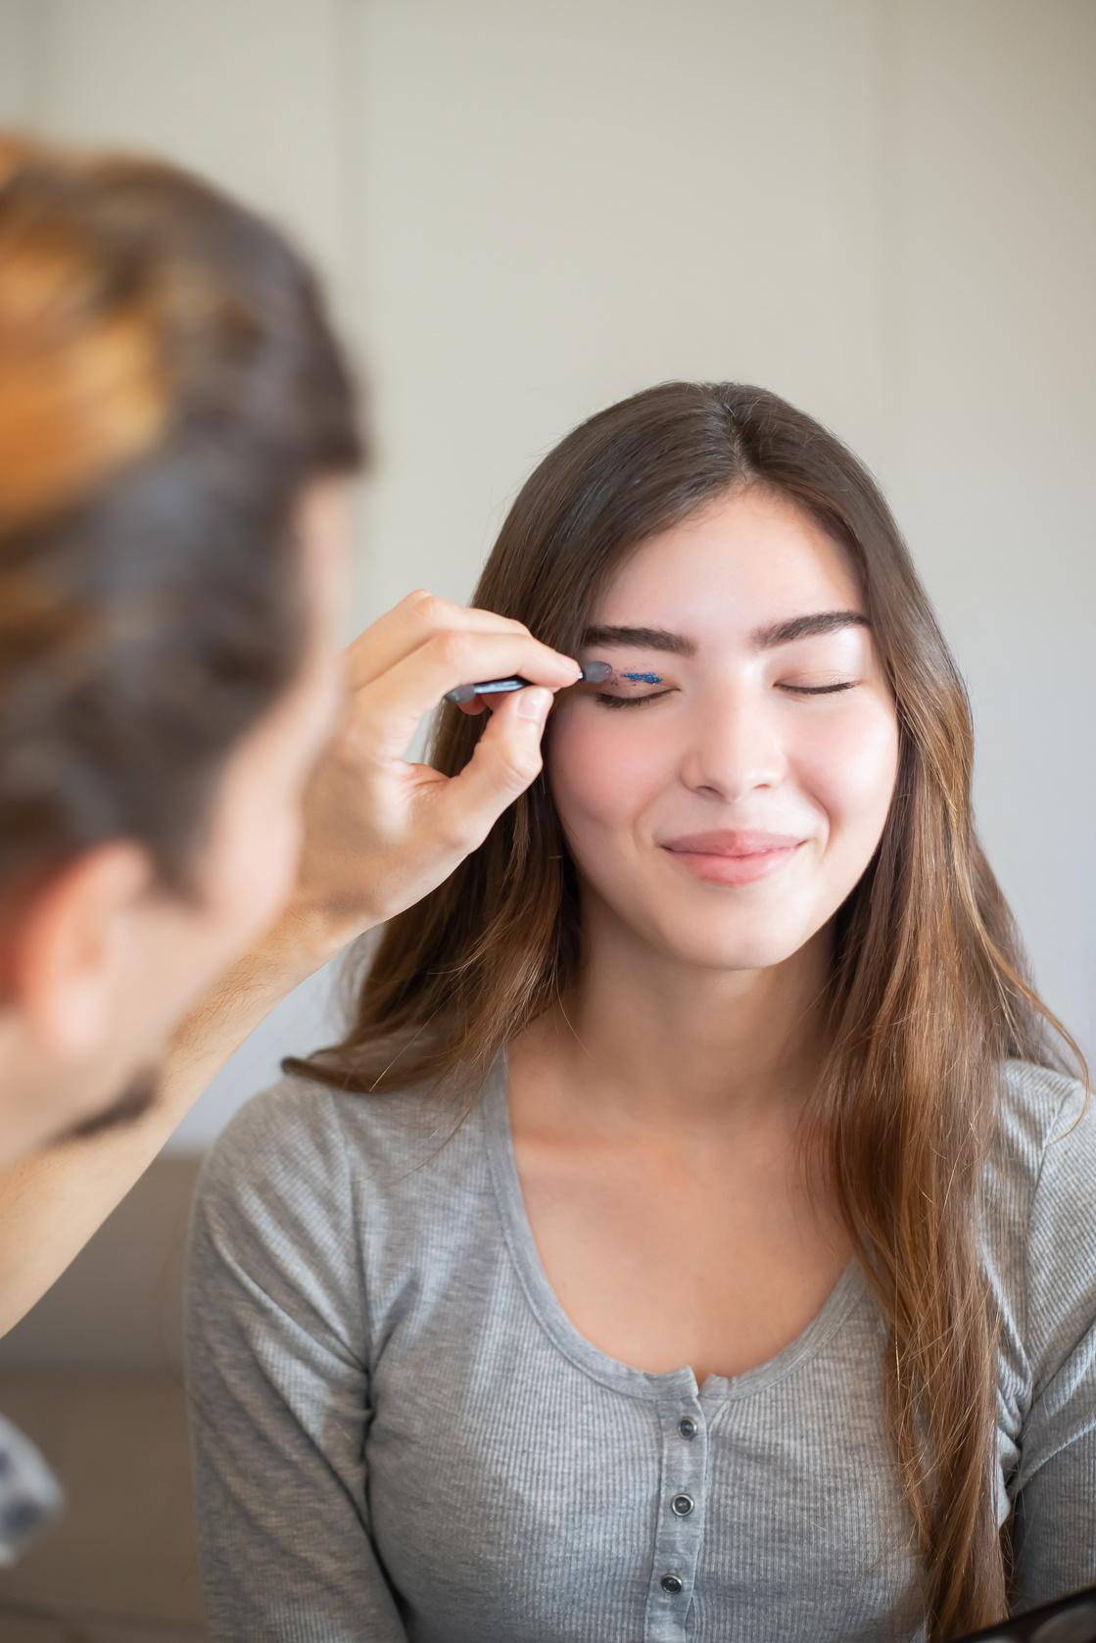

credits.
This presentation template is free for everyone to use thanks to the following:
SlidesCarnival for the presentation template
Pexels for the photos
Happy designing!

