Slide 1
Life Sciences
4th grade
Here is where your presentation begins

Slide 2
Contents of this template
You can delete this slide when you’re done editing the presentation
Fonts | To view this template correctly in PowerPoint, download and install the fonts we used
Used and alternative resources | An assortment of graphic resources that are suitable for use in this presentation
Thanks slide | You must keep it so that proper credits for our design are given
Colors | All the colors used in this presentation
Icons and infographic resources | These can be used in the template, and their size and color can be edited
Editable presentation theme | You can edit the master slides easily. For more info, click here
For more info:
Slidesgo | Blog | FAQs
You can visit our sister projects:
Freepik | Flaticon | Storyset | Wepik | Videvo

Slide 3
What will we learn in this presentation?
01
02
03
04
Science education
Engaging experiments
Learn what science education is for elementary school students
Prepare some interesting and educational science experiments
Choosing science topics
Fun game time
Discover two ways to choose science topics for elementary!
Let's play and have a good time while learning in the classroom

Slide 4
Introduction
Hello, budding scientists! We are thrilled to have you join us today as we embark on a fascinating journey into the incredible world of science. Today's adventure is all about exploration, discovery, and understanding the wonders that surround us every day. Science is like a magical key that unlocks the mysteries of the natural world. From the tiniest insects to the vastness of outer space, there's so much to explore and learn. Throughout our time together, we'll be learning so many new topics about science
We'll delve into the lives of plants, discovering how they grow and thrive. We'll explore the habitats of fascinating animals, learning about their homes and unique behaviors. Rocks and minerals will reveal their ancient stories, and we'll even take a journey to the stars to unravel the mysteries of the night sky. But here's the best part: science isn't just about knowing facts; it's about asking questions and finding creative ways to answer them. So, get ready to use your imagination and curiosity. Let’s start!

Slide 5
01
Science education
Let’s discover the world of science!

Slide 6
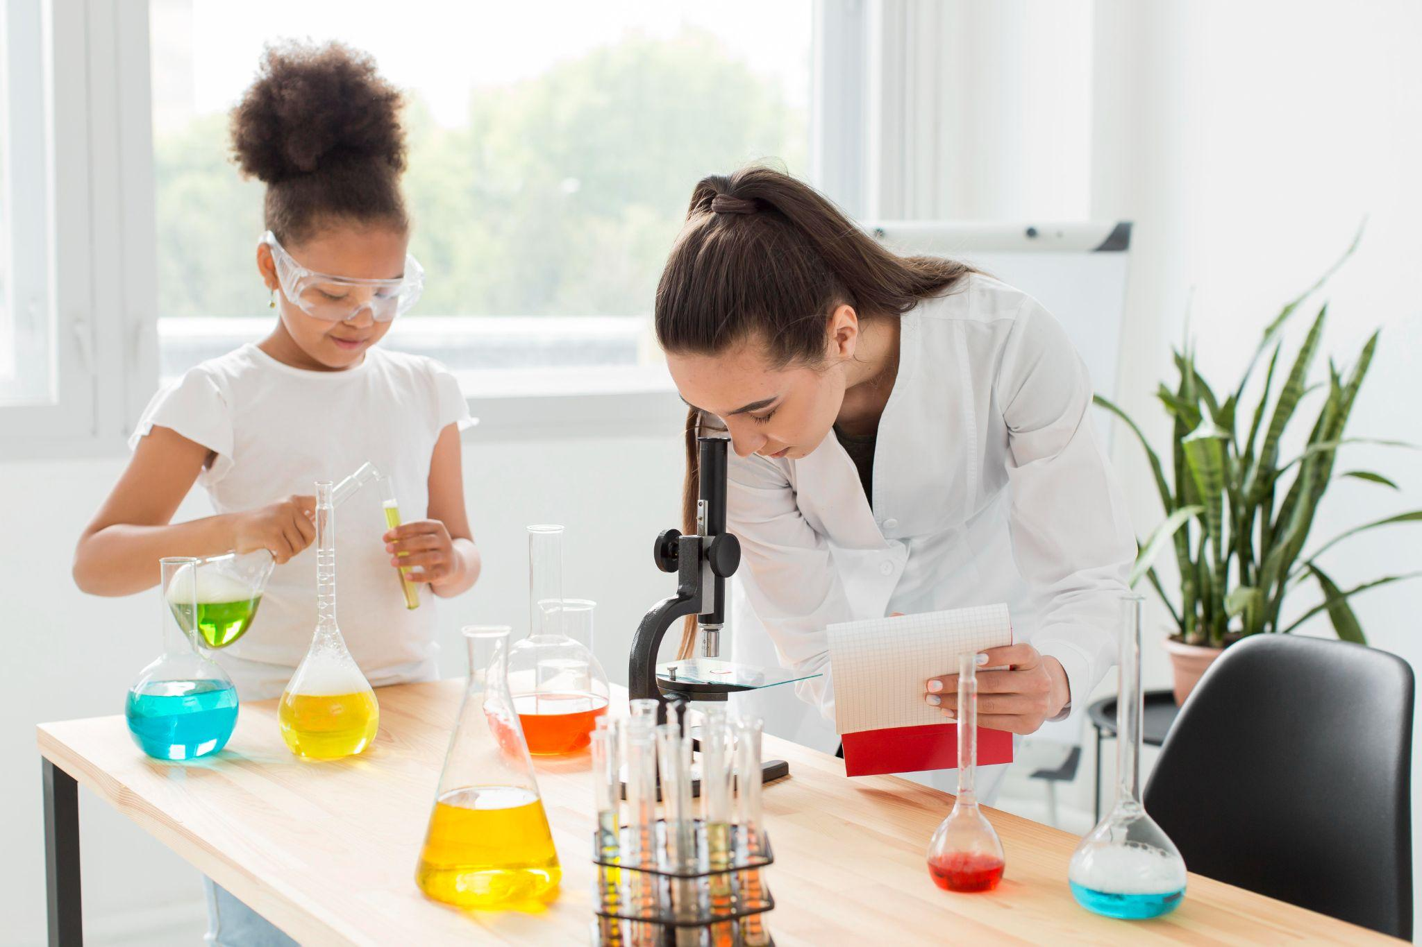
What’s science education?
Science education for elementary aims to introduce foundational concepts and develop a curiosity about the natural world
Encouraging questions and curiosity
Foster love for science
The emphasis in this education is often on hands-on activities, experiments, and real-world observations to engage students

Slide 7
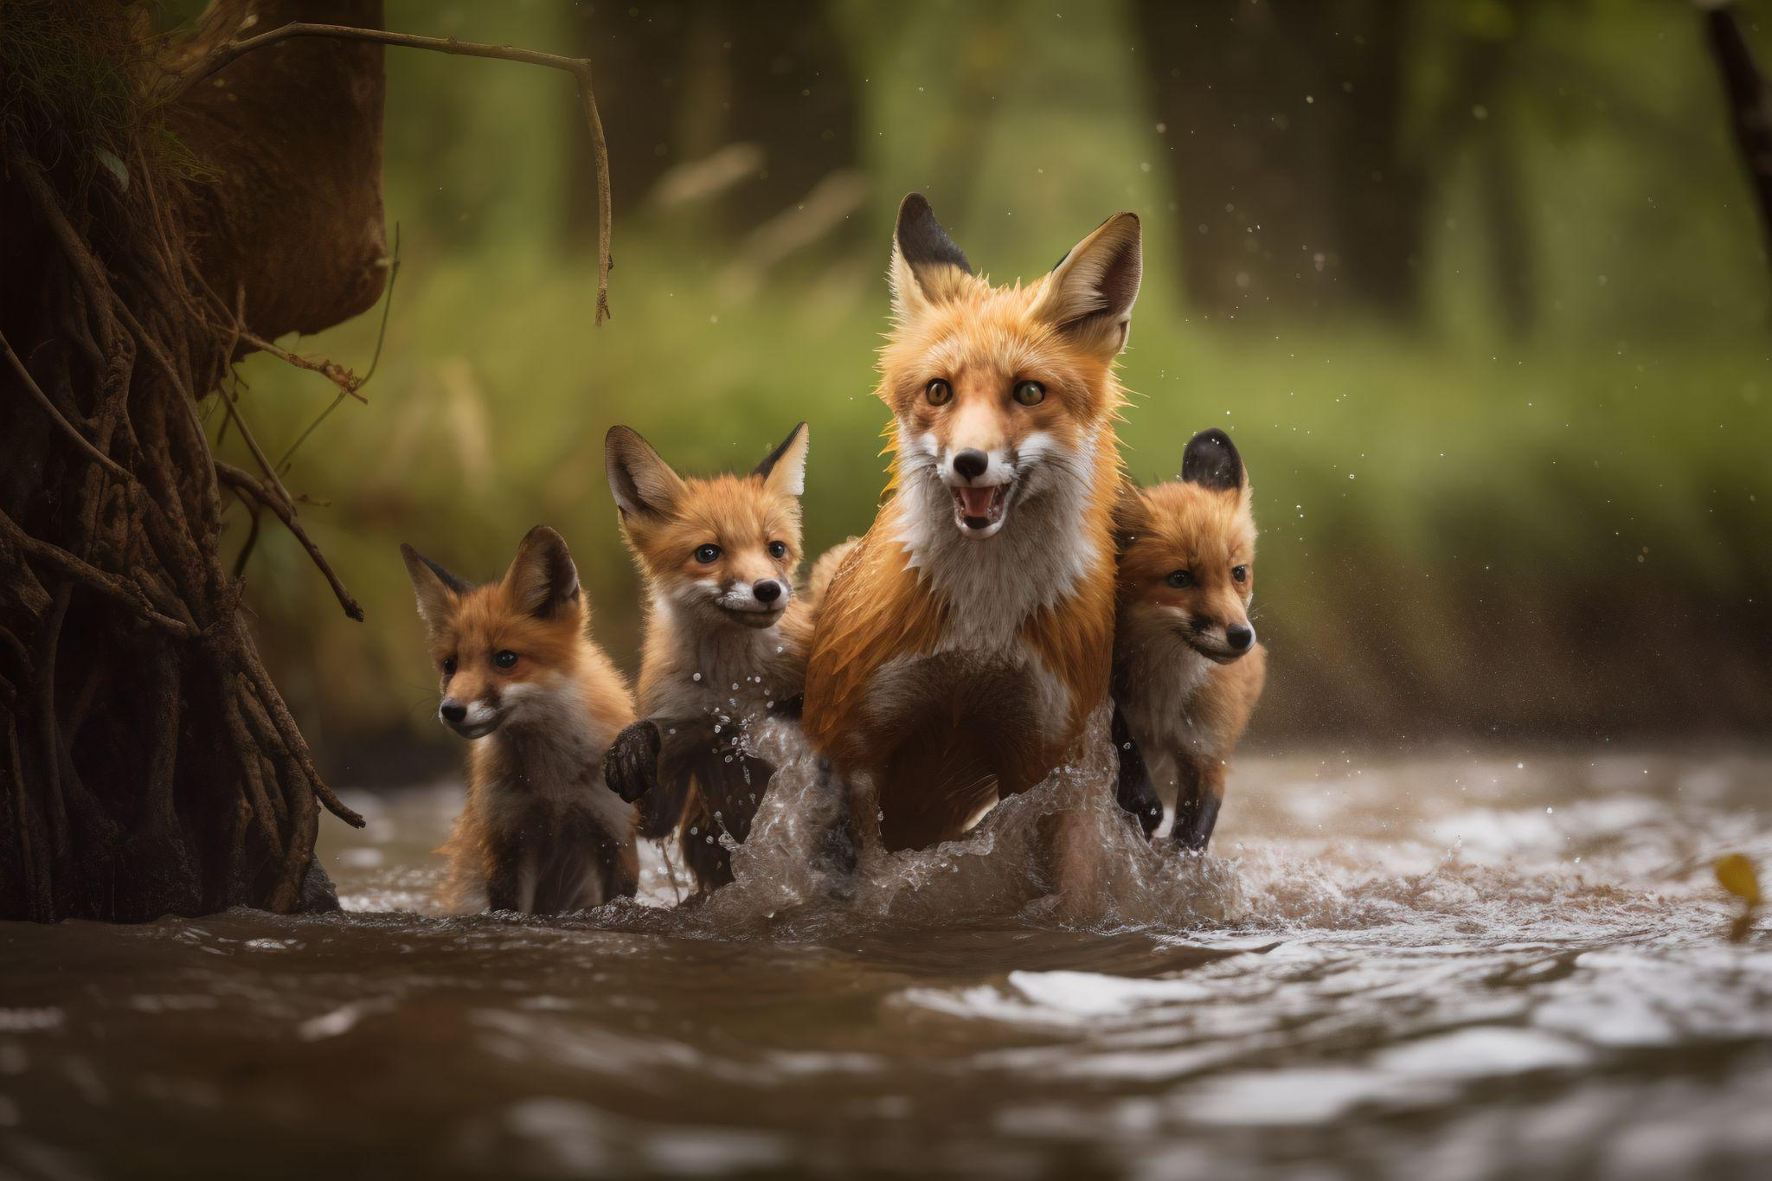
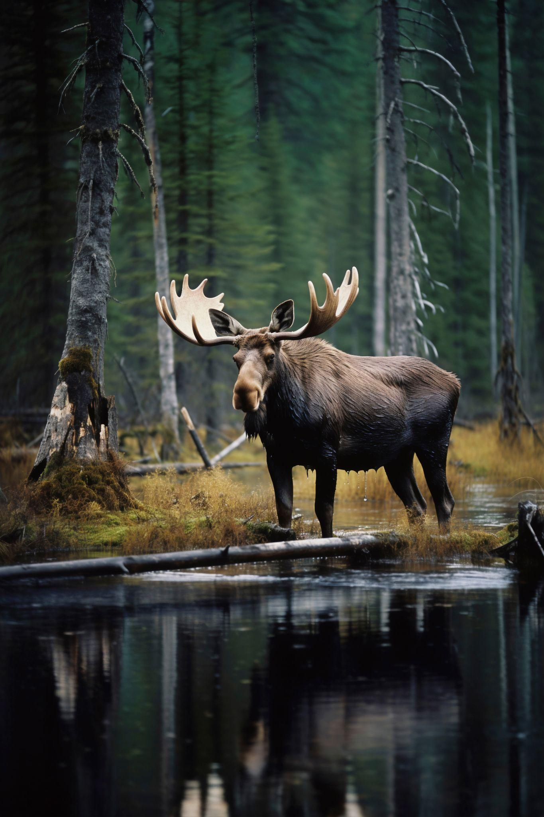
Activity 1: Describe the ecosystem
Display pictures of ecosystems. Students should answer questions about elements in the image related to different science topics, writing the answer in their paper or tog
1
What living things do you see in each picture?
2
Can you identify any interactions between the living things?
3
Are there any non-living elements in the pictures that support life?
4
What do you think the climate might be like in these environments

Slide 8
How to make learning science fun?
Field trips
Use of visual aids
Take students on field trips. Real-world experiences can deepen their understanding and appreciation for science
Utilize visual aids like diagrams, pictures, and videos to enhance understanding. It makes concepts more memorable
Group projects
Collaborative projects provide an opportunity for elementary students to explore scientific concepts together

Slide 9
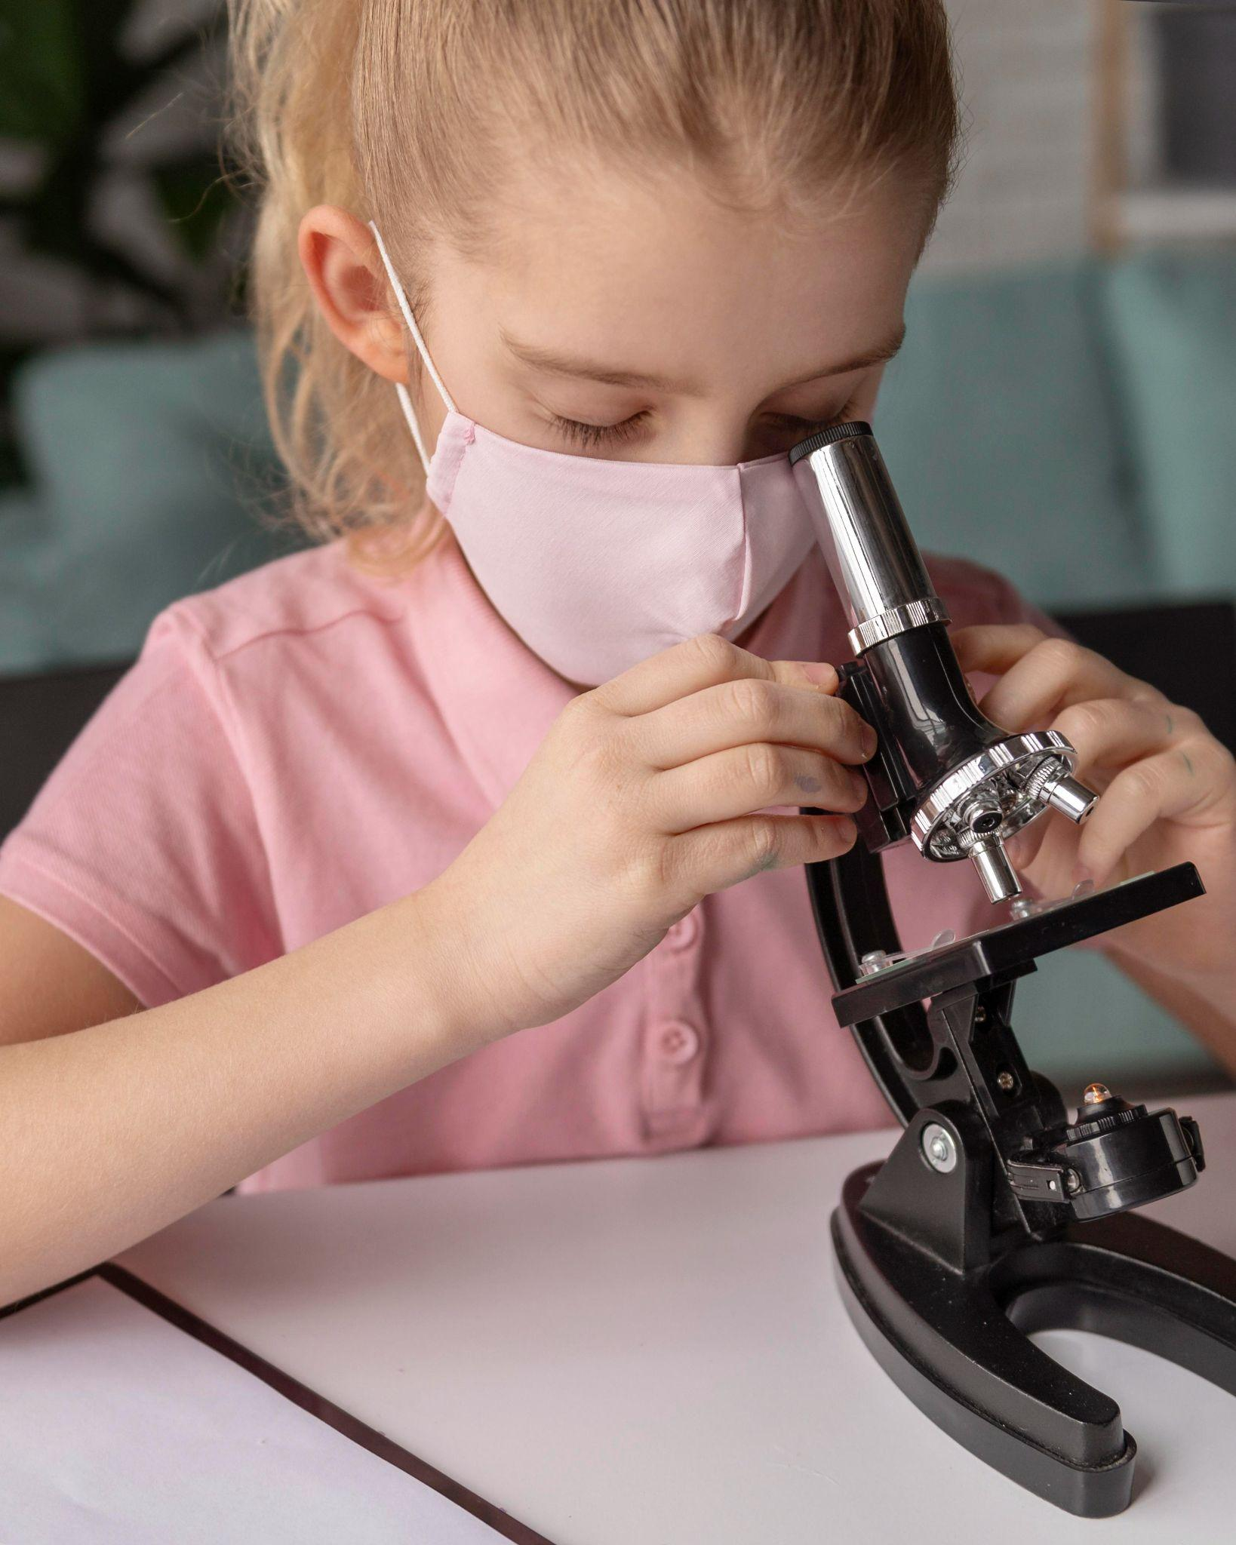
Experiment 1: Observing change
Provide the materials to the students and ask them to place them into water and observe any changes. Students should document observations and discuss them together
What items were placed into the water?
What happened when they were placed in water?
Were there any patterns in the observations?

Slide 10
How to choose science topics?
Observation and exploration
Problem-solving challenges
Encourage students to observe the world around them and identify questions they have about everyday occurrences. By focusing on their environment, they can better connect with and understand the concepts
Present students with real-world problems that can be explored scientifically. This approach allows students to see the practical applications of science and motivates them to find suitable solutions

Slide 11

Visual elements capture students' attention and interest!

Slide 12
Benefits of scientific experiments
Engagement and motivation
Hands-on learning
Problem-solving skills
Fun experiments capture students' interest, making learning more engaging
They encourage a natural desire to explore the world around them
Conducting experiments involve critical thinking and problem-solving skills
Real-life relevance
Communication skills
Building confidence
They help them see the practical applications of scientific concepts
They provide opportunities to develop effective communication skills
Successfully completing experiments can boost students' confidence

Slide 13
Activity 2: Match the fact
Display science facts on one side of the screen and their corresponding answers on the other. Have the class match them correctly
This process is needed for this
Name of the important person
The smallest unit of element is called…
Name of what causes the phenomenon
This phenomenon is formed when this happens
Name of the unit
This is an important discovery by this person
Name of the process

Slide 14
Let’s learn science together

Slide 15
1.67 sextillion
It’s the amount of water molecule that a single drop of water contains

Slide 16
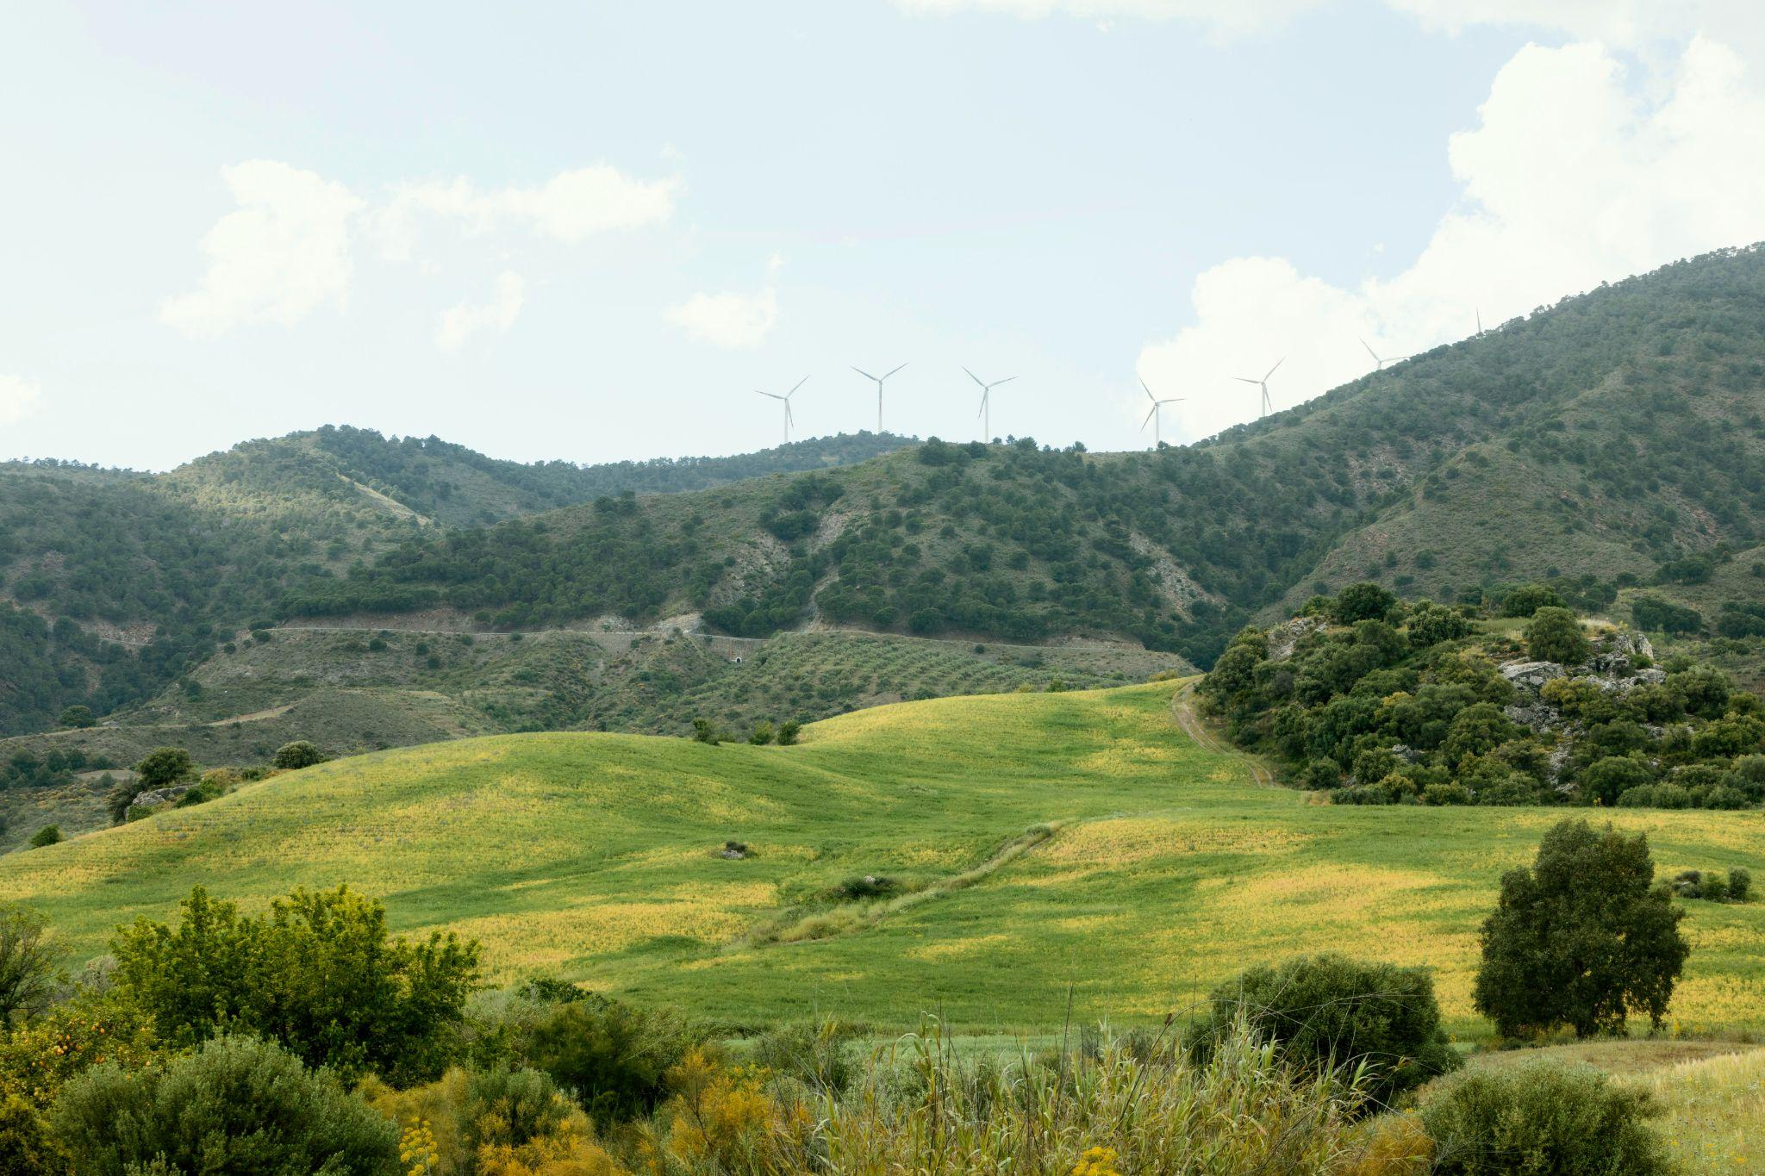
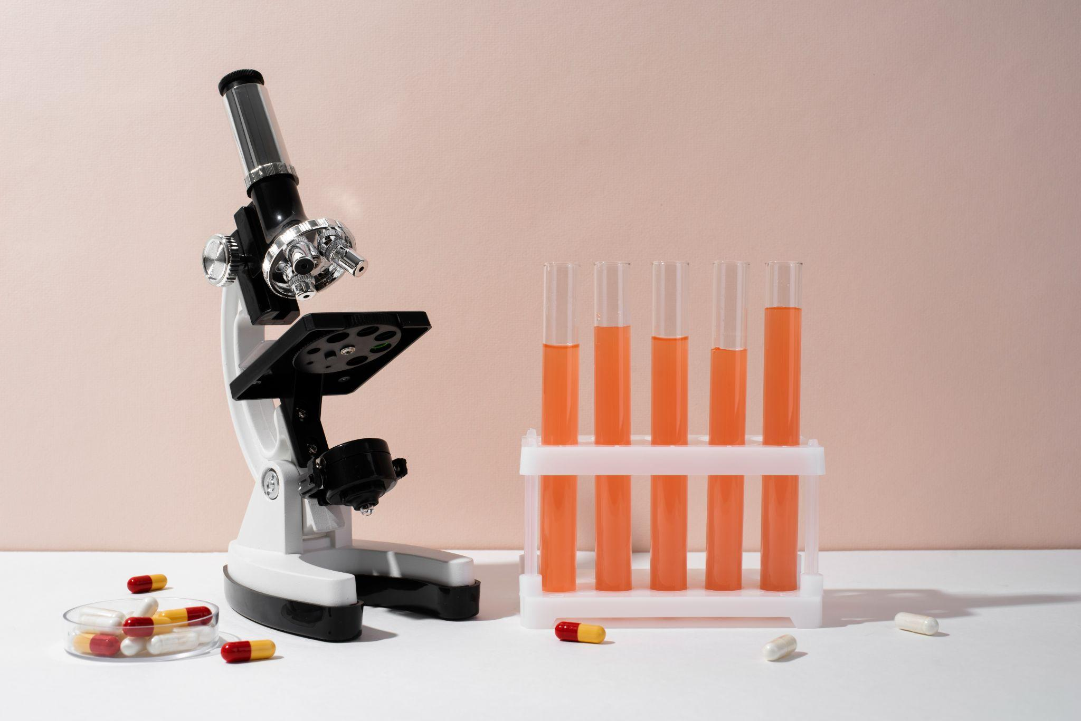
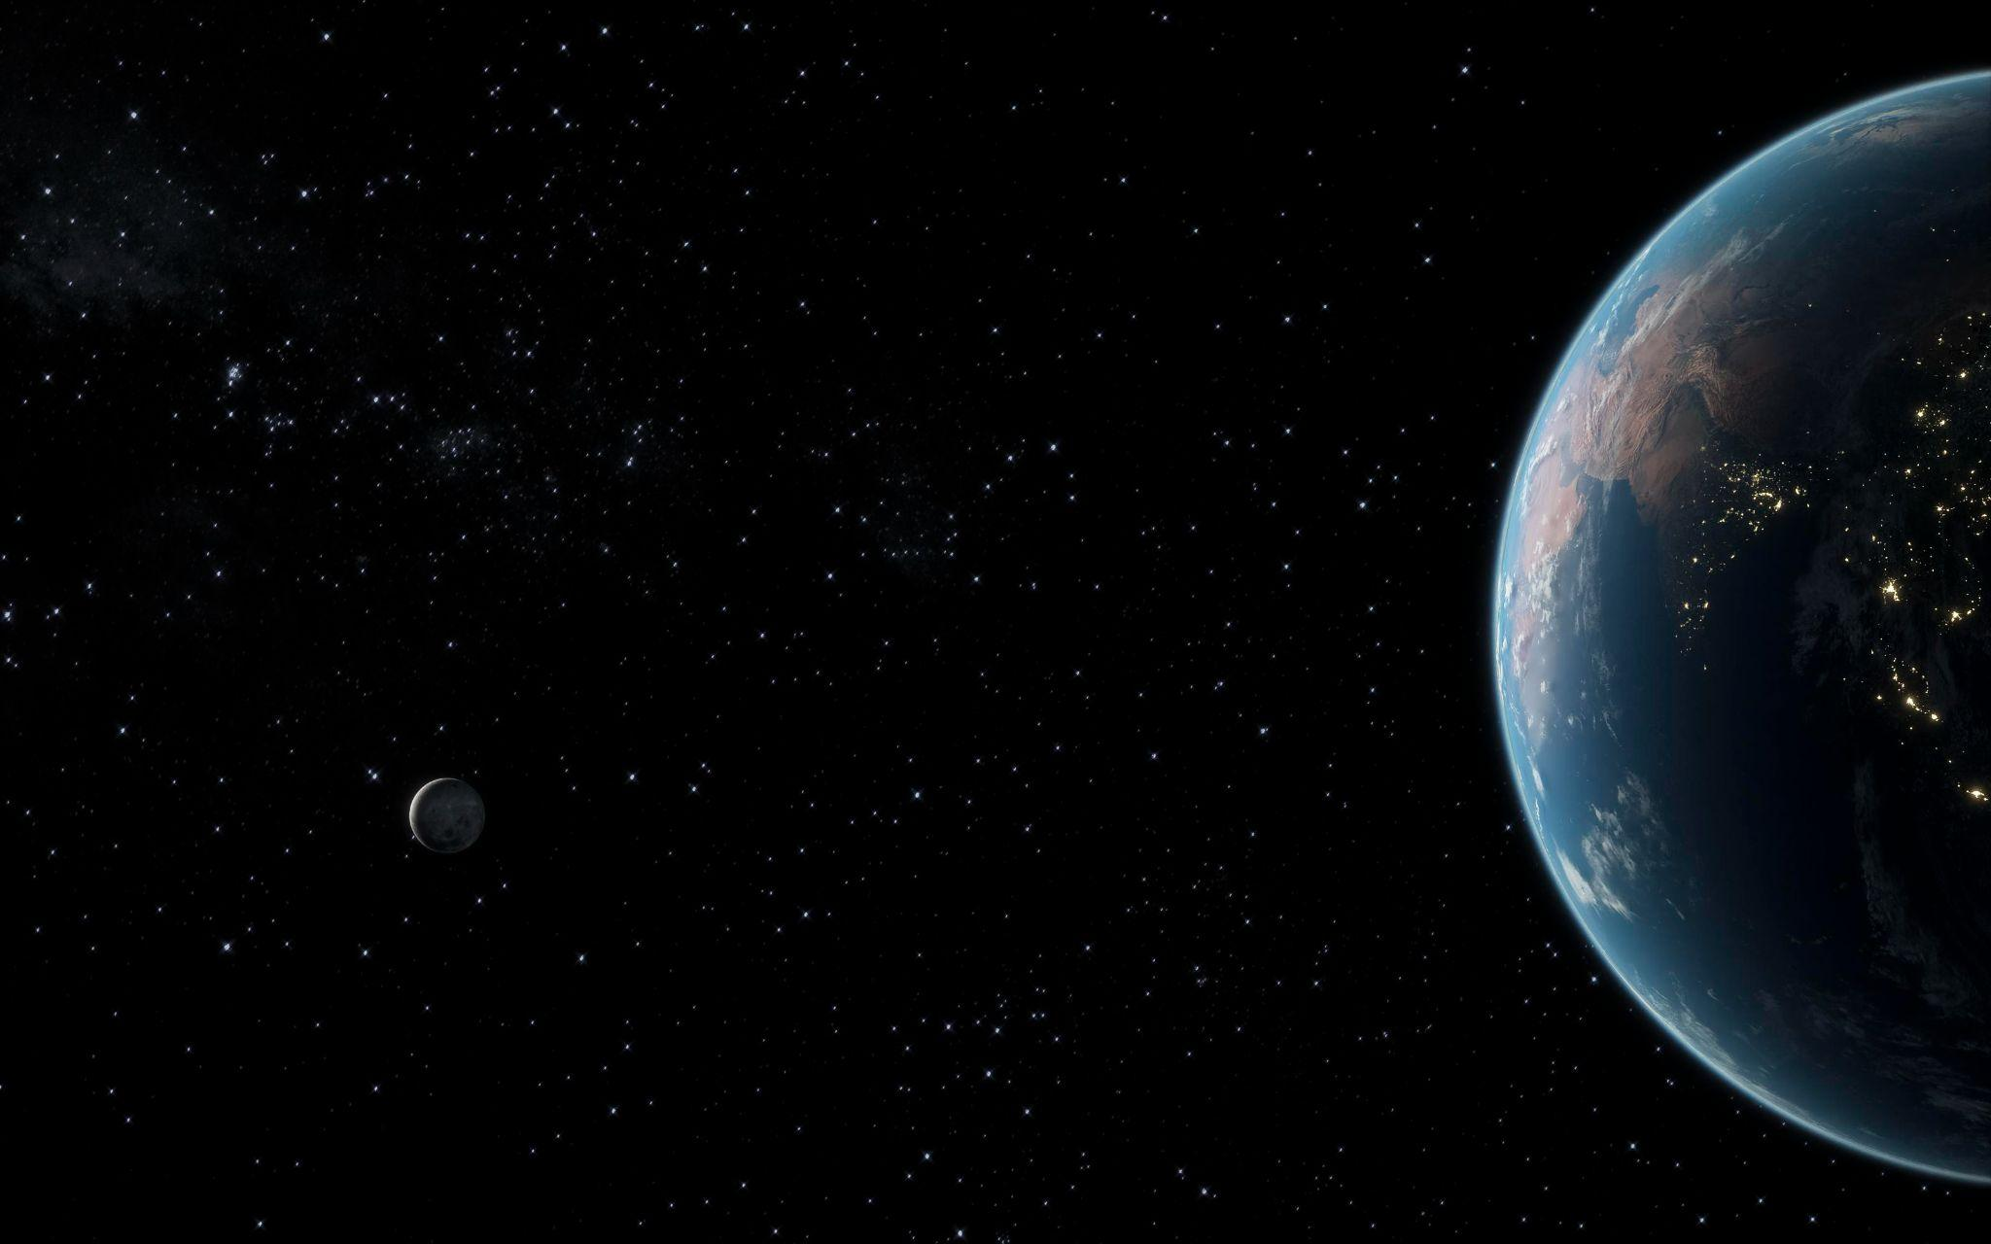
Activity 3: Story building
Share statements about a science topics. Have students decide if each statement is true or false, color the correct option and explain their reasoning as a class
In this environment, this animal can live
We use these items to learn about this
This was created by this phenomenon
True
False
True
False
True
False

Slide 17
This is a timeline!
Renaissance
Present Day
Da Vinci made detailed sketches of many things
Advancements in renewable energy sources
XXXX
XXXX
XXXX
XXXX
Ancient Greece
20th Century
Ancient Greeks invented the water clock
The double helix structure of DNA was determined

Slide 18
What have we learned?
Science topics
Experiments
Science history
Fun science facts
Basic science

Slide 19
Game time: Treasure hunt
Choose a topic, create a treasure and prepare a series of clues related the subject. Students will have to solve puzzles and do actions in order to reach the treasure
Write your first clue
Delete to show Clue 1
Teams | Clue 1 | Clue 2 | Clue 3
Team 1
Team 2
Write your second clue
Delete to show Clue 2
Write your third clue
Delete to show Clue 3

Slide 20
Thanks!
Do you have any questions?
youremail@freepik.com
+34 654 321 432
yourwebsite.com
Please keep this slide for attribution

Slide 21
Alternative resources
Here’s an assortment of alternative resources whose style fits the one of this template:
Biological hierarchy cartoon colorful demonstrated ecosystem with plants animals and fishes illustration

Slide 22
Resources
Did you like the resources of this template? Get them for free at our other websites!
Photos:
Female scientist looking through microscope with girl and test tubes
Cute fox with babies in nature
View of wild elk in nature
Close up kid learning with microscope
Top view on various medical equipment with microscope
Galaxy night landscape
Front view of girl next to desk with potions holding notepad
Extra long shot peaceful landscape with trees
Vectors:
Exotic animals landscape composition
Biological hierarchy color set of isolated animals and plants images with arrows and editable text captions vector

Slide 23
Instructions for use
If you have a free account, in order to use this template, you must credit Slidesgo by keeping the Thanks slide. Please refer to the next slide to read the instructions for premium users.
As a Free user, you are allowed to:
Modify this template.
Use it for both personal and commercial projects.
You are not allowed to:
Sublicense, sell or rent any of Slidesgo Content (or a modified version of Slidesgo Content).
Distribute Slidesgo Content unless it has been expressly authorized by Slidesgo.
Include Slidesgo Content in an online or offline database or file.
Offer Slidesgo templates (or modified versions of Slidesgo templates) for download.
Acquire the copyright of Slidesgo Content.
For more information about editing slides, please read our FAQs or visit our blog:
https://slidesgo.com/faqs and https://slidesgo.com/slidesgo-school

Slide 24
Instructions for use (premium users)
As a Premium user, you can use this template without attributing Slidesgo or keeping the "Thanks" slide.
You are allowed to:
Modify this template.
Use it for both personal and commercial purposes.
Hide or delete the “Thanks” slide and the mention to Slidesgo in the credits.
Share this template in an editable format with people who are not part of your team.
You are not allowed to:
Sublicense, sell or rent this Slidesgo Template (or a modified version of this Slidesgo Template).
Distribute this Slidesgo Template (or a modified version of this Slidesgo Template) or include it in a database or in any other product or service that offers downloadable images, icons or presentations that may be subject to distribution or resale.
Use any of the elements that are part of this Slidesgo Template in an isolated and separated way from this Template.
Register any of the elements that are part of this template as a trademark or logo, or register it as a work in an intellectual property registry or similar.
For more information about editing slides, please read our FAQs or visit our blog:
https://slidesgo.com/faqs and https://slidesgo.com/slidesgo-school

Slide 25
Fonts & colors used
This presentation has been made using the following fonts:
Candal
(https://fonts.google.com/specimen/Candal)
Asap
(https://fonts.google.com/specimen/Asap)
#333333
#e9f1ef
#ffffff
#f3ef73
#5cb8a1
#6dc6b2
#22514d
#ec7f43
#8e827f
#b0dce1

Slide 26





Storyset
Create your Story with our illustrated concepts. Choose the style you like the most, edit its colors, pick the background and layers you want to show and bring them to life with the animator panel! It will boost your presentation. Check out how it works.
Pana
Amico
Bro
Rafiki
Cuate

Slide 27
Use our editable graphic resources...
You can easily resize these resources without losing quality. To change the color, just ungroup the resource and click on the object you want to change. Then, click on the paint bucket and select the color you want. Group the resource again when you’re done. You can also look for more infographics on Slidesgo.

Slide 30
JANUARY
FEBRUARY
MARCH
APRIL
MAY
JUNE
PHASE 1
Task 1
Task 2
PHASE 2
Task 1
Task 2
JANUARY
FEBRUARY
MARCH
APRIL
PHASE 1
Task 1
Task 2

Slide 33
...and our sets of editable icons
You can resize these icons without losing quality.
You can change the stroke and fill color; just select the icon and click on the paint bucket/pen.
In Google Slides, you can also use Flaticon’s extension, allowing you to customize and add even more icons.

Slide 34
Educational Icons
Medical Icons

Slide 37
Creative Process Icons
Performing Arts Icons

Slide 38
Nature Icons

Slide 39
SEO & Marketing Icons

Slide 40


