Slide 1
Be My Valentine
Infographics
Here is where love begins

Slide 2
Be my valentine infographics
This template contains an assortment of complementary infographic resources for the Be My Valentine presentation.
These infographics are adapted to the style of the aforementioned presentation, so you can insert them easily and have them completely integrated at once. You just need to do the following:
  Select the element that you want to copy
  Right-click and choose “Copy”
  Go to the slide where you want the element to appear
  Right-click and choose “Paste”

Slide 3
Be my valentine infographics
25%
75%
Neptune
Venus
Neptune is the farthest planet from the Sun
Venus has a beautiful name, but it’s hot

Slide 4
Be my valentine infographics
Jupiter
Saturn
Jupiter is the biggest planet of them all
It’s the ringed planet and a gas giant
Venus
Mercury
Venus has a beautiful name, but it’s hot
Mercury is the closest planet to the Sun

Slide 5
Be my valentine infographics
Jupiter
50%
25%
Saturn
Jupiter is the biggest planet of them all
It’s the ringed planet and a gas giant
Venus
75%
Venus
100%
Venus has a beautiful name, but it’s hot
Venus has a beautiful name, but it’s hot

Slide 6
Be my valentine infographics
Step 1
Step 2
Step 3
Venus is a hot planet
Mercury is very small
Mars is made of basalt
Step 6
Step 5
Step 4
Saturn has rings
The Sun is a star
We live on Earth

Slide 7
Be my valentine infographics
Jupiter
Saturn
15%
50%
Jupiter is the biggest planet of them all
It’s the ringed planet and a gas giant
Venus
Mercury
25%
10%
Venus has a beautiful name, but it’s hot
Mercury is the closest planet to the Sun

Slide 8
Be my valentine infographics
0%-25%
51%-75%
Jupiter is the biggest planet of them all
It’s the ringed planet and a gas giant
26%-50%
76%-100%
Venus has a beautiful name, but it’s hot
Venus has a beautiful name, but it’s hot

Slide 9
Be my valentine infographics
Bio
Hobbies
Despite being red, Mars is actually a cold place. The planet is full of iron oxide dust
Name | Education
Jenna & John | MBA
Age | Location
40 & 42 | USA
Occupation | Teachers
Personalities
Introvert
Extrovert
Mature
Immature
Cheerful
Serious
Dependent
Independent

Slide 10
Be my valentine infographics
Mercury
Mars
Mercury is the closest planet to the Sun
Despite being red, it is actually a cold place
Neptune
Neptune is the farthest planet from the Sun and the fourth-largest in our Solar System
Saturn
Venus
Saturn is the ringed one and a gas giant
Venus has a beautiful name, but it’s hot

Slide 11
Be my valentine infographics
Mercury is very small
The Sun is a star
Venus
Saturn
Earth
20xx
20xx
20xx
20xx
20xx
Mercury
The Sun
Venus is a hot planet
Saturn has rings
We live on Earth

Slide 12
Be my valentine infographics
Step 1
Step 2
Jupiter is the biggest planet of them all
It’s the ringed planet and a gas giant
Step 4
Step 3
Venus has a beautiful name, but it’s hot
Mercury is the closest planet to the Sun

Slide 13
Be my valentine infographics
Service | Description | Price
Venus | Venus is the second planet from the Sun | $xx
Mercury | Mercury is the closest planet to the Sun | $xx
Mars | Despite being red, Mars is a very cold place | $xx
Jupiter | Jupiter is the biggest planet of them all | $xx

Slide 14
Be my valentine infographics
“Neptune is the farthest planet from the Sun”
“It’s composed mostly of hydrogen and helium”
Neptune
Saturn
“Despite being red, Mars is actually a cold place”
“Jupiter is the biggest planet of them all”
Mars
Jupiter

Slide 15
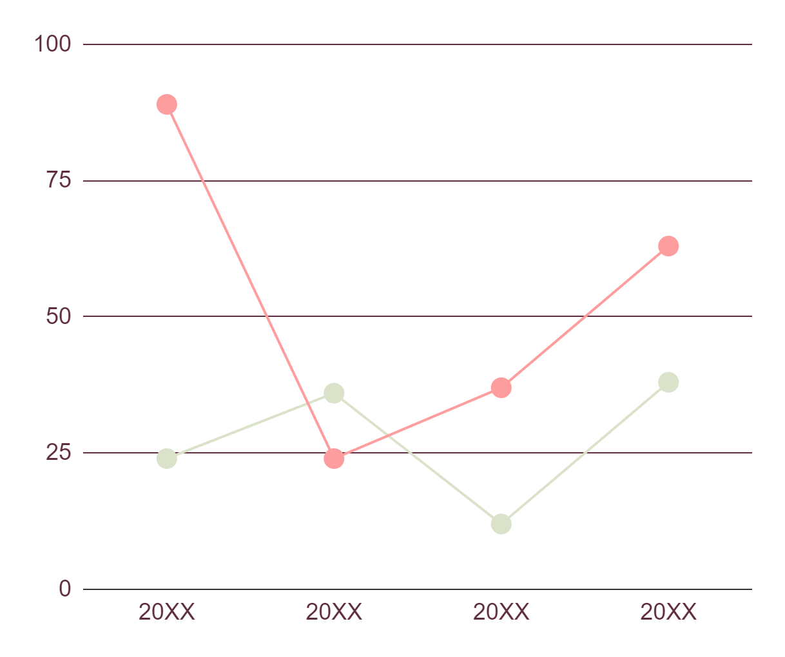
Be my valentine infographics
Saturn
Venus
Venus has a beautiful name and is the second planet from the Sun. It’s terribly hot, even hotter than Mercury
Saturn is a gas giant and has rings. It’s composed mostly of hydrogen and helium. It’s the sixth planet from the Sun
Follow the link in the graph to modify its data and then paste the new one here. For more info, click here

Slide 16
Be my valentine infographics
Mercury
10%
Saturn
35%
Venus
25%
Mars
20%
Mercury is the closest planet to the Sun
Saturn is the ringed one and a gas giant
Venus has a beautiful name, but it’s hot
Despite being red, it is actually a cold place

Slide 17
Be my valentine infographics
50%
35%
15%
Jupiter is the biggest planet
Venus has a beautiful name
Saturn is the ringed planet
Jupiter
Venus
Saturn

Slide 18
Be my valentine infographics
10%
Jupiter
Saturn
40%
Jupiter is the biggest planet of them all
It’s the ringed planet and a gas giant
20%
Venus
Mercury
30%
Venus has a beautiful name, but it’s hot
Mercury is the closest planet to the Sun

Slide 19
Be my valentine infographics
Sun
Venus
Neptune
Venus is the second planet from the Sun
Neptune is the farthest planet from the Sun
Saturn
Mercury
Jupiter
Mars
Saturn is a gas giant with rings
Mercury is the smallest planet
Jupiter is the biggest planet
Mars is actually a very cold place

Slide 20
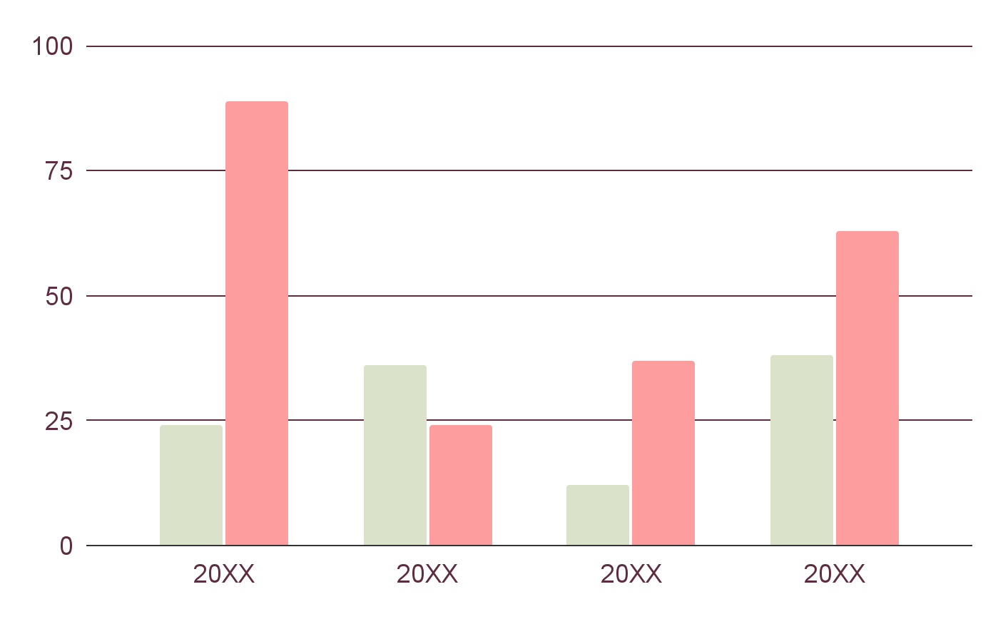
Be my valentine infographics
Saturn
It’s the ringed planet and a gas giant
Venus
Venus has a beautiful name, but it’s hot
Follow the link in the graph to modify its data and then paste the new one here. For more info, click here

Slide 21
Be my valentine infographics
Mercury
Venus
Mars
65%
35%
75%
25%
Mars is actually a cold place
Saturn
25%
75%
50%
50%
Saturn is the ringed one and a gas giant
Jupiter
Earth

Slide 22
Be my valentine infographics
20xx
20xx
20xx
20xx
Mercury
Saturn
Venus
Mars
Mercury is the closest planet to the Sun
Saturn is the ringed one and a gas giant
Venus has a beautiful name, but it’s hot
Despite being red, it is actually a cold place

Slide 23
Be my valentine infographics
Mercury
Mars
Mercury is the closest planet to the Sun
Despite being red, it is actually a cold place
Saturn
Venus
Saturn is the ringed one and a gas giant
Venus has a beautiful name, but it’s hot

Slide 24
Be my valentine infographics
Mars
Mars is actually a cold place
30%
60%
20%
60%
10%
20%
Venus
Venus has a beautiful name
Mercury
Saturn
Jupiter
Mercury is the closest planet to the Sun
Saturn is the ringed one and a gas giant
Jupiter is the biggest planet

Slide 25
Be my valentine infographics
Mercury
Venus
Mercury is the closest planet to the Sun
Venus has a beautiful name, but it’s hot
Mars
80%
Mars
90%
Saturn
50%
Saturn
30%
15%
30%
50%
25%
70%
75%
20xx
20xx
20xx
20xx
20xx
20xx

Slide 26
Be my valentine infographics
#1
#2
Saturn
Venus
#3
Mercury
Venus has a beautiful name, but it’s hot
Saturn is the ringed one and a gas giant
Mercury is the closest planet to the Sun

Slide 27
Be my valentine infographics
Pluto
Jupiter
Pluto is considered a dwarf planet
It’s the biggest planet in our Solar System
Neptune
Mars
Mercury
Neptune is the farthest planet from the Sun and the fourth-largest in our Solar System
Despite being red, it is actually a cold place
Mercury is the closest planet to the Sun
Venus
Saturn
Venus has a beautiful name, but it’s hot
Saturn is the ringed one and a gas giant

Slide 28
Be my valentine infographics
20xx
Mercury
Mercury is the closest planet to the Sun
20xx
Venus
Venus has a beautiful name, but it’s hot
20xx
Mars
Despite being red, it is actually a cold place

Slide 29
Be my valentine infographics
Mercury
Mars
Mercury is the closest planet to the Sun
Despite being red, it is actually a cold place
Saturn
Venus
Saturn is the ringed one and a gas giant
Venus has a beautiful name, but it’s hot

Slide 30
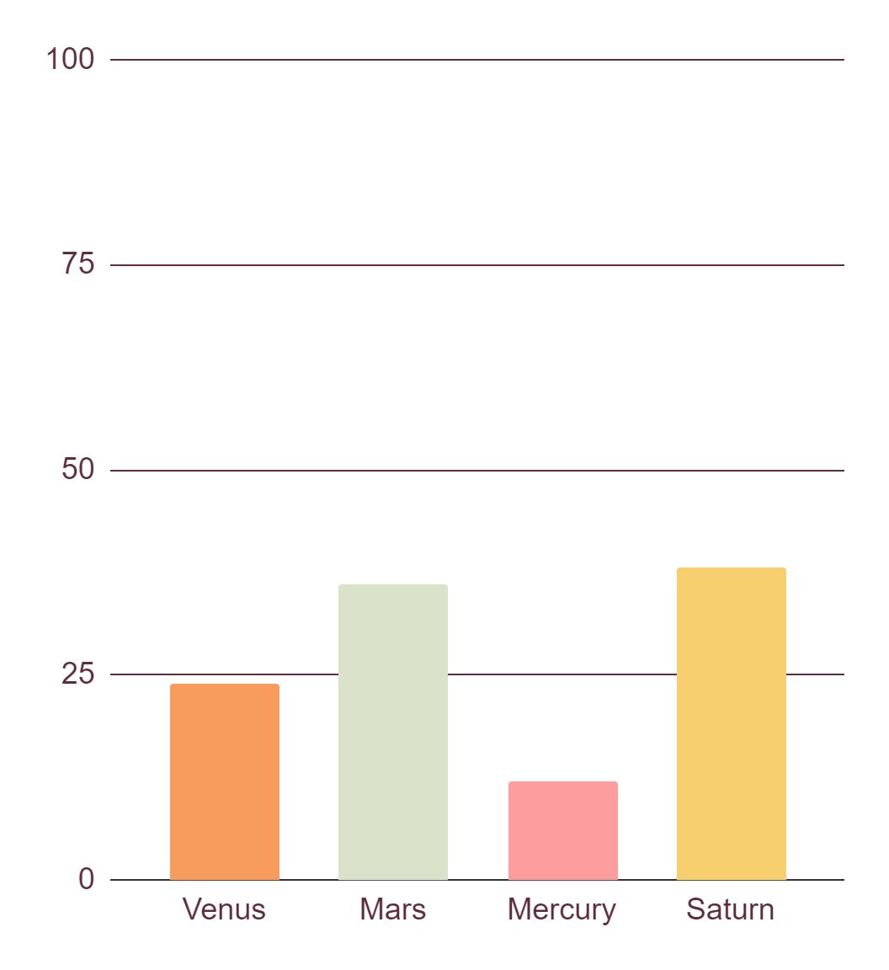
Be my valentine infographics
Venus
Mars
Venus has a beautiful name, but it’s hot
Mars is actually a cold place
Mercury
Saturn
Mercury is the closest planet to the Sun
Saturn is the ringed one and a gas giant
Follow the link in the graph to modify its data and then paste the new one here. For more info, click here

Slide 31
Be my valentine infographics
Things they like to do as a couple
Jupiter
Saturn
Jupiter is the biggest planet of them all
It’s the ringed planet and a gas giant
Venus
Mercury
Venus has a beautiful name, but it’s hot
Mercury is the closest planet to the Sun

Slide 32
Be my valentine infographics
Mercury
Mars
Mercury is the closest planet to the Sun
Despite being red, it is actually a cold place
Saturn
Venus
Saturn is the ringed one and a gas giant
Venus has a beautiful name, but it’s hot

Slide 33
Instructions for use
If you have a free account, in order to use this template, you must credit Slidesgo in your final presentation. Please refer to the next slide to read the instructions for premium users.
As a Free user, you are allowed to:
- Modify this template.
- Use it for both personal and commercial projects.
You are not allowed to:
- Sublicense, sell or rent any of Slidesgo Content (or a modified version of Slidesgo Content).
- Distribute Slidesgo Content unless it has been expressly authorized by Slidesgo.
- Include Slidesgo Content in an online or offline database or file.
- Offer Slidesgo templates (or modified versions of Slidesgo templates) for download.
- Acquire the copyright of Slidesgo Content.
For more information about editing slides, please read our FAQs or visit our blog:
https://slidesgo.com/faqs and https://slidesgo.com/slidesgo-school

Slide 34
Instructions for use (premium users)
As a Premium user, you can use this template without attributing Slidesgo.
You are allowed to:
Modify this template.
Use it for both personal and commercial purposes.
Share this template in an editable format with people who are not part of your team.
You are not allowed to:
Sublicense, sell or rent this Slidesgo Template (or a modified version of this Slidesgo Template).
Distribute this Slidesgo Template (or a modified version of this Slidesgo Template) or include it in a database or in any other product or service that offers downloadable images, icons or presentations that may be subject to distribution or resale.
Use any of the elements that are part of this Slidesgo Template in an isolated and separated way from this Template.
Register any of the elements that are part of this template as a trademark or logo, or register it as a work in an intellectual property registry or similar.
For more information about editing slides, please read our FAQs or visit our blog:
https://slidesgo.com/faqs and https://slidesgo.com/slidesgo-school

Slide 35
Infographics
You can add and edit some infographics to your presentation to present your data in a visual way.
Choose your favourite infographic and insert it in your presentation using Ctrl C + Ctrl V or Cmd C + Cmd V in Mac.
Select one of the parts and ungroup it by right-clicking and choosing “Ungroup”.
Change the color by clicking on the paint bucket.
Then resize the element by clicking and dragging one of the square-shaped points of its bounding box (the cursor should look like a double-headed arrow). Remember to hold Shift while dragging to keep the proportions.
Group the elements again by selecting them, right-clicking and choosing “Group”.
Repeat the steps above with the other parts and when you’re done editing, copy the end result and paste it into your presentation.
Remember to choose the “Keep source formatting” option so that it keeps the design. For more info, please visit our blog.

