Slide 1







Acting
Studio Name

Slide 2



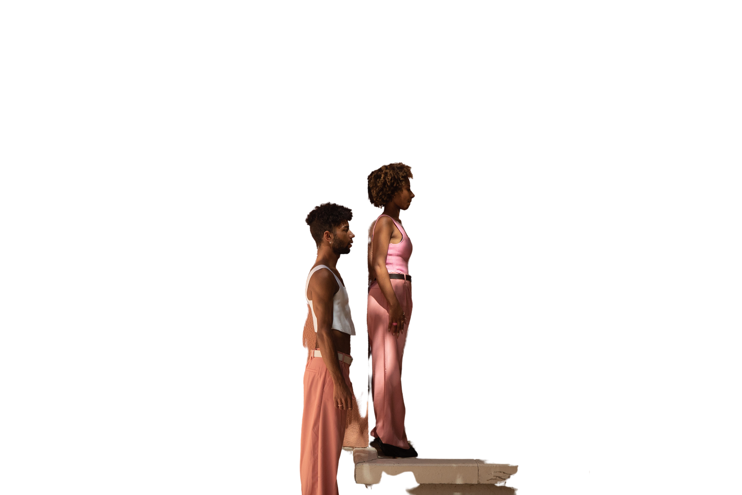
How to Use
Google Slides
PowerPoint
Canva
Click on the "Google Slides" button below this presentation preview. Make sure to sign in to your Google account. Click on "Make a copy." Start editing your presentation.
Alternative: Click on the "Share" button on the top right corner in Canva and click on "More" at the bottom of the menu. Enter "Google Drive" in the search bar and click on the GDrive icon to add this design as a Google slide in your GDrive.
Click on the "PowerPoint" button below this presentation preview. Start editing your presentation.
Alternative: From Canva template file, Click on the "Share" button on the top right corner in Canva and click on "More" at the bottom of the menu. Enter "PowerPoint" in the search bar and click on the PowerPoint icon to download.
Click on the "Canva" button under this presentation preview. Start editing your presentation. You need to sign in to your Canva account.

Slide 3



Agenda Page
Write an agenda here.
Write an agenda here.
Write an agenda here.
Write an agenda here.

Slide 4




Hello there!
  I'm Rain, and I'll be sharing with you my beautiful ideas. Follow me at @reallygreatsite to learn more.

Slide 5

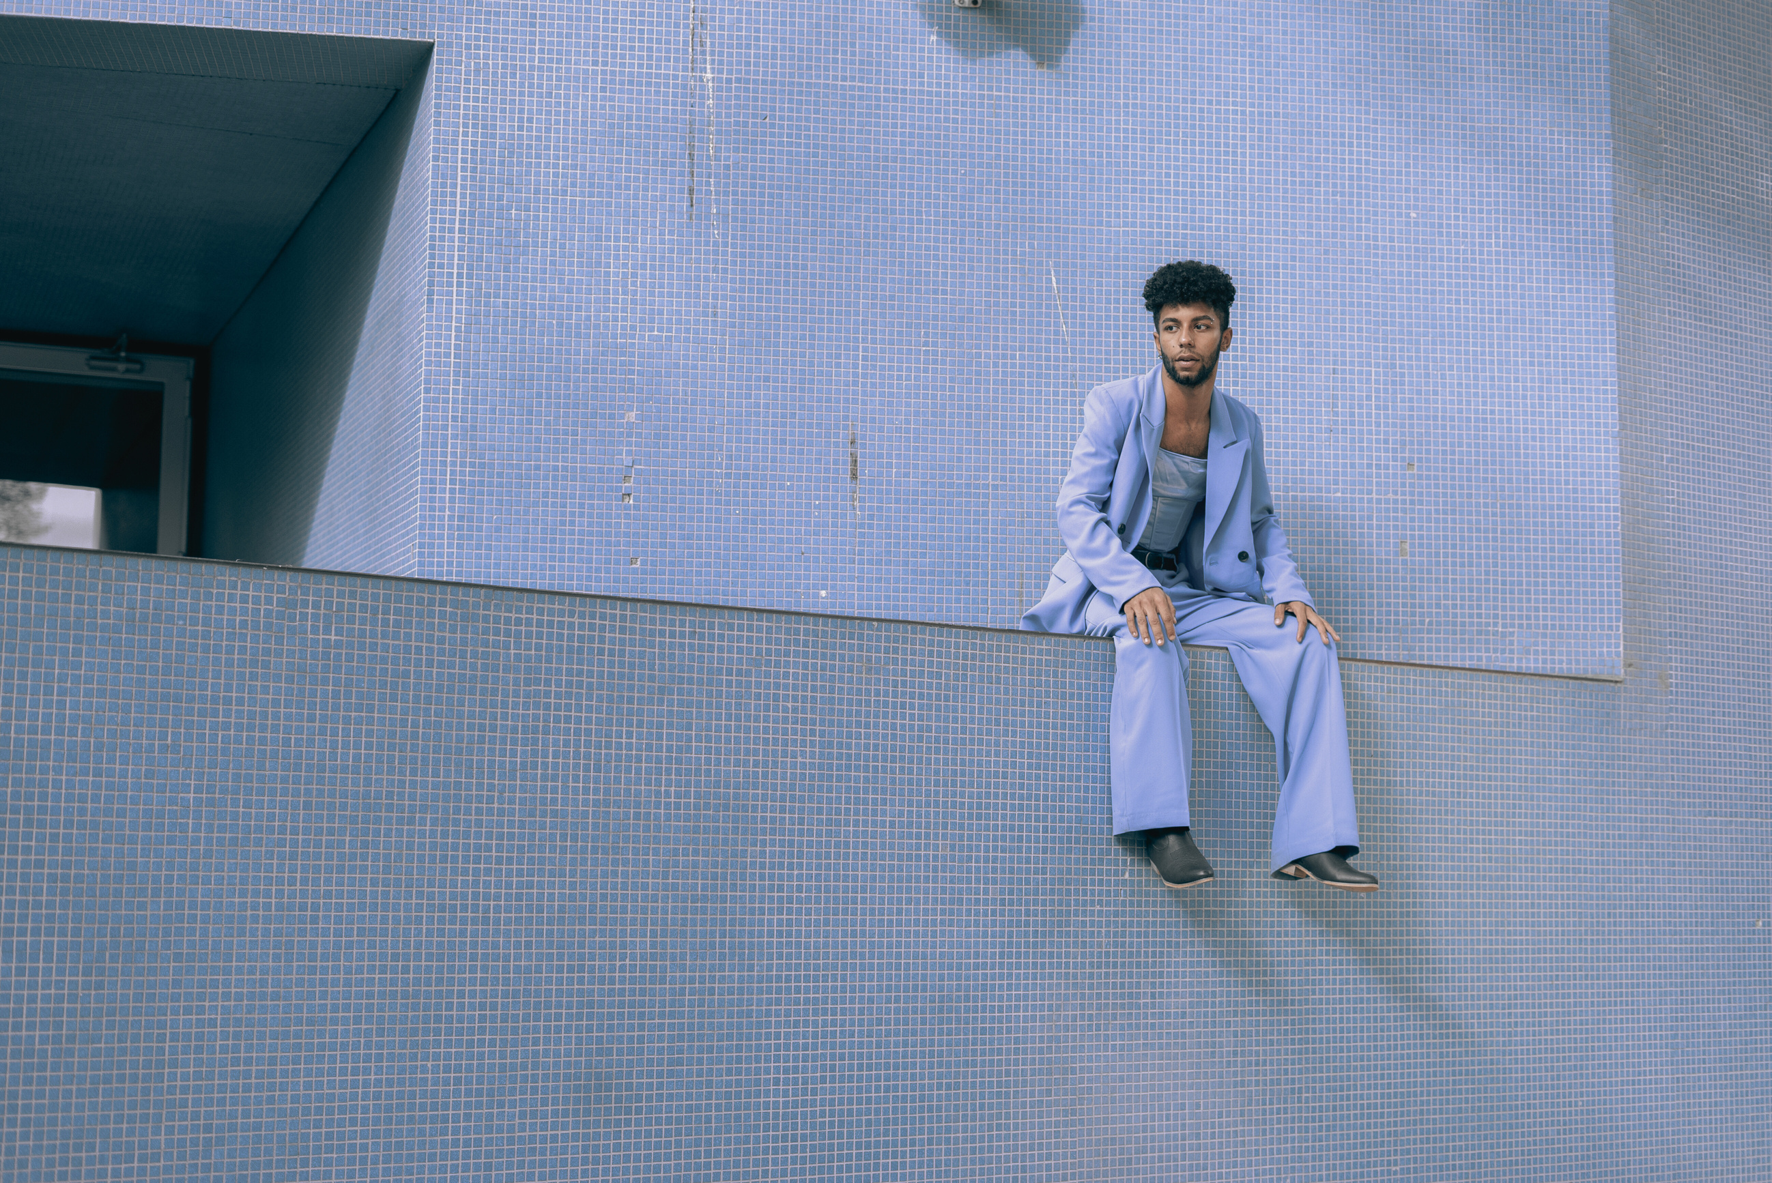
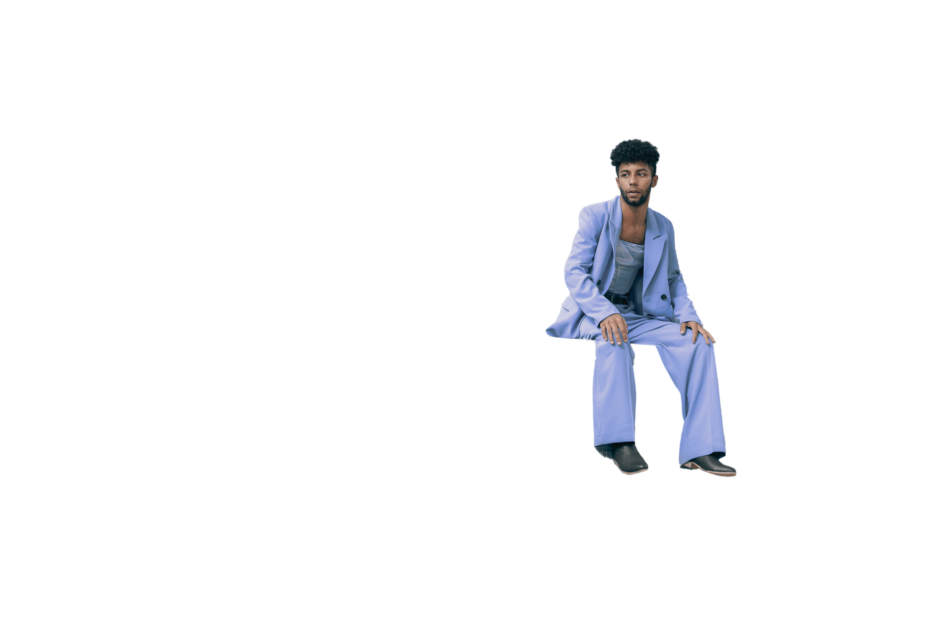


Character Development Techniques
Backstory Exploration
This technique involves creating a detailed history for a character, even if it won't be explicitly shown in the performance.
Objective-Obstacle Alignment
Actors identify their character's primary objective or goal in a scene and the obstacles preventing them from achieving it.

Slide 6



Physicality and Gestures:
  Developing distinct physical traits and gestures for a character can significantly enhance their portrayal. Actors explore how their character moves, stands, and uses gestures, allowing them to convey personality traits, emotions, and intentions nonverbally. This technique adds depth and authenticity to the character.

Slide 7



Define Objectives:
Identify Obstacles:
Clearly articulate what you're trying to achieve. These objectives should be specific, measurable, achievable, relevant, and time-bound (SMART).
Brainstorm and list potential obstacles or challenges that could hinder your progress. These could be internal or external factors
Prioritize Obstacles:
Communication:
Determine the likelihood and impact of each obstacle. Focus on the obstacles that are most likely to occur and have the greatest potential to disrupt your progress.
If you're working within a team or organization, make sure everyone is aware of the potential obstacles and the strategies in place to address them.

Slide 8


"Yes, And..." Principle:
This foundational technique encourages actors to accept and build upon their scene partner's contributions. By agreeing ("Yes") and then adding new information ("And"), improvisers create a seamless and collaborative scene that progresses naturally.
Emotional Focus:
This technique centers on exploring and conveying genuine emotions within improvised scenes. By tapping into their own emotions and connecting with their character's feelings, actors can create more relatable and emotionally resonant performances.

Slide 9


Casting and Auditioning Practices
Cattle Call Auditions:
Cattle call auditions, often referred to as open auditions, are large-scale casting events where actors of all levels of experience and background can audition for roles.
Self-Tape Auditions:
Actors receive audition materials (sides, script excerpts) and record their performances on camera, often at home or in a controlled environment.

Slide 10






Write a caption for the photos.

Slide 11




Add a Section Header

Slide 12







Research:
  Here are some key areas of market research related to acting:
  Elaborate on the featured statistic.
  Elaborate on the featured statistic.
  Elaborate on the featured statistic.

Slide 13


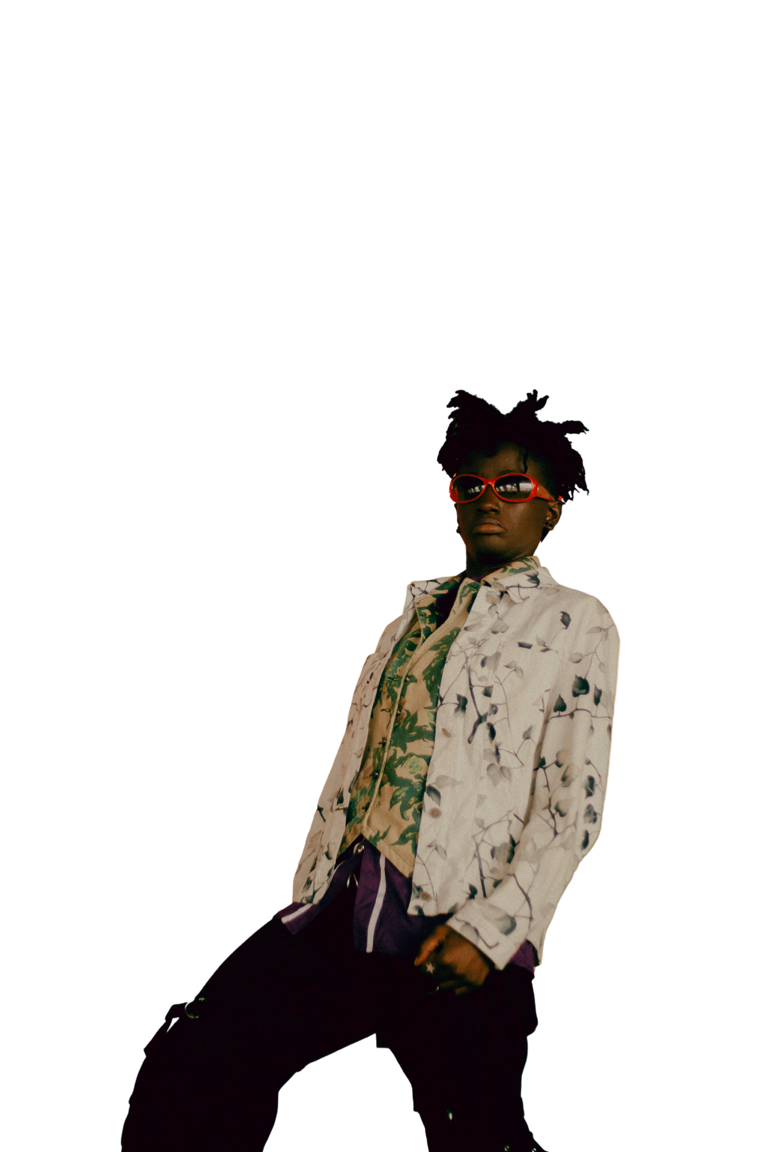


Add a Team Members Page
Name
Name
Name
Name
Title Or Position
Title Or Position
Title Or Position
Title Or Position

Slide 14

Write an original statement or inspiring quote
  — Include a credit, citation, or supporting message

Slide 15

Thank you!
  Write a closing statement or call-to-action here.

Slide 16
Resource
Page
Use these design resources in your
Canva Presentation.
This presentation template uses the following free fonts:
Titles: Batangas
Headers: Alata
Body Copy: Montserrat
You can find these fonts online too. Happy designing!
Don't forget to delete this page
before presenting.

Slide 17

This presentation template is free for everyone to use thanks to the following:
  SlidesCarnival for the presentation template
  Pexels for the photos
Happy designing!

