Slide 1
5G Wireless Technology Campaign
Here is where your presentation begins

Slide 2
Contents of this template
You can delete this slide when you’re done editing the presentation
Fonts | To view this template correctly in PowerPoint, download and install the fonts we used
Used and alternative resources | An assortment of graphic resources that are suitable for use in this presentation
Thanks slide | You must keep it so that proper credits for our design are given
Colors | All the colors used in this presentation
Icons and infographic resources | These can be used in the template, and their size and color can be edited
Editable presentation theme | You can edit the master slides easily. For more info, click here
For more info:
SLIDESGO | BLOG | FAQs
You can visit our sister projects:
FREEPIK | FLATICON | STORYSET | WEPIK | VIDEVO

Slide 3
Table of contents
01
04
02
05
03
06
Campaign objectives
Content design and creation
Target audience identification
Promotion and distribution
Content strategy
Metrics and analysis

Slide 4

Marketing campaign
Creating a successful marketing campaign requires careful planning and execution. To ensure success, every campaign should include:
Clear objectives aligned with business goals
A deep understanding of the target audience
A comprehensive content strategy that outlines creation, distribution, and promotion
By including these essential components, businesses can create effective, efficient, and impactful campaigns

Slide 5
01
Campaign objectives

Slide 6
Campaign objectives
Defining objectives
Clear, measurable objectives are crucial for a successful marketing campaign. Start by considering what you want to achieve and define key performance indicators (KPIs) to measure success
Business goals
Align campaign objectives with business goals by understanding your company's mission, vision, and values. Identify how the campaign can contribute to achieving these goals and adjust objectives accordingly

Slide 7
Target audience identification
Market research
Buyer personas
Targeting
Gather data on demographics, interests, pain points, and purchasing habits of potential customers. Analyze the data to understand your ideal customer
Create detailed buyer personas based on demographic and psychographic data to tailor your marketing message and strategy to resonate with your target audience
Refine your targeting with audience segmentation and retargeting. Segment your audience based on shared characteristics or behaviors. Retarget people who have interacted with your brand

Slide 8
Content strategy
Content goals
The audience
Set SMART (Specific, Measurable, Achievable, Relevant, Time-bound) goals to align your content strategy with your business objectives
Create content that resonates with your target audience by understanding their pain points, interests, and the behavior the audience shows
Content plan
Measure and refine
Create a content plan that maps out topics, formats, channels, and timelines. Consider the buyer's journey and use a content calendar to organize
Measure the effectiveness of your content and refine your strategy based on data. Analyze metrics such as traffic, engagement, and conversion

Slide 9
Content design and creation
Brand identity
Visual elements
Engaging headlines
Define your brand identity with a clear brand message, voice, and visual elements. Use a style guide to ensure consistency across all your content
Choose visual elements that reflect your brand personality and align with your message. Use high-quality images, graphics, and videos to engage
Create headlines that grab attention and communicate the value of your content. Use numbers, questions, and power words for your headlines
Concise copy
Visual hierarchy
Mobile
Craft copy that is clear, concise, and easy to understand. Use simple language and avoid jargon. Break up long paragraphs into shorter ones
Incorporate visual hierarchy to guide the viewer's attention through your content. Use contrast, size, and placement to create a clear visual hierarchy
Optimize your content for mobile devices with a responsive design and easy-to-read font sizes. Use high-quality images

Slide 10
$143,752
The budget for our next marketing campaign

Slide 11
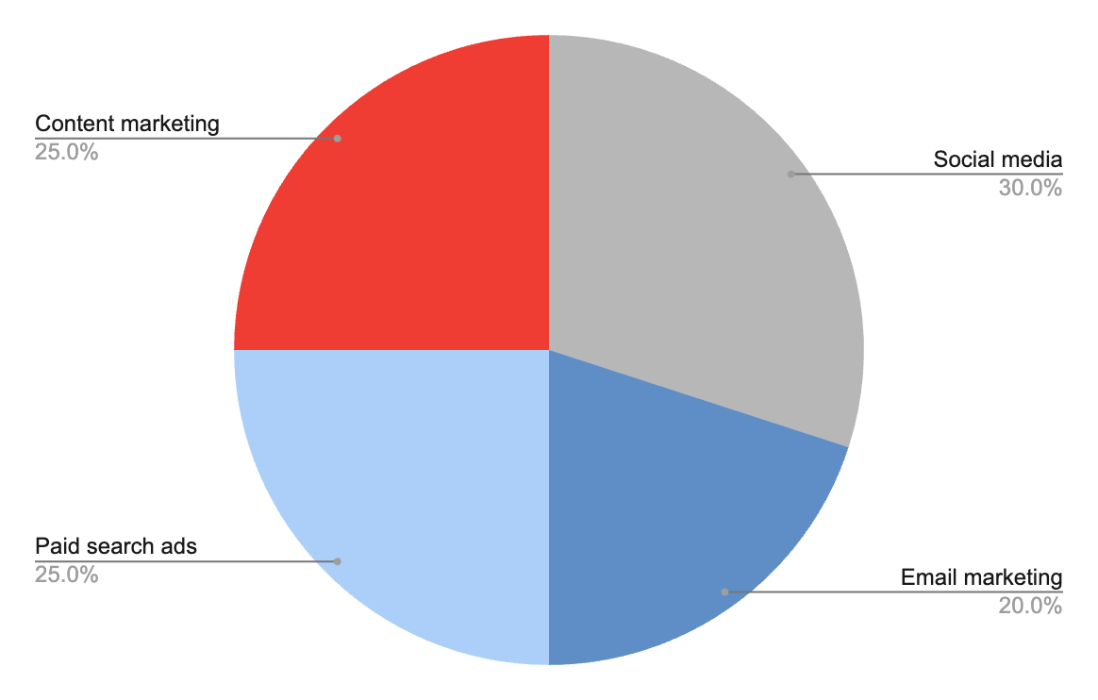
Budget breakdown
This is how we use
our resources
Our marketing budget is divided into social media advertising (30%), email marketing (20%), paid search ads (25%), and 25% for content marketing and influencer partnerships. This allocation is based on our previous campaign's effectiveness and targets
Follow the link in the graph to modify its data and then paste the new one here. For more info, click here

Slide 12
Budget of the campaign
Item | Objective/metric | Estimated cost ($)
Research and planning | Market research, competitor analysis, etc. | $500
Creative content | Design, copywriting, content creation, etc. | $1,000
Digital marketing | Website development, SEO, online ads, etc. | $1,500
Social media advertising | Reach and engagement on social media | $800
Email marketing | Click-through rate, conversion rate, etc. | $300
Pay-per-click advertising | Click-through rate, conversion rate, etc. | $700
Event or sponsorship | Brand exposure, lead generation, etc. | $1,000
Contingency (5-10% of budget) |  | $300-600
Total |  | $6,300-6,800

Slide 13



The tone of the campaign
Use a friendly and approachable tone that fosters a sense of connection and trust with the audience. Showcase vibrant visuals that reflect the brand personality and resonate with the audience

Slide 14

Buyer persona infographic
Jenna Doe
Bio
Motivations
32 years old
Marketing manager
Busy professional who loves the field but also enjoys traveling and spending time with family and friends
1
Grow my business
"I always look for brands that share my values and beliefs"
2
Achieve financial independence
3
Find work-life balance
Personality
Pain points
Confident and assertive when it comes to decision-making
Creative and always looking for new ideas
Empathetic and able to understand others' perspectives and ideas
Struggles to balance work and personal life due to a busy schedule and overwhelming tasks both at home and work

Slide 15
Roadmap infographic
Initiative | Objective | Week 1 | Week 2 | Week 3 | Week 4 | Week 5 | Week 6
Research and planning | Market research, competitor analysis, defining objectives |  |  | X | X
Creative development | Design marketing materials, write copy | X | X
Social Media | Create and schedule social media posts, run paid ads |  | X | X | X
Pay-Per-Click Ads | Set up and optimize PPC advertising |  |  |  | X | X
Event or Sponsorship | Expand the company's reach to new target markets |  |  |  |  | X | X
Campaign Review | Increase brand recognition through brand awareness campaigns |  |  |  | X | X | X

Slide 16
SWOT
Strengths
Weaknesses
List internal strengths that give a competitive advantage
Include unique selling propositions, talented team, strong brand reputation, etc
S
W
Identify internal weaknesses that may hinder success
Mention resource limitations, expertise gaps, or potential obstacles
Opportunities
Threats
Highlight external opportunities to leverage
Include market trends, untapped segments, favorable industry developments
O
T
Recognize external threats that could impact performance
Address competition, changing consumer behavior, or risks

Slide 17
Key communication channels
Social media platforms
Utilize engaging posts, captivating visuals, and relevant hashtags to increase brand visibility and foster interaction
Email marketing
Implement email marketing as a personalized and direct communication channel with potential and existing customers
Influencer partnerships
Collaborate with influencers and key opinion leaders (KOLs) in the industry to expand the campaign's reach and credibility

Slide 18
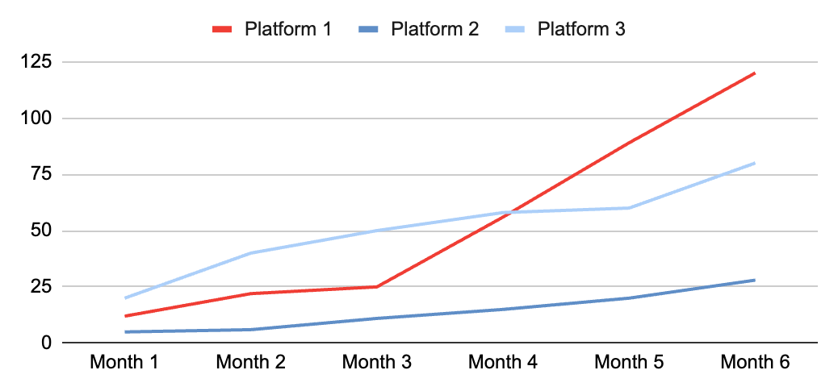
Metrics
Increase website traffic
Social media follower growth
Achieve a 30% increase in website traffic compared to the previous quarter
The graph will showcase the campaign's success in attracting new followers and increasing its
social media reach
Boost conversion rate
Improve the conversion rate by 15% from the current baseline
Enhance social media engagement
Achieve a 20% increase in engagement compared to the previous month
Follow the link in the graph to modify its data and then paste the new one here. For more info, click here

Slide 19
Case studies
Campaign objective
Approach
"Highlight the product impact to boost sales"
Utilize email marketing campaigns to promote the case study and highlight key product features
Leverage the power of social media to engage with our target audience
Deploy targeted ads to reach potential customers and increase brand visibility
Results
23%
Increase in page views
Key takeaway 1
Targeted ads, social media, and email reach customers
80%
Increase in sales
Increase in clicks
Key takeaway 2
Improved profitability through different streamlined operations
+10%

Slide 20
Thanks
Does anyone have any questions?
addyouremail@freepik.com
+91 620 421 838
yourwebsite.com
Please keep this slide for attribution

Slide 21
Alternative resources
Here’s an assortment of alternative resources whose style fits the one of this template:
Illustrations:
5g internet flat color set with human characters and gadgets isolated on white background vector illustration

Slide 22
Resources
Did you like the resources on this template? Get them for free at our other websites:
Illustrations:
5g internet flat color set with human characters and gadgets isolated on white background vector illustration
Photos:
Team working together on project
Team working together on project
People having fun in their break time
Person using ai tool at job
Beautiful woman with curly hair posing in a confident way

Slide 23
Instructions for use
If you have a free account, in order to use this template, you must credit Slidesgo by keeping the Thanks slide. Please refer to the next slide to read the instructions for premium users.
As a Free user, you are allowed to:
Modify this template.
Use it for both personal and commercial projects.
You are not allowed to:
Sublicense, sell or rent any of Slidesgo Content (or a modified version of Slidesgo Content).
Distribute Slidesgo Content unless it has been expressly authorized by Slidesgo.
Include Slidesgo Content in an online or offline database or file.
Offer Slidesgo templates (or modified versions of Slidesgo templates) for download.
Acquire the copyright of Slidesgo Content.
For more information about editing slides, please read our FAQs or visit our blog:
https://slidesgo.com/faqs and https://slidesgo.com/slidesgo-school

Slide 24
Instructions for use (premium users)
As a Premium user, you can use this template without attributing Slidesgo or keeping the "Thanks" slide.
You are allowed to:
Modify this template.
Use it for both personal and commercial purposes.
Hide or delete the “Thanks” slide and the mention to Slidesgo in the credits.
Share this template in an editable format with people who are not part of your team.
You are not allowed to:
Sublicense, sell or rent this Slidesgo Template (or a modified version of this Slidesgo Template).
Distribute this Slidesgo Template (or a modified version of this Slidesgo Template) or include it in a database or in any other product or service that offers downloadable images, icons or presentations that may be subject to distribution or resale.
Use any of the elements that are part of this Slidesgo Template in an isolated and separated way from this Template.
Register any of the elements that are part of this template as a trademark or logo, or register it as a work in an intellectual property registry or similar.
For more information about editing slides, please read our FAQs or visit our blog:
https://slidesgo.com/faqs and https://slidesgo.com/slidesgo-school

Slide 25
Fonts & colors used
This presentation has been made using the following fonts:
Roboto Mono
(https://fonts.google.com/specimen/Roboto+Mono)
Roboto
(https://fonts.google.com/specimen/Roboto)
#000000
#f3f3f3
#b7b7b7
#5f8ec7
#accff9
#f03d34
#ffffff

Slide 26





Storyset
Create your Story with our illustrated concepts. Choose the style you like the most, edit its colors, pick the background and layers you want to show and bring them to life with the animator panel! It will boost your presentation. Check out how it works.
Pana
Amico
Bro
Rafiki
Cuate

Slide 27
Use our editable graphic resources...
You can easily resize these resources without losing quality. To change the color, just ungroup the resource and click on the object you want to change. Then, click on the paint bucket and select the color you want. Group the resource again when you’re done. You can also look for more infographics on Slidesgo.

Slide 30
JANUARY
FEBRUARY
MARCH
APRIL
MAY
JUNE
PHASE 1
Task 1
Task 2
PHASE 2
Task 1
Task 2
JANUARY
FEBRUARY
MARCH
APRIL
PHASE 1
Task 1
Task 2

Slide 33
...and our sets of editable icons
You can resize these icons without losing quality.
You can change the stroke and fill color; just select the icon and click on the paint bucket/pen.
In Google Slides, you can also use Flaticon’s extension, allowing you to customize and add even more icons.

Slide 34
Educational Icons
Medical Icons

Slide 35
Business Icons
Teamwork Icons

Slide 36
Help & Support Icons
Avatar Icons

Slide 37
Creative Process Icons
Performing Arts Icons

Slide 38
Nature Icons

Slide 39
SEO & Marketing Icons

Slide 40


