Slide 1
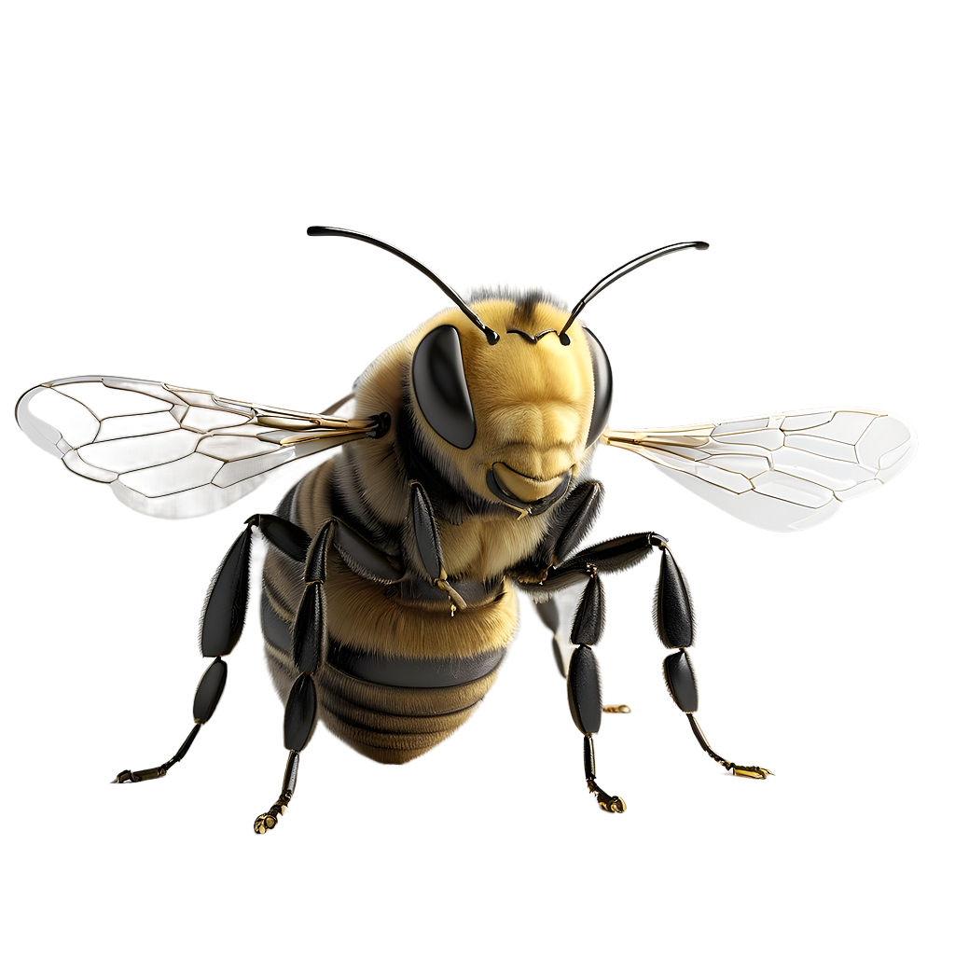
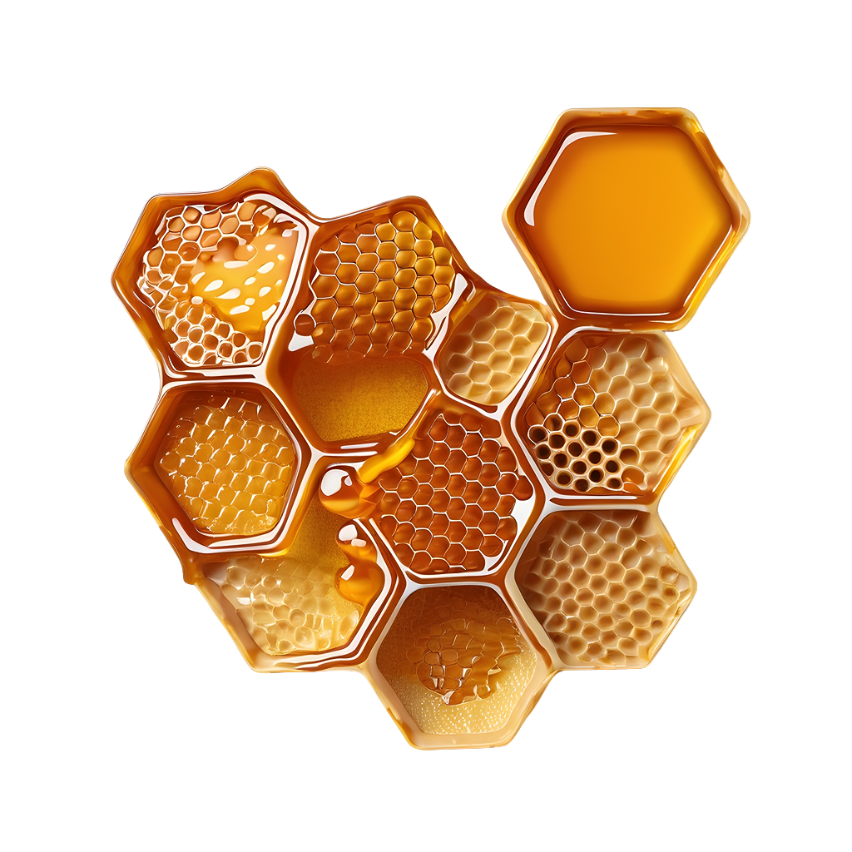
Bee Theme for Middle School
Here is where your presentation begins

Slide 2
Contents of this template
You can delete this slide when you’re done editing the presentation
Fonts | To view this template correctly in PowerPoint, download and install the fonts we used
Used and alternative resources | An assortment of graphic resources that are suitable for use in this presentation
Thanks slide | You must keep it so that proper credits for our design are given
Colors | All the colors used in this presentation
Icons and infographic resources | These can be used in the template, and their size and color can be edited
Editable presentation theme | You can edit the master slides easily. For more info, click here
For more info:
Slidesgo | Blog | FAQs
You can visit our sister projects:
Freepik | Flaticon | Storyset | Wepik | Videvo

Slide 3
Introduction
Science is not just a subject studied in school; it permeates every aspect of our daily lives. From the moment we wake up to the time we go to bed, science plays a crucial role. When we check our smartphones in the morning, we are using technology made possible by advances in computer science and engineering. As we prepare our breakfast, we are unknowingly conducting a series of chemical reactions, whether it's toasting bread or brewing coffee
In the field of healthcare, scientific research has led to life-saving medicines and therapies that have significantly improved human life expectancy. Environmental science helps us understand the impact of our actions on the planet, guiding us towards more sustainable practices. It informs us about climate change, biodiversity, and conservation efforts. Thus, science shapes our understanding of the world and empowers us to make informed decisions about our health, lifestyle, and the environment

Slide 4
Table of contents
01
02
03
04
The role of science in everyday life
Interactive experiments
It’s not only a subject in school, but a part of our daily lives
Engage students with
hands-on experiments
Understanding the scientific process
Learn with case studies
Teach students about the steps involved in the scientific process
Use real-world case studies to illustrate scientific principles

Slide 5
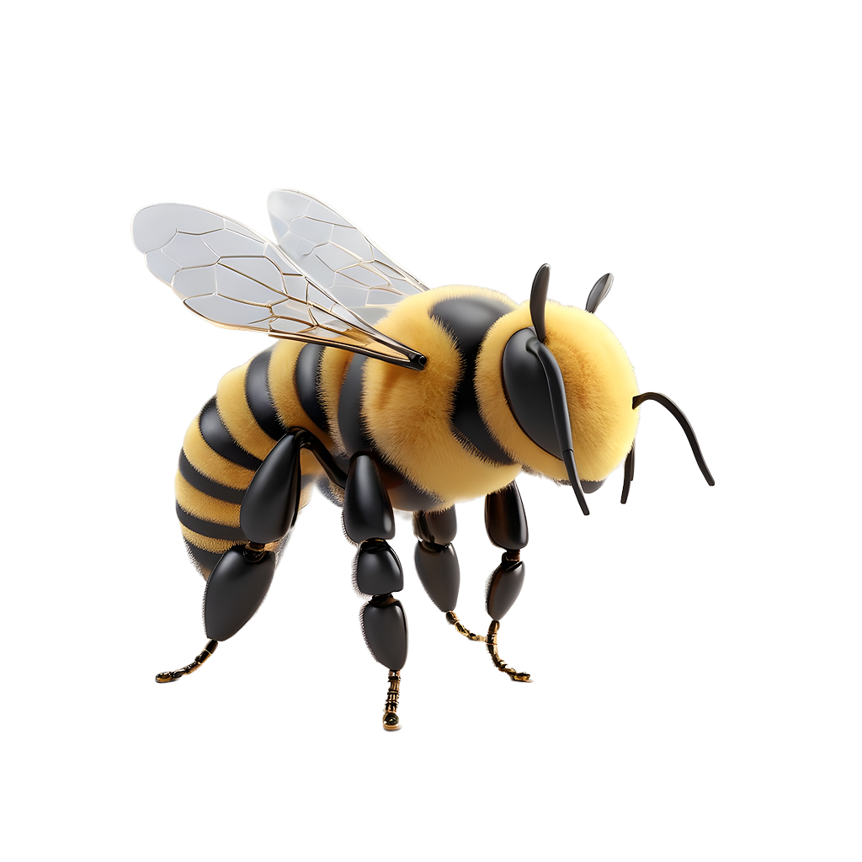
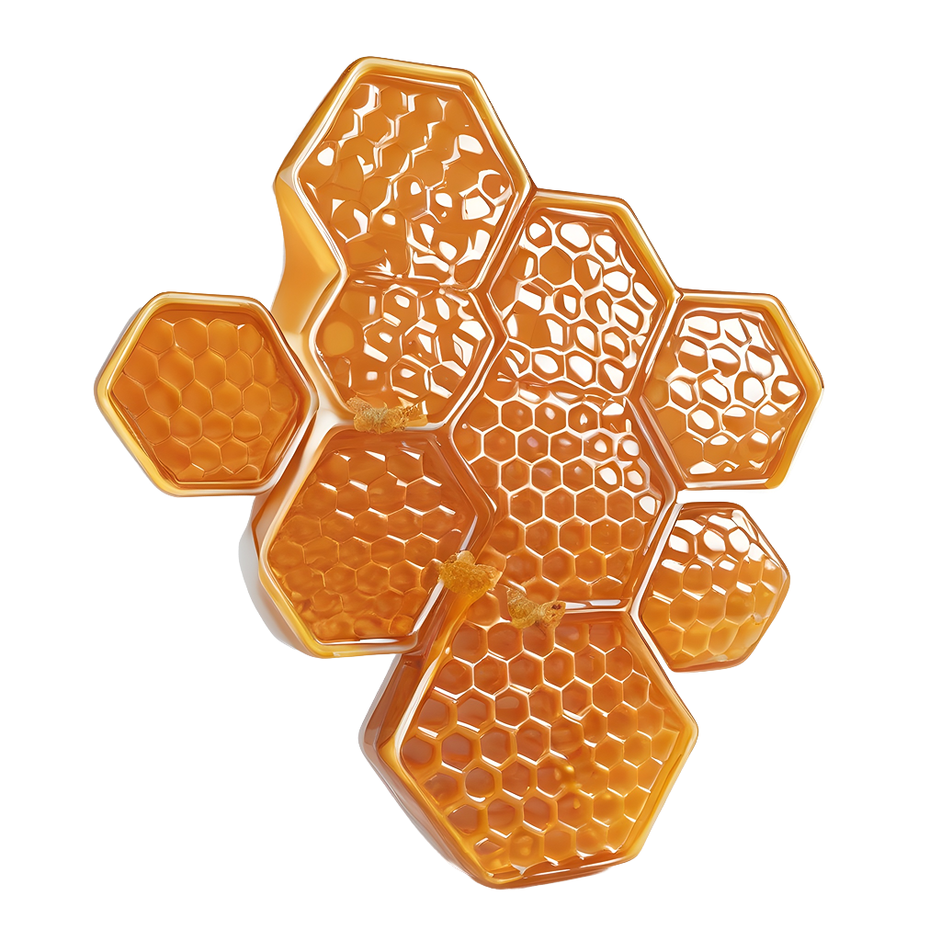
01
The role of science in everyday life
How present is it in our daily lives?

Slide 6
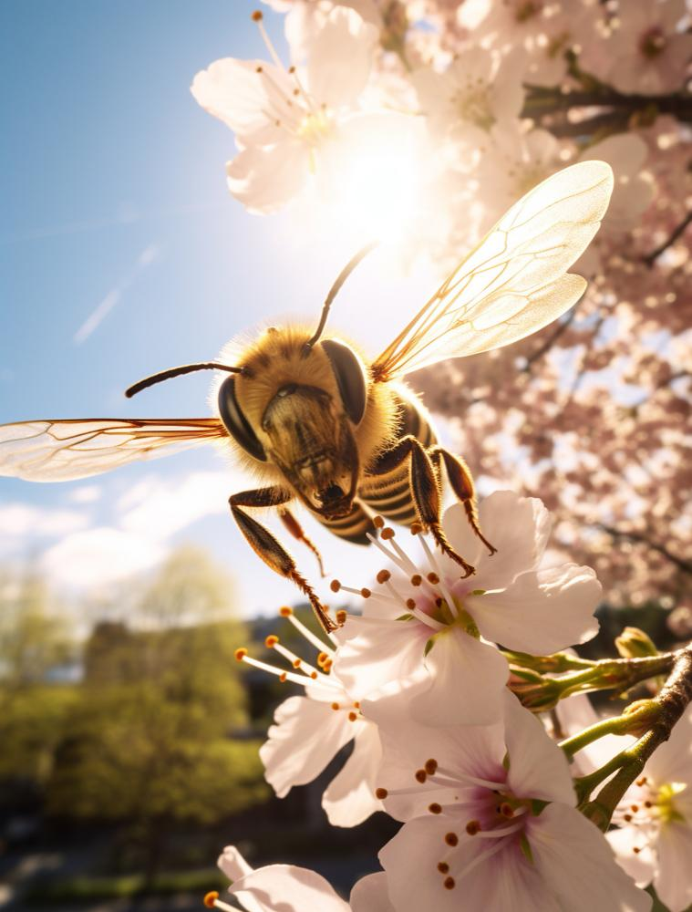
It’s experiment time!
By conducting experiments, students move beyond theoretical learning and experience science in action. Here are three examples for your class:
The egg drop
Homemade lava lamp
Invisible ink with lemon juice
These hands-on activities not only make lessons more engaging but also foster a deeper understanding of scientific concepts

Slide 7
Understanding the scientific process
Understanding
Applying
The scientific process begins with observing a phenomenon and asking questions about it. This leads to formulating a hypothesis, which is an educated guess that can be tested. After conducting experiments to test this hypothesis, the collected data is analyzed to draw conclusions
The application doesn't end at conclusion. If the results support the hypothesis, further tests might be conducted for validation. If they don't, the hypothesis may need to be revised. The findings are finally shared so they can be evaluated by the scientific community

Slide 8
Some examples of case studies
Water quality testing
Effect of light on plant growth
Bird species identification
By testing a local pond or river, they'd learn about indicators of water health
This involves growing plants under different light conditions
Students count local birds over a period of time and identify different species
Chemical reactions
Invasive species impact
Observing weather patterns
They will observe the chemical reactions that occur while baking
They can research how the species was introduced and its effects on the ecosystem
Over a period of time, they track weather patterns to understand climate trends

Slide 9
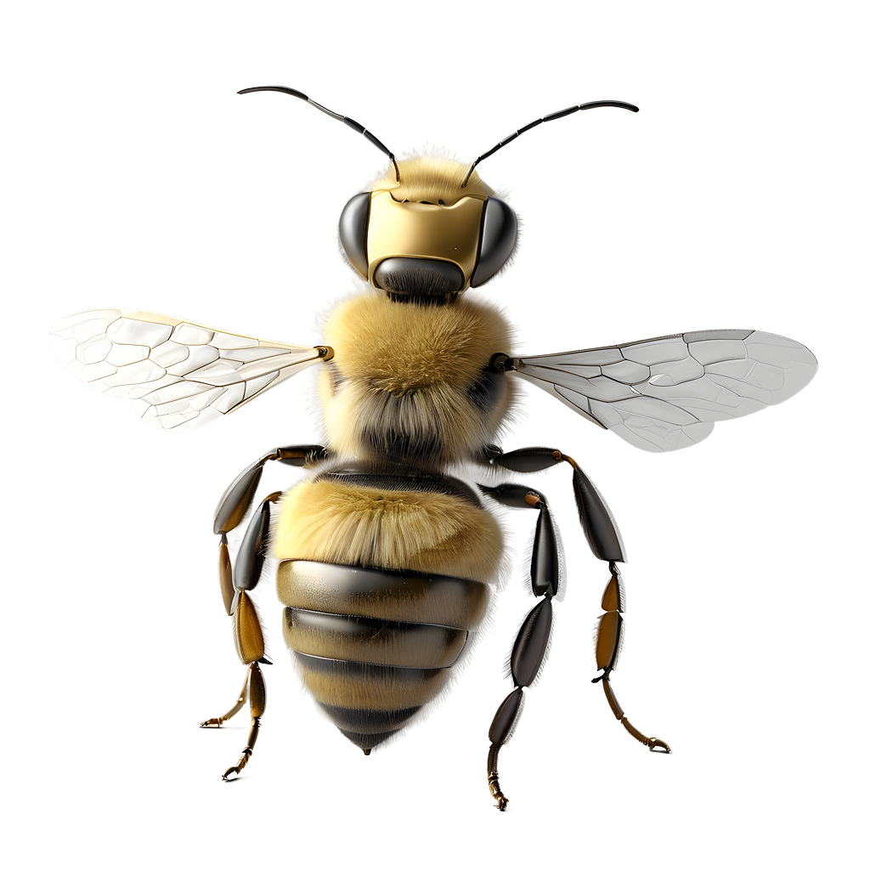
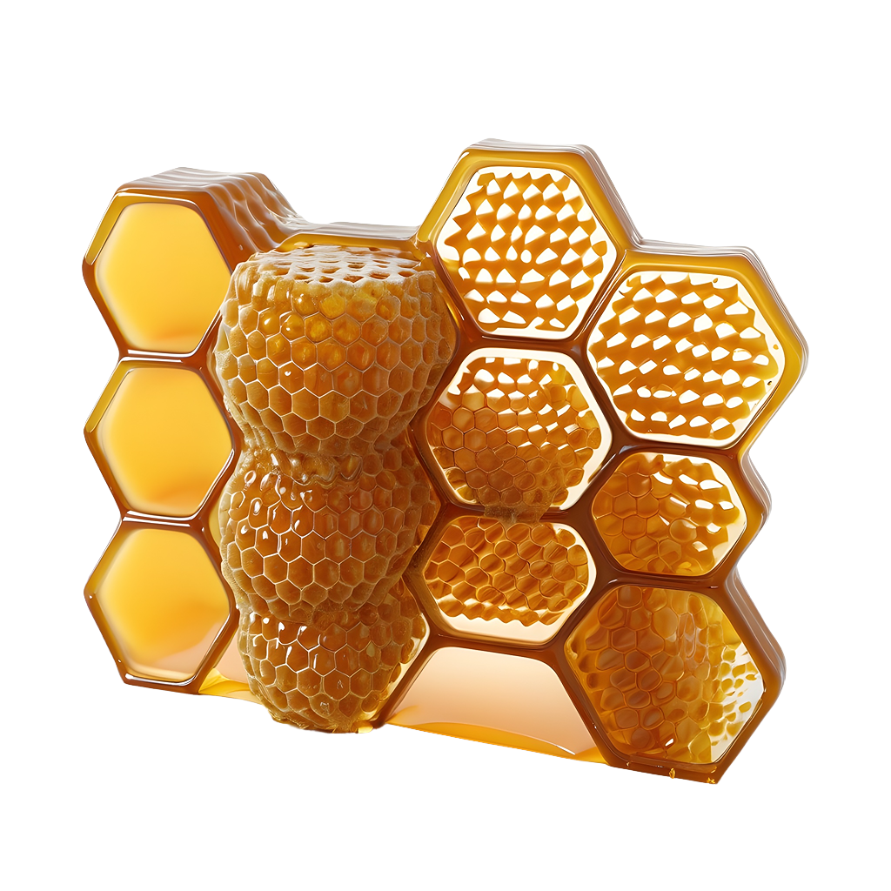

Every question you ask is a step towards knowledge

Slide 10
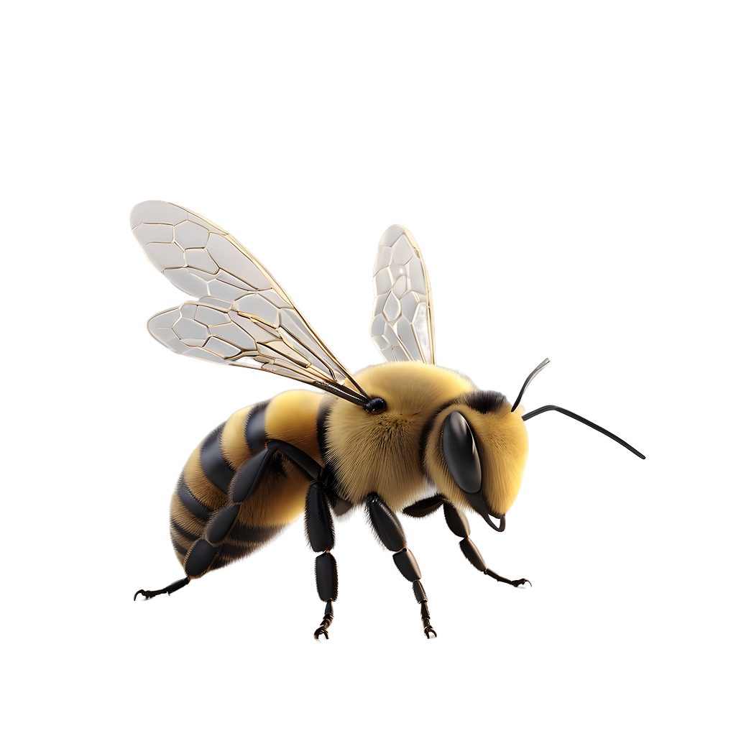
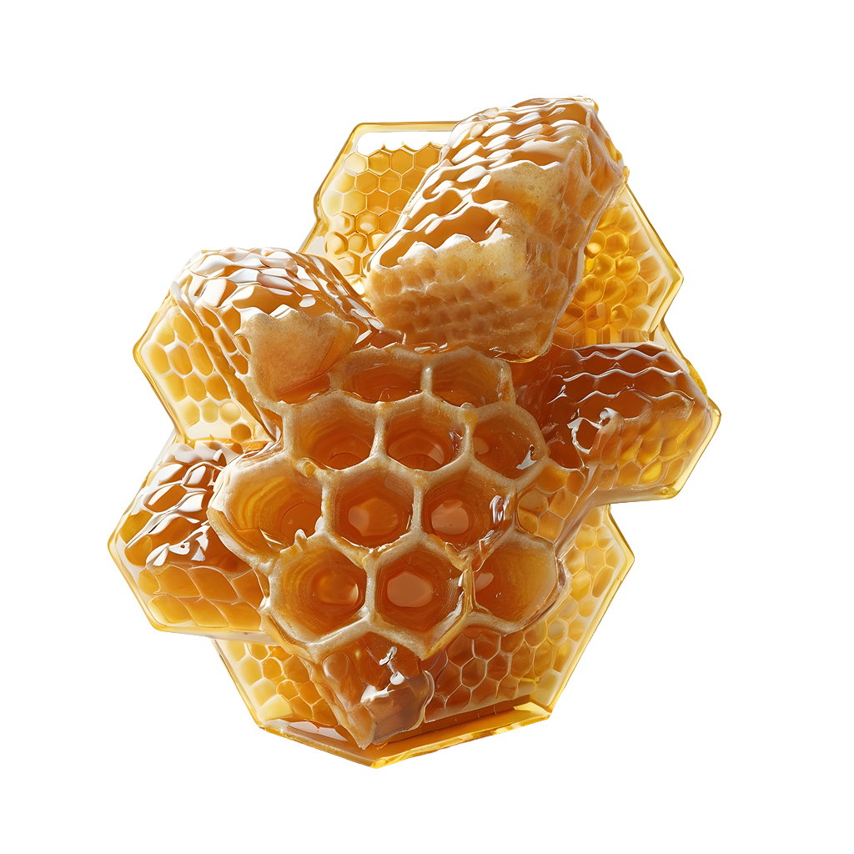
100,000
Did you know that an average human heart beats around these many times a day?

Slide 11
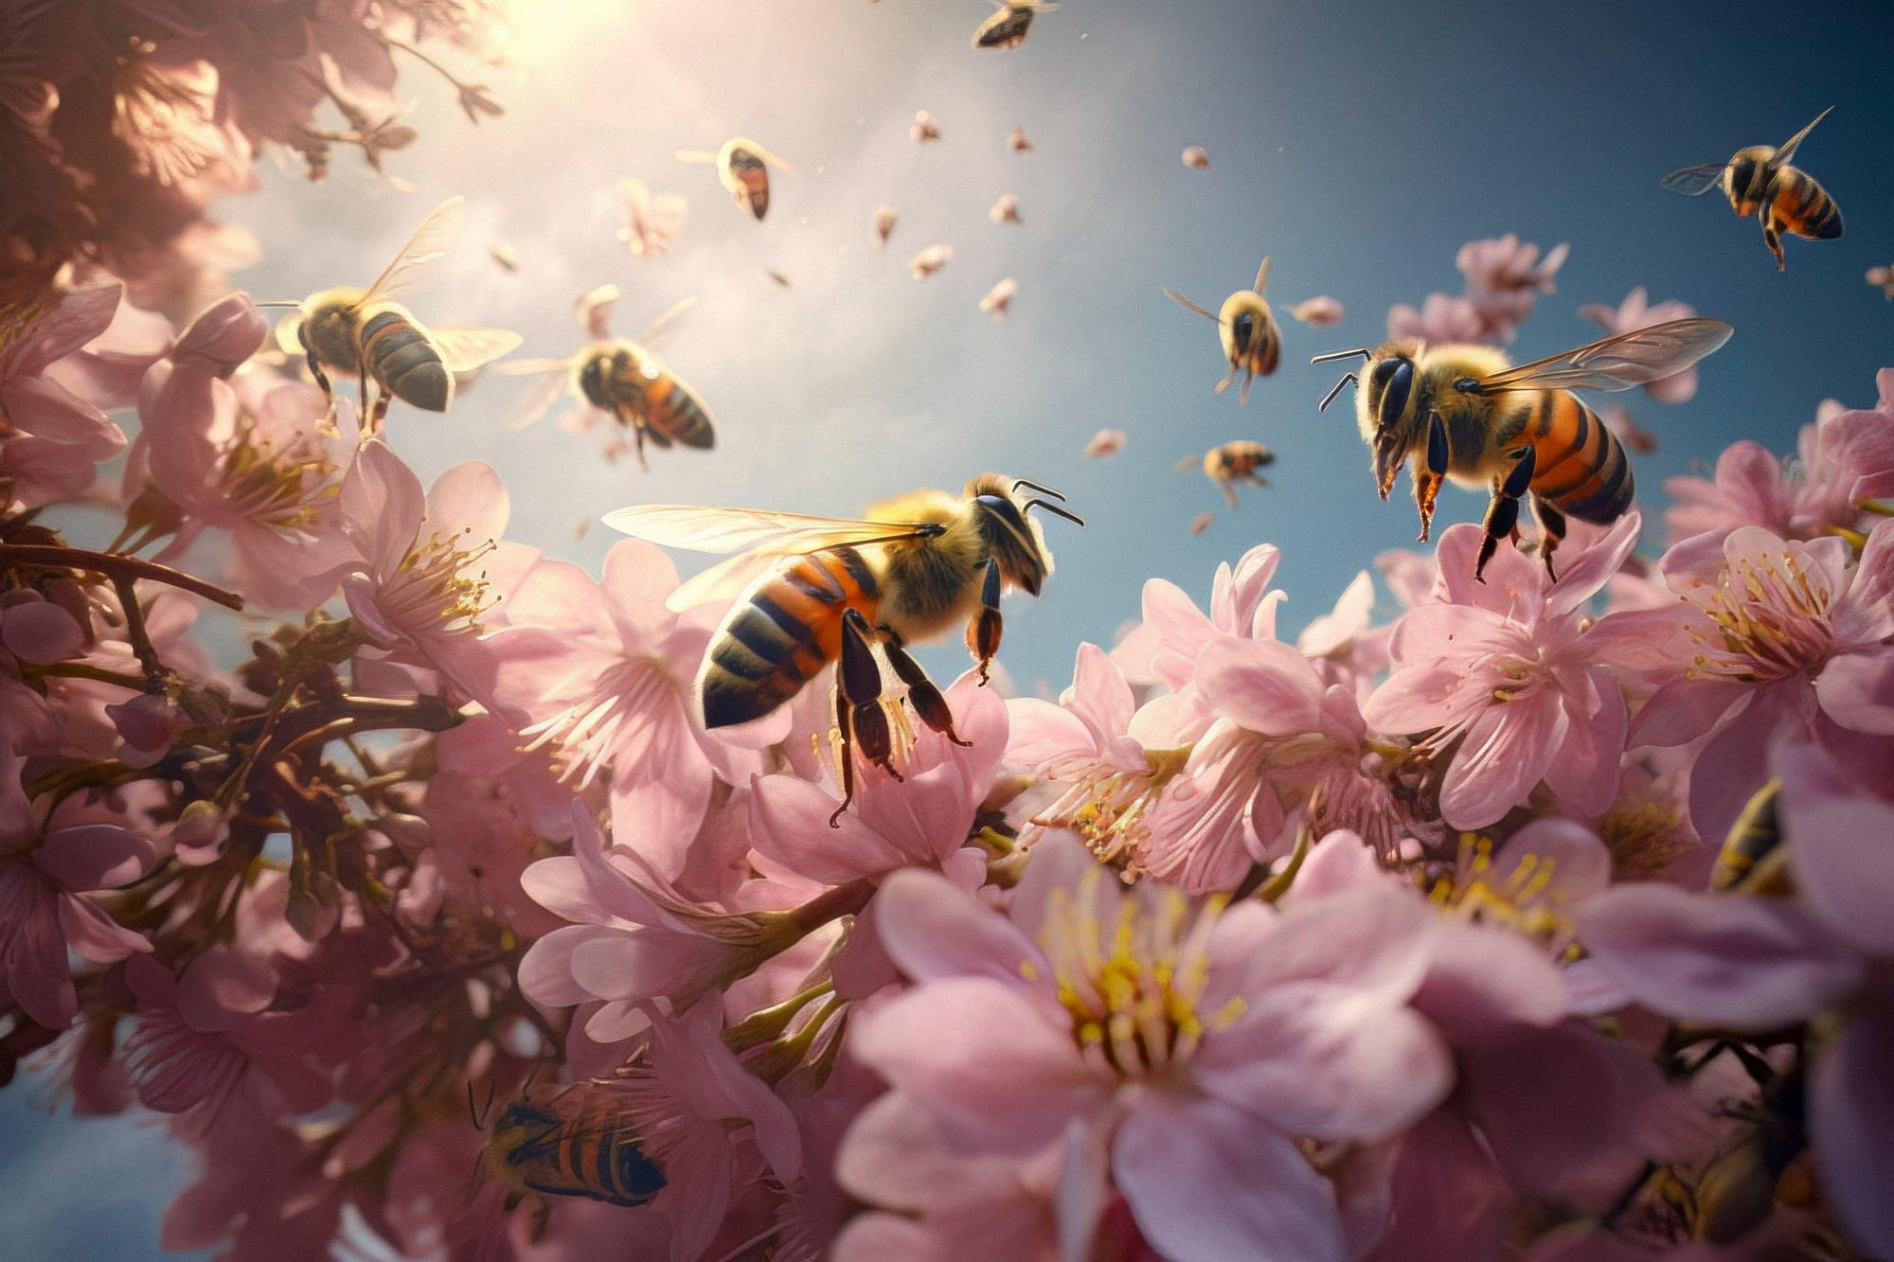

Visual elements help illustrating your information

Slide 12
Some interesting country studies
Venus
Venus is the second planet from the Sun
Mercury
Mercury is the closest planet to the Sun

Slide 13
The steps for a successful experiment
Plan your experiment
Analyze results and draw conclusions
What materials will you need? What steps will you follow?
Look at the data you collected. Did it support your hypothesis?
01
02
03
04
Define the hypothesis
Conduct it and collect data
Think about what you want to discover and guess the outcome
Make sure to record all your observations and results

Slide 14
Rubric
Criteria | Insufficient level | Basic level | Competent Level | Outstanding Level
Content and Argument | Mercury is the closest planet to the Sun | Venus is the second planet from the Sun | Earth is the third planet from the Sun | Despite being red, Mars is very cold
Investigation | Despite being red, Mars is actually a cold place | Jupiter is the biggest planet of them all | Saturn was named after a Roman god | Neptune is the farthest planet from the Sun
Citation and References | Pluto is now considered a dwarf planet | Earth is the only planet known to harbor life | Venus is extremely hot, even more than Mercury | Mercury is the smallest planet of them all

Slide 15

What materials did we use?
Saturn
40%
Saturn is a gas giant with rings
Jupiter
35%
Jupiter is an enormous planet
Mercury
25%
Mercury is quite a small planet
Follow the link in the graph to modify its data and then paste the new one here. For more info, click here

Slide 16
Short answer questions
The students should read the following questions and answer them in their paper. These questions require students to demonstrate their understanding of key concepts
Describe a natural phenomenon that captivates your curiosity. How would you approach investigating and explaining it scientifically?
01
02
03
What is the scientific method, and why is it important in scientific research?
ExIn what ways do scientific discoveries impact our daily lives?

Slide 17
Group discussion
Divide the class into small groups of 3-5 students. Assign each group a discussion topic or question. In their groups, they should discuss the topic and reach conclusions
Importances
Contribution
Mercury is the closest planet to the Sun and the smallest of them all
Venus has a beautiful name and is the second planet from the Sun
Topic
Atmosphere
Risks
Despite being red, Mars is actually a cold place. It’s full of iron oxide dust
Jupiter is a gas giant and the biggest planet in the Solar System

Slide 18
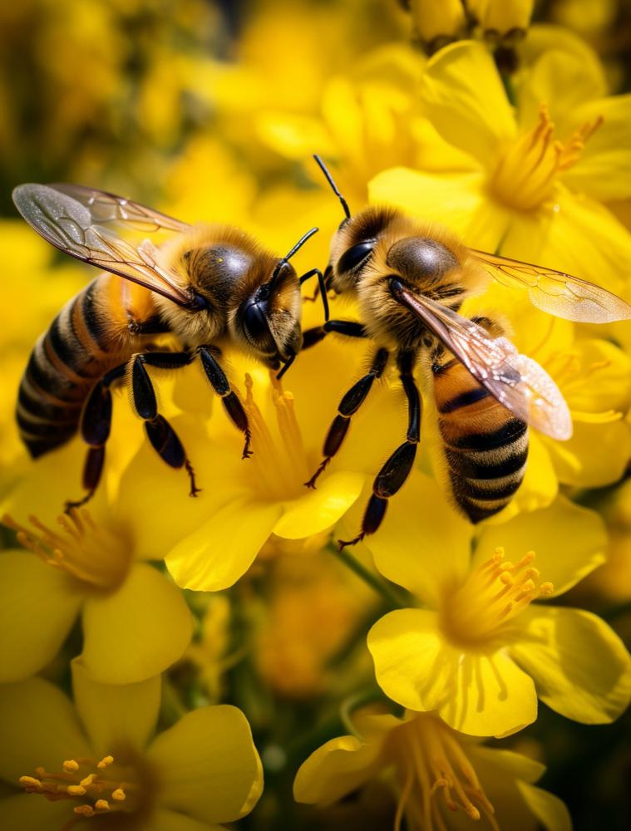
Essay
Select a topic for the essay. Students should research the topic, outline the structure and write a well-constructed essay
Topics
The interconnectedness of scientific disciplines: Choose two scientific fields and discuss how discoveries in one field can influence and contribute to advancements in another
The role of science in addressing global challenges: analyze the role of science in addressing global challenges. Choose one or more pressing issues and discuss how scientific advancements contribute to understanding, mitigating, or solving these challenges

Slide 19
Conclusions
Scientific
method
Data representation
Understanding materials
The process of conducting an experiment is crucial to understanding science. It helps students learn how to hypothesize, plan, execute, and analyze data in a systematic way
Visual representation of data can improve the understanding and interpretation of the results. It provides a clear way to present complex data sets and allows for easy comparisons
Knowledge about different materials is fundamental in science. This understanding can help students comprehend why certain materials are chosen for specific purposes

Slide 20
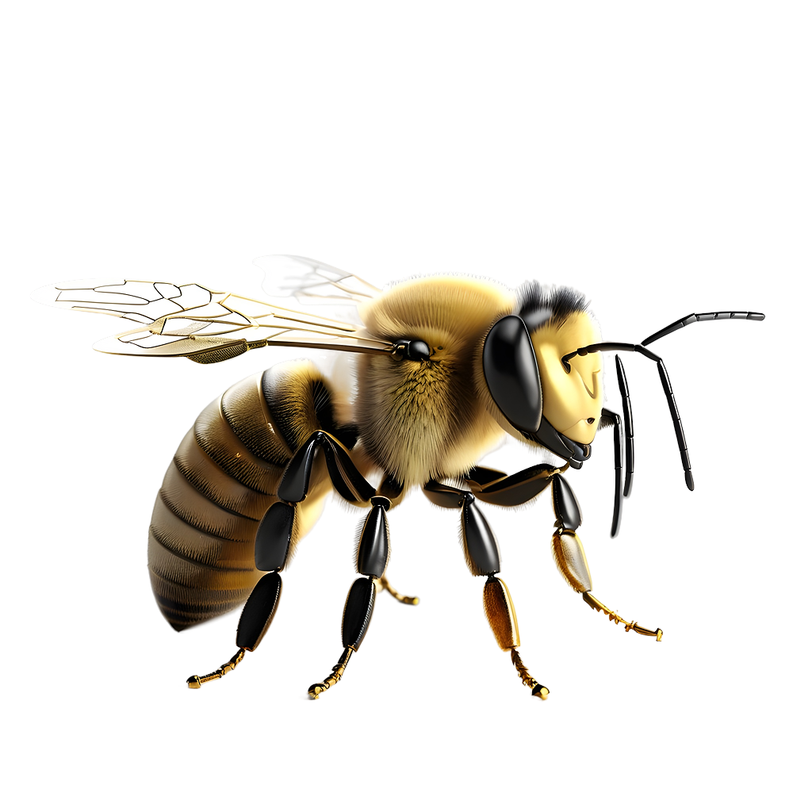
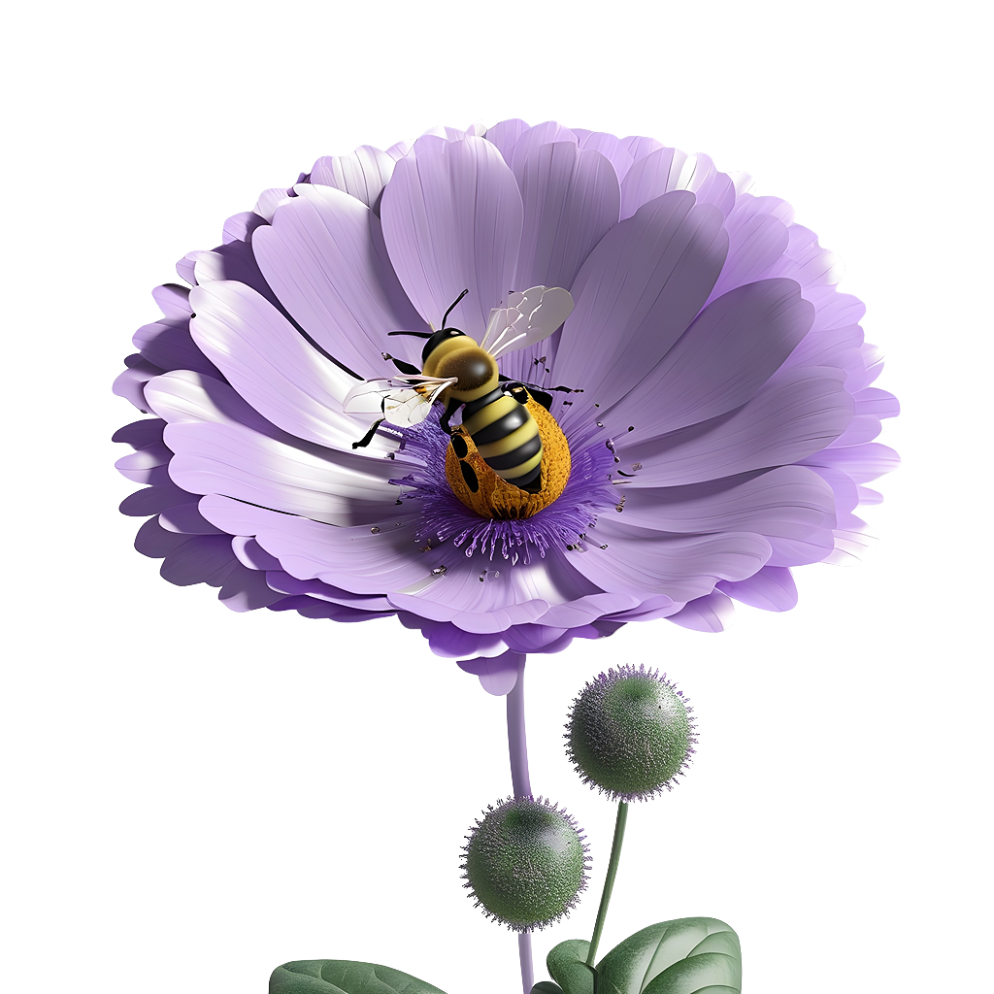
Thanks!
Do you have any questions?
youremail@freepik.com
+34 654 321 432
yourwebsite.com
Please keep this slide for attribution

Slide 21
Alternative resources: AI
Here’s an assortment of prompts that you can use to create AI-generated images yourself. To do this, copy the prompt you need and then go to Freepik's AI Image Generator > paste the prompt into the text box > choose “Photo” > click “Generate”
Generate an image of a beehive with bees flying around.
Create an image of a honeycomb with bees working on it.
Generate an image of a bee collecting pollen from a flower.
Create an image of a beekeeper inspecting a hive.
Generate an image of a queen bee surrounded by other worker bees.
Create an image of a field of flowers with bees buzzing around.
Generate an image of a bee constructing a honeycomb.
Create an image of a bee carrying a drop of nectar to the hive.
Generate an image of a bear attempting to reach a beehive to steal honey.

Slide 22
Resources
Did you like the resources in this template? Get them at these websites:
Illustrations
AI-generated images by Freepik AI Image Generator
Honey realistic abstract composition with bees sitting on amber honeycombs vector illustration
Gradient hexagonal background
Photos
Close up on bee collecting nectar (I)
Close up on bee collecting nectar (II)
Fantasy style bee in nature

Slide 23
Instructions for use
If you have a free account, in order to use this template, you must credit Slidesgo by keeping the Thanks slide. Please refer to the next slide to read the instructions for premium users.
As a Free user, you are allowed to:
Modify this template.
Use it for both personal and commercial projects.
You are not allowed to:
Sublicense, sell or rent any of Slidesgo Content (or a modified version of Slidesgo Content).
Distribute Slidesgo Content unless it has been expressly authorized by Slidesgo.
Include Slidesgo Content in an online or offline database or file.
Offer Slidesgo templates (or modified versions of Slidesgo templates) for download.
Acquire the copyright of Slidesgo Content.
For more information about editing slides, please read our FAQs or visit our blog:
https://slidesgo.com/faqs and https://slidesgo.com/slidesgo-school

Slide 24
Instructions for use (premium users)
As a Premium user, you can use this template without attributing Slidesgo or keeping the "Thanks" slide.
You are allowed to:
Modify this template.
Use it for both personal and commercial purposes.
Hide or delete the “Thanks” slide and the mention to Slidesgo in the credits.
Share this template in an editable format with people who are not part of your team.
You are not allowed to:
Sublicense, sell or rent this Slidesgo Template (or a modified version of this Slidesgo Template).
Distribute this Slidesgo Template (or a modified version of this Slidesgo Template) or include it in a database or in any other product or service that offers downloadable images, icons or presentations that may be subject to distribution or resale.
Use any of the elements that are part of this Slidesgo Template in an isolated and separated way from this Template.
Register any of the elements that are part of this template as a trademark or logo, or register it as a work in an intellectual property registry or similar.
For more information about editing slides, please read our FAQs or visit our blog:
https://slidesgo.com/faqs and https://slidesgo.com/slidesgo-school

Slide 25
Fonts & colors used
This presentation has been made using the following fonts:
Fredoka
(https://fonts.google.com/specimen/Fredoka)
Albert Sans
(https://fonts.google.com/specimen/Albert+Sans)
#492727
#fff4dd
#ffc440
#ffa31d
#d87819
#7a4141

Slide 26





Storyset
Create your Story with our illustrated concepts. Choose the style you like the most, edit its colors, pick the background and layers you want to show and bring them to life with the animator panel! It will boost your presentation. Check out how it works.
Pana
Amico
Bro
Rafiki
Cuate

Slide 27
Use our editable graphic resources...
You can easily resize these resources without losing quality. To change the color, just ungroup the resource and click on the object you want to change. Then, click on the paint bucket and select the color you want. Group the resource again when you’re done. You can also look for more infographics on Slidesgo.

Slide 30
JANUARY
FEBRUARY
MARCH
APRIL
MAY
JUNE
PHASE 1
Task 1
Task 2
PHASE 2
Task 1
Task 2
JANUARY
FEBRUARY
MARCH
APRIL
PHASE 1
Task 1
Task 2

Slide 33
...and our sets of editable icons
You can resize these icons without losing quality.
You can change the stroke and fill color; just select the icon and click on the paint bucket/pen.
In Google Slides, you can also use Flaticon’s extension, allowing you to customize and add even more icons.

Slide 34
Educational Icons
Medical Icons

Slide 35
Business Icons
Teamwork Icons

Slide 36
Help & Support Icons
Avatar Icons

Slide 37
Creative Process Icons
Performing Arts Icons

Slide 38
Nature Icons

Slide 39
SEO & Marketing Icons

Slide 40


