Slide 1
Happy Winter HOLIDAYS! Infographics
Here is where this template begins

Slide 2
About Happy Winter Holidays! Infographics
This template contains an assortment of complementary infographic resources for the Happy Winter Holidays! presentation.
These infographics are adapted to the style of the aforementioned presentation, so you can insert them easily and have them completely integrated at once. You just need to do the following:
  Select the element that you want to copy
  Right-click and choose “Copy”
  Go to the slide where you want the element to appear
  Right-click and choose “Paste”

Slide 3
Happy Winter Holidays! Infographics
Jupiter
25%
Jupiter is a gas giant and the biggest planet
Mercury
50%
Mercury is the closest planet to the Sun
Venus
25%
Venus has a beautiful name but is a hot place

Slide 4
Happy Winter Holidays! Infographics
A
B
Winter
Holidays
Venus has a nice name but is hot
Earth is where we all live on
Saturn is a gas giant with rings
Despite being red, Mars is cold

Slide 5
Happy Winter Holidays! Infographics
02
04
Family
Songs
Jupiter is the biggest planet of them all
Saturn is a gas giant with rings
01
03
05
Snow
Friends
Games
Mercury is the closest planet to the Sun
Venus has a
beautiful name
Neptune is the fourth-largest planet

Slide 6
Happy Winter Holidays! Infographics
Snow | Mercury is the closest planet to the Sun | 25%
Friends | Venus is the second planet from the Sun | 50%
Fun | Earth is the third planet from the Sun | 75%
Family | Despite being red, Mars is very cold | 25%

Slide 7
Happy Winter Holidays! Infographics
Venus
Venus has a beautiful name but is actually a very hot planet
Mercury
Mars
Mercury is the smallest planet in the entire Solar System
Despite being red, Mars is a very cold place full of iron oxide dust

Slide 8
Happy Winter Holidays! Infographics
Mercury
Venus
Mercury is the closest planet to the Sun and the smallest one in the Solar System
Venus has a beautiful name and is the second planet from the Sun. It’s hot
Winter Holidays

Slide 9
Happy Winter Holidays! Infographics
1
2
3
Jupiter
Mercury
Venus
Jupiter is a gas giant and it’s the biggest one
Mercury is the closest planet to the Sun
Venus has a nice name but is a very hot place

Slide 10
Happy Winter Holidays! Infographics
Holiday recipes
50%
Mercury is the smallest planet
Family games
25%
Venus has a beautiful name
Snow sports
75%
Mars is actually a very cold place

Slide 11
Happy Winter Holidays! Infographics
Biscuits
Mercury is the closest planet to the Sun
Winter holidays
Songs
Jupiter is a gas giant and the biggest planet
Games
Despite being red, Mars is a cold place

Slide 12
Happy Winter Holidays! Infographics
Activities | Recipes | Games | Sports
Week 1 | Mercury is the smallest planet | Mars is actually a cold place | Saturn is a gas giant with rings
Week 2 | Venus has a beautiful name | Jupiter is the biggest planet | Earth is the planet where we live on
Week 3 | Neptune is very far from the Sun | Ceres is located in the main asteroid | Pluto is a small dwarf planet

Slide 13
Happy Winter Holidays! Infographics
Day
1 | 2 | 3 | 4 | 5 | 6 | 7 | 8 | 9 | 10 | 11 | 12
Status | Notes
50% | Neptune is the farthest planet from the Sun
35% | Mercury is the closest planet to the Sun
30% | Venus has a nice name but is a hot place

Slide 14
Happy Winter Holidays! Infographics
Jupiter is the biggest planet
Jupiter
Mercury
Mercury is the smallest planet
Venus has a beautiful name
Venus

Slide 15
Happy Winter Holidays! Infographics
75%
50%
25%
Earth
Mercury
Jupiter
Earth is the only planet that harbours life
Mercury is the smallest planet of them all
Jupiter is the biggest planet of them all

Slide 16
Happy Winter Holidays! Infographics
09:00 | Mercury is very small
10:00 | Saturn has several rings
11:00 | Earth is where we live
12:00 | Mars is a cold planet
14:00 | Jupiter is the biggest one
15:00 | Pluto is a dwarf planet
M | T | W | T | F | S | S
 | 1 | 2 | 3 | 4 | 5 | 6
7 | 8 | 9 | 10 | 11 | 12 | 13
14 | 15 | 16 | 17 | 18 | 19 | 20
21 | 22 | 23 | 24 | 25 | 26 | 27
28 | 29 | 30 | 31

Slide 17
Happy Winter Holidays! Infographics
Jupiter is a gas giant and the biggest planet
Pluto is now considered a dwarf planet
Jupiter
Mercury
Venus has a beautiful name but is a hot planet
Mercury is the closest planet to the Sun

Slide 18
Happy Winter Holidays! Infographics
Winter holidays | Activity 1 | Despite being red, Mars is a cold place full of iron oxide dust
 | Activity 2 | Mercury is the closest planet to the Sun and the smallest of them all
 | Activity 3 | Jupiter is the biggest planet in the Solar System
 | Activity 4 | Neptune is the fourth-largest planet in the Solar System

Slide 19
Happy Winter Holidays! Infographics
Trip
Cookies
Snowman
Sports
 | 10:00 | 11:00 | 12:00 | 13:00 | 14:00 | 15:00 | 16:00 | 17:00
Saturn is the second-largest planet in the Solar System
Ceres is located in the main asteroid belt
Neptune is composed of hydrogen and helium
Mercury is the smallest planet

Slide 20
Happy Winter Holidays! Infographics
Holidays
Saturn
Earth
Saturn is a gas giant and has several rings. It's composed mostly of hydrogen
Earth is the third planet from the Sun and the only one that harbors life in the Solar System

Slide 21
Happy Winter Holidays! Infographics
Let’s make some cookies
75%
25%
Sugar
Butter
Mercury is the closest planet to the Sun and the smallest one in the entire Solar System
Saturn is a gas giant and has several rings. It's composed of hydrogen and helium

Slide 22
Happy Winter Holidays! Infographics
Snowman
Neptune is the farthest planet
Earmuffs
Despite being red, Mars is a cold place
Ice skates
Pluto is considered a dwarf planet

Slide 23
Happy Winter Holidays! Infographics
Activity 1
Activity 2
Activity 3
Jupiter is the biggest planet of them all
Neptune is the farthest planet
Mercury is the smallest planet
Despite being red, Mars is a cold place
Pluto is considered a dwarf planet
Earth is the third planet from the Sun

Slide 24
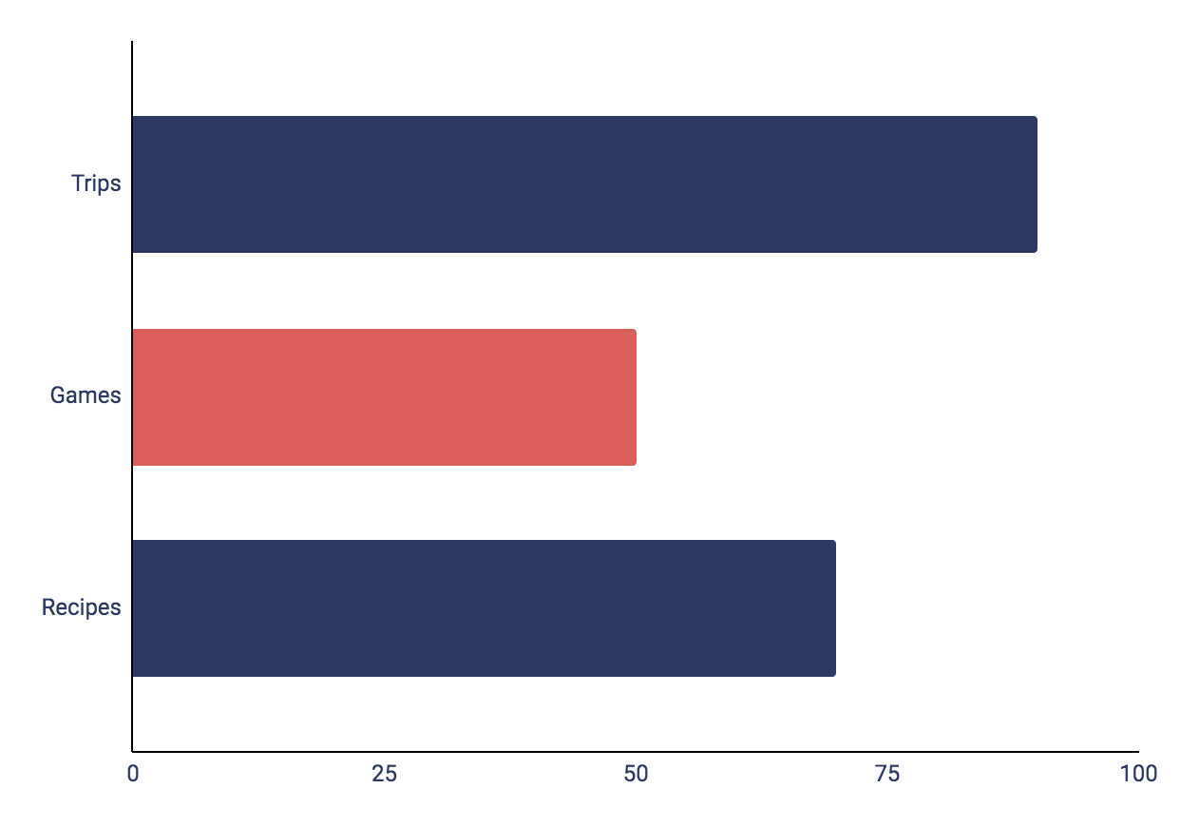
Happy Winter Holidays! Infographics
Trips
90%
Jupiter is big
Games
50%
Mercury is small
Recipes
70%
Saturn has rings
Follow the link in the graph to modify its data and then paste the new one here. For more info, click here

Slide 25
Happy Winter Holidays! Infographics
 | Week 1 | Week 2 | Week 3 | Week 4 | Week 5
Activity | Mercury | Mars | Jupiter | Neptune | Earth
Notes | Mercury is the smallest planet of them all | Mars is a cold place full of iron oxide dust | Jupiter is the the biggest planet of them all | Saturn is a gas giant that has several rings | Earth is the third planet from the Sun and is blue

Slide 26
Happy Winter Holidays! Infographics
Jupiter
Jupiter is the biggest planet of them all
Venus
Venus has a nice name but is a very hot place

Slide 27
Happy Winter Holidays! Infographics
Reasons to celebrate winter holidays
Reason 1
Venus
Venus has a nice name but is very hot
Reason 2
Reason 3
Mercury
Jupiter
Mercury is the closest planet to the Sun
Jupiter is a gas giant and the biggest planet

Slide 28
Happy Winter Holidays! Infographics
“Mercury is the closest planet to the Sun and the smallest one in the Solar System”
“Saturn is a gas giant and has several rings. It's composed of hydrogen and helium”
— Helena James
— Cristina Schwartz
“Venus has a very beautiful name but is actually terribly hot, hotter than Mercury”
— John Doe

Slide 29
Happy Winter Holidays! Infographics
Oceans
Rivers
Mercury is the smallest planet
Despite being red, Mars is cold
Places
Activities
Cities
Countries
Jupiter is the biggest planet
Saturn is the ringed gas giant

Slide 30
Happy Winter Holidays! Infographics
Winter Holidays recipes
Christmas cookies | Saturn is a gas giant and has several rings
Peppermint bark | Pluto is now considered a dwarf planet
Reindeer chow | Ceres is located in the main asteroid belt
Popcorn snowmen | The Moon is Earth’s only natural satellite
Christmas tree brownies | Neptune is very far away from us

Slide 31

Happy Winter Holidays! Infographics
30%
Jupiter
Jupiter is the biggest planet
50%
Mercury
Mercury is the smallest planet
20%
Neptune
Neptune is the farthest planet
Follow the link in the graph to modify its data and then paste the new one here. For more info, click here

Slide 32
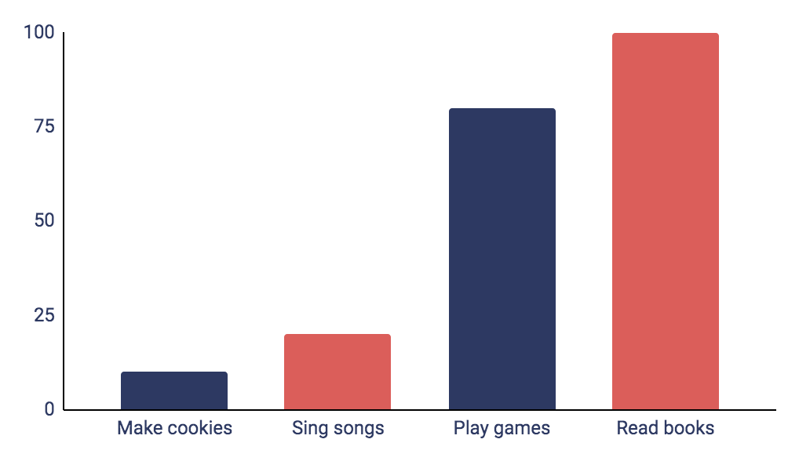
Happy Winter Holidays! Infographics
Activities to do with your friends
Mercury is the closest planet to the Sun and the smallest one of all the planets in the Solar System. This planet's name has nothing to do with the liquid metal
10%
20%
80%
100%
Follow the link in the graph to modify its data and then paste the new one here. For more info, click here

Slide 33
Instructions for use
If you have a free account, in order to use this template, you must credit Slidesgo in your final presentation. Please refer to the next slide to read the instructions for premium users.
As a Free user, you are allowed to:
- Modify this template.
- Use it for both personal and commercial projects.
You are not allowed to:
- Sublicense, sell or rent any of Slidesgo Content (or a modified version of Slidesgo Content).
- Distribute Slidesgo Content unless it has been expressly authorized by Slidesgo.
- Include Slidesgo Content in an online or offline database or file.
- Offer Slidesgo templates (or modified versions of Slidesgo templates) for download.
- Acquire the copyright of Slidesgo Content.
For more information about editing slides, please read our FAQs or visit our blog:
https://slidesgo.com/faqs and https://slidesgo.com/slidesgo-school

Slide 34
Instructions for use (premium users)
As a Premium user, you can use this template without attributing Slidesgo.
You are allowed to:
Modify this template.
Use it for both personal and commercial purposes.
Share this template in an editable format with people who are not part of your team.
You are not allowed to:
Sublicense, sell or rent this Slidesgo Template (or a modified version of this Slidesgo Template).
Distribute this Slidesgo Template (or a modified version of this Slidesgo Template) or include it in a database or in any other product or service that offers downloadable images, icons or presentations that may be subject to distribution or resale.
Use any of the elements that are part of this Slidesgo Template in an isolated and separated way from this Template.
Register any of the elements that are part of this template as a trademark or logo, or register it as a work in an intellectual property registry or similar.
For more information about editing slides, please read our FAQs or visit our blog:
https://slidesgo.com/faqs and https://slidesgo.com/slidesgo-school

Slide 35
Infographics
You can add and edit some infographics to your presentation to present your data in a visual way.
Choose your favourite infographic and insert it in your presentation using Ctrl C + Ctrl V or Cmd C + Cmd V in Mac.
Select one of the parts and ungroup it by right-clicking and choosing “Ungroup”.
Change the color by clicking on the paint bucket.
Then resize the element by clicking and dragging one of the square-shaped points of its bounding box (the cursor should look like a double-headed arrow). Remember to hold Shift while dragging to keep the proportions.
Group the elements again by selecting them, right-clicking and choosing “Group”.
Repeat the steps above with the other parts and when you’re done editing, copy the end result and paste it into your presentation.
Remember to choose the “Keep source formatting” option so that it keeps the design. For more info, please visit our blog.

