Slide 1
Dating Apps Infographics
Here is where this template begins

Slide 2
Dating Apps Infographics
Oliver
Sammy
Mercury is the closest planet to the Sun and the smallest one in the Solar System—it’s only a bit larger than the Moon
This planet has a beautiful name and is the second one from the Sun. It’s hot and has a very poisonous atmosphere
First cat
Second cat

Slide 3
Dating Apps Infographics
1
2
3
4
Let time pass
Enjoy your hobby
Open your heart
Find love
Jupiter is the biggest planet of them all
Venus is the second planet from the Sun
Mercury is the smallest planet
Saturn is a gas giant and has several rings

Slide 4
Dating Apps Infographics
1
Sign up
Present yourself
4
Jupiter is the biggest planet of them all
Saturn is a gas giant and has several rings
2
Meet them
Chat
5
Venus is the second planet from the Sun
Despite being red, Mars is a cold place
3
First date
Fall in love
6
Mercury is the smallest planet
Earth is the planet where we all live on

Slide 5
Dating Apps Infographics
First date
Be honest
Listen
Speak sincerely
Mercury is the closest planet to the Sun and the smallest of them all
Jupiter is a gas giant and the biggest planet in the Solar System
Despite being red, Mars is actually a cold place full of iron oxide dust

Slide 6
Dating Apps Infographics
1
Photo selfie
Your Profile Picture
15%
Jupiter is the biggest planet of them all
2
Sports photos
60 %
Venus is the second planet from the Sun
3
Group photo
25 %
Mercury is the smallest planet

Slide 7
Dating Apps Infographics
Find love
Fall out of love
Saturn is a gas giant and has several rings
Saturn is a gas giant and has several rings
25 %
10 %
Try again
Lay out the strategy
Earth is the planet where we all live on
Earth is the planet where we all live on
50 %
15 %

Slide 8
Dating Apps Infographics
1
Match
Open up
5
Venus is the second planet from the Sun
Mars is actually a cold place
Chat
Trust
Neptune is far away from us
Mercury is the smallest planet
Share your likes
2
4
Earth is the planet that harbors life
3

Slide 9
Dating Apps Infographics
Lifestyle
Animal lover
Jupiter is a gas giant and the biggest planet in the Solar System
1
2
Despite being red, Mars is actually a cold place full of iron oxide dust
Musician
Traveler
3
4
Mercury is the closest planet to the Sun and the smallest one
Venus has a beautiful name and is the second planet from the Sun

Slide 10
Dating Apps Infographics
Inactivity
Fake
Match
Unmatch
Mercury is the smallest planet
Earth is the planet that harbors life
Venus has a beautiful name
Saturn is the ringed planet
30%
35%
65%
30%

Slide 11
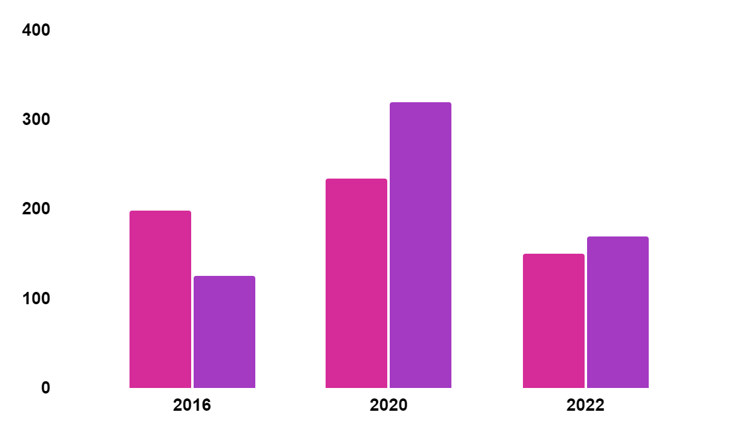
Dating Apps Infographics
The importance of lifestyle
Sports addict
Venus is the second planet from the Sun
Travel lover
Mercury is the closest planet to the Sun
Follow the link in the graph to modify its data and then paste the new one here. For more info, click here

Slide 12
Dating Apps Infographics
Neptune
Mars
Neptune is the farthest planet from the Sun
Despite being red, Mars is a cold place
Mercury
Earth
Mercury is the smallest planet of them all
Earth is the planet where we all live on

Slide 13
Dating Apps Infographics
Sign up
1
4
Present yourself
Jupiter is the biggest planet of them all
Saturn is a gas giant and has several rings
Meet them
2
Chat
5
Neptune is the farthest planet from the Sun
Despite being red, Mars is a cold place
First date
Fall in love
3
6
Mercury is the smallest planet of them all
Earth is the planet where we all live on

Slide 14
Dating Apps Infographics
Monday | Tuesday | Wednesday | Thursday | Friday
10:00 | 10:00 | 10:00 | 10:00 | 10:00
13:00 | 13:00 | 13:00 | 13:00 | 13:00
18:00 | 18:00 | 18:00 | 18:00 | 18:00
20:00 | 20:00 | 20:00 | 20:00 | 20:00
Normal
Mercury is the smallest planet
Fire time
Earth is the planet that harbors life

Slide 15
Dating Apps Infographics
Sportman
Graphic Designer
Timmy Jimmy
Will James
Despite being red, Mars is a cold place. It’s full of iron oxide dust
It has a beautiful name and is the second planet from the Sun
Architect
Pharmaceutical
Susan Kitty
Anne Bones
Jupiter, the biggest planet in the Solar System, is a gas giant
Saturn is a gas giant, composed mostly of hydrogen and helium

Slide 16
Dating Apps Infographics
Best time to swipe up
10:00
16:00
18:00
21:00
24:00
Mercury is the smallest planet
Earth is the planet that harbors life
Venus has a beautiful name
Saturn is the ringed planet
The farthest planet from Sun

Slide 17
Dating Apps Infographics
Free | List your features List your features | $0
Basic | List your features List your features | $25
Pro | List your features List your features | $50
Premium | List your features List your features | $75

Slide 18
Dating Apps Infographics
Inactivity
25%
15%
Match
Mercury is the smallest planet
Venus has a beautiful name
Fake
50%
75%
Unmatch
Earth is the planet that harbors life
Saturn is the ringed planet

Slide 19
Dating Apps Infographics
“Hello”
Confident
Neptune is the farthest planet from the Sun
Despite being red, Mars is a cold place
Nervous
First match
Fall in love
Earth is the third planet from the Sun
It’s composed of hydrogen and helium
Mercury is the closest object to the Sun

Slide 20
Dating Apps Infographics
Venus has a beautiful name, but also high temperatures
Venus
Neptune is the farthest planet from the Sun
Neptune
Despite being red, Mars is actually a cold place
Mars
Jupiter is the biggest planet in the Solar System
Jupiter

Slide 21
Dating Apps Infographics
Jupiter
25%
Jupiter is a gas giant and the biggest planet of them all
Venus
50%
Venus has a beautiful name and very high temperatures
Mars
65%
Despite being red, Mars is actually a very cold place

Slide 22
Dating Apps Infographics
1
Jupiter
Jupiter is a gas giant and the biggest planet of them all
2
Venus
Venus has a beautiful name and very high temperatures
3
Mars
Despite being red, Mars is actually a very cold place

Slide 23
Dating Apps Infographics
Earth
Mercury
Earth is the third planet from the Sun
Planet Mercury is the closest object to the Sun
Neptune
Mars
Neptune is the farthest planet from the Sun
Despite being red,
Mars is a cold place
Saturn
Jupiter
Saturn is composed of hydrogen and helium
Jupiter is a gas giant
and the biggest planet

Slide 24
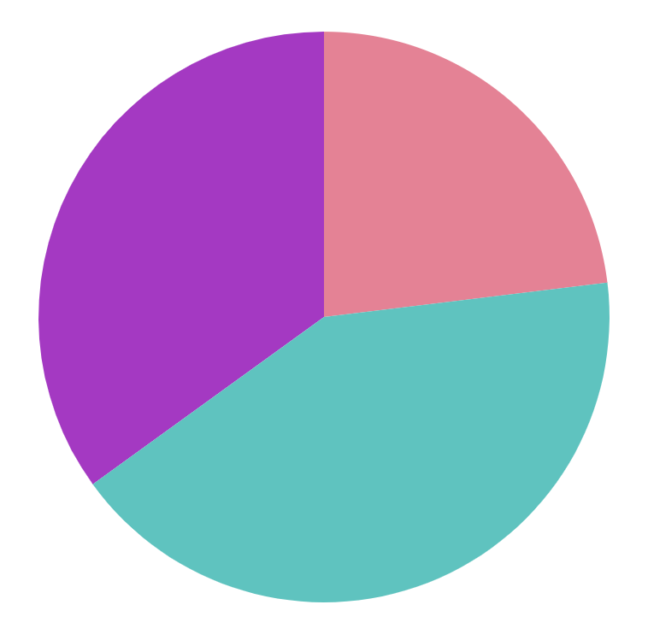
Dating Apps Infographics
Best time to make match
30%
Morning
Venus is the second planet from the Sun
19%
Midday
Saturn is a gas giant and has several rings
51%
Afternoon
Jupiter is the biggest planet of them all
Follow the link in the graph to modify its data and then paste the new one here. For more info, click here

Slide 25
Dating Apps Infographics
Earth
Mercury
Earth is the third planet from the Sun
Planet Mercury is the closest object to the Sun
Saturn
Mars
Saturn is composed of hydrogen and helium
Despite being red, planet Mars is a very cold place

Slide 26
Dating Apps Infographics
Saturn
Jupiter
Mercury
Mars
Planet Saturn is composed of hydrogen and helium gas
Jupiter is a gas giant and the biggest object in the Solar System
Mercury is the closest planet to the Sun and the smallest one
Despite being red, this planet, Mars, is a big very cold place

Slide 27
Infographics
You can add and edit some infographics to your presentation to present your data in a visual way.
Choose your favourite infographic and insert it in your presentation using Ctrl C + Ctrl V or Cmd C + Cmd V in Mac.
Select one of the parts and ungroup it by right-clicking and choosing “Ungroup”.
Change the color by clicking on the paint bucket.
Then resize the element by clicking and dragging one of the square-shaped points of its bounding box (the cursor should look like a double-headed arrow). Remember to hold Shift while dragging to keep the proportions.
Group the elements again by selecting them, right-clicking and choosing “Group”.
Repeat the steps above with the other parts and when you’re done editing, copy the end result and paste it into your presentation.
Remember to choose the “Keep source formatting” option so that it keeps the design. For more info, please visit Slidesgo School.

