Slide 1
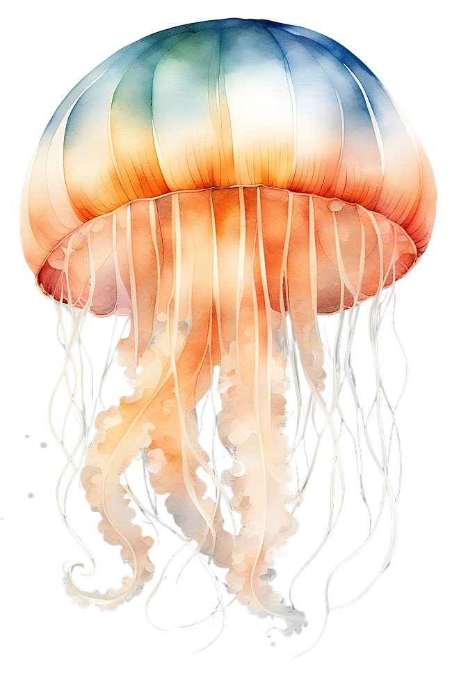
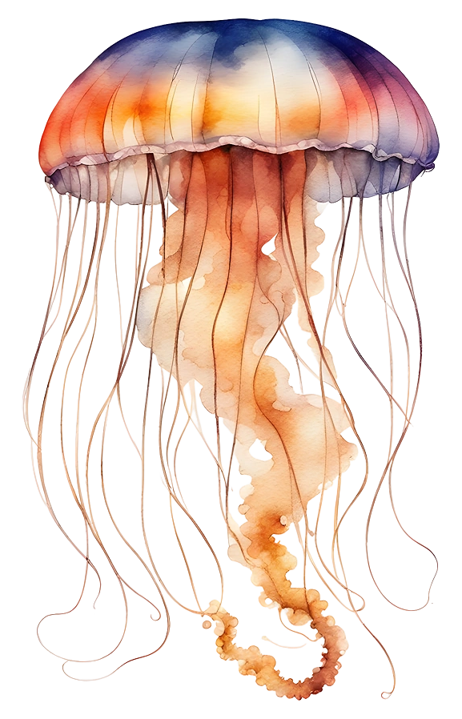
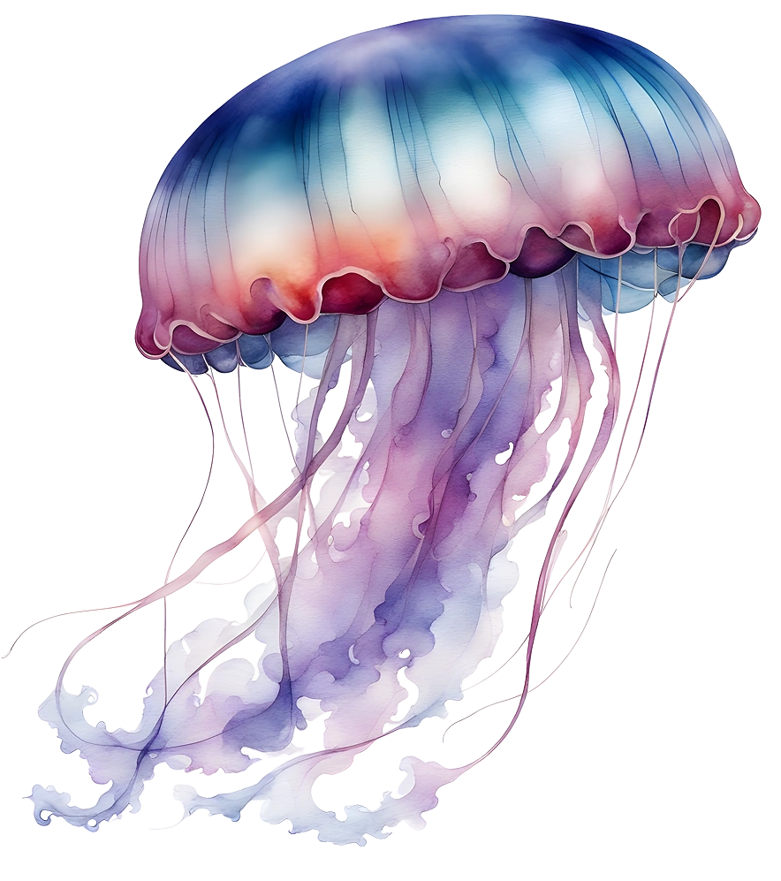
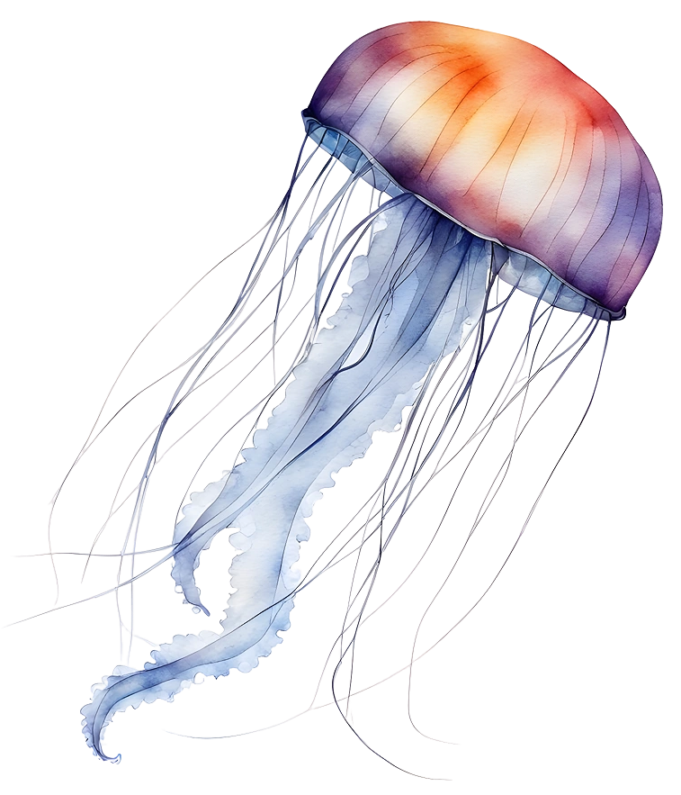
Jellyfish Theme for Education
Here is where your presentation begins

Slide 2
Contents of this template
You can delete this slide when you’re done editing the presentation
Fonts | To view this template correctly in PowerPoint, download and install the fonts we used
Used and alternative resources | An assortment of graphic resources that are suitable for use in this presentation
Thanks slide | You must keep it so that proper credits for our design are given
Colors | All the colors used in this presentation
Icons and infographic resources | These can be used in the template, and their size and color can be edited
Editable presentation theme | You can edit the master slides easily. For more info, click here
For more info:
Slidesgo | Blog | FAQs
You can visit our sister projects:
Freepik | Flaticon | Storyset | Wepik | Videvo

Slide 3
Table of contents
01
02
03
04
05
06
Introduction
Anatomy
Classification
You can describe the topic of the section here
You can describe the topic of the section here
You can describe the topic of the section here
Lifecycle
Habitats
Jellyfish & human
You can describe the topic of the section here
You can describe the topic of the section here
You can describe the topic of the section here

Slide 4
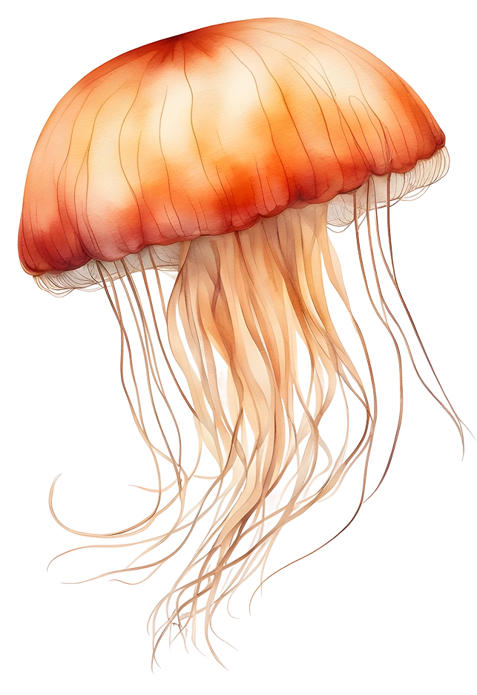
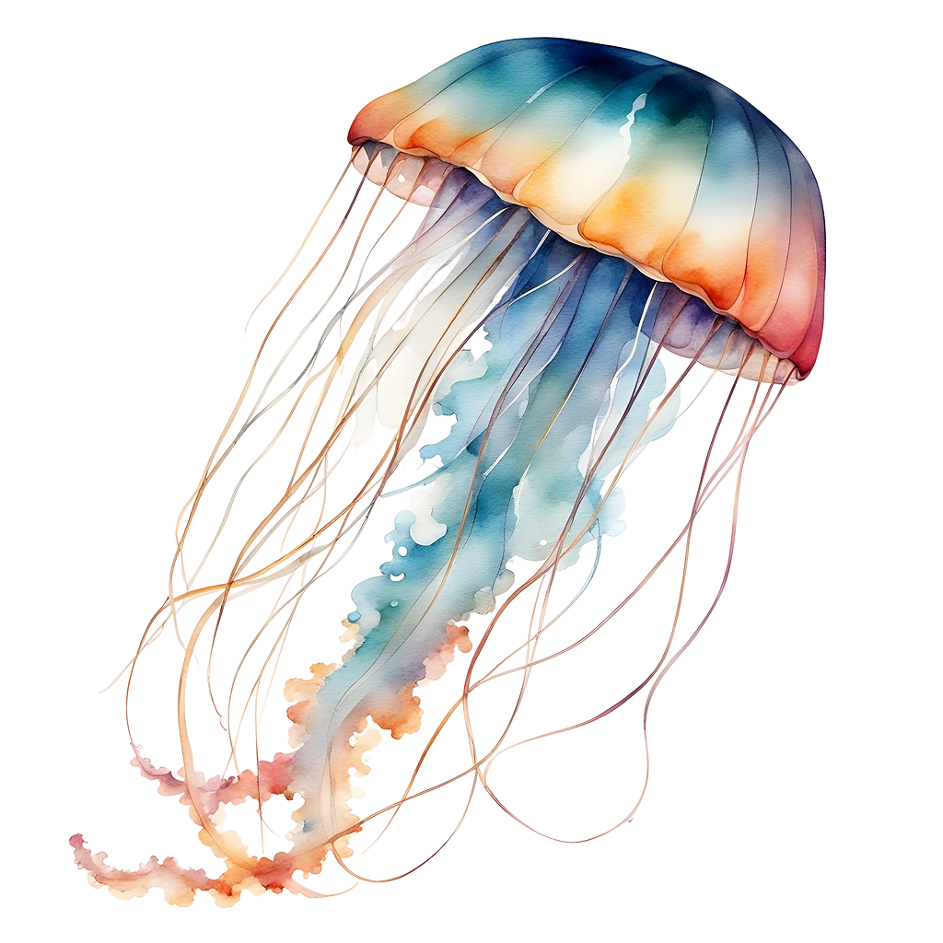
Whoa!
This can be the part of the presentation where you introduce yourself, write your email…

Slide 5
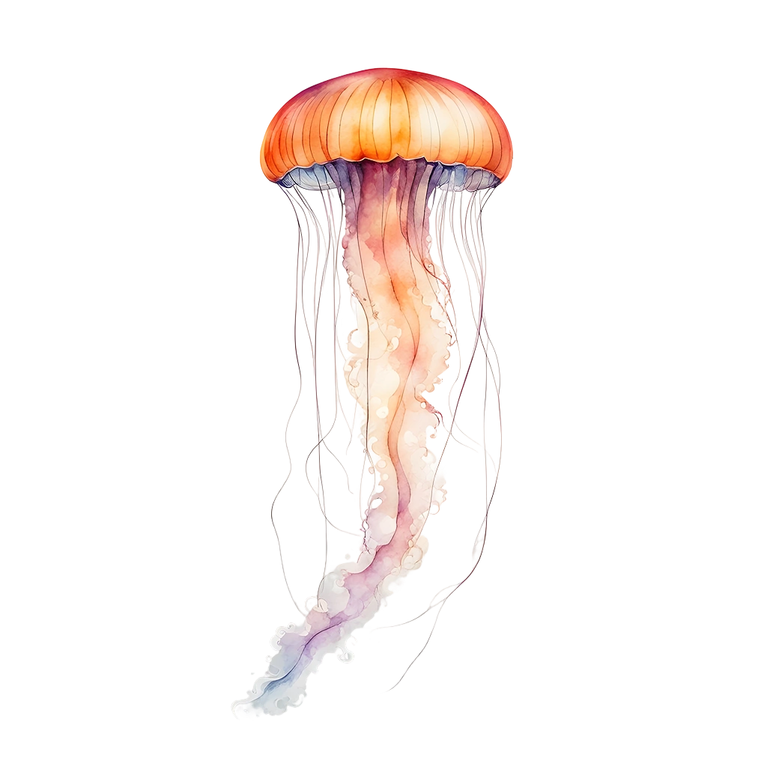
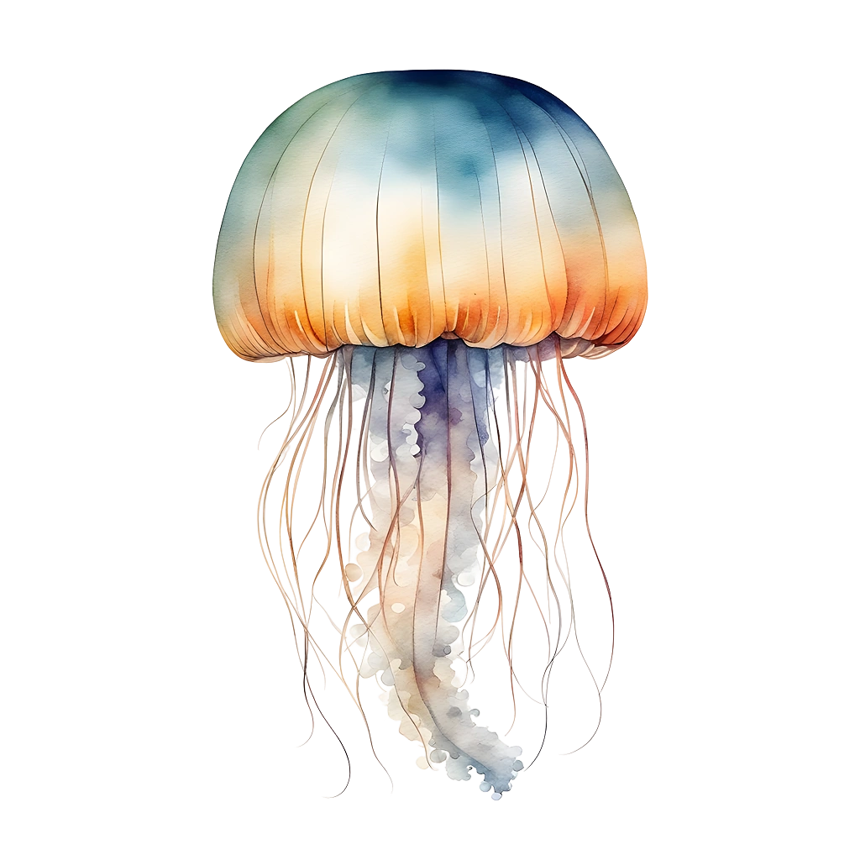
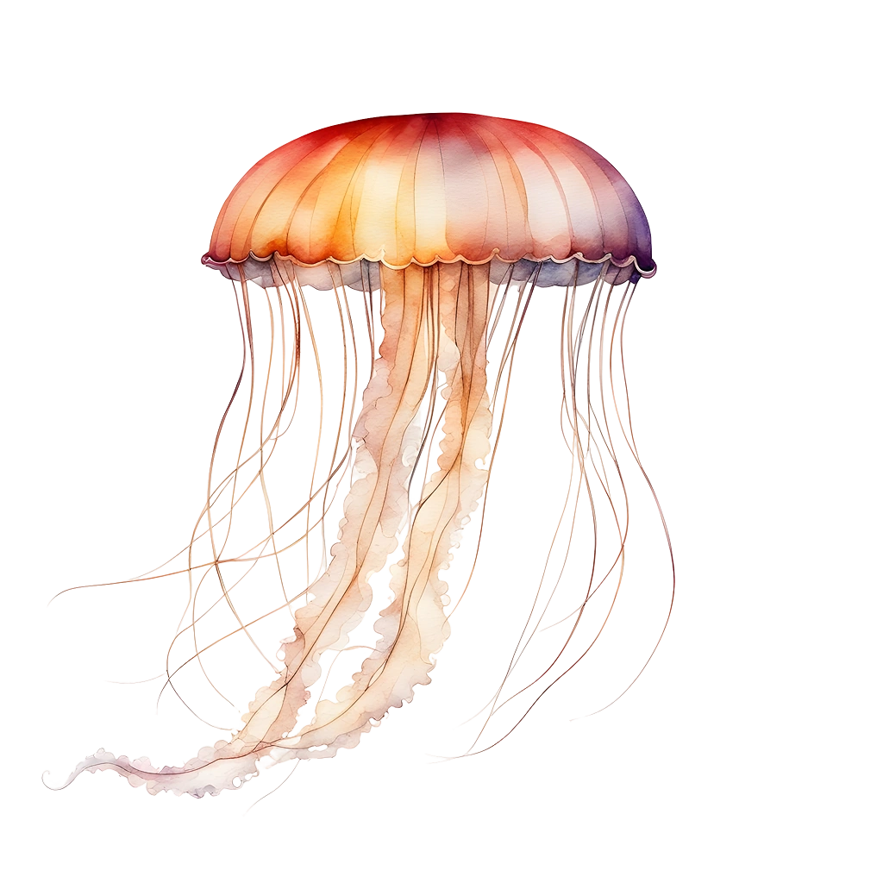
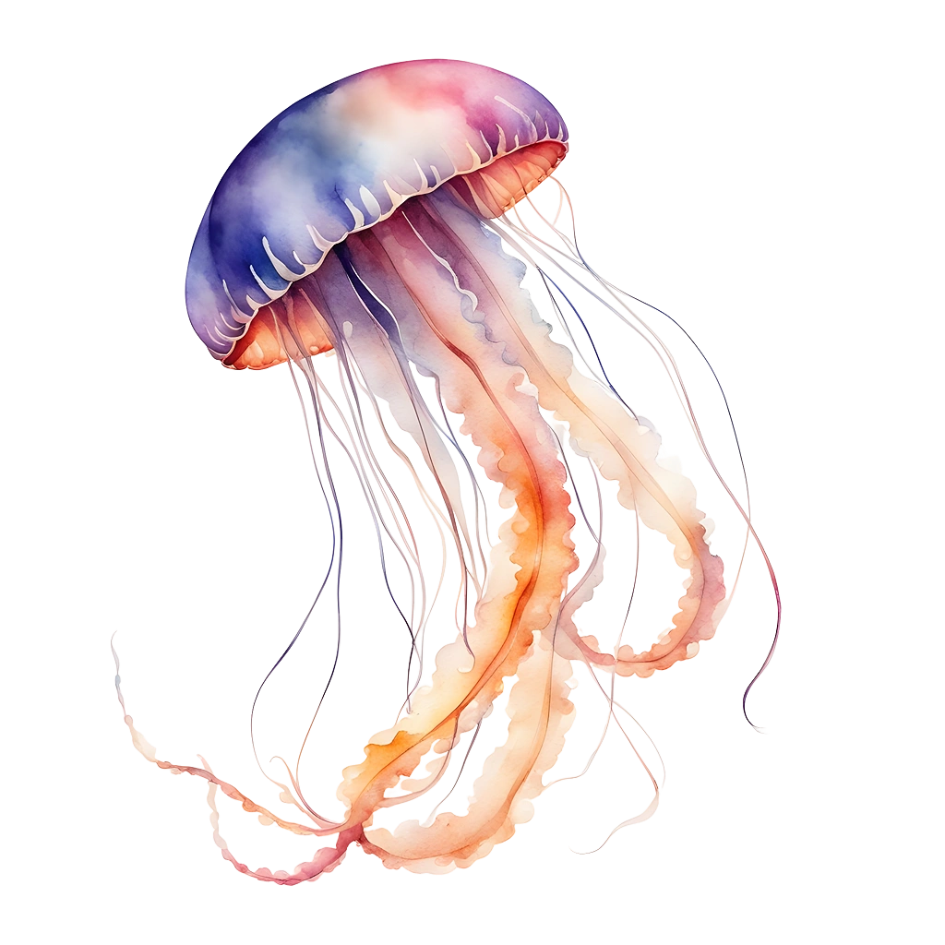
01
Introduction
You can enter a subtitle here if you need it

Slide 6
What are jellyfish
Mercury is the closest planet to the Sun and the smallest one in the entire Solar System. Contrary to popular belief, this planet's name has nothing to do with the liquid metal. Mercury was, instead, named after the famous Roman messenger god Mercurius
Mercury takes a little more than 58 days to complete its rotation, so try to imagine how long days must be there! Since the temperatures are so extreme, albeit not as extreme as on Venus, Mercury has been deemed to be non-habitable for humans

Slide 7
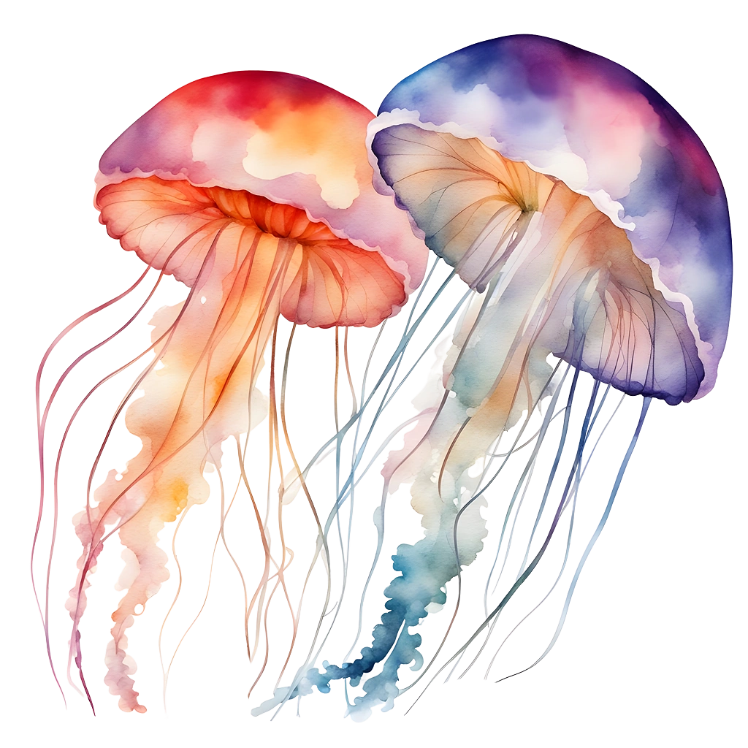
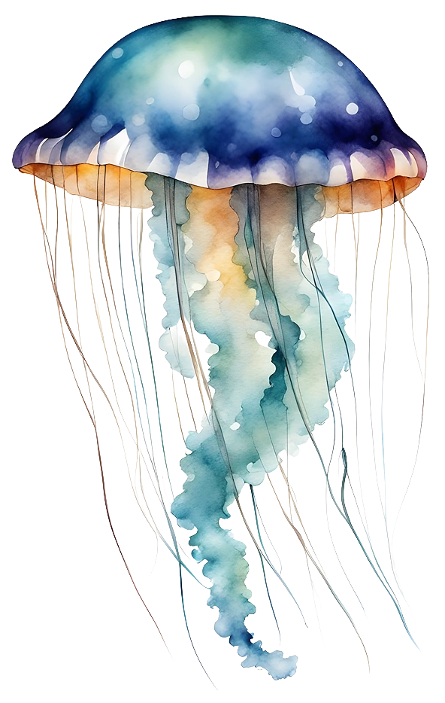
Ecological importance of jellyfish
Do you know what helps you make your point crystal clear?
Lists like this one:
They’re simple
You can organize your ideas clearly
You’ll never forget to buy milk!
And the most important thing: the audience won’t miss the point of your presentation

Slide 8
Phylogeny and taxonomy
Mercury
Venus
Mercury is the closest planet to the Sun and the smallest one in the Solar System—it’s only a bit larger than the Moon
Venus has a beautiful name and is the second planet from the Sun. It’s hot and has a poisonous atmosphere

Slide 9
Trophic interactions
Mercury
Venus
Mars
Mercury is the closest planet to the Sun and the smallest of them all
Venus has a beautiful name and is the second planet from the Sun
Despite being red, Mars is actually a cold place. It’s full of iron oxide dust

Slide 10
Distinguishing features
Mercury
Venus
Mercury is the closest planet to the Sun and the smallest of them all
Venus has a beautiful name and is the second planet from the Sun
Mars
Saturn
Despite being red, Mars is actually a cold place. It's full of iron oxide dust
It's also the fourth-largest object by diameter in the Solar System

Slide 11
Main groups of jellyfish
Mercury
Venus
Mars
Mercury is the closest planet to the Sun and the smallest of them all
Venus has a beautiful name and is the second planet from the Sun
Despite being red, Mars is actually a cold place. It's full of iron oxide dust
Saturn
Jupiter
Neptune
It was named after the Roman god of wealth and agriculture
Jupiter is a gas giant and the biggest planet in the Solar System
It's also the fourth-largest object by diameter in the Solar System

Slide 12
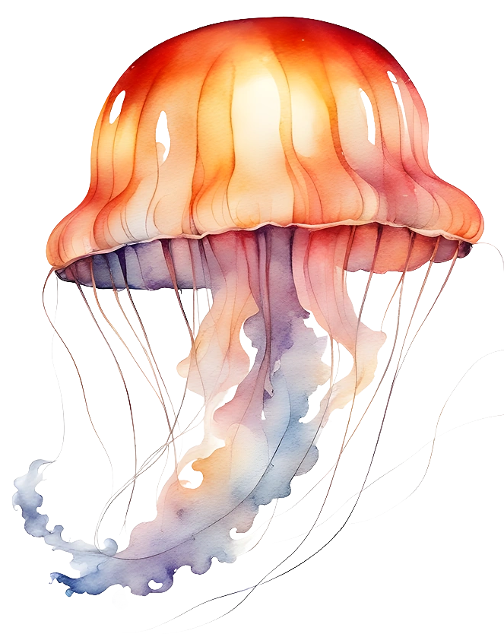
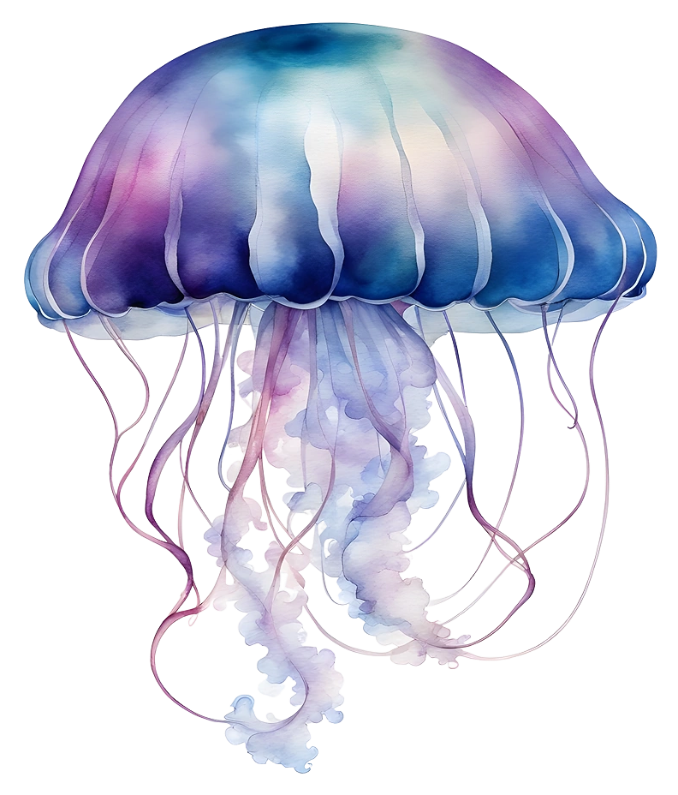
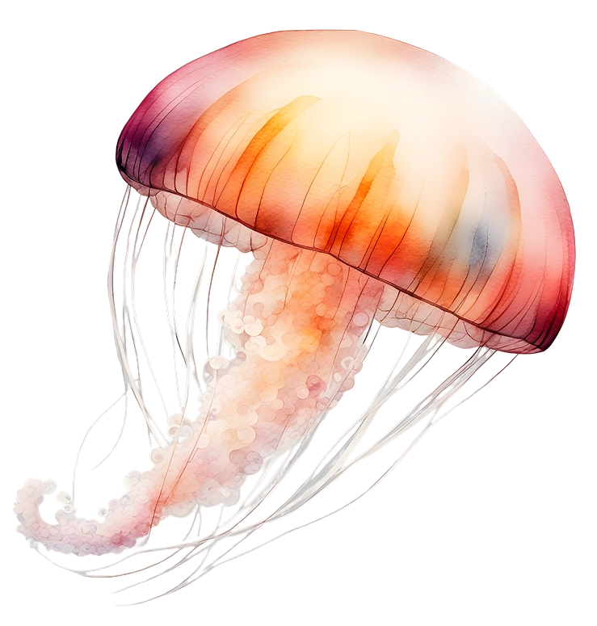
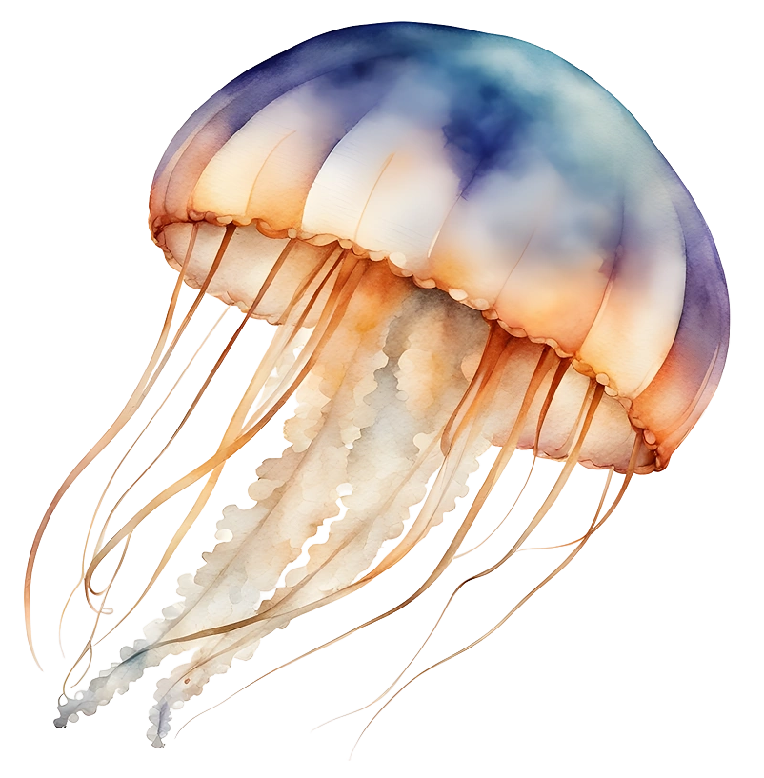
Awesome Words

Slide 13
—Someone Famous
“This is a quote, words full of wisdom that someone important said and can make the reader get inspired”

Slide 14
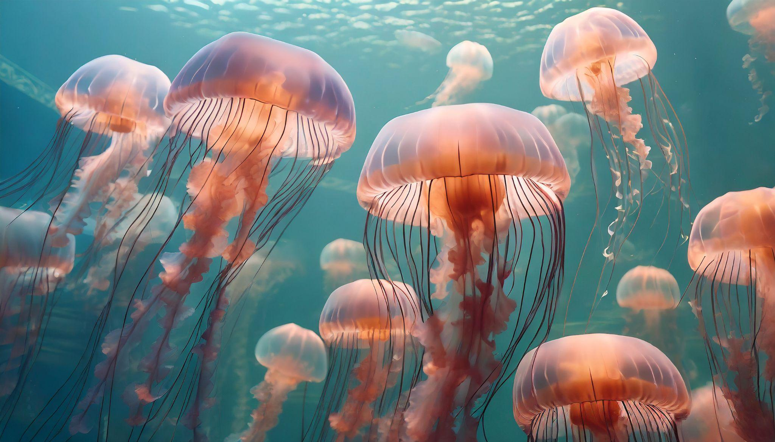
A picture is worth a thousand words

Slide 15
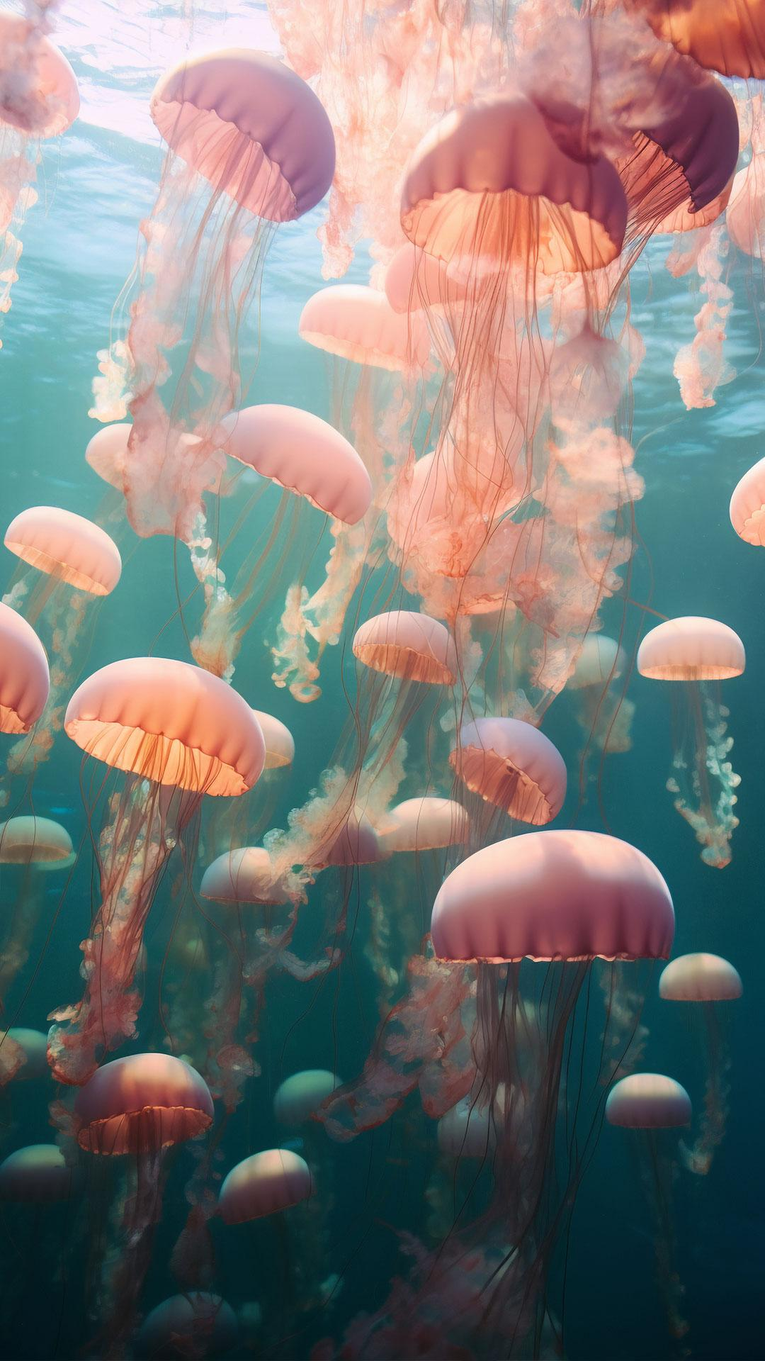
A picture always reinforces
the concept
Images reveal large amounts of data, so remember: use an image instead of a long text. Your audience will appreciate it

Slide 16
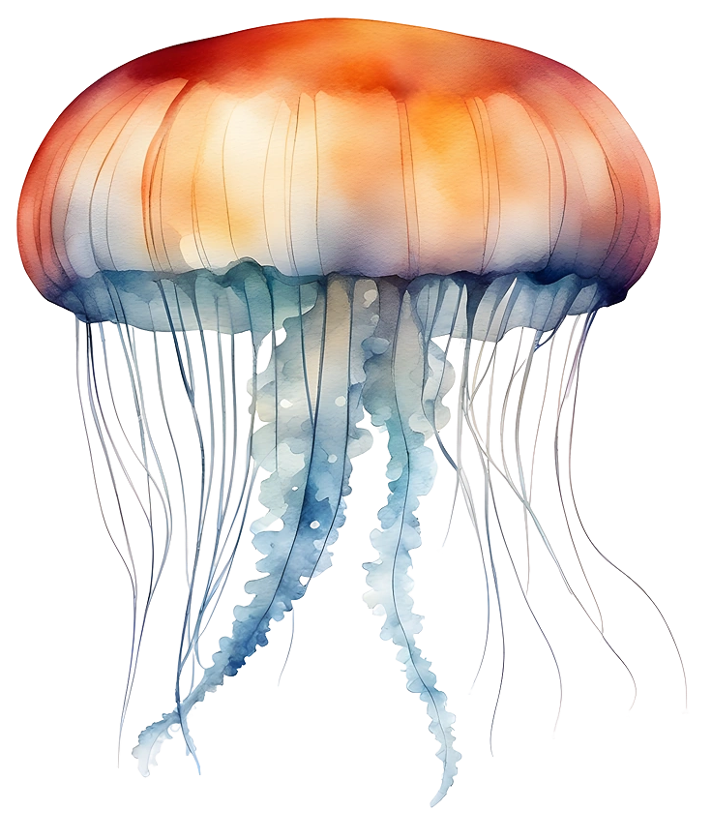
98.300.000
Big numbers catch your audience’s attention

Slide 17
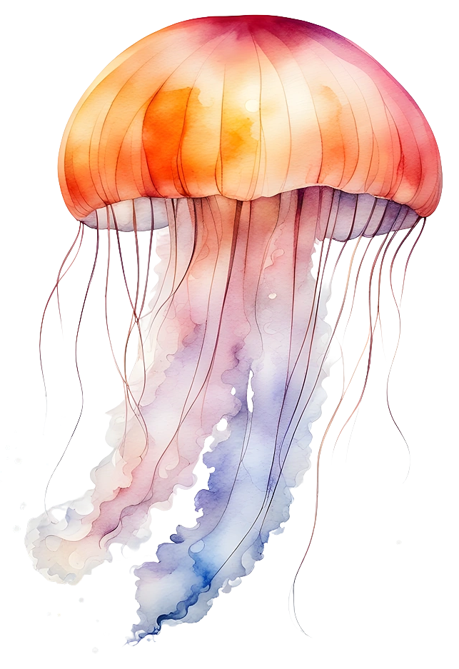
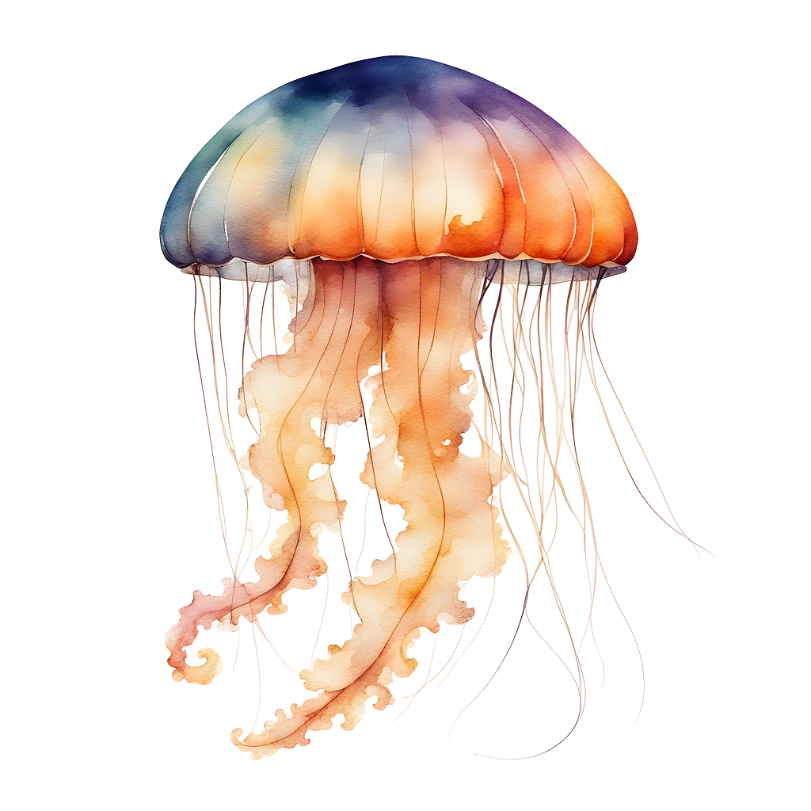
9h 55m 23s
333.000
386.000 km
Jupiter’s rotation period
The Sun’s mass compared to Earth’s
Distance between Earth and the Moon

Slide 18
Jellyfish in the oceans
25%
45%
90%
Mercury
Venus
Mars
Mercury is the closest planet to the Sun and the smallest of them all
Venus has a beautiful name and is the second planet from the Sun
Despite being red, Mars is actually a cold place. It’s full of iron oxide dust

Slide 19
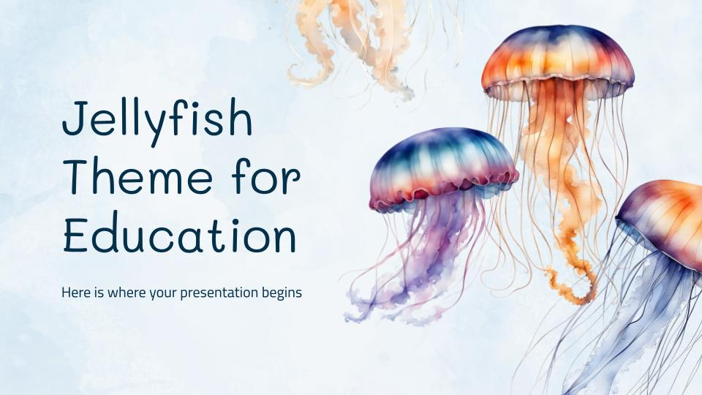
Computer mockup
You can replace the image on the screen with your own work. Just right-click on it and select “Replace image”

Slide 20
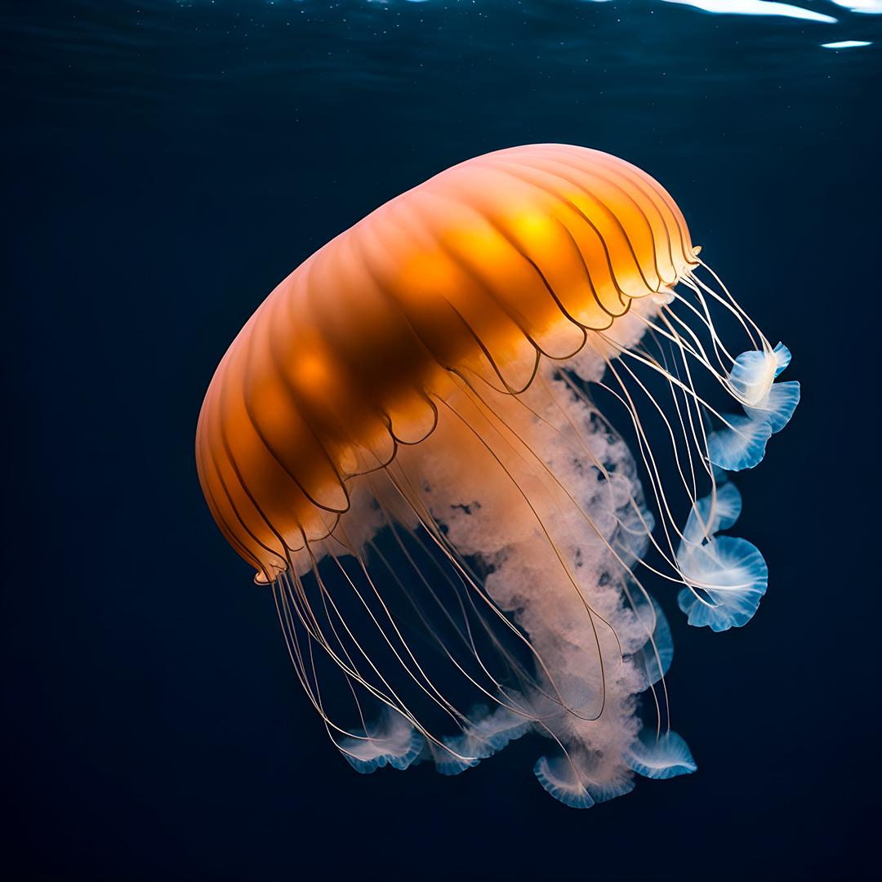
Tablet mockup
You can replace the image on the screen with your own work. Just right-click on it and select “Replace image”

Slide 21
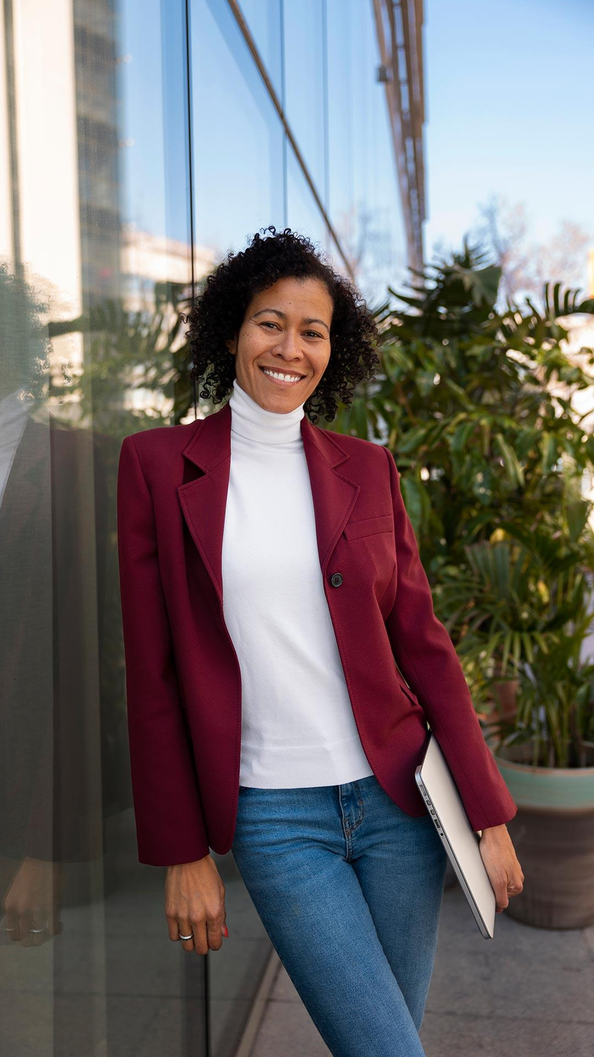
Phone mockup
You can replace the image on the screen with your own work. Just right-click on it and select “Replace image”

Slide 22
Jellyfish Migratory Routes
Mars
Despite being red, Mars is actually a cold place. It's full of iron oxide dust which gives the planet its reddish cast.
Country name
Country name
Country name
Country name

Slide 23
Discovery of new species
1xxx
1xxx
2xxx
Earth is the third planet from the Sun
Venus is the second planet from the Sun
Mars is actually a very cold place
1xxx
1xxx
Jupiter was named after a (Roman) god
Neptune is very far away from the Sun

Slide 24
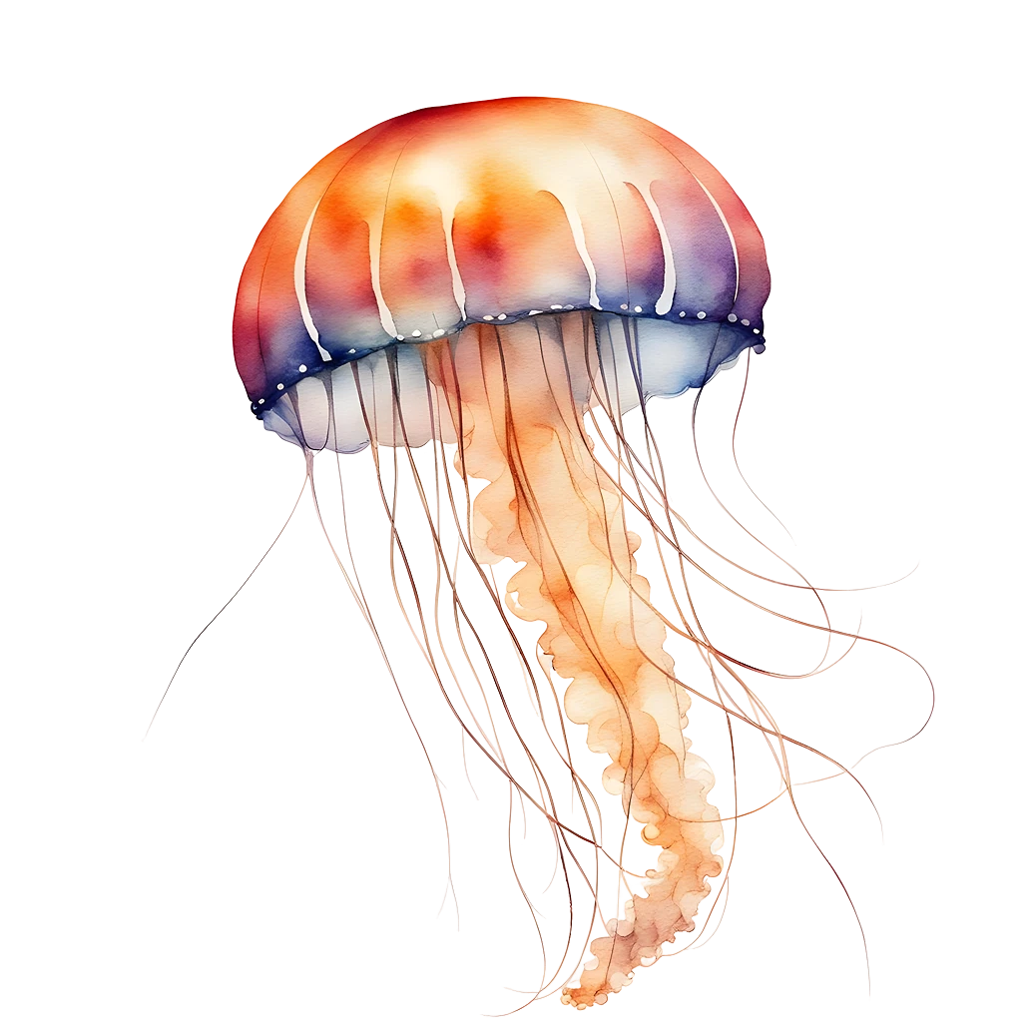
Mysterious sea creatures
Mercury
Venus
Mercury is the closest planet to the Sun and the smallest of them all
Venus has a beautiful name and is the second planet from the
Jellyfish
Mars
Jupiter
Despite being red, Mars is actually a cold place. It's full of iron oxide dust
Jupiter is a gas giant and the biggest planet in the Solar System

Slide 25
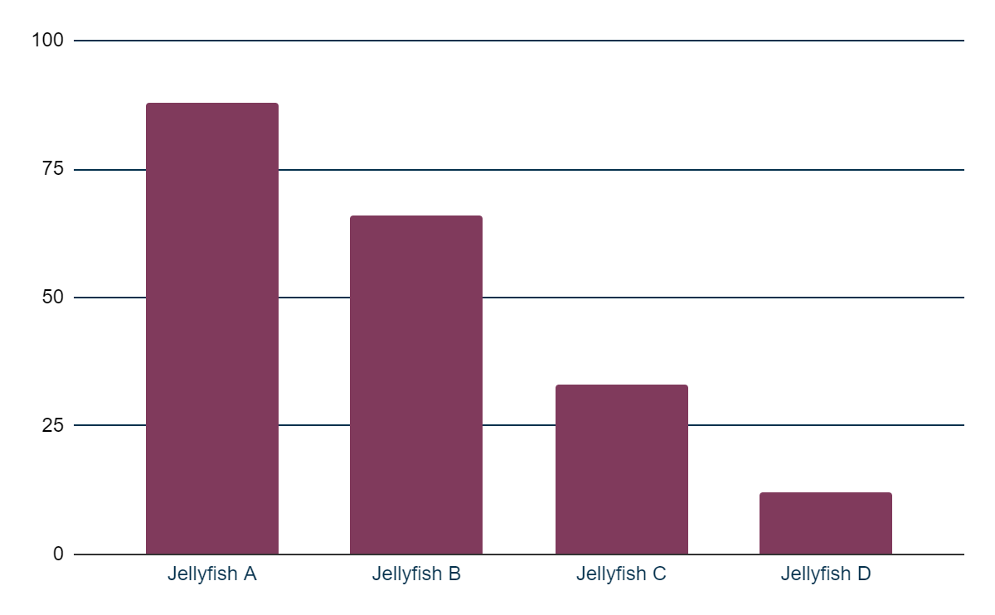
Jellyfish diversity
Mars
Despite being red, Mars is actually a cold place. It's full of iron oxide dust which gives the planet its reddish cast.
Jellyfish A
Jellyfish B
Jellyfish C
Jellyfish D
Follow the link in the graph to modify its data and then paste the new one here. For more info, click here

Slide 26
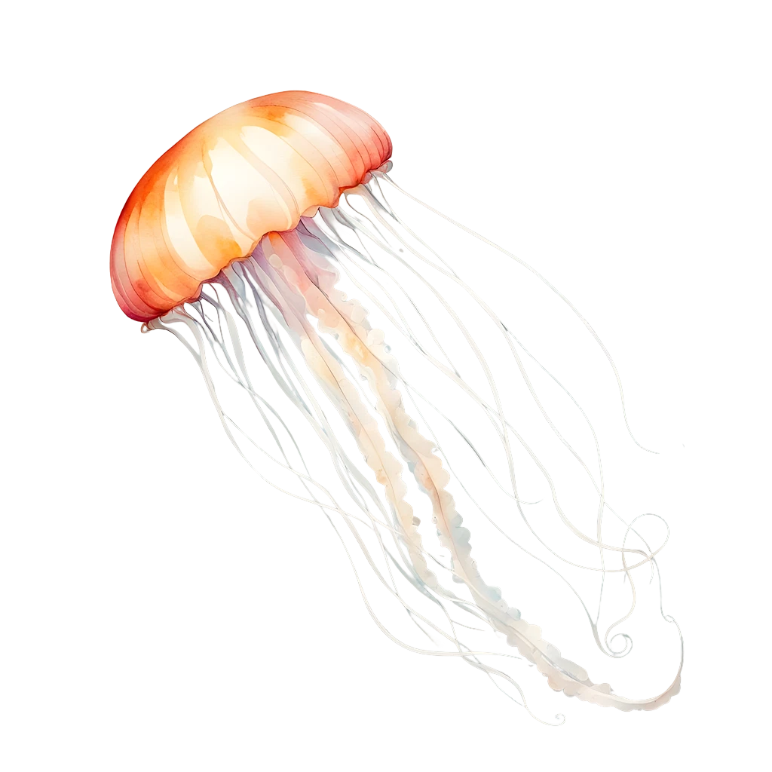
Characteristics of different jellyfish
Species of jellyfish | Average Size | Color | Main Habitat
Jellyfish A | 12cm | Transparent | Atlantic Ocean
Jellyfish B | 24cm | White | Mediterranean sea
Jellyfish C | 45cm | Pink | Sea of Japan
Jellyfish D | 5cm | Yellow | Ocean I indicate
Jellyfish F | 60cm | Blue | Oceania
Observations: Earth is the third planet from the Sun and the only one that harbors life in the Solar System. This is where we all live on

Slide 27
Impact on fisheries and aquaculture
Mercury
Mercury is the closest planet to the Sun and the smallest of them all
Saturn
Venus
Venus has a beautiful name and is the second planet from the Sun
Saturn is a gas giant and has several rings. It's composed mostly of hydrogen and helium. It was named after the Roman god of wealth and agriculture
Mars
Despite being red, Mars is actually a cold place. It's full of iron oxide dust
Jupiter
Jupiter is a gas giant and the biggest planet in the Solar System

Slide 28
Jellyfish and ecosystem exploration
Instructions: Takes a close look at jellyfish and their marine habitat. Closely examine the physical characteristics of a jellyfish, their behavior, and how they interact with their environment. Then, answer the questions by providing specific details and examples based on your observations. Feel free to share your observations and conclusions during the group discussion.
What are the most outstanding characteristics of the jellyfish you observed (color, shape, size, tentacles, etc.)?
How do you think the physical characteristics of jellyfish help them survive in their marine habitat?
What role do you think jellyfish play in the marine ecosystem? How might they affect other species?
What are some of the threats jellyfish currently face and what measures could be taken to protect them?

Slide 29
Complete the answers
Instructions: Fill in the blank with the appropriate word below to complete each sentence
Jellyfish belong to the phylum __________ and are animals __________, which means they have a gelatinous body and symmetry __________.
In their life cycle, jellyfish go through a metamorphosis from the polyp stage to the __________ stage, which is the stage at which they are most recognizable.
Jellyfish capture prey with their tentacles loaded with __________, highly specialized cells that inject __________ into their prey to immobilize them.
Jellyfish have been the subject of study and admiration throughout history and have become symbols of __________ and __________ in various cultures.
Cnidaria | Diversity | Radial | Venom
Beauty | Cnidocitos | Jellyfish | Invertebrates

Slide 30
Climate change impact and solutions
Instructions: Carefully examine the reference image and observe the distinctive features of the jellyfish. Be sure to depict its unique characteristics, such as umbrella shape, tentacles, and colors.
Answer: Write your answer here…

Slide 31
Impact of climate change on jellyfish
Instructions: According to the impact of climate change on jellyfish and their habitats, let’s have a discussion about these interesting questions and create a debate.
What are the main effects of climate change on jellyfish and their habitats?
How does climate change affect marine biodiversity and the ecosystems where jellyfish live?
What individual and collective actions could contribute to the protection of jellyfish in the context of climate change?
Form small groups to discuss the answers to the questions.
Share your group's opinions with other classmates.

Slide 32
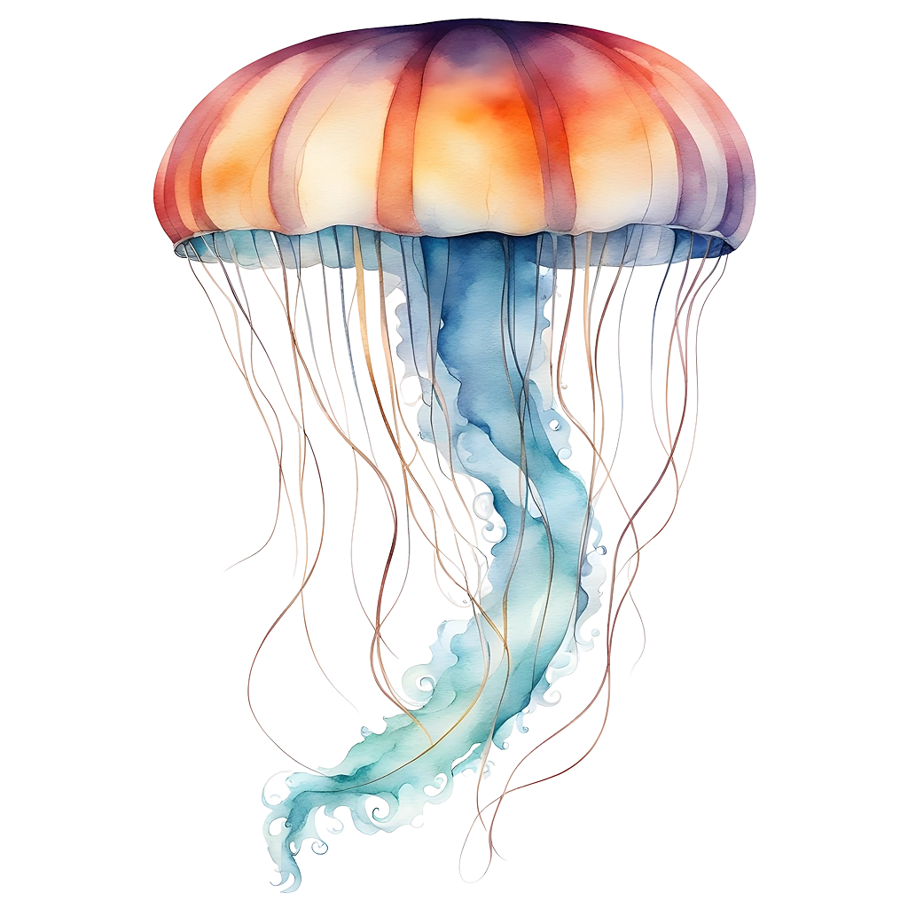
Fascinating creatures of the ocean
Mercury
Venus
Mercury is the closest planet to the Sun and the smallest of them all
Venus has a beautiful name and is the second planet from the Sun
Mars
Saturn
Despite being red, Mars is actually a cold place. It's full of iron oxide dust
It's also the fourth-largest object by diameter in the Solar System

Slide 33
Conclusions
General conclusion
Student A
Mercury is the closest planet to the Sun and the smallest one in the entire Solar System. This planet’s name has nothing to do with the liquid metal, since Mercury was named after the Roman messenger god. Despite being closer to the Sun than Venus, its temperatures aren't as terribly hot as that planet’s. Its surface is quite similar to that of Earth’s Moon
Saturn is a gas giant and has several rings. It's composed mostly of hydrogen and helium.
Student B
Earth is the third planet from the Sun and the only one that harbors life in the Solar System.

Slide 34
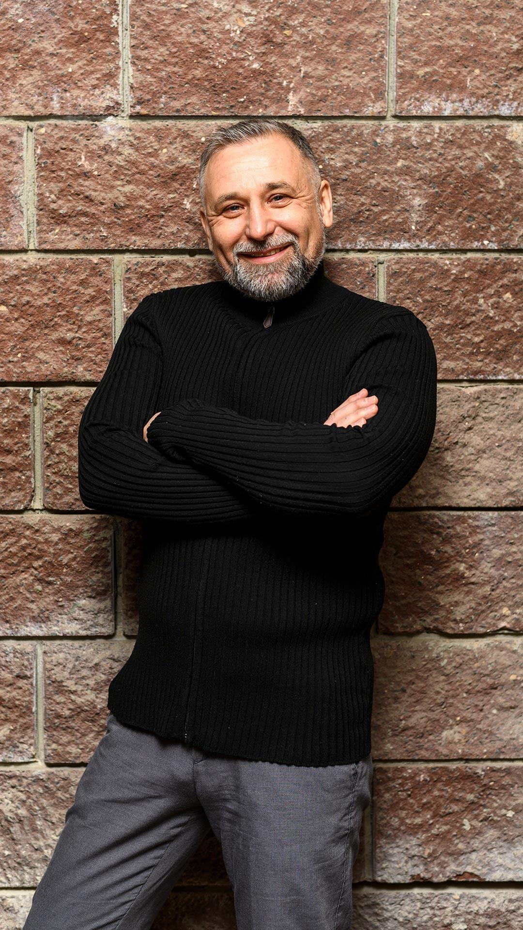
Our team
Timmy Jimmy
Kaliyah Harris
You can speak a bit about this person here
You can speak a bit about this person here

Slide 35
Thanks!
Do you have any questions?
youremail@freepik.com
+34 654 321 432
yourwebsite.com
Please keep this slide for attribution

Slide 36
Icon pack

Slide 37
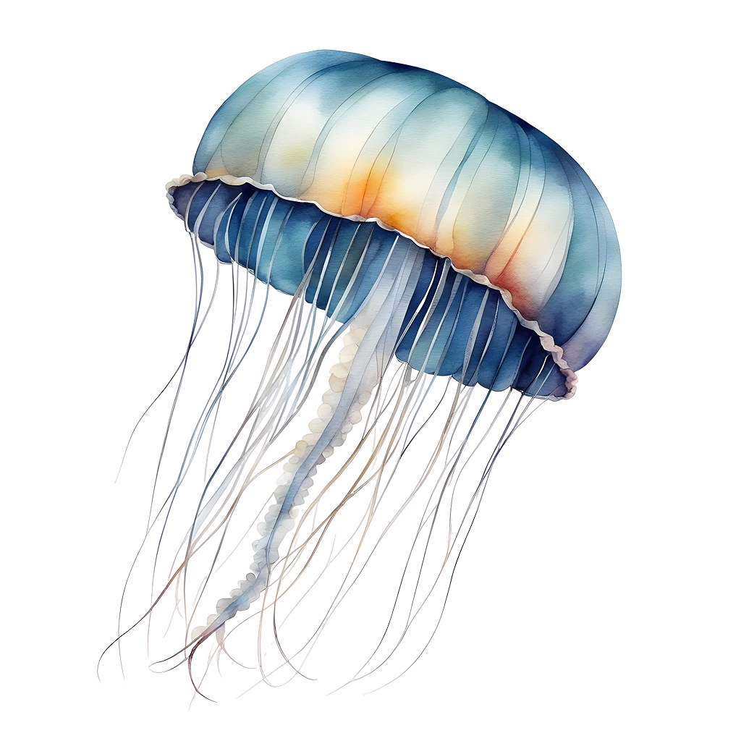
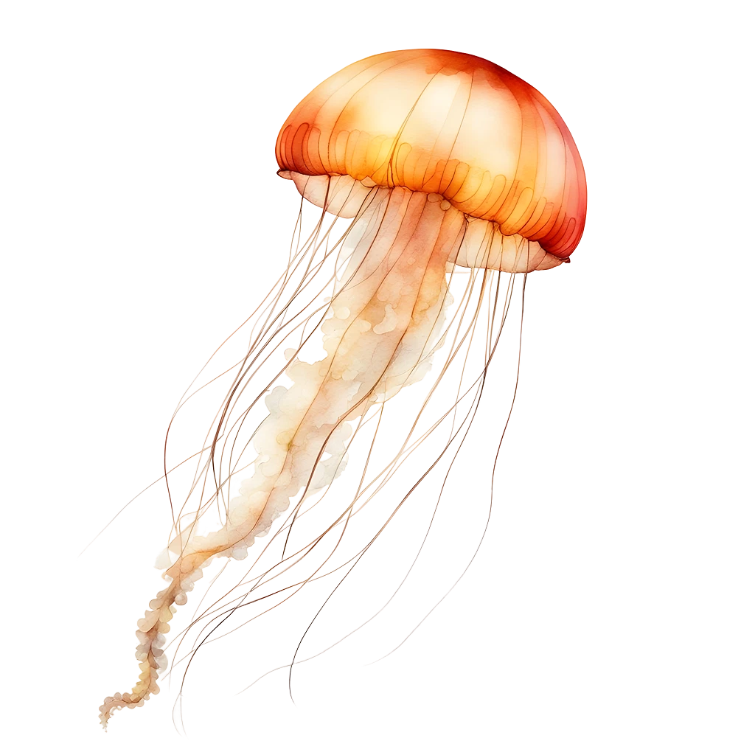
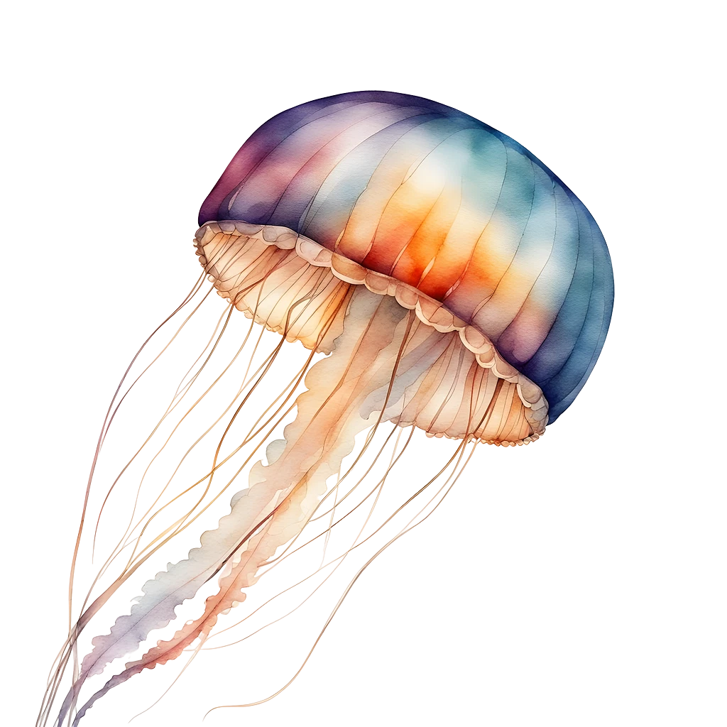
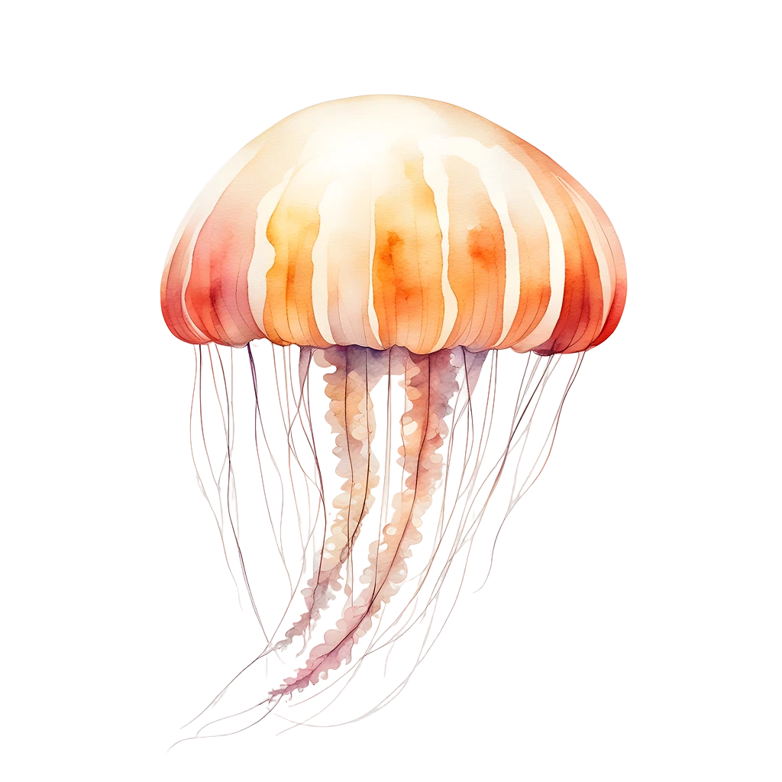
Alternative resources
Here’s an assortment of alternative resources whose style fits the one of this template:
Vectors
AI-generated images by Freepik AI Image Generator

Slide 38
Resources
Did you like the resources on this template? Get them on these websites:
Vectors
AI-generated images by Freepik AI Image Generator
Hand painted abstract blue wallpaper in watercolor I
Hand painted abstract blue wallpaper in watercolor II
Photos
AI-generated images by Adobe Firefly
Medium shot man posing next to brick wall
View of majestic jellyfish swarm in the ocean
Portrait of senior woman in professional blazer outdoors and laptop
Icons
Icon Pack: World Oceans Day | Filled

Slide 39
Instructions for use
If you have a free account, in order to use this template, you must credit Slidesgo by keeping the Thanks slide. Please refer to the next slide to read the instructions for premium users.
As a Free user, you are allowed to:
Modify this template.
Use it for both personal and commercial projects.
You are not allowed to:
Sublicense, sell or rent any of Slidesgo Content (or a modified version of Slidesgo Content).
Distribute Slidesgo Content unless it has been expressly authorized by Slidesgo.
Include Slidesgo Content in an online or offline database or file.
Offer Slidesgo templates (or modified versions of Slidesgo templates) for download.
Acquire the copyright of Slidesgo Content.
For more information about editing slides, please read our FAQs or visit our blog:
https://slidesgo.com/faqs and https://slidesgo.com/slidesgo-school

Slide 40
Instructions for use (premium users)
As a Premium user, you can use this template without attributing Slidesgo or keeping the "Thanks" slide.
You are allowed to:
Modify this template.
Use it for both personal and commercial purposes.
Hide or delete the “Thanks” slide and the mention to Slidesgo in the credits.
Share this template in an editable format with people who are not part of your team.
You are not allowed to:
Sublicense, sell or rent this Slidesgo Template (or a modified version of this Slidesgo Template).
Distribute this Slidesgo Template (or a modified version of this Slidesgo Template) or include it in a database or in any other product or service that offers downloadable images, icons or presentations that may be subject to distribution or resale.
Use any of the elements that are part of this Slidesgo Template in an isolated and separated way from this Template.
Register any of the elements that are part of this template as a trademark or logo, or register it as a work in an intellectual property registry or similar.
For more information about editing slides, please read our FAQs or visit our blog:
https://slidesgo.com/faqs and https://slidesgo.com/slidesgo-school

Slide 41
Fonts & colors used
This presentation has been made using the following fonts:
Mail
(https://fonts.google.com/specimen/Mali)
Cairo
(https://fonts.google.com/specimen/Cairo)
#04304c
#f8f8f8
#77b0d4
#c44e28
#e26f34
#f6e5be
#091e62
#467288
#803a5c

Slide 42





Storyset
Create your Story with our illustrated concepts. Choose the style you like the most, edit its colors, pick the background and layers you want to show and bring them to life with the animator panel! It will boost your presentation. Check out how it works.
Pana
Amico
Bro
Rafiki
Cuate

Slide 43
Use our editable graphic resources...
You can easily resize these resources without losing quality. To change the color, just ungroup the resource and click on the object you want to change. Then, click on the paint bucket and select the color you want. Group the resource again when you’re done. You can also look for more infographics on Slidesgo.

Slide 46
JANUARY
FEBRUARY
MARCH
APRIL
MAY
JUNE
PHASE 1
Task 1
Task 2
PHASE 2
Task 1
Task 2
JANUARY
FEBRUARY
MARCH
APRIL
PHASE 1
Task 1
Task 2

Slide 49
...and our sets of editable icons
You can resize these icons without losing quality.
You can change the stroke and fill color; just select the icon and click on the paint bucket/pen.
In Google Slides, you can also use Flaticon’s extension, allowing you to customize and add even more icons.

Slide 50
Educational Icons
Medical Icons

Slide 51
Business Icons
Teamwork Icons

Slide 52
Help & Support Icons
Avatar Icons

Slide 53
Creative Process Icons
Performing Arts Icons

Slide 54
Nature Icons

Slide 55
SEO & Marketing Icons

Slide 56


