Slide 1




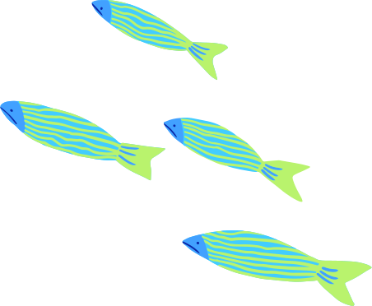

01/20
WORLD OCEAN DAY
AT SCHOOL

Slide 2

02/20
TABLE OF CONTENTS
01
INTRODUCTION
02
OCEAN POLLUTION
Elaborate on what you want to discuss.
Elaborate on what you want to discuss.
03
WHY OCEANS MATTER
Elaborate on what you want to discuss.

Slide 3
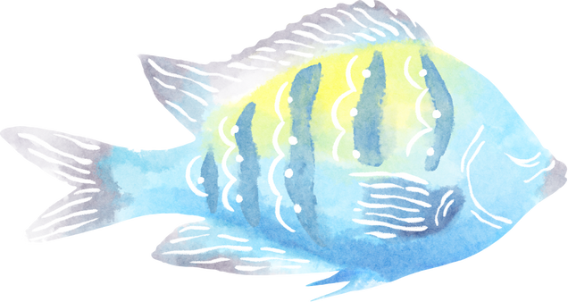

03/20
INTRODUCTION
Welcome, everyone, to our World Ocean Day celebration at [Your School Name]! We are thrilled to have you join us today as we embark on a journey to explore the wonders of our planet's greatest treasure—the ocean.
As we gather here, let us take a moment to appreciate the beauty and vastness of our oceans. Stretching across the globe, they are home to an incredible diversity of life, from the tiniest plankton to the majestic whales that roam their depths.

Slide 4


04/20
WELCOME TO OCEAN
I'm Rain, and I'll be sharing with you my beautiful ideas. Follow me at @reallygreatsite to learn more.

Slide 5




05/20
IMPORTANCE OCEANS FOR LIFE
Oceans are home to an astonishing array of life forms, from the tiniest plankton to the largest whales. They support diverse ecosystems, including coral
Marine organisms provide essential services such as oxygen production, nutrient cycling, and carbon sequestration, which are vital for
Marine organisms provide essential services such as oxygen production, nutrient cycling, and carbon sequestration, which are vital for

Slide 6


06/20
WHY OCEANS MATTER
LIFE SUPPORT SYSTEM
  Oceans are teeming with life, from the smallest microorganisms to the largest whales. They harbor an extraordinary diversity of species, many of which are yet to be discovered and studied.
  Marine ecosystems provide essential services, such as oxygen production, carbon sequestration, and nutrient cycling, which are vital for maintaining life on Earth. For instance, phytoplankton, tiny marine plants, produce over half of the world's oxygen through photosynthesis.

Slide 7




07/20
CLIMATE REGULATION
Oceans are home to an astonishing array of life forms, from the tiniest plankton to the largest whales. They support diverse ecosystems, including coral
Oceans are home to an astonishing array of life forms, from the tiniest plankton to the largest whales. They support diverse ecosystems, including coral
Oceans are home to an astonishing array of life forms, from the tiniest plankton to the largest whales. They support diverse ecosystems, including coral
Oceans are home to an astonishing array of life forms, from the tiniest plankton to the largest whales. They support diverse ecosystems, including coral

Slide 8



08/20
ECONOMIC SIGNIFICANCE
(FISHING, TOURISM, SHIPPING)

Slide 9
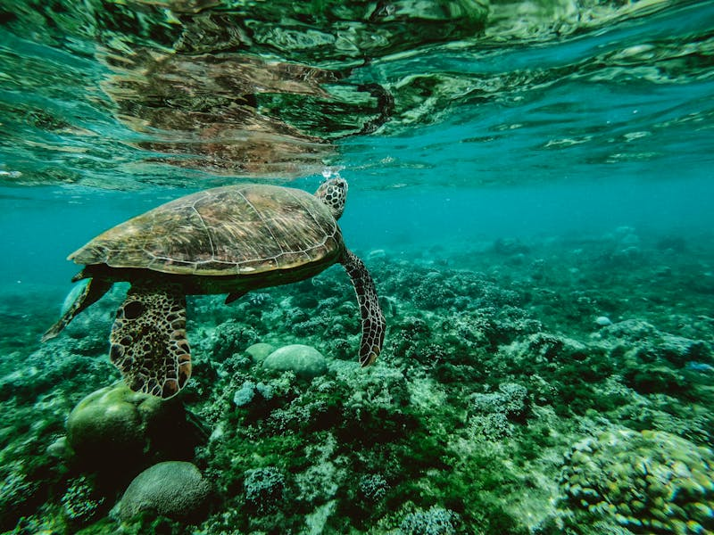
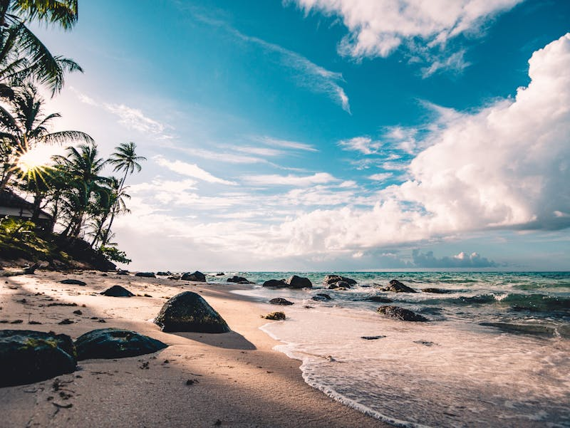
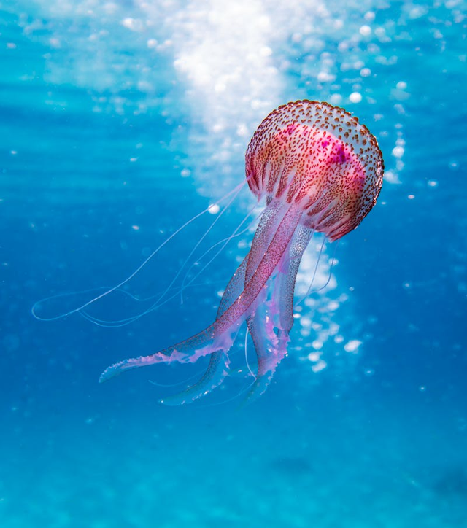
09/20
GALLERY IMAGE

Slide 10

10/20
FISHING INDUSTRY
Oceans serve as a vast source of seafood, supporting one of the world's most important food-producing sectors. Fisheries provide protein-rich food for billions of people, particularly in coastal communities and developing countries.
The fishing industry encompasses a wide range of activities, including commercial fishing, aquaculture (fish farming), and seafood processing. It employs millions of people worldwide, from fishermen and fish farmers to processors, distributors, and retailers.
Fish and other marine resources are valuable commodities traded globally, contributing to national economies and international trade. However, overfishing and unsustainable practices threaten the long-term viability of fish stocks and the livelihoods of fishing communities.

Slide 11

11/20
TOURISM
Oceans are prime destinations for tourism and recreation, attracting millions of visitors each year to coastal regions and island destinations. Marine tourism encompasses a diverse range of activities, including beach holidays, scuba diving, snorkeling, surfing, sailing, and whale watching.
Coastal tourism generates substantial revenue for local economies, supporting hotels, restaurants, tour operators, souvenir shops, and other businesses. It creates employment opportunities and stimulates economic growth in coastal.

Slide 12
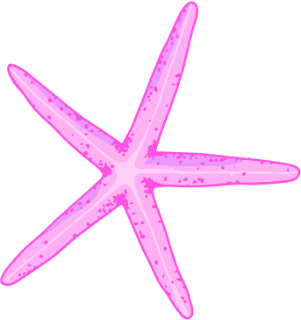


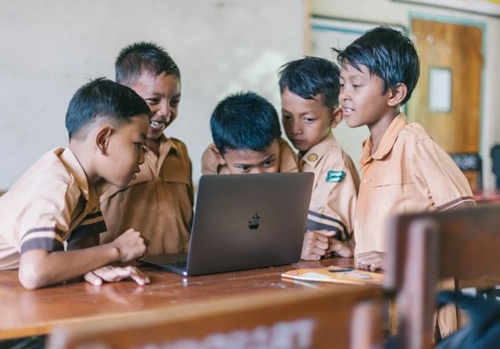
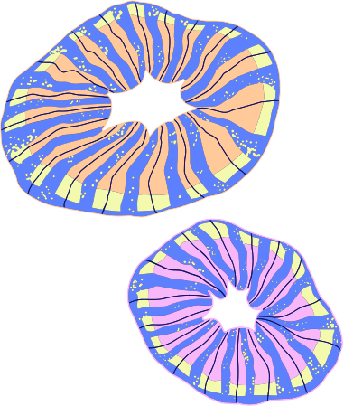
12/20
STUDENTS
STUDENT NAME
STUDENT NAME
STUDENT NAME
  Elaborate on what you want to discuss.
  Elaborate on what you want to discuss.
  Elaborate on what you want to discuss.

Slide 13

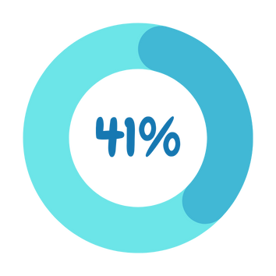



13/20
STATISTICS ON PLASTIC POLLUTION IN OCEANS
  Elaborate on what you want to discuss.
  Elaborate on what you want to discuss.
  Elaborate on what you want to discuss.

Slide 14



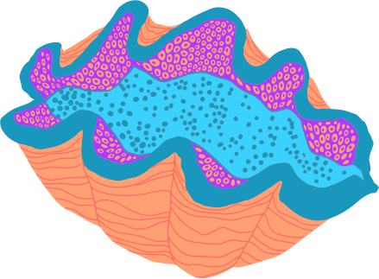
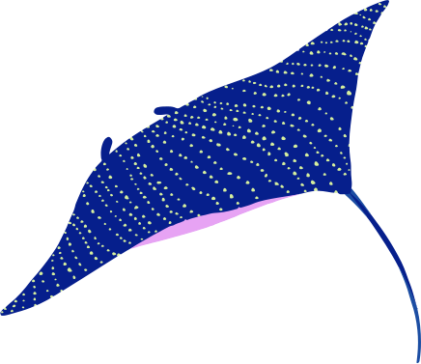
14/20
  SOLUTIONS
  Presentations are communication tools that can be used as demonstrations, lectures, speeches, reports, and more. It is mostly presented before an audience.
  Elaborate on what you want to discuss.
  Elaborate on what you want to discuss.
  Elaborate on what you want to discuss.
  Elaborate on what you want to discuss.

Slide 15


15/20
  OUR HISTORY
MAIN POINT
MAIN POINT
MAIN POINT
MAIN POINT
  Elaborate on what you want to discuss.
  Elaborate on what you want to discuss.
  Elaborate on what you want to discuss.
  Elaborate on what you want to discuss.

Slide 16
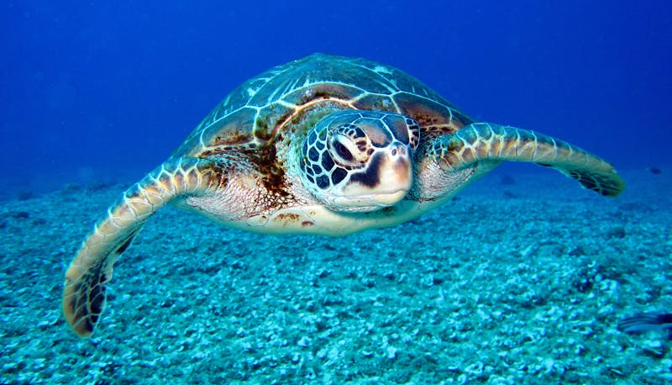
  A PICTURE IS WORTH A THOUSAND WORDS

Slide 17
17/20
  WRITE AN ORIGINAL STATEMENT OR INSPIRING QUOTE
  — Include a credit, citation, or supporting message

Slide 18


  THANK YOU!
Remember, the journey to safeguard our oceans doesn't end here. We encourage you to take action in your daily lives to support ocean conservation efforts, whether it's reducing plastic waste, supporting sustainable seafood practices, or raising awareness in your community.

Slide 19








  RESOURCE
  PAGE
  Use these design resources in your Canva Presentation.
  You can find these fonts online too. Happy designing!
  Don't forget to delete this page before presenting.
  This presentation template uses the following free fonts:
  Titles: Chewy
  Headers: Chewy
  Body Copy: Schoolbell

Slide 20

  CREDITS
  This presentation template is free for everyone to use thanks to the following:
  SlidesCarnival for the presentation template
  Pexels for the photos
  HAPPY DESIGNING!

