Slide 1






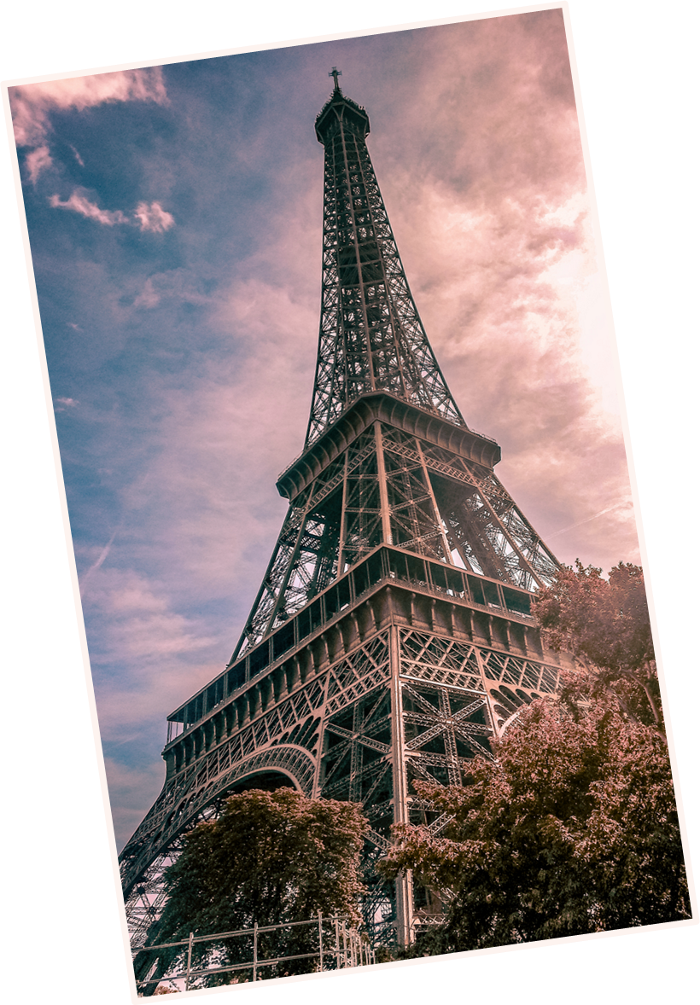


Valentine's
Day
in France

Slide 2
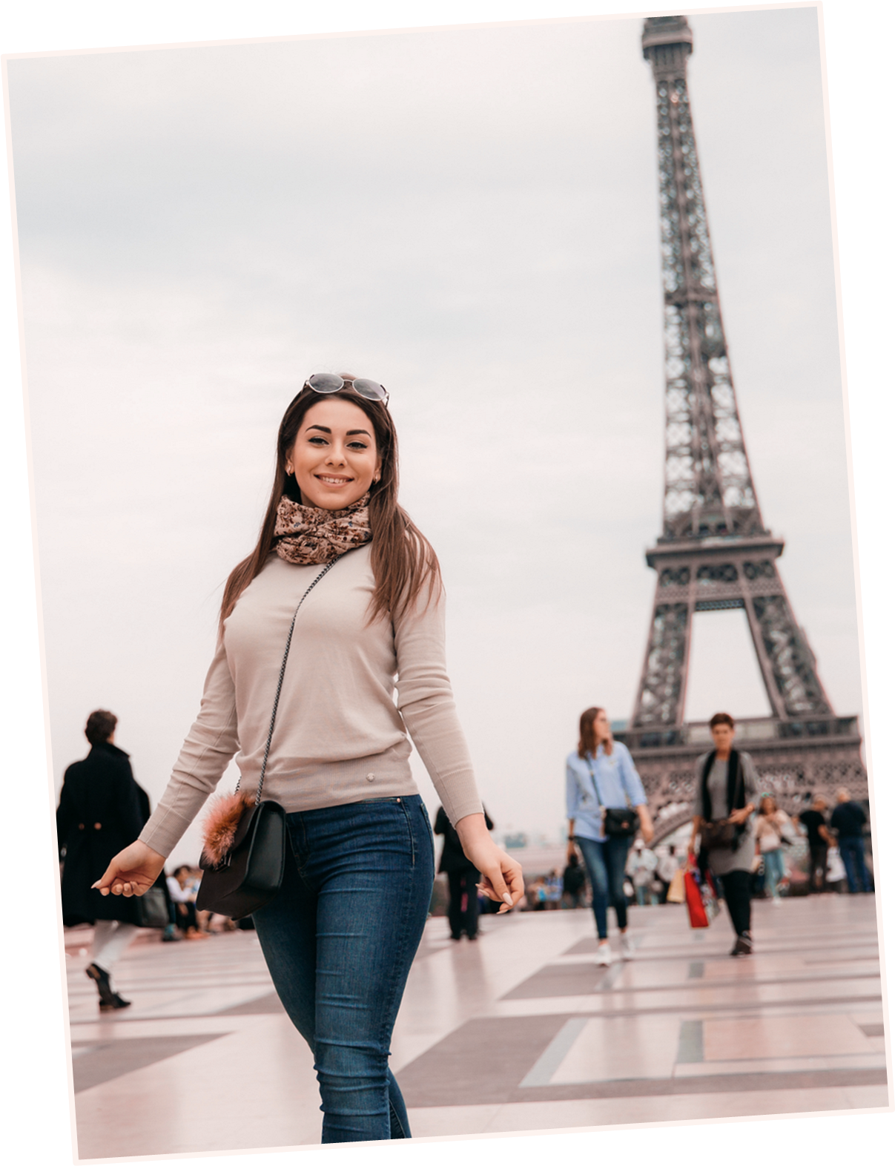

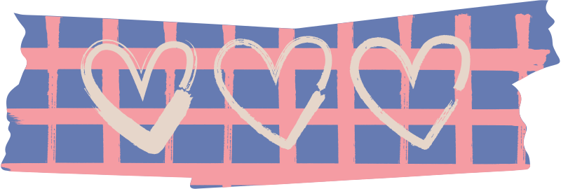



Hello there!
I'm Rain, and I'll be sharing with you my beautiful ideas. Follow me at @reallygreatsite to learn more.

Slide 3

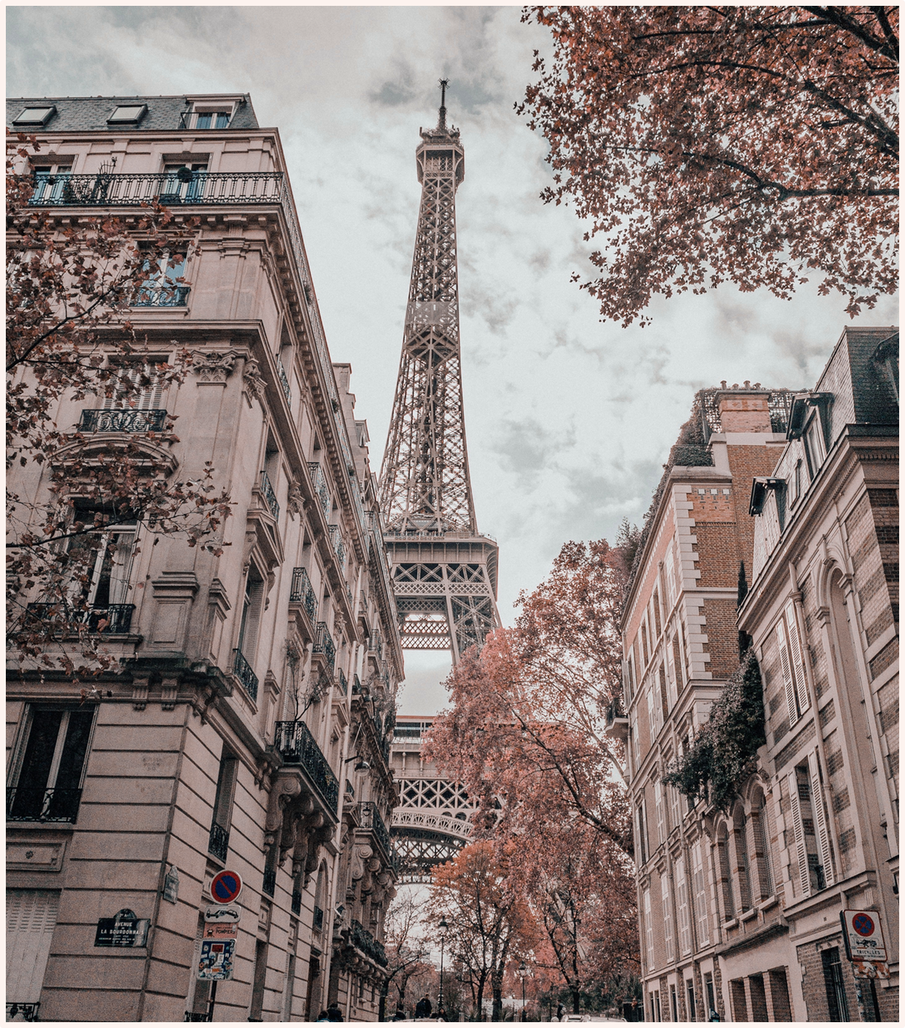

Navigating Valentine's Day in France
Essential Insights
Topic One
Topic Two
Elaborate on what you want to discuss.
Elaborate on what you want to discuss.
Topic Three
Topic Four
Elaborate on what you want to discuss.
Elaborate on what you want to discuss.

Slide 4



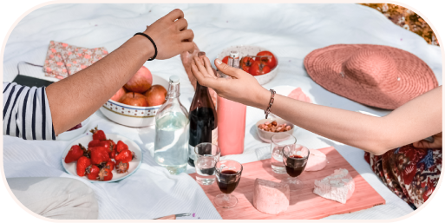

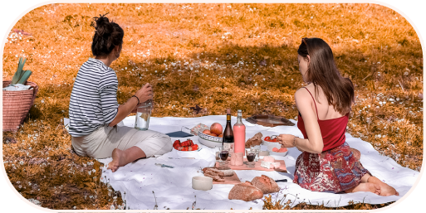
Dream Vacation
Valentine's Day, known as "La Saint-Valentin" in France, is a celebration of love and romance. This presentation explores the unique traditions and ways in which this special day is celebrated in France.
Main Point
Main Point
Elaborate on what you want to discuss.
Elaborate on what you want to discuss.

Slide 5
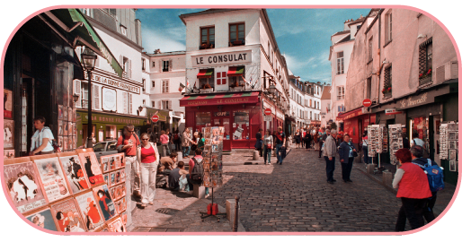
Romantic Paris
Paris, often called the "City of Love," is a popular destination for Valentine's Day. Couples enjoy romantic activities such as boat rides on the Seine, visits to the Eiffel Tower, and dining in cozy bistros. The charming streets and iconic landmarks provide a perfect backdrop for love-filled moments and memorable experiences.
Strolling hand-in-hand along the Champs-Élysées, enjoying a sunset picnic in the Luxembourg Gardens, or exploring the art at the Louvre, Paris offers endless opportunities for romance and connection.
Main Point
Elaborate on what you want to discuss.

Slide 6
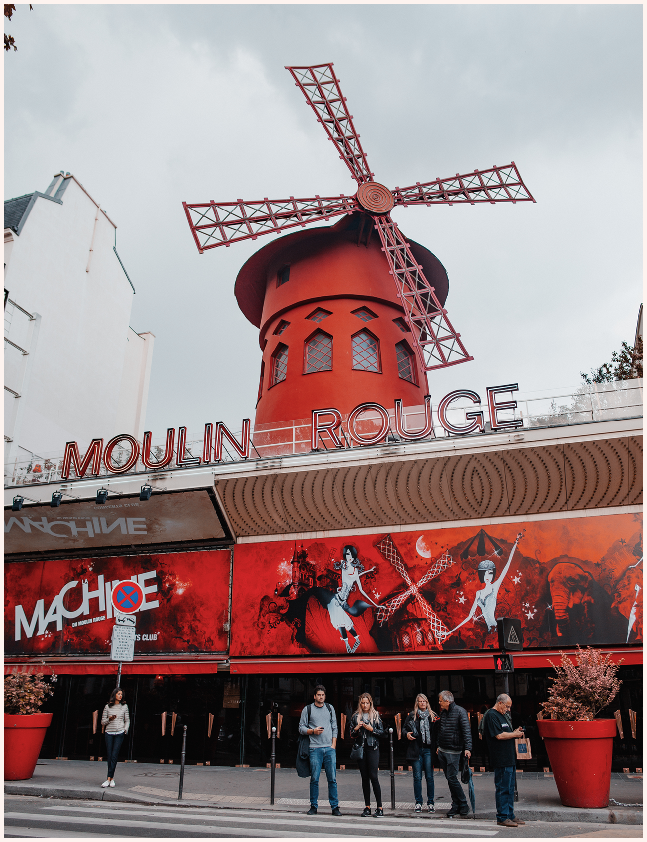

Moulin Rouge
A date night at the iconic Moulin Rouge in Paris offers an unforgettable romantic experience. Known for its vibrant cabaret performances and rich history, the Moulin Rouge is a symbol of Parisian nightlife. Couples can enjoy a spectacular show featuring talented dancers, elaborate costumes, and stunning stage designs.

Slide 7

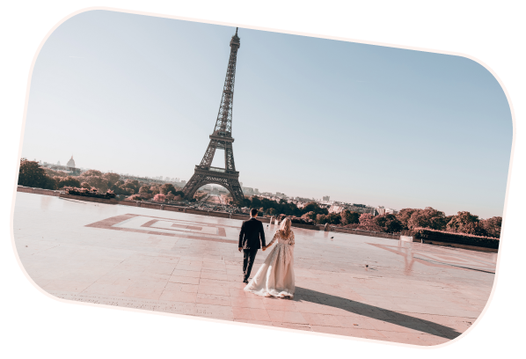

Main Point
Main Point
Briefly elaborate on what you want to discuss.
Briefly elaborate on what you want to discuss.
Main Point
Main Point
Briefly elaborate on what you want to discuss.
Briefly elaborate on what you want to discuss.
Main Point
Main Point
Briefly elaborate on what you want to discuss.
Briefly elaborate on what you want to discuss.

Slide 8

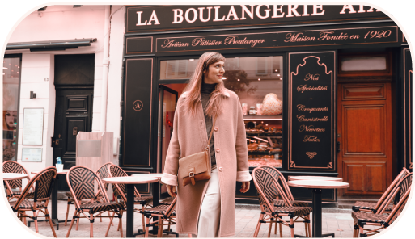

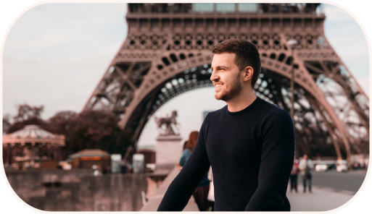
Capturing Romance
Add a main point
Add a main point
France, where love is not just a feeling but a celebration echoing through the cobblestone streets, a symphony of passion and devotion.
In France, Valentine's Day is not just a date but a rendezvous with romance itself, where every gesture whispers of love's timeless allure.

Slide 9

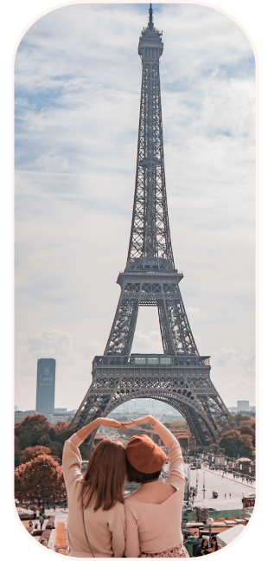
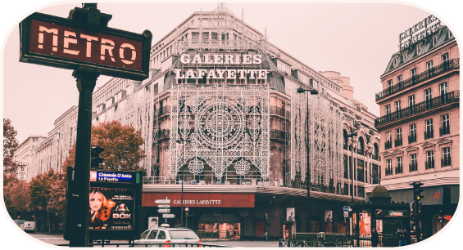
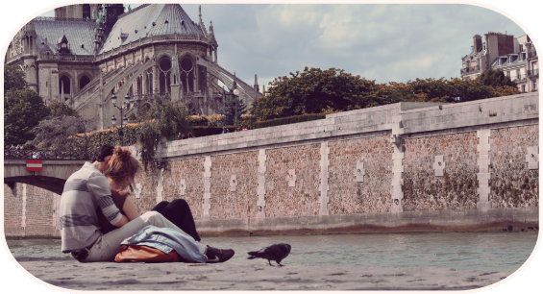
01.
02.
01.
Main Point
Briefly elaborate on what you want to discuss.
02.
Main Point
03.
Briefly elaborate on what you want to discuss.
03.
Main Point
Briefly elaborate on what you want to discuss.

Slide 10
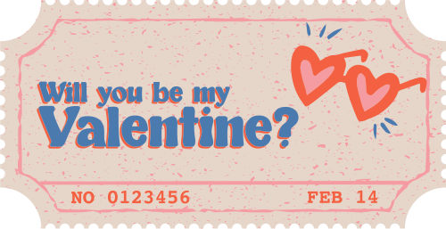

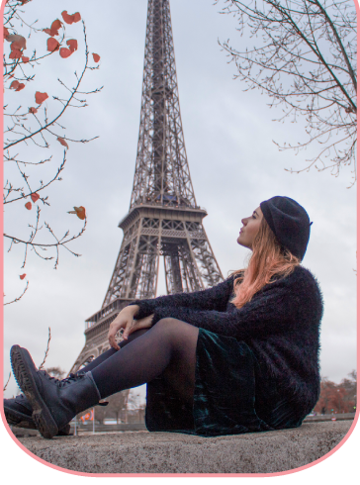
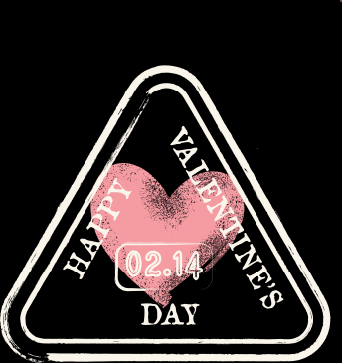
Romantic Escapes
Welcome to our guide to romantic escapes in Paris, where every corner of the city is steeped in love and enchantment. Whether you're seeking a cozy café for a tête-à-tête or a scenic spot for a sunset stroll, Paris offers an array of perfect date spots to ignite sparks and create lasting memories. From iconic landmarks like the Eiffel Tower to hidden gems in Montmartre, let us be your guide to crafting unforgettable moments of romance in the City of Love.
Name
Celebrating love amidst the charm of Paris, I found my favorite date in a candlelit dinner by the Seine, where every moment felt like a whispered promise of forever.

Slide 11
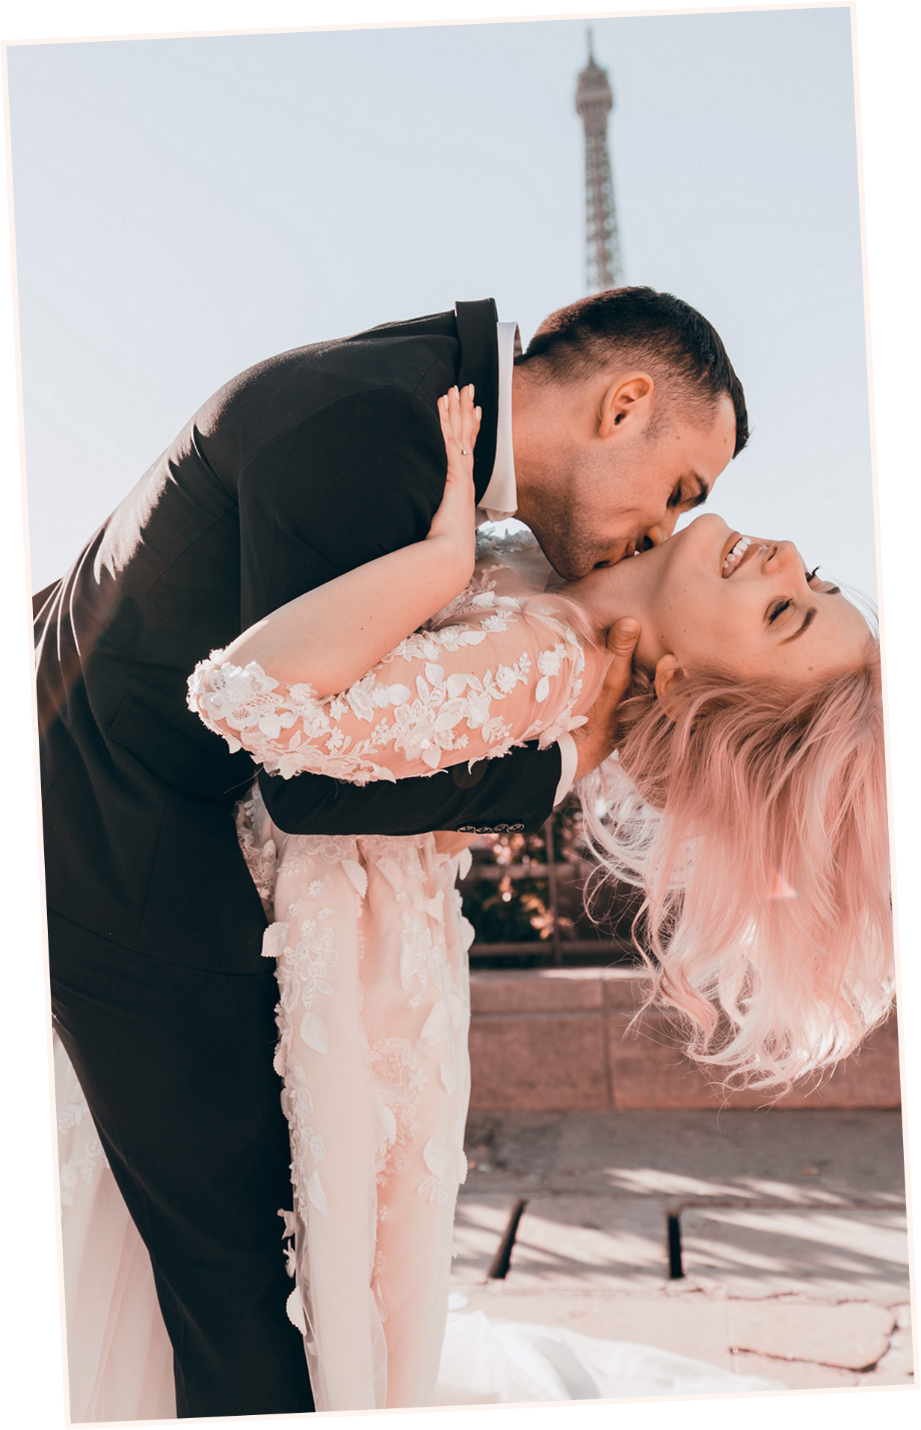
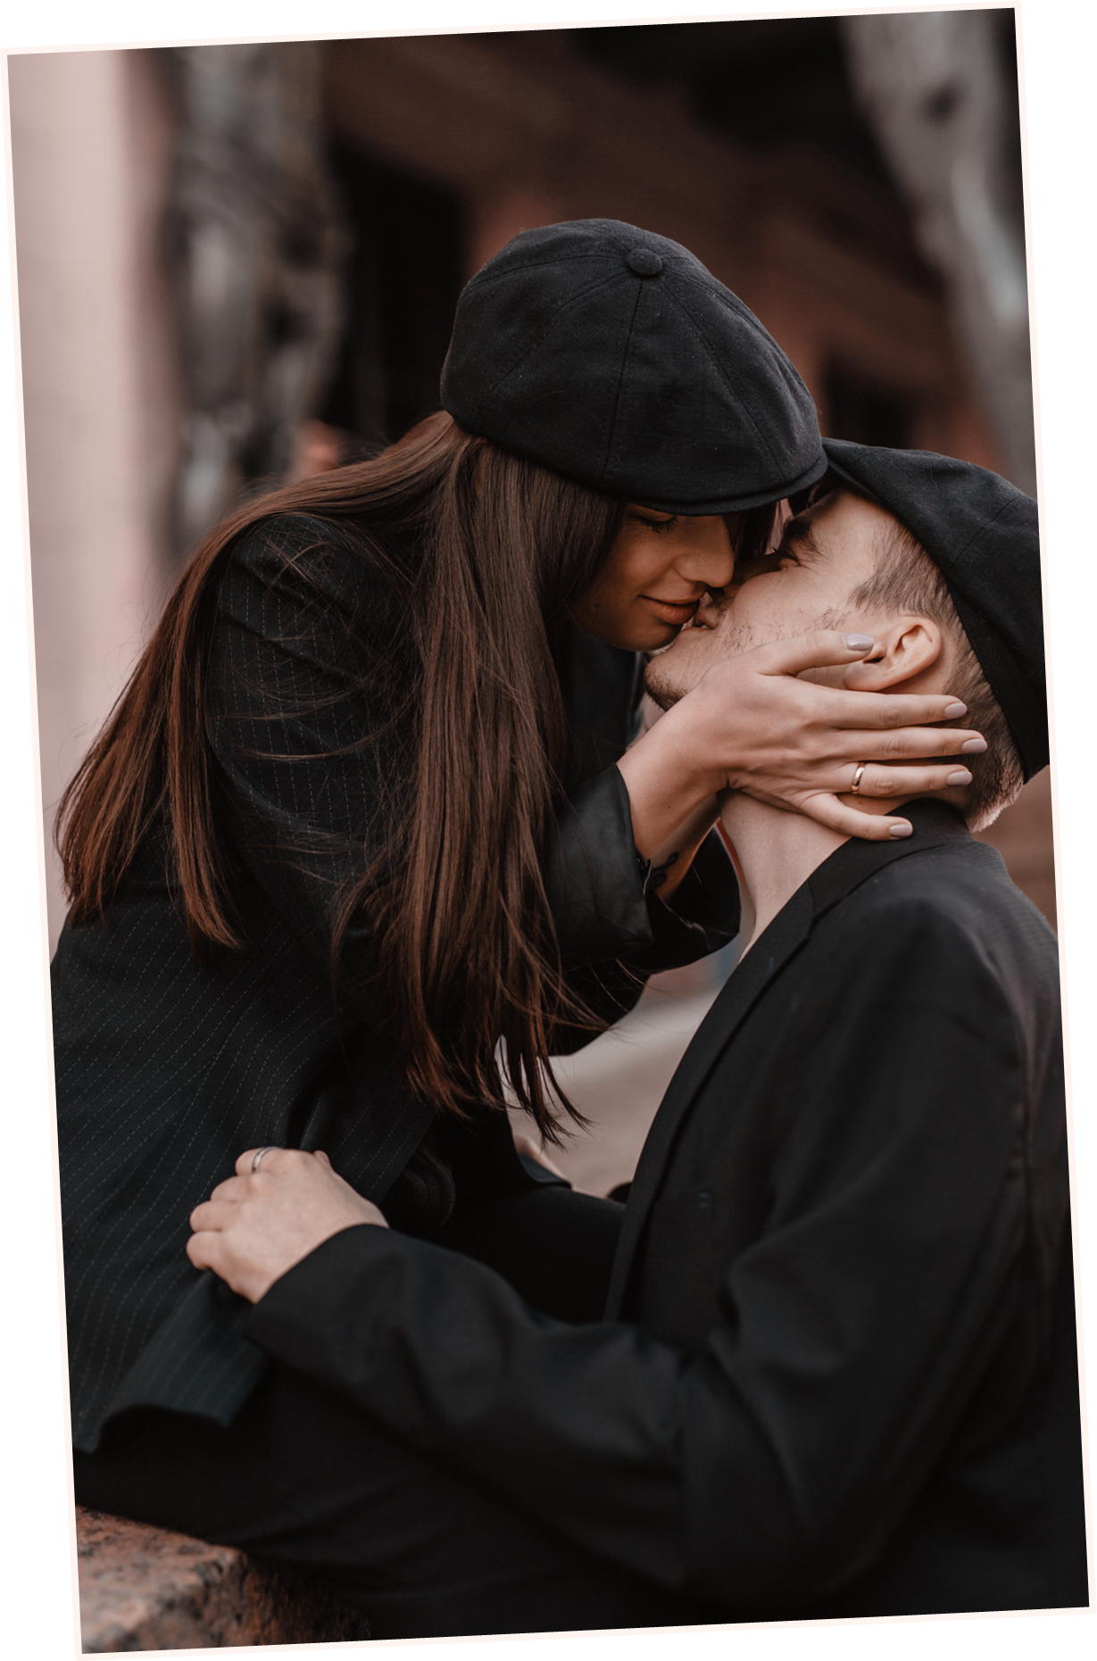




Slide 12
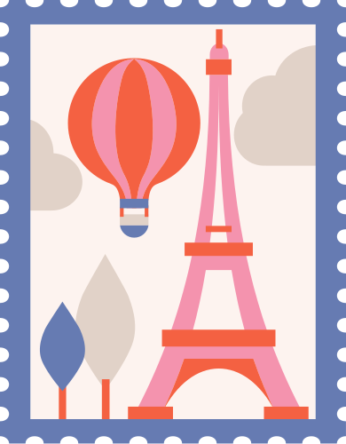
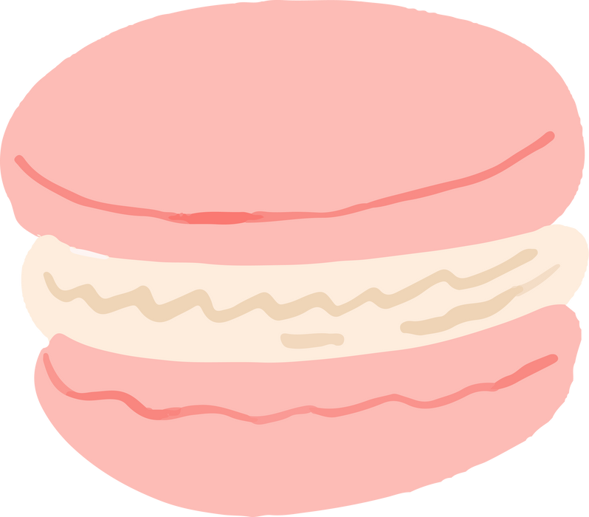



Key Aspects of Valentine's
Main Point
Main Point
Main Point
Main Point
Briefly elaborate on what you want to discuss.
Briefly elaborate on what you want to discuss.
Briefly elaborate on what you want to discuss.
Briefly elaborate on what you want to discuss.

Slide 13



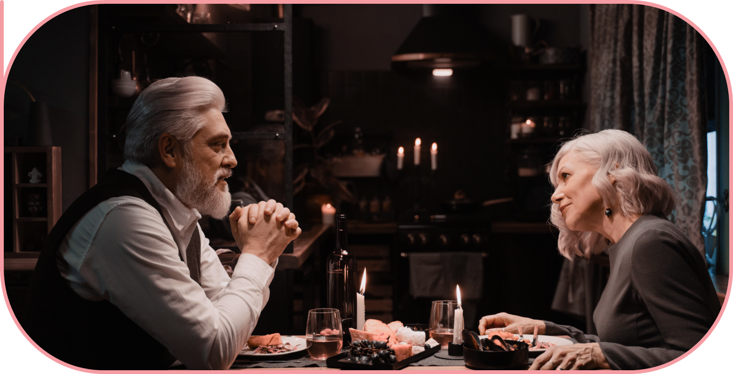
Valentine's Day in
French Culture
Valentine's Day is deeply embedded in French culture, celebrated not just by couples but also by friends and family. It’s a day for expressing affection and appreciation to all loved ones.
Valentine's Day is deeply embedded in French culture, celebrated not just by couples but also by friends and family. It’s a day for expressing affection and appreciation to all loved ones.
Add A Main Point

Slide 14
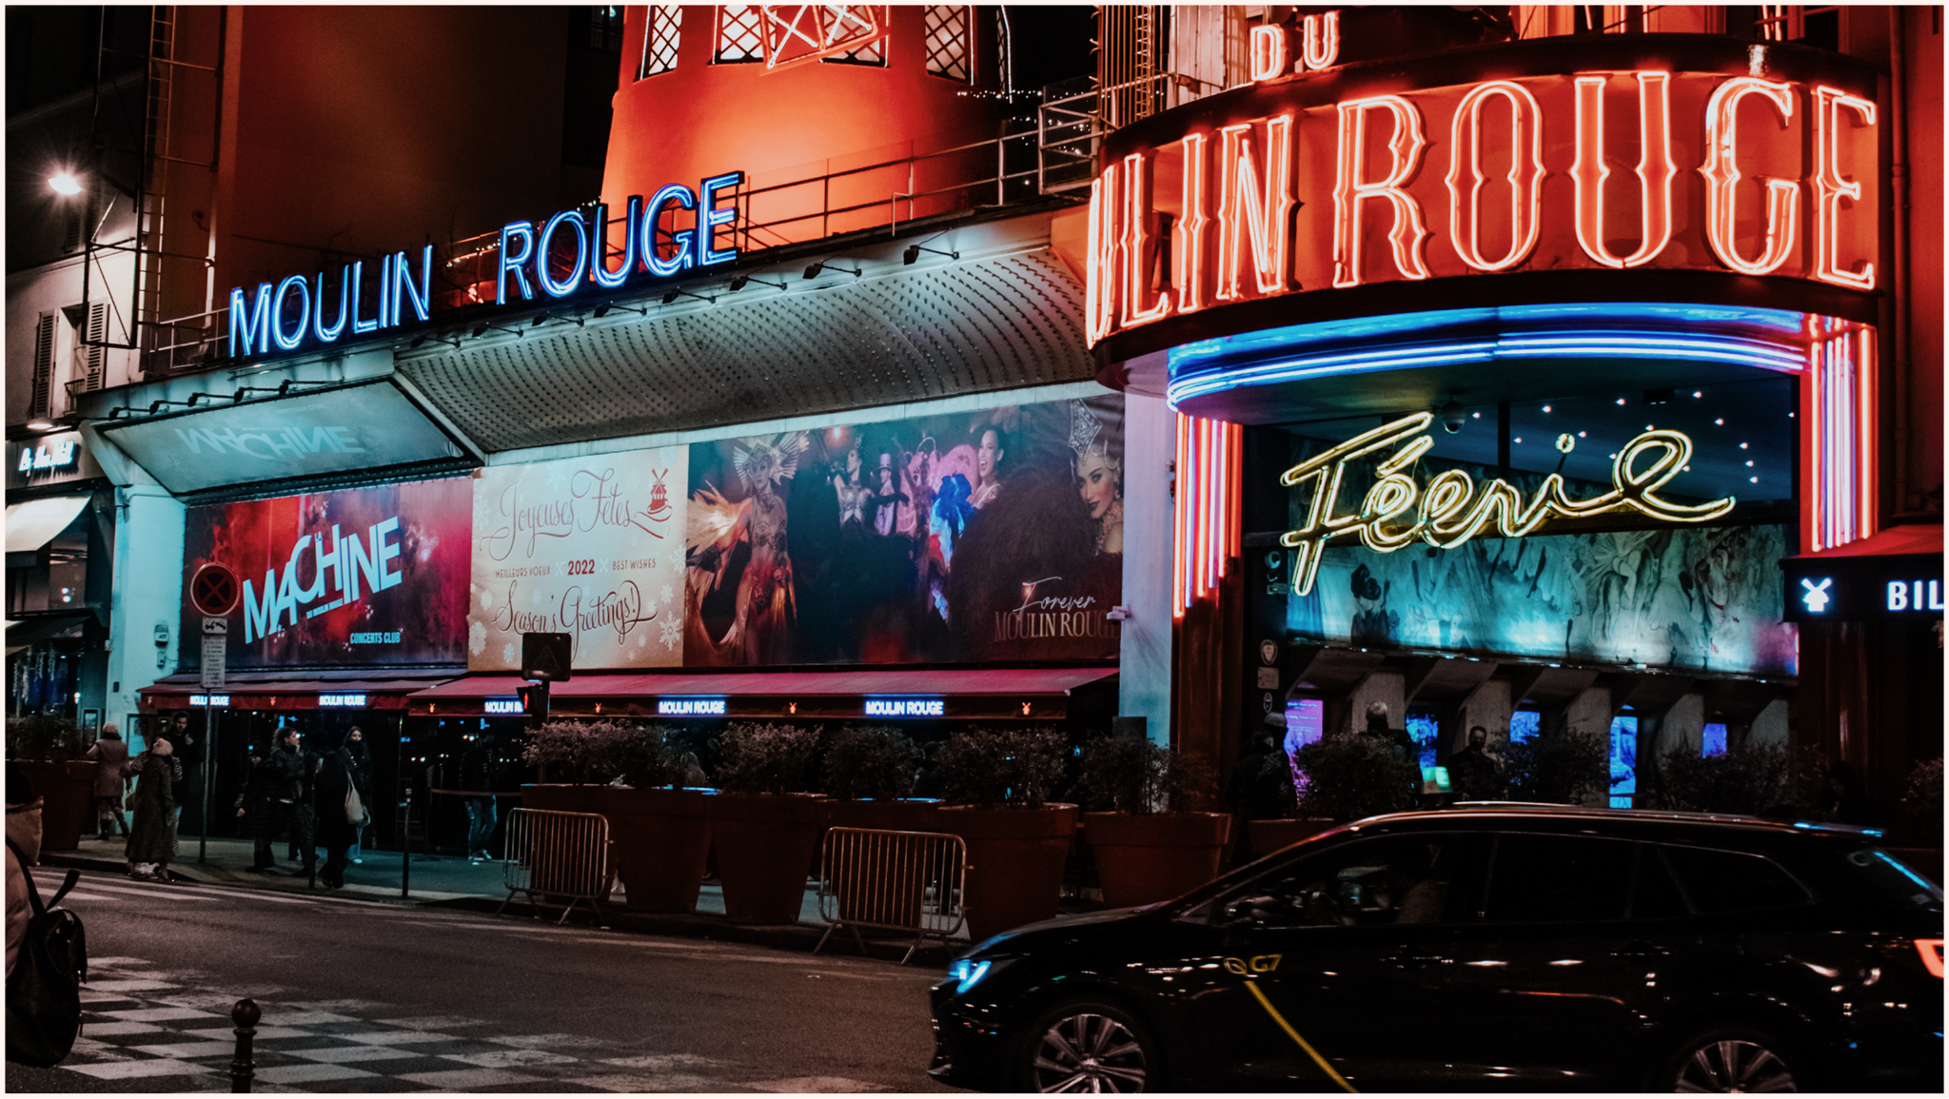



A Love Letter
Dear You,
From the land of wine and romance, I pen these words with a mischievous grin, knowing you're the reason for my Parisian adventures. In the city where love swirls in the air like fine champagne, thoughts of you intoxicate my every moment.
Here's to us, my partner in crime, stirring up mischief and passion wherever we go. Let's keep painting the town red, one cheeky escapade at a time.

Slide 15

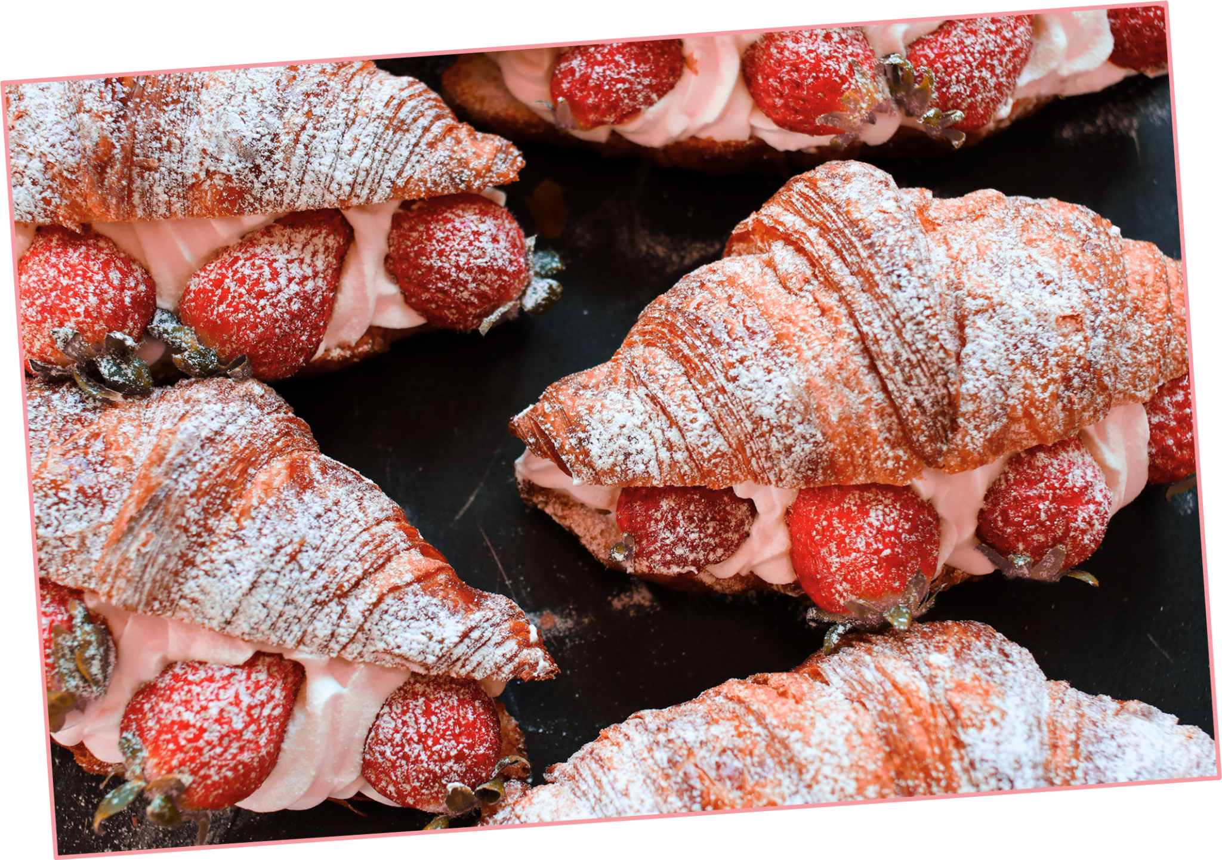
A picture is worth a thousand words
Share a buttery croissant with your loved one as you bask in the morning sunlight, sipping on café au lait in a quaint café along the cobblestone streets of Montmartre. Let the aroma of freshly baked pastries and the charm of Parisian ambiance set the stage for a morning filled with love and laughter.

Slide 16
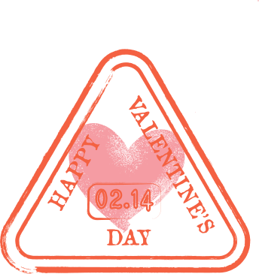
Resource Page
Use these design resources in your Canva Presentation.
Fonts
Design Elements
This presentation template
uses the following free fonts:
TITLES:
OLEO SCRIPT
HEADERS:
BREE SERIF BOLD
BODY COPY:
BREE SERIF
You can find these fonts online too.
Colors
#E84715
#FECE41
#FF9CB6
#F7F5E0
  DON'T FORGET TO DELETE THIS PAGE BEFORE PRESENTING.

Slide 17

Credits
This presentation template is free for everyone to use thanks to the following:
  for the presentation template
Pexels, Pixabay
  for the photos
Happy designing!

