Slide 1






Teacher Jane’s Class
BACK TO SCHOOL
CLASSROOM RULES
Welcome to Our Happy Classroom

Slide 2




Welcome Back to School

Slide 3







We're so excited to have you here. Let's have fun and learn together!

Slide 4

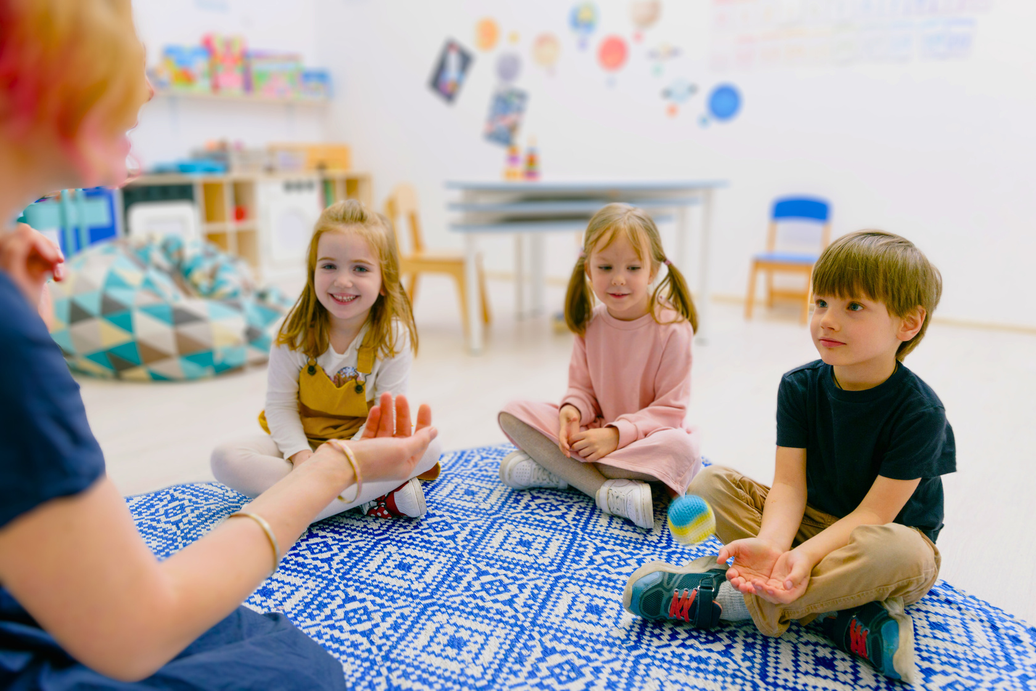

INTRODUCTION TO MY CLASS
Hi, I'm Ms. Jane.
In our class, we love to explore, play, and learn new things every day!"

Slide 5

01
Discovering Letters & Numbers
WHAT YOU'LL LEARN
We'll have fun learning the alphabet and counting together. You'll enjoy reading stories and exploring the magical world of letters and numbers.
02
Creative Arts & Songs
Get ready to unleash your creativity with exciting art projects and sing along to fun songs. We'll paint, draw, and make beautiful crafts while also enjoying music and dance.

Slide 6




5
MY 5 CLASSROOM RULES
In our class, we follow these rules to have a happy and safe place to learn and play.

Slide 7
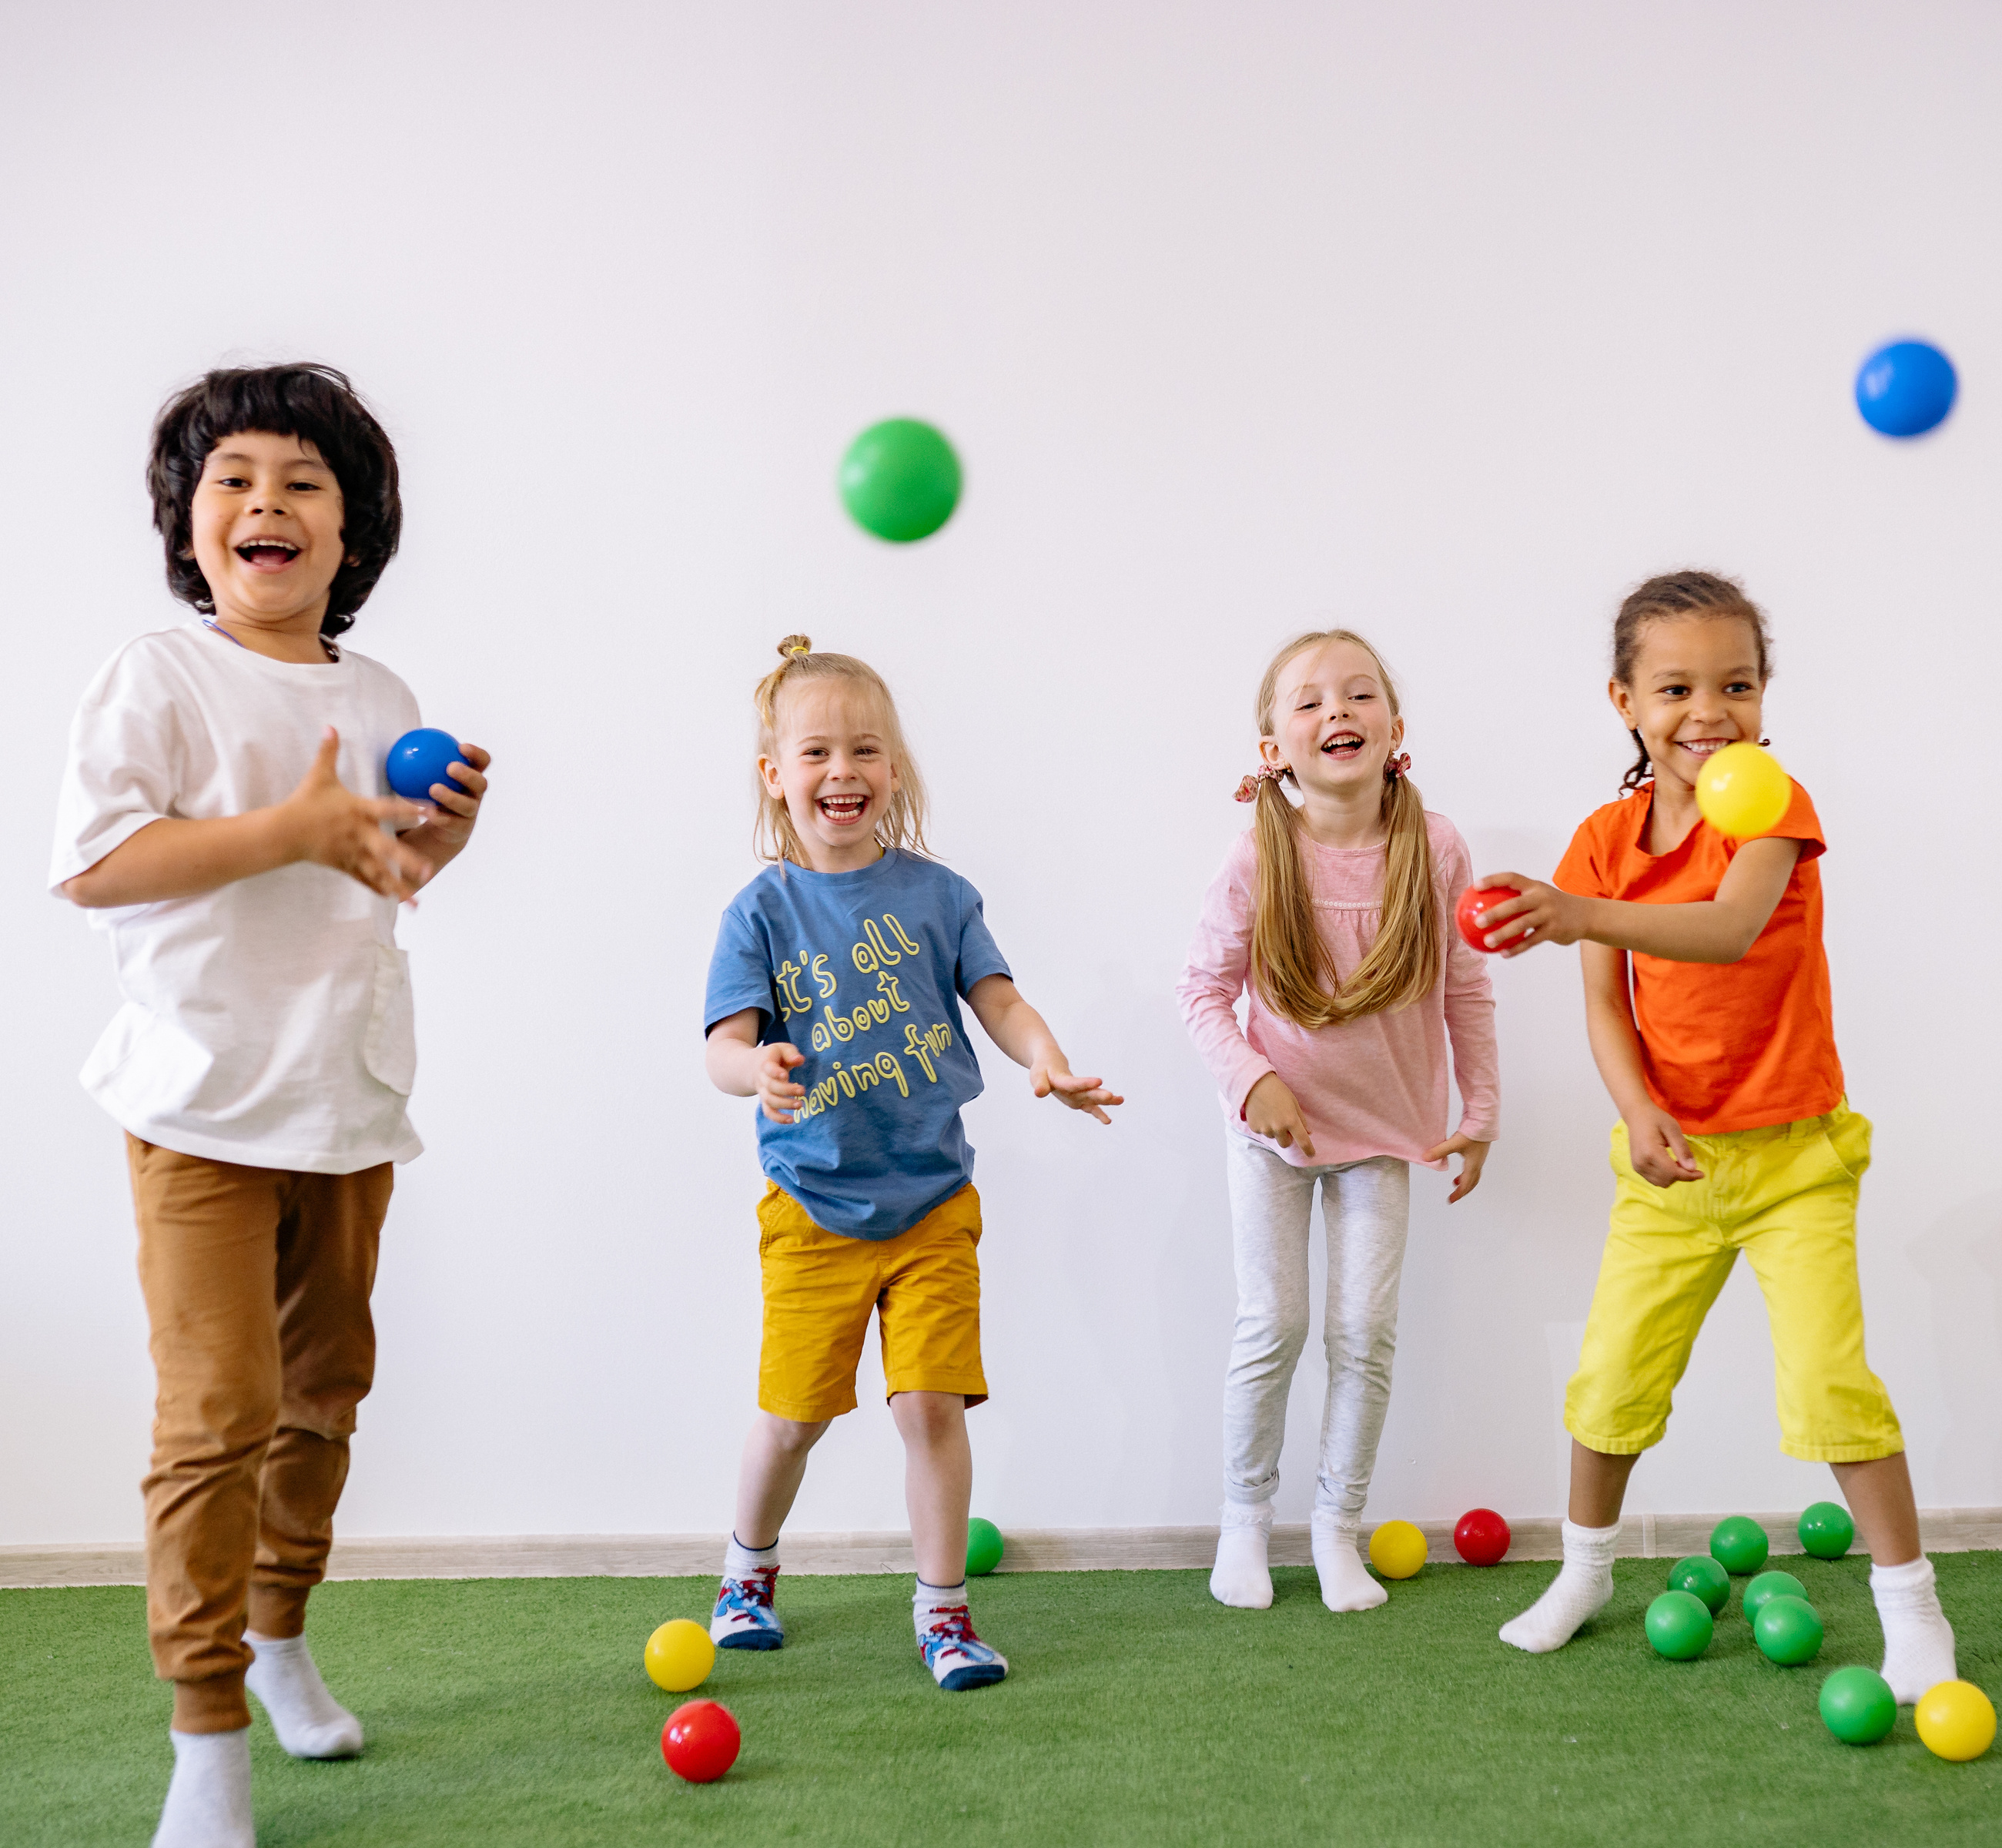



Rule 1
Be Kind
We use kind words and actions to help everyone feel happy and safe.

Slide 8
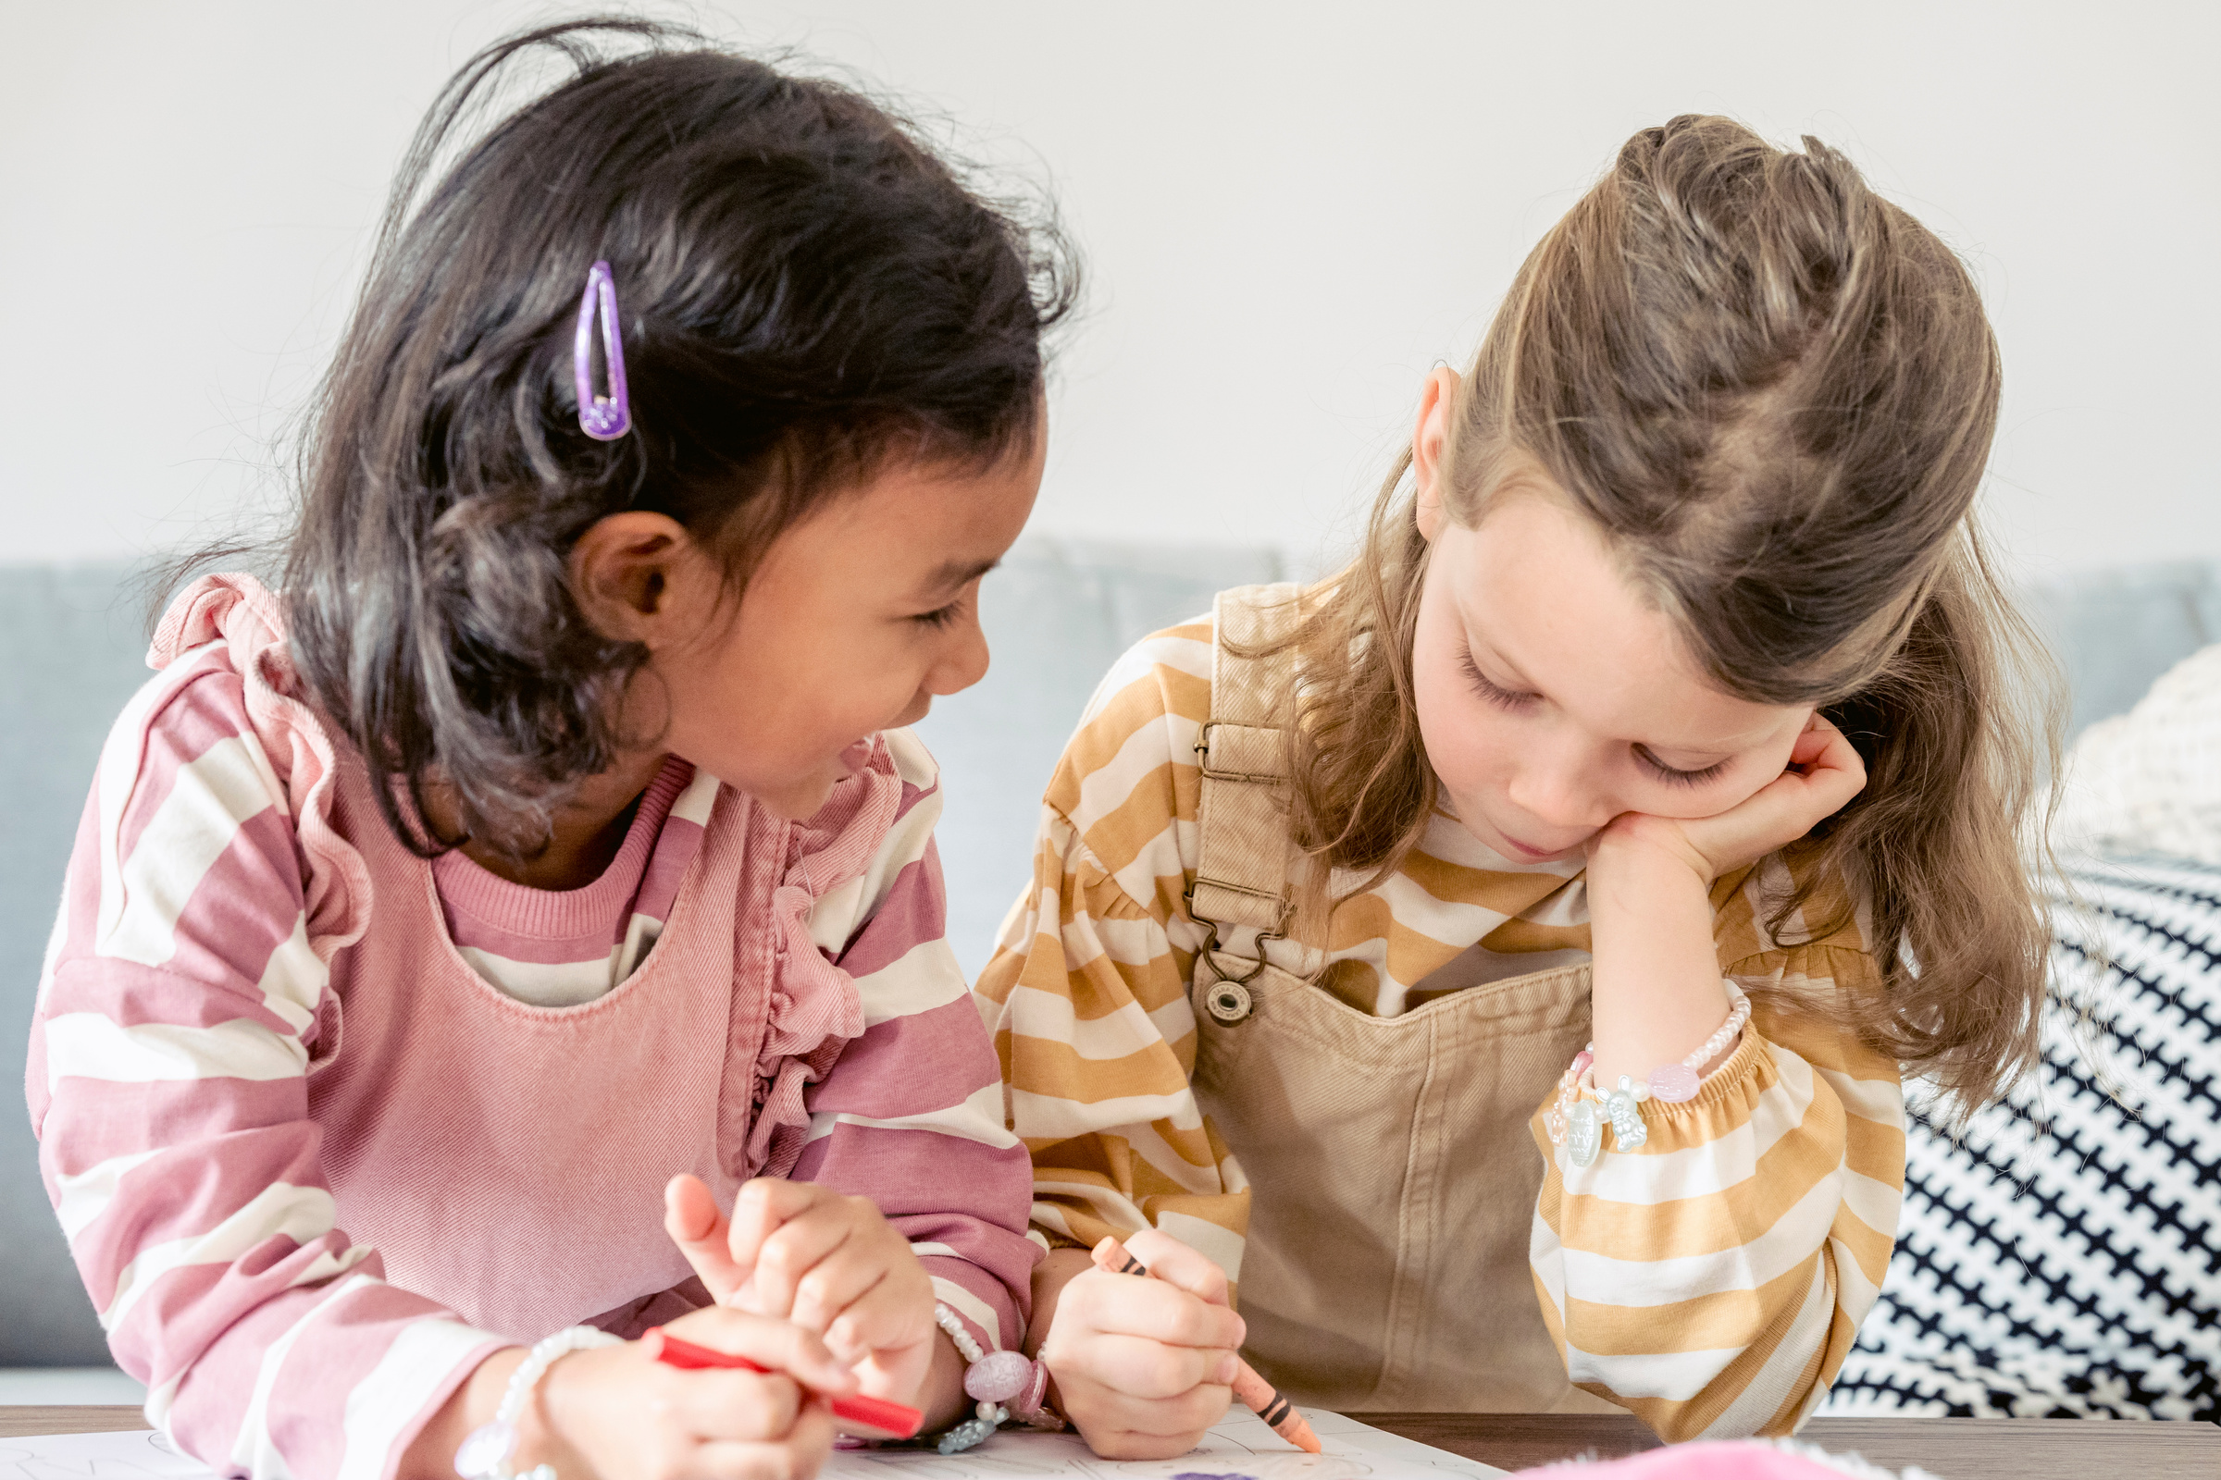


Rule 2
Listen Carefully
We listen when someone is talking so we can understand and learn.

Slide 9



Rule 3
Follow Directions
We follow directions the first time to keep our class running smoothly.

Slide 10



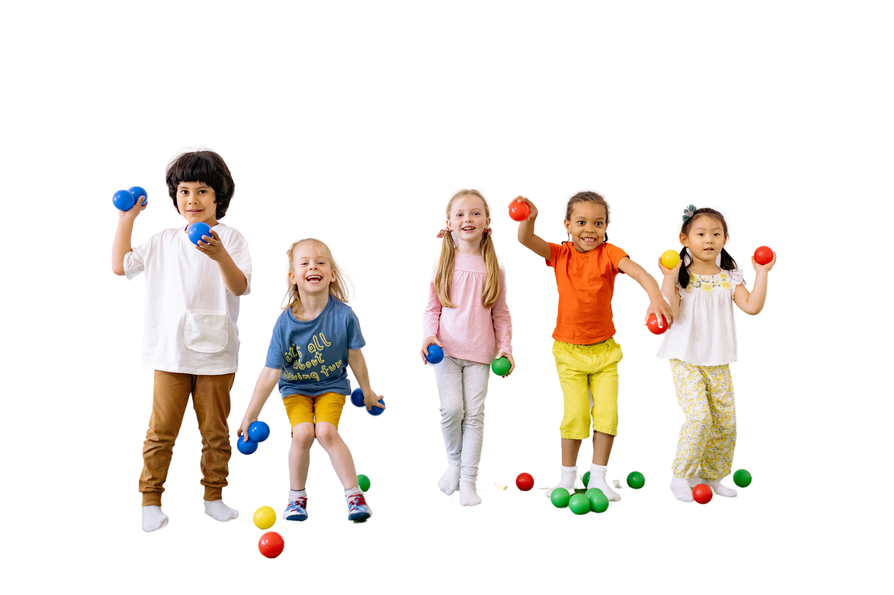
Rule 4
Take Turns
We wait for our turn to play and share with our friends.

Slide 11



Rule 5
Be On Time
We arrive on time to make the most of our learning and playtime

Slide 12






MY 5 SPECIAL REMINDERS
Remember these special tips to make our classroom a wonderful place to be.

Slide 13


MY 5 SPECIAL REMINDERS
01
Always Try Your Best
02
Be a Good Friend
03
Use Inside Voices
Remember these special tips to make our classroom a wonderful place to be.
04
Ask for Help
05
Have Fun!

Slide 14

Daily Schedule
Here’s what our day will look like.
Time | Mon | Tue | Wed | Thur | Fri
7:00-8:00 | Free Play | Free Play | Free Play | Free Play | Free Play
8:00-9:00 | Circle Time |  | Group Activity
9:00-10:00 |  | Snack Time |  | Snack Time
10:00-11:00 | Learning Centers |  | Art & Craft |  | Art & Craft
11:00-12:00 |  | Movement | Snack Time | Music
12:00-1:00 | Outdoor Play | Lunch
1:00-2:00 |  | Free Play | Free Play | Free Play | Free Play

Slide 15








QUESTIONS & ANSWERS

Slide 16
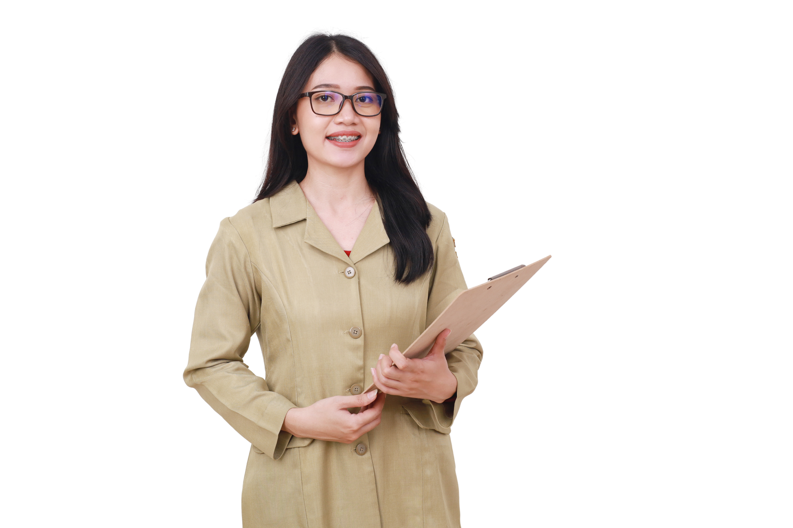



Thank you
for listening!

Slide 17
Resource Page
Use these design resources in your Canva Presentation.
  FONTS
This presentation template
uses the following free fonts:
Titles
Headers
Body Copy
Darumadrop One
Cloud
Cloud
You can find these fonts online too.
  Colors
#23A4DB
#5BC683
#E980A4
#F4D232
#E4462F
#EA6E25

Slide 18

Resource Page
Use these design resources in your Canva Presentation.

Slide 19

CREDITS
This presentation template is free for
everyone to use thanks to the following:
for the presentation template
Pexels & Pixabay
for the photos

