Slide 1




HOME
ABOUT
SERVICE
CONTACT
PSYCHOLOGICAL
THEORIES OF CRIME
Unraveling the mind: An in-depth analysis of psychological theories of crime and their implications for criminal behavior and justice systems.
SLIDES

Slide 2


TABLE OF CONTENTS
01.
02.
03.
INTRODUCTION
OUR PROJECTS
ABOUT US
Elaborate on what you want to discuss.
Elaborate on what you want to discuss.
Elaborate on what you want to discuss.

Slide 3

INTRODUCTION
To the enchanting world of creativity and imagination, where every thought can blossom into a masterpiece. This journey will take you through realms of wonder, where words paint vivid pictures and stories come to life with every sentence.
Whether you are a seasoned writer or just beginning to explore the art of storytelling, this adventure promises to ignite your passion and inspire your spirit. Here, you will find that the only limit is your imagination. Discover characters who leap off the page, settings that transport you to distant lands, and plots that twist and turn with delightful unpredictability.

Slide 4

WELCOME TO PRESENTATION
I'm Rain, and I'll be sharing with you my beautiful ideas. Follow me at @reallygreatsite to learn more.

Slide 5





  OUR COMPANY
WHO WE ARE?
Briefly elaborate on what you want to discuss.
WHAT WE DO?
Briefly elaborate on what you want to discuss.

Slide 6




  MISSION
  VISION
Embarking on a mission is a journey filled with purpose and determination. It is a quest to achieve a goal, to make a difference, to leave a mark on the world. A mission calls for courage, resilience.
Vision is the guiding force that propels us forward, illuminating the path towards our aspirations and goals. It is the clear image of what we wish to achieve, a beacon of hope in times of uncertainty.

Slide 7

  OUR PROJECTS
At our core, we are driven by a passion for innovation and a commitment to excellence in all that we do. Our projects embody our dedication to creating impactful solutions that make a difference in the world. From groundbreaking technological advancements to community-driven initiatives, each project we undertake is a testament to our belief in the power of creativity and collaboration.
We strive to push the boundaries of what is possible, constantly seeking new ways to address challenges and improve lives. Our diverse portfolio reflects our unwavering determination to tackle complex problems with fresh perspectives and unwavering dedication. With each new project.

Slide 8







  WHAT WE OFFER
SERVICE ONE
SERVICE TWO
Elaborate on what you want to discuss.
Elaborate on what you want to discuss.
SERVICE THREE
SERVICE FOUR
Elaborate on what you want to discuss.
Elaborate on what you want to discuss.

Slide 9

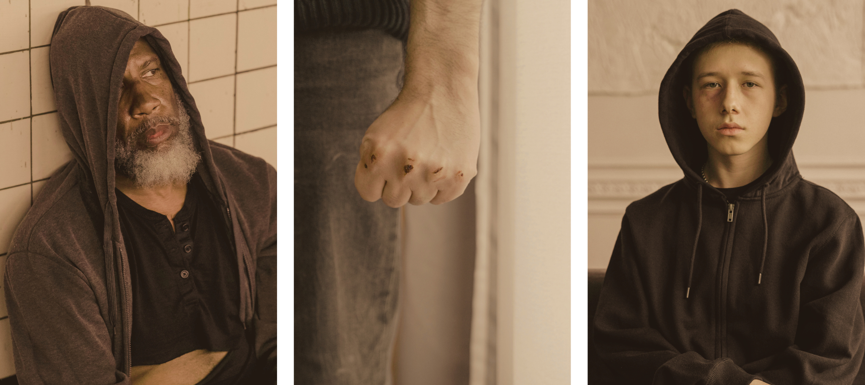
  GALLERY IMAGE
What can you say about your projects? Share it here!

Slide 10




  MARKET RESEARCH
Elaborate on the featured statistic.
Elaborate on the featured statistic.
Elaborate on the featured statistic.
Elaborate on the featured statistic.

Slide 11


  S
  W
STRENGTHS
WEAKNESSES
What are you doing well?
What sets you apart? What are your good qualities?
Where do you need to improve?
Are resources adequate? What do others do better than you?
  0
  T
OPPORTUNITIES
THREATS
What are your goals?
Are demands shifting? How can it be improved?
What are the blockers you're facing?
What are factors outside of your control?

Slide 12

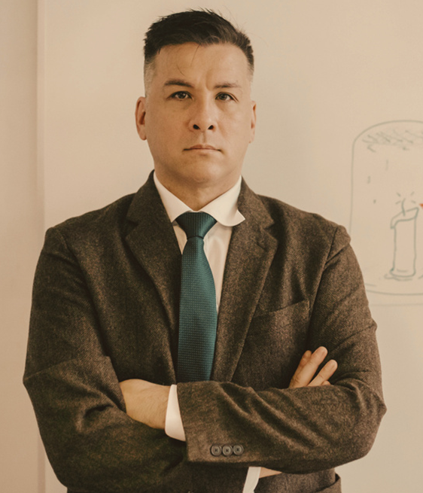
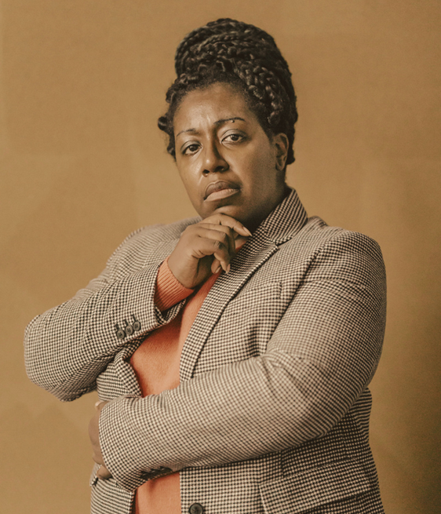
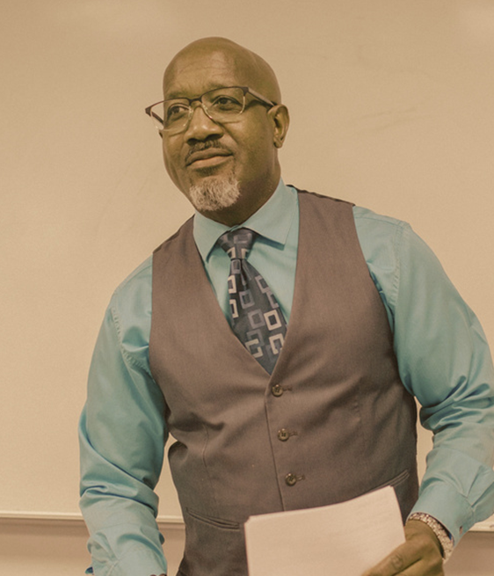

  TESTIMONIALS
CLIENT NAME
CLIENT NAME
CLIENT NAME
Elaborate on what you want to discuss.
Elaborate on what you want to discuss.
Elaborate on what you want to discuss.

Slide 13


  ABOUT US
We are a team of passionate individuals dedicated to providing exceptional service and creating memorable experiences for our clients. With a commitment to excellence and a focus on innovation, we strive to exceed expectations and deliver top-notch results. Our goal is to build lasting relationships with our clients and make a positive impact in everything we do. Thank you for choosing us to be a part of your journey.

Slide 14

  OUR History
Is a rich tapestry woven from countless stories, triumphs, and challenges that have shaped who we are today. From the ancient civilizations that laid the foundations of human knowledge to the groundbreaking discoveries of the modern era, each chapter in our collective past offers valuable lessons and inspiration.
Centuries ago, people gathered around fires, sharing tales of heroism and hardship, passing down wisdom through generations. These early narratives helped build the cultural and moral frameworks that still influence us. As time marched on, great empires rose and fell, leaving behind legacies of art, science, and philosophy that continue to resonate.

Slide 15





  OUR History
ADD A MAIN POINT
ADD A MAIN POINT
ADD A MAIN POINT
Elaborate on what you want to discuss.
Elaborate on what you want to discuss.
Elaborate on what you want to discuss.

Slide 16
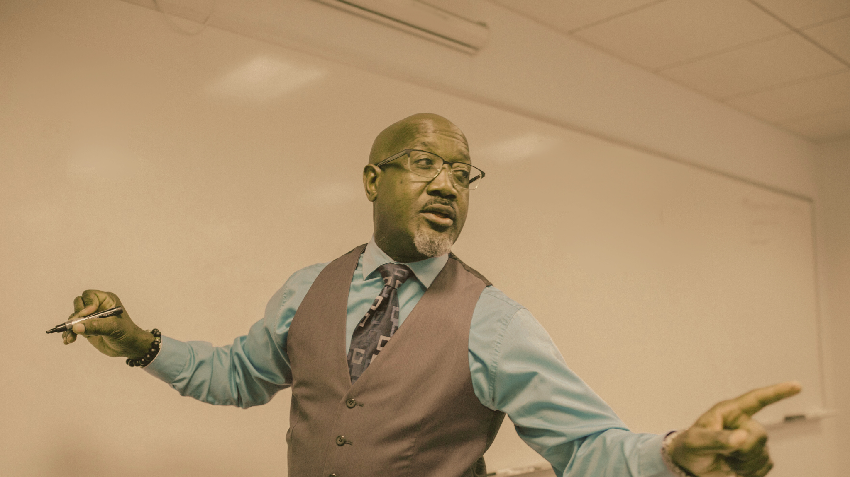
  A PICTURE IS WORTH A THOUSAND WORDS

Slide 17

  WRITE AN ORIGINAL STATEMENT OR INSPIRING QUOTE
— Include a credit, citation, or supporting message

Slide 18


  CONTACT US
123 Anywhere St., Any City,ST 12345
123-456-7890
hello@reallygreatsite.com
@reallygreatsite
reallygreatsite.com

Slide 19

  RESOURCE
  PAGE
Use these design resources in your Canva Presentation.
You can find these fonts online too. Happy designing!
Don't forget to delete this page before presenting.
This presentation template uses the following free fonts:
  Titles: Archivo Black
  Headers: Archivo Black
  Body Copy: Open Sans

Slide 20




  CREDITS
This presentation template is free for everyone to use thanks to the following:
SlidesCarnival for the presentation template
Pexels for the photos
Happy designing!

