Slide 1

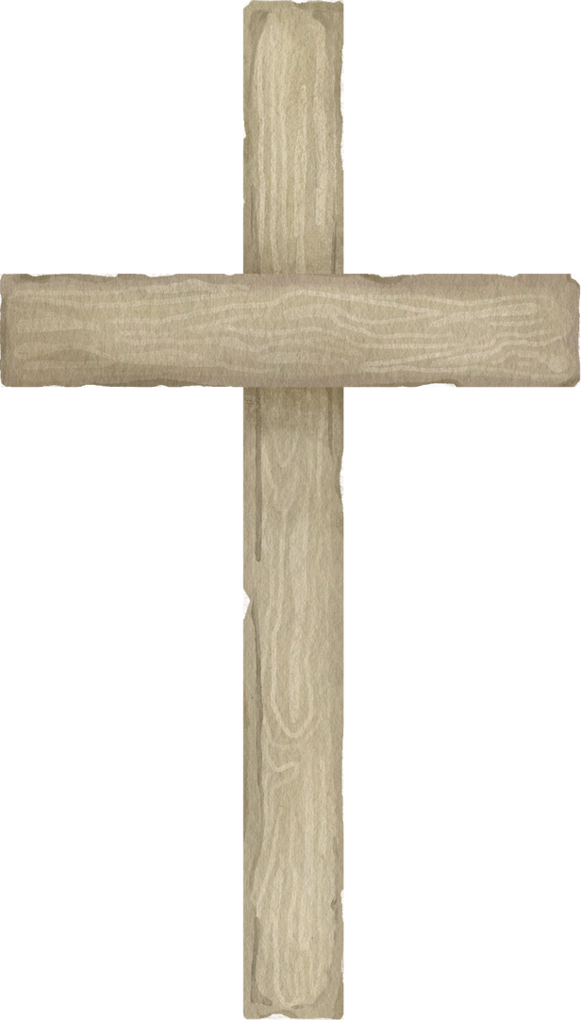
BAPTISM
Background Slides

Slide 2
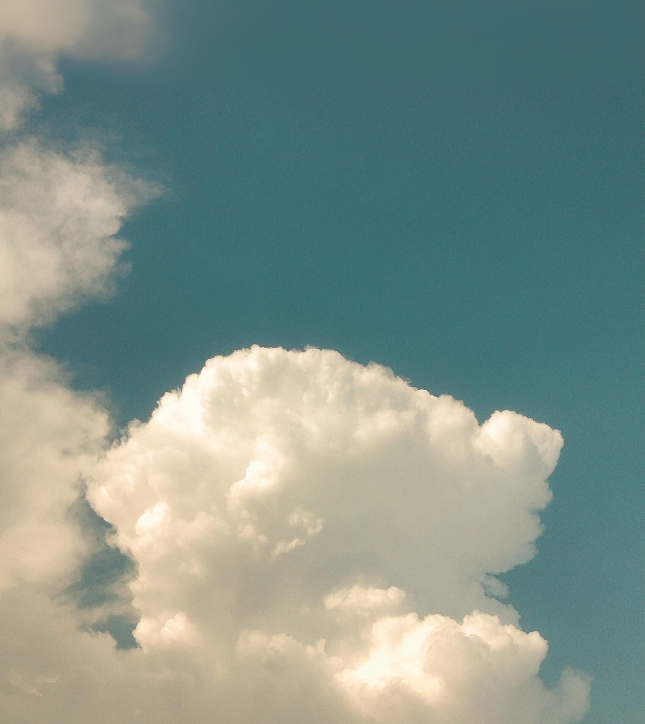
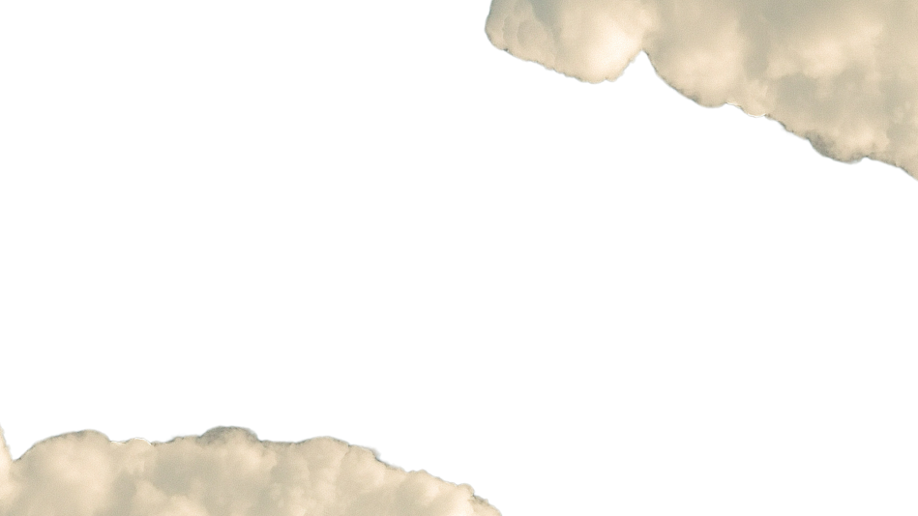
My past was made clean by my king.
You must be born again.

Slide 3


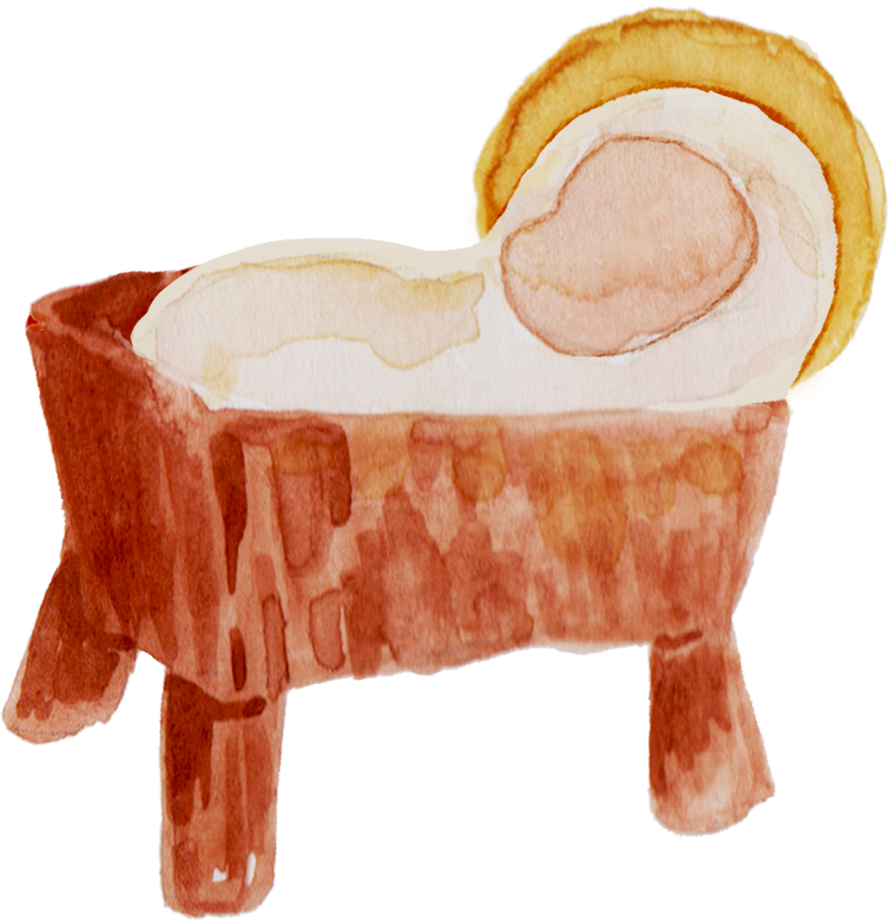

Slide 4



Baptism is an outward testimony of an inward transformation. It’s the first step of obedience for a disciple of Christ.

Slide 5


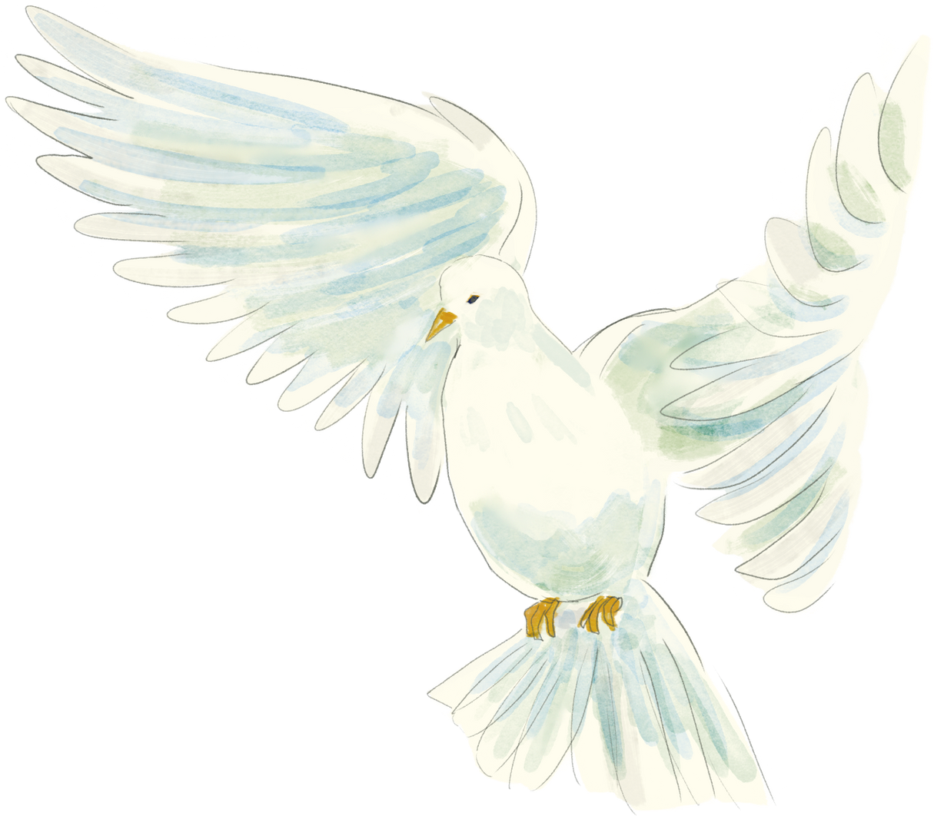

Slide 6


Therefore we are buried with him by baptism into death: that like as Christ was raised up from the dead by the glory of the father, even so we also should walk in newness of life.

Slide 7
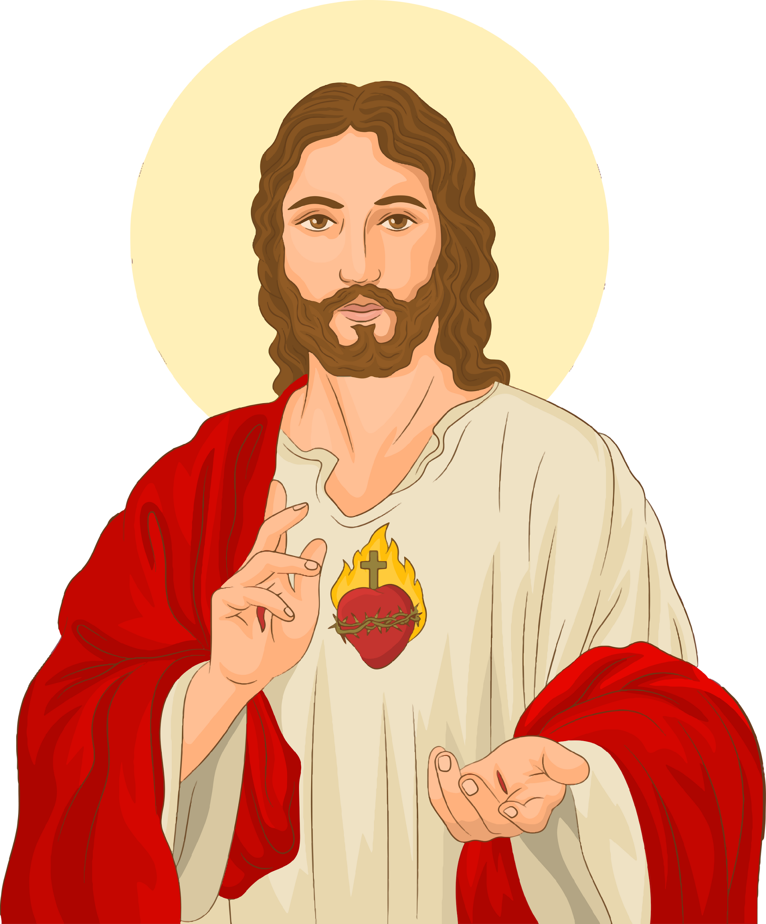




Slide 8

I want my life to be as clean as earth right after rain.

Slide 9

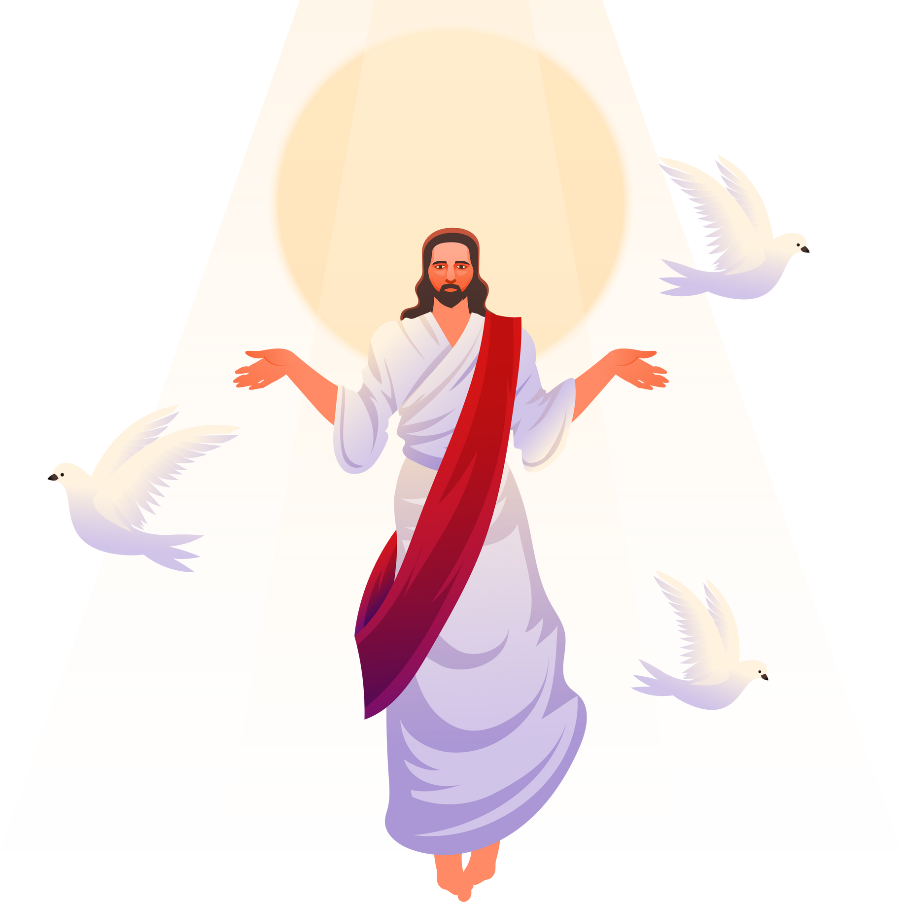

Slide 10

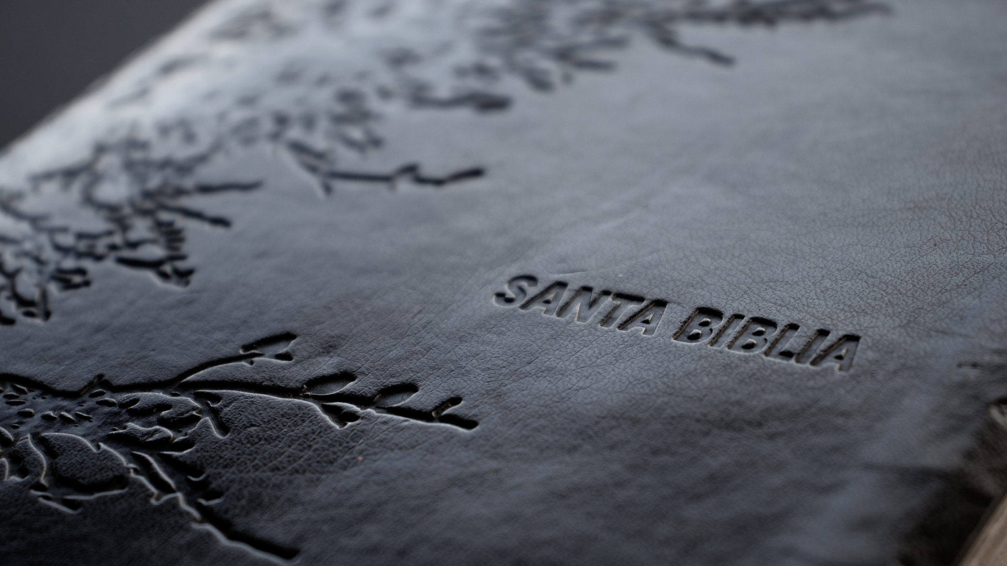
On this day of baptism may God, who loves us all, smile lovingly upon this child, so innocent and small… and may he guide this girl/boy throughout the years ahead as blessings light the pathway where those tiny feet are led.

Slide 11





Slide 12

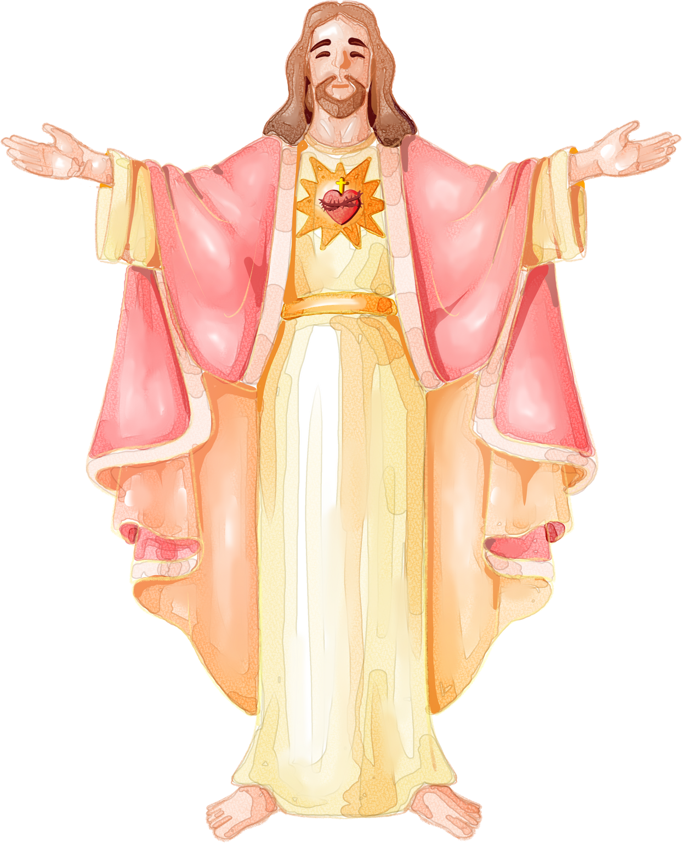


Slide 13



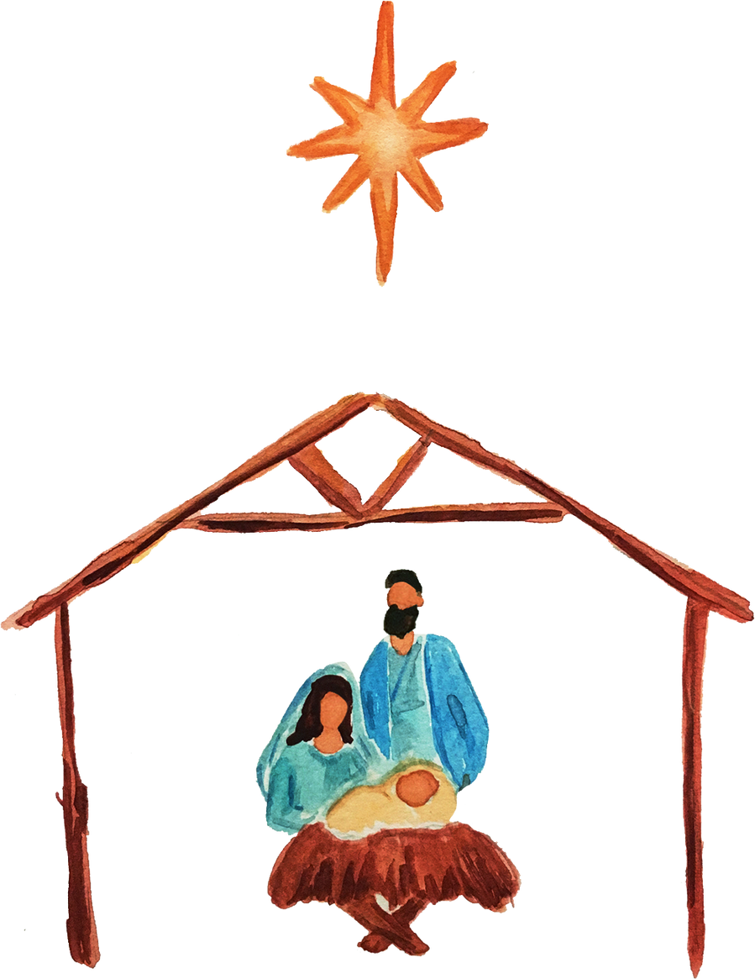

Slide 14
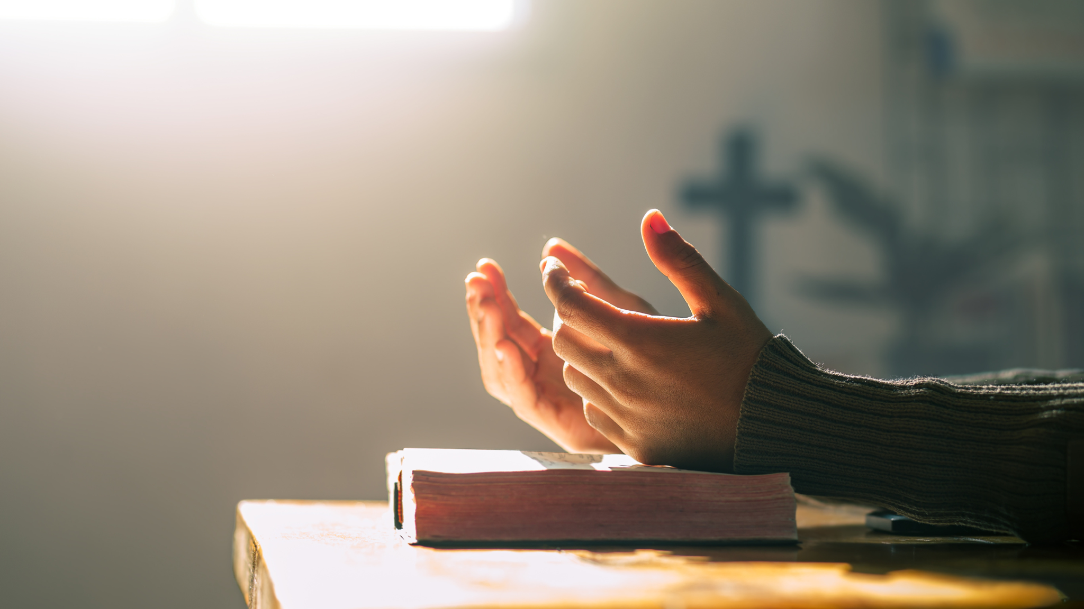

Perhaps this is the moment for which you have been created.

Slide 15




Baptism is an outward testimony of an inward transformation. It’s the first step of obedience for a disciple of Christ.

Slide 16

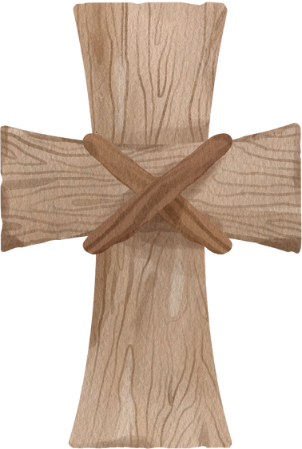



The most beautiful things in the world cannot be seen or touched, they are felt with the heart.

Slide 17




Slide 18







































Resource Page
Use these design resources in your Canva Presentation.
Fonts
Design Elements
This presentation template
uses the following free fonts:
TITLES:
PLAYFAIR DISPLAY
HEADERS:
PLAYFAIR DISPLAY
BODY COPY:
PLAYFAIR DISPLAY
You can find these fonts online too.
Colors
#FFFFFF
#416A72
  DON'T FORGET TO DELETE THIS PAGE BEFORE PRESENTING.

Slide 19


Credits
This presentation template is free for everyone to use thanks to the following:
  for the presentation template
Pexels, Pixabay
  for the photos
Happy designing!

