Slide 1












Evaluating Expressions through
Lesson for Elementary

Slide 2






Lesson Outline
Evaluating Expressions
PEMDAS Graphic Organizer

Slide 3







Introduction
Let’s dive into the order of operations, utilizing
PEMDAS to grasp the evaluation of expressions
involving multiple operations.
With a nifty graphic organizer, we can independently practice problem-solving, strengthening our understanding of this fundamental mathematical concept.

Slide 4



Evaluating Expressions
We use the order of operations to understand and remember how to evaluate expressions involving two or more operations.

Slide 5

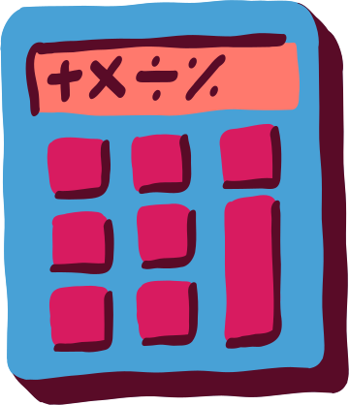


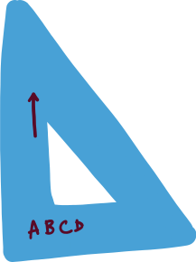
PEMDAS is a common acronym
that can help us remember the order:
We use the order of operations to understand and remember how to evaluate expressions involving two or more operations.

Slide 6


() parentheses or grouping symbols
aⁿ exponents
× multiply
We multiply and divide from left to right.
÷ divide
+ add
Then we add and subtract from left to right.
Then we add
and subtract
from left to right.
− subtract

Slide 7



Let’s Practice!
Work on the example on the next slides

Slide 8




Let's evaluate this expression!
Step 1
Step 2
4³ − 36 ÷ 6 + 2 (9 + 12)
4﻿³ − 36 ÷ 6 + 2 × 21
9 + 12 = 21
4³ = 4 × 4 × 4 = 64

Slide 9

From left to right, we first divide and then we multiply.
Step 3
Step 4
64 − 36 ÷﻿ 6 + 2 × 21
64 − 6 + 2 × 21
36 ÷ 6 = 6
2 x 21 = 42

Slide 10




From left to right, we subtract first, and lastly, we add.
This is your final answer!
Step 5
Step 6
64 −﻿ 6 + 42
58 + 42
64 - 6 = 58
100
INSPIRED BY

Slide 11



PEMDAS
Graphic Organizer
Whiteboard
Whiteboard Activity

Slide 12





Let’s Recap!
Add main point here
Add main point here
Elaborate on what you want to discuss
Elaborate on what you want to discuss

Slide 13













Slide 14















Resource Page
Use these design resources in your Canva presentation.
Fonts
This presentation template
uses the following free fonts:
Titles: Ahkio
Headers: Ahkio
Body: Bricolage Grotesque 18
Colors

Slide 15














Design Elements

Slide 16




Credits
This presentation template is free for
everyone to use thanks to the following:
Pexels and Pixabay
for the presentation template
For the photos
Happy designing!

