Slide 1
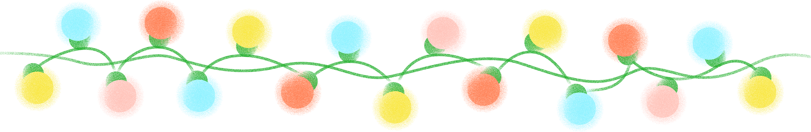

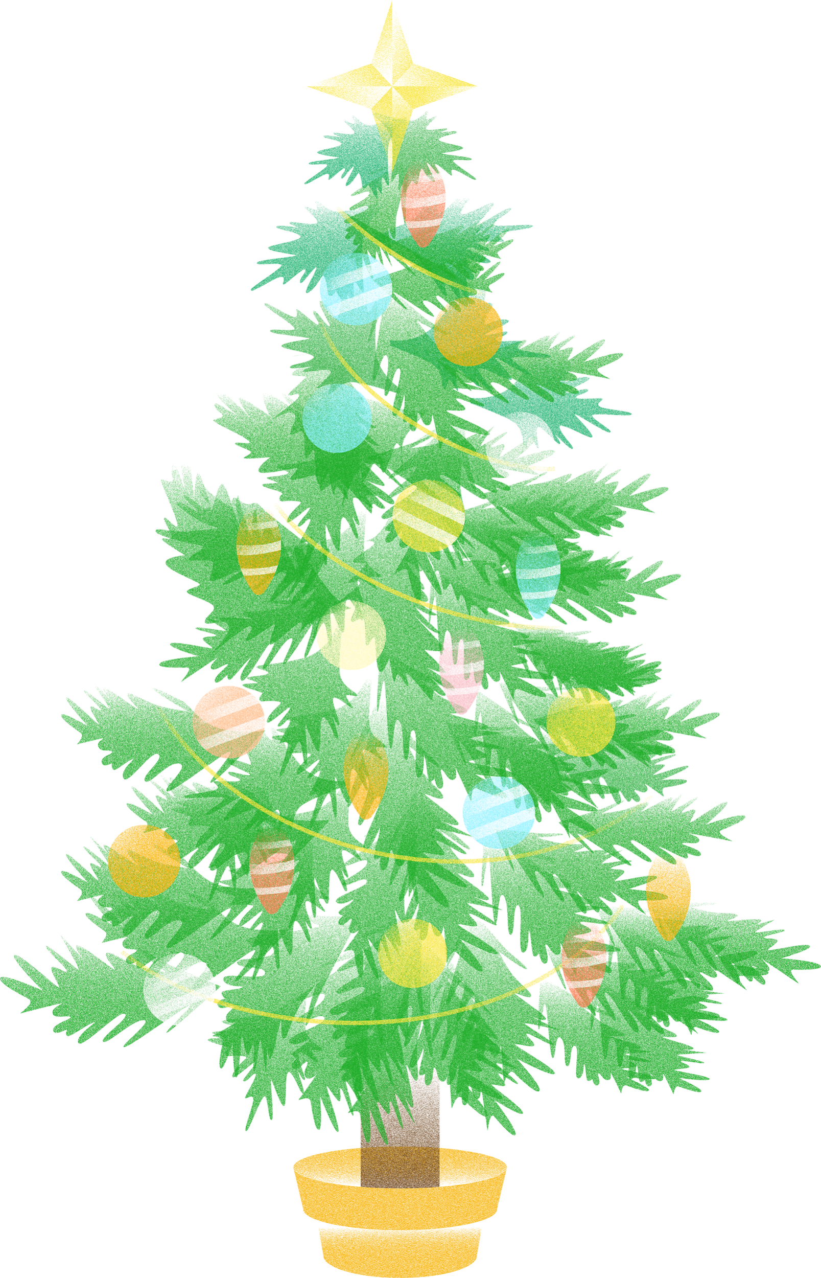


Guess
the
Scrambled
WORD
CHRISTMAS HOLIDAY GAME

Slide 2
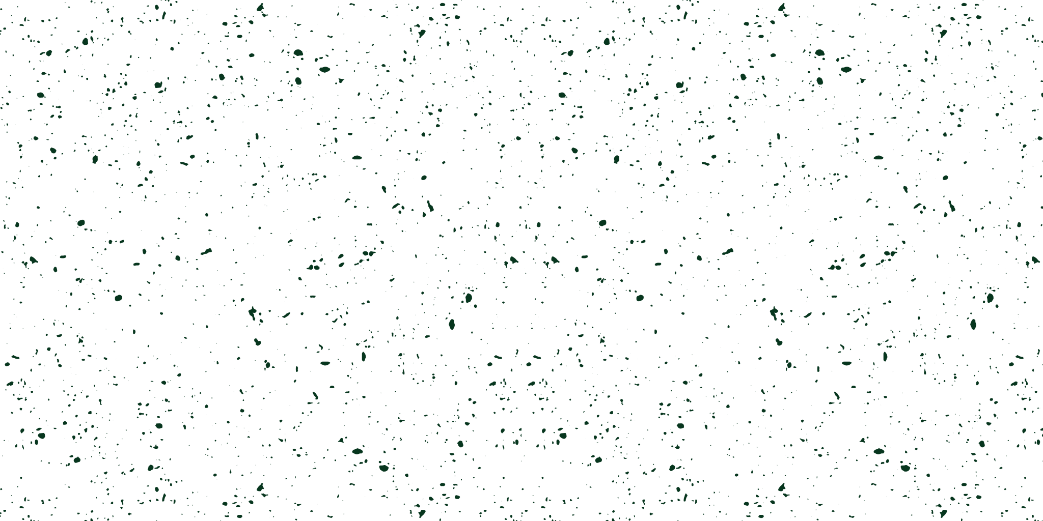
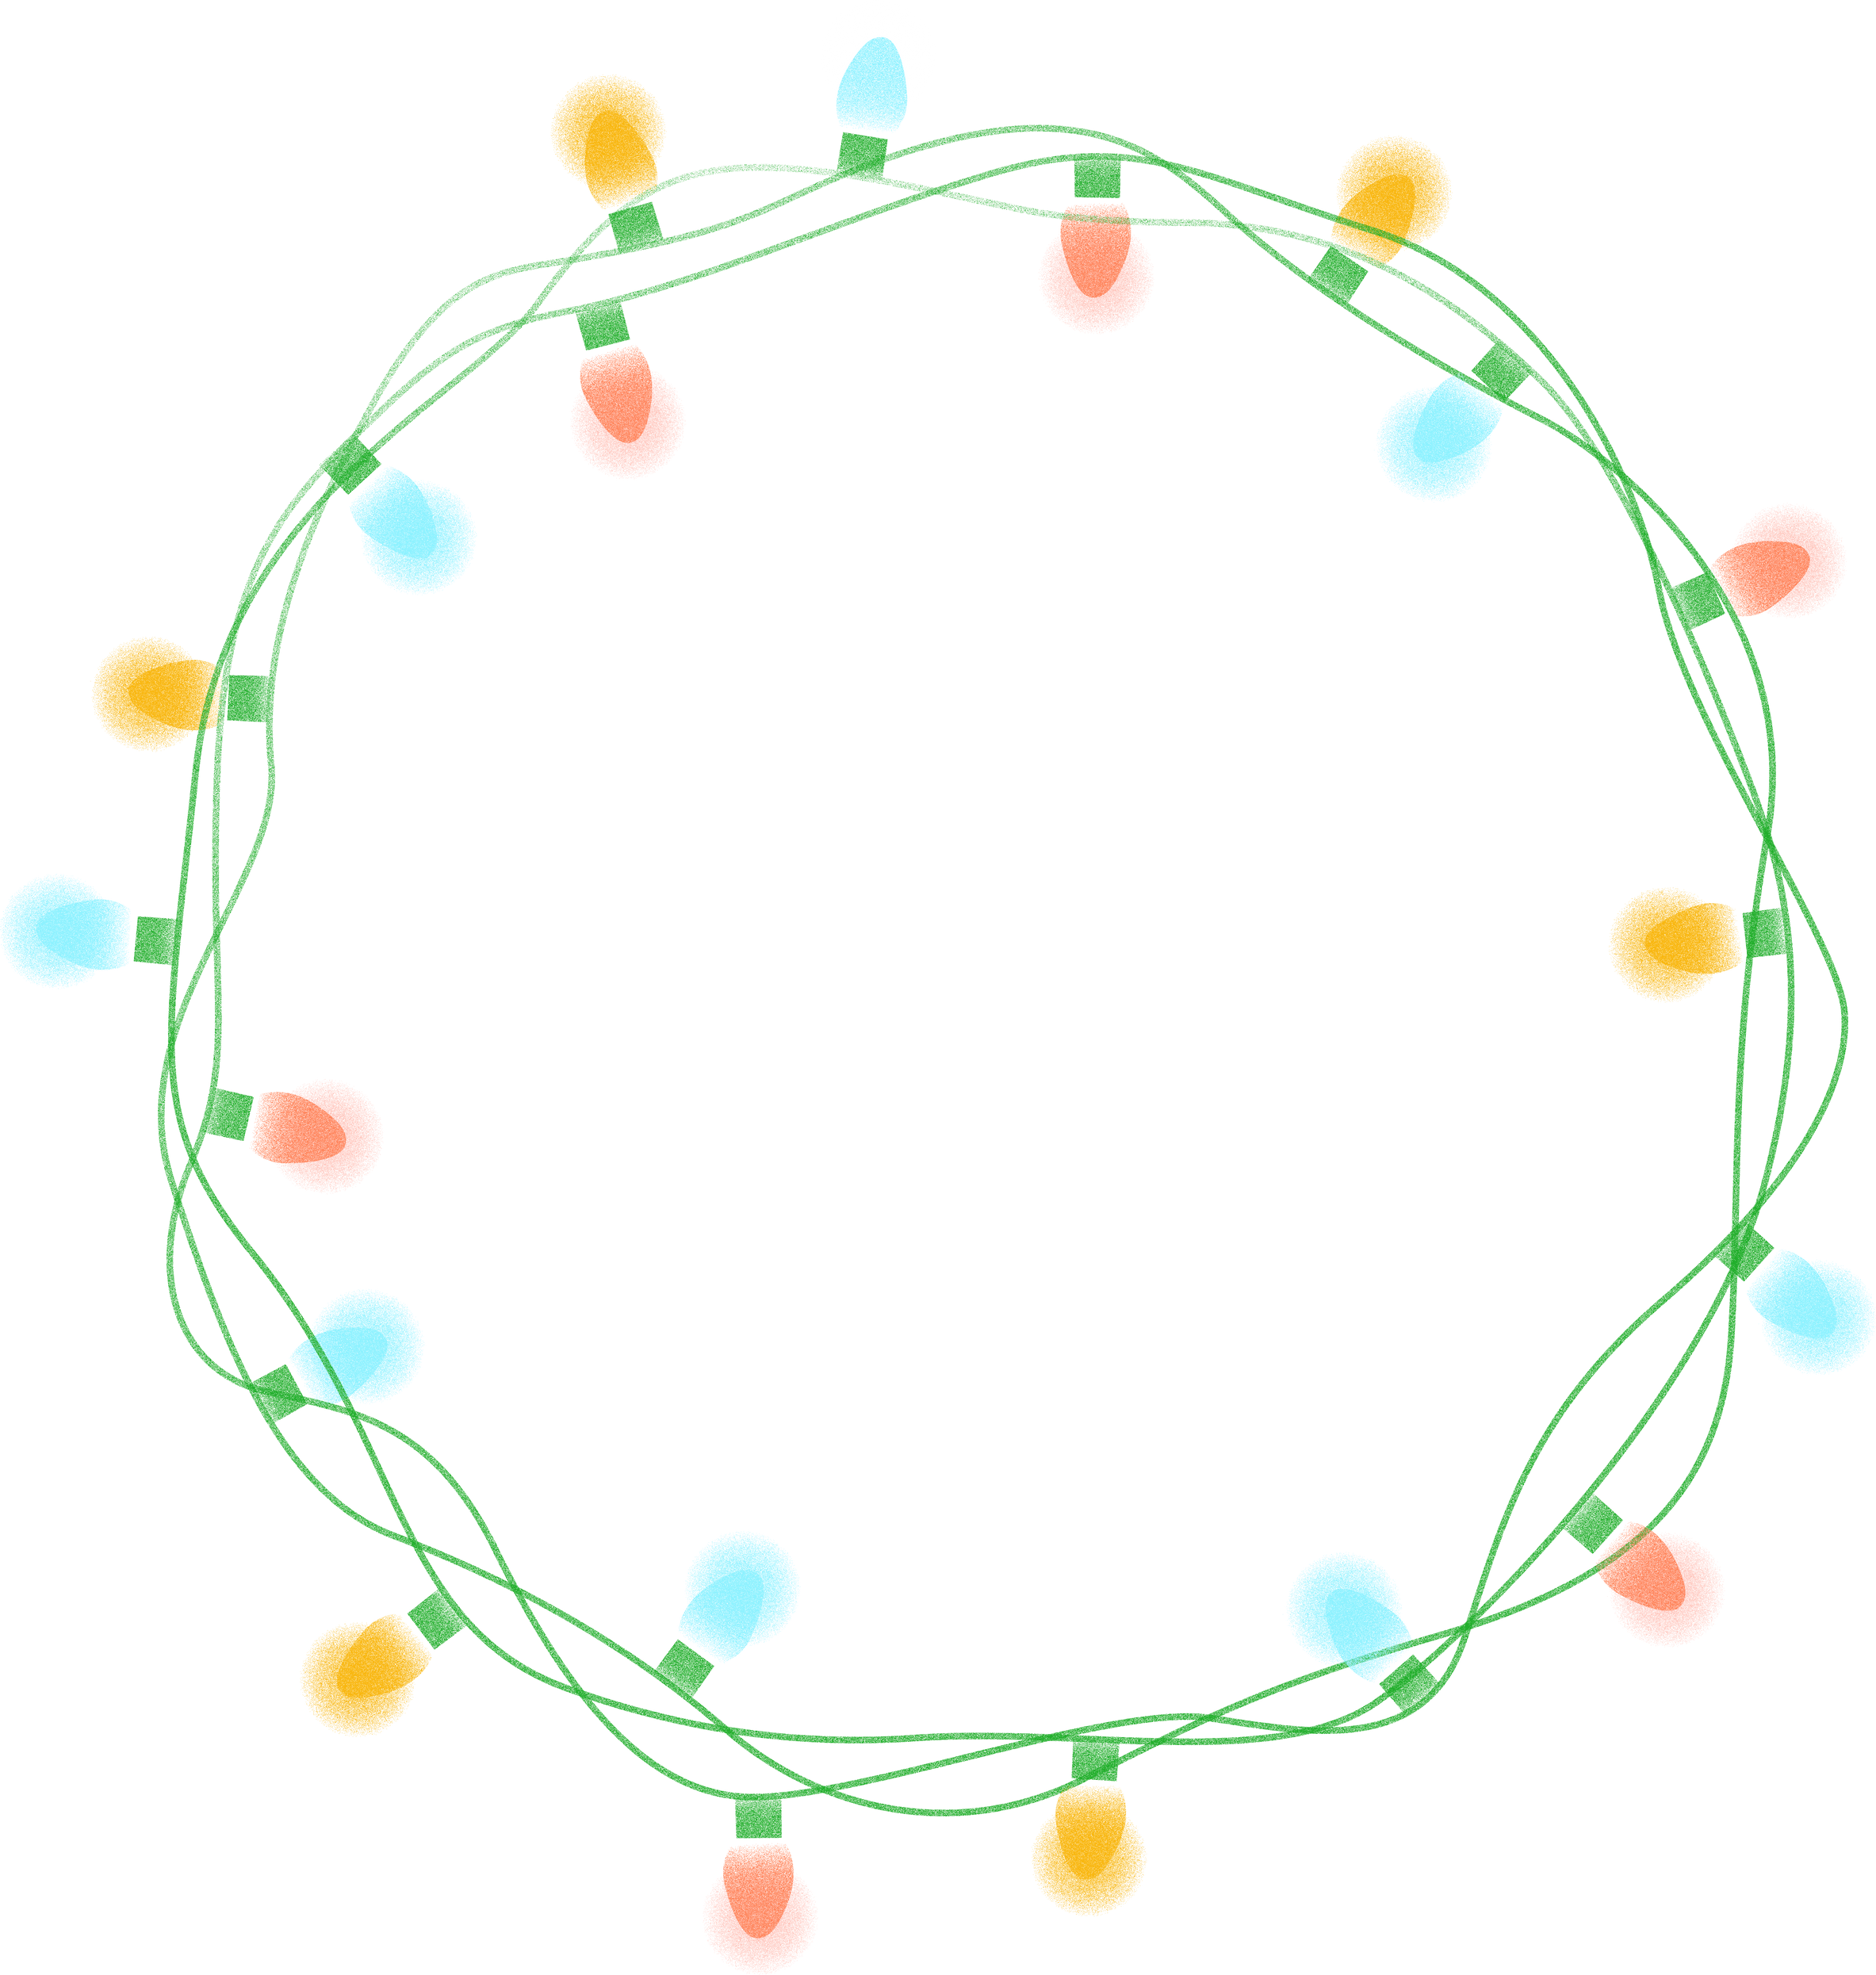
Game Rules
Elaborate on what you want to discuss.
Rule #1
Rule #3
Elaborate on what you want to discuss.
Elaborate on what you want to discuss.
Rule #2
Elaborate on what you want to discuss.

Slide 3


ARE YOU READY?
Let’s Start!
Elaborate on what you want to discuss.

Slide 4
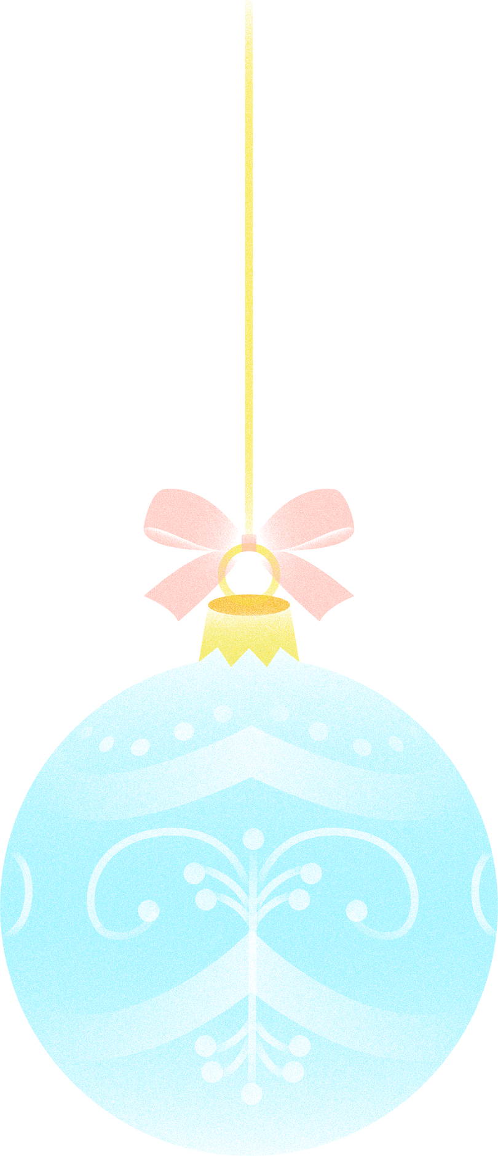
Scoreboard
100 pts
120 pts
180 pts
AMANDA
ROBERT
SAMMY

Slide 5
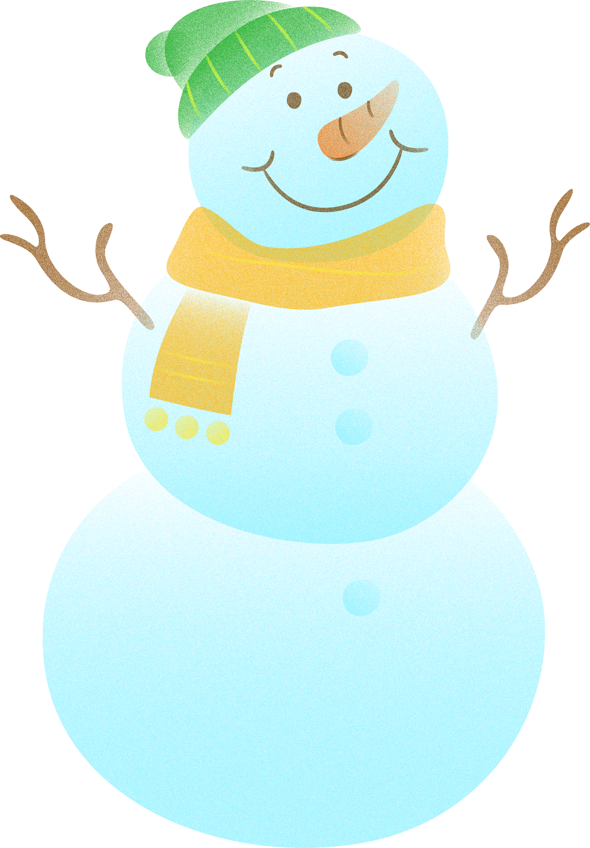
10 PTS.
Guess the Scrambled Word
N
O
S
W
N
A
M

Slide 6
YOU WON 10 PTS!
CORRECT ANSWER:
S
N
O
W
M
A
N

Slide 7

10 PTS.
Guess the Scrambled Word
P
E
E
R
N
T
S

Slide 8
YOU WON 10 PTS!
CORRECT ANSWER:
P
R
E
S
E
N
T

Slide 9

10 PTS.
Guess the Scrambled Word
C
N
A
C
Y
D
A
E
N

Slide 10
YOU WON 10 PTS!
CORRECT ANSWER:
C
A
N
D
Y
C
A
N
E

Slide 11

ARE YOU READY?
Bonus Round
Elaborate on what you want to discuss.

Slide 12
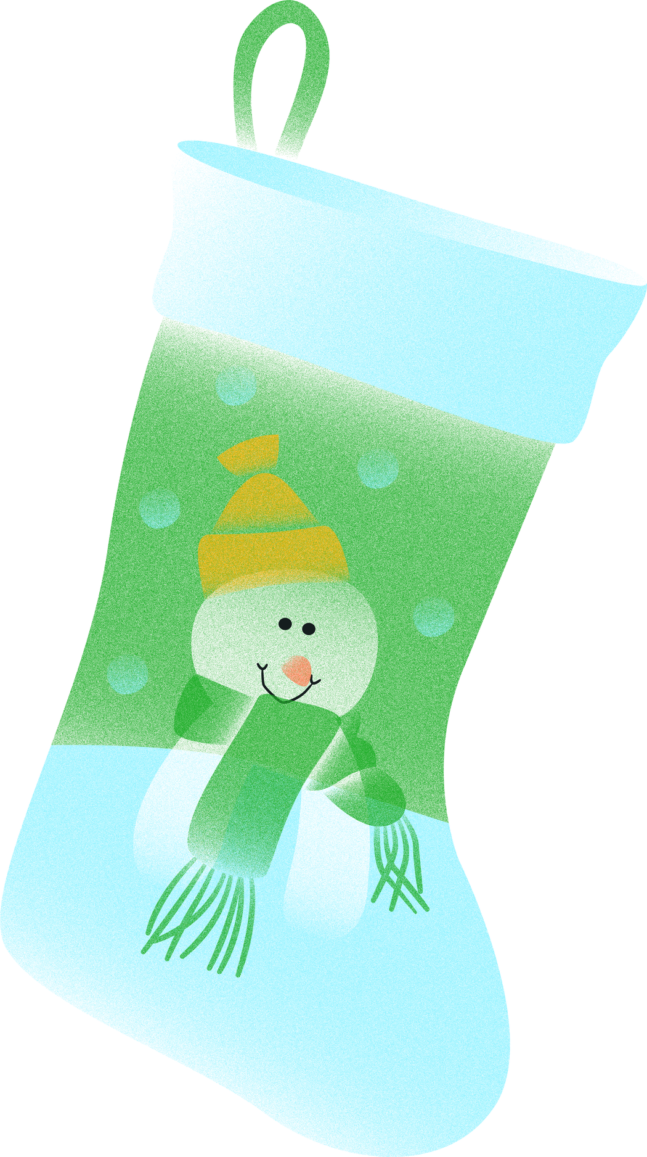
10 PTS.
Guess the Scrambled Word
O
T
S
C
N
K
I
G

Slide 13
YOU WON 10 PTS!
CORRECT ANSWER:
S
T
O
C
K
I
N
G

Slide 14
10 PTS.
Guess the Scrambled Word
S
W
O
N
A
F
L
E
K

Slide 15
YOU WON 10 PTS!
CORRECT ANSWER:
S
N
O
W
F
L
A
K
E

Slide 16
3RD PLACE
2ND PLACE
150 pts
1ST PLACE
190 pts
200 pts
AMANDA
SAMMY
ROBERT
Final Score

Slide 17
End of Presentation
Elaborate on what you want to discuss.

Slide 18
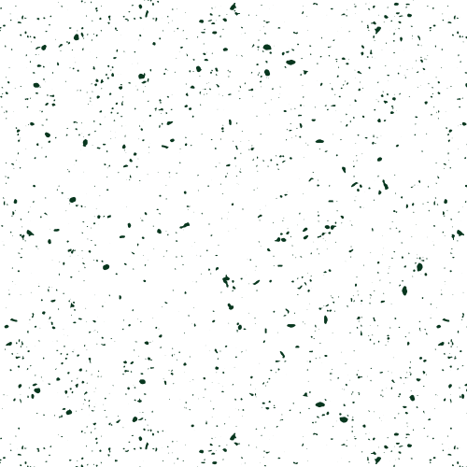
RESOURCE PAGE
  Use these design resources in your Canva Presentation.
Fonts
Design Elements
This presentation template
uses the following free fonts:
TITLES:
SHRIKHAND
HEADERS:
OLEO SCRIPT
BODY COPY:
NUNITO
You can find these fonts online too.
Colors
#0F2645
#051F12
#051F12
#91E2E7
#206C45
  DON'T FORGET TO DELETE THIS PAGE BEFORE PRESENTING.

Slide 19

CREDITS
  This presentation template is free for everyone to use thanks to the following:
  for the presentation template
Pexels, Pixabay
  for the photos
  Happy designing!

