Slide 1




2030
My Money
in Review
REFLECTING ON MY FINANCIAL JOURNEY
Presenter Name

Slide 2


Contents
01
02
03
04
Financial snapshot
Monthly breakdown
Biggest expense
Best purchase
05
06
07
08
Regrets
Financial wins
Money lessons to
carry forward
Next year’s goals

Slide 3
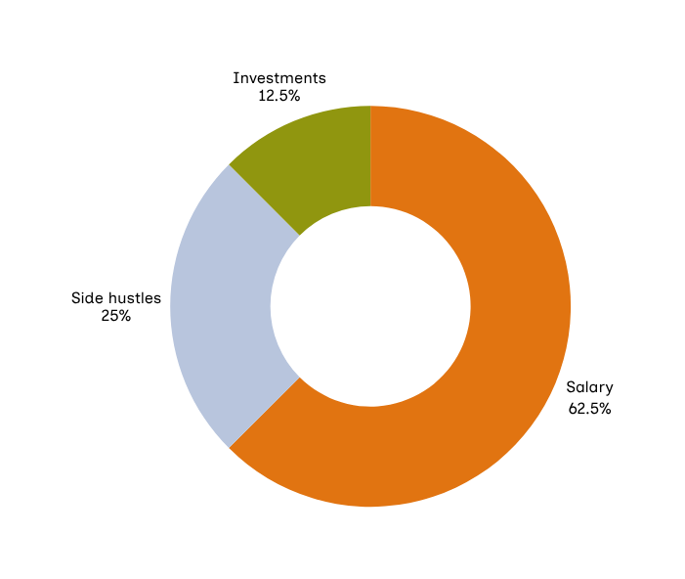
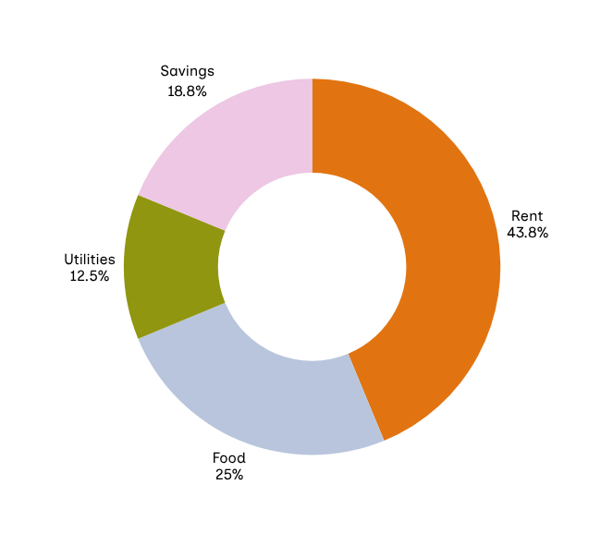


Financial snapshot
Highlight your total income, savings, and spending for the year.
Where my money came from
Where my money went

Slide 4

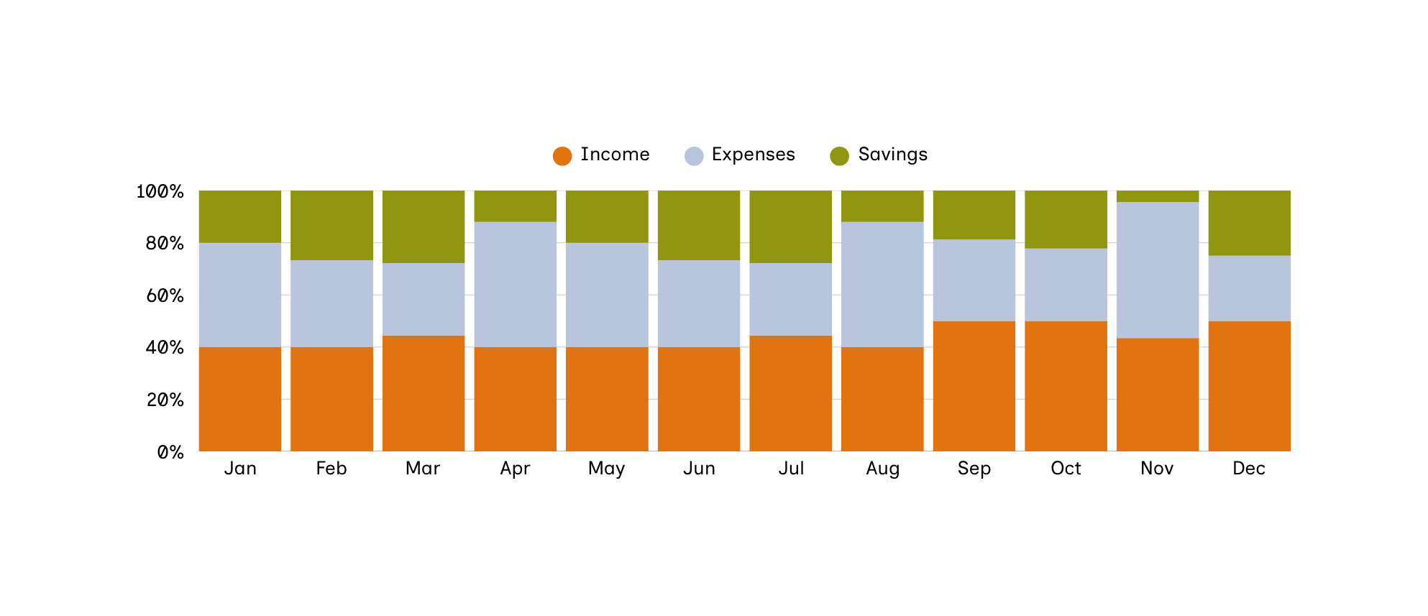
Monthly breakdown
Review each month’s income, expenses, and savings to see how your financial patterns changed throughout the year.

Slide 5


Biggest expense
Look back at where you spent the most money this year. What category topped your expenses? Was it worth it? Share why it mattered or what you'd do differently next time.

Slide 6




Best purchase
Think about the one purchase that brought you the most joy, value, or impact this year. What made it meaningful? Tell the story behind it. If you can, add a photo to capture the moment or memory.

Slide 7




Regrets
Describe a purchase or spending habit you regret. What was the situation, and how did it feel in hindsight? Then share what you learned from it.
Add an item
Supporting details go here
Add another item
Supporting details go here

Slide 8



01
Paid off my debt
Cleared a long-standing credit card debt by committing to extra monthly payments
02
Another win here
Supporting details go here
03
Another win here
Supporting details go here
Financial wins

Slide 9

01
Money lessons to carry forward
The 50/30/20 rule became my financial GPS
Having 30% for ‘wants’ meant I could enjoy life without guilt. knowing my needs and future were covered first.
02
Another lesson here
Supporting details here
03
Another lesson here
Supporting details here

Slide 10



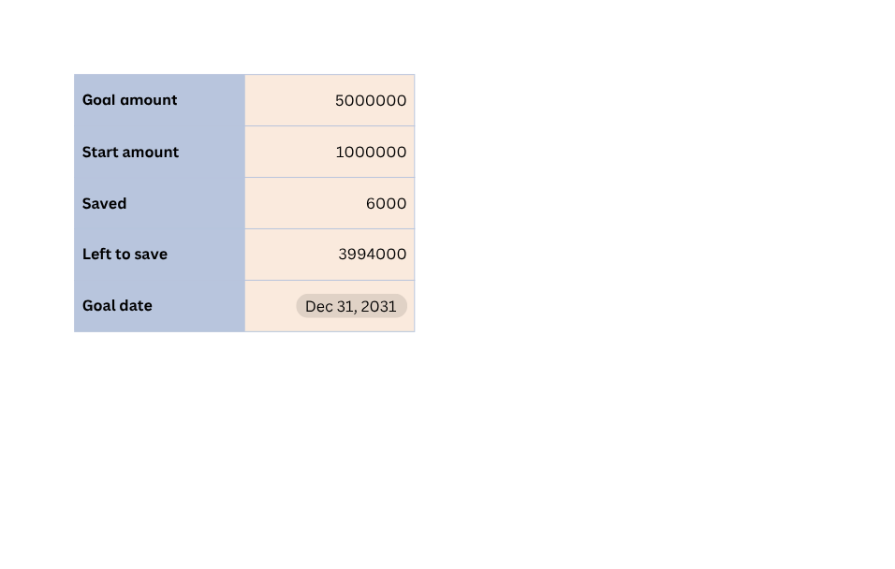
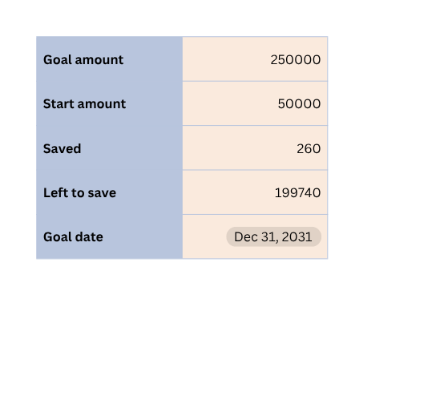
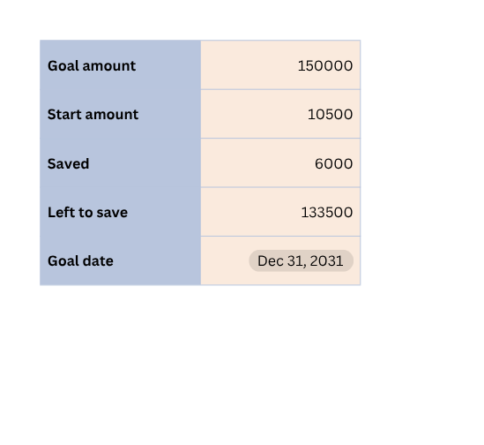
Think about what you want to work toward financially in the coming year. Use the goal-setting template to break down your big goals into smaller, achievable steps.
Next year’s goals
Emergency fund
Dream vacation
Investment

Slide 11



A quote to inspire you to stay focused on your financial goals.
— Credit or citation

Slide 12







Resource Page
  Use these in your presentation. Delete or hide this page before presenting.
Fonts
Design Elements / Icons
This presentation template
uses the following free fonts:
TITLES:
Martel
BODY TEXT:
Inclusive Sans
You can find these fonts online too.
Colors
#EDC7E3
#E17411
#90960F
#B8C5DD
#BB723D

Slide 13




Credits
  THIS PRESENTATION TEMPLATE IS FREE FOR EVERYONE TO USE, THANKS TO THE FOLLOWING:
Pexels, Pixabay, Sketchify
  for this presentation template
  for the photos, graphics, and elements
Happy designing!

