Slide 1


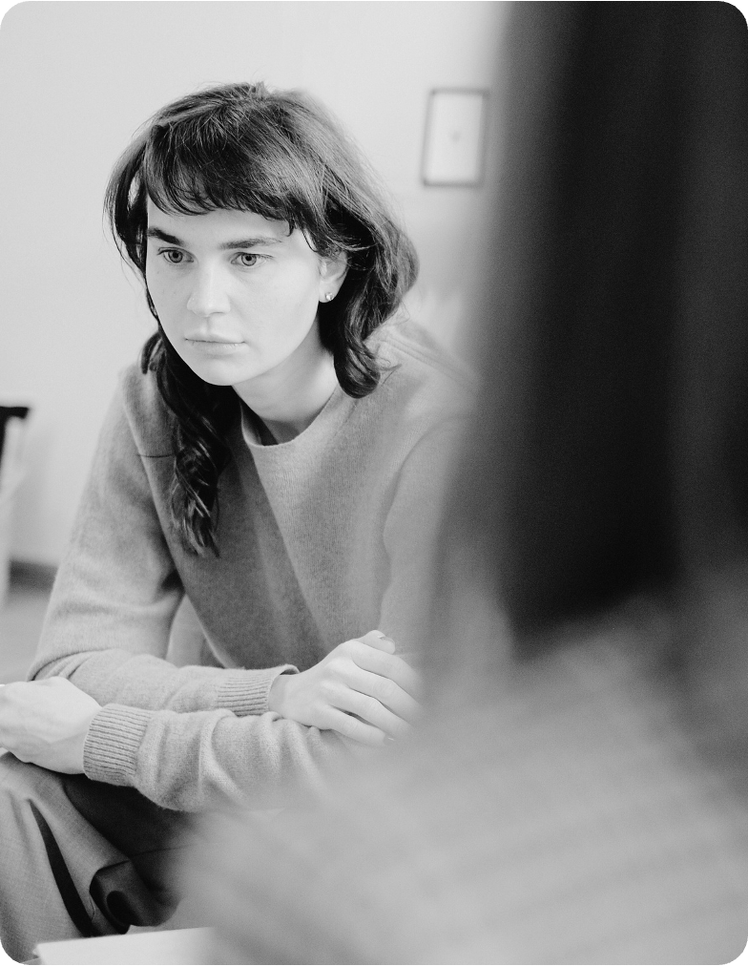

Gentle Wellness
Center
STRESS AWARENESS MONTH
APRIL 2026

Slide 2
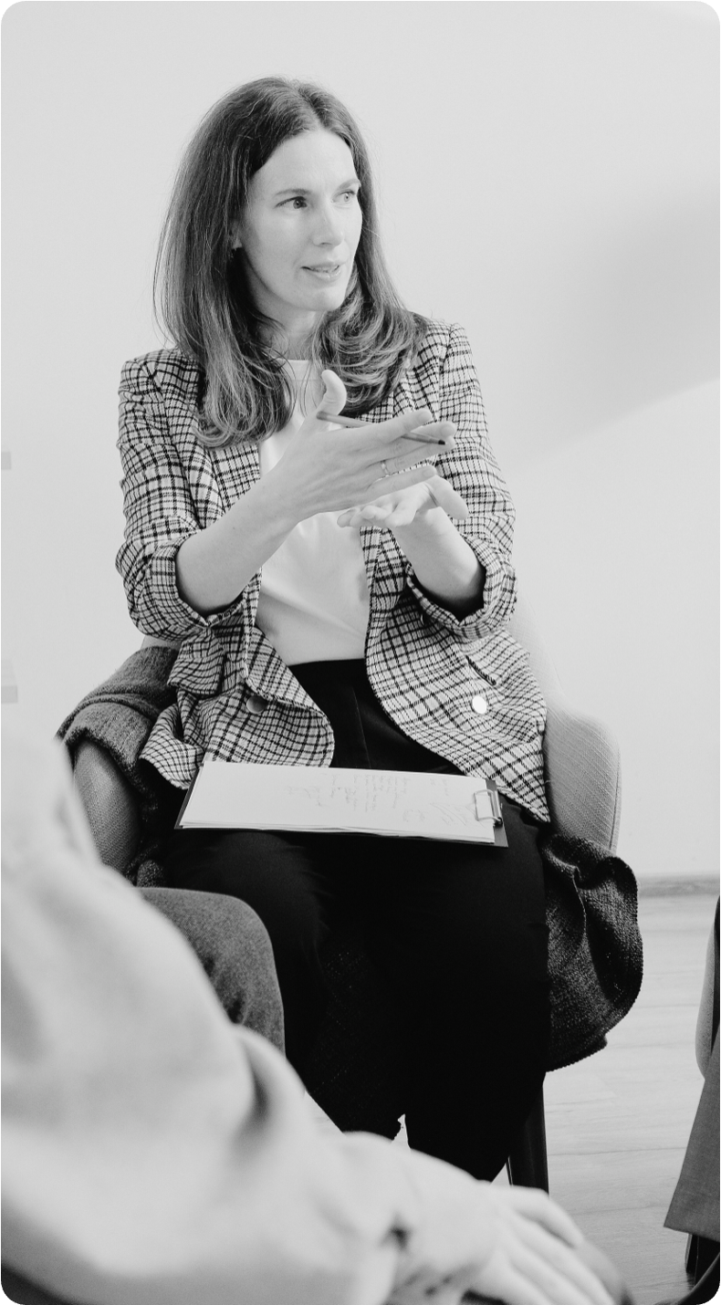
CONTENTS
What is stress?
Why this month matters
Recognizing stress
How stress impacts long-term health
How you can get involved
Stress awareness month challenge
Supporting others
Support services
Key takeaways

Slide 3



WHAT IS STRESS?
Stress is the body’s natural response to challenges and demands.
When we face something unfamiliar or demanding, our body releases hormones that prepare us to respond. This reaction can help us focus or act quickly, but when stress persists for too long or feels overwhelming, it can begin to impact our well-being.

Slide 4
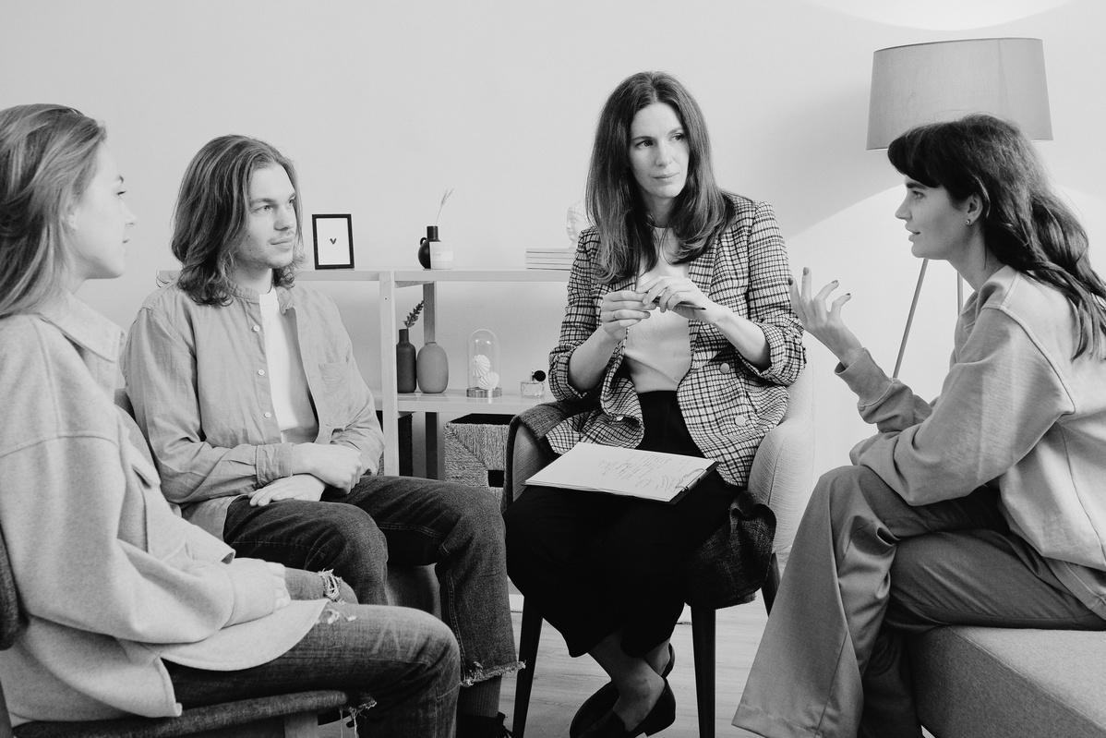



WHY THIS MONTH MATTERS
Fosters supportive relationships
Encourages early awareness and action
Reduces stigma around mental health
This month creates space for open conversations and helps individuals feel seen and supported.
Recognizing stress early enables individuals to respond effectively before it becomes overwhelming.
Talking about stress normalizes the fact that everyone experiences it at some point.

Slide 5


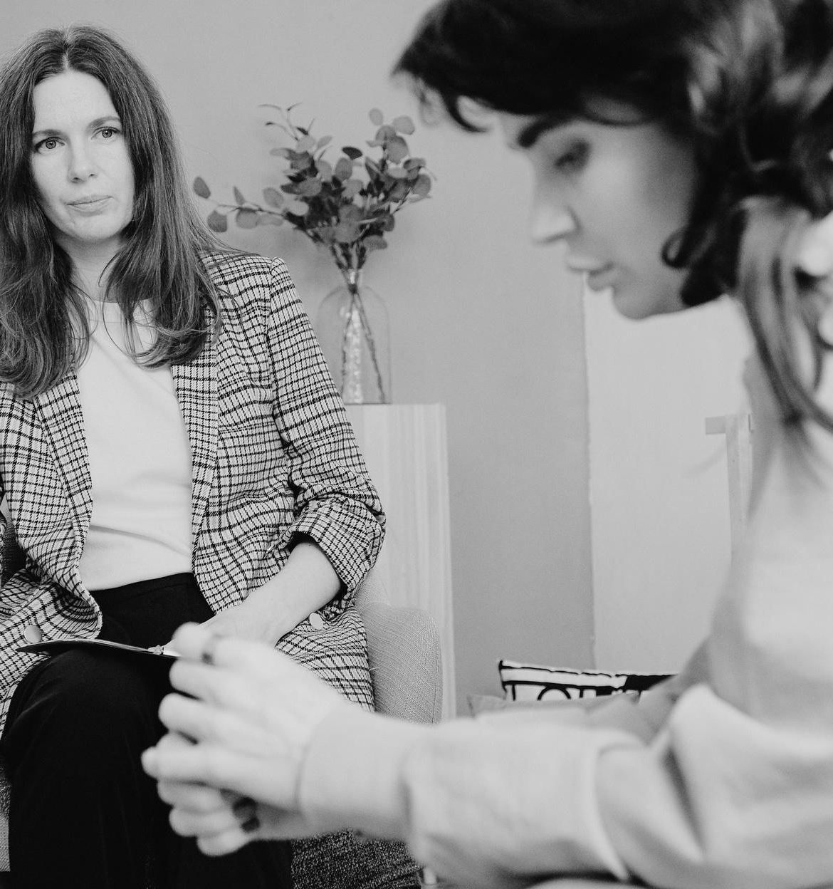
RECOGNIZING STRESS
You may need support if you notice you’re:
  Withdrawing from people or activities you usually enjoy
  Another sign you shouldn't ignore
  Another sign you shouldn’t ignore

Slide 6

HOW STRESS IMPACTS LONG-TERM HEALTH
Chronic stress can have serious long-term health consequences.
Cardiovascular problems
Weakened immune system
Digestive disorders
Mental health challenges
Increased risk of high blood pressure, heart disease, and stroke
An explanation of how chronic stress may reduce the body’s ability to fight illness
A description of how stress can influence digestion and gut health
A description of how prolonged stress can affect emotional well-being

Slide 7


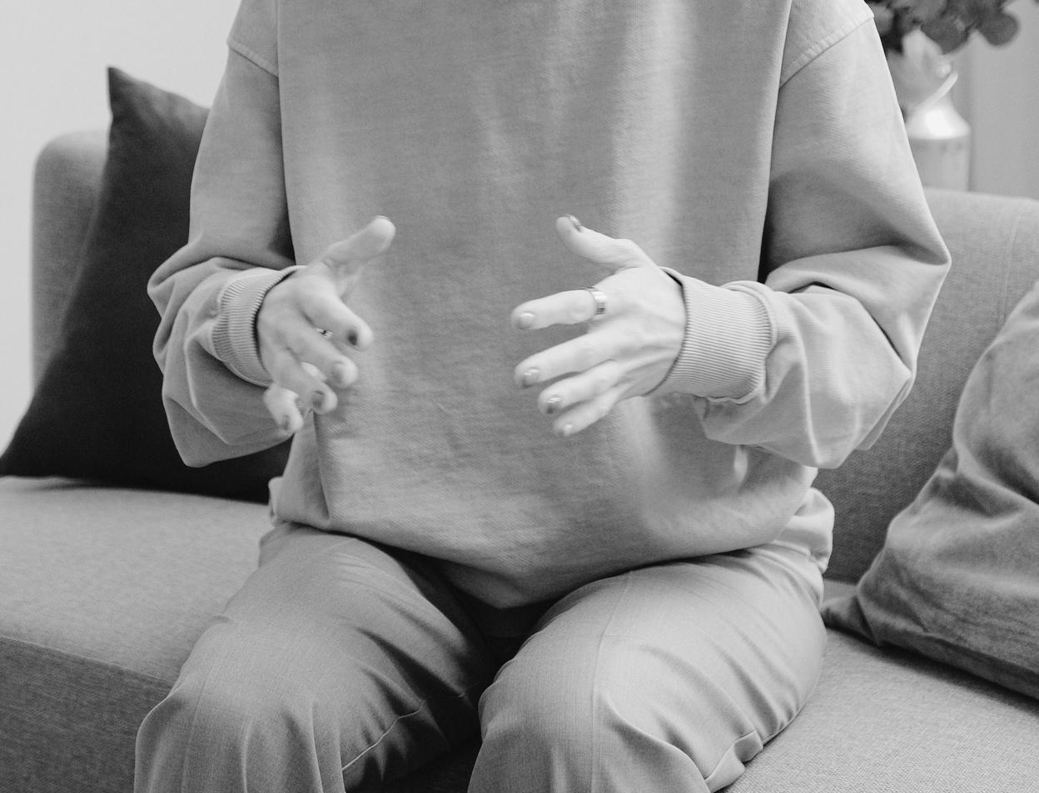
HOW YOU CAN GET INVOLVED
Awareness and education activities
Mindfulness and relaxation activities
Creative and connection initiatives
Participate in wellness talks, lunch-and-learn sessions, or sharing informational resources about stress and coping strategies.
Join guided breathing exercises, short mindfulness sessions, stretching breaks, and yoga classes.
Take part in journaling, art sessions, or other creative workshops that’ll allow your to express emotions.

Slide 8
STRESS AWARENESS MONTH CHALLENGE
S | M | T | W | T | F | S
 |  |  | Notice body sensations | Practice deep breathing | Walk for ten minutes | Send a check-in message
Go to bed earlier | Write one main stressor | List three things you’re grateful for | Silence notifications for one day | Do one kind act | Eat one meal mindfully | Step outside briefly
Drink eight glasses of water | Create something simple | Ask “What do I need?” | Stretch for six minutes | Take a three-hour screen break | Identify one support person | Speak kindly to yourself
Clear one small space | Take 10 slow breaths | Do something enjoyable | Notice stress triggers | Walk without destination | Talk to someone trusted | Take a proper break
Pause and listen | Say “no” once | Thank someone today | Choose one habit | Write one takeaway

Slide 9
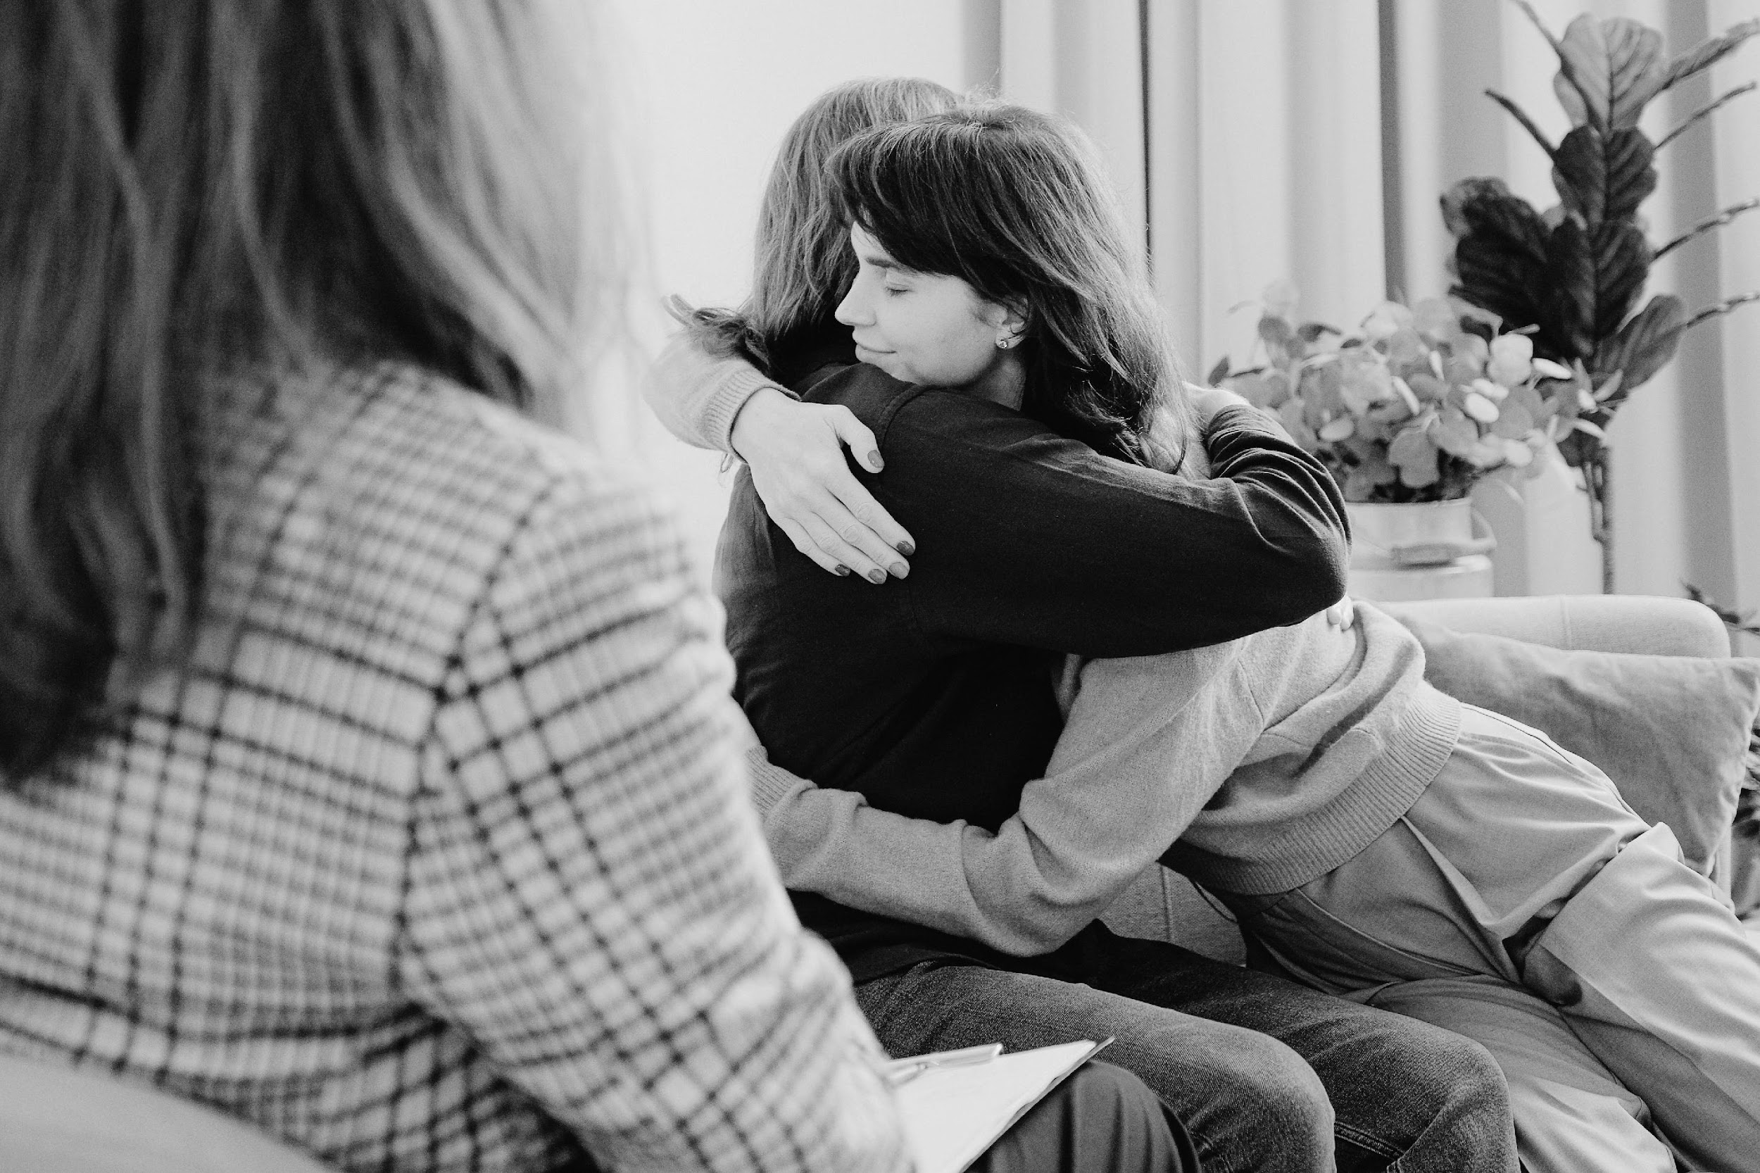
SUPPORTING OTHERS
DO’S
DON’TS
List compassionate, practical actions:
  Action here
  Action here
  Action here
List actions that may unintentionally cause harm:
  Action here
  Action here
  Action here

Slide 10

SUPPORT SERVICES
Organization here
Helpline or number here
Organization here
Helpline or number here
Organization here
Helpline or number here

Slide 11
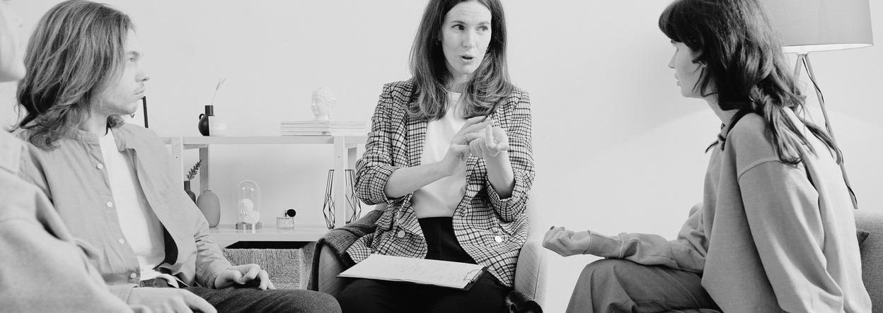

Stress is a normal response
KEY
TAKEAWAYS
Stress is the body’s natural response to challenges. It can be helpful in brief moments, but prolonged stress may negatively impact overall well-being if left unaddressed.
Awareness leads to healthier choices
Recognizing stress early allows individuals to respond with supportive actions before it becomes overwhelming.
Stress affects both body and mind
Ongoing stress can influence physical health, including the heart, immune system, and digestion, as well as emotional well-being over time.
Support is always available
Open conversations, community activities, and professional support all play crucial roles in managing stress. No one has to navigate stress alone.

Slide 12
RESOURCE PAGE
  Use these in your presentation. Delete or hide this page before presenting.
Fonts
Design Elements / Icons
This presentation template
uses the following free fonts:
TITLES:
News Cycle Bold
BODY TEXT:
News Cycle Regular
You can find these fonts online too.
Colors
#2DCD9D
#2A6251
#FFF6E8
#1E1A1B

Slide 13

CREDITS
  This presentation template is free for everyone to use, thanks to the following:
  for this presentation template
Pexels, Pixabay, Sketchify
  for the photos, graphics, and elements
  Happy designing!

