Slide 1

FEBRUARY 4, 2026
World Cancer Day 2026
United by Unique

Slide 2

Contents
01
Opening message
02
What is World Cancer Day?
03
The global impact
04
Unique stories
05
The role of support systems
06
Key takeaways

Slide 3
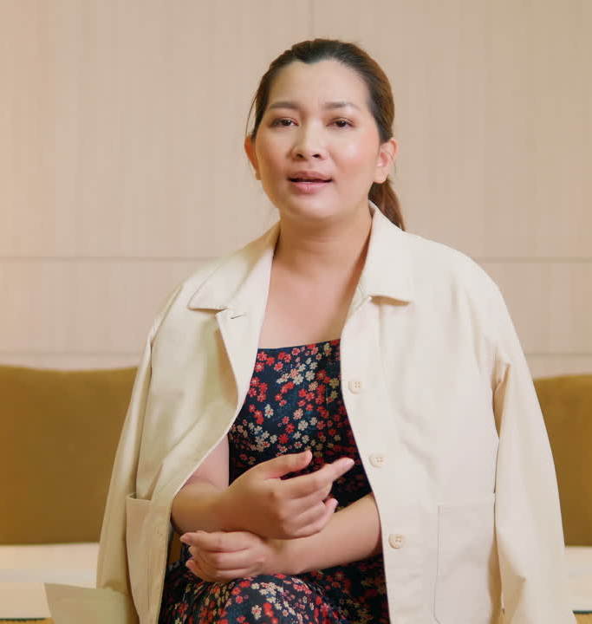
Opening message
A short introductory message reflecting on the significance of World Cancer Day, the collective effort behind it, and the purpose of this presentation.

Slide 4

What is World Cancer Day?
World Cancer Day is a chance to pause, reflect, and come together. Observed every year on February 4, it reminds us that cancer touches many lives.
This day is not only about understanding the disease, but also recognizing the strength and hope found in people everywhere.
Add more context as needed.

Slide 5

Why this
day matters
A brief statement explaining the purpose of World Cancer Day and why it is observed globally. Replace this text with your organization’s framing or key message.
You can also explain the focus of this year’s theme.
Keep this people-centered and values-driven.

Slide 6
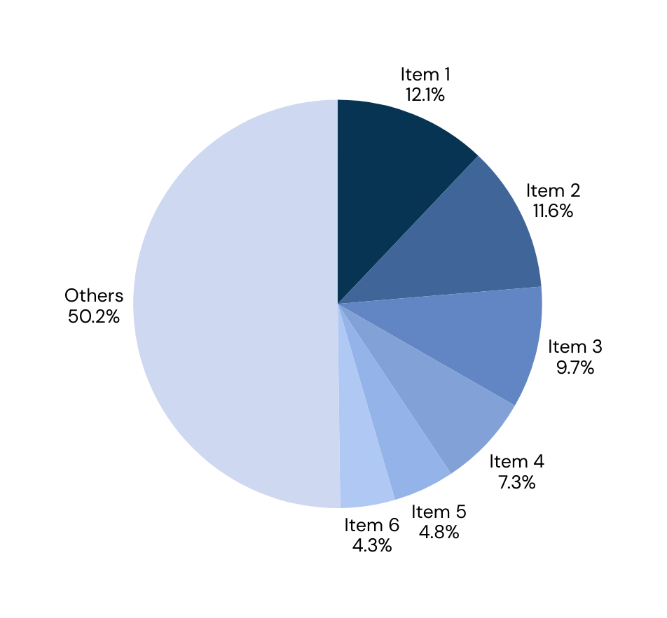
Global cancer incidence
The Global Impact
Insert a chart showing relevant statistics and data related to the global scale of cancer.
Support with data-driven statements to help the reader better process the information.

Slide 7
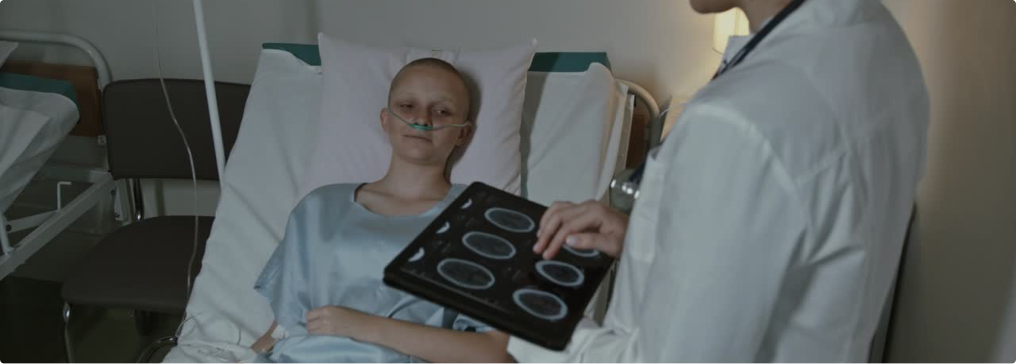
Unique stories
Parker
Central City

Slide 8
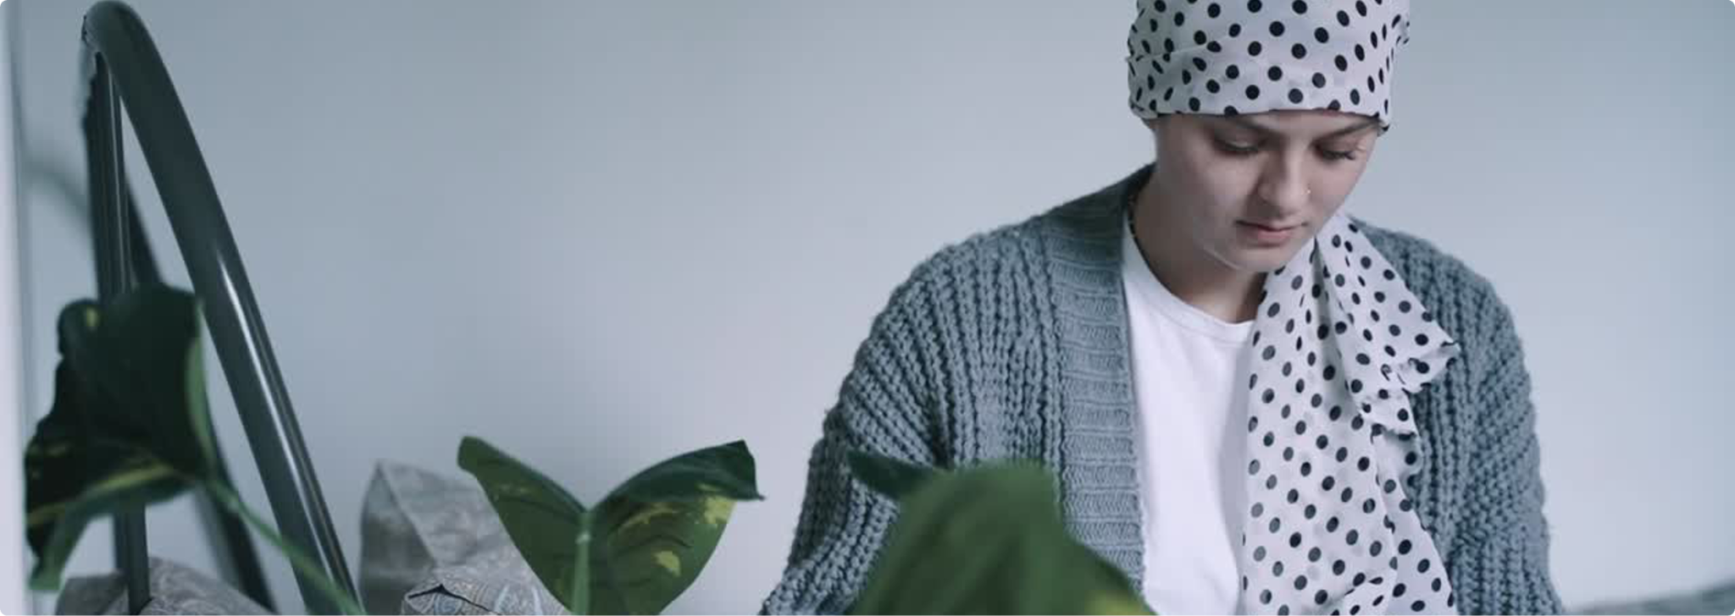
Unique stories
Jasmine
Tower Hill

Slide 9



The role of support systems
Emotional encouragement, practical help, and simply having someone to listen can make a meaningful difference during uncertain or challenging times.
Family and friends
Healthcare
Community
Add a short description.
Add a short description.
Add a short description.

Slide 10

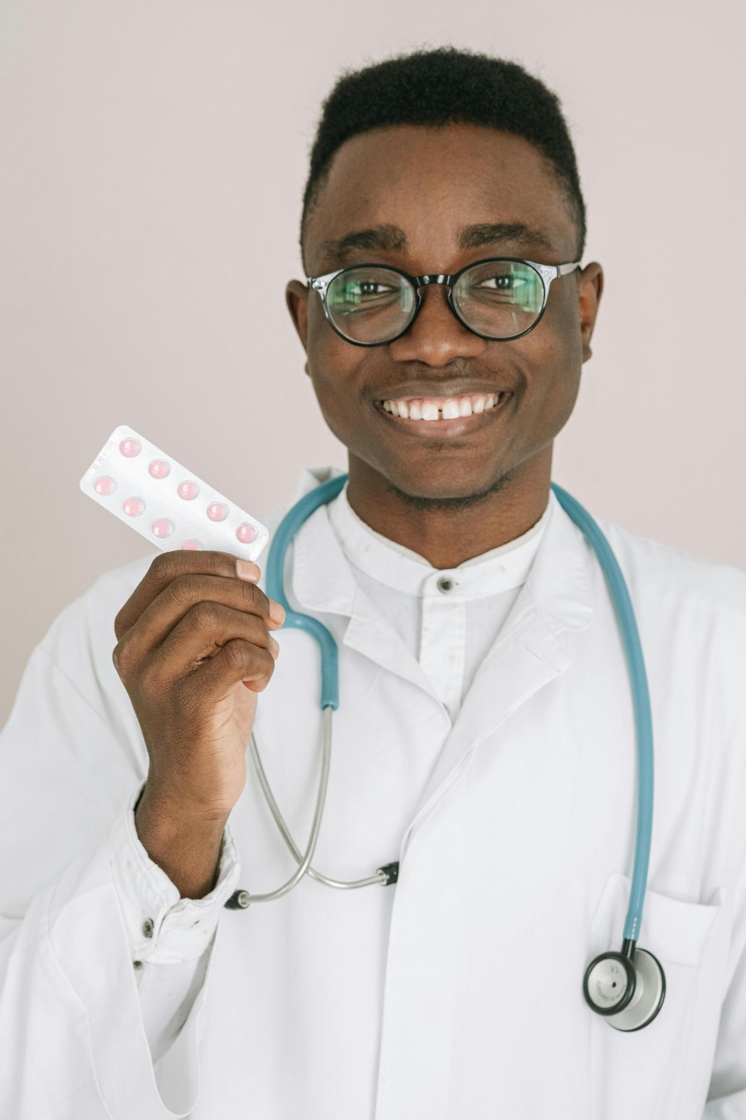
Life after cancer
Describe one physical or emotional effect someone may experience after treatment.
Add tips, strategies, or considerations that can help improve the quality of life.
Help the audience understand what life may look like after successful cancer treatment.

Slide 11
Key takeaways
Main point 1
Main point 2
Reinforce core message here.
Reinforce core message here.
Main point 3
Main point 4
Reinforce core message here.
Reinforce core message here.

Slide 12
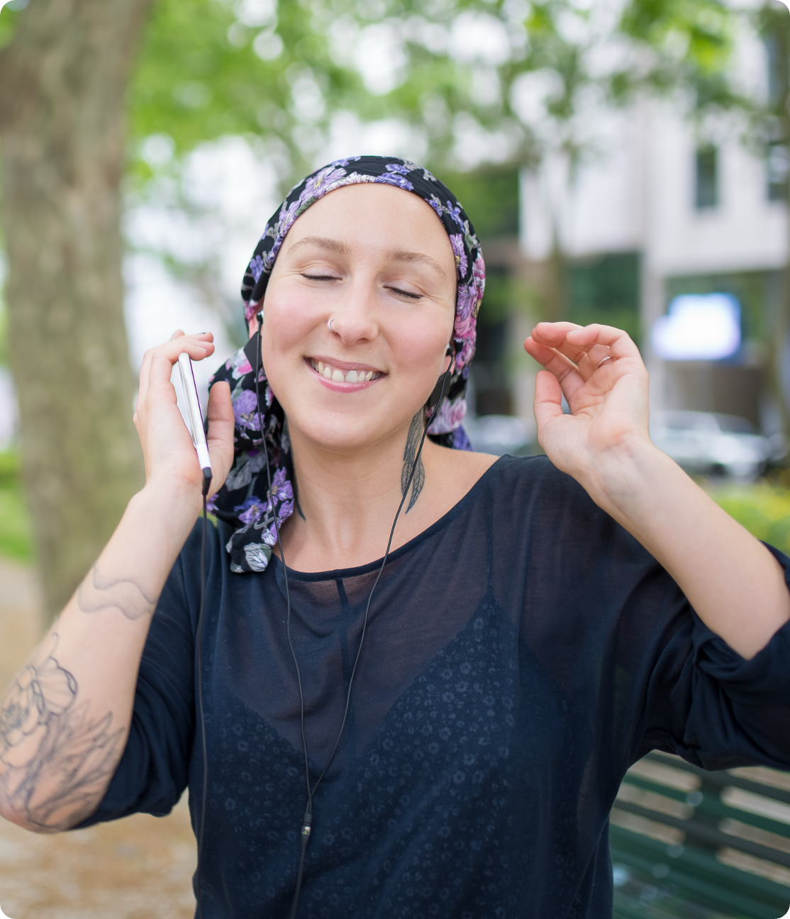
Thank you!
A message of gratitude to everyone involved

Slide 13

Social media
@reallygreatsite
Website
reallygreatsite.com
Got questions?
Email
hello@reallygreatsite.com
Phone
123-456-7890

Slide 14






Resource Page
  Use these in your presentation. Delete or hide this page before presenting.
Fonts
Design Elements / Icons
This presentation template
uses the following free fonts:
TITLES:
Petrona
BODY TEXT:
IBM Plex Sans
You can find these fonts online too.
Colors
#000000
#F6D7B3
#CED9F1
#E6EFD3
#FFFFFC

Slide 15

Credits
  This presentation template is free for everyone to use, thanks to the following:
Pexels, Pixabay,
Sketchify
  for this presentation template
  for the photos, graphics, and elements
Happy designing!

