Slide 1
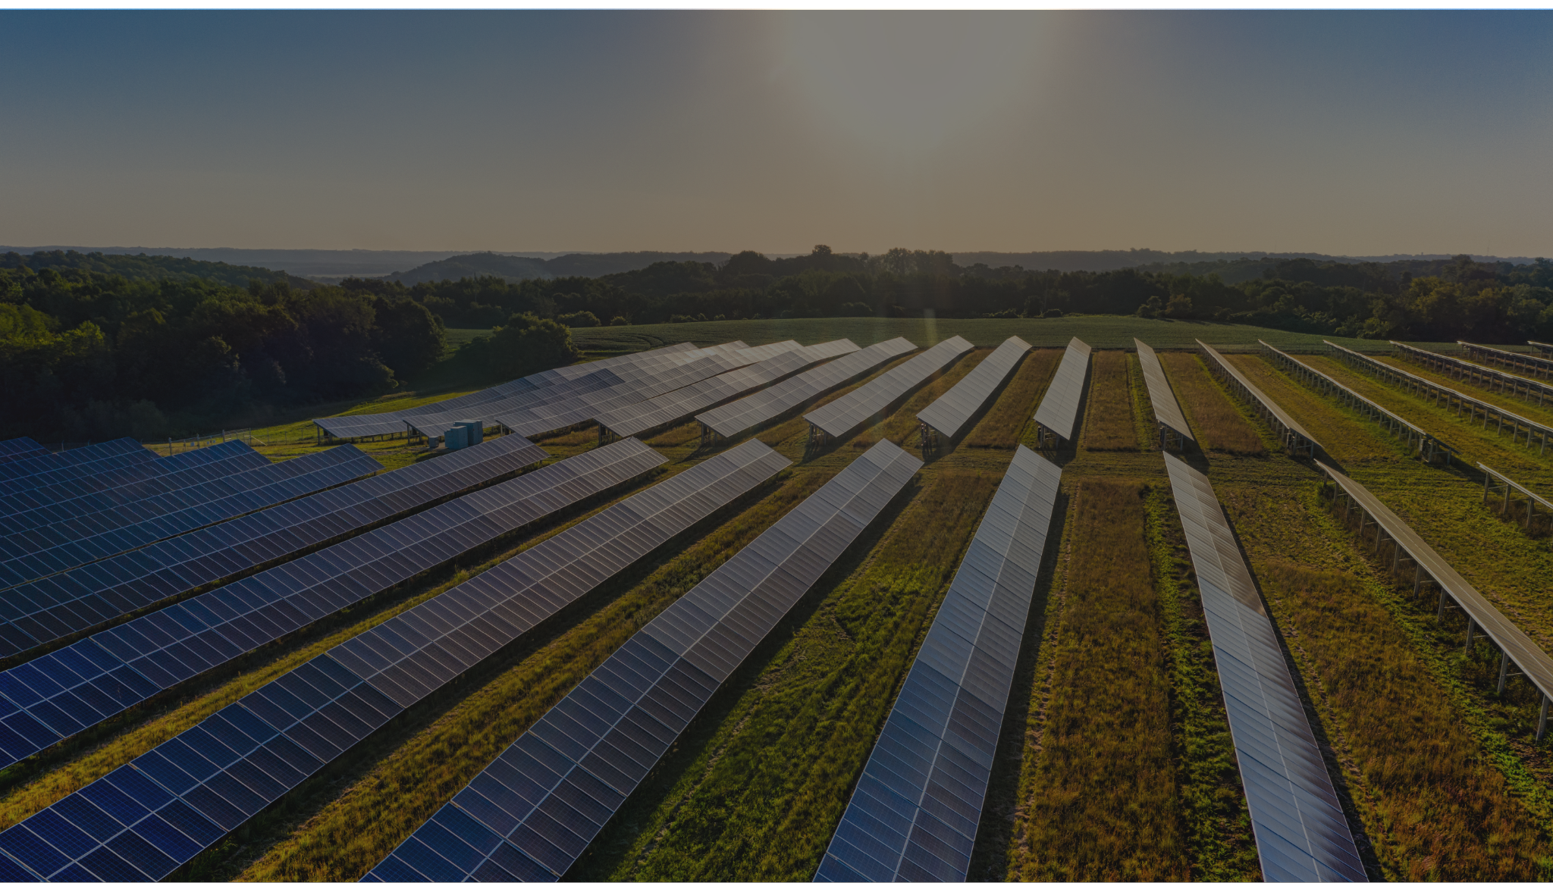

BRIGHT PEAK SOLAR CO.
SOLAR ENERGY SALES PITCH SLIDES
Solar energy made simple, affordable, and accessible.

Slide 2
Agenda
1
The Problem
2
Why This Matters Now
3
Bright Peak Solar
4
Our Solution
5
What Our Customers Say
6
Next Steps
BRIGHT PEAK SOLAR CO.

Slide 3


The Problem
Rising Electricity Costs
Dependence on fossil fuels
Unpredictable energy supply
Limited access to other options
Back to Agenda Page
BRIGHT PEAK SOLAR CO.

Slide 4
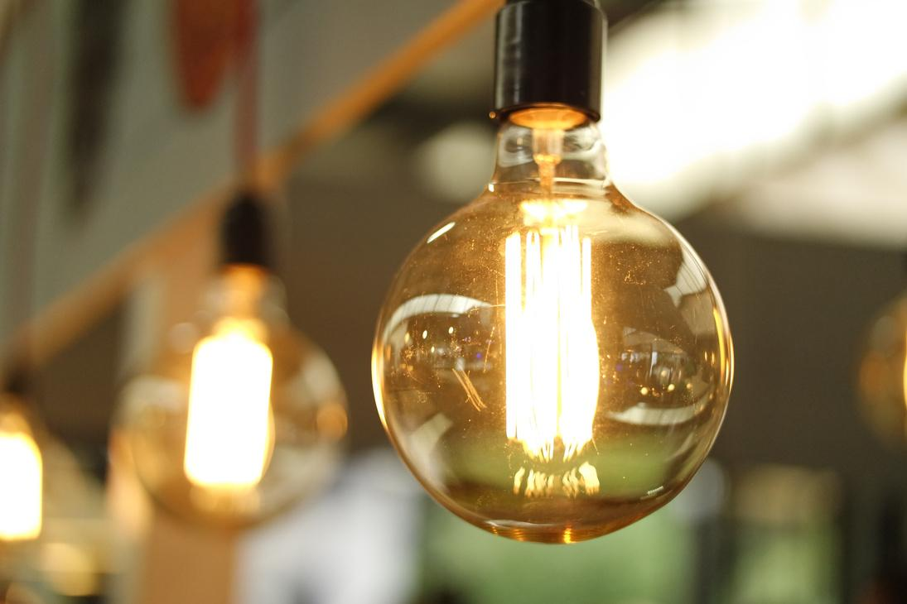
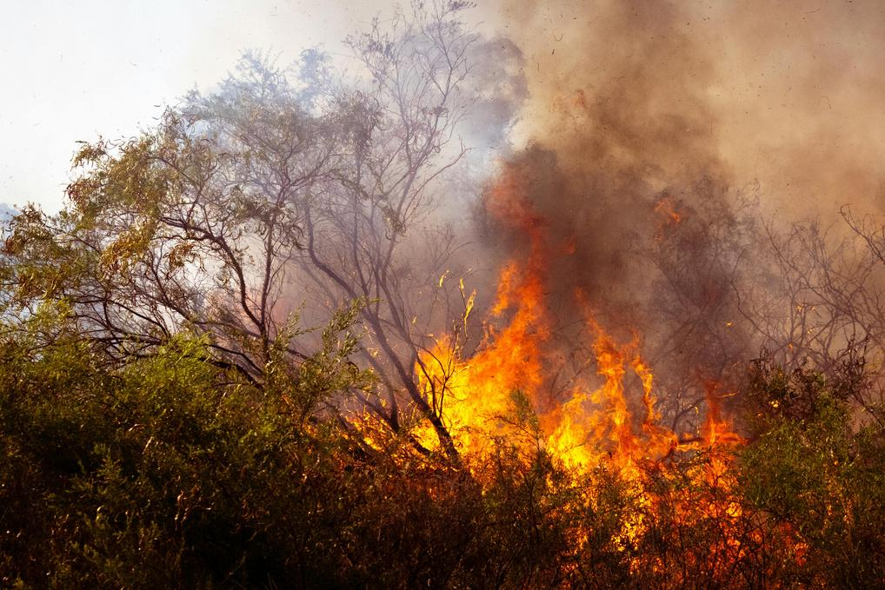
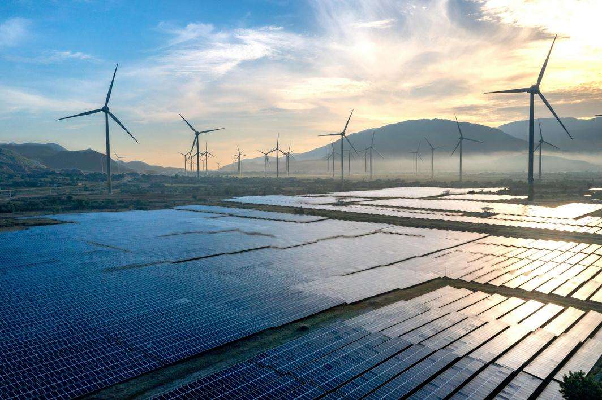

Why This Matters Now
Energy demand is increasing globally
Climate change pressures are rising
Everyone wants cleaner solutions
Adoption is increasing, but there are barriers
Back to Agenda Page
BRIGHT PEAK SOLAR CO.

Slide 5
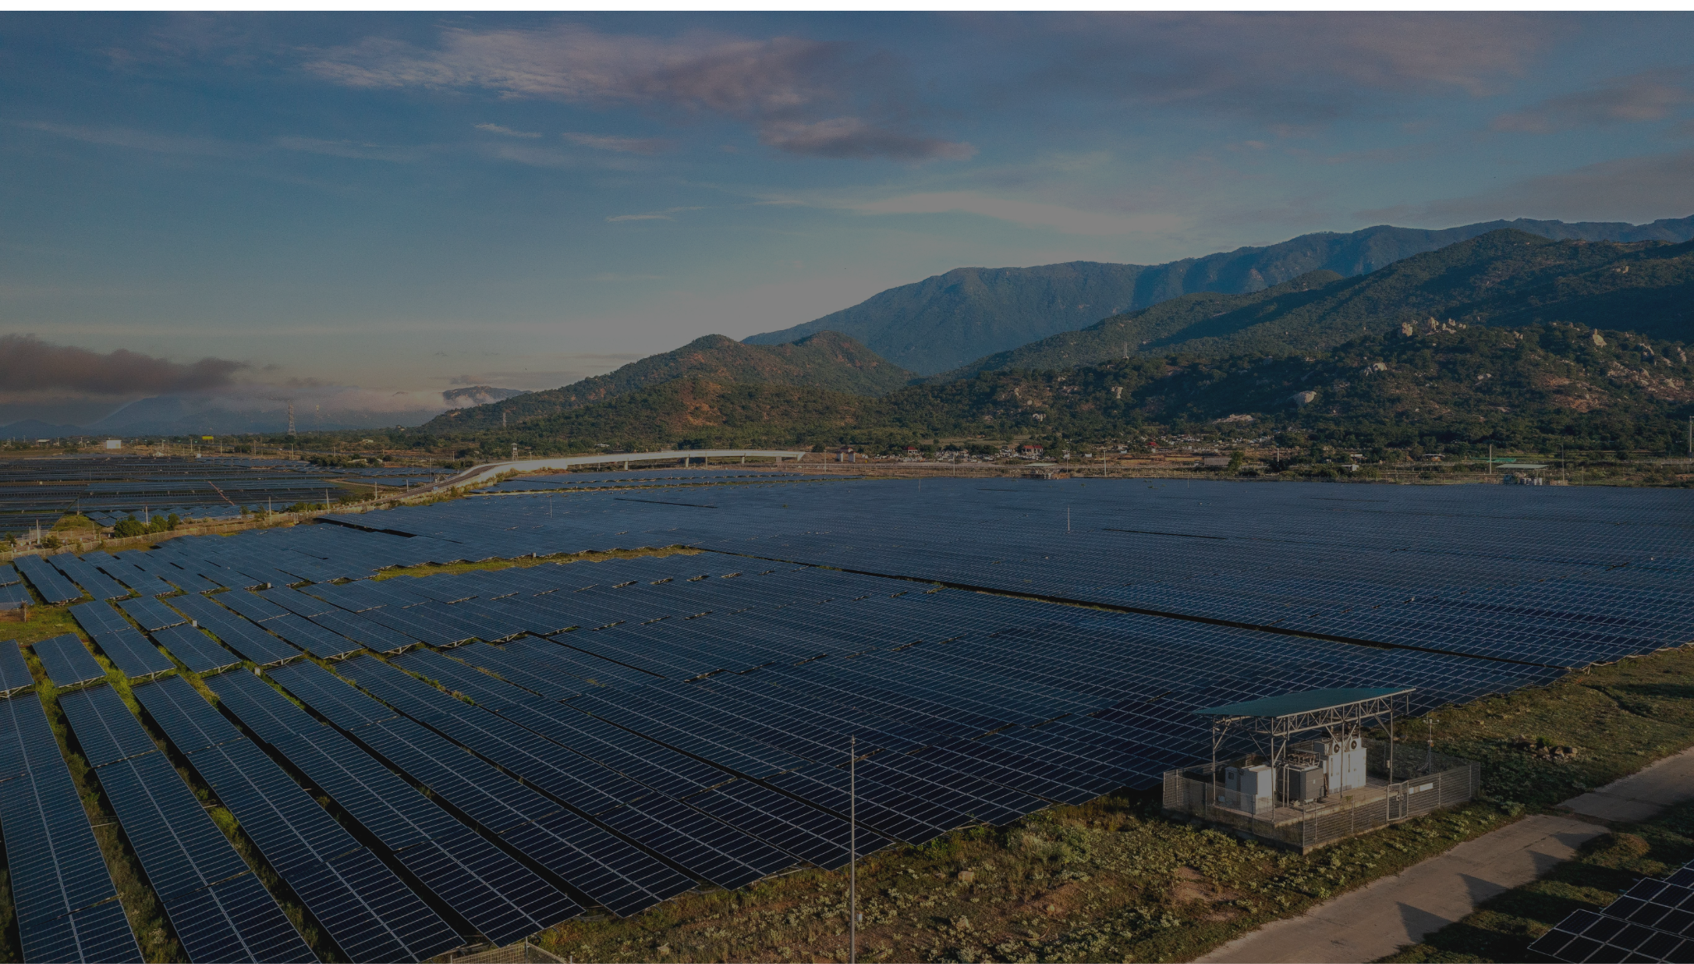
Introducing:
BRIGHT PEAK SOLAR CO.
We design and install solar systems that help you generate your own clean energy—without the complexity.
Simple setup. Real savings. Long-term impact.

Slide 6
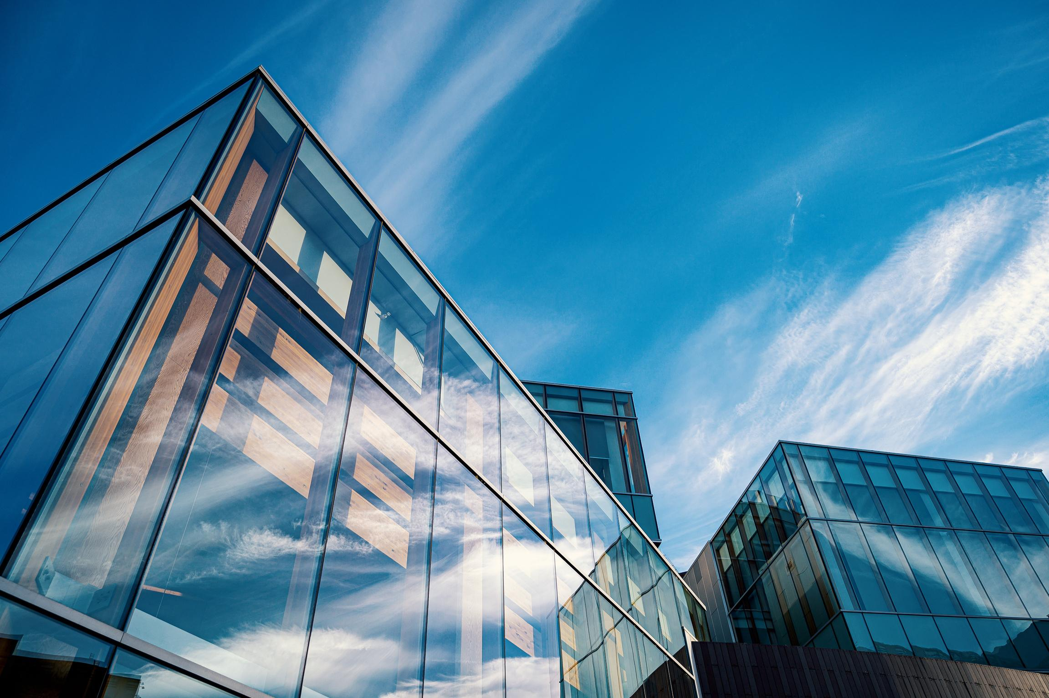

Why We Exist
Who We’re Built For
To make clean energy understandable, accessible, and practical for real people and real businesses.
  Homeowners planning for the long term
  Small to mid-sized businesses
  Organizations serious about sustainability

Slide 7

Our Solution
End-to-end solar energy systems:
Design
Installation
Monitoring
Maintenance
We assess your energy needs and space to create a solar system tailored to how you live or work.
Our certified technicians install efficiently, with minimal disruptions to your daily operations.
You can track your energy production and usage in real time with simple, easy-to-read tools.
We provide ongoing support and maintenance to keep your system performing at its best over time.
01
02
03
04
Back to Agenda Page
BRIGHT PEAK SOLAR CO.

Slide 8
What Our Customers Say
“Bright Peak Solar made everything clear and stress-free.”
“This service helped us reduce costs without disrupting operations.”
“We finally feel in control of our energy costs.”
Parker, Homeowner
Ava, Facilities Director
Gravity Tech
Colin, Retail Store Owner
Back to Agenda Page
BRIGHT PEAK SOLAR CO.

Slide 9



Homeowners
Small to mid-sized business
Large organizations

Slide 10
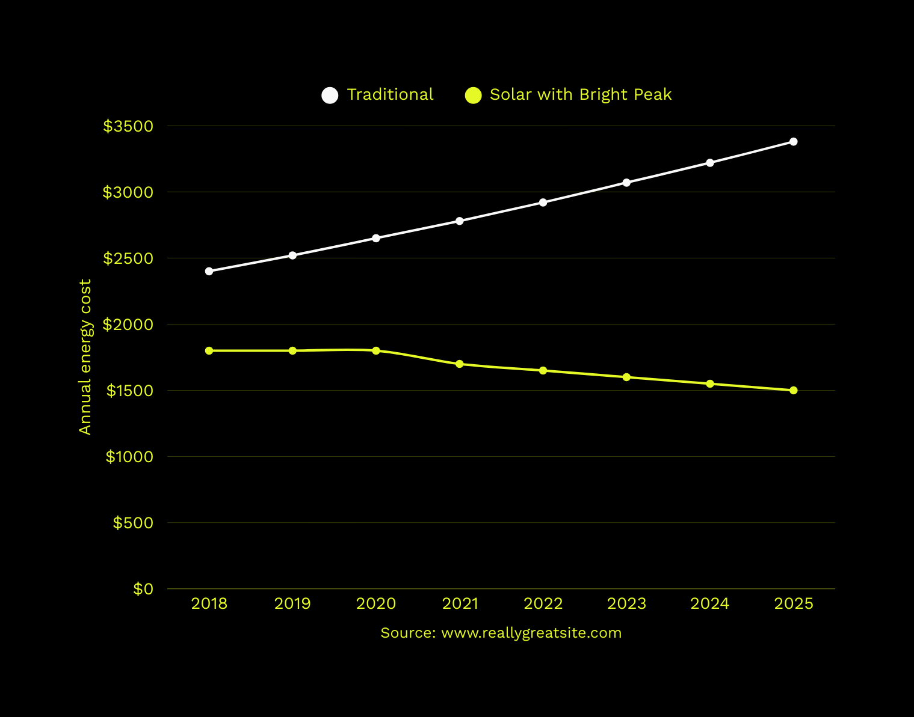

Your Savings Over Time
Energy cost comparison between traditional power vs solar power with Bright Peak Solar
Traditional energy costs increase year after year, while solar provides stable, predictable savings over time.
BRIGHT PEAK SOLAR CO.

Slide 11
Next Steps
03
02
Go solar with confidence
We take care of the details—you enjoy clean, reliable energy.
01
Review your custom plan
Get a clear breakdown of costs, savings, and next steps.
Book a free consultation
Let’s talk about your energy goals and see if solar is the right fit.
Back to Agenda Page
BRIGHT PEAK SOLAR CO.

Slide 12

Email
Social Media
Thank you!
hello@reallygreatsite.com
@reallygreatsite
Questions? Let’s talk.
Contact Number
Secondary Contact Number
123-456-7890
123-456-7890
Back to Agenda Page
BRIGHT PEAK SOLAR CO.

Slide 13







































Resource Page
  Use these in your presentation. Delete or hide this page before presenting.
Fonts
Design Elements / Icons
This presentation template
uses the following free fonts:
TITLES:
Space Mono
BODY TEXT:
Work Sans Medium
You can find these fonts online too.
Colors
#1A1A1A
#0D4D47
#75D385
#E4F925
#F9F9F9

Slide 14

Credits
  This presentation template is free for everyone to use, thanks to the following:
Pexels, Pixabay, & Sketchify
  for this presentation template
  for the photos, graphics, and elements
  Happy designing!

