Slide 1

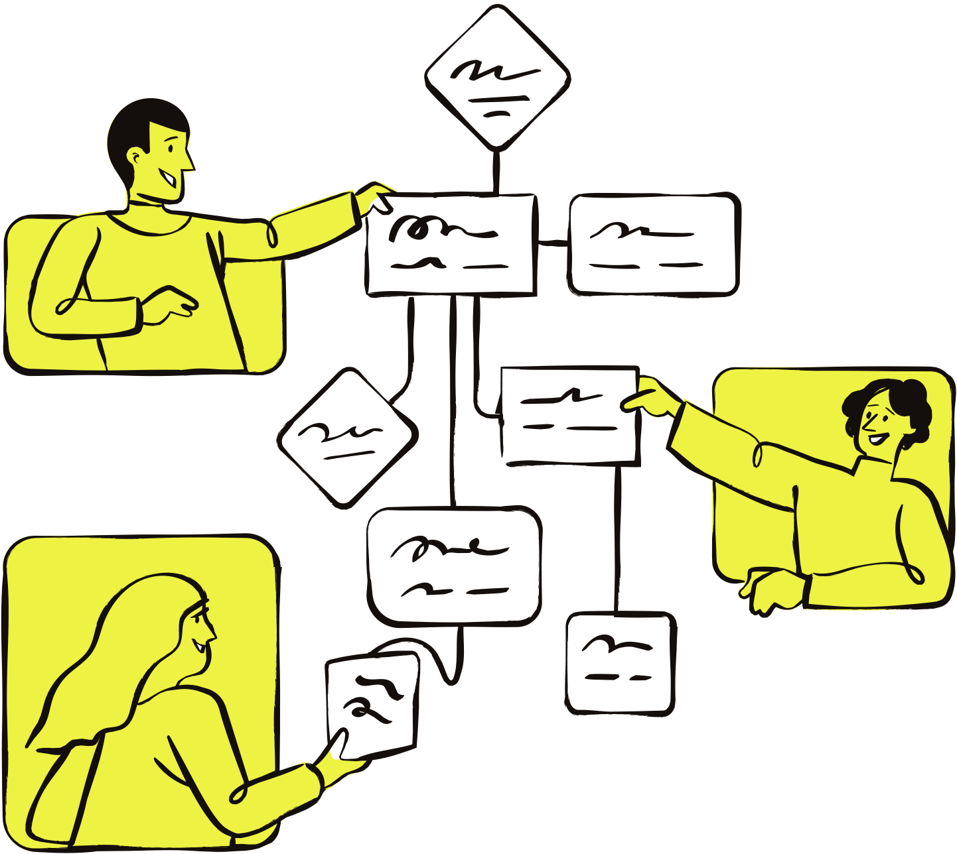
IMPACT
TRAINING CENTER
Sales Closing
Techniques
A practical guide to closing with confidence

Slide 2



Contents
1
What closing means
2
When should you close
3
Common sales closing techniques
4
Quick check-in

Slide 3


ICEBREAKER
Would you say yes?
For each scenario shown, think:
  Would you say yes?
  What would help you decide faster?
A friend suggests trying a new café after work.
You’re booking a trip, and only one seat is left at the price you want.
You’re choosing between next-day delivery or standard shipping for
an order.
Back to Contents

Slide 4

What “closing” really means
Closing is...
Closing is NOT...
Guiding the final decision
Tricking
Confirming readiness
Rushing
Removing last doubts
Forcing a yes
Back to Contents

Slide 5

When should
you close?
You’re ready to close when:
The customer asks detailed questions
They discuss pricing or timelines
They imagine using the product
Objections shift from “why” to “how”
Back to Contents

Slide 6


Common sales
closing techniques
Back to Contents

Slide 7

The assumptive close
Act as if the decision is already made
WHY IT WORKS:
  Reduces friction
  Signals confidence
  Feels natural when interest is high
“Would you like us to start on Monday or Wednesday?”
BEST USED WHEN:
  Buyer has shown strong intent
  Objections are already addressed
  Timing feels right
“Which plan works best for your team?”
Back to Contents

Slide 8
The summary close
Recap the value before asking
for the decision
WHY IT WORKS:
  Reinforces value
  Refreshes memory
  Creates clarity
“You get speed, simplicity, and visibility. Want to take the next step?”
BEST USED WHEN:
  Longer sales conversations
  Multiple stakeholders
  Complex products
“It covers your main needs and fits your timeline. Shall we proceed?”
Back to Contents

Slide 9
The soft close
Test readiness without pressure
WHY IT WORKS:
  Feels conversational
  Opens honest feedback
  Builds trust
“How does this option
feel so far?”
BEST USED WHEN:
  Interest is there but commitment isn’t clear
  You want to surface questions or objections
“Does this sound like something you’d want
to try?”
Back to Contents

Slide 10
QUICK CHECK-IN
What’s the best closing technique to use next?
You’ve just finished a product walkthrough with a potential client.
A
Assumptive close
  They clearly agreed that the solution meets their needs
  They asked about onboarding and next steps
  They haven’t raised any objections
  They say, “This looks good.”
B
Summary close
C
Soft close
D
None of the above
Back to Contents

Slide 11

Summary
What closing means
When you should close
Use the right closing techniques
Closing is about guiding a confident decision, not applying pressure.
Close when buyers show clear interest and readiness to move forward.
Some common closing techniques include the assumptive close, the summary close, and the soft close.
Back to Contents

Slide 12

Thank you!
Questions or thoughts? Let’s talk.
Email
hello@reallygreatsite.com
Social media
@reallygreatsite
Contact number
123-456-7890

Slide 13
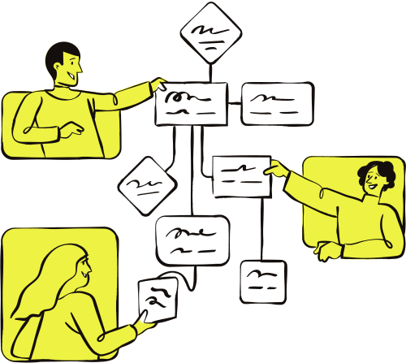


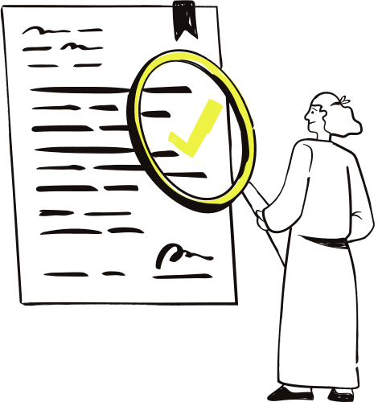
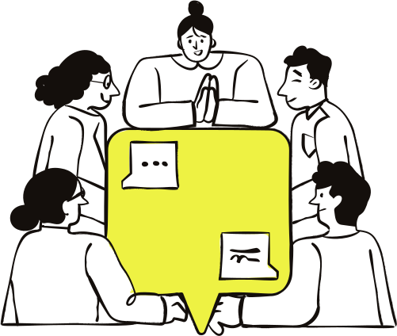
Resource Page
  Use these in your presentation. Delete or hide this page before presenting.
FONTS
DESIGN ELEMENTS / ICONS
This presentation template
uses the following free fonts:
TITLES:
Libre Baskerville
BODY TEXT:
Bricolage Grotesque
You can find these fonts online too.
COLORS
#140F0C
#EEF243
#C5B7A5
#FFFFFF

Slide 14
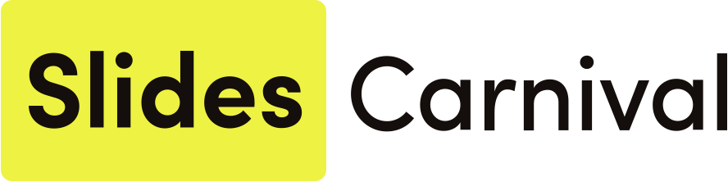
Credits
  This presentation template is free for everyone to use, thanks to the following:
  for this presentation template
Pexels, Pixabay, Sketchify
  for the photos, graphics, and elements
HAPPY DESIGNING!

