Slide 1
HERE GOES YOUR PRESENTATION TITLE

Slide 2
TITLE HERE
Did you know that dogs can smell your feelings?
Dogs can pick up on subtle changes in your scent, which can help him figure out how you are feeling, such as by smelling your perspiration when you become nervous or fearful.

Slide 3
TITLE HERE
Did you know that elephants can sense storms?
Elephants may be able to detect a thunderstorm from hundreds of miles away, and will head towards it, looking for water.

Slide 4
TITLE HERE
Did you know that a cat uses its whiskers as feelers to determine if a space is too small to squeeze through?
Also, cats love to sleep. A fifteen-year-old cat has probably spent ten years of its life sleeping.

Slide 5
MAYBE YOU NEED TO MAKE A LIST
Alligator
Beaver
Caiman
Deer
Elephant
Flamingo
Goose
Horse
Iguana
Jaguar
Koala
Lemur

Slide 6
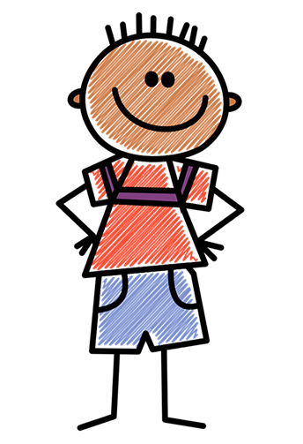



Did you know there are more kangaroos than humans in Australia?
It is estimated that more than 50 million kangaroos live there. They are Australia’s national symbol and appear on postage stamps, coins, and airplanes.

Slide 7
TITLE HERE
Did you know Koalas are even more lazy than cats?
Koalas don’t have much energy and, when not feasting on leaves, they spend their time dozing in the branches. Believe it or not, they can sleep for up to 18 hours a day!

Slide 8
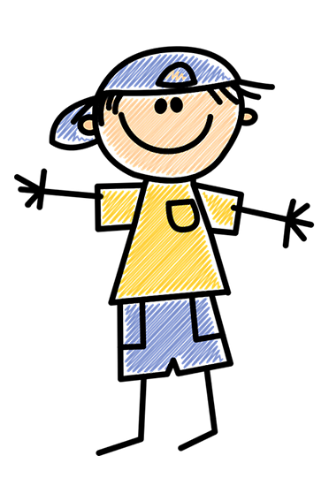


Slide 9
TITLE HERE
Did you know that pandas don’t hibernate?
When winter approaches, they head lower down their mountain homes to warmer temperatures, where they continue to chomp away on bamboo!

Slide 10
THANK YOU!
Slides: SlidesMania
FONTS USED:
Amatic+SC
Pangolin

