Slide 1
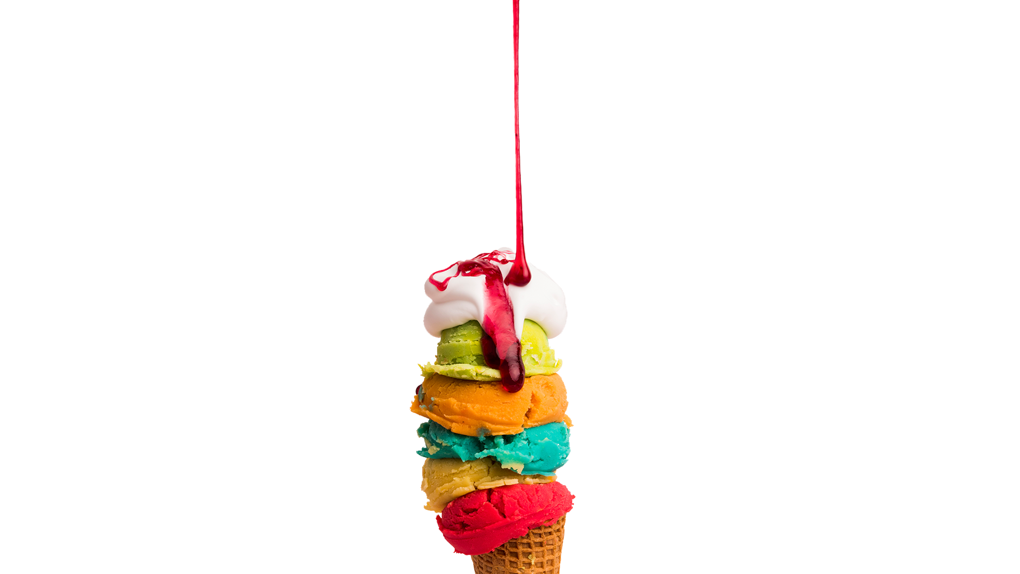
VEGAN ICE CREAM
Here is where your
presentation begins

Slide 2
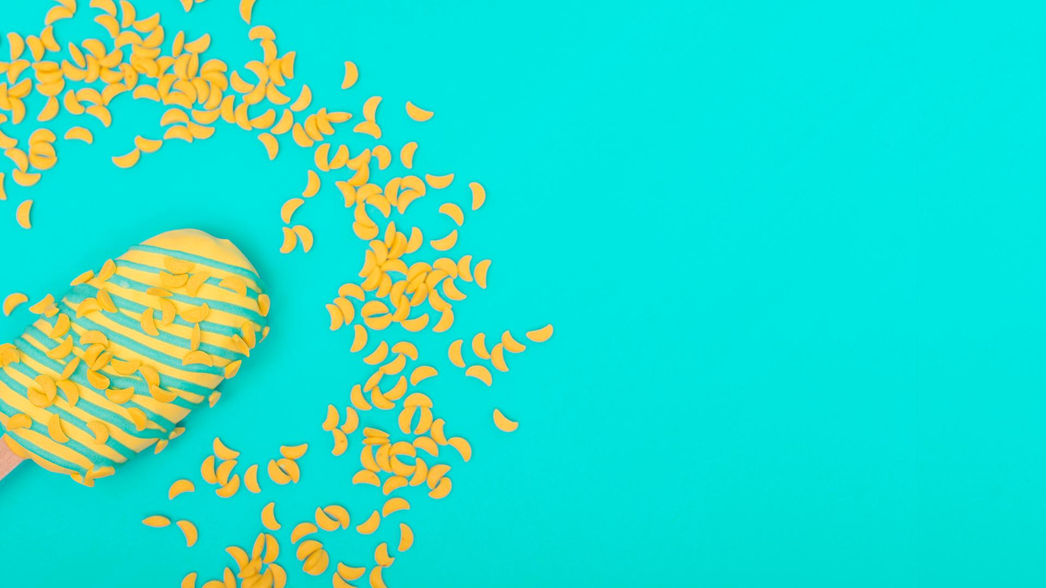
CONTENTS
1. ABOUT OUR COMPANY
2. OUR PRODUCTS
3. OUR CLIENTS
4. EXPECTED PROJECTION
Here you could describe the topic of the section
Here you could describe the topic of the section
Here you could describe the topic of the section
Here you could describe the topic of the section

Slide 3
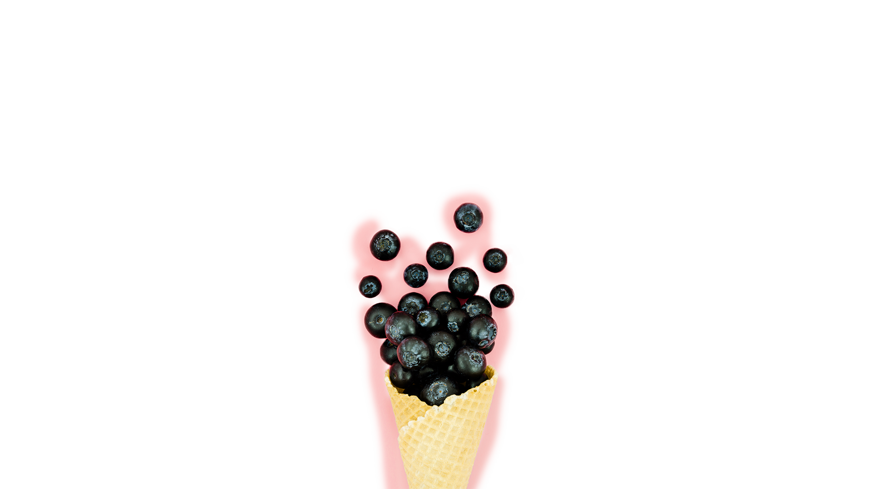
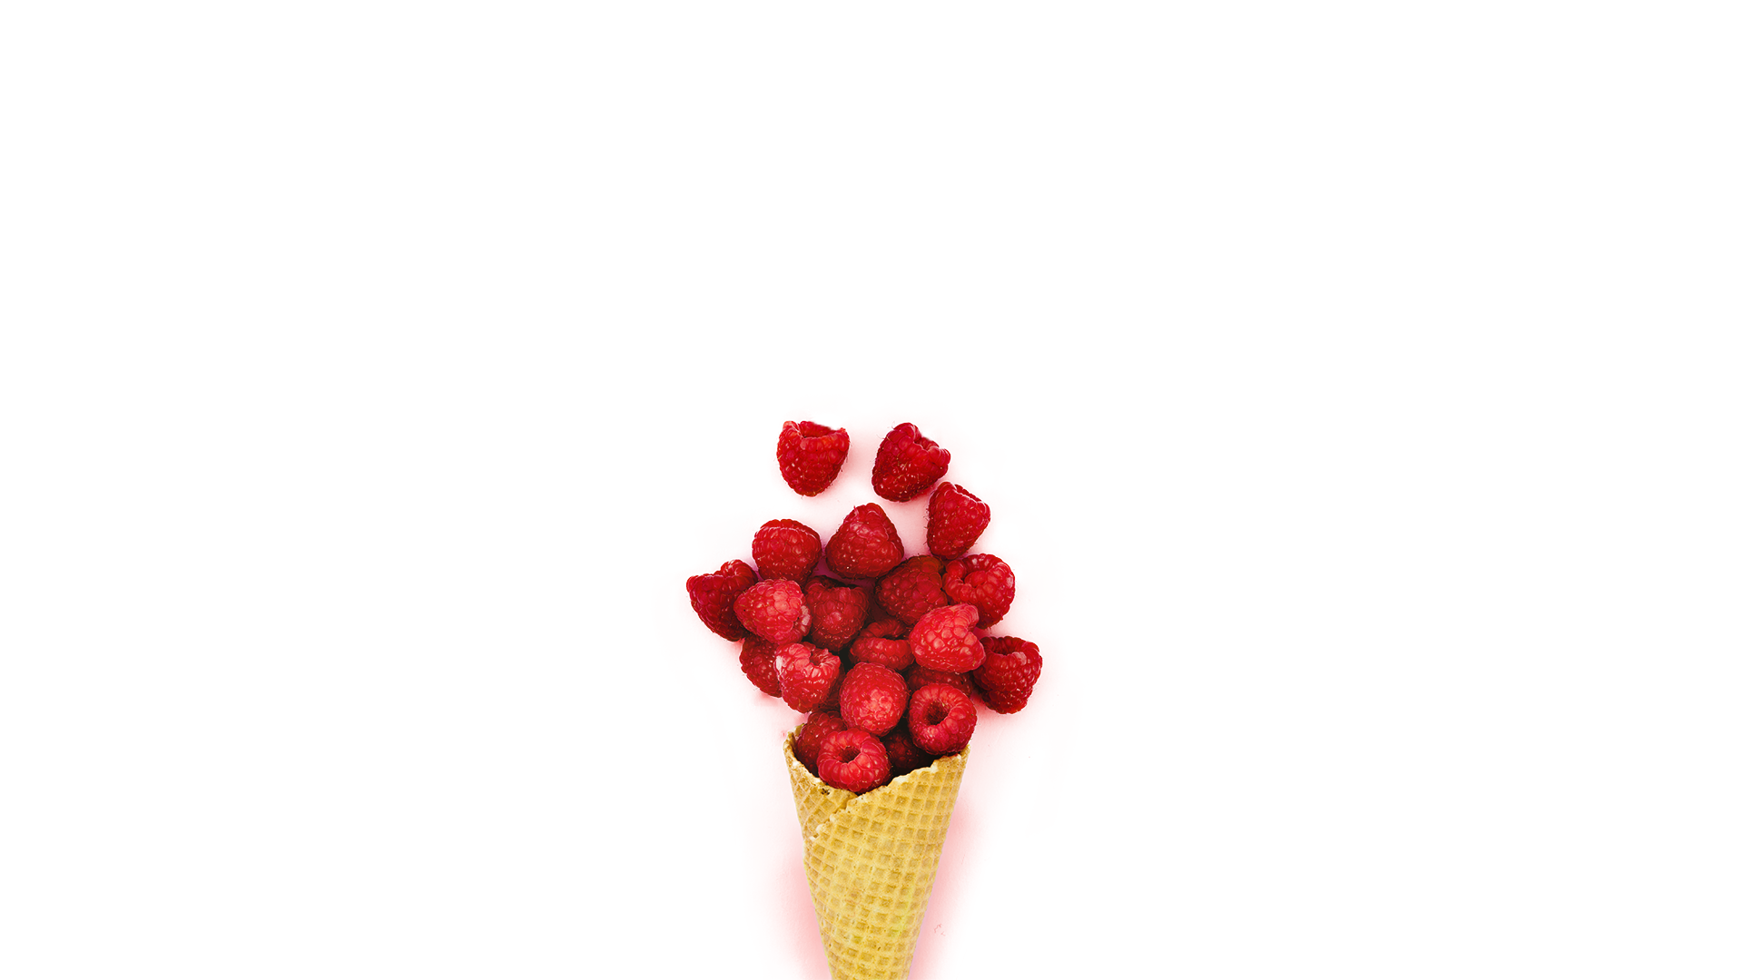
ABOUT US
Mercury is the closest planet to the Sun and the smallest one in the Solar System—it’s only a bit larger than our Moon. The planet’s name has nothing to do with the liquid metal since it was named after the Roman messenger god, Mercury

Slide 4
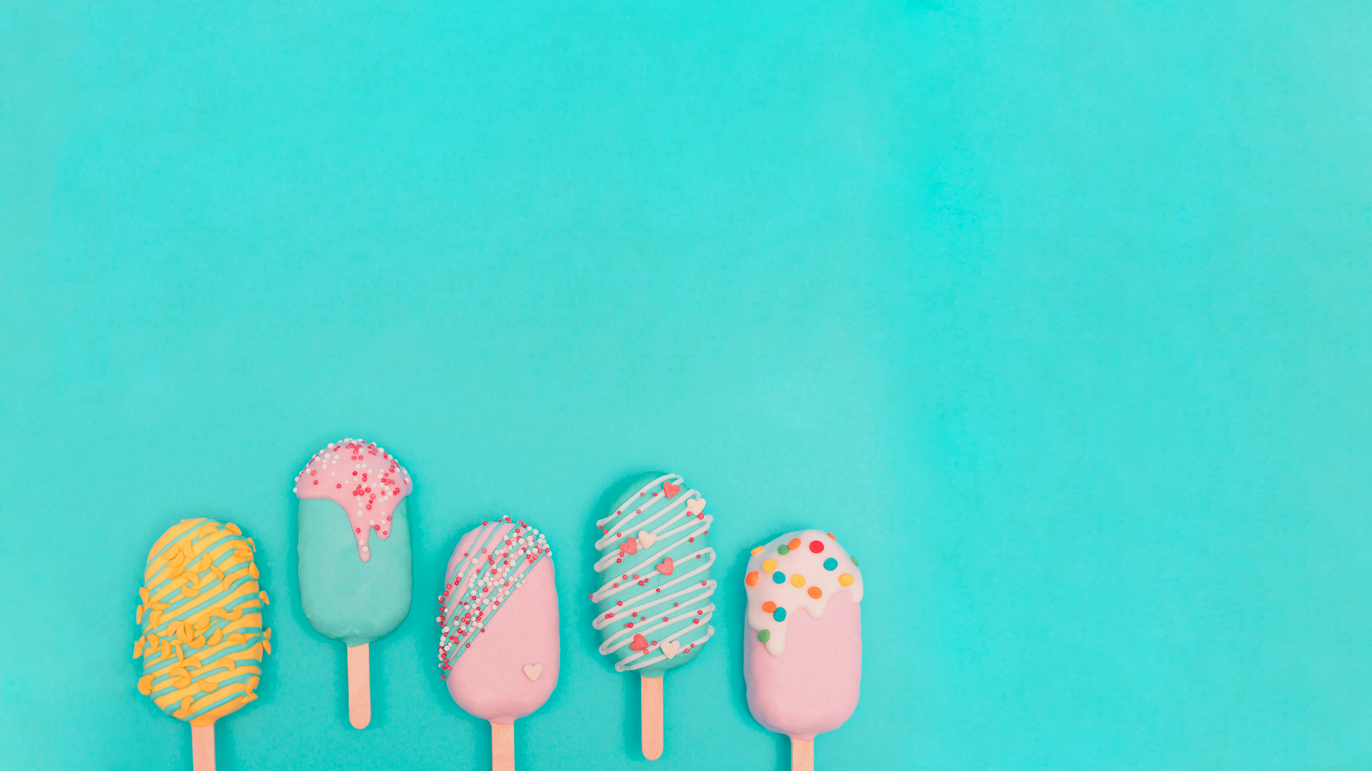
OUR STORY
2008
2018
Despite being red, Mars is a cold place, not hot
Mercury is the smallest planet in our Solar System
2005
2015
Jupiter is a gas giant and the biggest planet in our Solar System
Saturn is composed mostly of hydrogen and helium
AND STILL GOING STRONG!

Slide 5
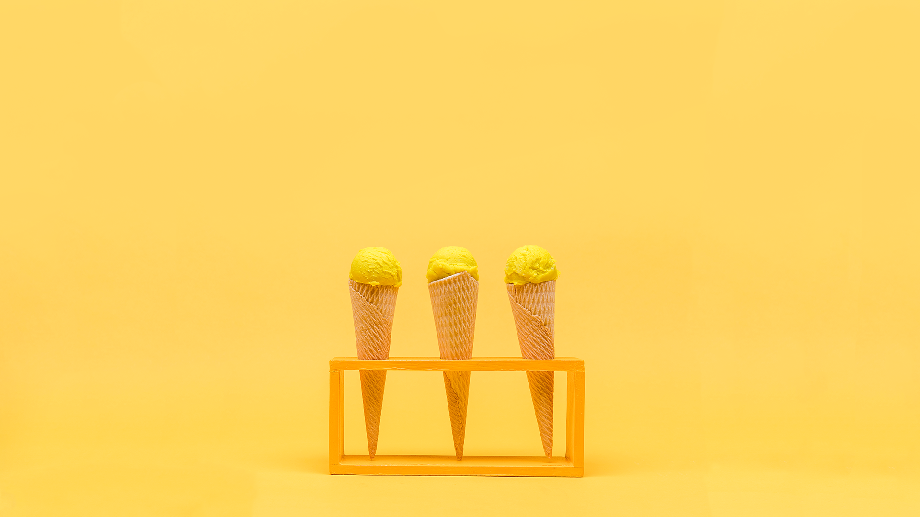
OUR PHILOSOPHY
VISSION
VALUES
MISSION
Neptune is the farthest planet from the Sun and the fourth-largest by diameter in our Solar System
Despite being red, Mars is a cold place, not hot. It’s full of iron oxide dust, which gives the planet its reddish cast
Neptune is the farthest planet from the Sun and the fourth-largest by diameter in our Solar System

Slide 6
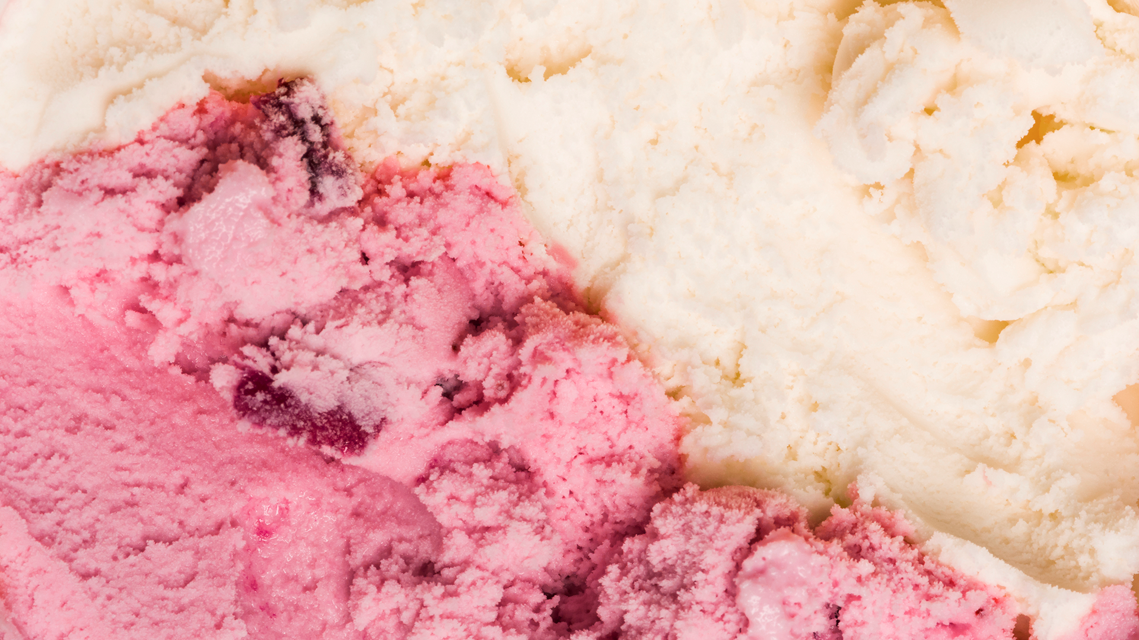
“This is a quote. Words full of wisdom that someone important said and can make the reader get inspired.”
—SOMEONE FAMOUS

Slide 7
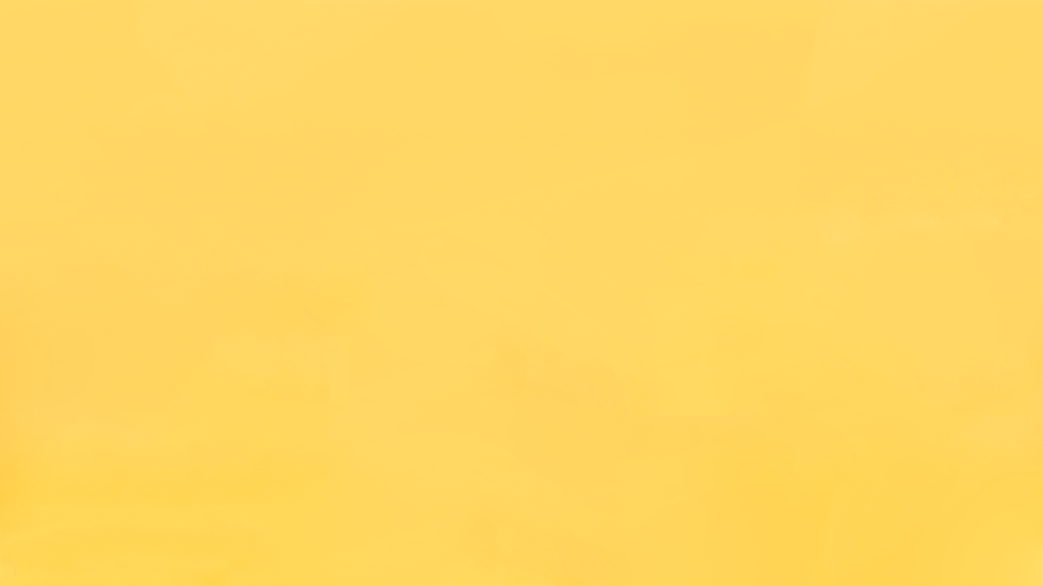
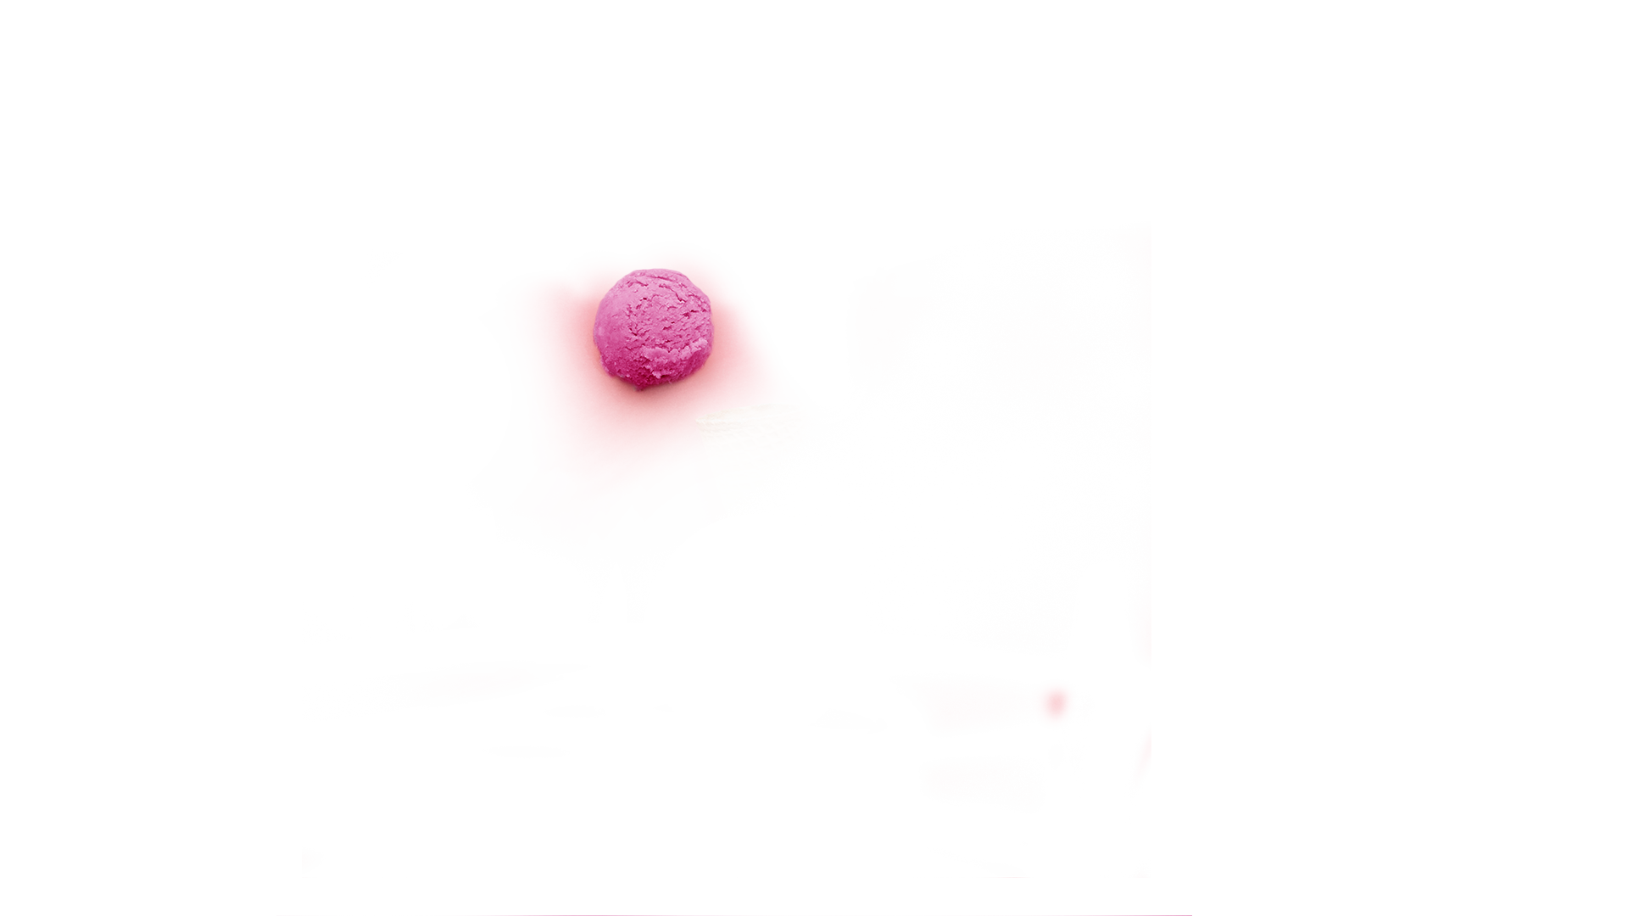
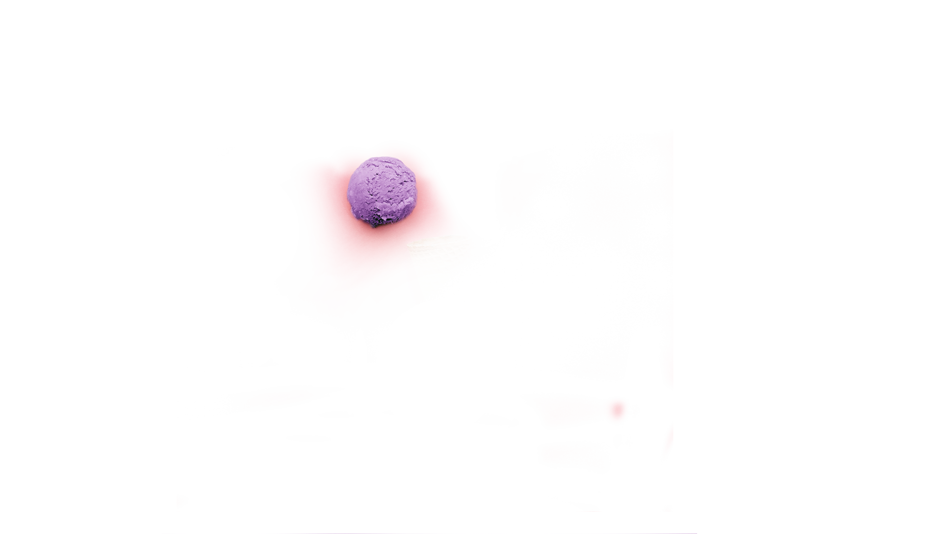
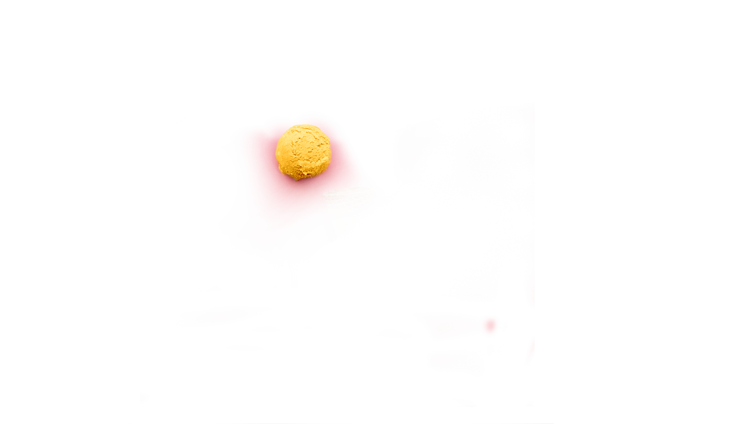
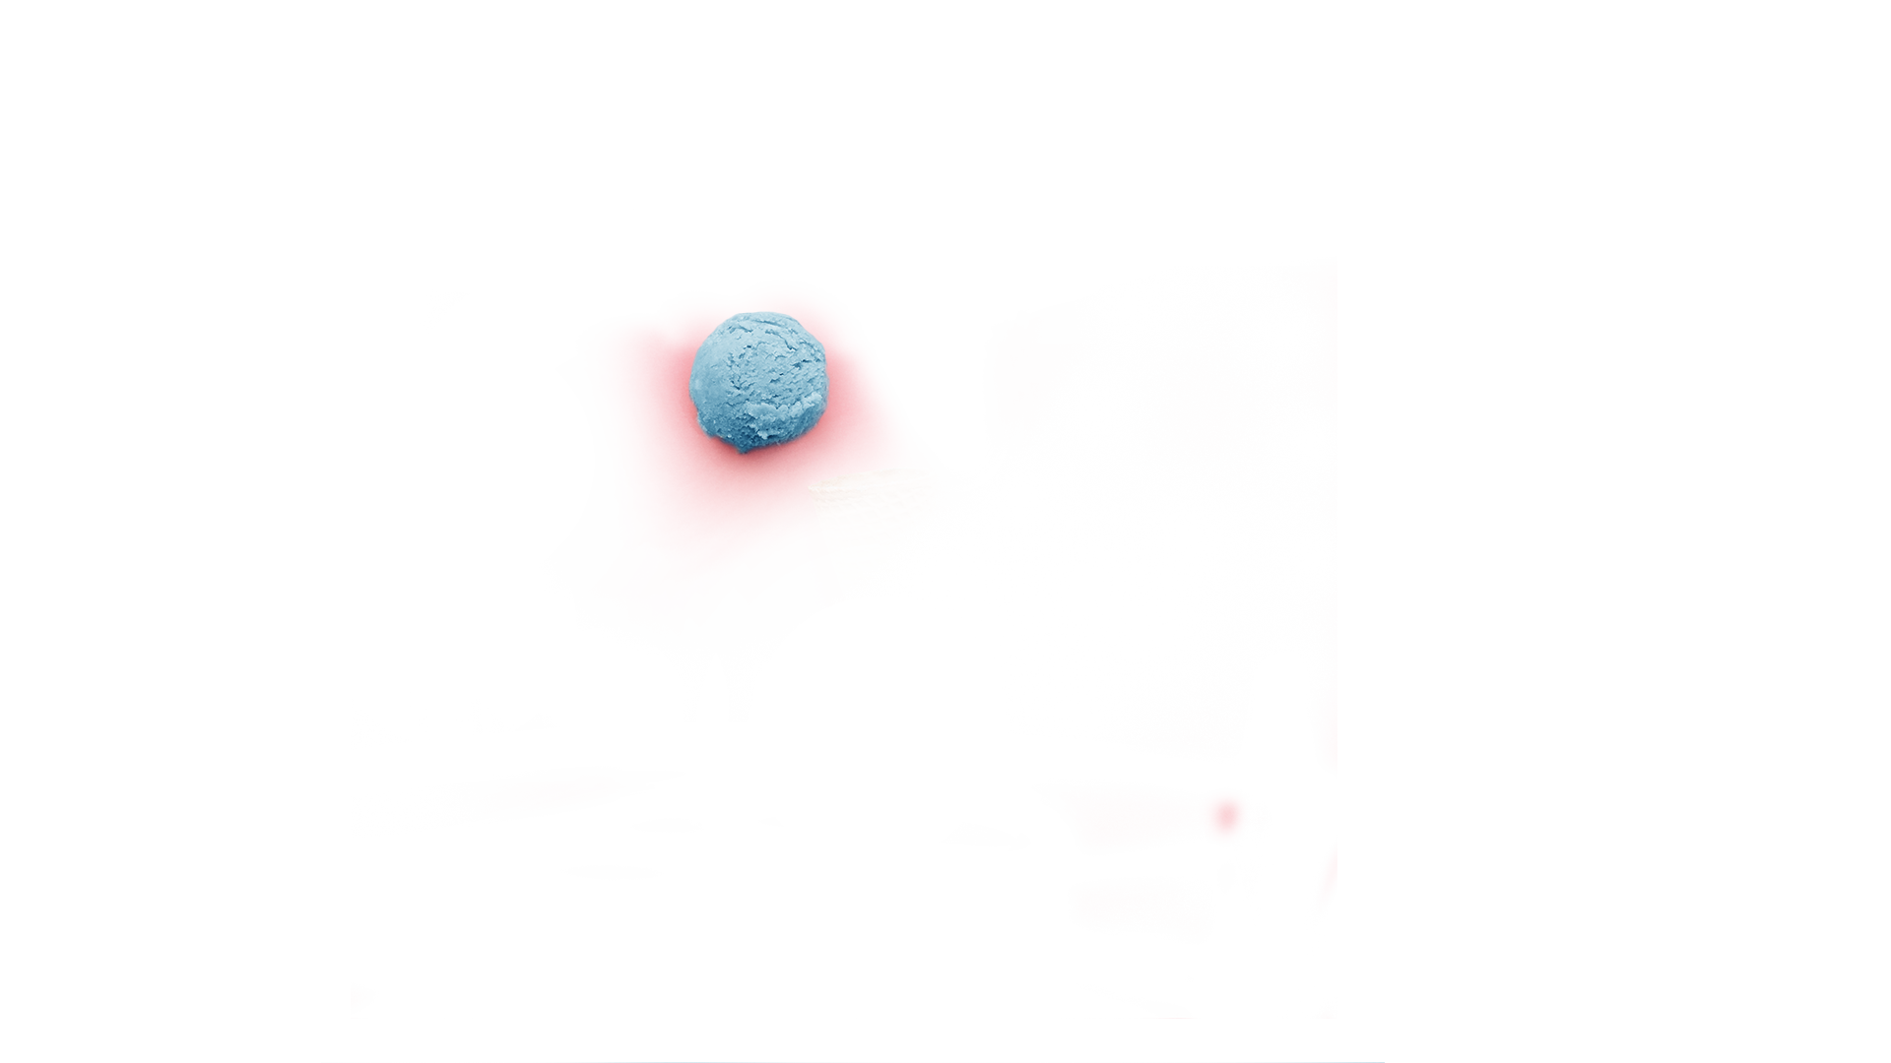
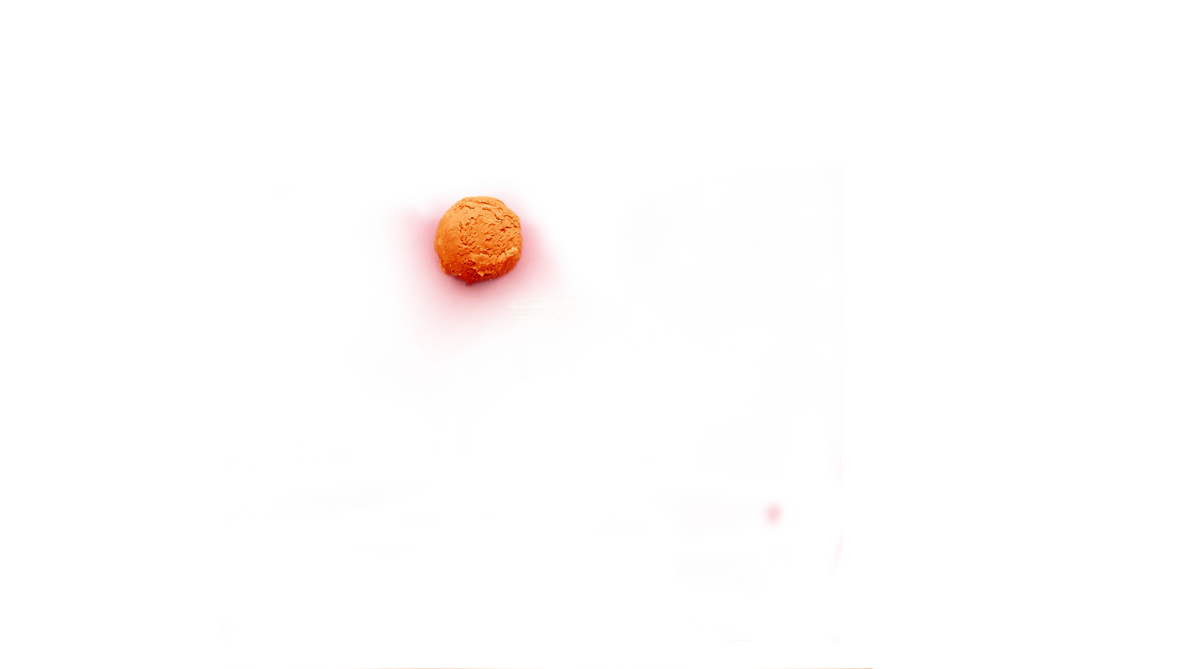
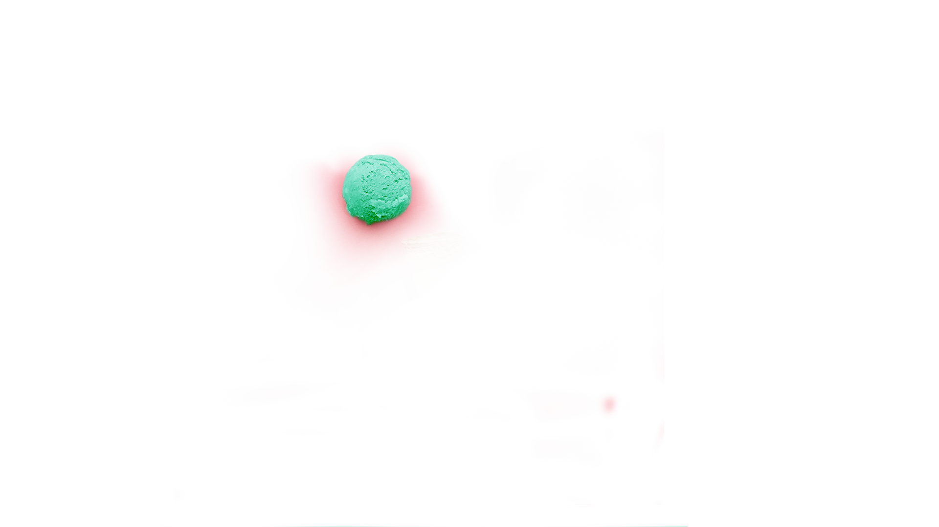
LOCATIONS
Ice-cream parlors
Department stores
Shopping malls
Ice-cream vans
These are the locations where you can find all our retailers and offices around the U.S.
Our offices

Slide 8
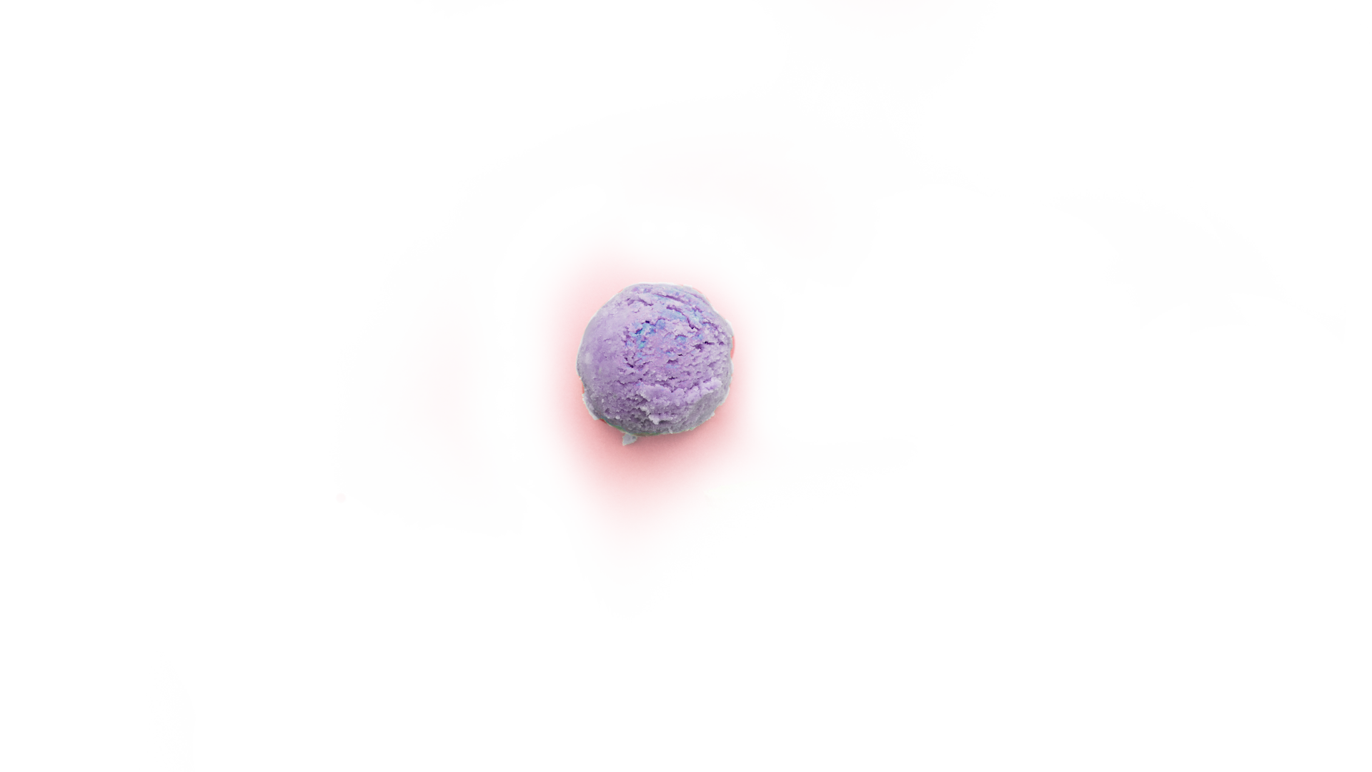
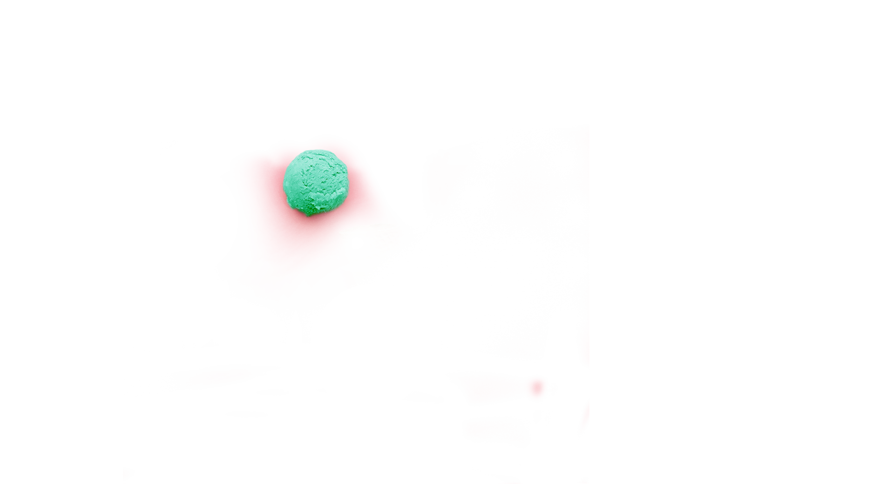
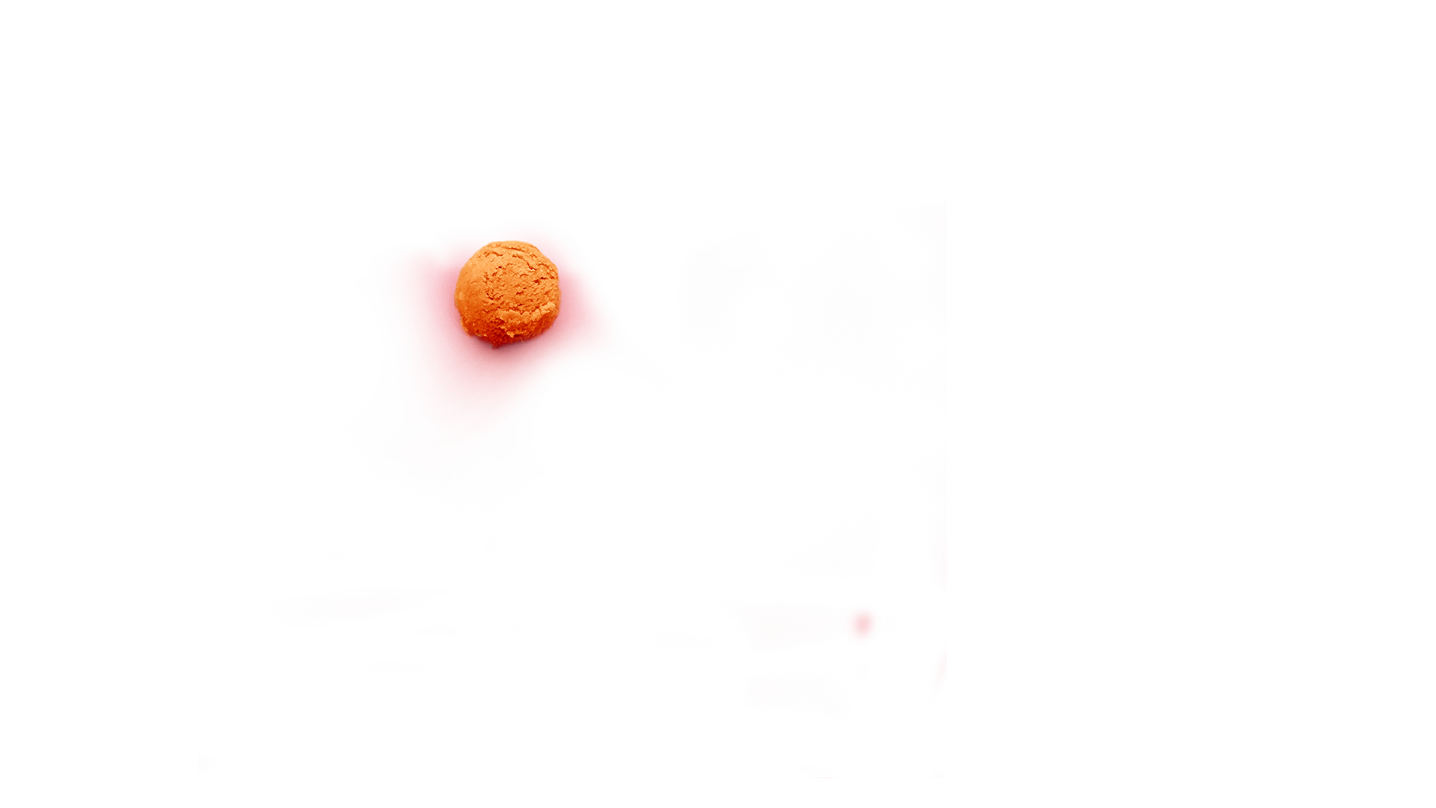
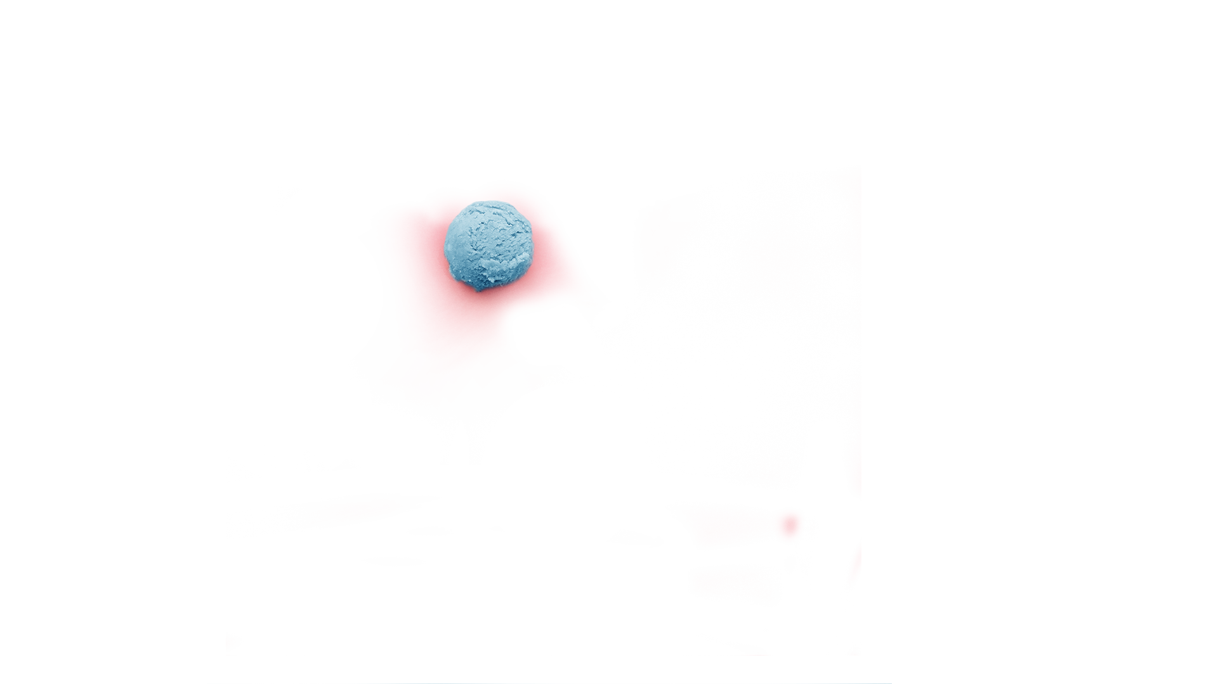
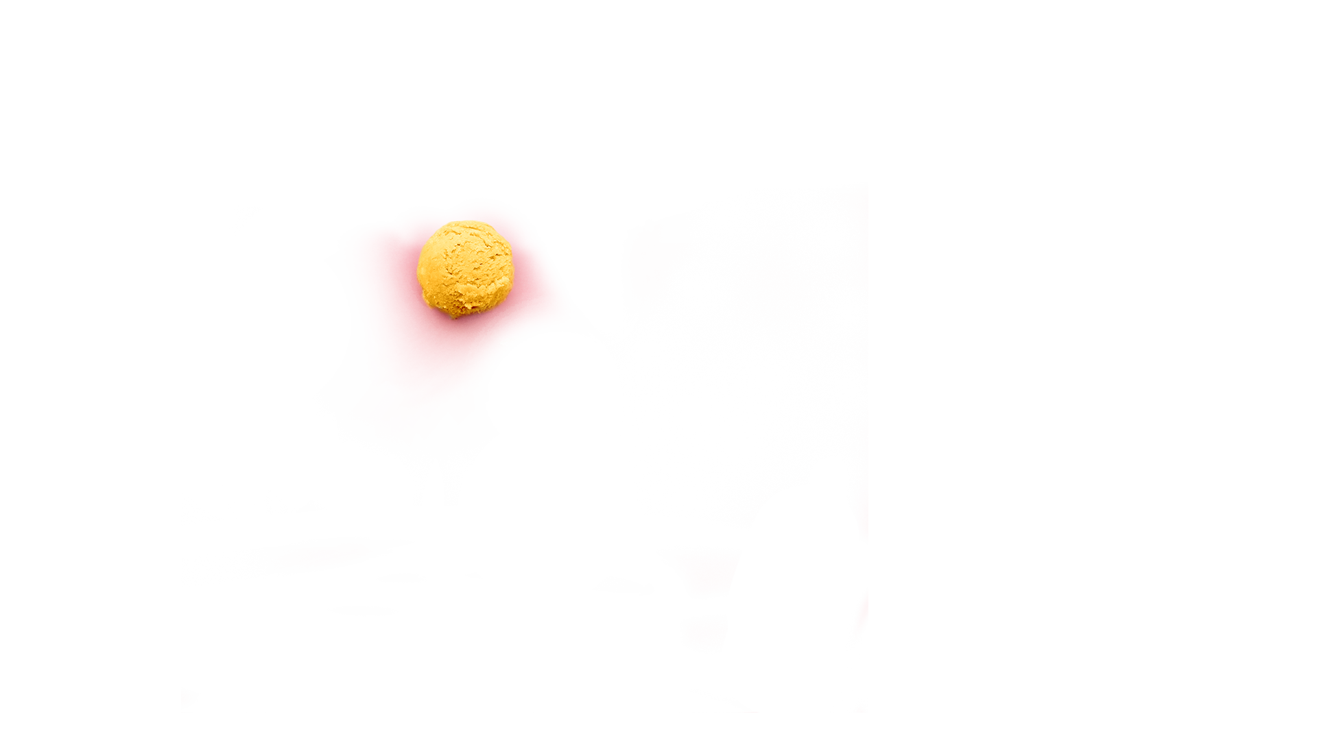
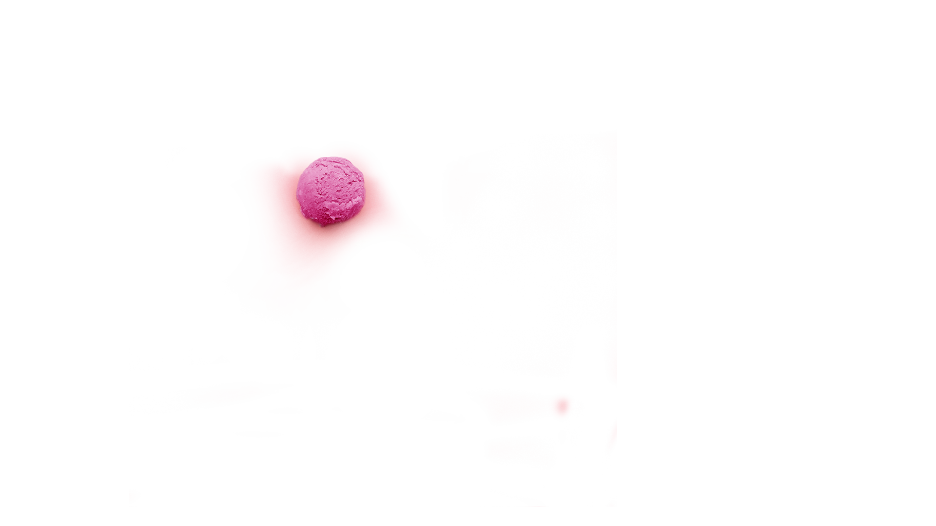
OUR PRODUCTS
Jupiter is the biggest planet in our Solar System
Mercury is the closest planet to the Sun
Venus has a beautiful name, but it’s terribly hot
Saturn is composed mostly of hydrogen and helium
Despite being red, Mars is a cold place, not hot
Neptune is the farthest planet from the Sun

Slide 9

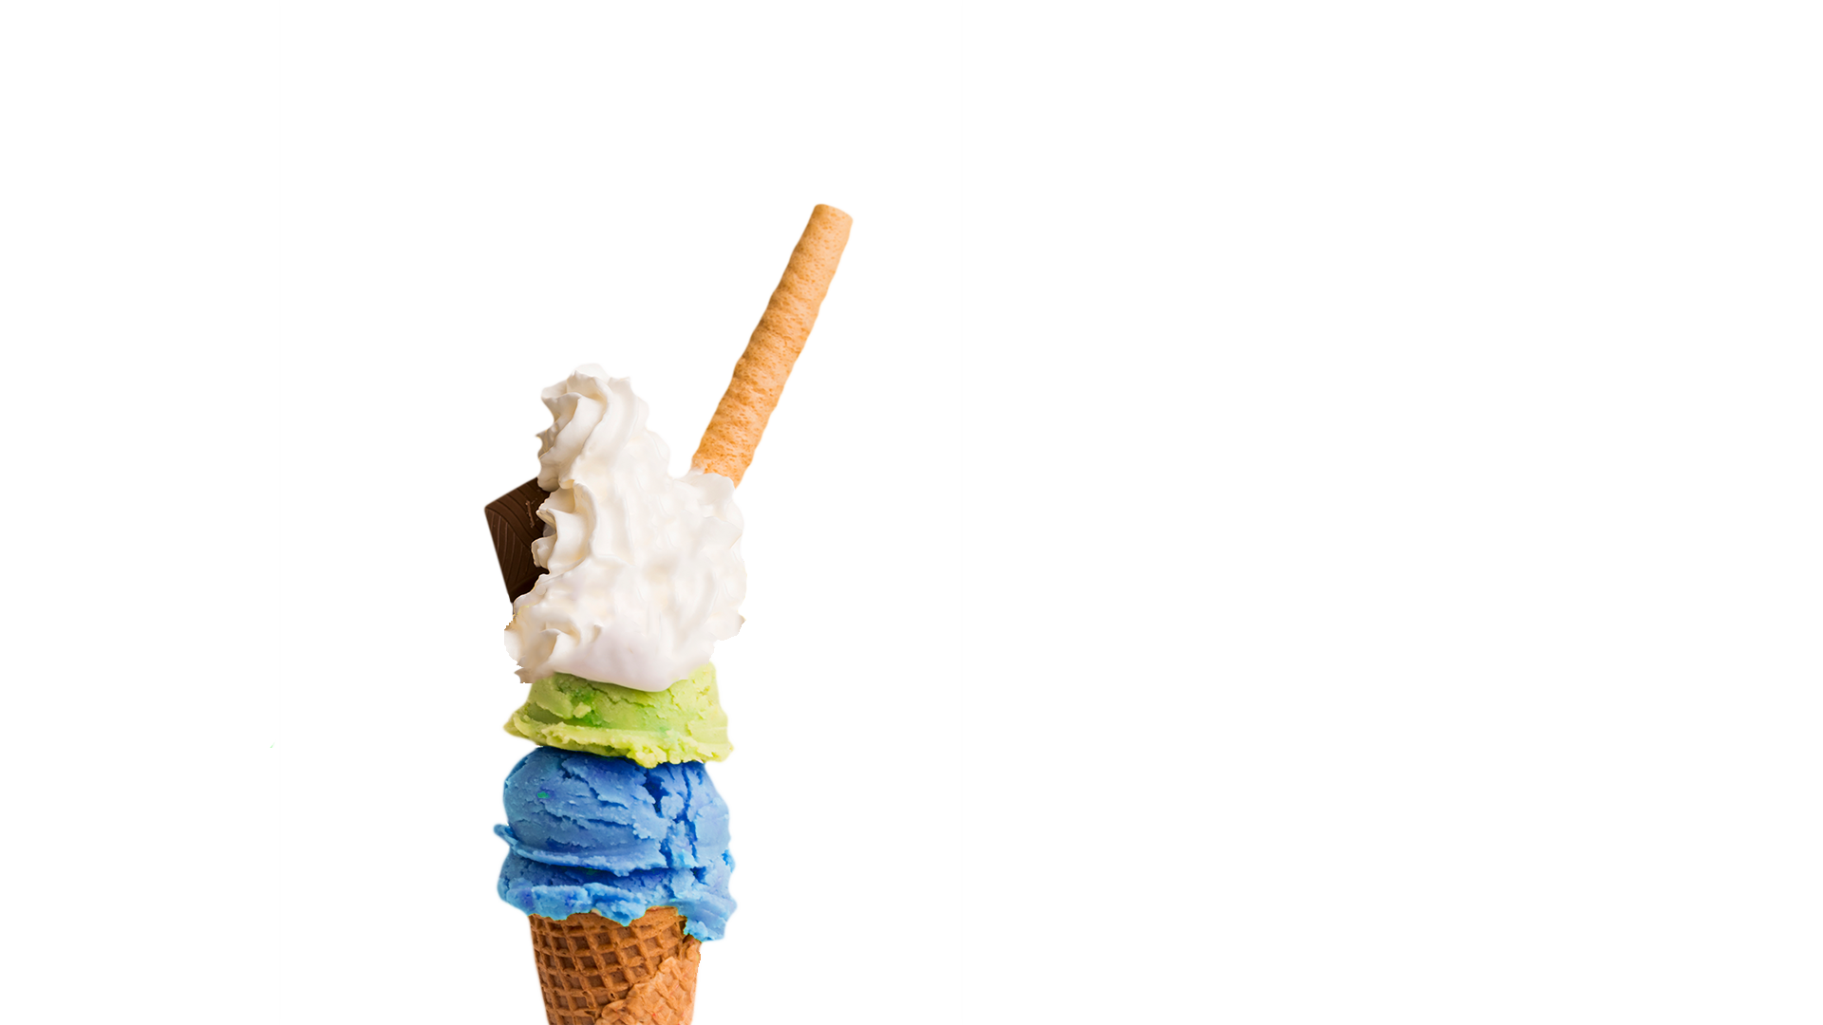
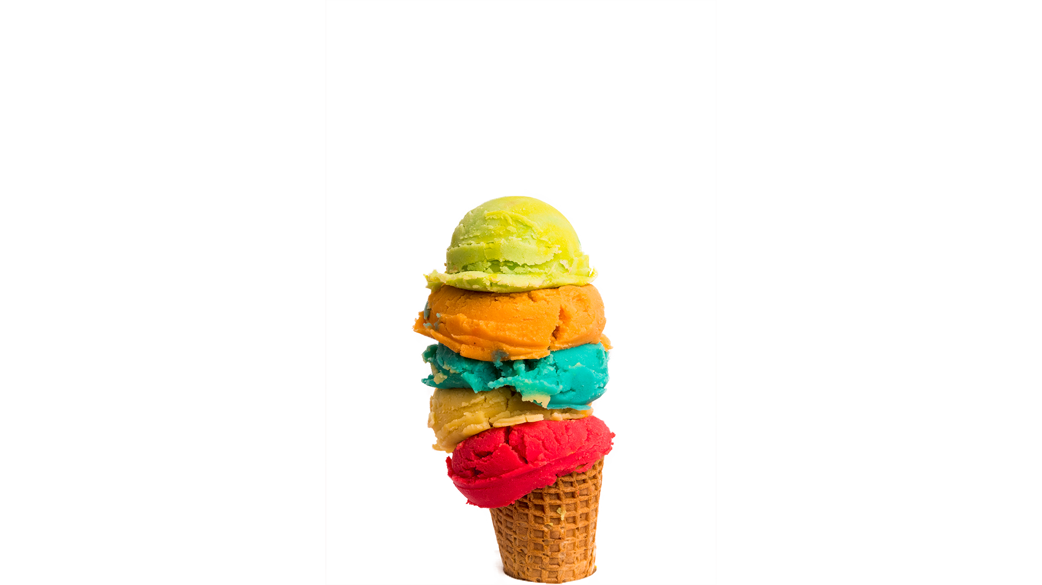
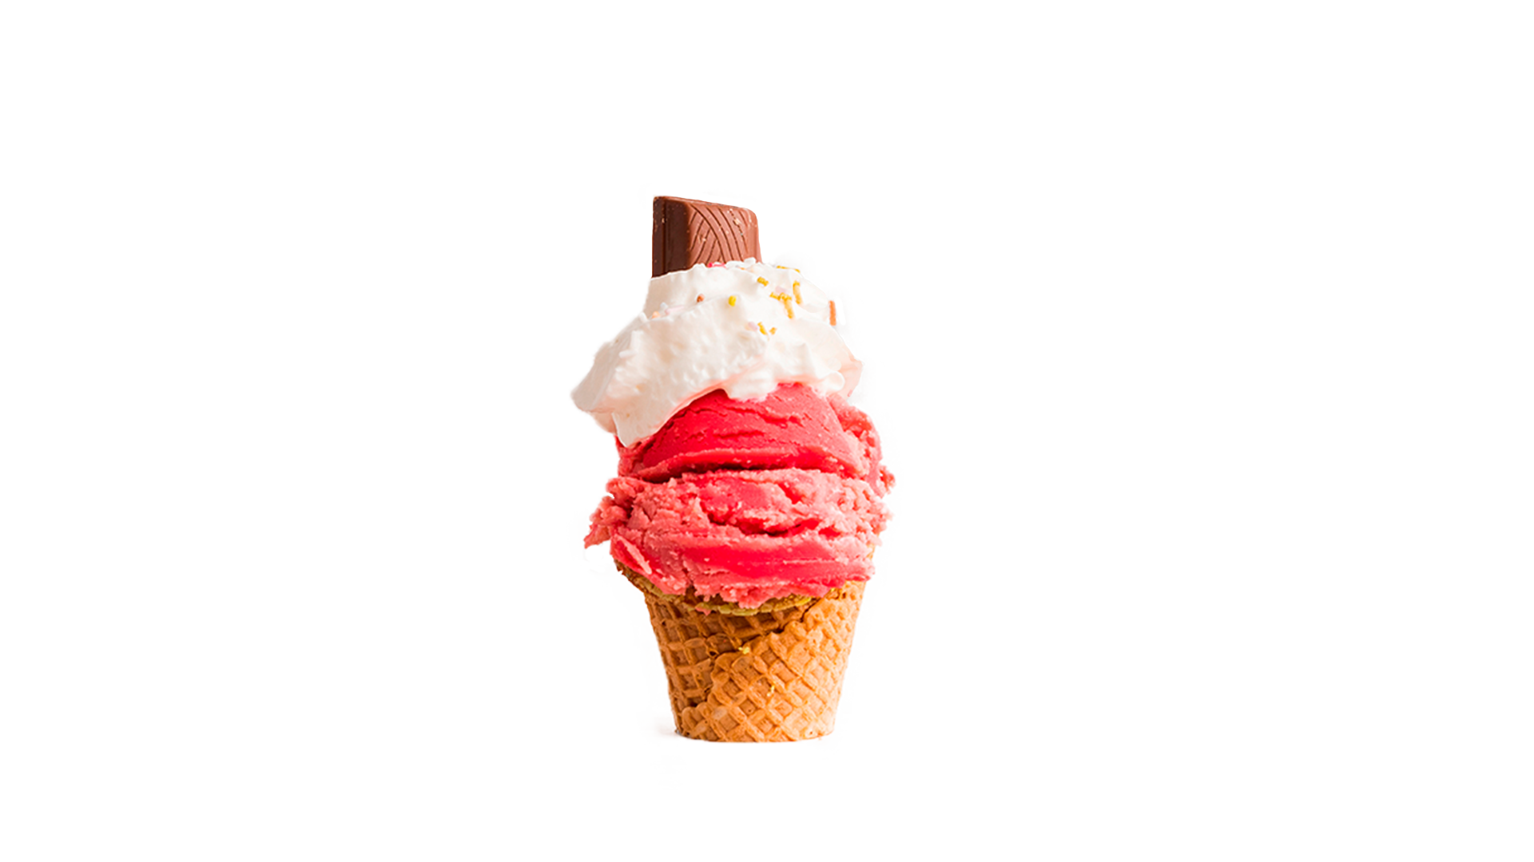
BEST SELLERS
HULKOLATE
ICEVENGERS
STARKBERRY
Venus has a beautiful name and is the second planet from the Sun. It’s terribly hot and its atmosphere is extremely poisonous
Despite being red, Mars is a cold place, not hot. It’s full of iron oxide dust, which gives the planet its reddish cast
Mercury is the closest planet to the Sun and the smallest one in our Solar System. It’s only a bit larger than our Moon

Slide 10
OUR STRENGTHS
SOY CREAM
100% CHOCOLATE
SOY MILK
EXOTIC FLAVORS
Jupiter is a gas giant and the biggest planet in our Solar System. It’s also the fourth-brightest object in the sky
Mercury is the closest planet to the Sun and the smallest one in our Solar System. It’s only a bit larger than our Moon
Despite being red, Mars is a cold place, not hot. It’s full of iron oxide dust, which gives the planet its reddish cast
Saturn is the ringed one. It’s a gas giant, composed mostly of hydrogen and helium. It’s named after the Roman god of agriculture

Slide 11
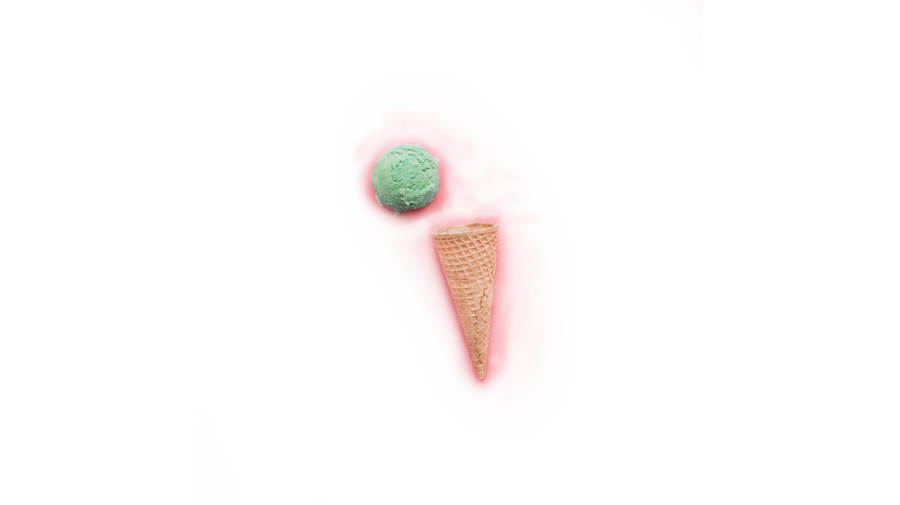
CUSTOMER PROFILE
GENDER & AGE
75%
25%
INTERESTS
PREFERENCES
FLAVORS
65%
35%
45%
15-35
1 scoop vs. 3 scoops
Vanilla
50%
50%
30%
35-55
Cup vs. cone
Blackberry
55%
45%
25%
55-85
Scoop vs. soft serve
Strawberry

Slide 12
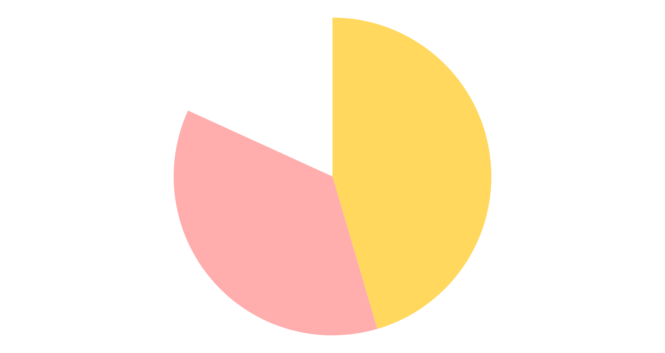
OUR NUMBERS
BUDGET
ADVERTISING
INGREDIENTS
LOGISTICS
2500
100%
Daily customers
Satisfied customers
$10
20
Spend per customer
Locations
75
15
If you want to modify this graph, click on it, follow the link, change the data and replace it
Retailers and shops
Ice-cream vans

Slide 13
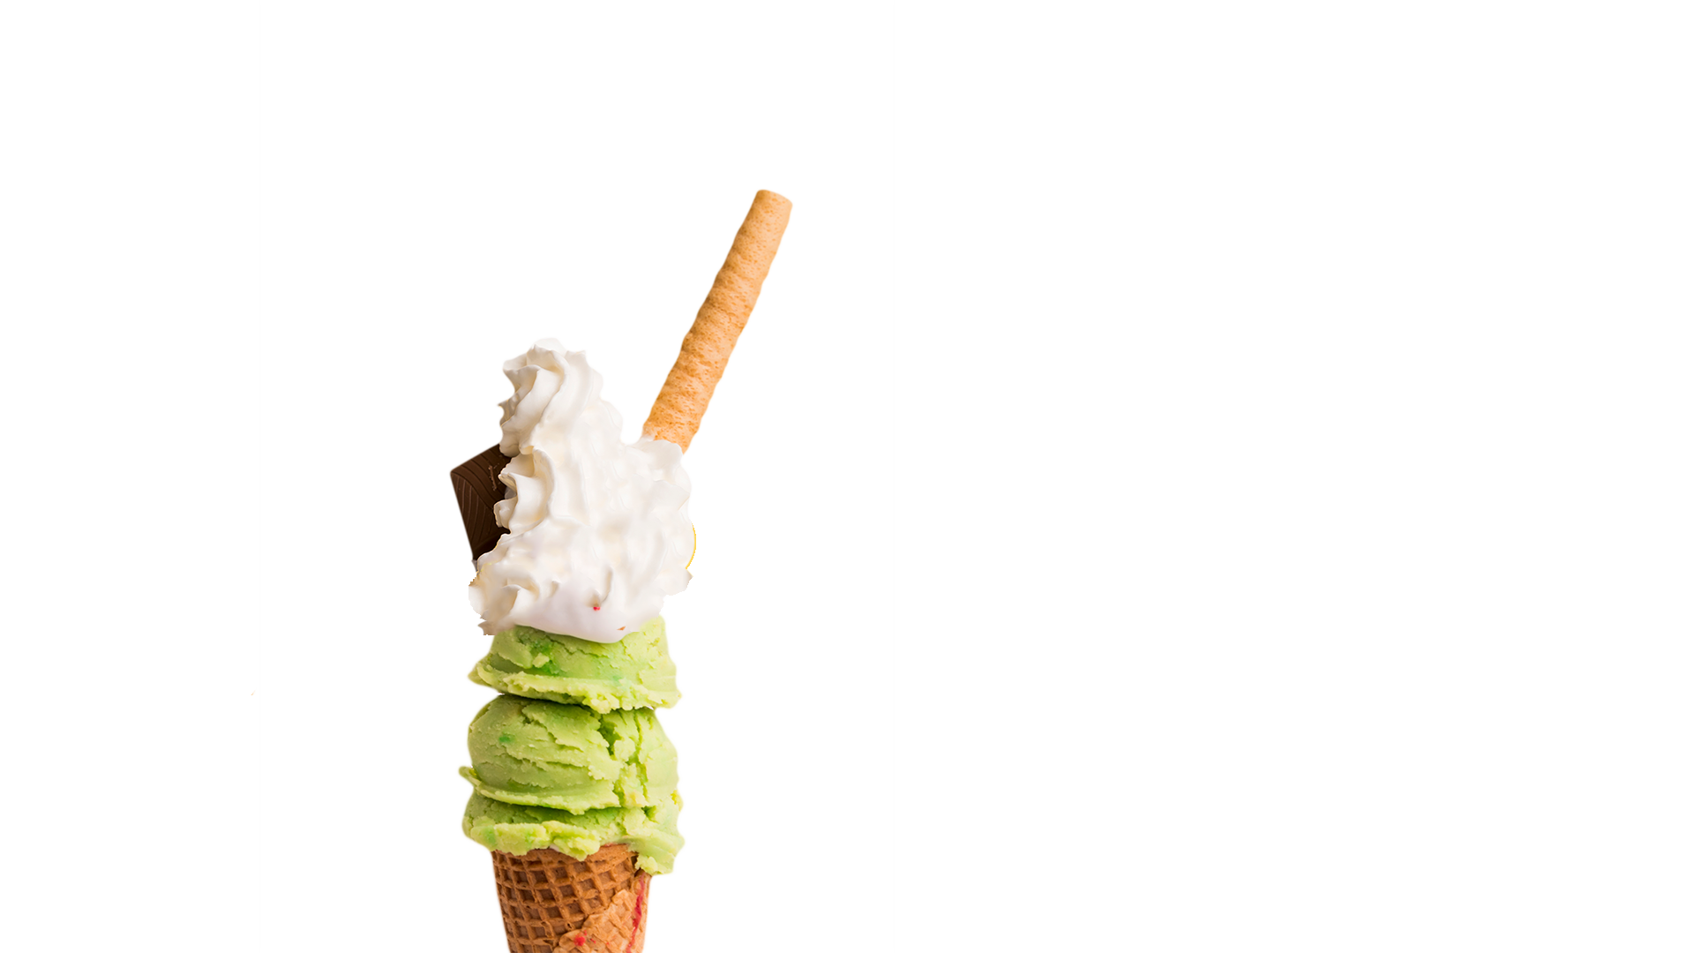
OUR GROWTH
$200,000
Expected income for 2020
150
New retailers next semester
100
New employees next year

Slide 14
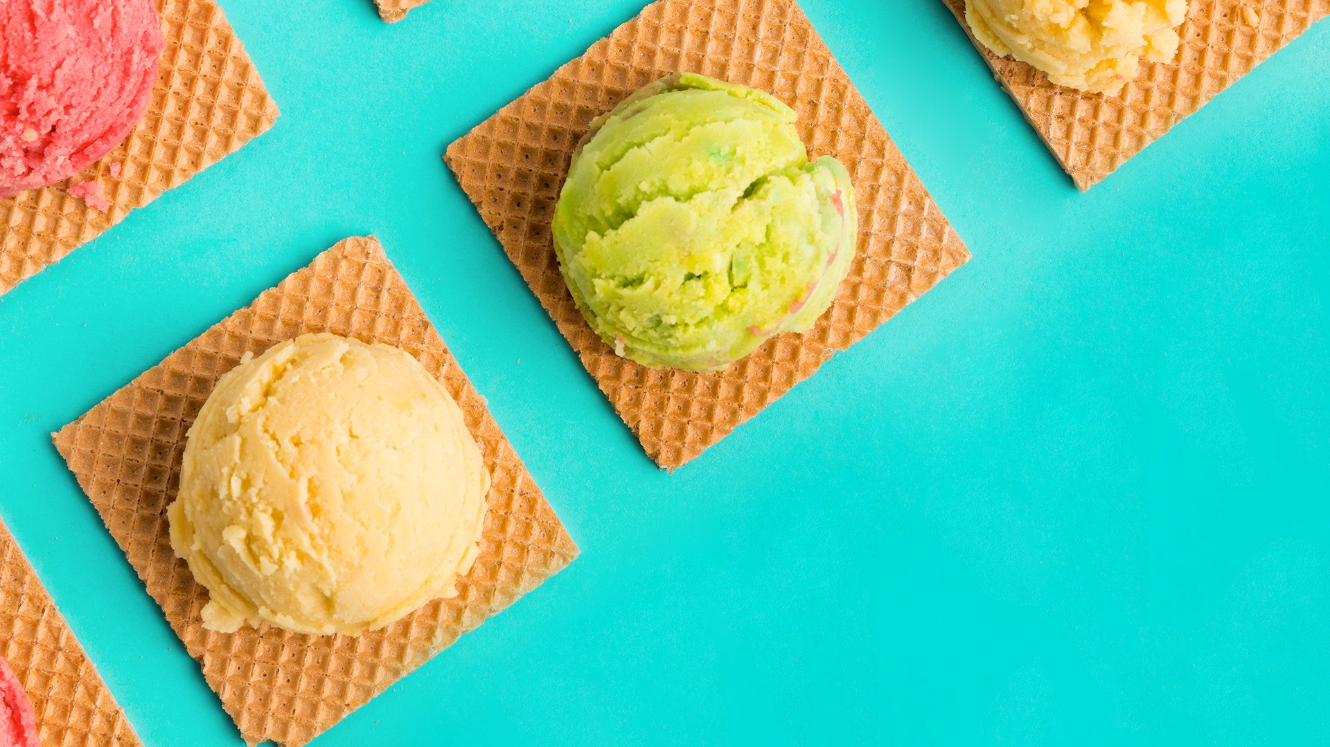
FUTURE PROJECTS
Mercury is the closest planet to the Sun and the smallest one in the Solar System—it’s only a bit larger than our Moon. The planet’s name has nothing to do with the liquid metal, since it was named after the Roman messenger god, Mercury

Slide 15
CUSTOMER TESTIMONIALS
ALBERT EVANS, 37
ANNE GOODWYN, 18
RUTH PATTERSON, 25
“Mercury is the closest planet to the Sun and the smallest one in our Solar System”
“Despite being red, Mars is a cold place, not hot. It’s full of iron oxide dust”
“Saturn is the ringed planet. It’s a gas giant, composed mostly of hydrogen and helium”

Slide 16
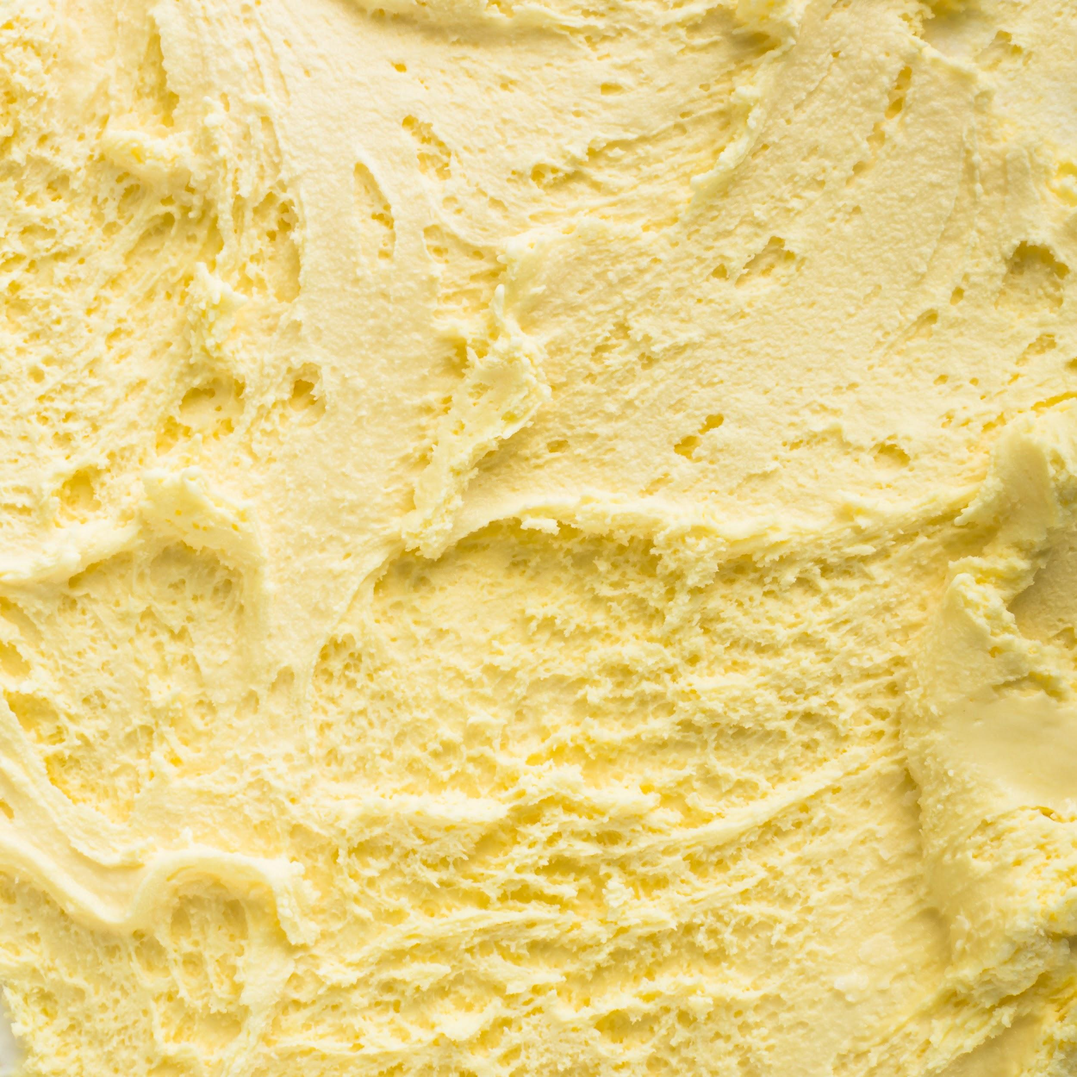
AWARDS
VEGAN PRIZE OF AWESOMENESS
ICEMAN’S PICK
SUMMER’S CHOICE
GOLDEN CONE
Mercury is the closest planet to the Sun and the smallest one in the Solar System
Mercury is the closest planet to the Sun and the smallest one in the Solar System
Mercury is the closest planet to the Sun and the smallest one in the Solar System
Mercury is the closest planet to the Sun and the smallest one in the Solar System

Slide 17
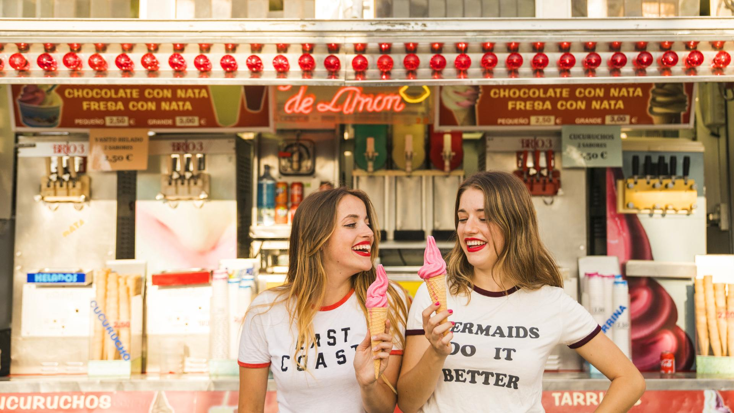
OUR TEAM
CAPTAIN ICE
WINTER CORONEL
Here you could talk a bit about this person
Here you could talk a bit about this person

Slide 18
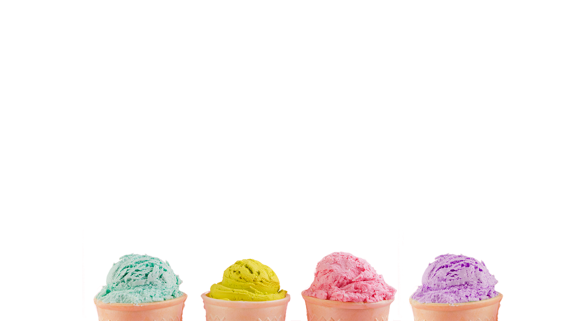
THANKS
Does anyone have any questions?
addyouremail@freepik.com
+91 620 421 838
yourcompany.com
facebook.com/Freepik
@Freepik_Vectors
company/freepik-company

Slide 19
CREDITS
This is where you give credit to the ones who are part of this project.
Did you like the resources on this template? Get them for free at our other websites.
Presentation template by Slidesgo
Icons by Flaticon
Infographics by Freepik
Images created by Freepik
Text & Image slide photo created by Freepik.com

Slide 20
RESOURCE LINKS
PHOTOS
VECTORS
Two happy women holding ice cream at amusement park
Colorful ice cream tower with syrup
Creative cake pop concept
Crispy ice cream cone with blueberry on light surface
Raspberries in waffle cone for ice cream on light background
Creative cake pop concept
Yellow still life of ice cream
Bright ice cream texture
Ice cream background
Various ice cream in sugar cone
Mint and vanilla ice cream in cone
Red frozen ice scoop with with whipped cream and chocolate in cone
Fruit ice cream scoop on square waffles on turquoise surface
Ice cream background II
Multicolored ice cream scoops
Avatars
Ice Cream shop
Lettuce
Statue of liberty
Favorite

Slide 21
Instructions for use
In order to use this template, you must credit Slidesgo by keeping the Credits slide.
You are allowed to:
- Modify this template.
- Use it for both personal and commercial projects.
You are not allowed to:
- Sublicense, sell or rent any of Slidesgo Content (or a modified version of Slidesgo Content).
- Distribute Slidesgo Content unless it has been expressly authorized by Slidesgo.
- Include Slidesgo Content in an online or offline database or file.
- Offer Slidesgo templates (or modified versions of Slidesgo templates) for download.
- Acquire the copyright of Slidesgo Content.
For more information about editing slides, please read our FAQs:
https://slidesgo.com/faqs

Slide 22
Fonts & colors used
This presentation has been made using the following fonts:
Knewave
(https://fonts.google.com/specimen/Knewave)
Barlow Semi Condensed
(https://fonts.google.com/specimen/Barlow+Semi+Condensed)
#ffadad
#ffd85d
#42ddd8
#434343

Slide 23
Use our editable graphic resources...
You can easily resize these resources keeping the quality. To change the color just ungroup the resource and click on the object you want to change. Then click on the paint bucket and select the color you want. Don’t forget to group the resource again when you’re done.

Slide 25
...and our set of editable icons
You can resize these icons keeping the quality.
You can change the stroke and fill color; just select the icon and click on the paint bucket/pen.

Slide 26
Business Icons

Slide 27
Avatar Icons

Slide 28
Creative Process Icons

Slide 29
Educational Process Icons

Slide 30
Help & Support Icons

Slide 31
Medical Icons

Slide 32
Nature Icons

Slide 33
Performing Arts Icons

Slide 34
SEO & Marketing Icons

Slide 35
Teamwork Icons

Slide 36
