Slide 1
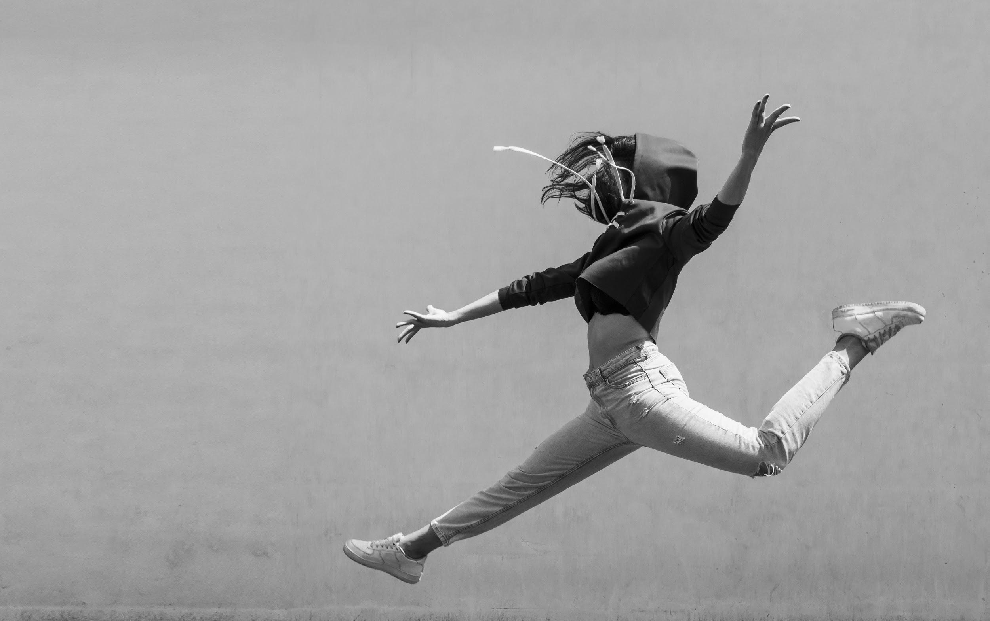
BE DANCE
ACADEMY
HERE IS WHERE YOUR PRESENTATION BEGINS

Slide 2
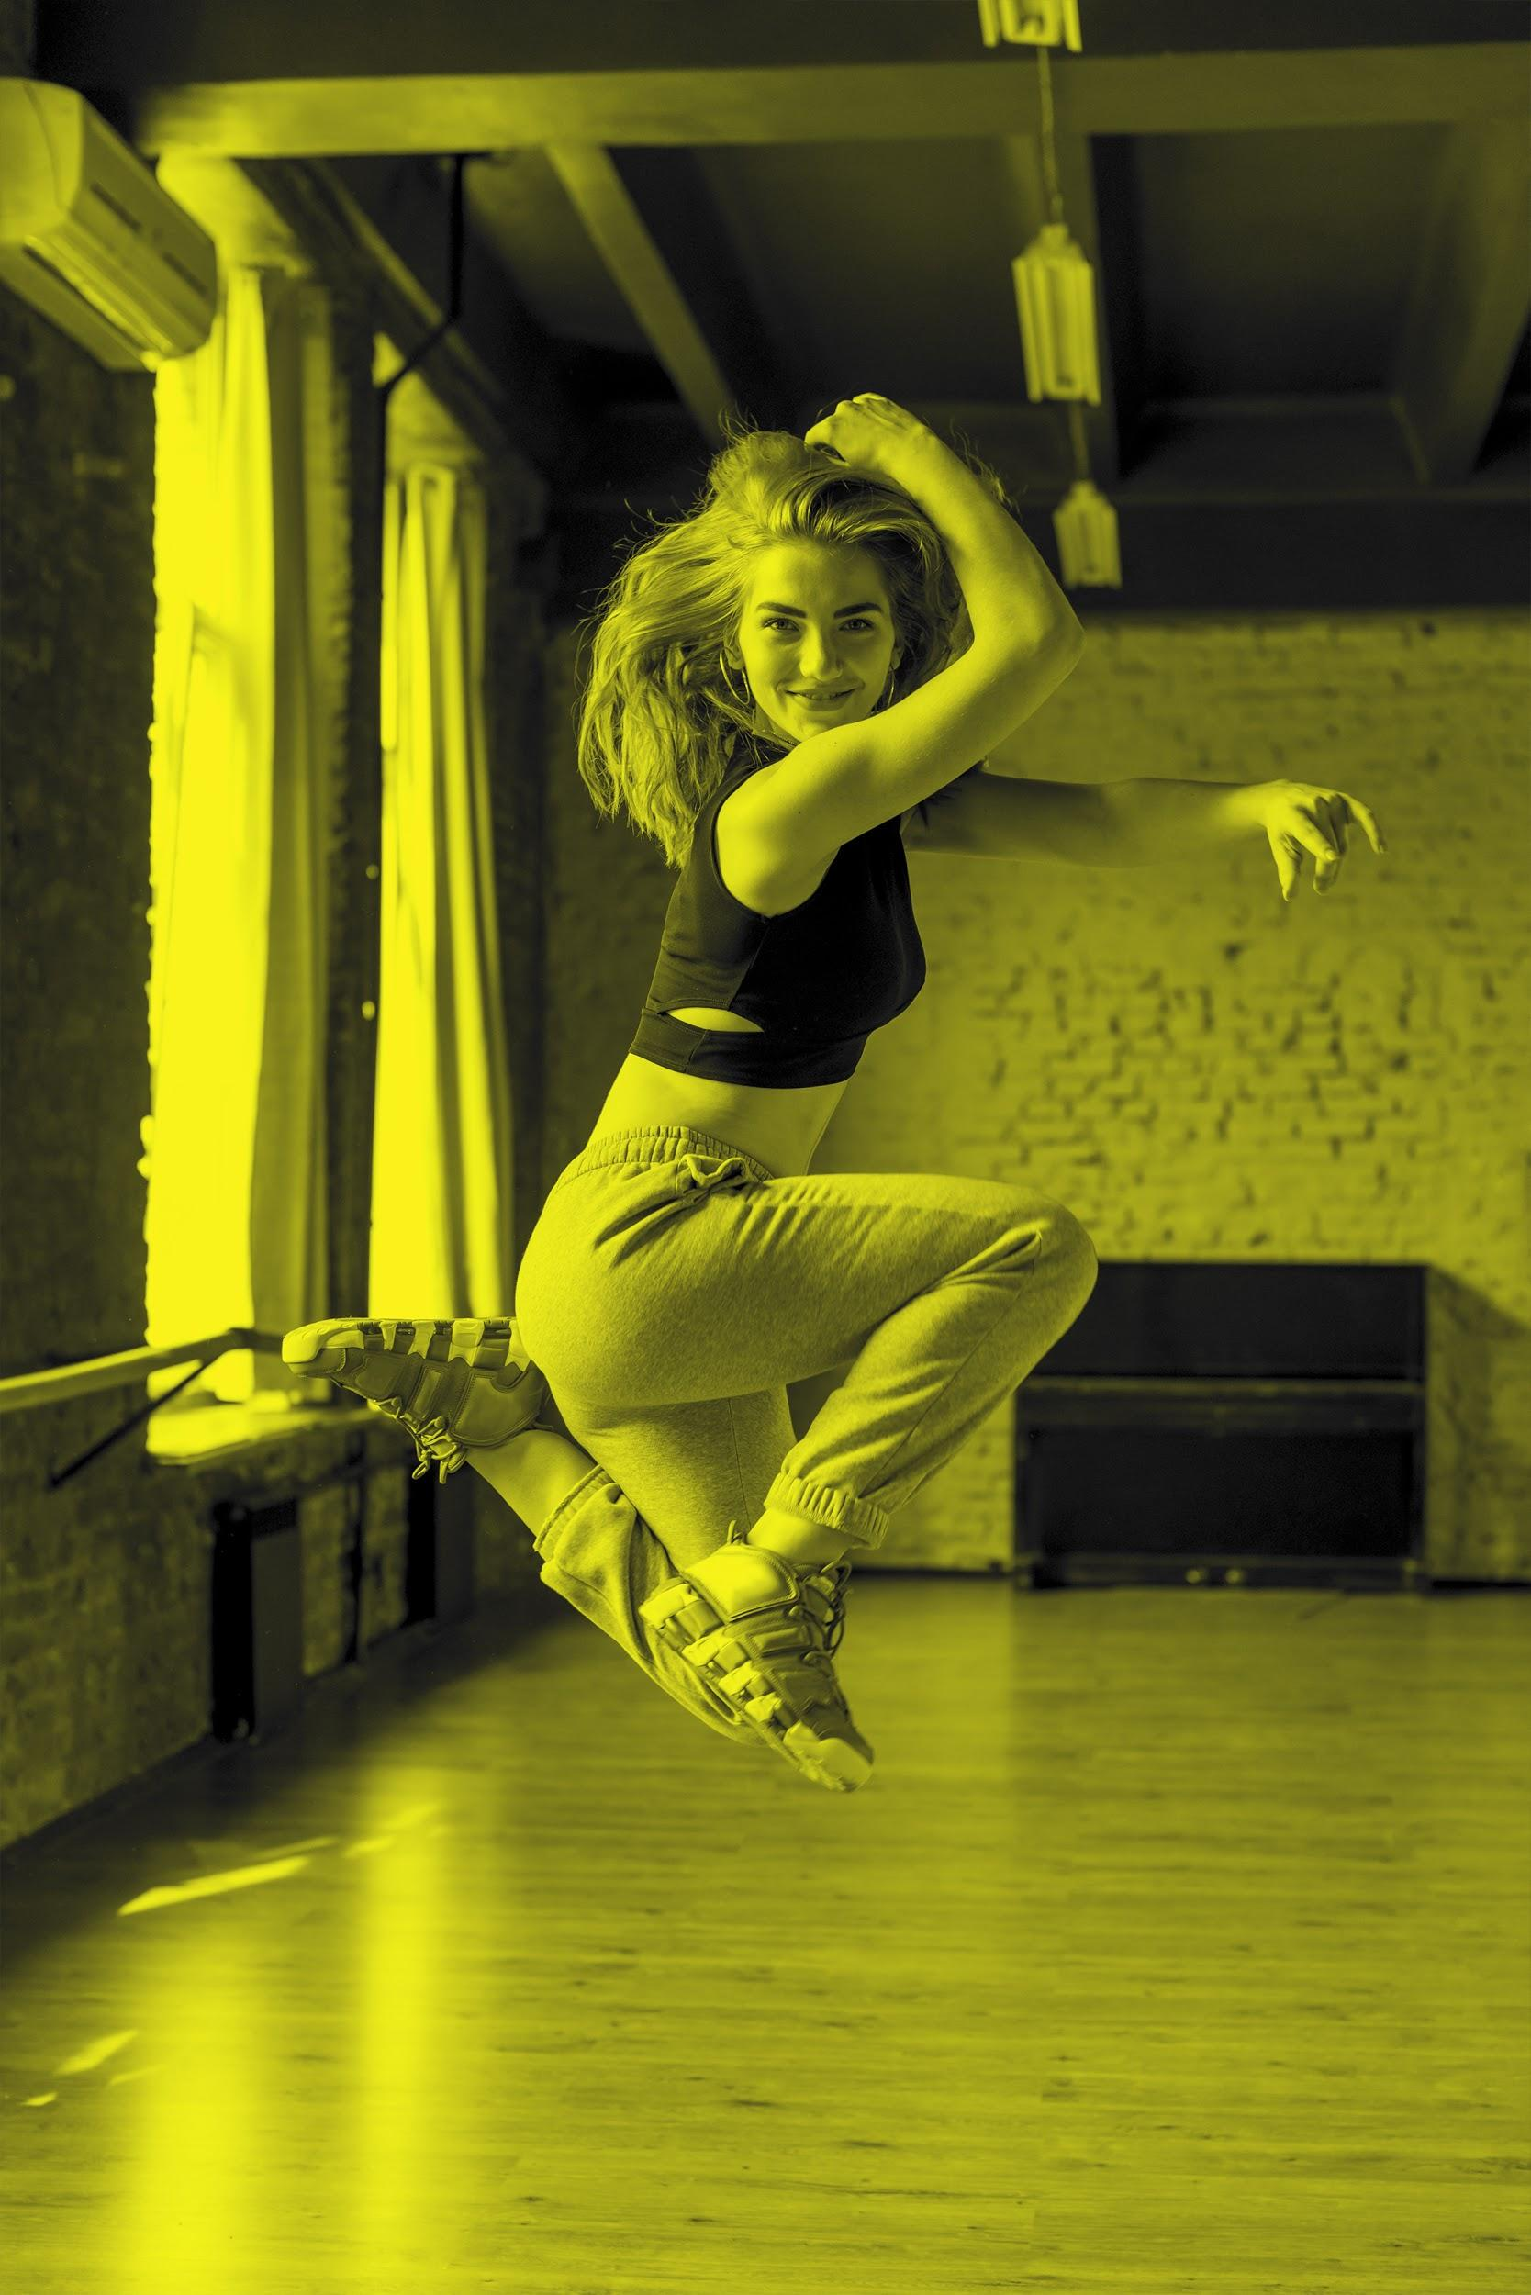
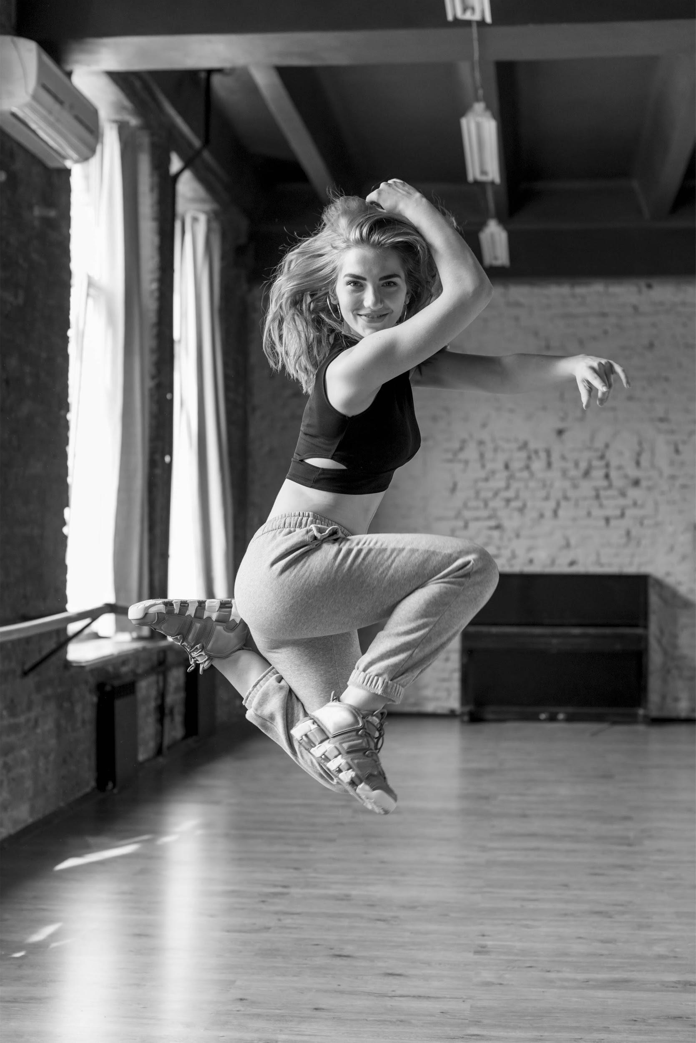
OUR TEACHING METHOD
01
TABLE OF CONTENTS
OUR ACADEMIC AREAS
02
TABLE OF CONTENTS
OUR TEACHERS
03
ENROLLMENT PROCESS
04
Here you could describe the topic of the section
Here you could describe the topic of the section
Here you could describe the topic of the section
Here you could describe the topic of the section

Slide 3
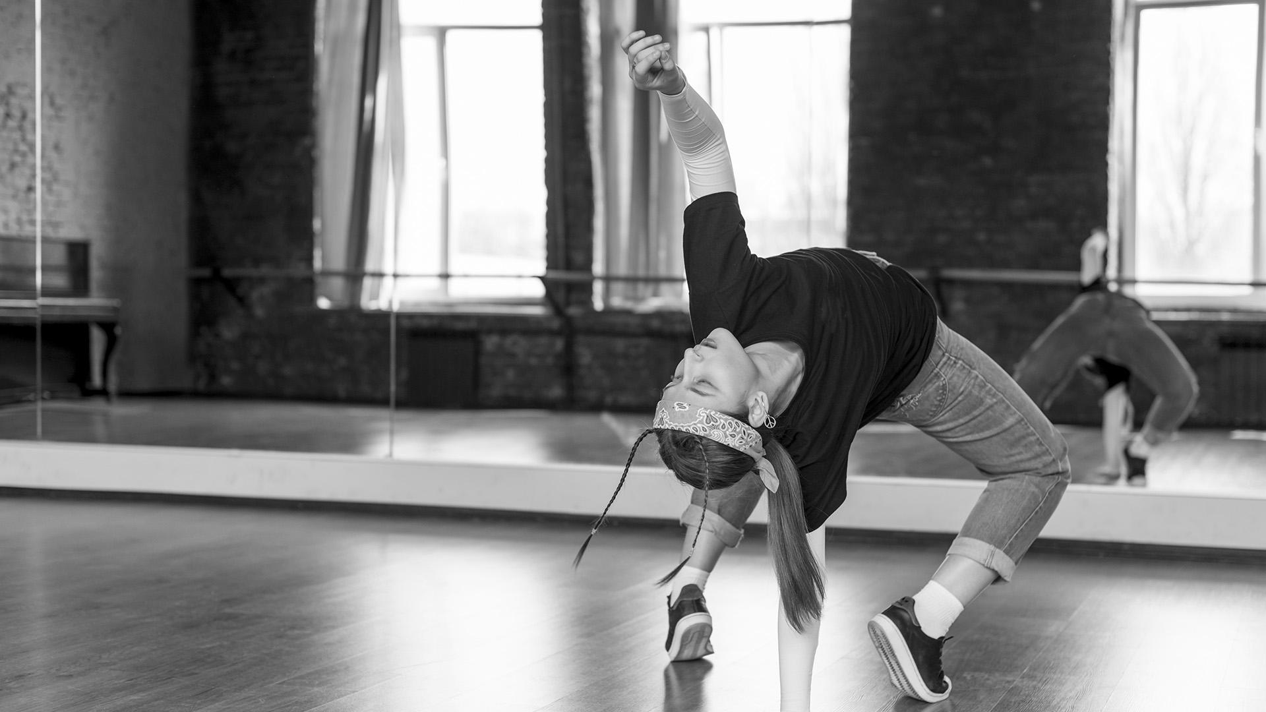
INTRODUCTION
INTRODUCTION
Mercury is the closest planet to the Sun and the smallest one in the Solar System—it’s only a bit larger than our Moon. The planet’s name has nothing to do with the liquid metal since it was named after the Roman messenger god, Mercury

Slide 4
QUOTE
“This is a quote. Words full of wisdom that someone important said and can make the reader get inspired.”
—SOMEONE FAMOUS

Slide 5
OUR TEACHING METHOD
OUR TEACHING METHOD
FOLLOWING GOALS
DOING
ACTIVITIES
FEEDBACK AND
EVALUATION
Despite being red, Mars is a cold place, not hot.
Mercury is the closest planet to the Sun
Neptune is the farthest planet from the Sun

Slide 6
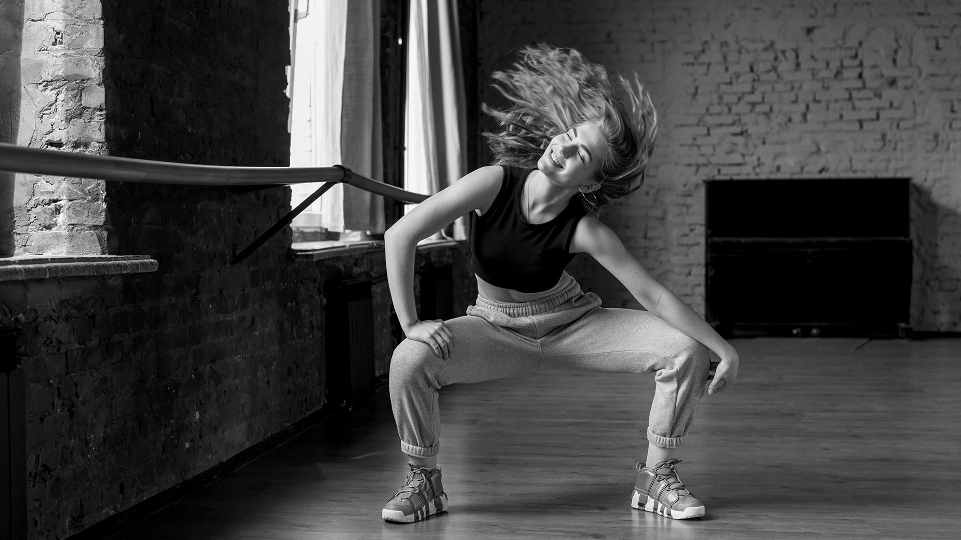
WHAT SET US APART
HIGH-PERFORMANCE
CENTER
MULTIDISCIPLINARY
ACTIVITIES
REAL
OPPORTUNITIES
Mercury is the closest planet to the Sun and also the smallest one in our Solar System
Neptune is the farthest planet from the Sun and the fourth-largest in our Solar System
Venus has a beautiful name and is the second planet from the Sun. It’s terribly hot

Slide 7
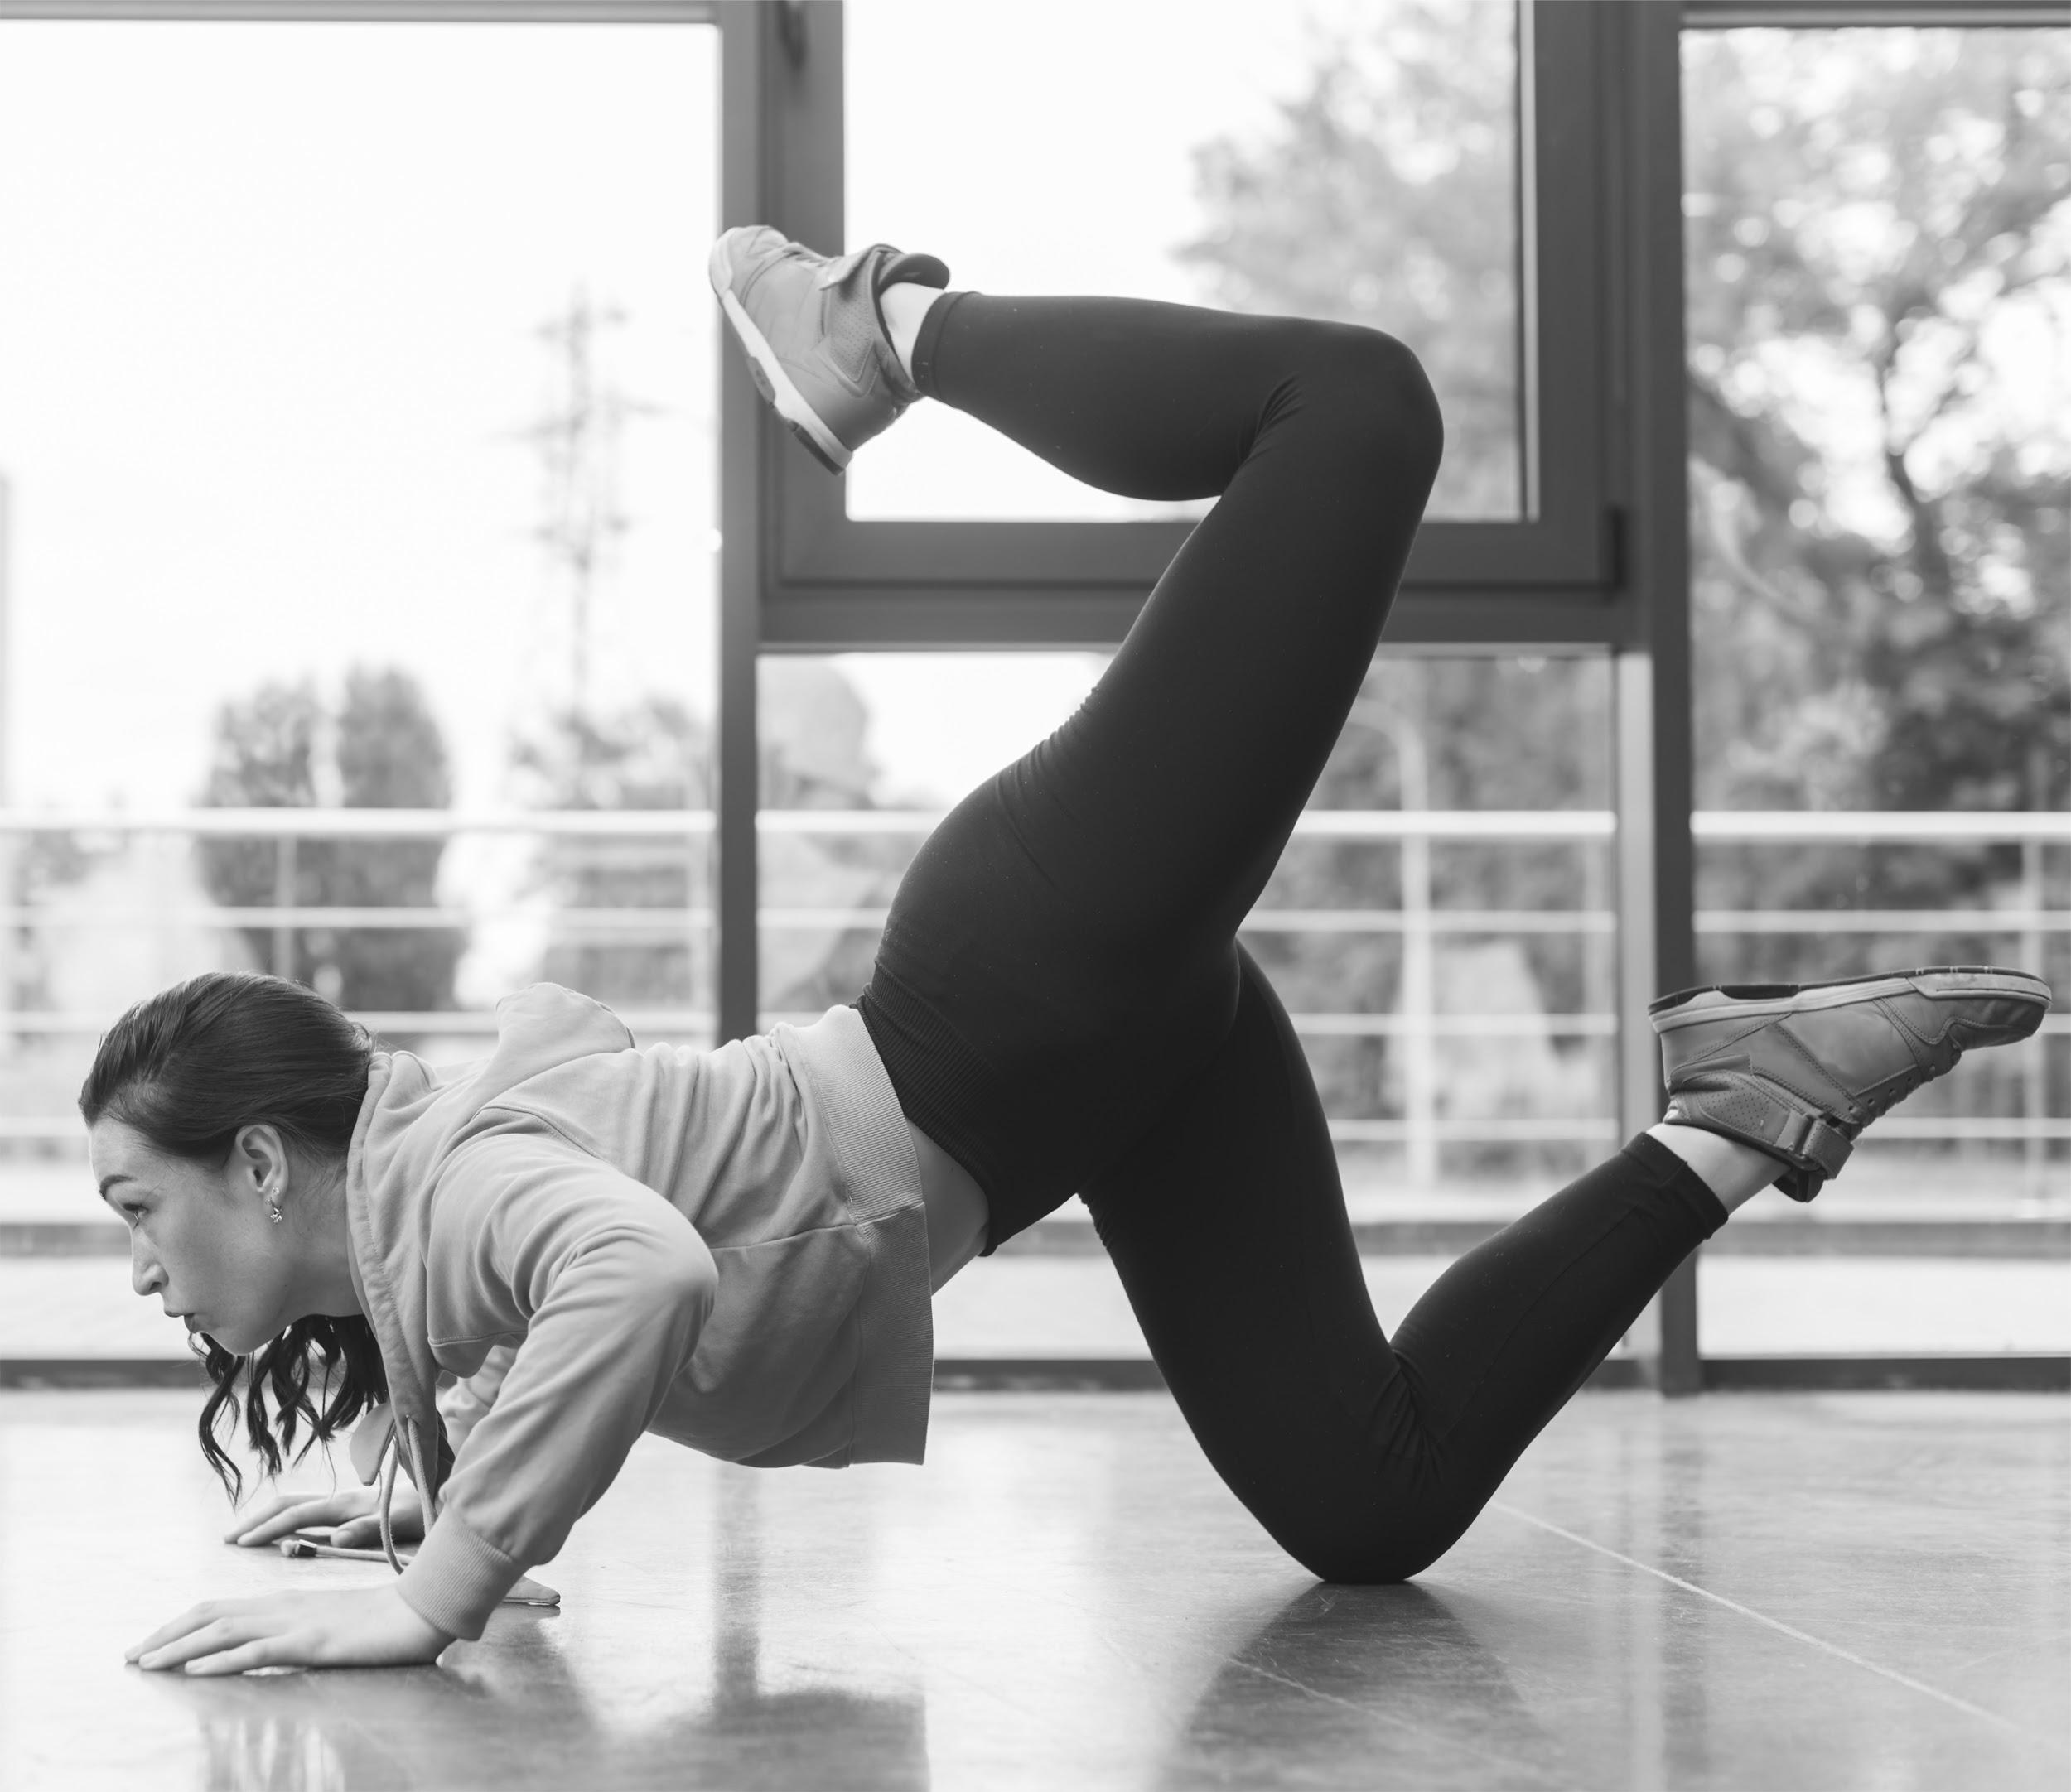
REAL EXPERIENCE
PROFESSIONALS
THE CURRICULUM
FORMATION
Jupiter is a gas giant and the biggest planet in our Solar System. It’s also the fourth-brightest object in the sky
Mercury is the closest planet to the Sun and the smallest one in our Solar System—it’s only a bit larger than our Moon
Venus has a beautiful name and is the second planet from the Sun. It’s terribly hot, even hotter than Mercury

Slide 8






BREAK DANCE
STREET DANCE
FUNKY
OUR AREAS
K-POP
LOCKING
CONTEMPORARY DANCE
Jupiter is a gas giant and the biggest planet in our Solar System
Saturn is composed mostly of hydrogen and helium
Venus has a beautiful name and is the second planet from the Sun
Mercury is the smallest planet in our Solar System
Despite being red, Mars is a cold place, not hot. It’s full of iron oxide dust
Neptune is the fourth-largest planet in our Solar System

Slide 9
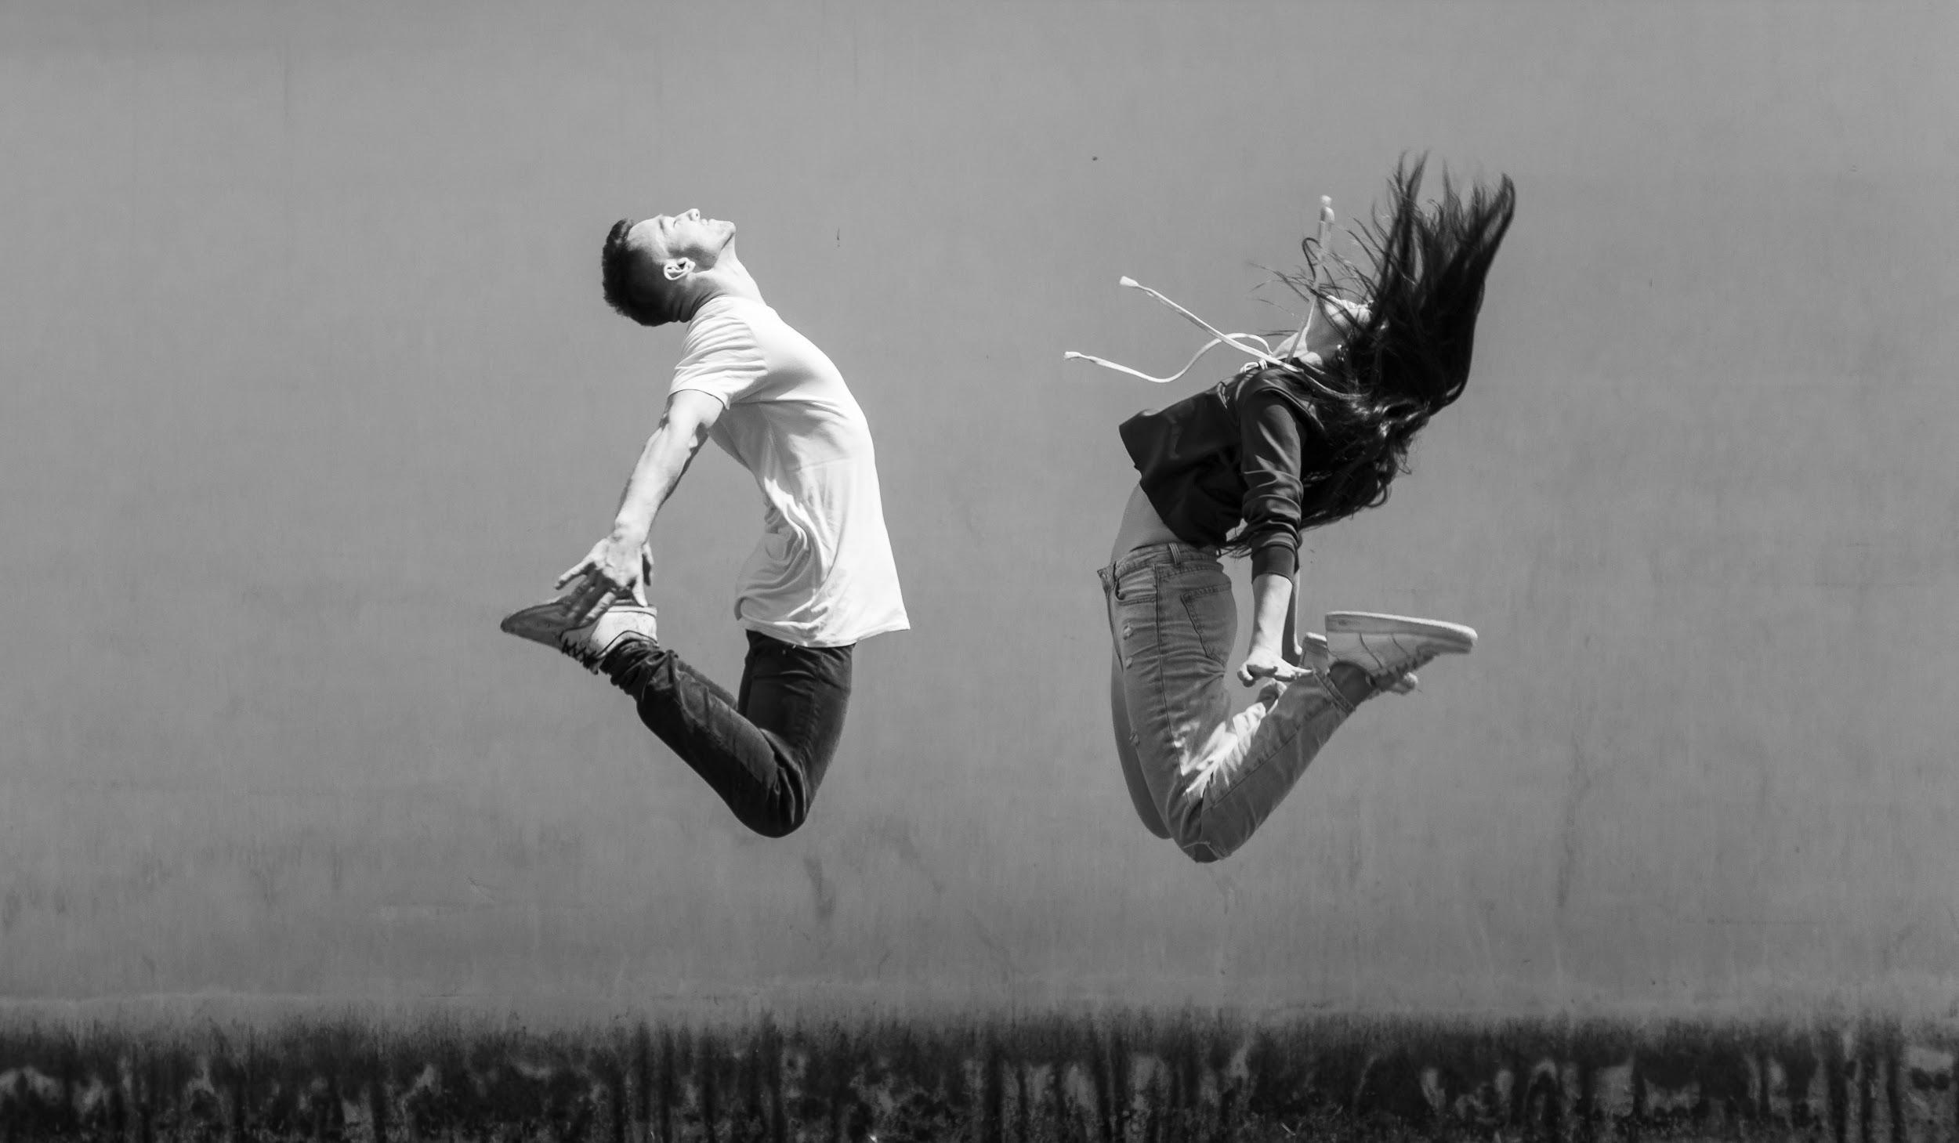
OUR MISSION
OUR MISSION AND VISION
OUR VISION
Mercury is the closest planet to the Sun and also the smallest one in our Solar System.
The planet’s name has nothing to do with the liquid metal, since it was named after the Roman messenger god, Mercury
Venus has a beautiful name and is the second planet from the Sun. It’s terribly hot—even hotter than Mercury—and its atmosphere is extremely poisonous. It’s the second-brightest natural object in the night sky

Slide 10
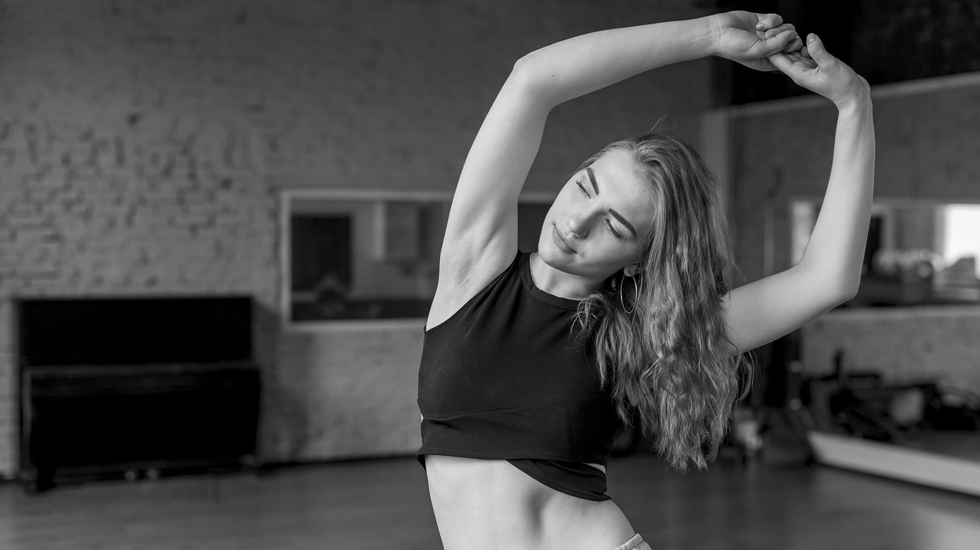
OUR VALUES
LOYALTY
EFFICIENCY
RELIABILITY
COMMITMENT
Despite being red, Mars is a cold place, not hot. It’s full of iron oxide dust, giving the planet its reddish cast
Neptune is the farthest planet from the Sun and the fourth-largest in our Solar System
Mercury is the closest planet to the Sun and also the smallest one in our Solar System
Jupiter is the biggest planet in our Solar System and the fourth-brightest object in the sky

Slide 11
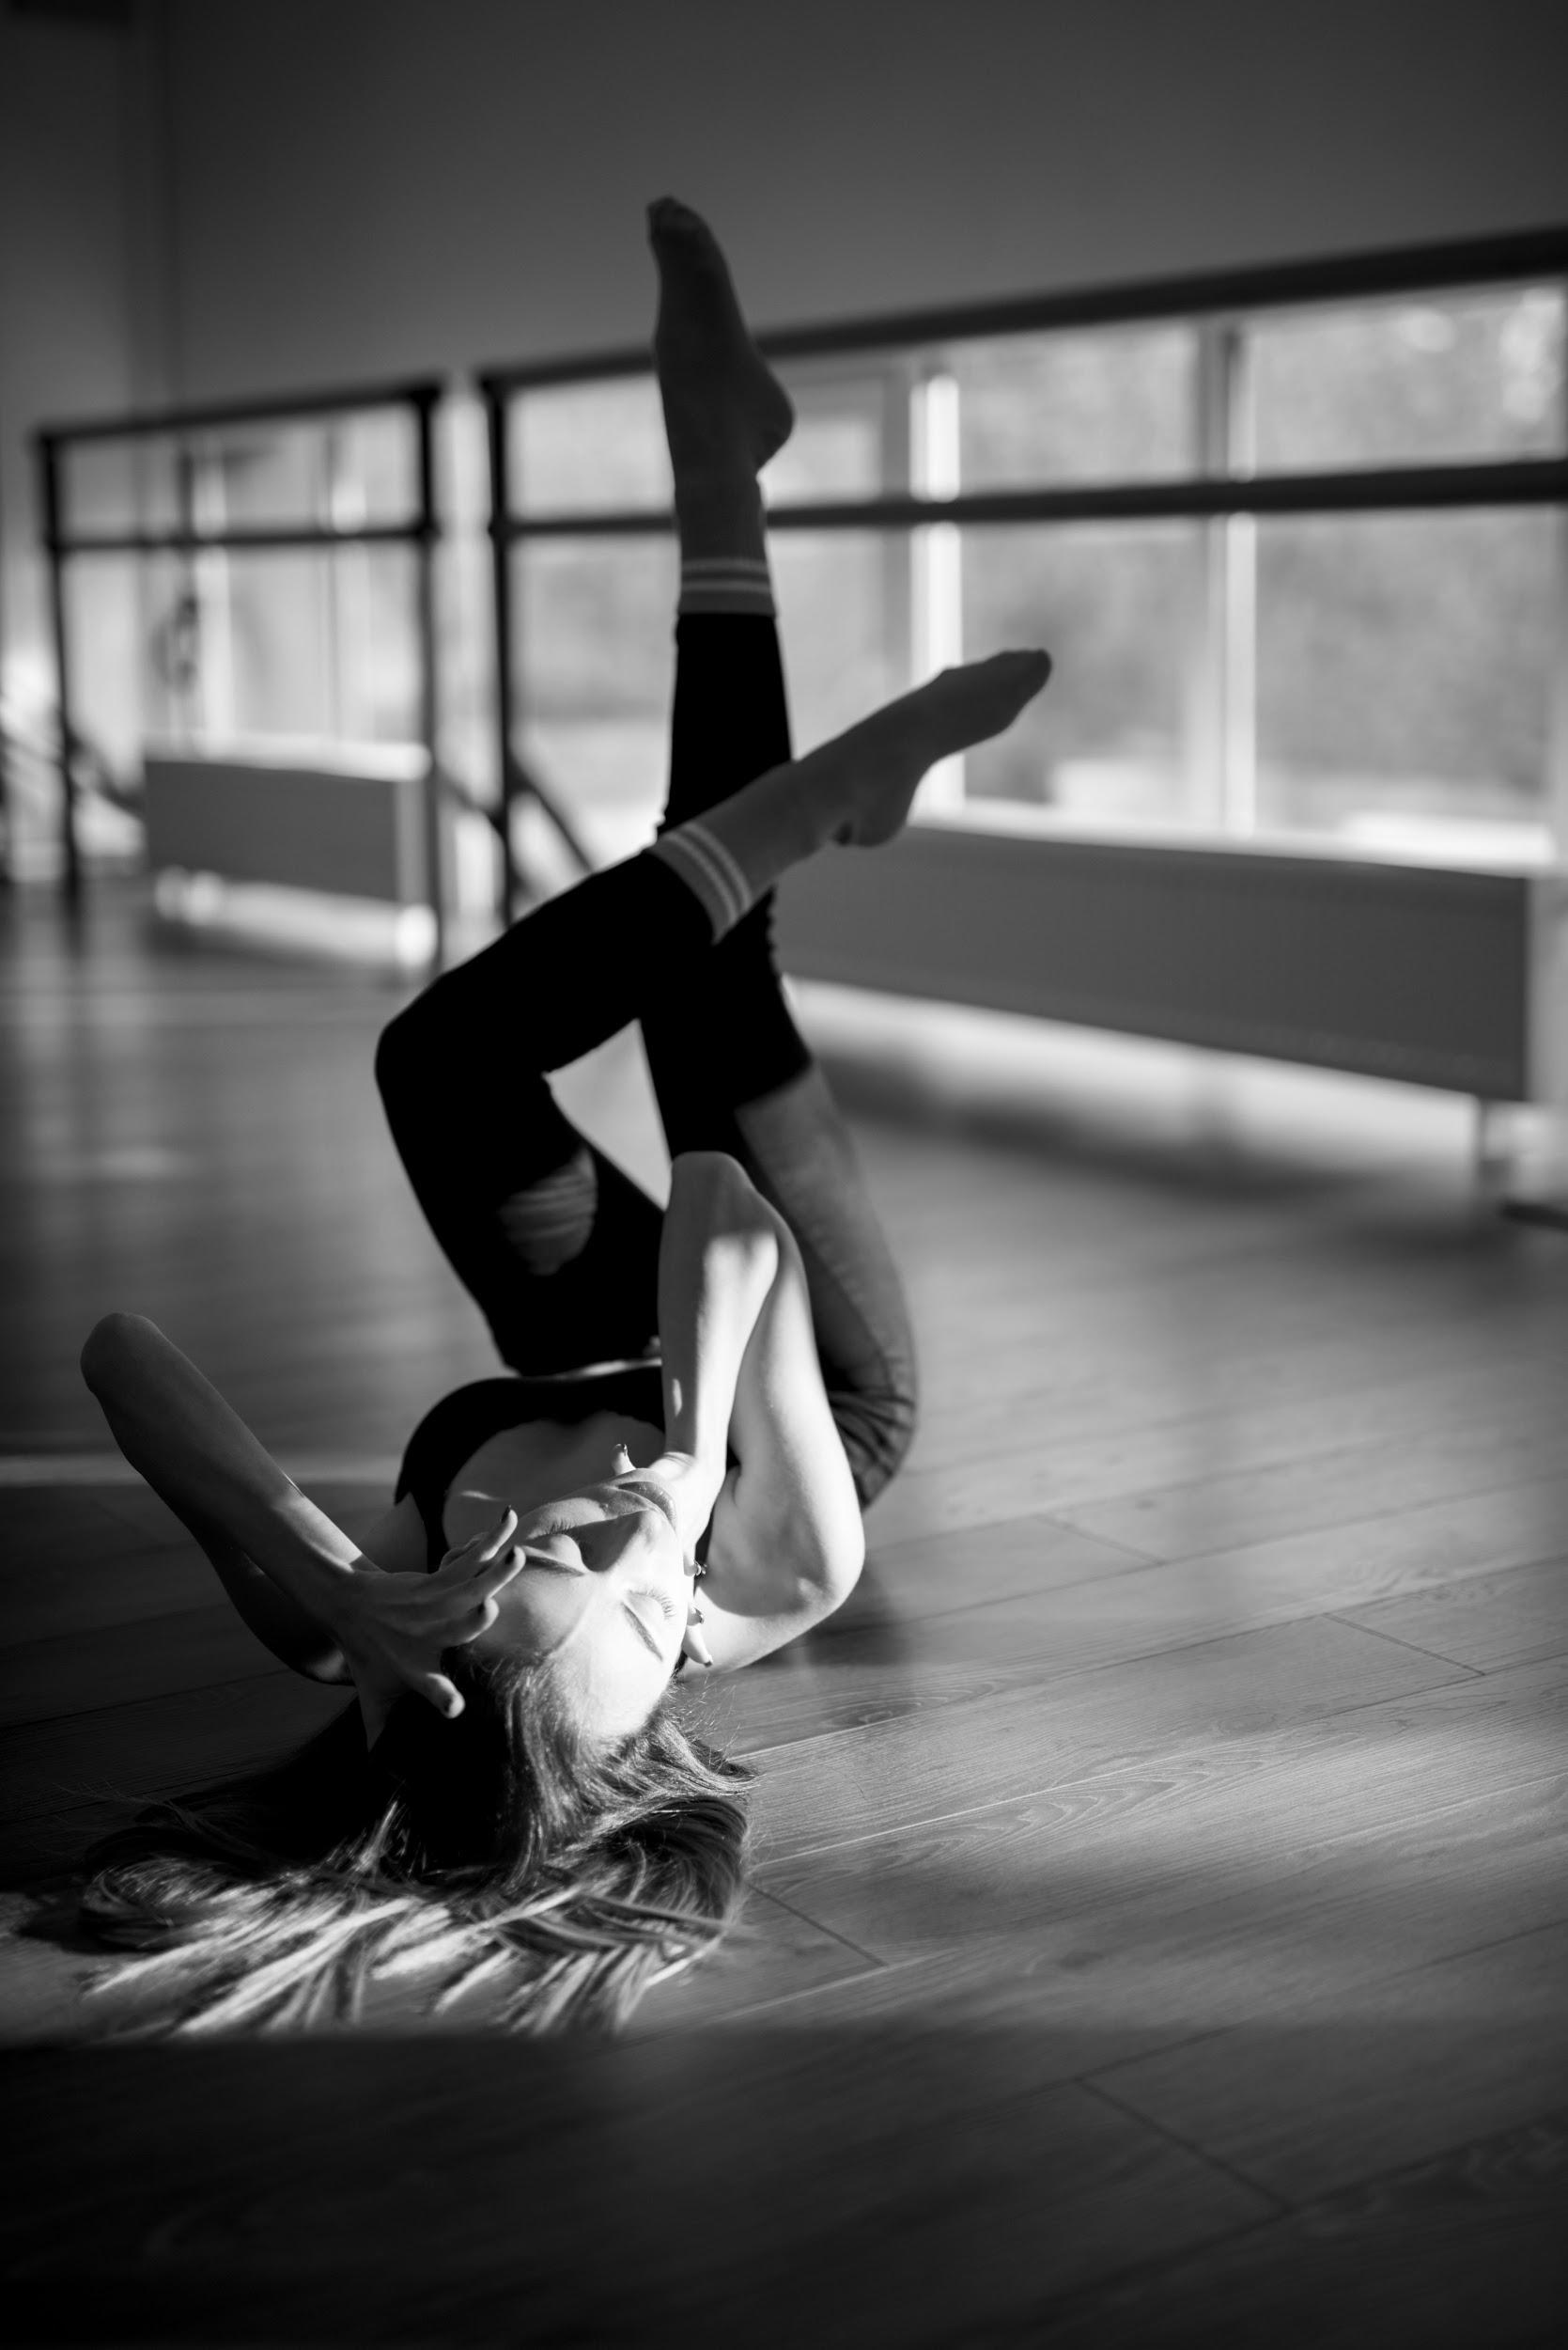
32%
345
OUR SUCCESS
46%
Mercury is the closest planet to the Sun and the smallest one in the Solar System—it’s only a bit larger than our Moon. The planet’s name has nothing to do with the liquid metal since it was named after the Roman messenger.
Venus has a beautiful name and is the second planet from the Sun. It’s terribly hot—even hotter than Mercury—and its atmosphere is extremely poisonous. It’s the second-brightest natural object in the sky
Jupiter is a gas giant and also the biggest planet in our Solar System. It’s the fourth-brightest object in the sky and Jovian is the adjective used for anything pertaining to Jupiter. The planet’s name comes from the Roman god of the sky and lightning

Slide 12
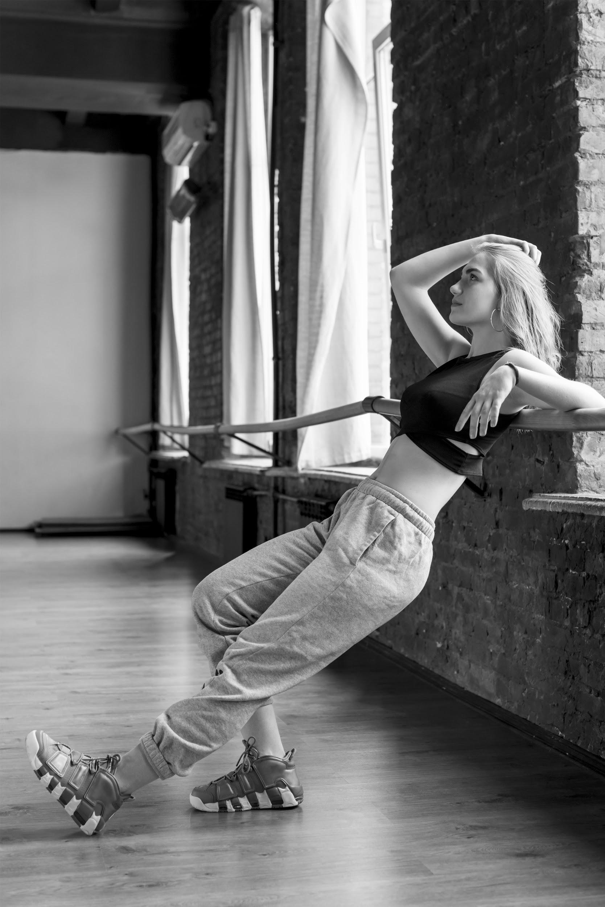
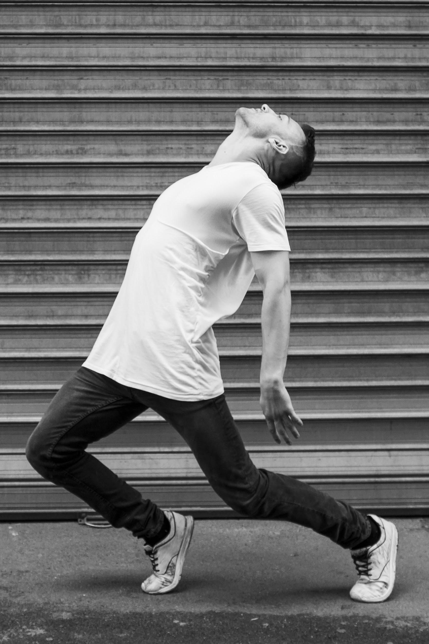
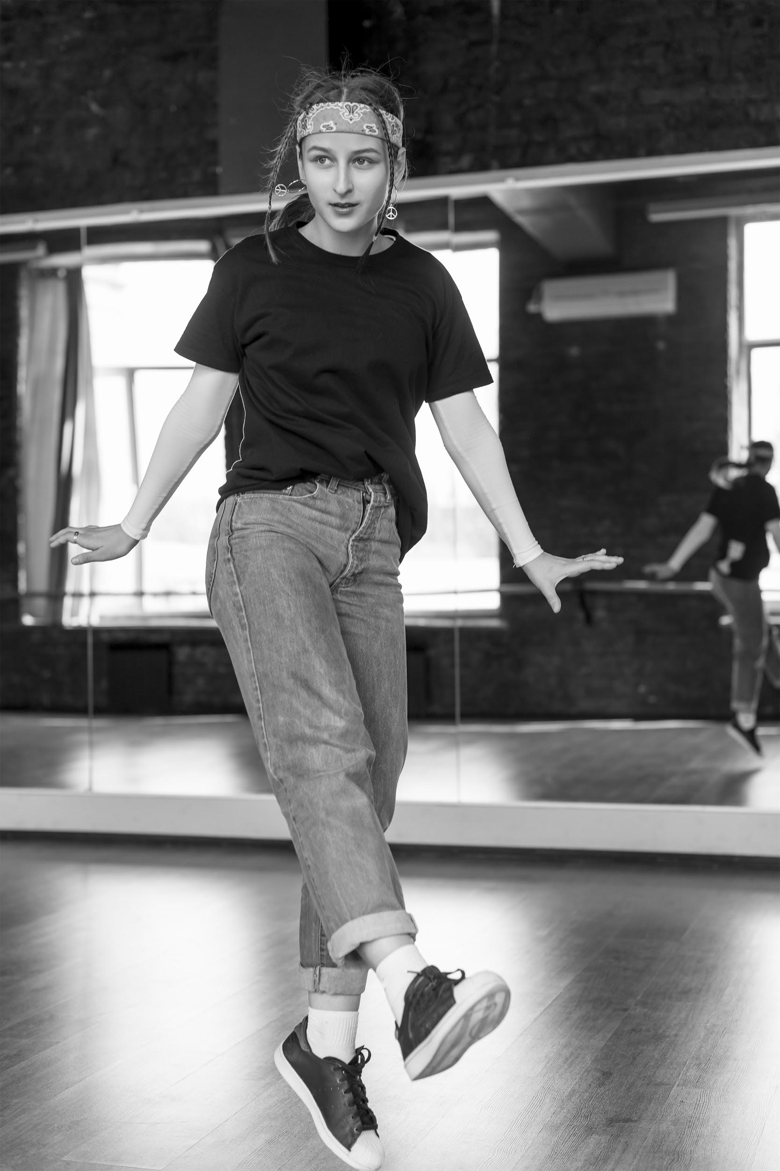
SUCCESSFUL STORIES
SARA PATTERSON
JOHN DOE
JESS SMITH
Mercury is the closest planet to the Sun and also the smallest one in our Solar System. The planet’s name comes from the Roman messenger god
Venus has a beautiful name and is the second planet from the Sun. It’s terribly hot—even hotter than Mercury—and its atmosphere is extremely poisonous
Jupiter is a gas giant and also the biggest planet in our Solar System. The planet’s name comes from the Roman god of the sky and lightning

Slide 13
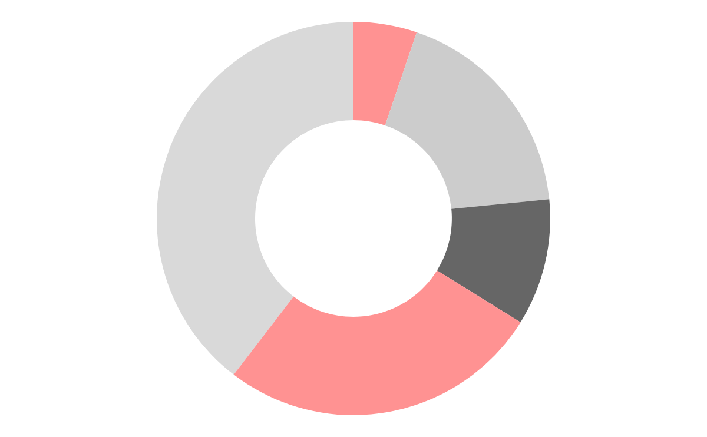
MOST DEMANDED STYLES
Street dance
Contemporary dance
Breakdance
Mercury is the closest planet to the Sun and also the smallest one in our Solar System—it’s only a bit larger than our Moon. The planet’s name has nothing to do with the liquid metal, since it was named after the Roman messenger god, Mercury
Locking
Funky
If you want to modify these graphs, click here, follow the link, change the data and replace them

Slide 14
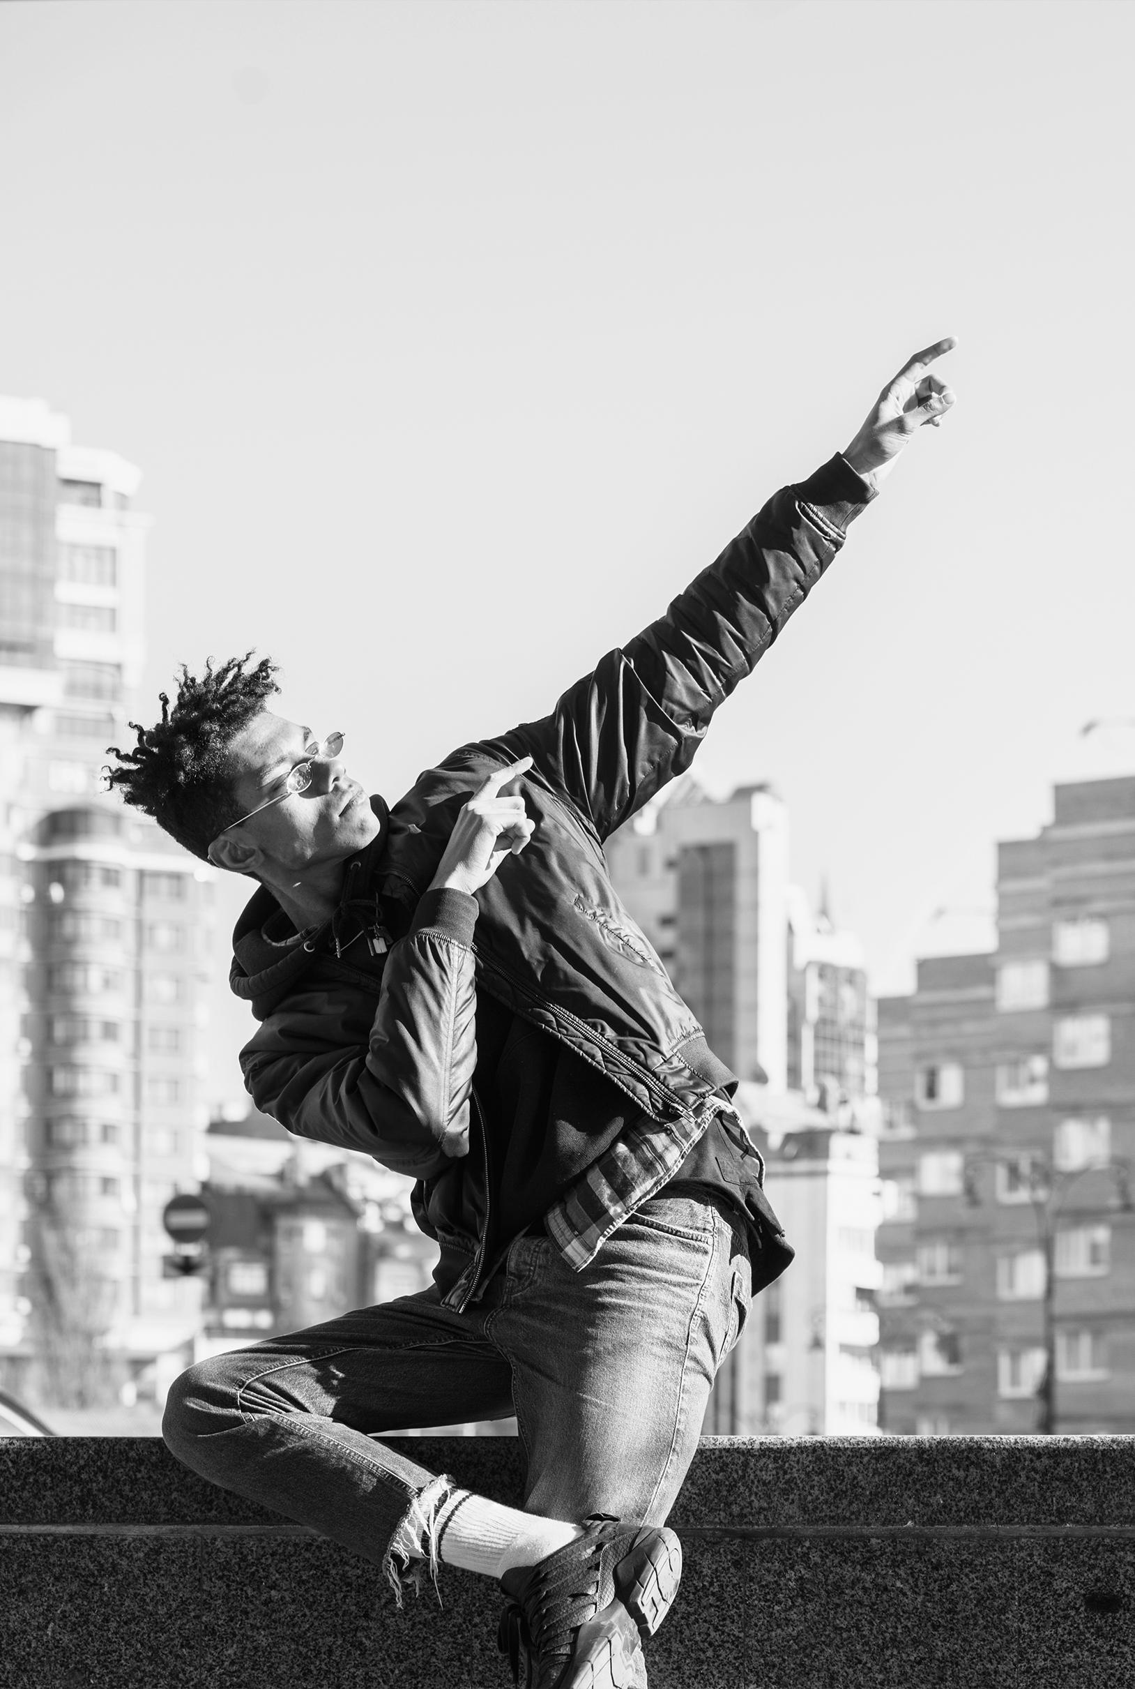

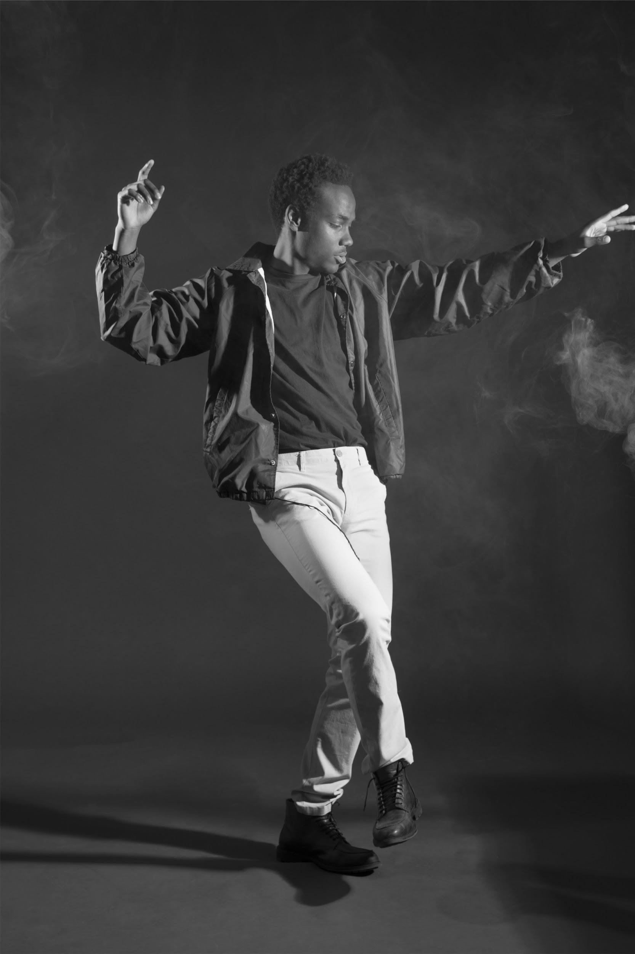
JOHN DOE
OUR TEACHERS
OSCAR SMITH
JANE PATTERSON
You can replace the image on the screen with your own
You can replace the image on the screen with your own
You can replace the image on the screen with your own

Slide 15
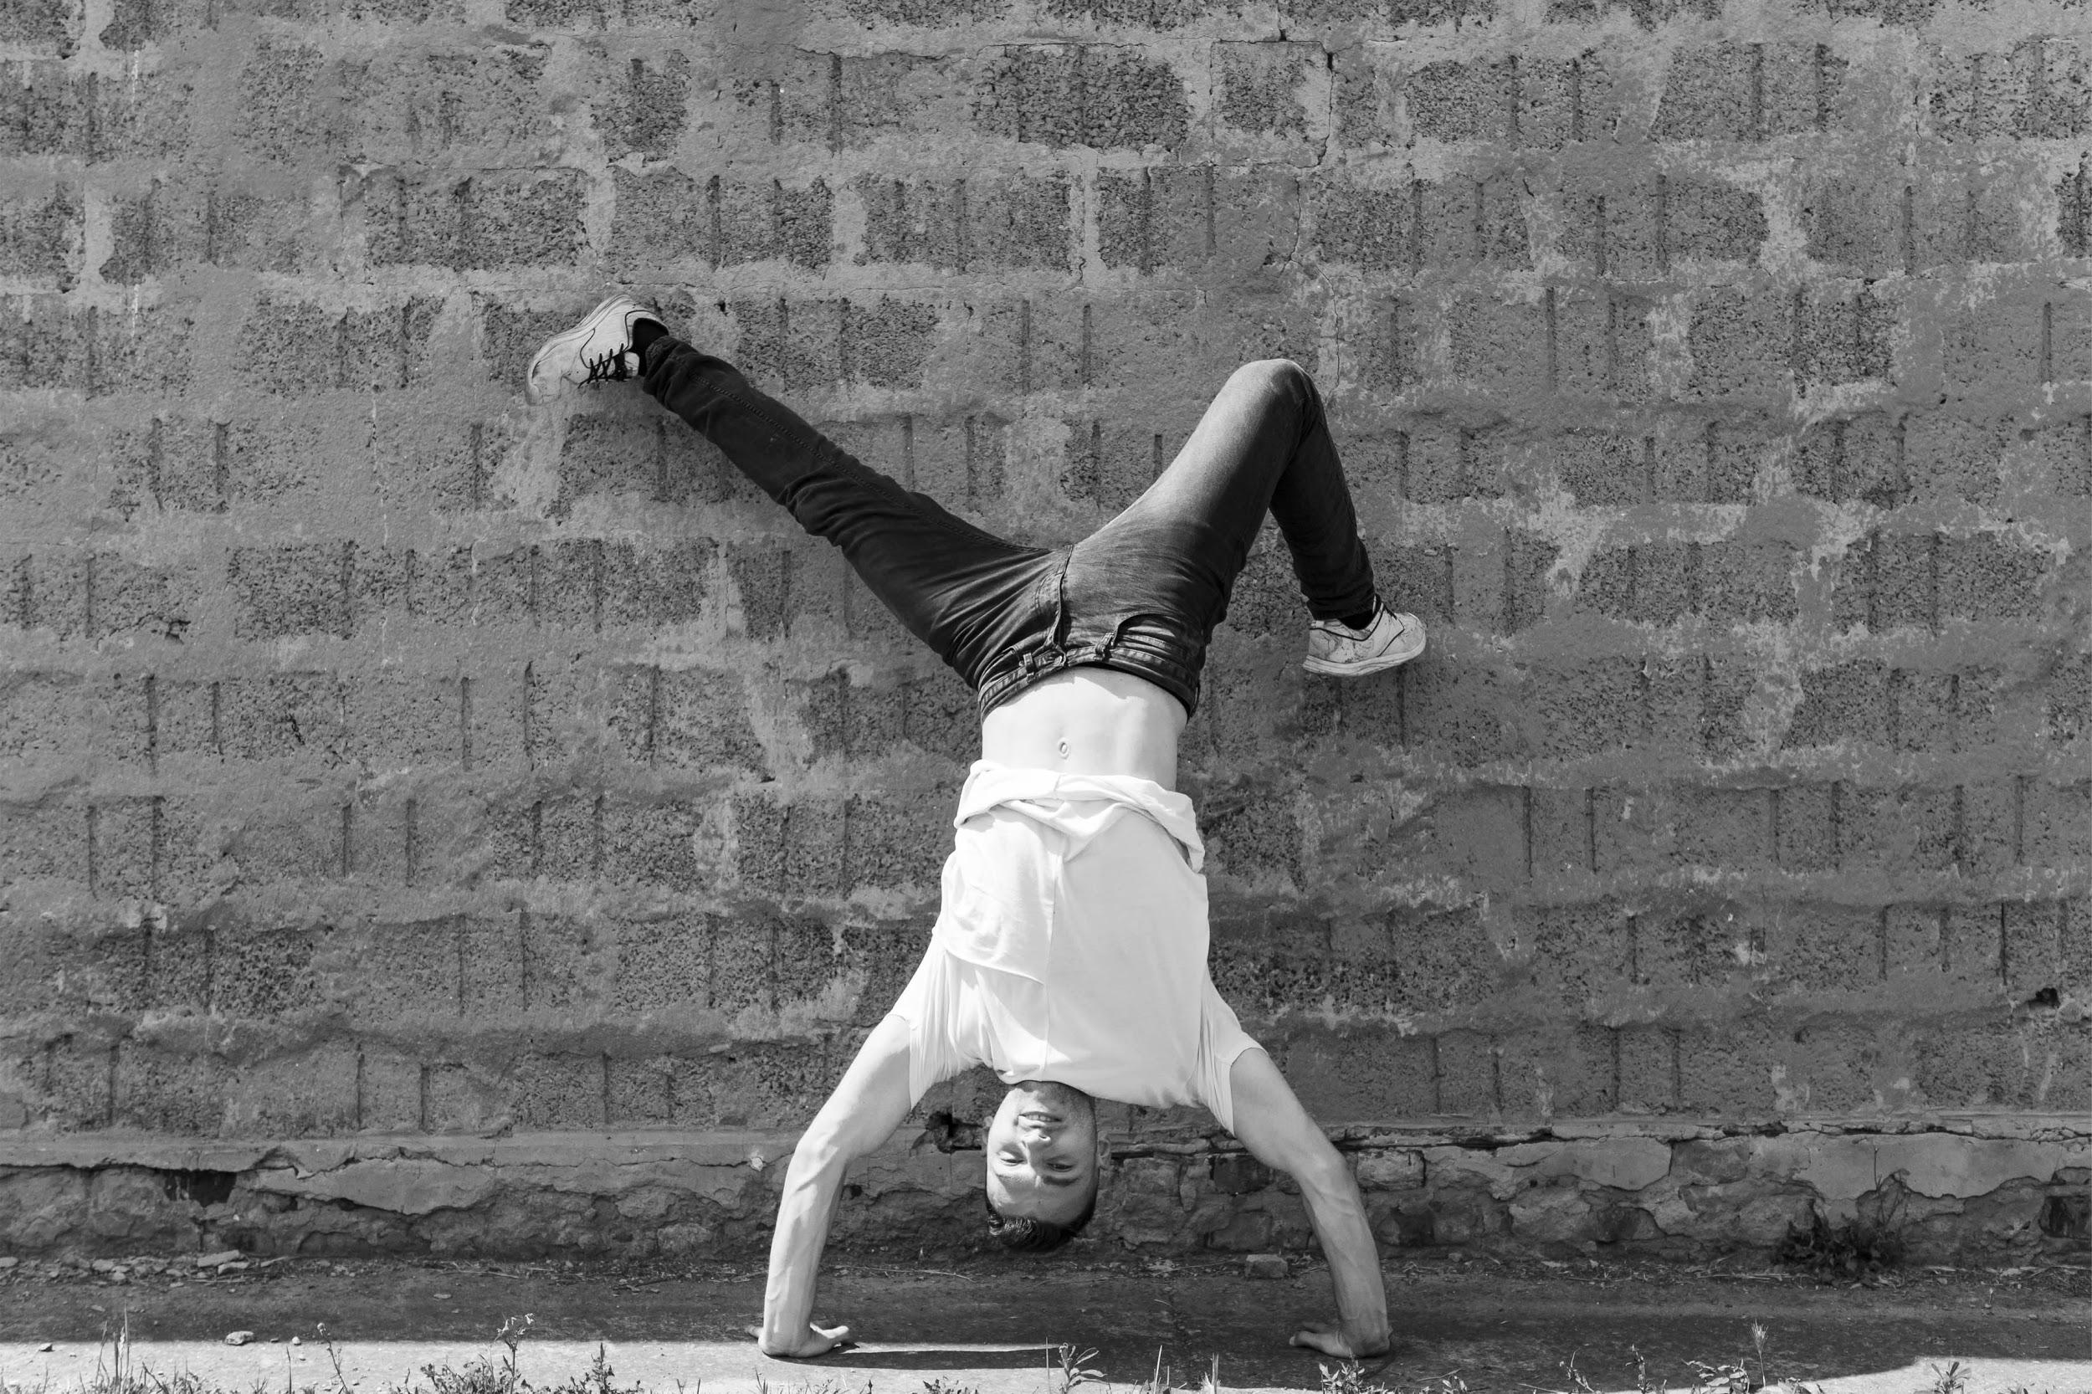
OUR GOALS
01.
OUR GOALS
02.
03.
Mercury is the closest planet to the Sun and also the smallest one in our Solar System
Venus has a beautiful name and is the second planet from the Sun
Despite being red, Mars is a cold place, not hot. It’s full of iron oxide dust

Slide 16
STUDENT
PROGRESS
STUDENTS PROGRESS
Introduction to dance
Mercury is the closest planet to the Sun
Testing phase
Despite being red, Mars is a cold place
Specialization
Venus has a beautiful name, but it’s very hot
Mercury is the closest planet to the Sun and the smallest one in the Solar System—it’s only a bit larger than our Moon. The planet’s name has nothing to do with the liquid metal since it was named after the Roman messenger god, Mercury
Intense training
Saturn is composed of hydrogen and helium
Exhibition
Neptune is the farthest planet from the Sun
Final test
The Earth is the planet we live in

Slide 17
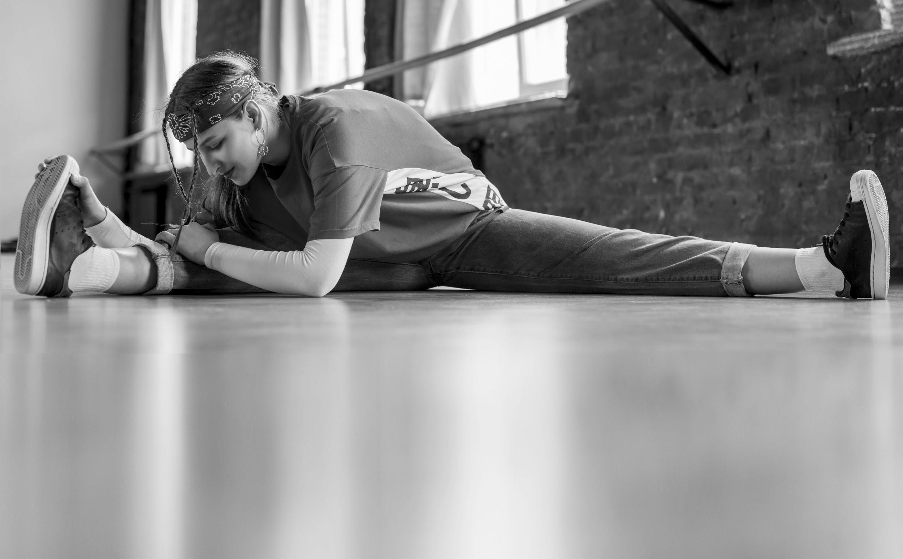
ENRROLLMENT PROCESS
MERCURY
NEPTUNE
JUPITER
Mercury is the closest planet to the Sun and also the smallest one in our Solar System—it’s only a bit larger than our Moon
Neptune is the farthest planet from the Sun and the fourth-largest by diameter in our Solar System. It’s also the densest
Jupiter is a gas giant and the biggest planet in our Solar System. Its name comes from the Roman god of the sky and lightning

Slide 18


SPECIAL REMINDERS
Mercury is the closest planet to the Sun and also the smallest one in our Solar System
Venus has a beautiful name and is the second planet from the Sun. It’s terribly hot
Saturn is the ringed planet. It’s a gas giant, composed mostly of hydrogen and helium

Slide 19
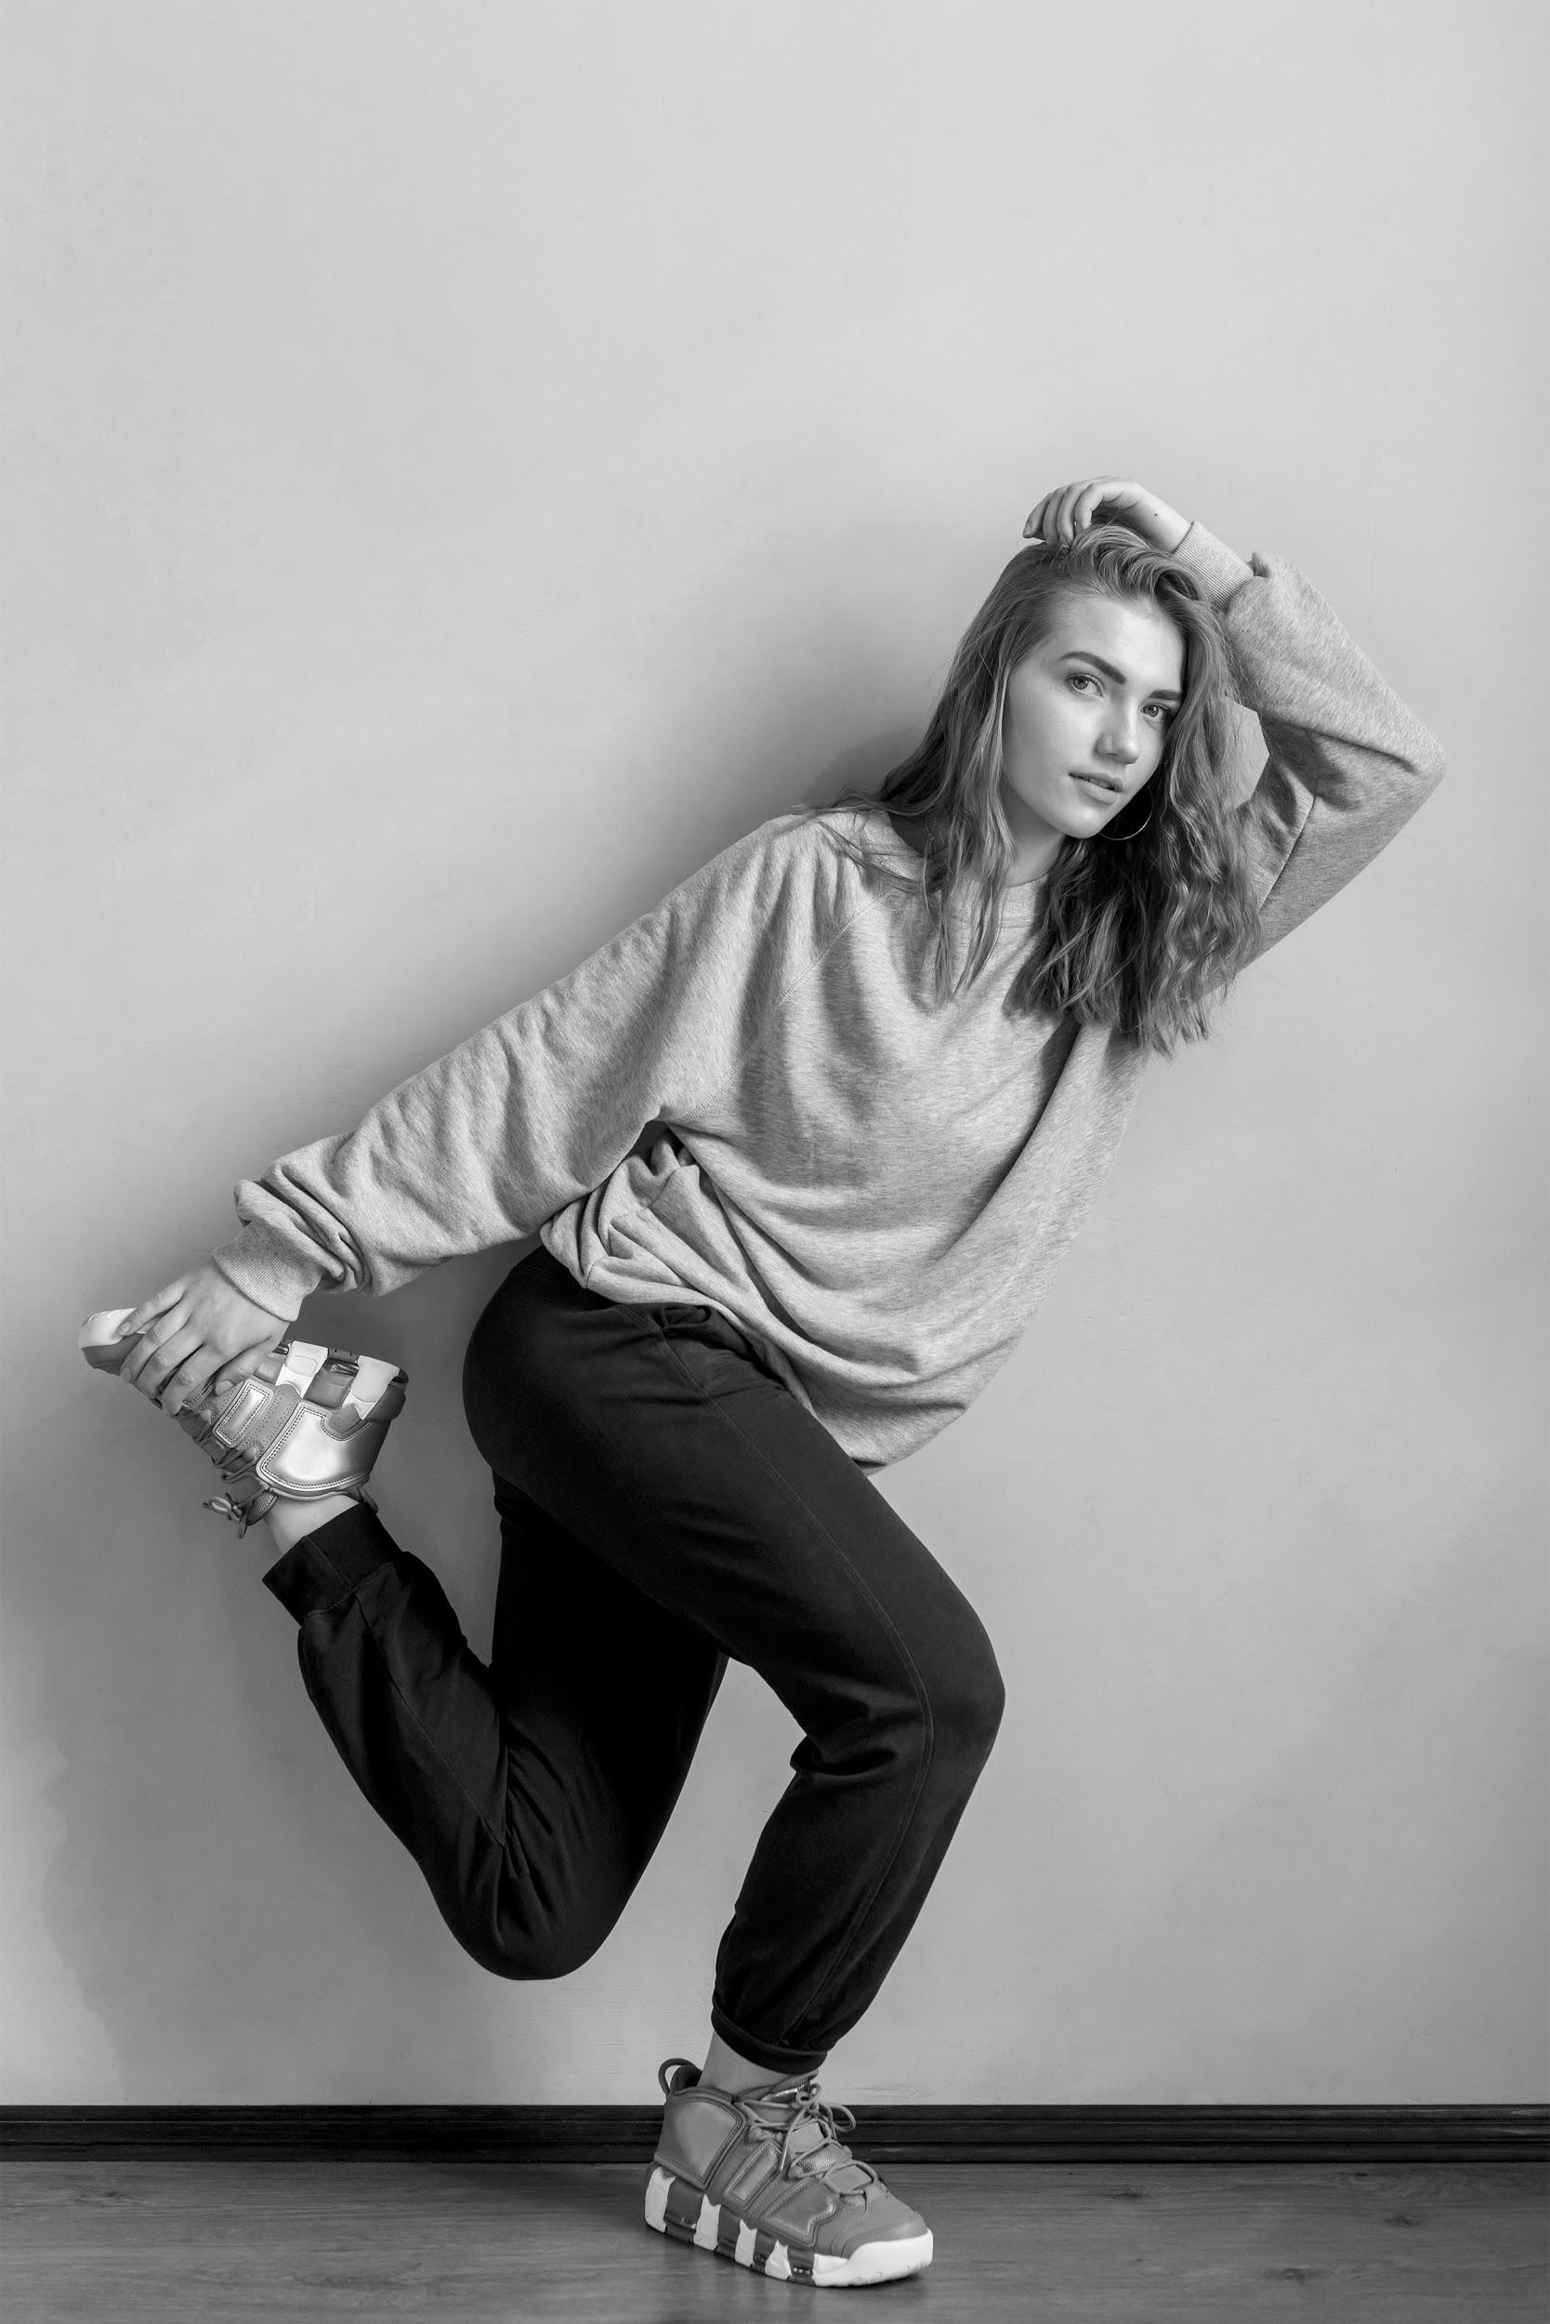
THANKS
THANKS
Does anyone have any questions?
addyouremail@freepik.com
+91 620 421 838
yourcompany.com

Slide 20
CREDITS
CREDITS
This is where you give credit to the ones who are part of this project.
Did you like the resources on this template? Get them for free at our other websites.
Presentation template by Slidesgo
Icons by Flaticon
Infographics by Freepik
Images created Freepik
Author introduction slide photo created by Freepik
Text & Image slide photo created by Freepik.com

Slide 21
RESOURCES
RESOURCES
PHOTOS
Professional female dancer posing on the floor
Female dancer in hood jumping against wall
Portrait of smiling blonde young woman jumping in the air
Young woman sitting on floor stretching his leg
Dancer jumping in air against gray wall
Young woman dancing hip hop
Male performer doing hip-hop dance against wall
Young african man sitting on wall gesturing in front of buildings in the city
Pretty young woman posing against grey wall
Smiling blonde young woman raising her hands against blue background
Black model posing
Street dancer
Young woman dancing in the studio
Beautiful young woman dancing in the studio
Blonde young woman dancing in front of grey wall
Portrait of a smiling young woman dancing in the studio
Young woman dancing in front of studio
VECTORS
Infographic timeline concept

Slide 22
Instructions for use
In order to use this template, you must credit Slidesgo by keeping the Credits slide.
You are allowed to:
- Modify this template.
- Use it for both personal and commercial projects.
You are not allowed to:
- Sublicense, sell or rent any of Slidesgo Content (or a modified version of Slidesgo Content).
- Distribute Slidesgo Content unless it has been expressly authorized by Slidesgo.
- Include Slidesgo Content in an online or offline database or file.
- Offer Slidesgo templates (or modified versions of Slidesgo templates) for download.
- Acquire the copyright of Slidesgo Content.
For more information about editing slides, please read our FAQs:
https://slidesgo.com/faqs

Slide 23
Fonts & colors used
This presentation has been made using the following fonts:
Roboto
(https://fonts.google.com/specimen/Roboto+bold)
Oswald
(https://fonts.google.com/specimen/Oswald)
#ff9292ff
#212121ff
#ffffffff

Slide 24
Use our editable graphic resources...
You can easily resize these resources keeping the quality. To change the color just ungroup the resource and click on the object you want to change. Then click on the paint bucket and select the color you want. Don’t forget to group the resource again when you’re done.

Slide 26
...and our set of editable icons
You can resize these icons keeping the quality.
You can change the stroke and fill color; just select the icon and click on the paint bucket/pen.

Slide 27
Business Icons

Slide 28
Avatar Icons

Slide 29
Creative Process Icons

Slide 30
Educational Process Icons

Slide 31
Help & Support Icons

Slide 32
Medical Icons

Slide 33
Nature Icons

Slide 34
Performing Arts Icons

Slide 35
SEO & Marketing Icons

Slide 36
Teamwork Icons

Slide 37


