Slide 1
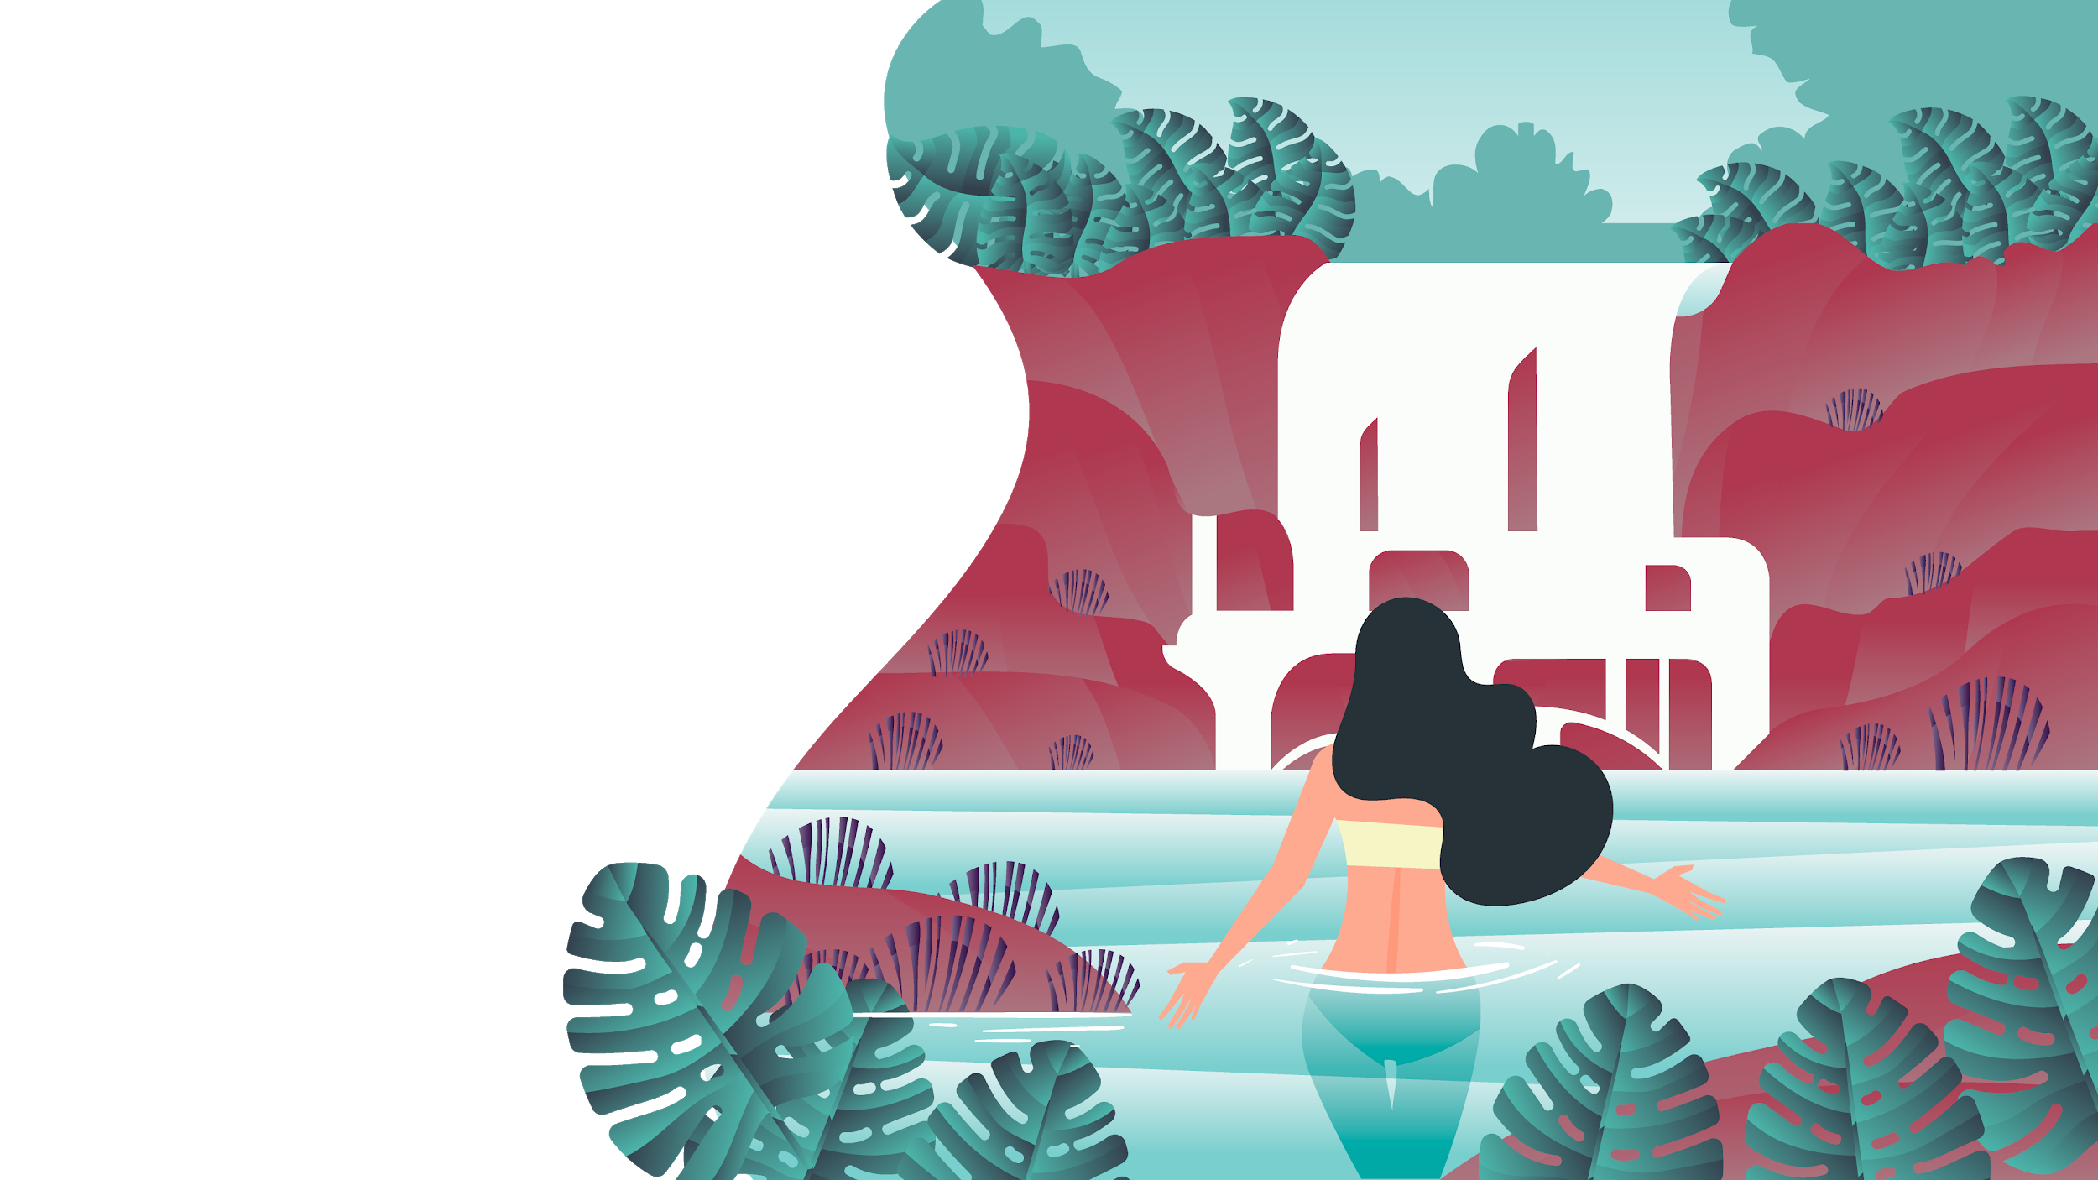
TRAVEL AGENCY
HERE IS WHERE YOUR PRESENTATION BEGINS!

Slide 2
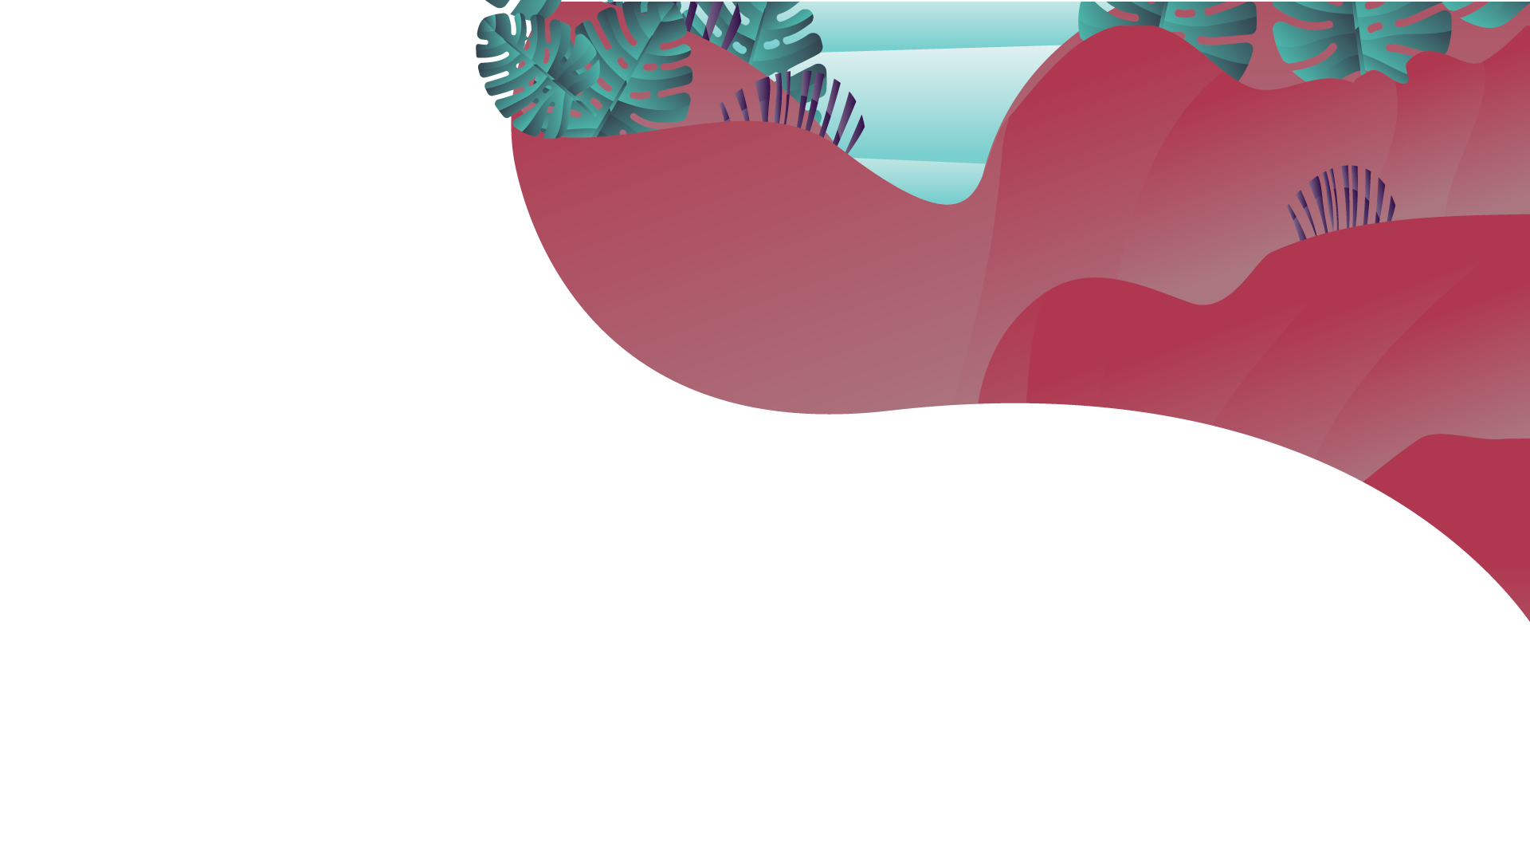
TABLE OF CONTENTS
01
03
05
02
04
06
BUSINESS OVERVIEW
SALES AND MARKETING PLAN
OPERATIONAL PLAN
MARKET ANALYSIS AND COMPETITION
MANAGEMENT PLAN
FINANCIAL PLAN

Slide 3
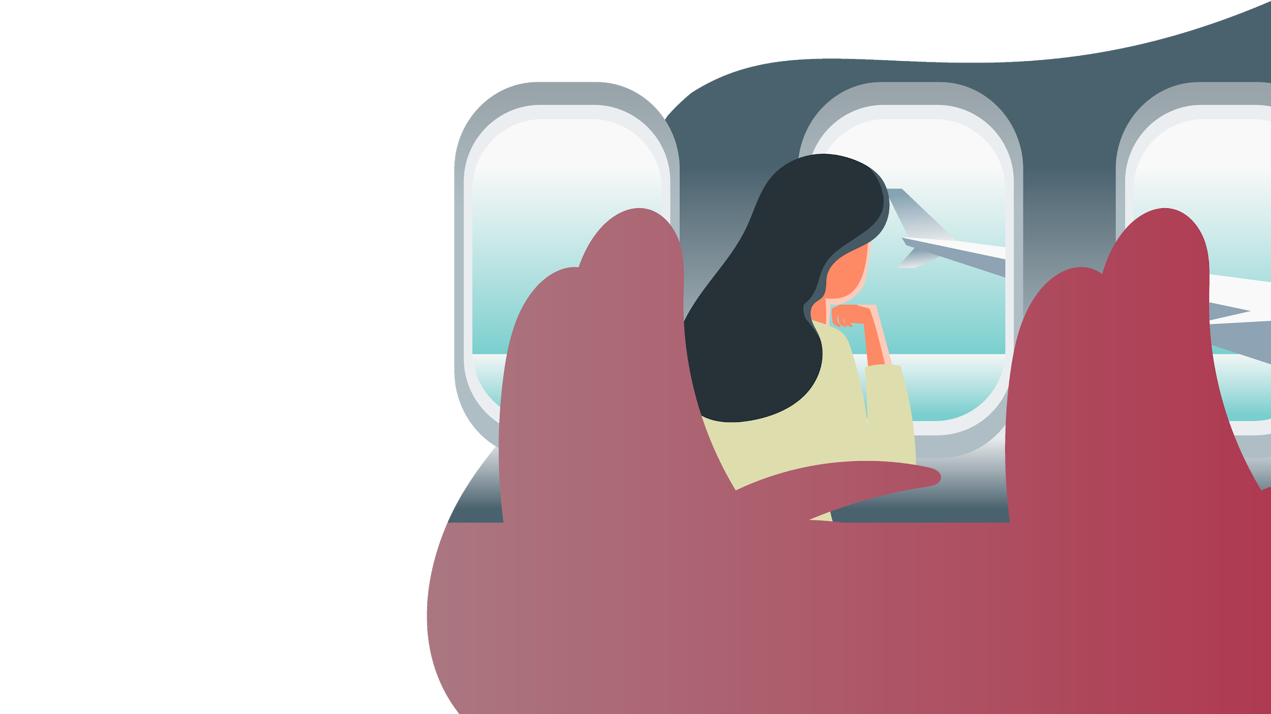
MISSION STATEMENT
Mercury is the closest planet to the Sun and the smallest one in the Solar System—it’s only a bit larger than our Moon. The planet’s name has nothing to do with the liquid metal since it was named after the Roman messenger god, Mercury

Slide 4
OUR COMPANY
Venus has a beautiful name and is the second planet from the Sun. It’s terribly hot—even hotter than Mercury—and its atmosphere is extremely poisonous. It’s the second-brightest natural object in the night sky after the Moon
YOUR LOGO

Slide 5
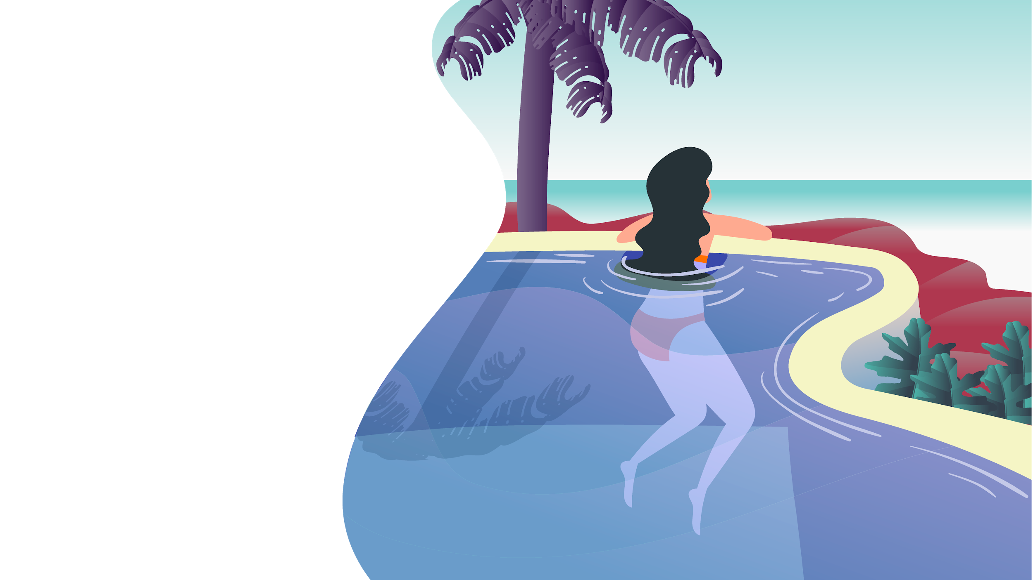
01.
BUSINESS OVERVIEW

Slide 6
MARKET TRENDS
MERCURY
MARS
VENUS
Mercury is the closest planet to the Sun and the smallest one in the Solar System—it’s only a bit larger than our Moon
Despite being red, Mars is a cold place, not hot. It’s full of iron oxide dust, which gives the planet its reddish cast
Venus has a beautiful name and is the second planet from the Sun. It’s terribly hot—even hotter than Mercury

Slide 7
PROBLEM VS. SOLUTION
PROBLEM
SOLUTION
Mercury is the closest planet to the Sun and the smallest one in the Solar System—it’s only a bit larger than our Moon. The planet’s name has nothing to do with the liquid metal since it was named after the Roman messenger god
Venus has a beautiful name and is the second planet from the Sun. It’s terribly hot—even hotter than Mercury—and its atmosphere is extremely poisonous. It’s the second-brightest natural object in the night sky after the Moon

Slide 8
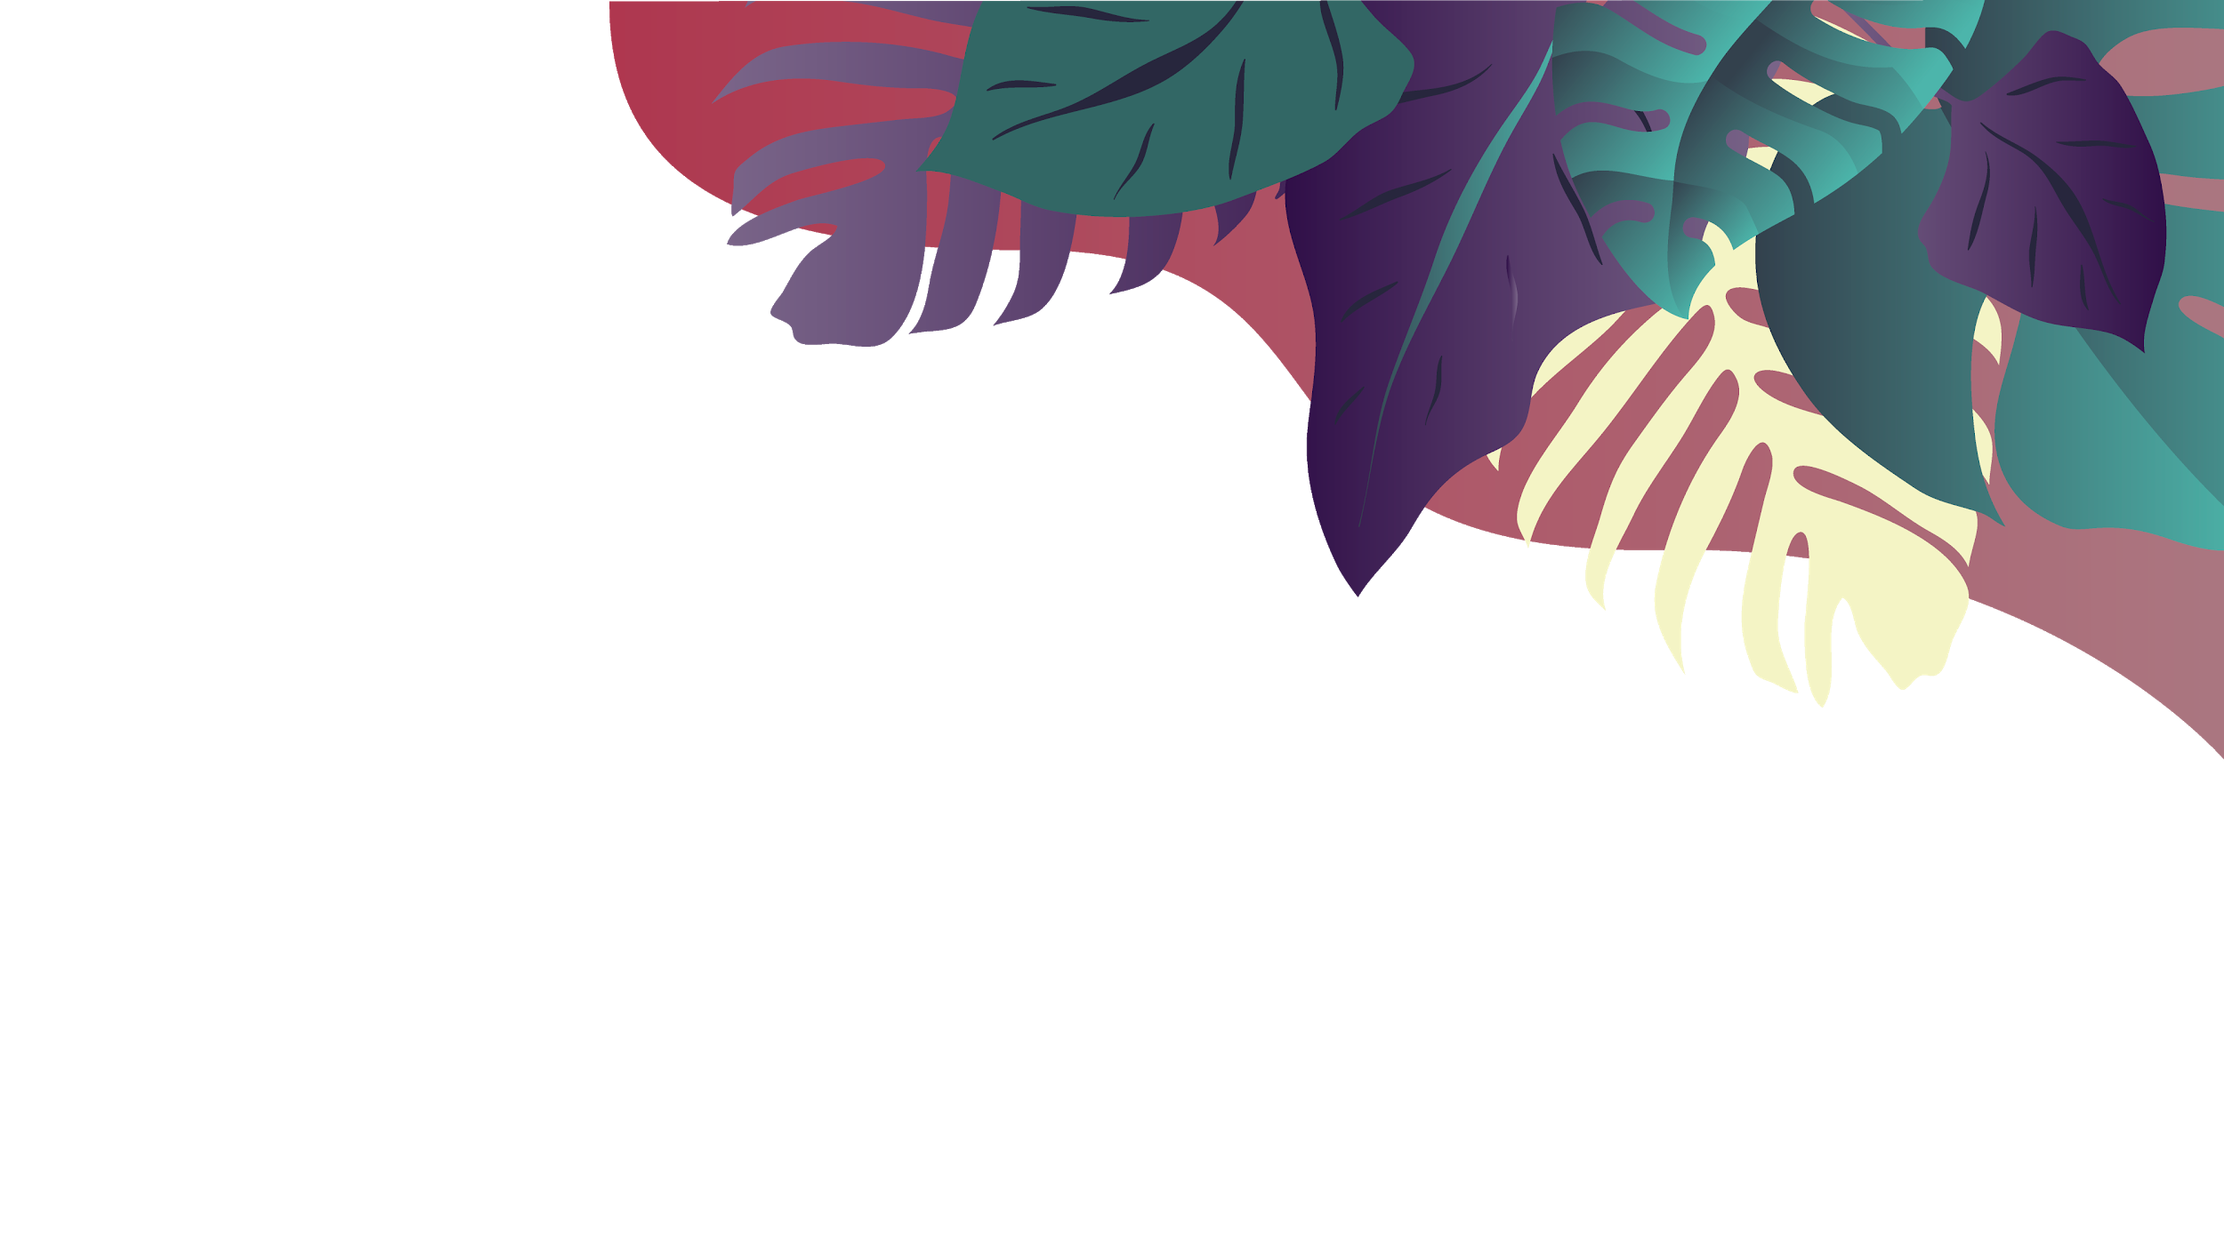
VALUE PROPOSITION
Despite being red, Mars is a cold place, not hot. It’s full of iron oxide dust
Mercury is the closest planet to the Sun and the smallest one in our Solar System
WHAT?
Venus has a beautiful name and is the second planet from the Sun
WHY?
HOW?

Slide 9
COMPETITORS
COMPETITORS
Saturn is the ringed one. It’s a gas giant, composed mostly of hydrogen and helium
It’s the biggest planet in our Solar System and the fourth-brightest object in the sky
Venus has a beautiful name and is the second planet from the Sun. It’s terribly hot
Mercury is the closest planet to the Sun and is only a bit larger than our Moon

Slide 10
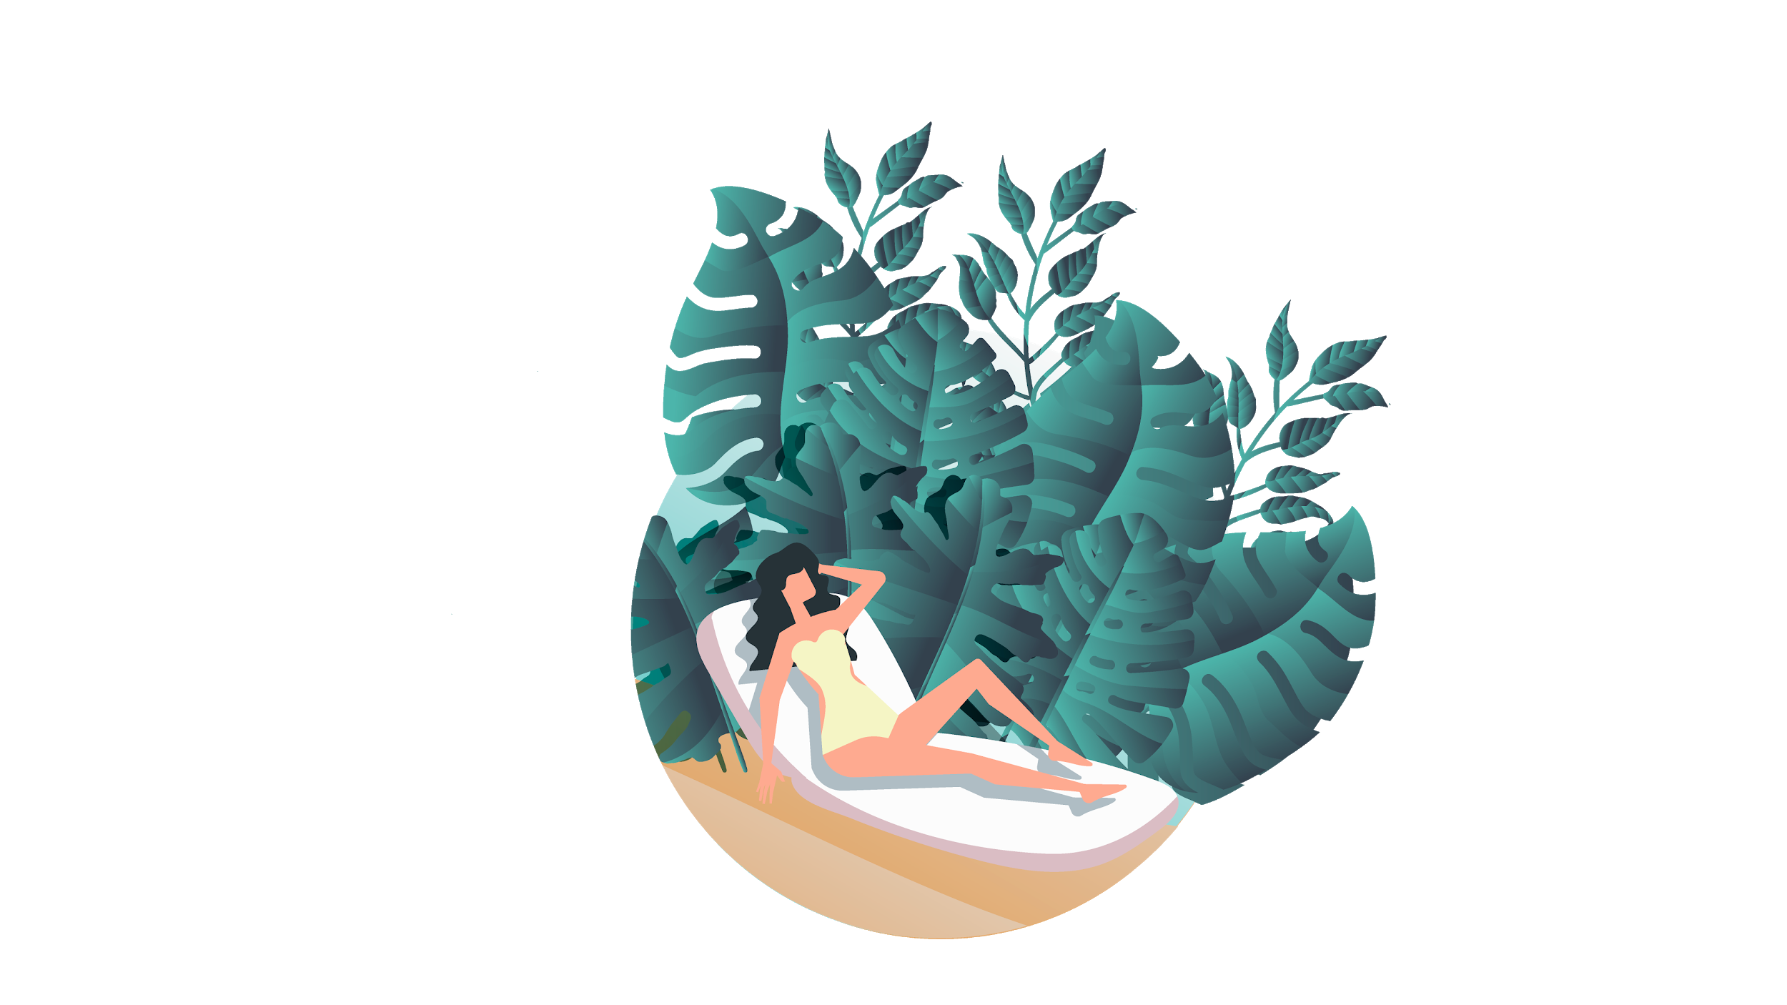

US
THEM
COMPETITIVE ADVANTAGE
Mercury is the closest planet to the Sun and the smallest one in the Solar System—it’s only a bit larger than our Moon. The planet’s name has nothing to do with the liquid metal since it was named after the Roman messenger god, Mercury
Venus has a beautiful name and is the second planet from the Sun. It’s terribly hot—even hotter than Mercury—and its atmosphere is extremely poisonous. It’s the second-brightest natural object in the night sky after the Moon

Slide 11
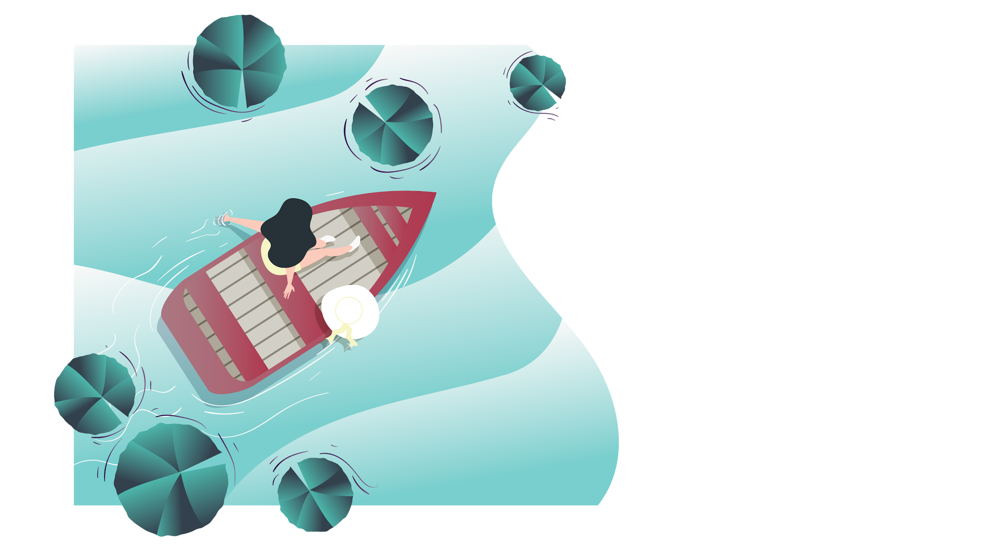
02.
MARKET ANALYSIS AND COMPETITION

Slide 12
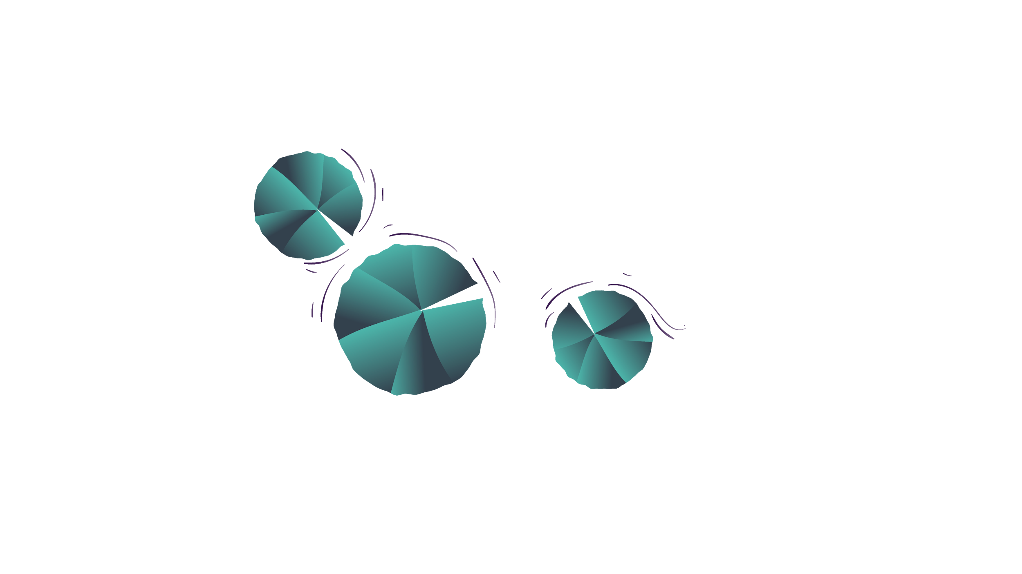
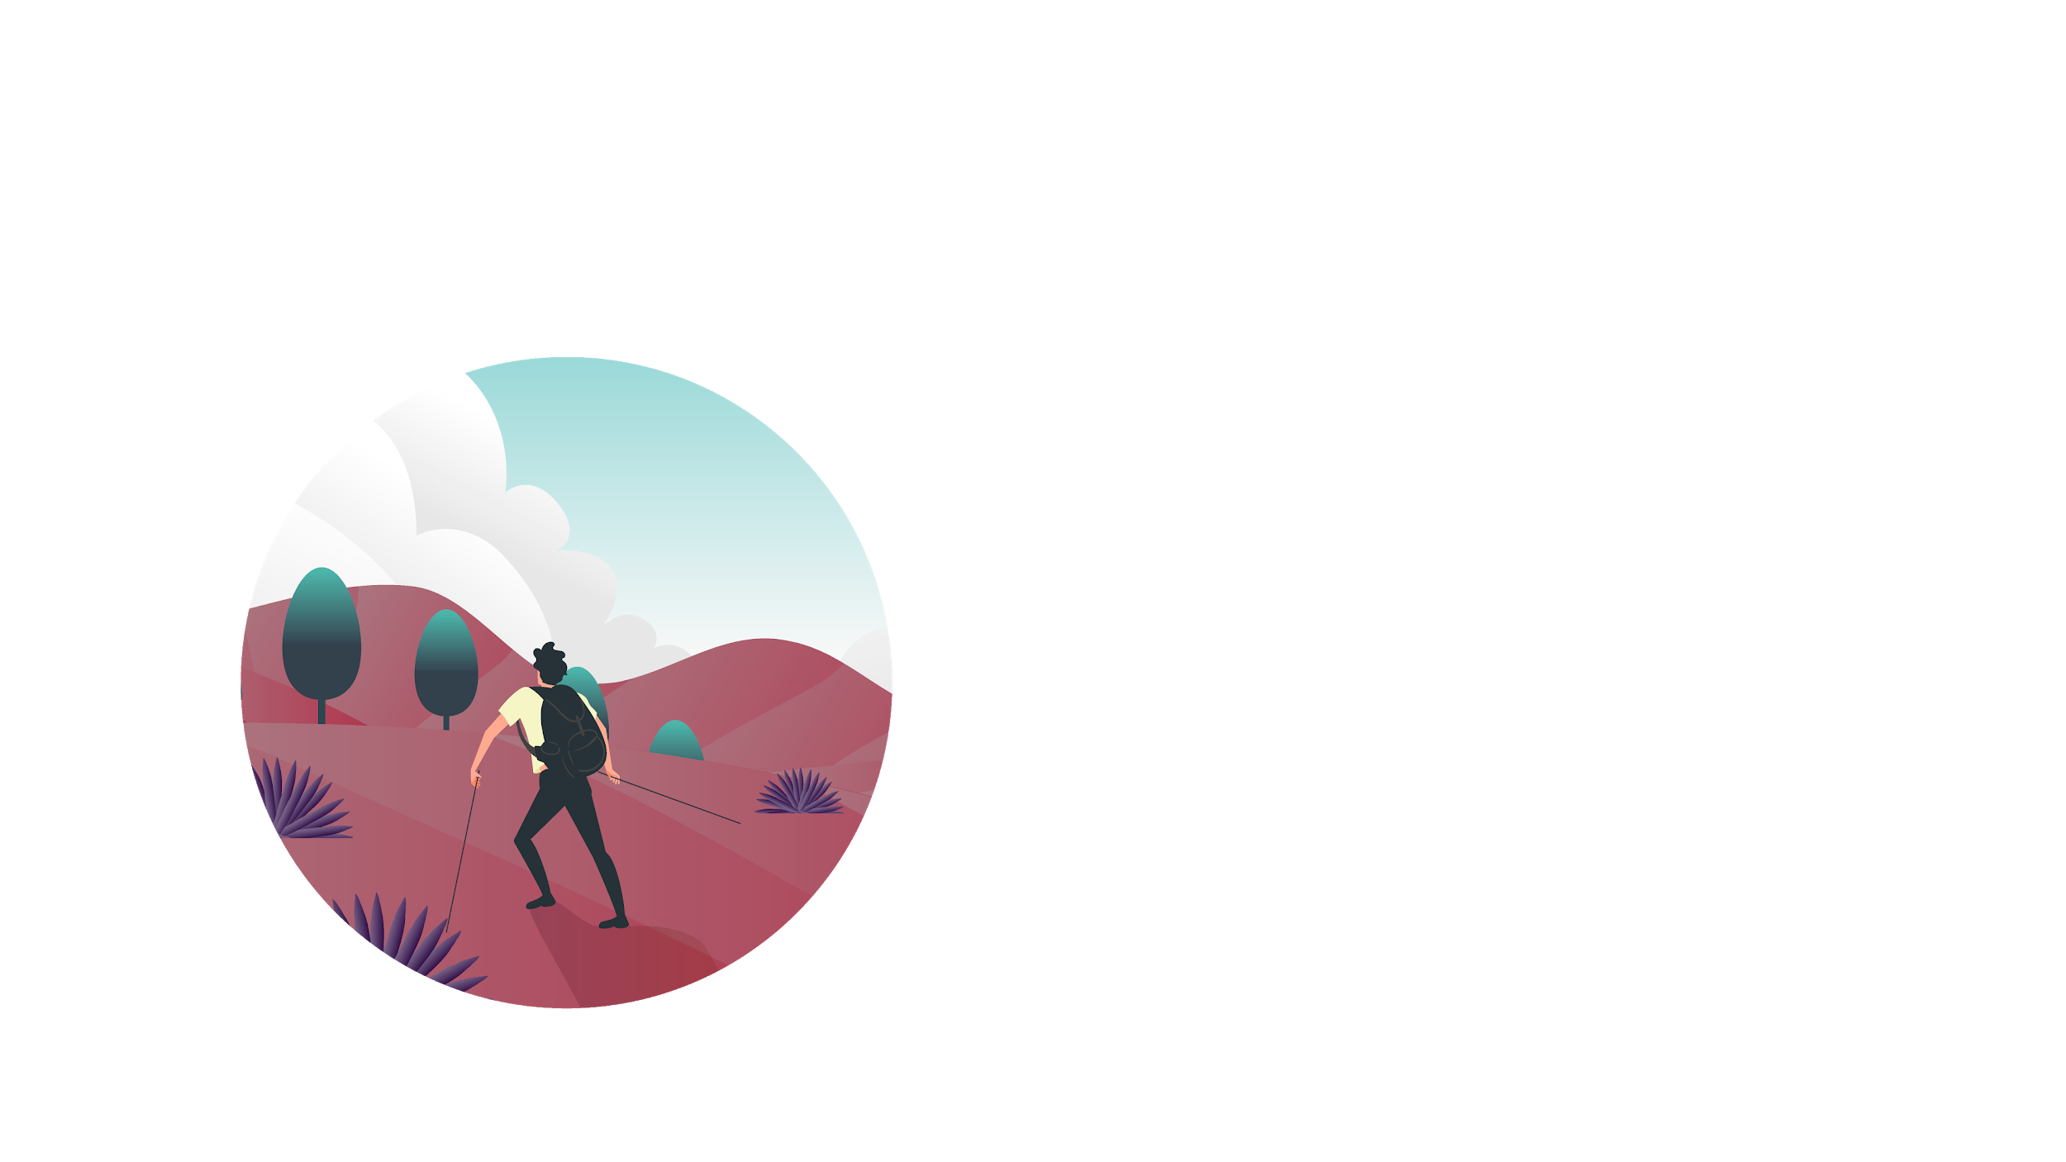
TARGET
500,00
GENDER
AVERAGE SPEND PER CUSTOMER
FEMALE
MALE
HOBBIES
AGE
25-45
45-65

Slide 13
MARKET SIZE
50,000
Agents Worldwide
500 - 1,000
1,000 - 1,500
1,500 - 2,000

Slide 14
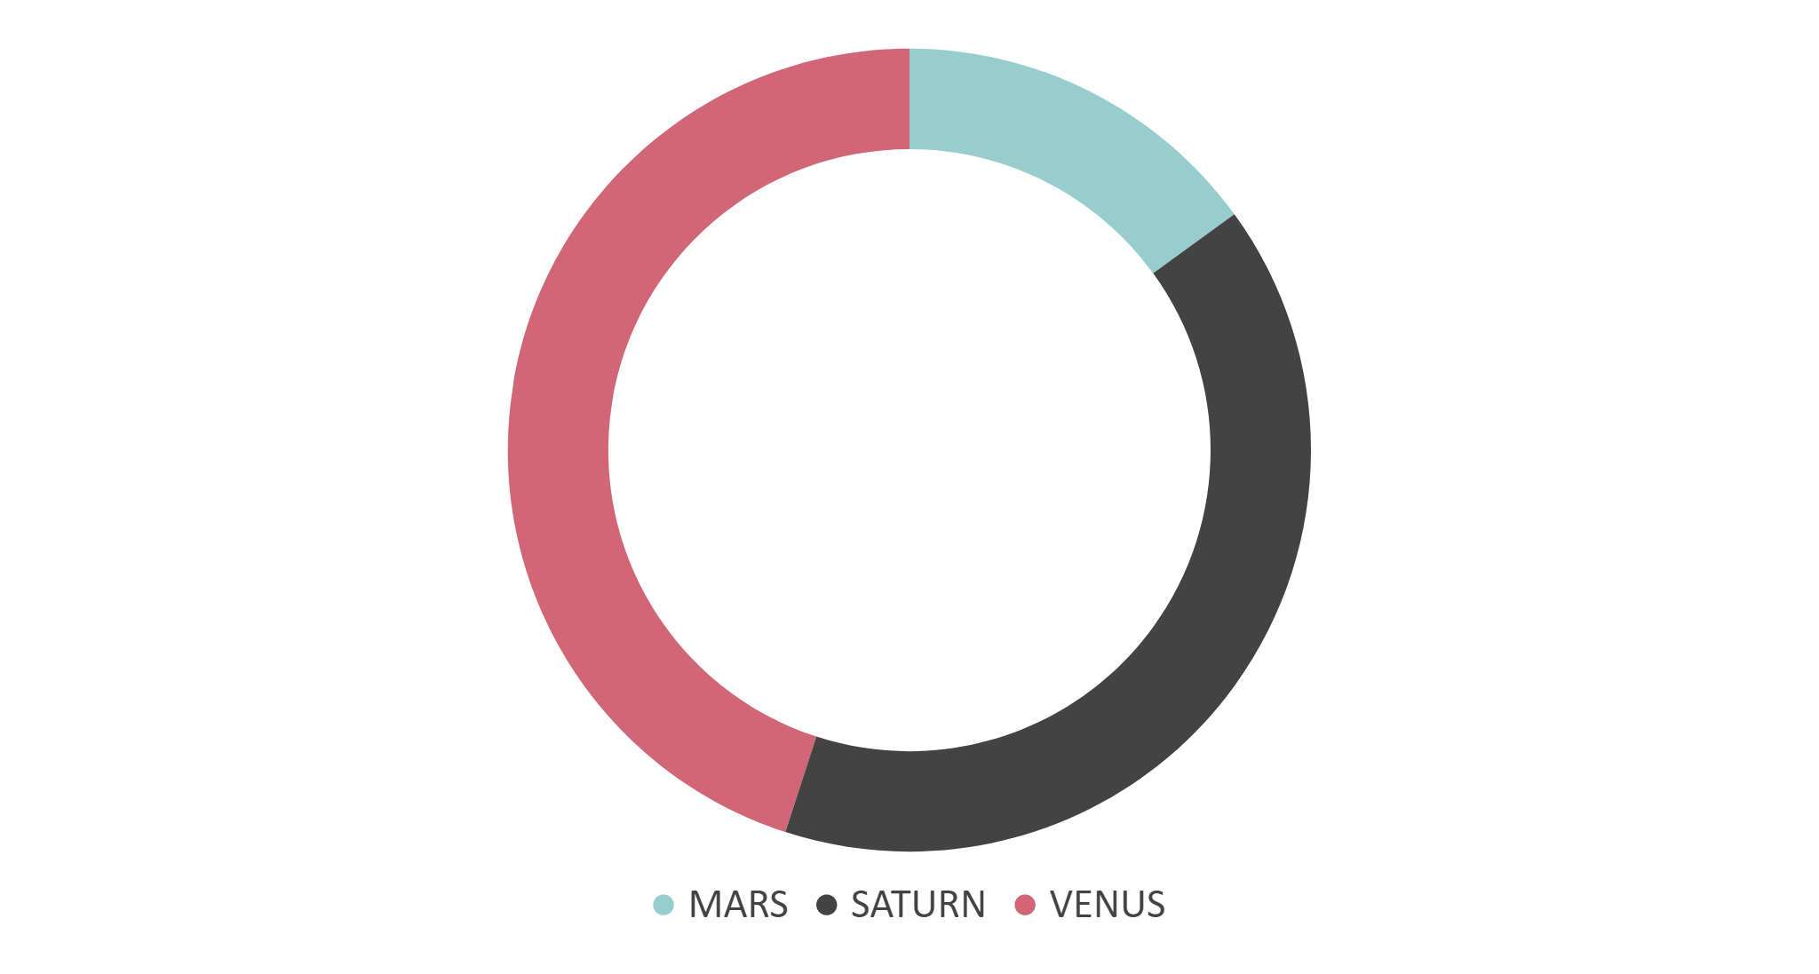
MARKET SHARE
10%
MARS
Despite being red, Mars is a cold place, not hot
45%
VENUS
Venus has a beautiful name, but it’s terribly hot
45%
SATURN
It’s a gas giant, composed mostly of hydrogen and helium
If you want to modify this graph, click on it, follow the link, change the data and replace it

Slide 15
COMPETITION ANALYSIS
MERCURY
VENUS
MARS
JUPITER
Saturn
Uranus

Slide 16
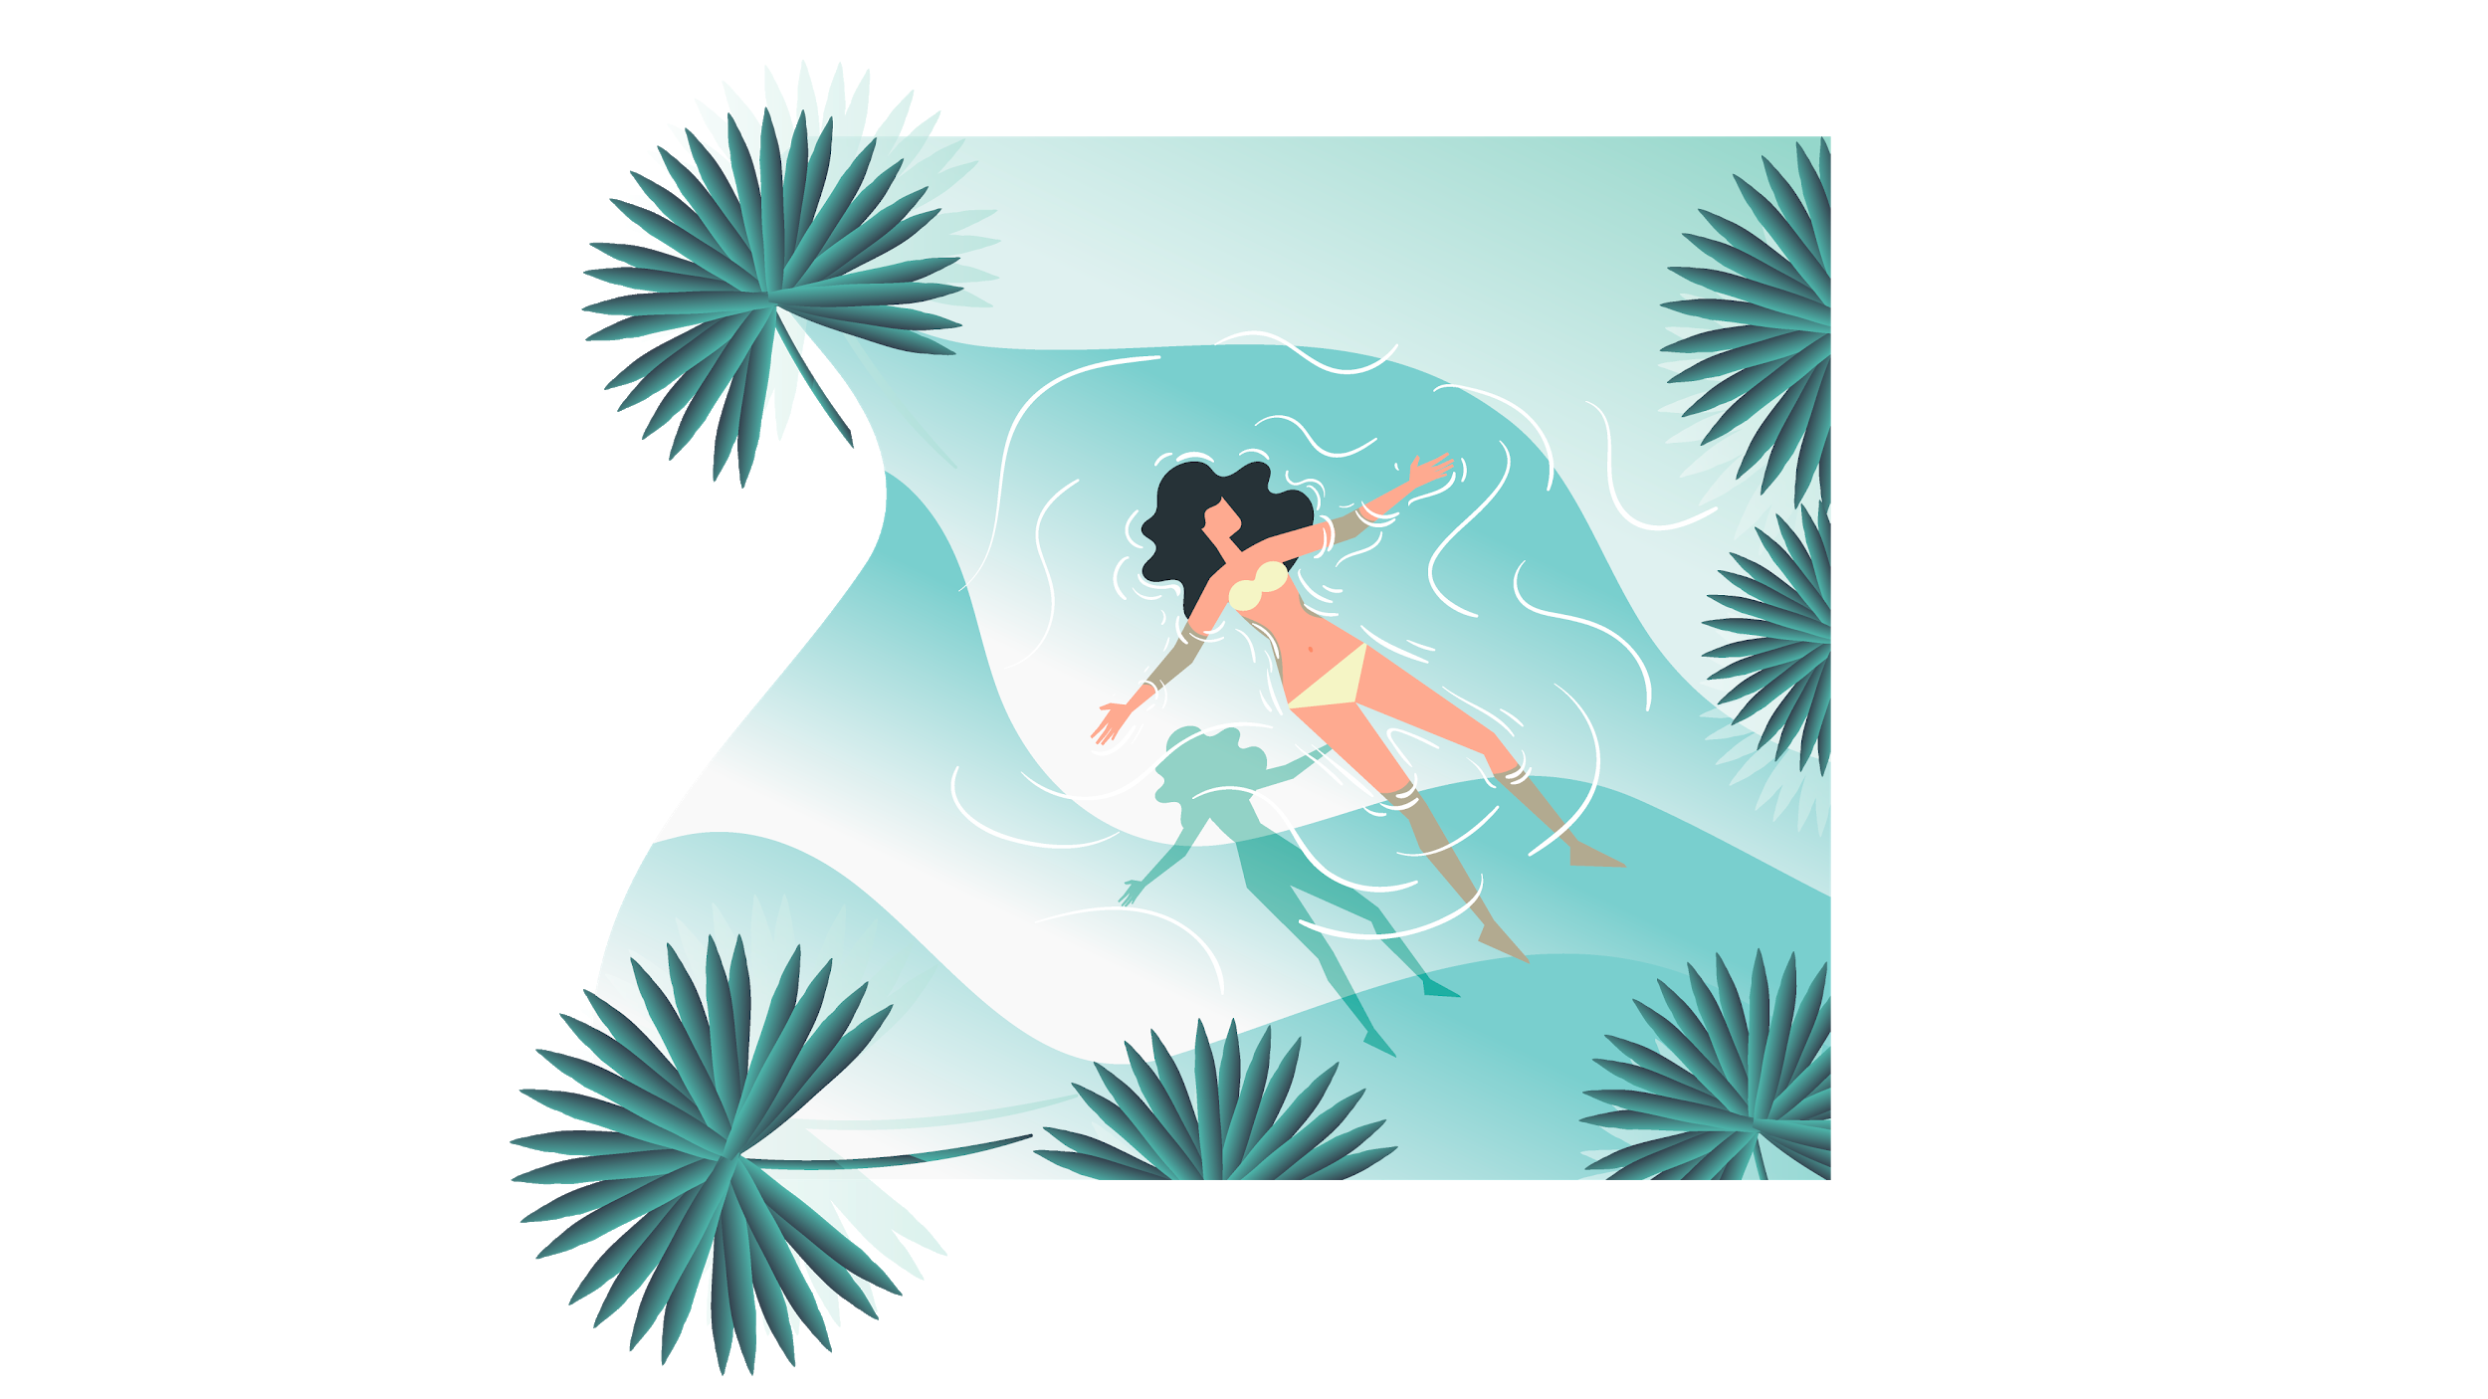
03.
SALES AND MARKETING PLAN

Slide 17

OUR SERVICES
JUPITER
MARS
VENUS
It’s a gas giant and the biggest planet in our Solar System
Despite being red, Mars is a cold place, not hot
Venus has a beautiful name, but it’s terribly hot
MERCURY
NEPTUNE
SATURN
Mercury is the closest planet to the Sun
Neptune is the farthest planet from the Sun
It’s a gas giant, composed mostly of hydrogen and helium

Slide 18
BREAK-EVEN ANALYSIS
HIGH PROFIT
Venus has a beautiful name, but it’s terribly hot
BREAK-EVEN POINT
Jupiter is the biggest planet in our Solar System
BIG LOSS
Mercury is the closest planet to the Sun
PROFIT
Neptune is the furthest planet from the Sun
LOSS
Despite being red, Mars is a cold place

Slide 19
OUR PLANS
BASIC
Jupiter is a gas giant and the biggest planet in our Solar System
PRO
Saturn is a gas giant, composed mostly of hydrogen and helium
PREMIUM
Venus has a beautiful name and is the second planet from the Sun

Slide 20
SALES AND DISTRIBUTION
CHANNEL 1
CHANNEL 2
CHANNEL 3
CHANNEL 4
Producer
Producer
Producer
Producer
Agent/Broker
Wholesaler or Distributor
Wholesaler or Distributor
Retailer
Retailer
Retailer
Consumers
Consumers
Consumers
Consumers

Slide 21
ADVERTISING AND PROMOTION
ADVERTISING
PR
ONLINE
Mercury is the closest planet to the Sun and the smallest one in the Solar System—it’s only a bit larger than our Moon
Despite being red, Mars is a cold place, not hot. It’s full of iron oxide dust, which gives the planet its reddish cast
Venus has a beautiful name and is the second planet from the Sun. It’s terribly hot—even hotter than Mercury

Slide 22
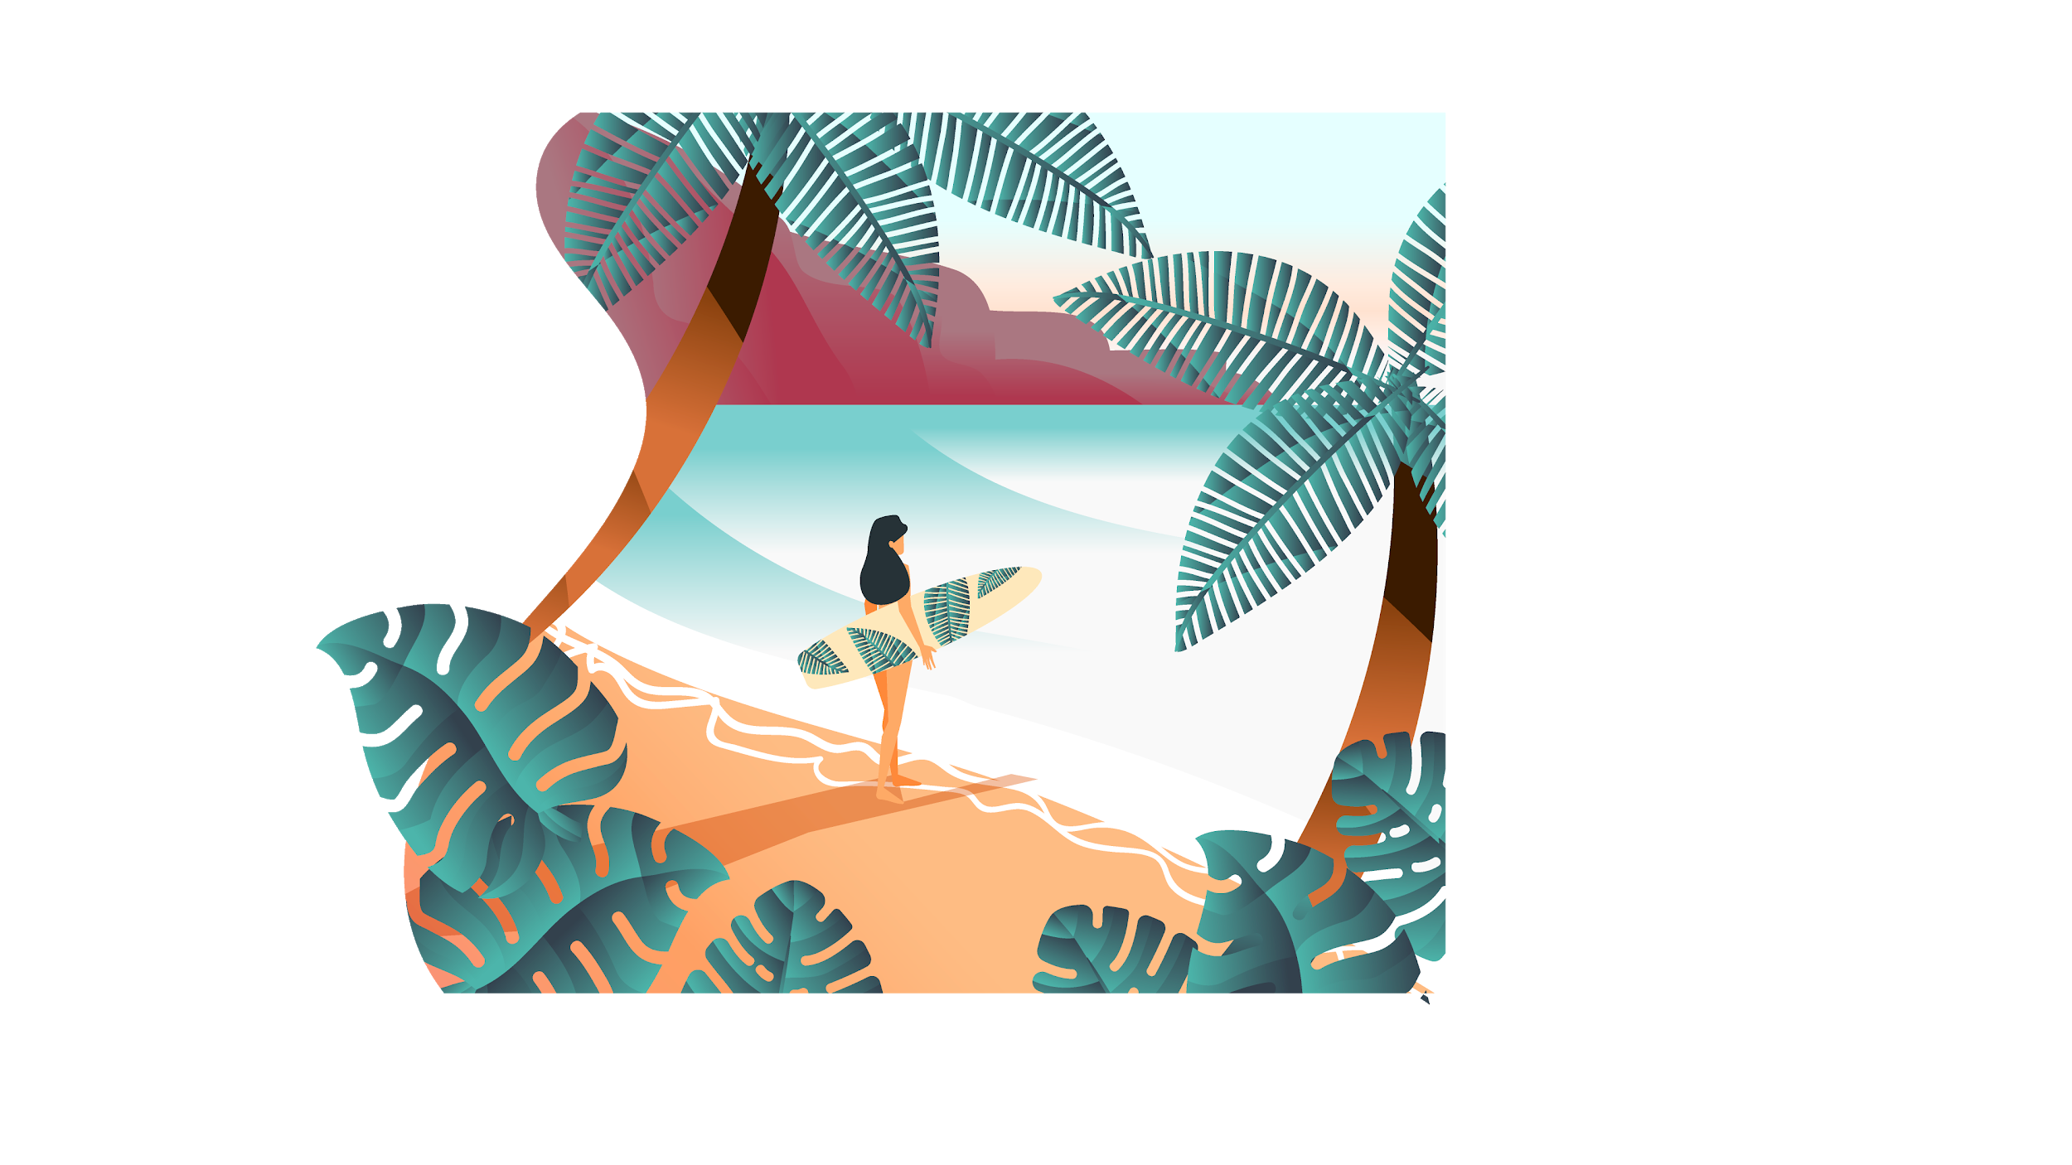
04.
MANAGEMENT PLAN

Slide 23
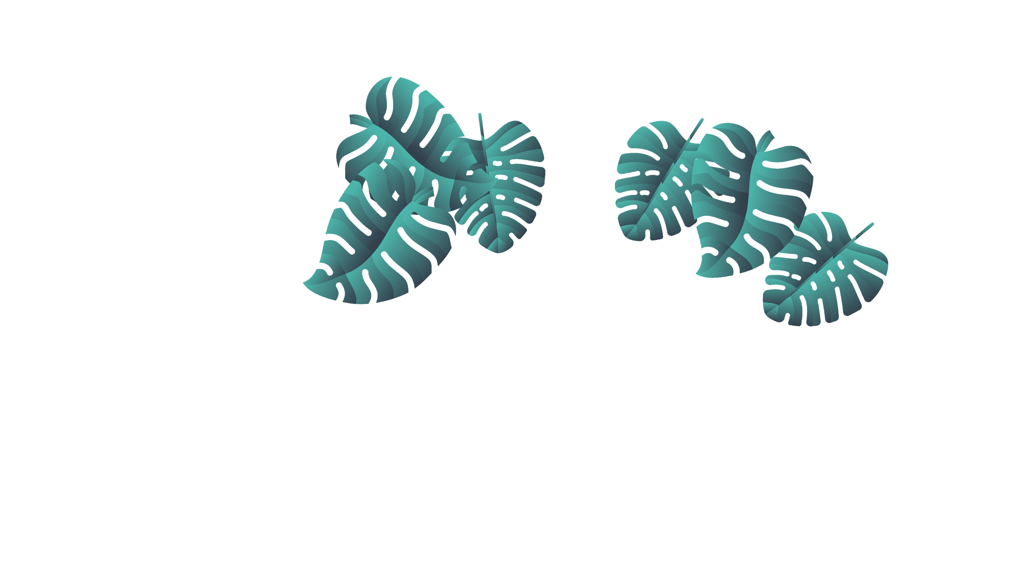
OUR TEAM
JAMES PATTERSON
JIMMY TIMMY
You can replace the image on the screen with your own
You can replace the image on the screen with your own
JOHN JAMES
JENNA DOE
You can replace the image on the screen with your own
You can replace the image on the screen with your own

Slide 24
ORGANIZATIONAL CHART
PRESIDENT
BUSINESS MANAGER
LEISURE MANAGER
BLEISURE MANAGER
Travel Consultant 1
Travel Consultant 1
Travel Consultant 1
Travel Consultant 2
Travel Consultant 2
Travel Consultant 2

Slide 25
OUR PARTNERS
JUPITER
VENUS
MARS
Yes, this is the ringed one. It’s composed mostly of hydrogen and helium
Venus has a beautiful name, but it’s terribly hot, even hotter than Mercury
Despite being red, Mars is a cold place, not hot. It’s full of iron oxide dust

Slide 26
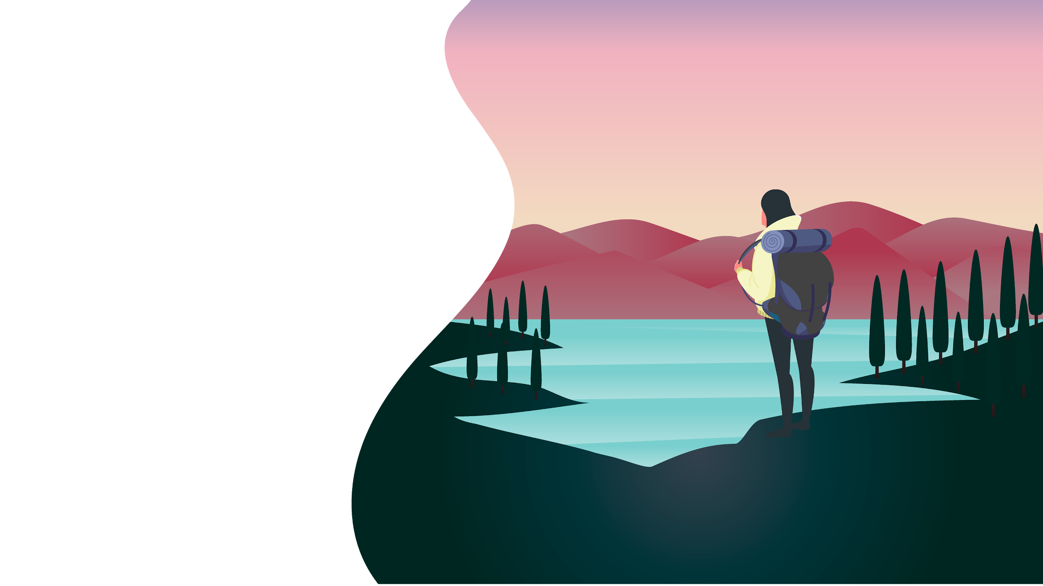
05.
OPERATIONAL PLAN

Slide 27
OUR PROCESS
MARS
JUPITER
NEPTUNE
SATURN
Despite being red, Mars is a cold place, not hot
Jupiter is the biggest planet in our Solar System
Neptune is the fourth-largest planet in our Solar System
Saturn is composed mostly of hydrogen and helium

Slide 28
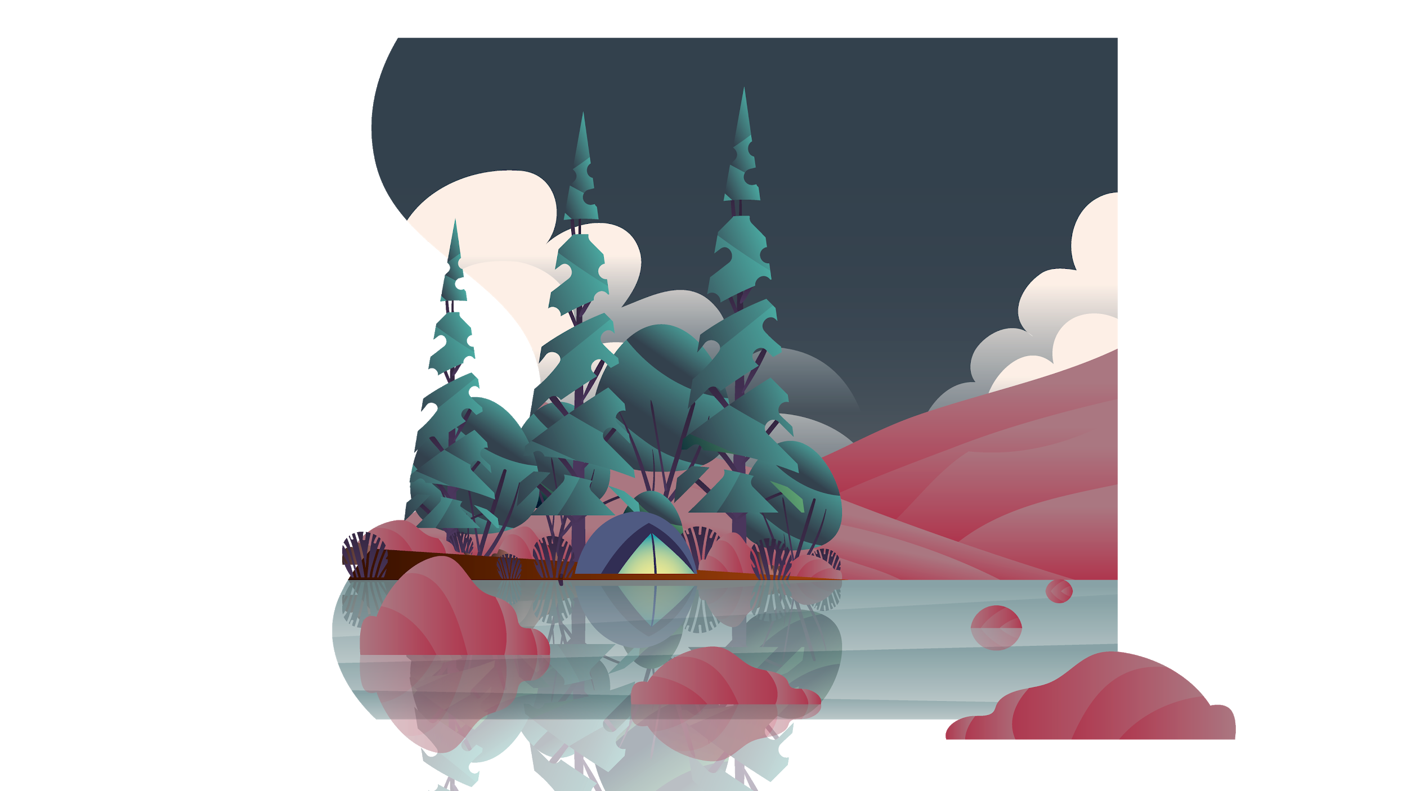
06.
FINANCIAL PLAN

Slide 29
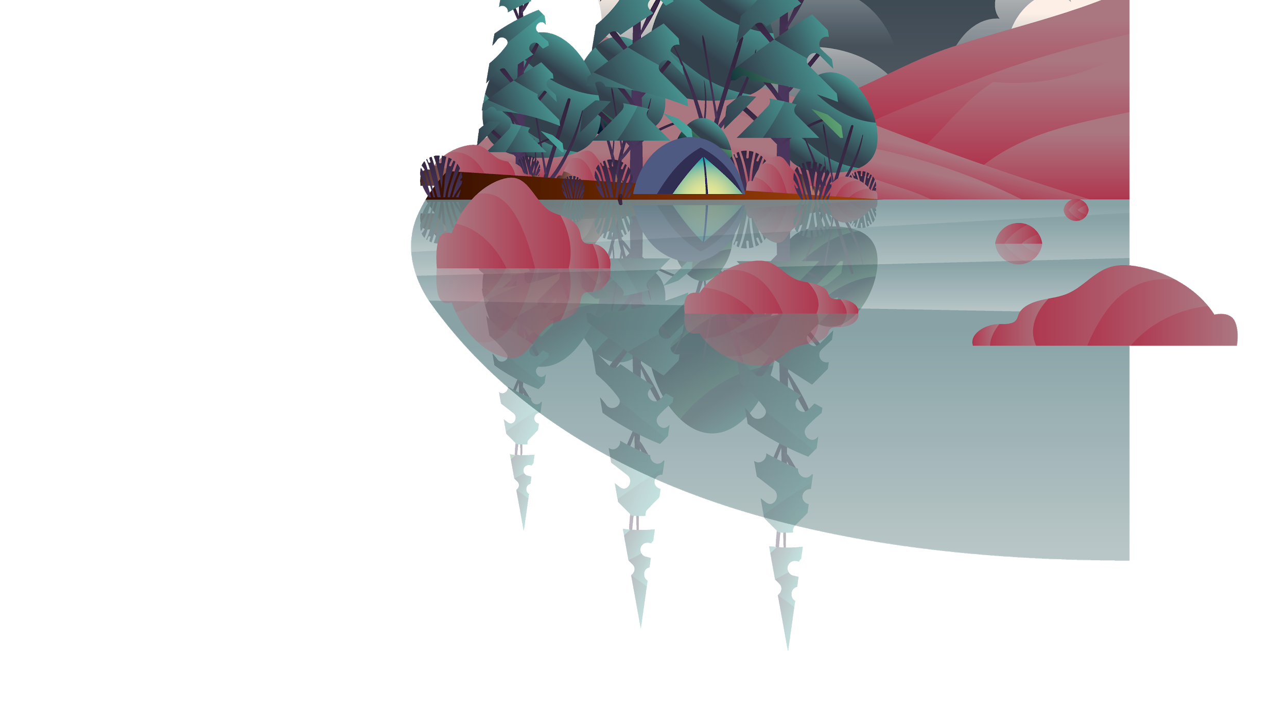
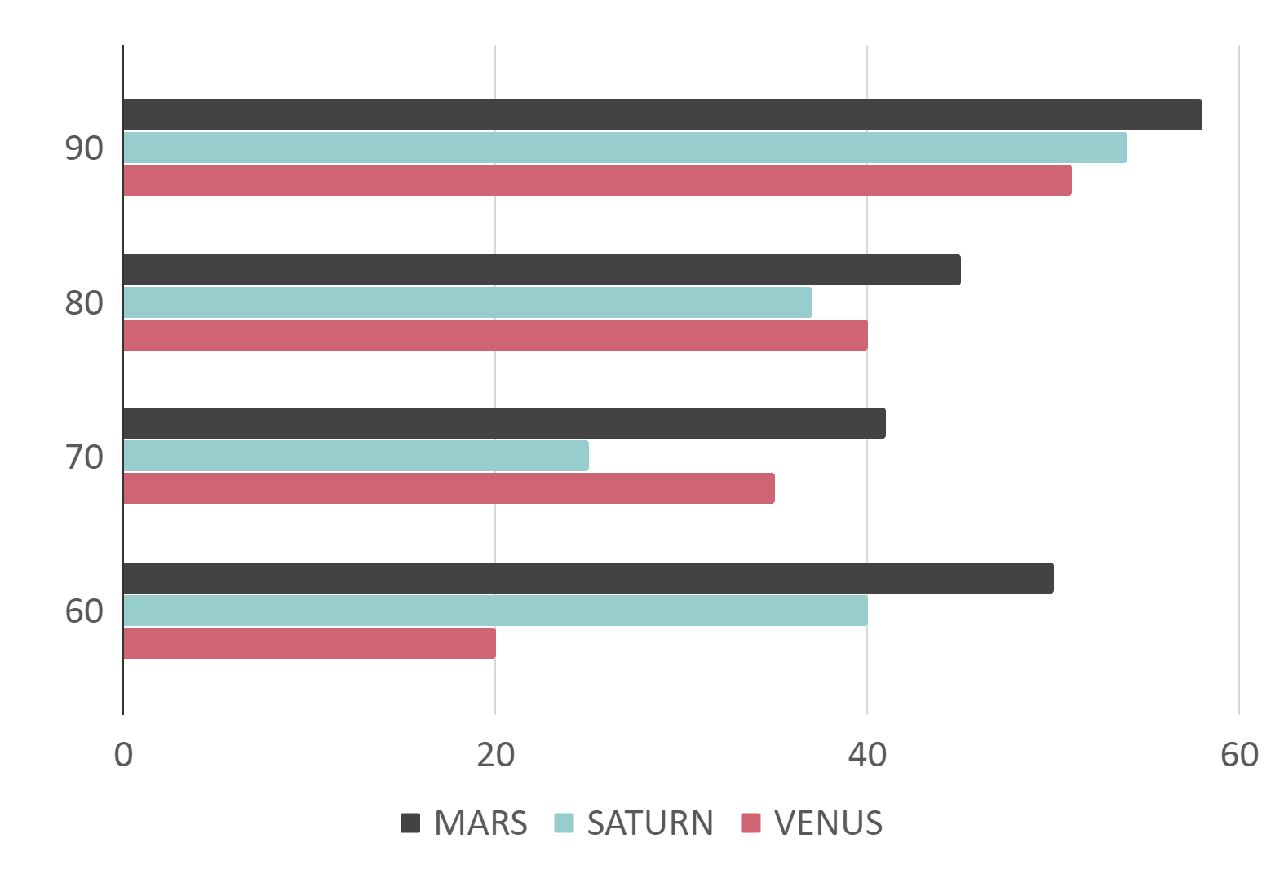
PREDICTED GROWTH
If you want to modify this graph, click on it, follow the link, change the data and replace it

Slide 30
BALANCE SHEETS
ASSETS
LIABILITIES
EQUITY
Jupiter is a gas giant and the biggest planet in our Solar System
Neptune is the fourth-largest planet in our Solar System
Saturn is a gas giant. It’s composed mostly of hydrogen and helium
3K
1M
7K

Slide 31
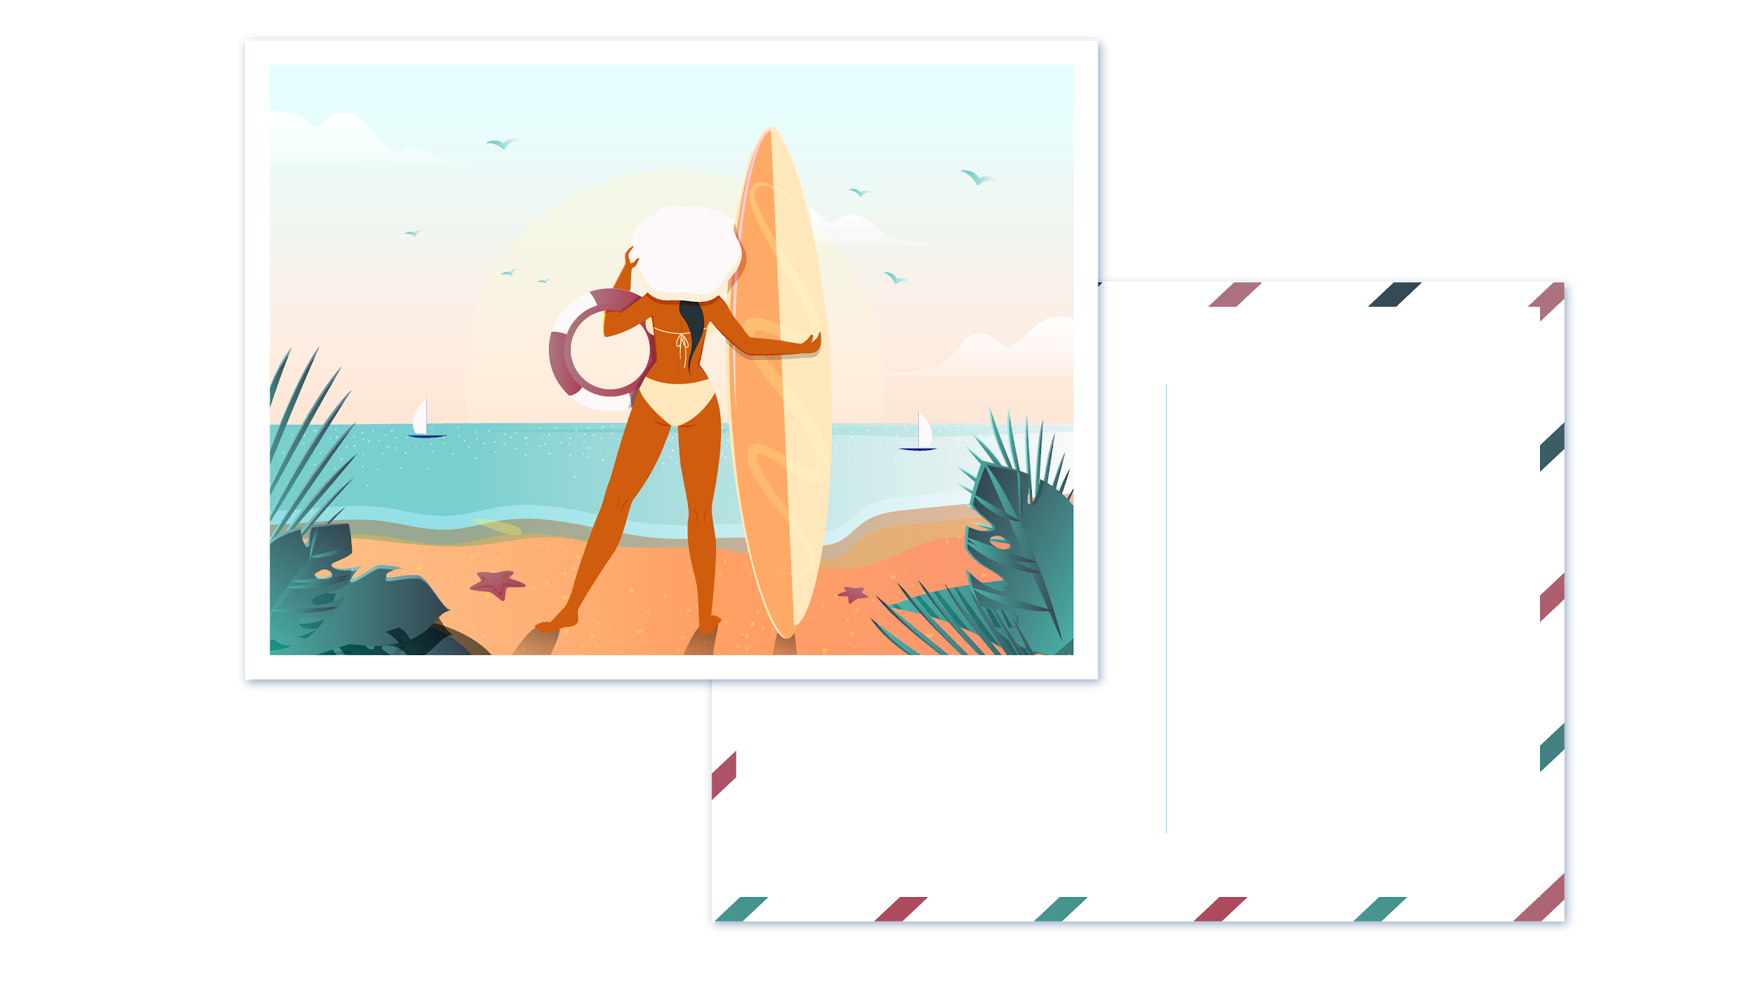
THANKS
THANKS
Does anyone have any questions?
addyouremail@freepik.com
+91 620 421 838
yourcompany.com

Slide 32
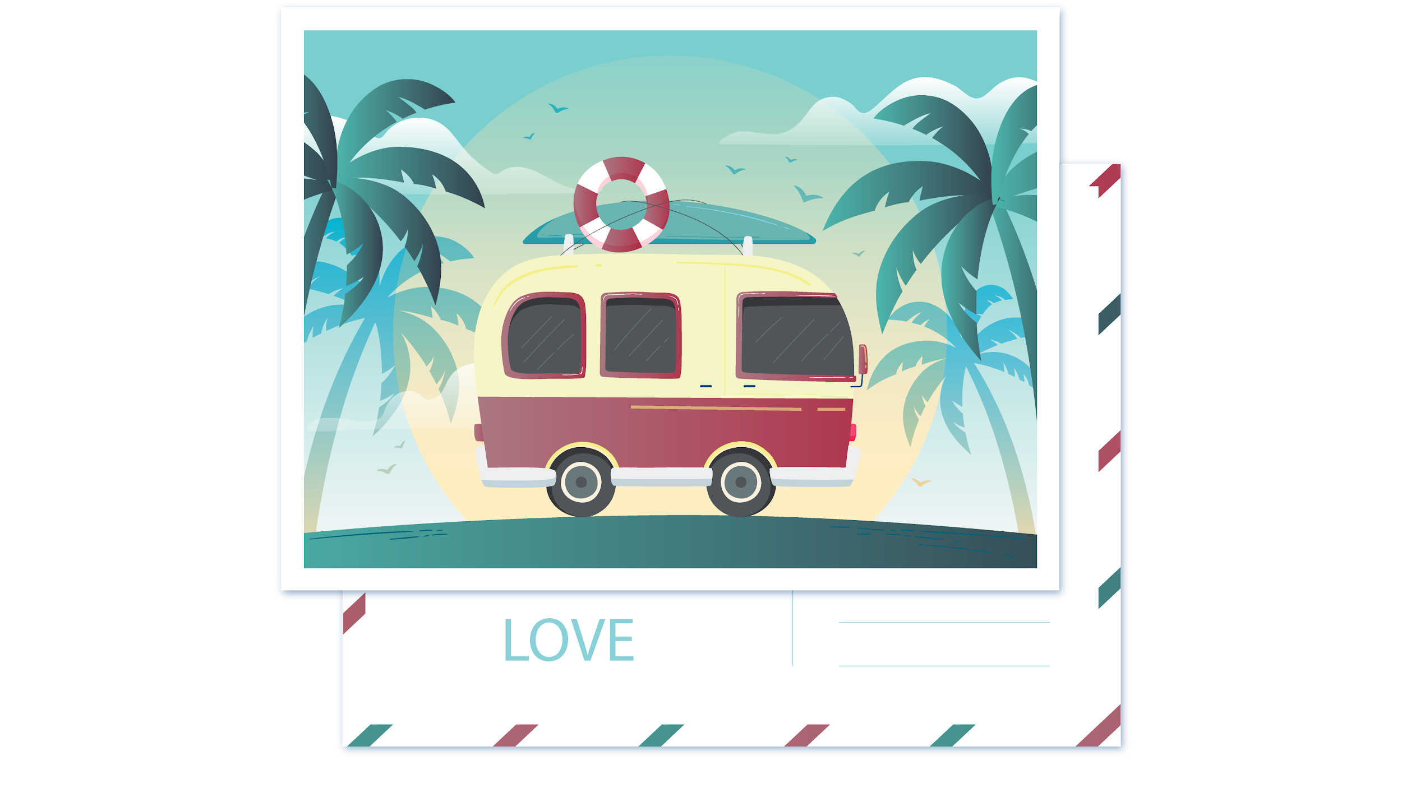
CREDITS
This is where you give credit to the ones who are part of this project.
Presentation template by Slidesgo
Icons by Flaticon
Infographics and images by Freepik
Author introduction slide photo created by Freepik
Text & Image slide photo created by Freepik.com

Slide 33
RESOURCES
Did you like the resources on this template? Get them for free at our other websites.
Tent Icon
Shack Icon
Car Icon
Equality Icon
Motivation Icon Pack
Aviation Icon Pack
Landscapes collection Icon Pack
Marketing Icon Pack
Outdoor Activities Icon Pack
Profession avatars Icon Pack
Flat vintage travel logo Free Vector
Travel landing page flat design Free Vector
Travel landing page flat design Free Vector
Travel landing page flat design Free Vector
Travel landing page flat design Free Vector
Travel landing page flat design Free Vector
Travel landing page flat design Free Vector
Travel landing page flat design Free Vector
Travel landing page flat design Free Vector
Travel landing page flat design Free Vector
Flat tropical summer holiday postcard Free Vector
Flat tropical summer holiday postcard Free Vector
Outdoor activities landing page template Free Vector
Hand drawn camping landing page template Free Vector

Slide 34
Instructions for use
In order to use this template, you must credit Slidesgo by keeping the Credits slide.
You are allowed to:
- Modify this template.
- Use it for both personal and commercial projects.
You are not allowed to:
- Sublicense, sell or rent any of Slidesgo Content (or a modified version of Slidesgo Content).
- Distribute Slidesgo Content unless it has been expressly authorized by Slidesgo.
- Include Slidesgo Content in an online or offline database or file.
- Offer Slidesgo templates (or modified versions of Slidesgo templates) for download.
- Acquire the copyright of Slidesgo Content.
For more information about editing slides, please read our FAQs:
https://slidesgo.com/faqs

Slide 35
Fonts & colors used
This presentation has been made using the following fonts:
Anton
(https://fonts.google.com/specimen/Anton)
Abel
(https://fonts.google.com/specimen/Abel)
#d16676
#97cecd
#434343
#f5f5c6

Slide 37
Use our editable graphic resources...
You can easily resize these resources, keeping the quality. To change the color, just ungroup the resource and click on the object you want to change. Then, click on the paint bucket and select the color you want. Don’t forget to group the resource again when you’re done.

Slide 38
...and our set of editable icons
You can resize these icons, keeping the quality.
You can change the stroke and fill color; just select the icon and click on the paint-bucket/pen

Slide 39
Business Icons

Slide 40
Avatar Icons

Slide 41
Creative Process Icons

Slide 42
Educational Process Icons

Slide 43
Help & Support Icons

Slide 44
Medical Icons

Slide 45
Nature Icons

Slide 46
Performing Arts Icons

Slide 47
SEO & Marketing Icons

Slide 48
Teamwork Icons

Slide 49


