Slide 1
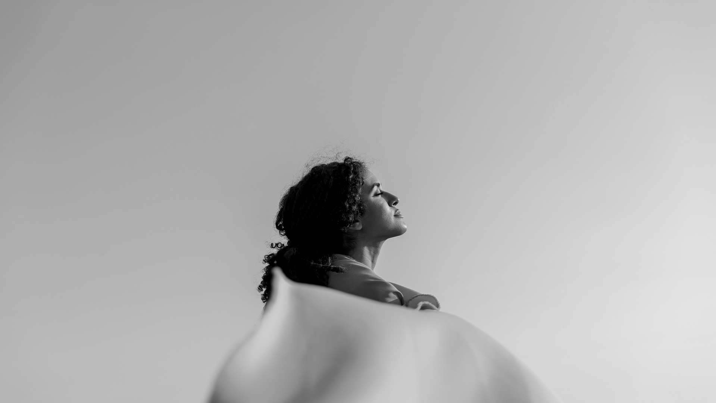
PHOTOGRAPHY PORTFOLIO
HERE IS WHERE YOUR PRESENTATION BEGINS

Slide 2
TABLE OF CONTENTS
01
02
03
ABOUT ME
MY VALUES
WHAT I DO
04
05
06
MY EXPERIENCE
MY WORK
CONTACT

Slide 3
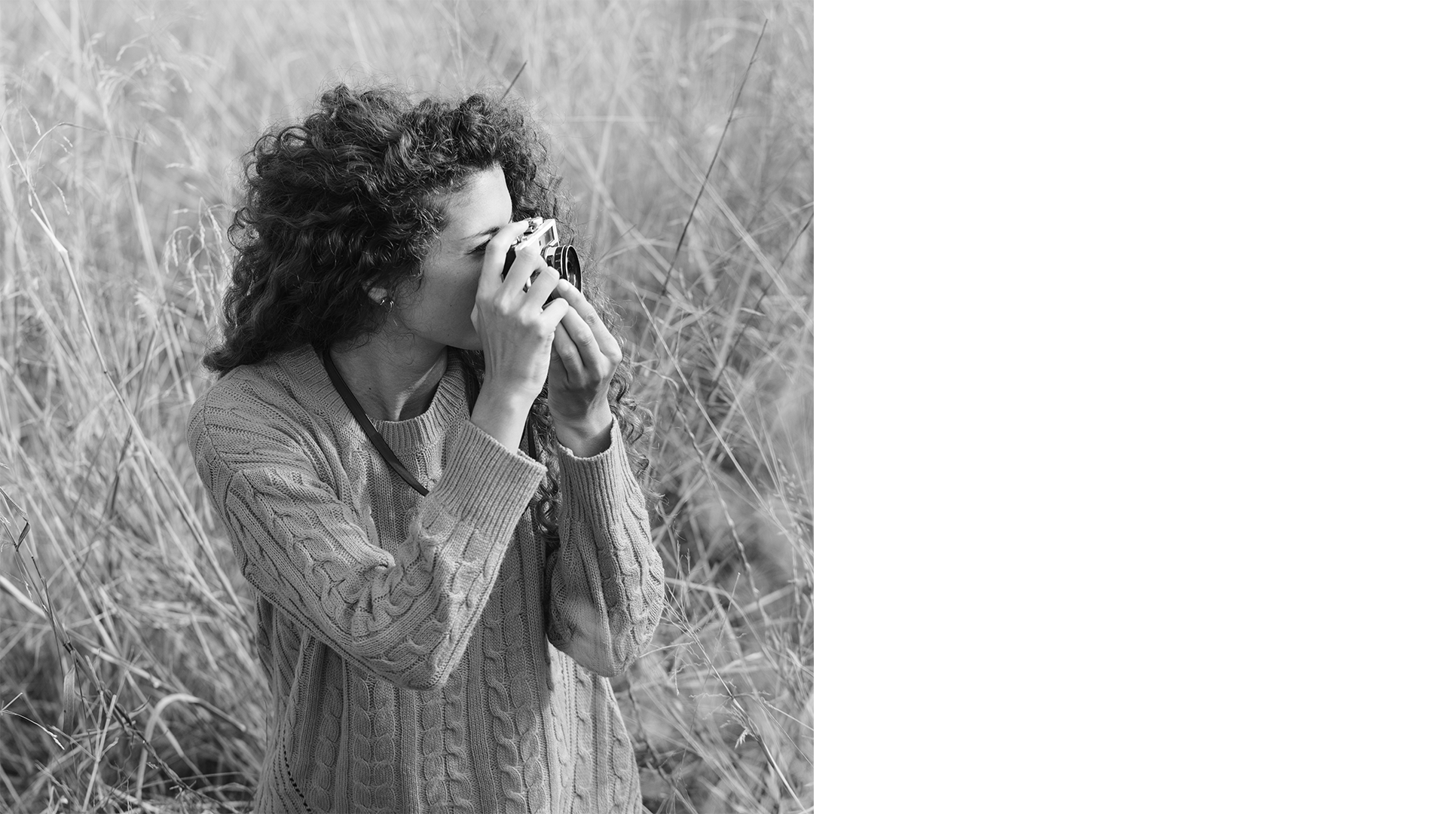
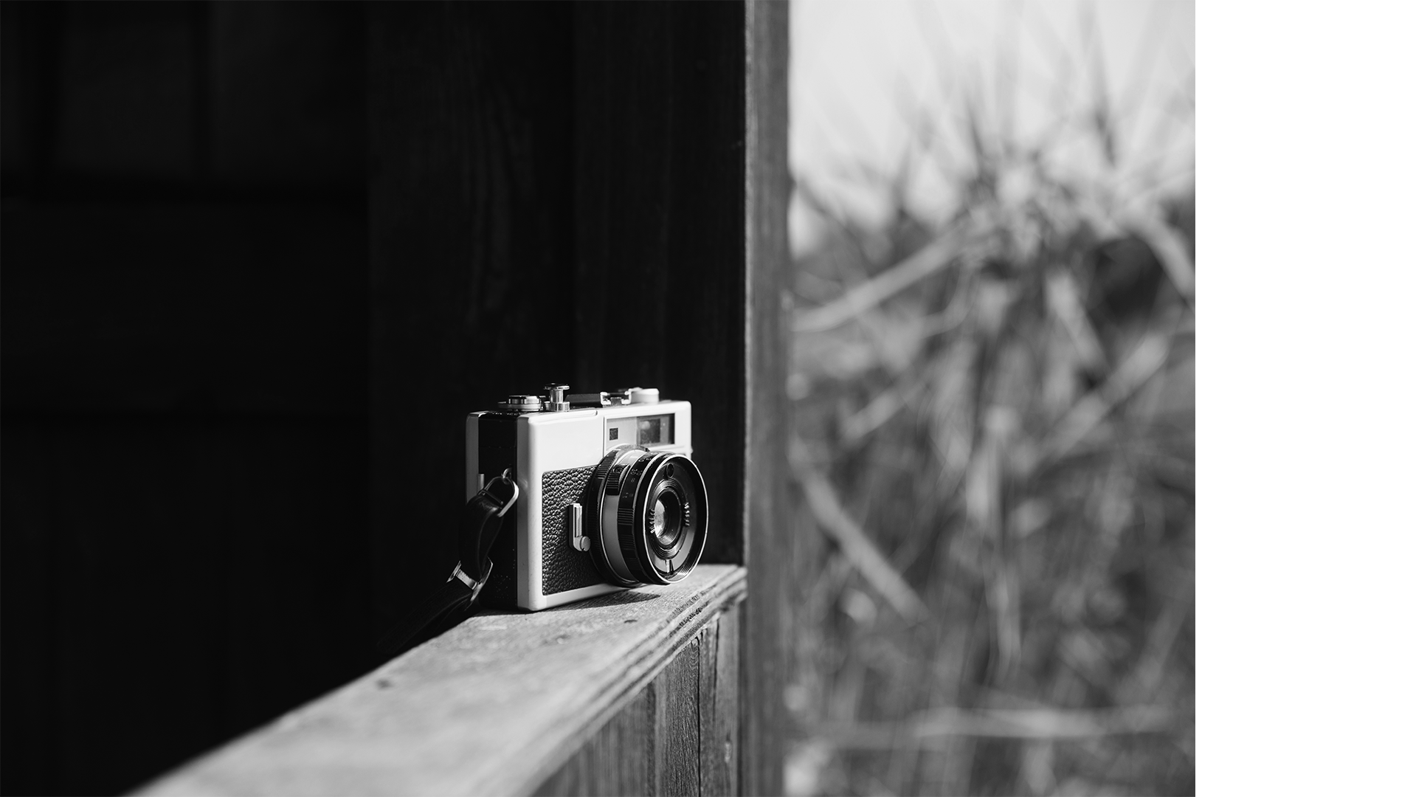
ABOUT ME
03
Venus has a beautiful name and is the second planet from the Sun. It’s terribly hot—even hotter than Mercury—and its atmosphere is extremely poisonous. It’s the second-brightest natural object in the night sky after the Moon

Slide 4
MY VALUES
04
MERCURY
VENUS
MARS
Mercury is the closest planet to the Sun and the smallest one in the Solar System. In fact, it’s only a bit larger than our Moon
Venus has a beautiful name and is the second planet from the Sun. It’s terribly hot, even hotter than Mercury
Despite being red, Mars is a cold place, not hot. It’s full of iron oxide dust, which gives the planet its reddish cast

Slide 5
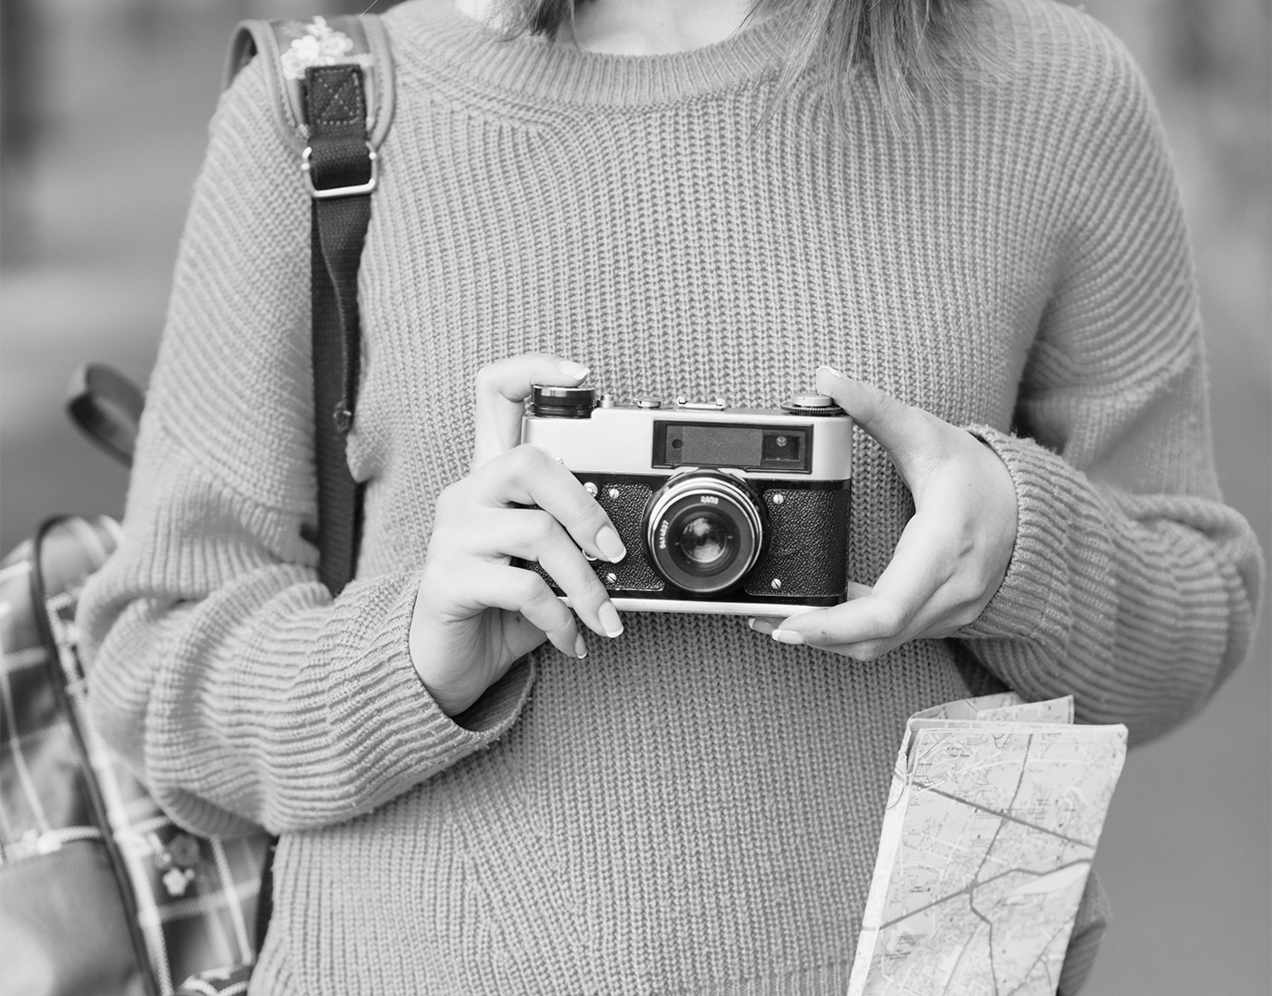
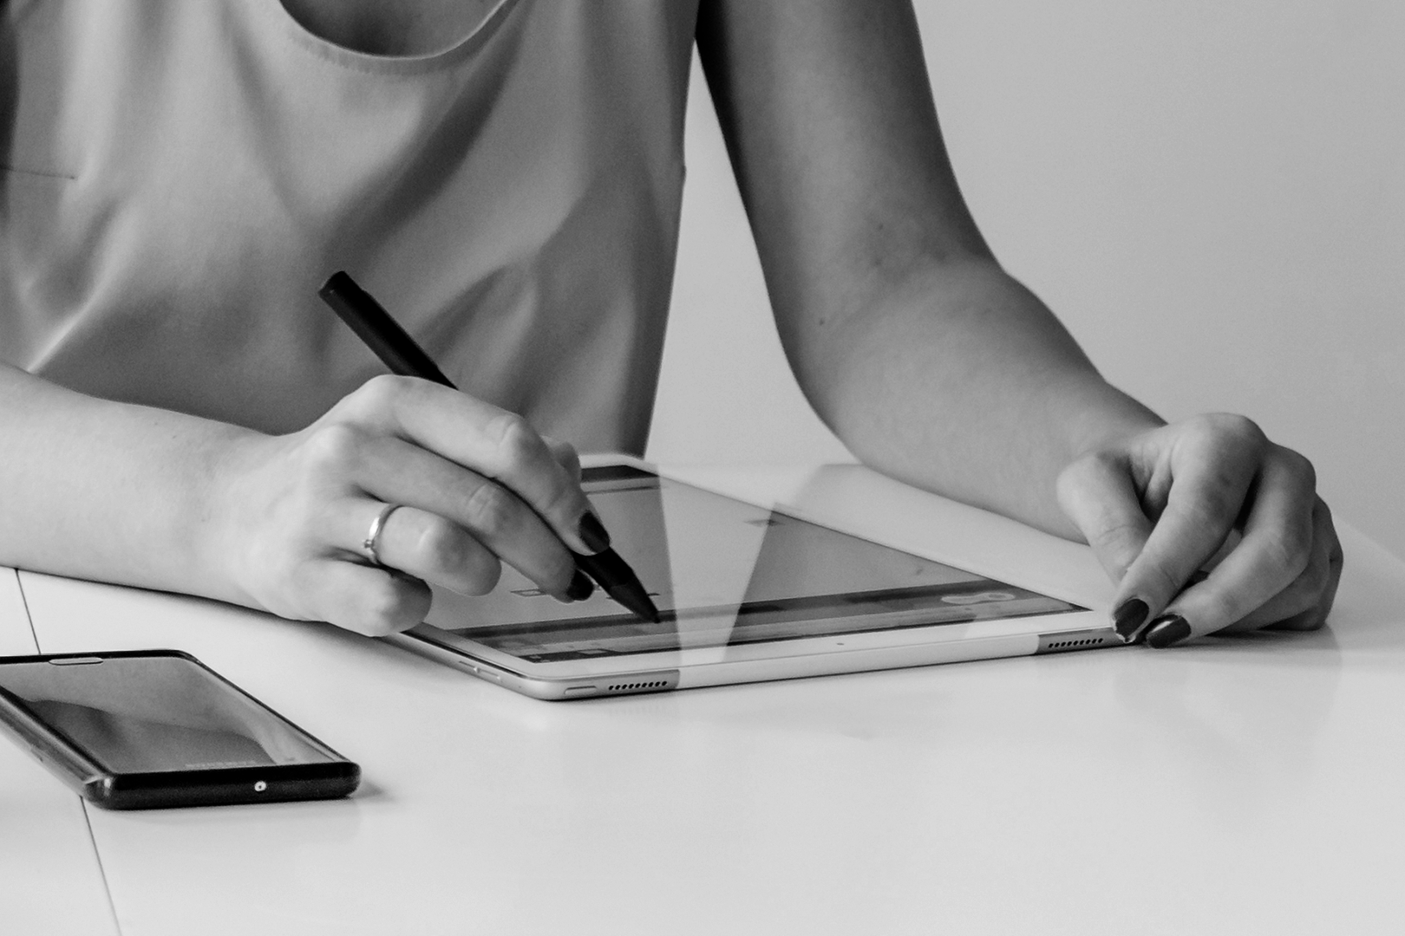
WHAT I DO
05
MERCURY
Mercury is the closest planet to the Sun and the smallest one in the Solar System—it’s only a bit larger than our Moon. The planet’s name has nothing to do with the liquid metal since it was named after the Roman messenger god, Mercury
VENUS
Venus has a beautiful name and is the second planet from the Sun. It’s terribly hot—even hotter than Mercury—and its atmosphere is extremely poisonous. It’s the second-brightest natural object in the night sky after the Moon

Slide 6
MY RESUME
EDUCATION
EXPERIENCES
PROFILE
HOBBIES
SKILLS
06
2015 - 2019
Mention the institution
List your studies here
2015 - 2019
Mention the institution
List your studies here
2015 - 2019
Mention the institution
List your studies here
2015 - 2019
Mention the institution
List your studies here
2015 - 2019
Mention the institution
List your studies here
2015 - 2019
Mention the institution
List your studies here
Mercury is the closest planet to the Sun and the smallest one in the Solar System—it’s only a bit larger than our Moon. The planet’s name has nothing to do with the liquid metal since it was named after the Roman messenger god, Mercury
PHOTOGRAPHY
PHOTO EDITING
DESIGN
VIDEOGRAPHY
ILLUSTRATION

Slide 7
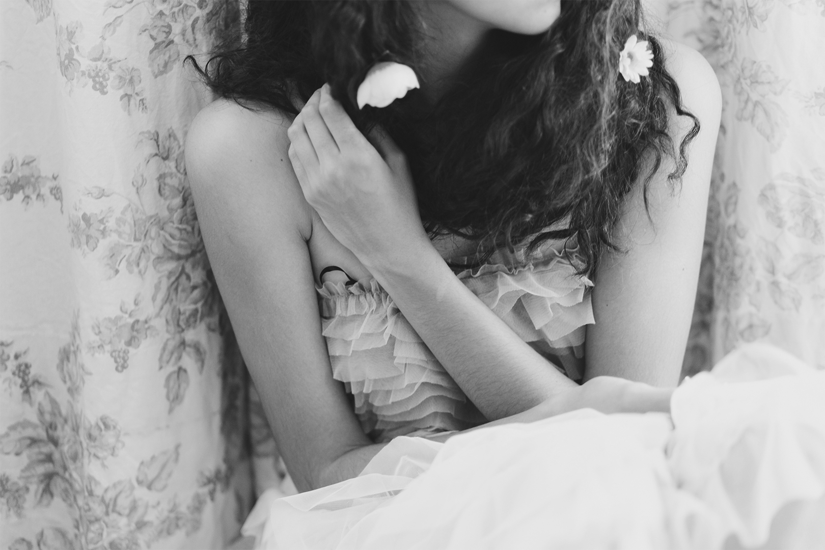
MY WORK
WEDDINGS
07

Slide 8
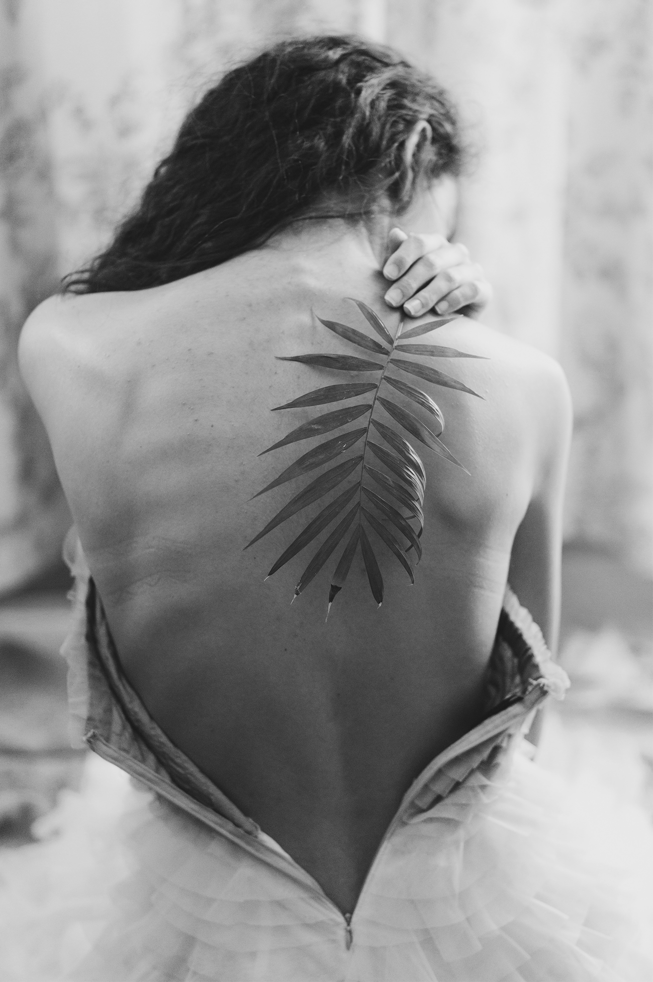
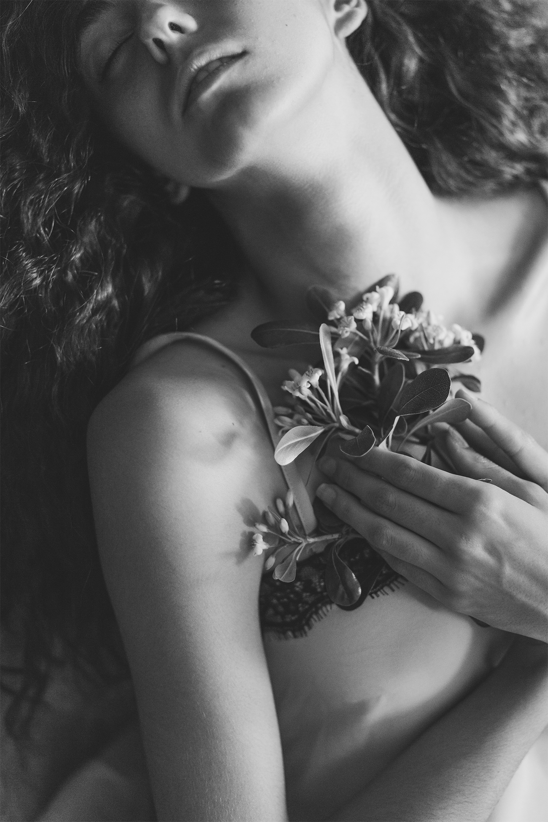
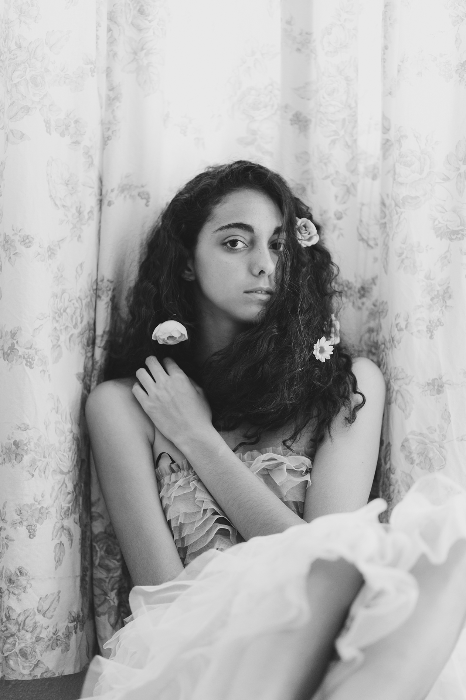
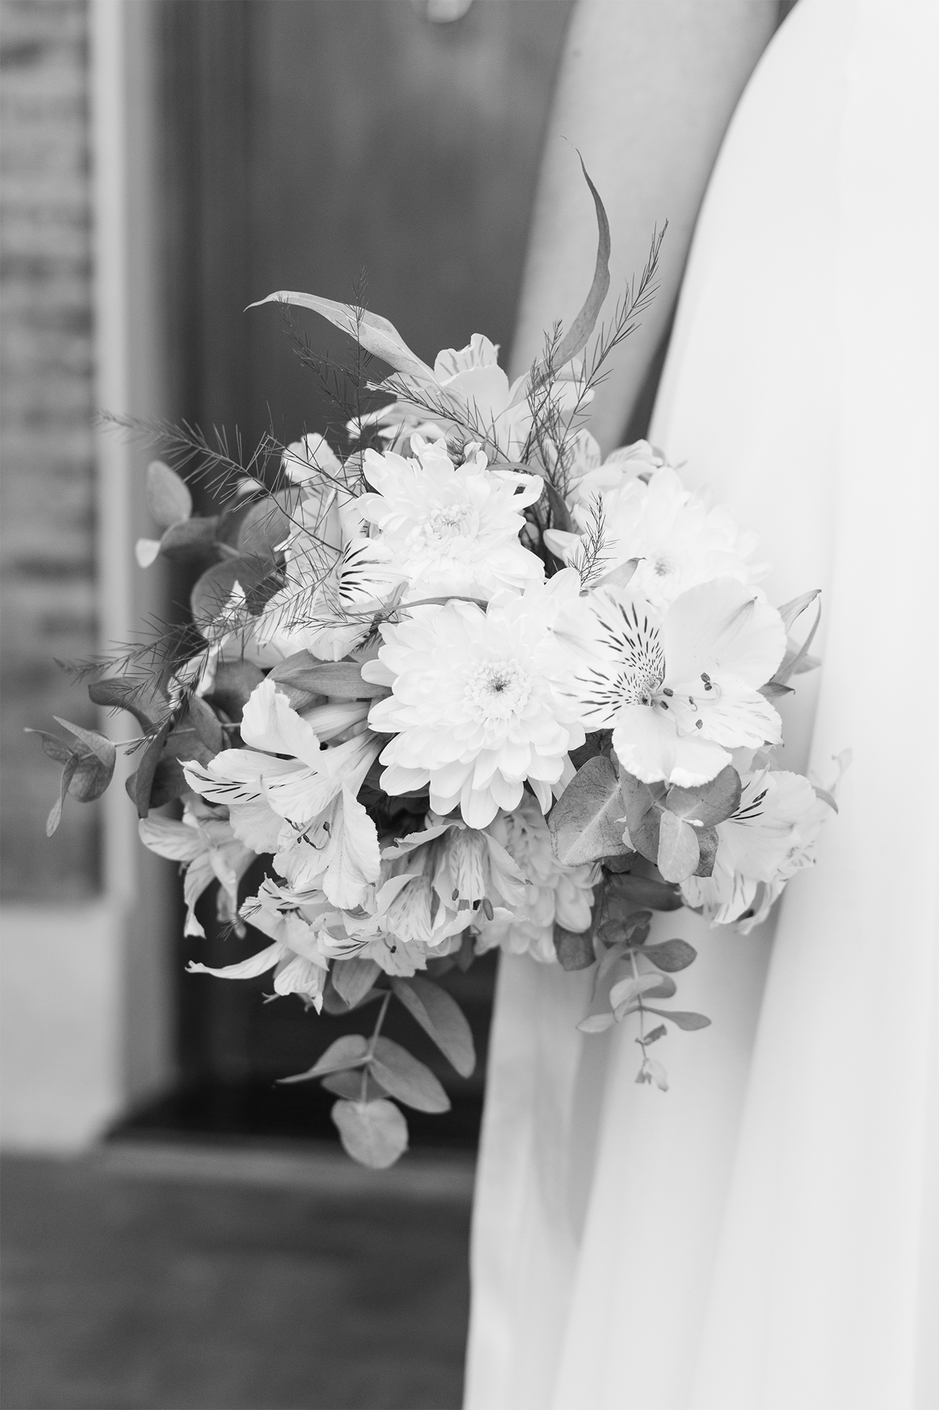
PROJECT VENUS
08
Venus has a beautiful name and is the second planet from the Sun. It’s terribly hot—even hotter than Mercury—and its atmosphere is extremely poisonous. It’s the second-brightest natural object in the night sky after the Moon

Slide 9
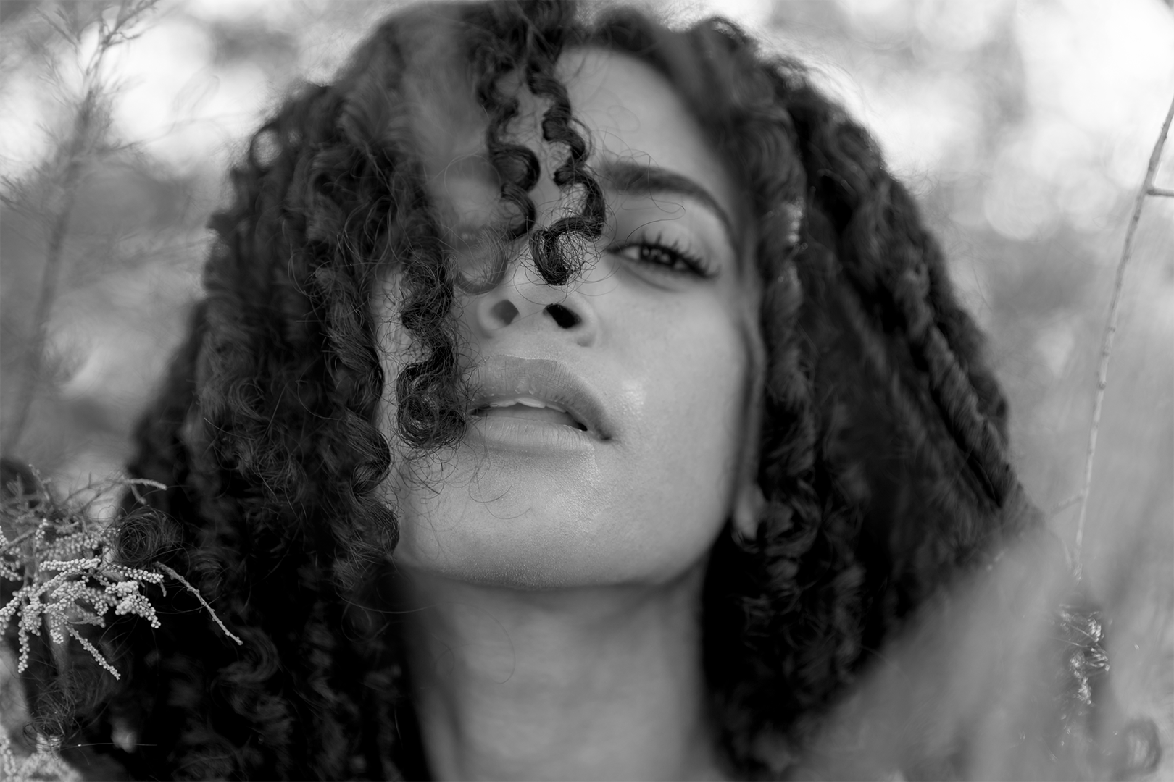
PORTRAITS
MY WORK
09

Slide 10
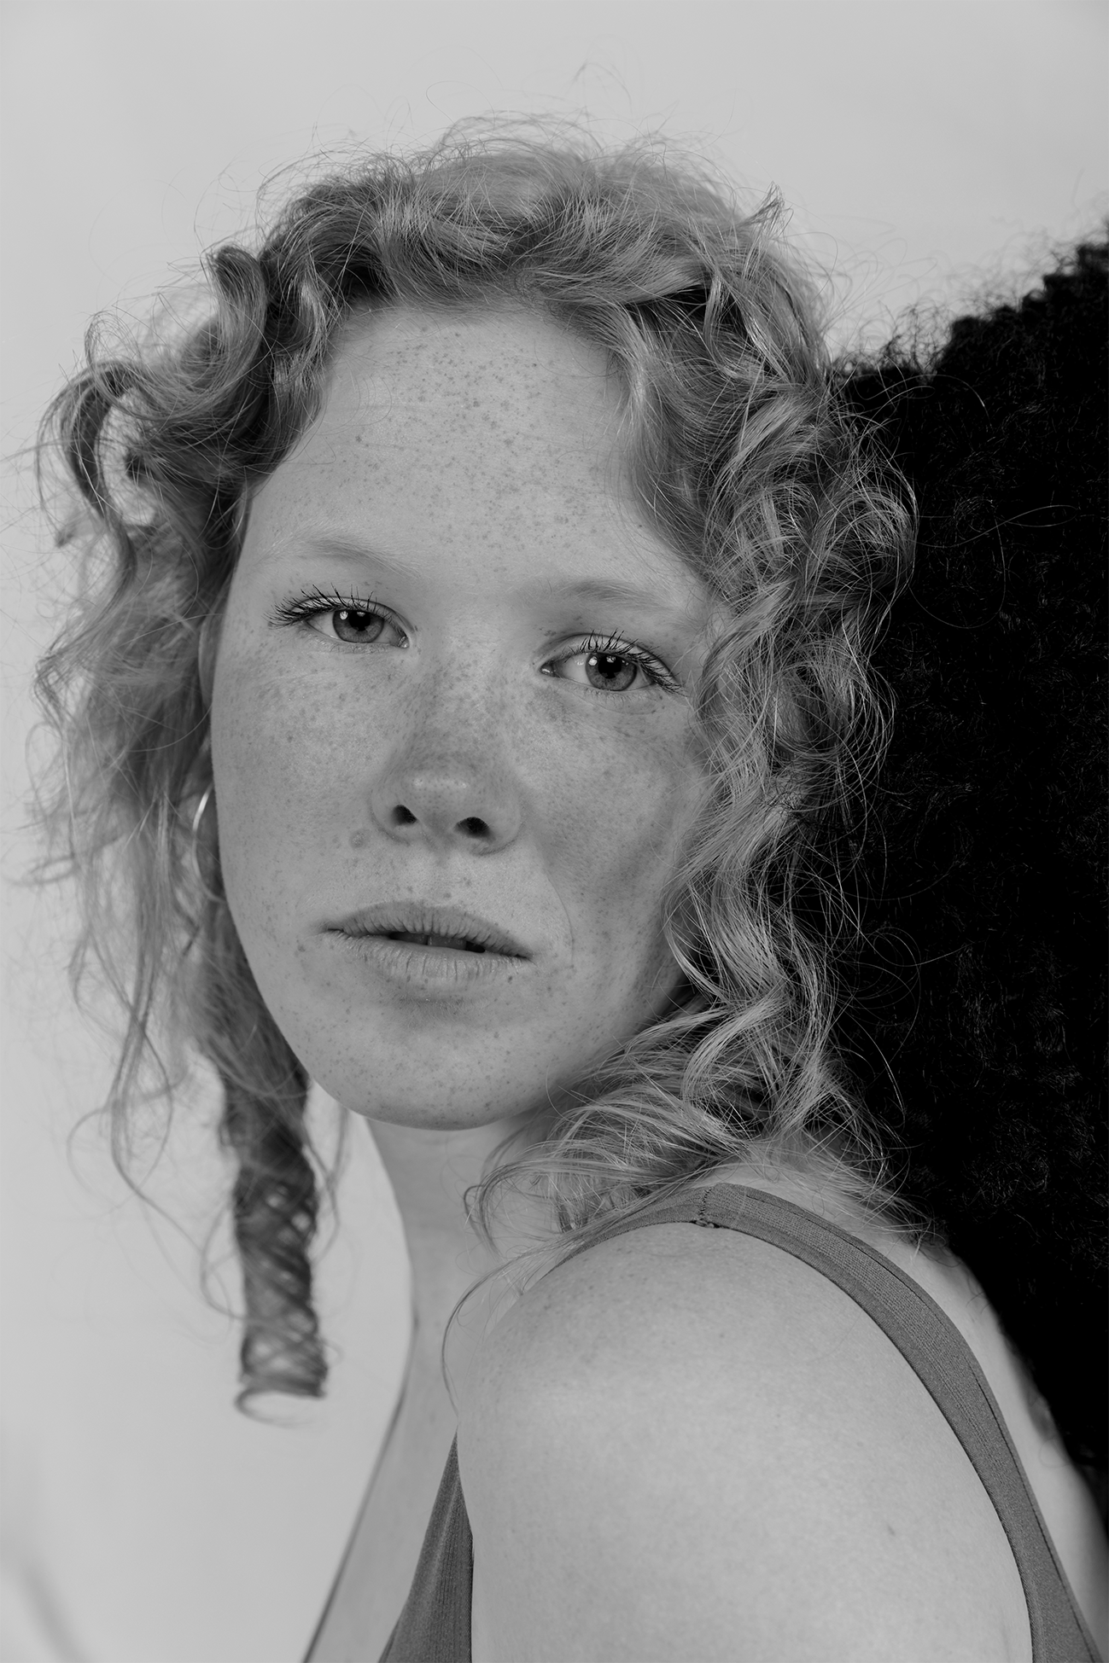
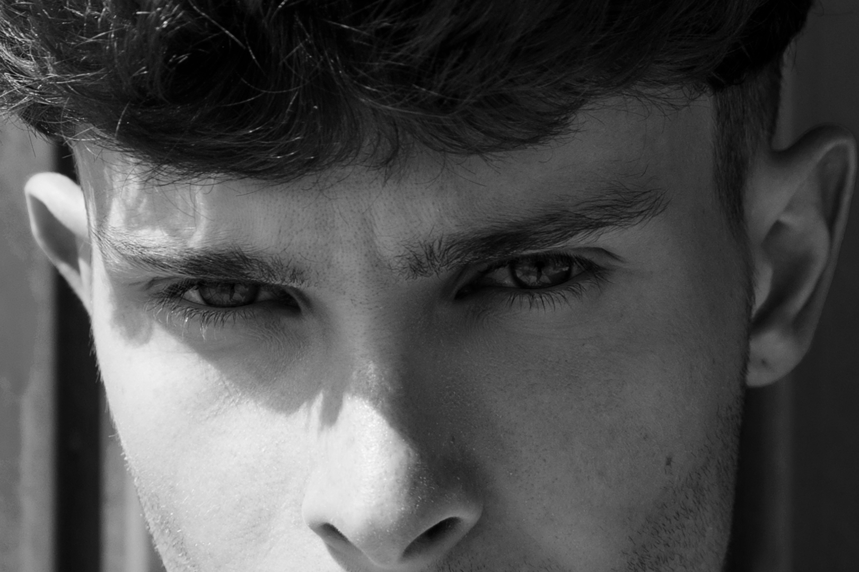
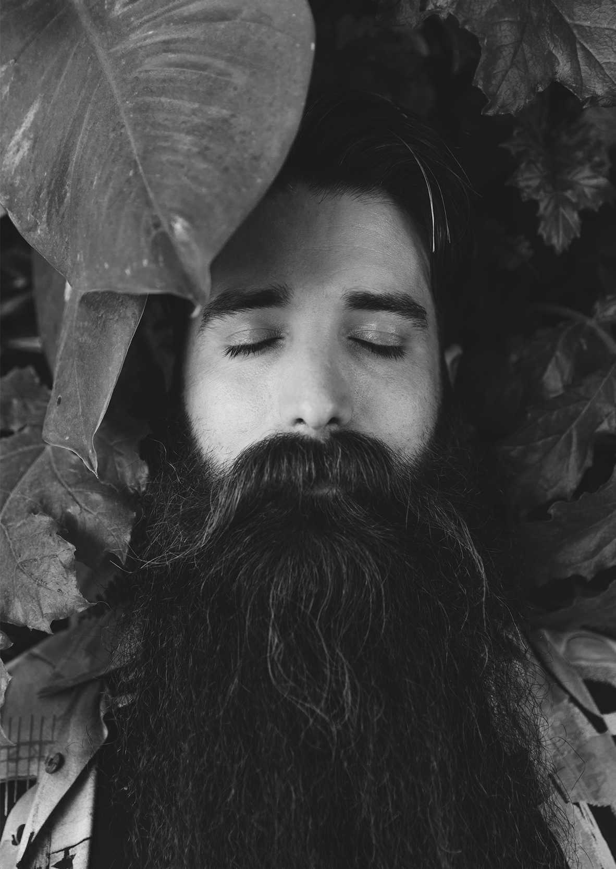
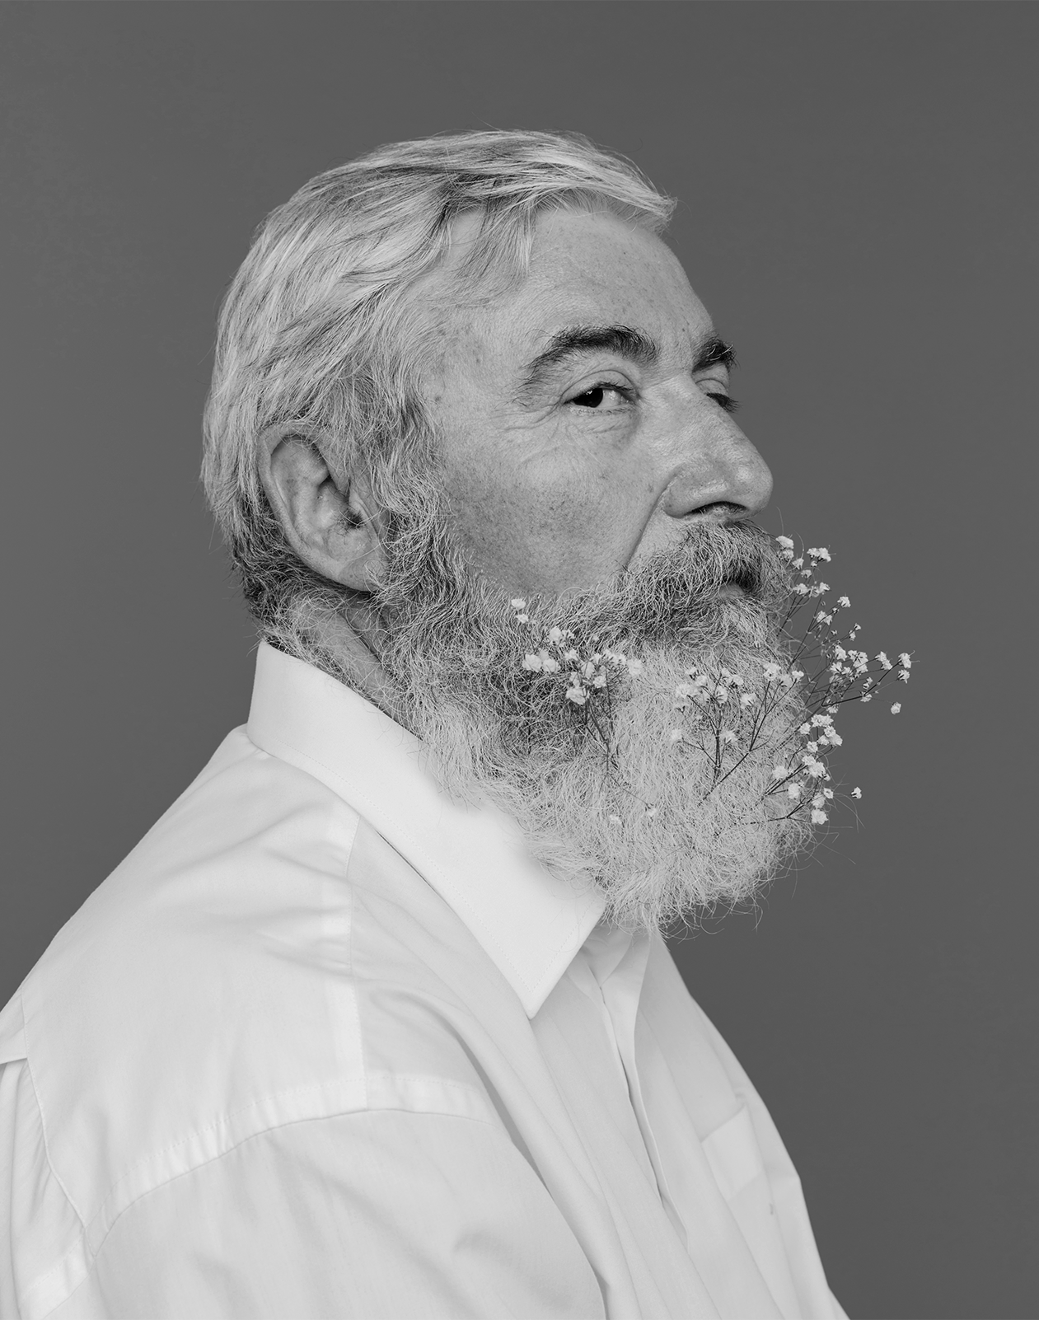
PROJECT MARS
10
Despite being red, Mars is a cold place, not hot. It’s full of iron oxide dust, which gives the planet its reddish cast. Mars is the fourth planet from the Sun and also the second-smallest one in our Solar System after Mercury

Slide 11
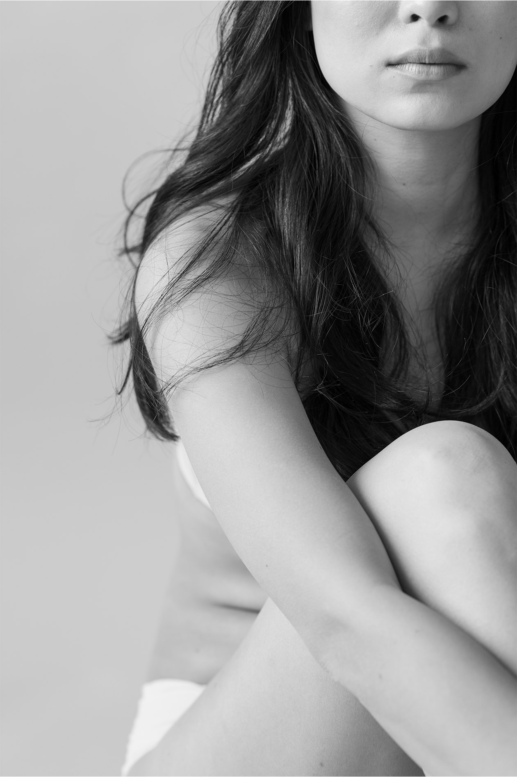
CONTACT
11
Does anyone have any questions?
addyouremail@freepik.com
+91 620 421 838
yourcompany.com

Slide 12
CREDITS
12
This is where you give credit to the ones who are part of this project.
Presentation template by Slidesgo
Icons by Flaticon
Infographics by Freepik
Images created by Freepik
Author introduction slide photo created by Freepik
Text & Image slide photo created by Freepik.com

Slide 13
RESOURCES
13
Did you like the resources on this template? Get them for free at our other websites.
VECTORS
Pack social media 27
Pack hobbies and freetime 11
Pack startups 8
PHOTOS
Freedom concept with woman holding cloth in nature
Woman taking photos in wheat field
Retro photo camera on a ledge
Traveling woman holding a camera
Young beautiful woman using stylus on graphic digital tablet
Crop woman with flowers in hair
Woman with leaf on shoulder
Young woman keeping flowers near chest
Young woman with flowers in hair
Close-up of bride's hand holding flower bouquet in hand
Portrait of young woman in nature
Portrait of a beautiful young woman touching her head with black hair
Portrait of fashionable boy against blue wall
Leaves on bearded young man with eye closed
Elderly man
Young woman in underwear sitting with legs crossed

Slide 14
Instructions for use
In order to use this template, you must credit Slidesgo by keeping the Credits slide.
You are allowed to:
- Modify this template.
- Use it for both personal and commercial projects.
You are not allowed to:
- Sublicense, sell or rent any of Slidesgo Content (or a modified version of Slidesgo Content).
- Distribute Slidesgo Content unless it has been expressly authorized by Slidesgo.
- Include Slidesgo Content in an online or offline database or file.
- Offer Slidesgo templates (or modified versions of Slidesgo templates) for download.
- Acquire the copyright of Slidesgo Content.
For more information about editing slides, please read our FAQs:
https://slidesgo.com/faqs

Slide 15
Fonts & colors used
This presentation has been made using the following fonts:
Playfair Display
(https://fonts.google.com/specimen/Playfair+Display)
Raleway
(https://fonts.google.com/specimen/Raleway)
#fa8072
#434343
#f5f4f4

Slide 17
Use our editable graphic resources...
You can easily resize these resources, keeping the quality. To change the color, just ungroup the resource and click on the object you want to change. Then, click on the paint bucket and select the color you want. Don’t forget to group the resource again when you’re done.

Slide 18
...and our set of editable icons
You can resize these icons, keeping the quality.
You can change the stroke and fill color; just select the icon and click on the paint-bucket/pen.
In Google Slides, you can also use Flaticon’s extension, allowing you to customize and add even more icons.

Slide 19
Business Icons

Slide 20
Avatar Icons

Slide 21
Creative Process Icons

Slide 22
Educational Process Icons

Slide 23
Help & Support Icons

Slide 24
Medical Icons

Slide 25
Nature Icons

Slide 26
Performing Arts Icons

Slide 27
SEO & Marketing Icons

Slide 28
Teamwork Icons

Slide 29


