Slide 1
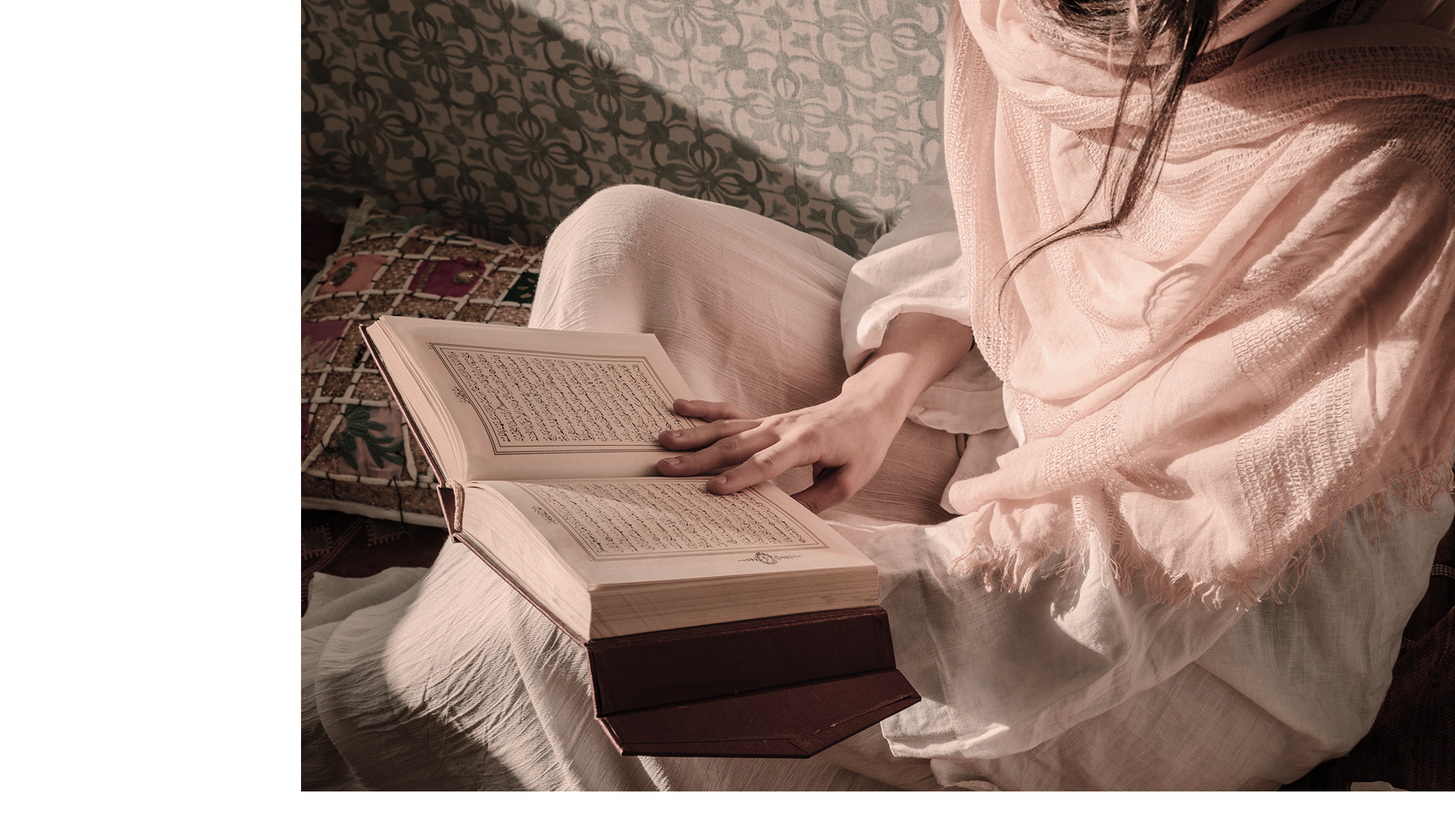
Religion
Lesson
Here is where your presentation begins

Slide 2
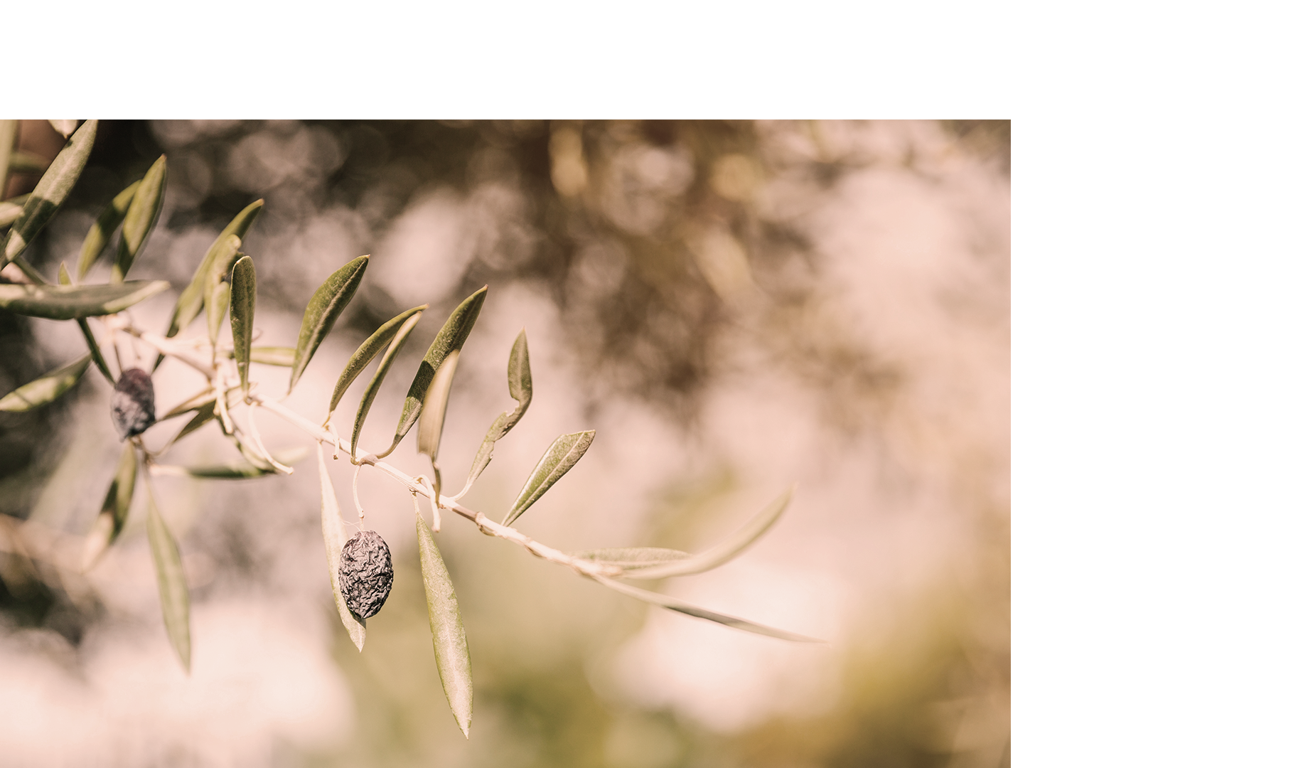
01
Table of Contents
About the Topic
02
Features
03
Overview
04
Assignment

Slide 3
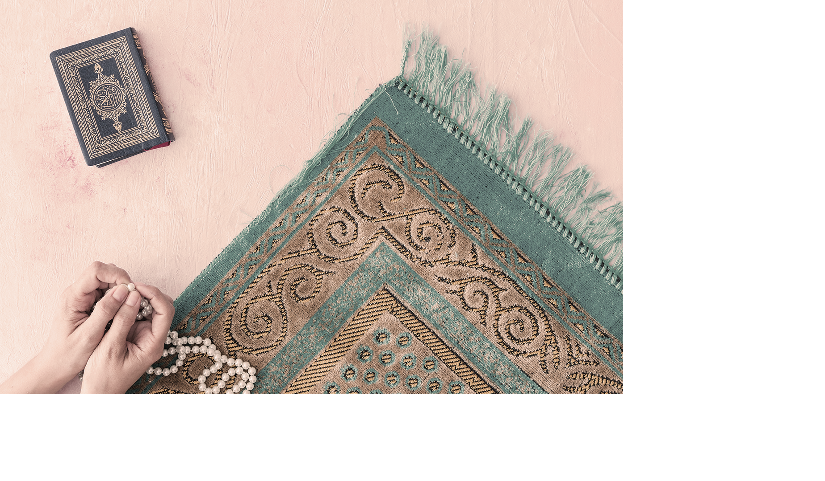
Introduction
Venus has a beautiful name and is the second planet from the Sun. It’s terribly hot—even hotter than Mercury—and its atmosphere is extremely poisonous. It’s the second-brightest natural object in the night sky after the Moon

Slide 4
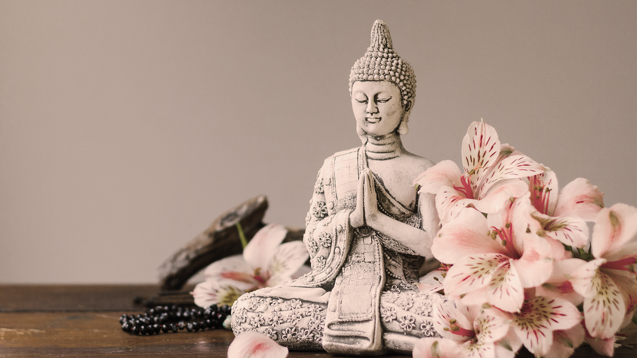
—Someone famous
“This is a quote. Words full of wisdom that someone important said and can make the reader get inspired.”

Slide 5
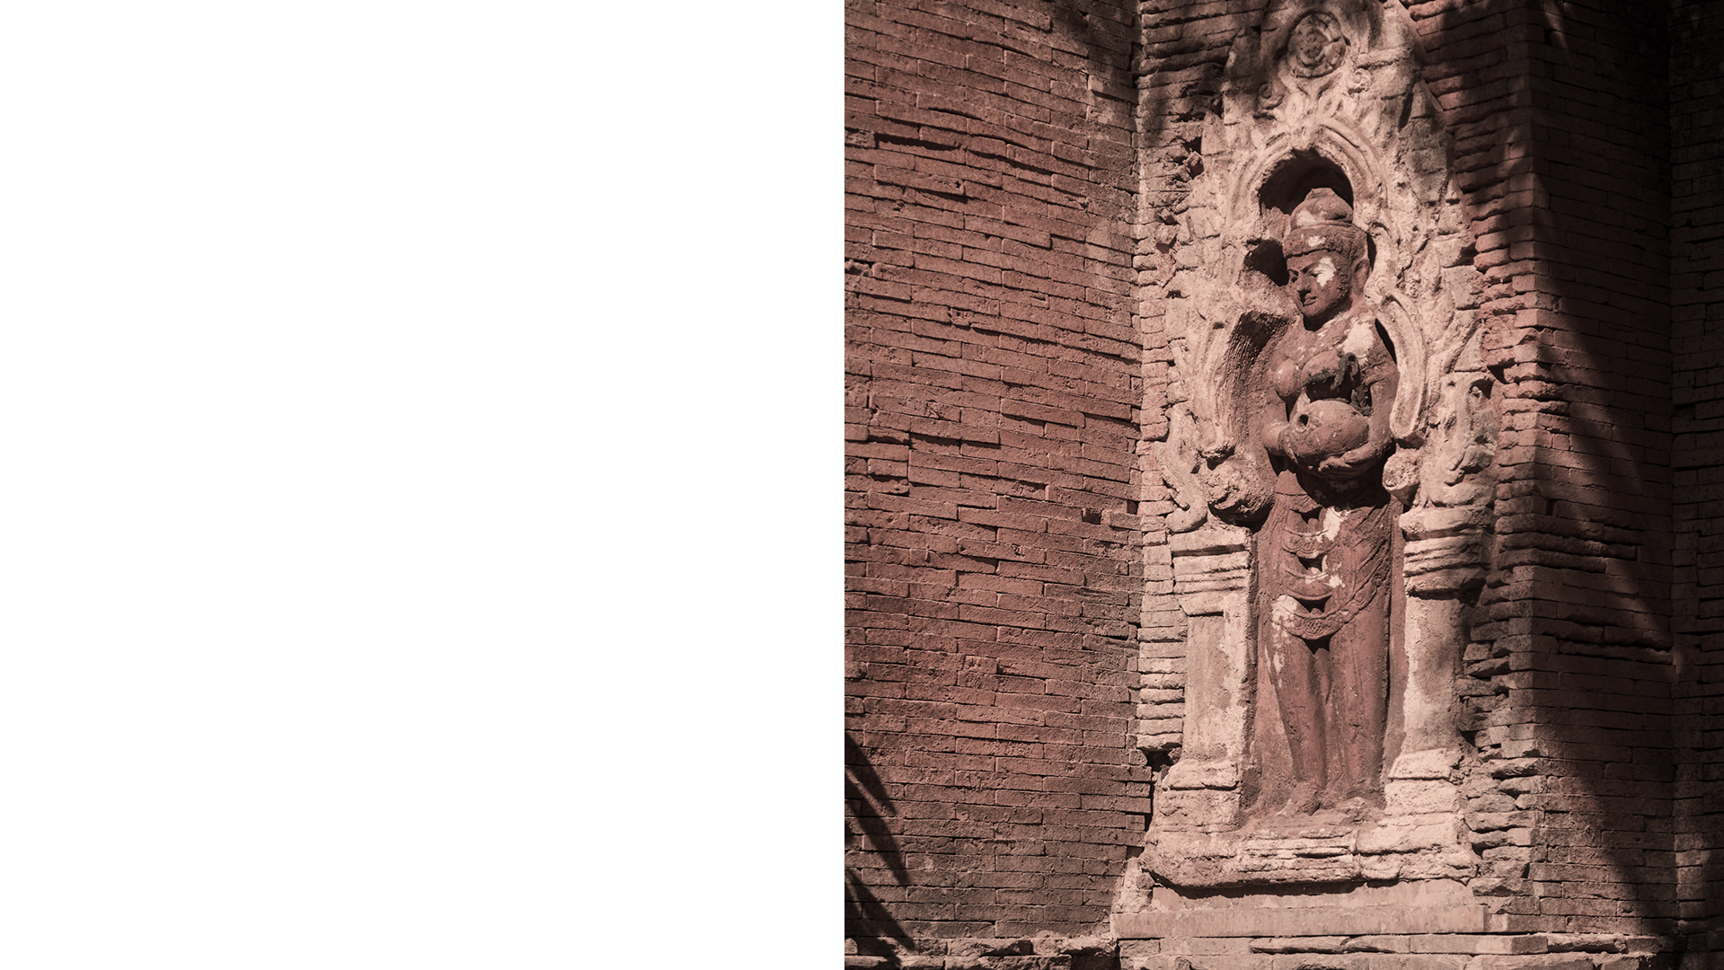
What Is This Topic About?
Mercury is the closest planet to the Sun and the smallest one in our Solar System—it’s only a bit larger than our Moon. The planet’s name has nothing to do with the liquid metal, since it was named after the Roman messenger god, Mercury

Slide 6
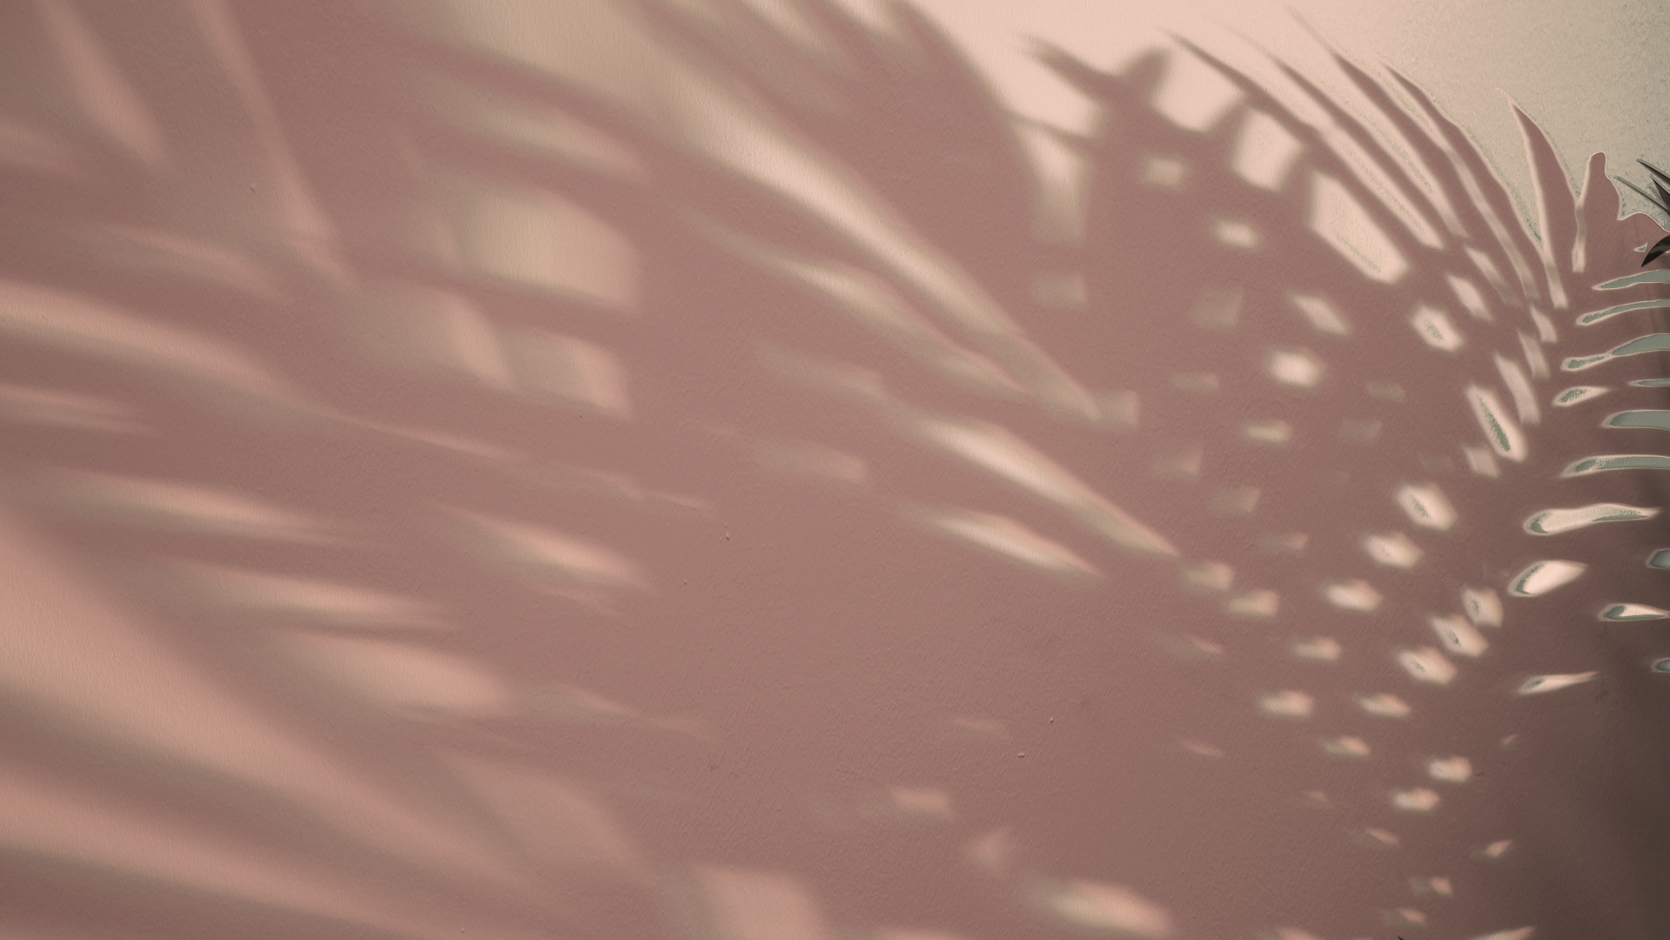
Definition of Concepts
Jupiter
Mars
Saturn
Venus
Neptune
Mercury
Jupiter is a gas giant, the biggest planet in our Solar System and the fourth-brightest object in the sky
Despite being red, Mars is a cold place. It’s full of iron oxide dust, giving the planet its reddish cast
Saturn is the ringed planet. It’s a gas giant, composed mostly of hydrogen and helium
Venus has a beautiful name and is the second planet from the Sun. It’s terribly hot
Neptune is the farthest planet from the Sun and the fourth-largest in our Solar System
Mercury is the closest planet to the Sun and the smallest one in the Solar System

Slide 7
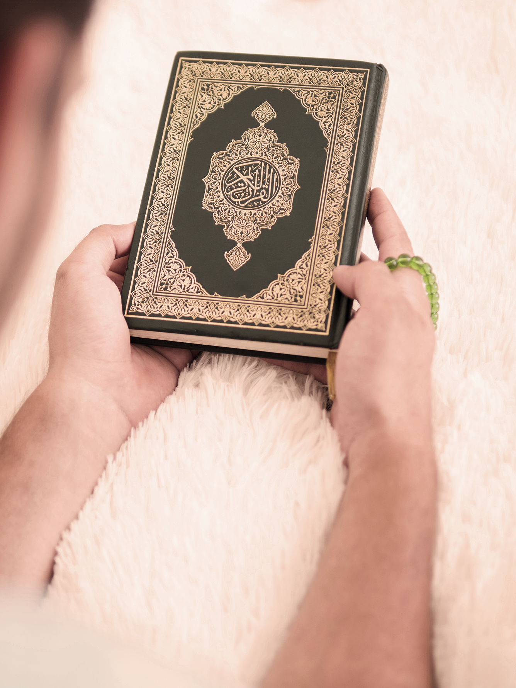
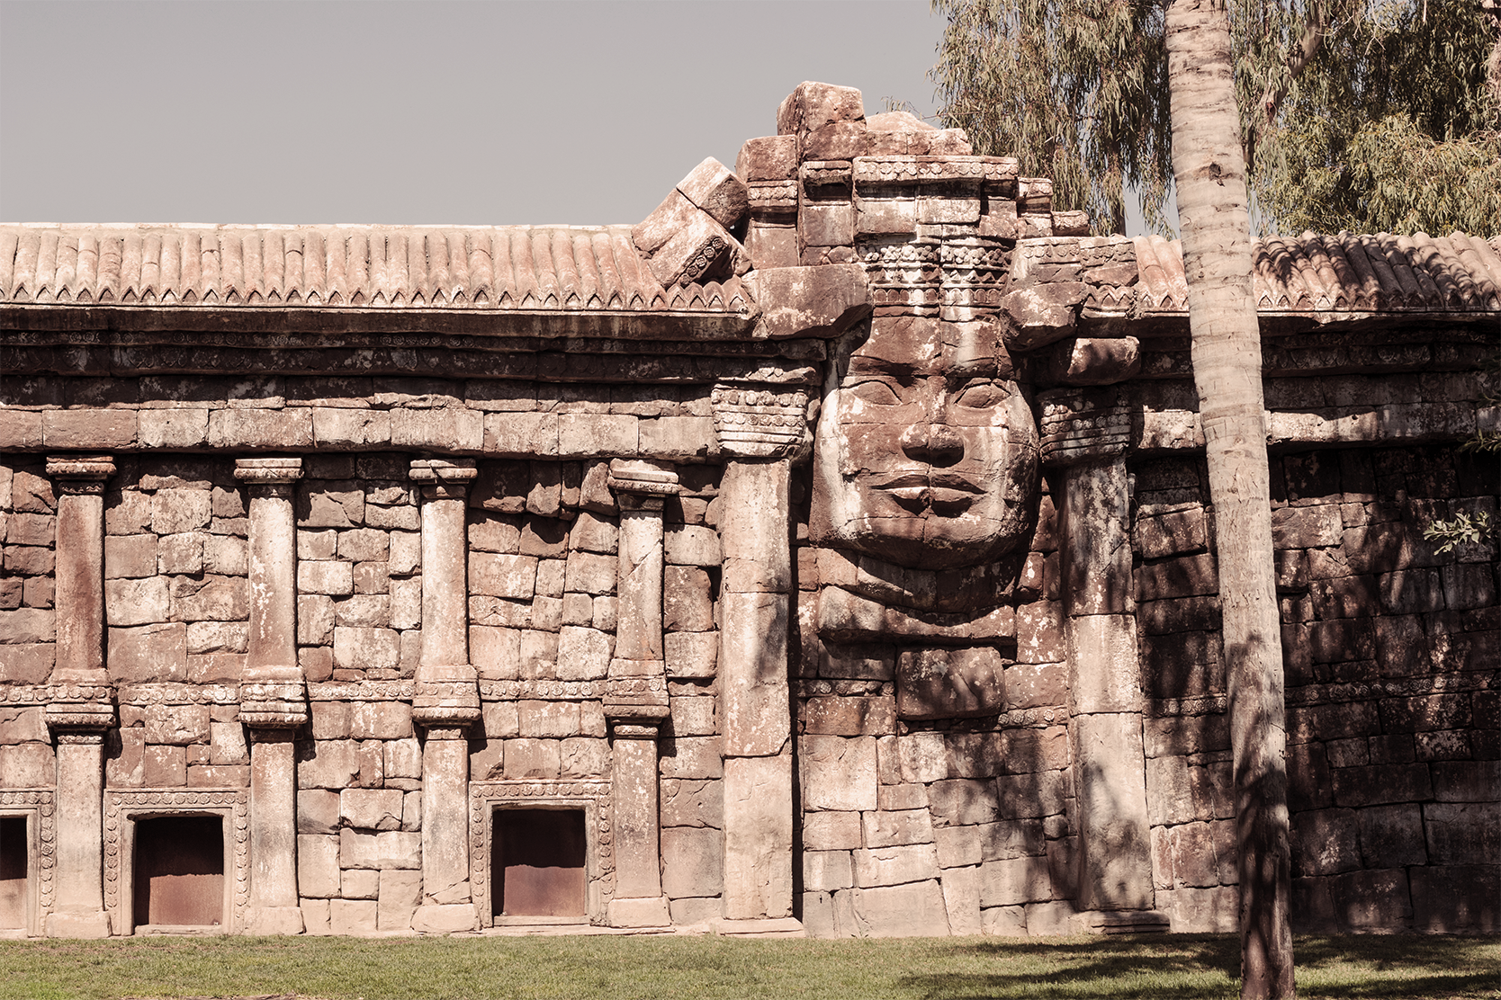
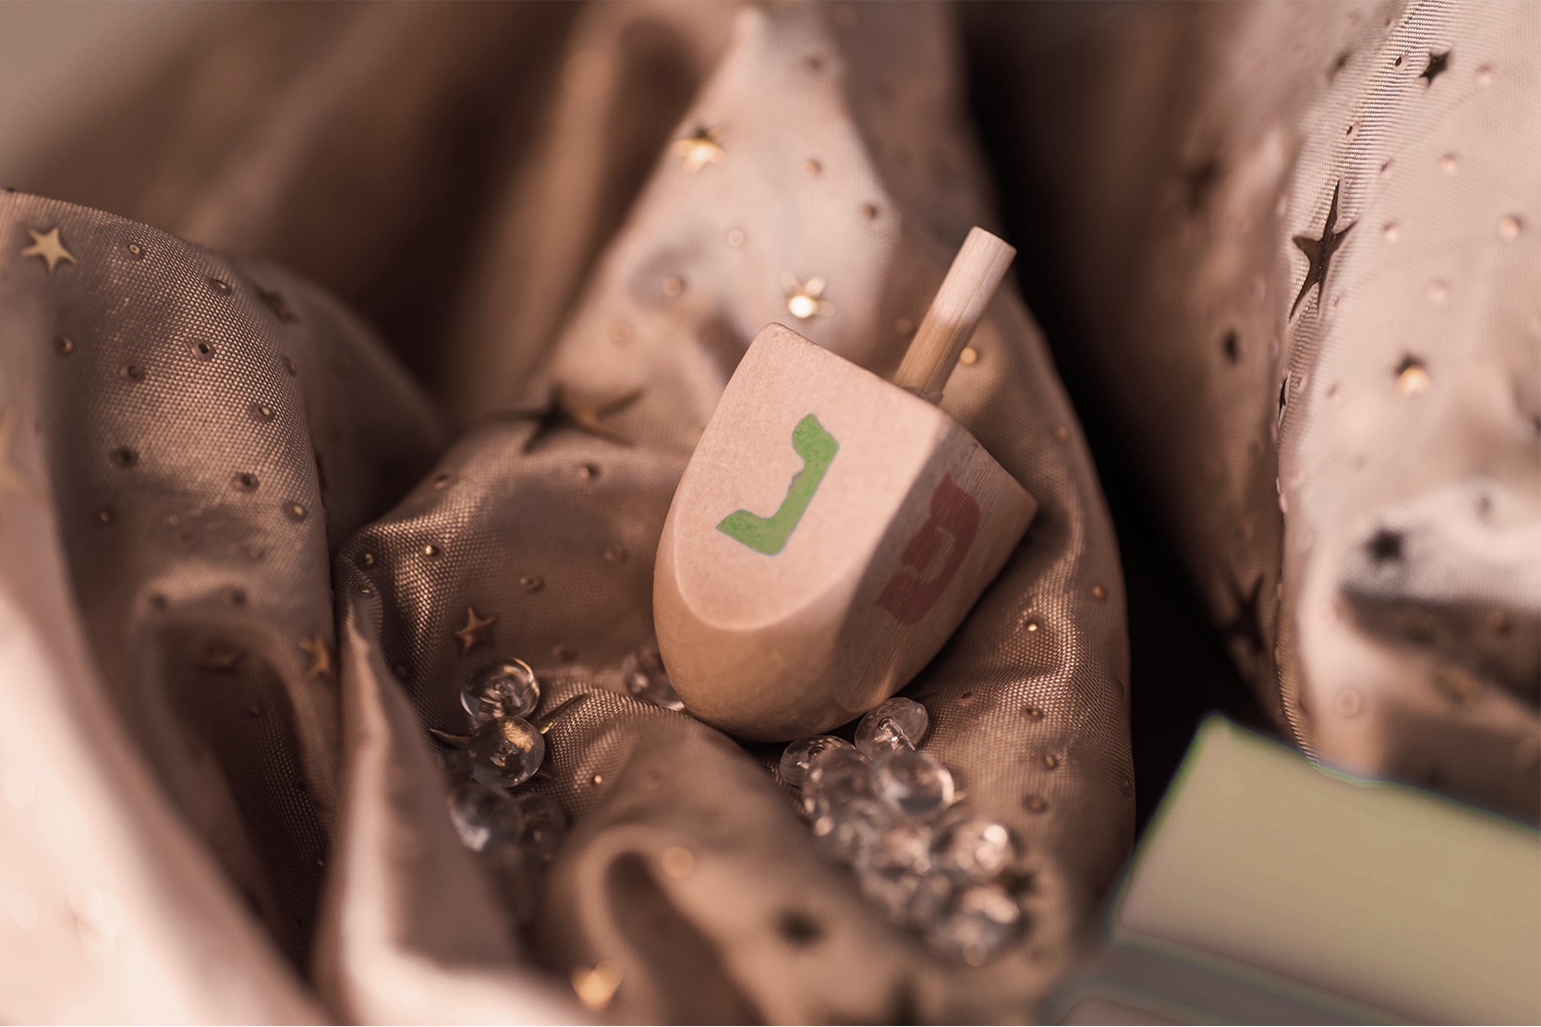
Features of the Topic
Mars
Mercury
Venus
Despite being red, Mars is a cold place. It’s full of iron oxide dust, giving the planet its reddish cast
Mercury is the closest planet to the Sun and the smallest one in our Solar System
Venus has a beautiful name and is the second planet from the Sun. It’s terribly hot

Slide 8
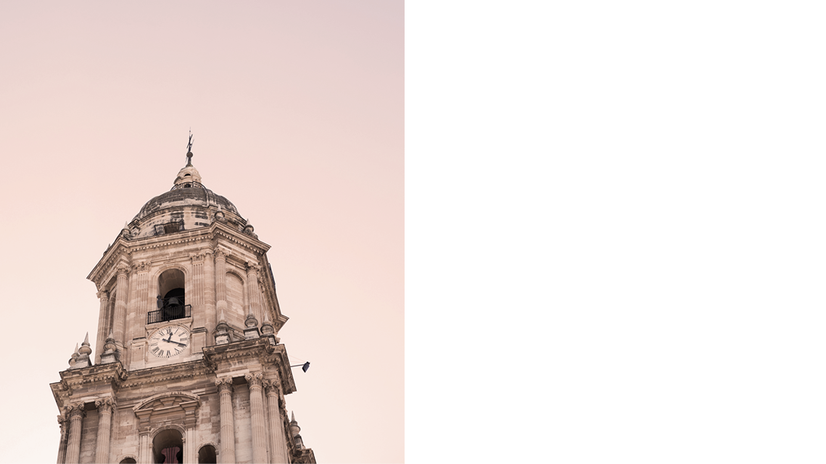
31,2%
6,300
622 CE
of the world’s population is Christian
Indians converted to Hinduism last year
was the year Islam began

Slide 9
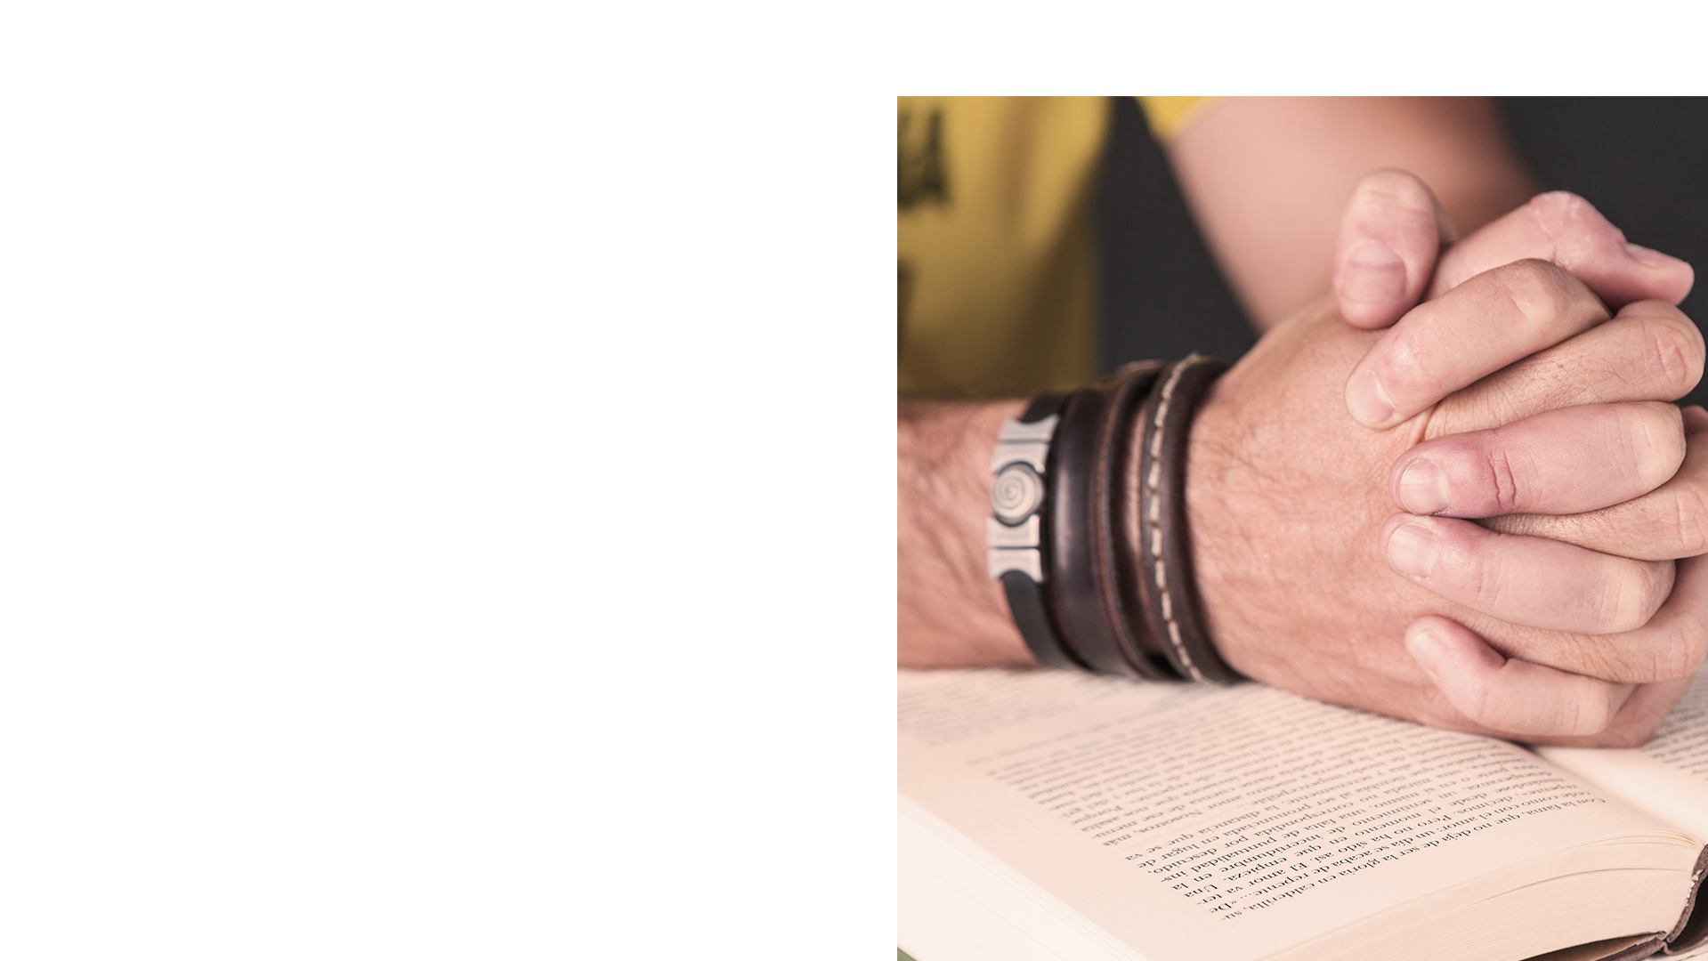
Practical Uses of This Subject
Venus
Mercury
Mars
Jupiter
Venus has a beautiful name and is the second planet from the Sun. It’s terribly hot, even hotter than Mercury
Mercury is the closest planet to the Sun and the smallest one in the Solar System. It’s only a bit larger than our Moon
Despite being red, Mars is a cold place, not hot. It’s full of iron oxide dust, which gives the planet its reddish cast
It’s a gas giant and the biggest planet in our Solar System. Jupiter is the fourth-brightest object in the sky

Slide 10
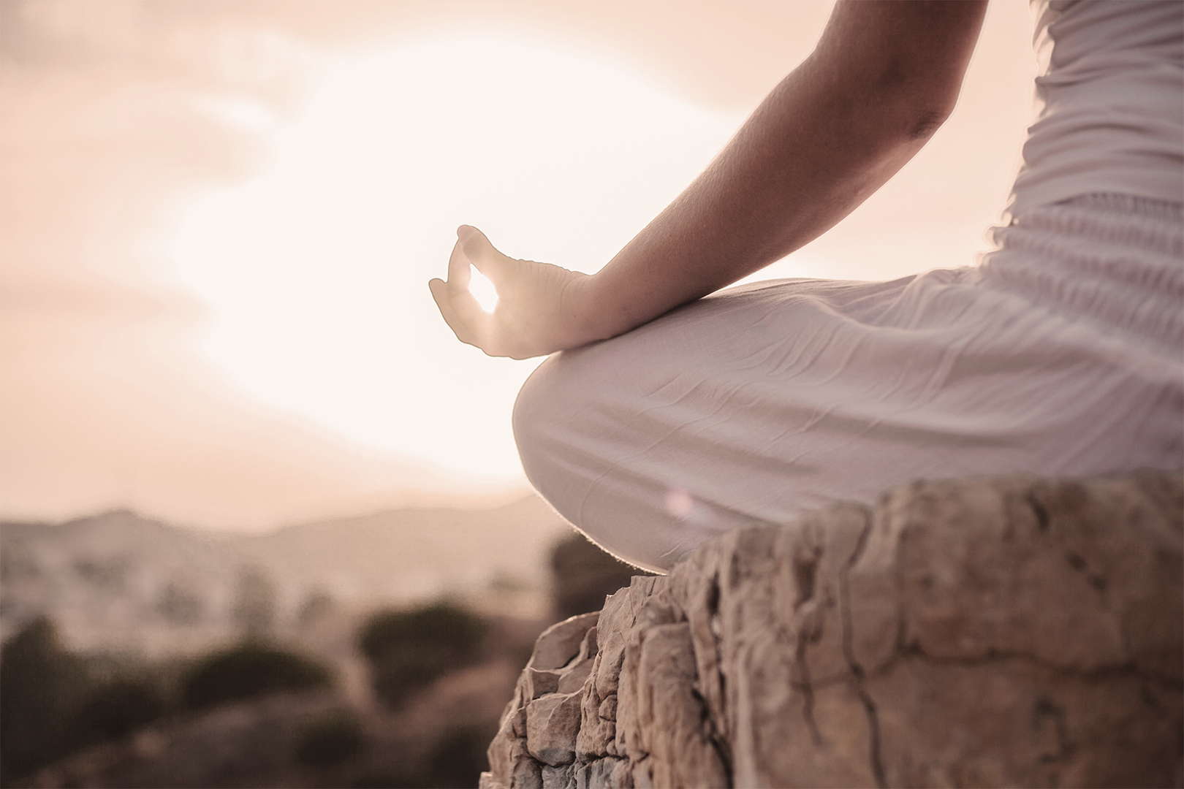
Mars
Despite being red, Mars is a cold place, not hot. It’s full of iron oxide dust, which gives the planet its reddish cast. It’s the fourth planet from the Sun and the second-smallest one in our Solar System
Insert your multimedia content here

Slide 11
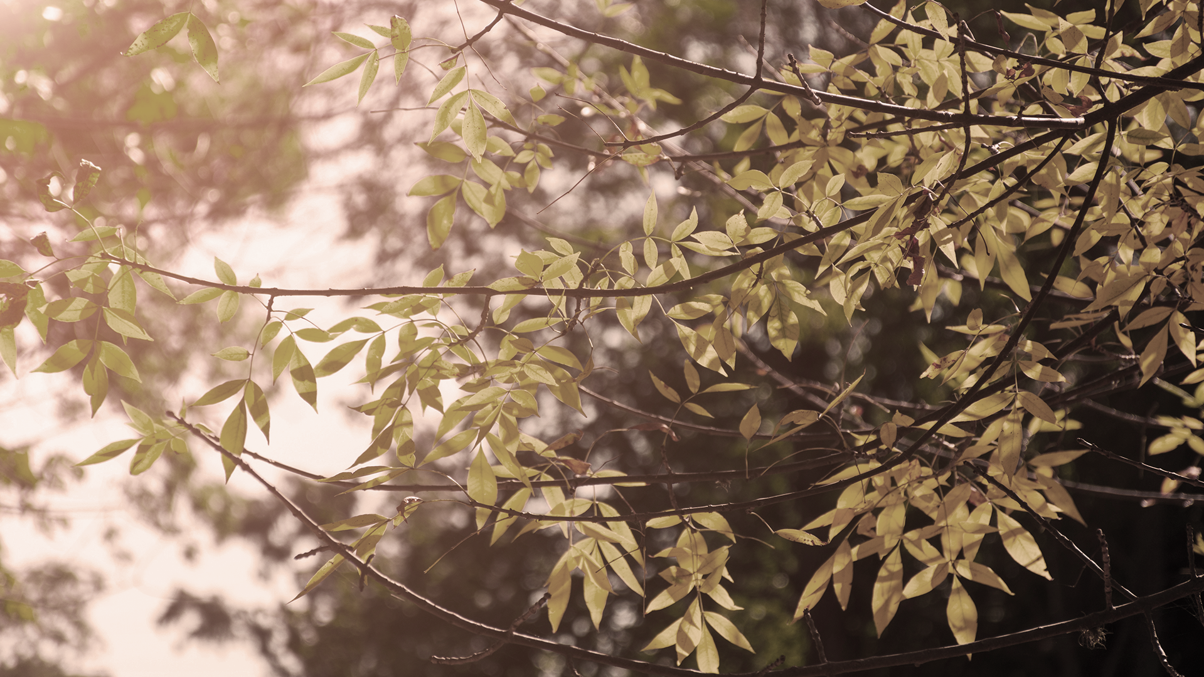
Did You Know This?
Buddhism is an extensive and diverse tradition with two main branches
Every finger in this Hindu hand symbol stands for individual energies
Today there are approximately 6m Christianity books in print

Slide 12
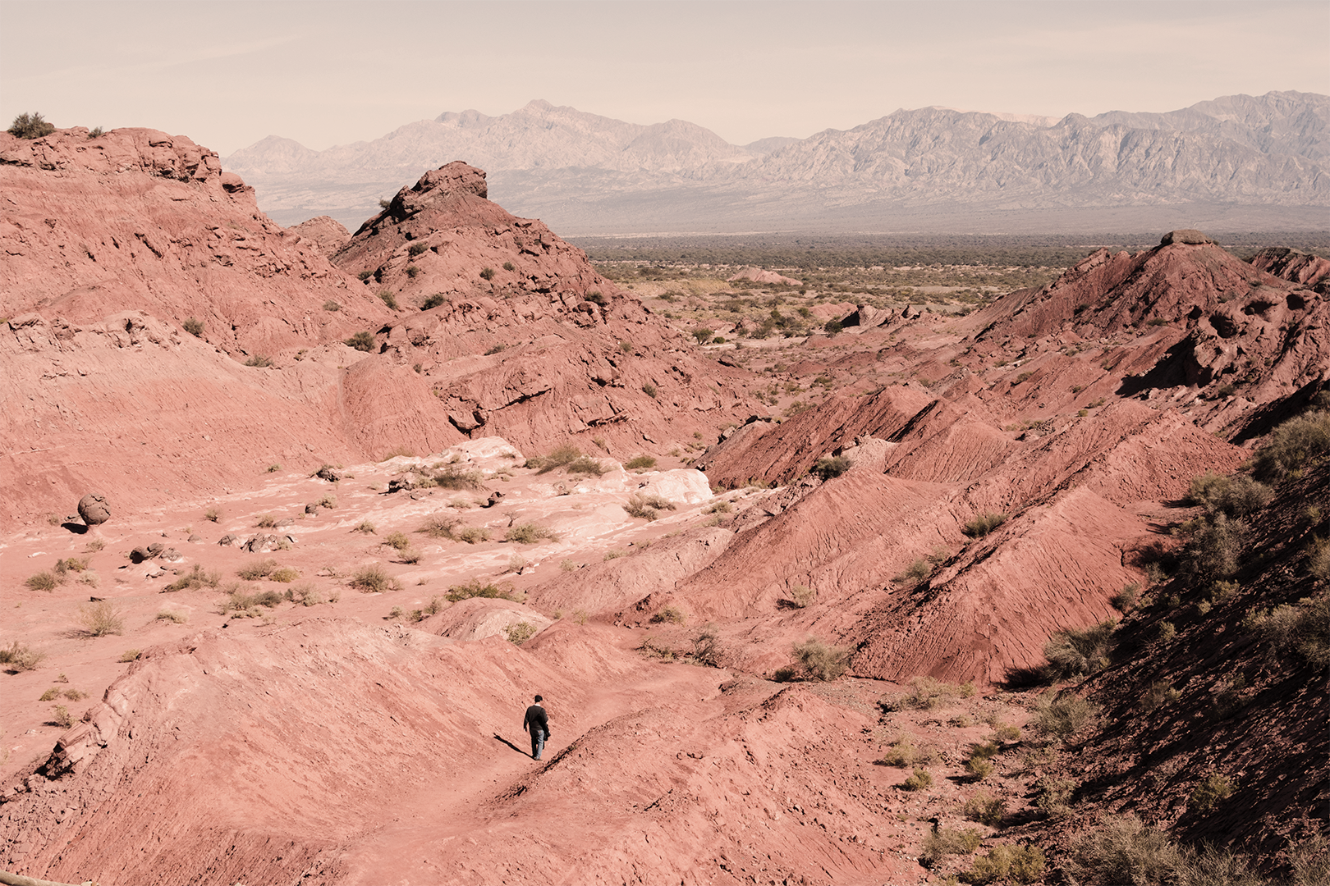
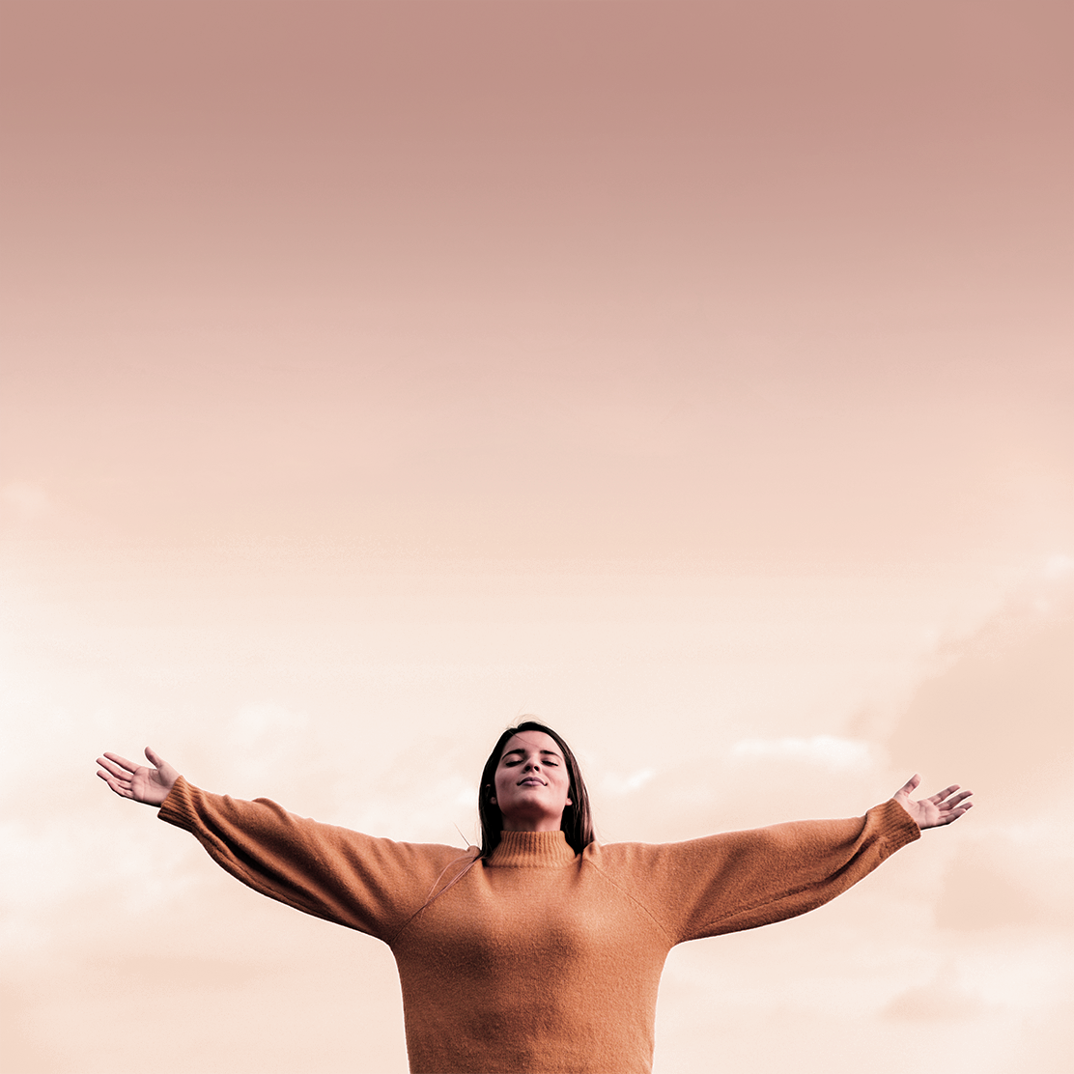
Problem
Solution
Venus has a beautiful name and is the second planet from the Sun. It’s terribly hot
Despite being red, Mars is a cold place. It’s full of iron oxide dust, giving the planet its reddish cast

Slide 13
Process
Step 1
Step 3
Saturn is composed of hydrogen and helium
Despite being red, Mars is a cold place, not hot
Step 2
Step 4
Mercury is the smallest planet in our Solar System
Venus has a beautiful name, but it’s terribly hot

Slide 14
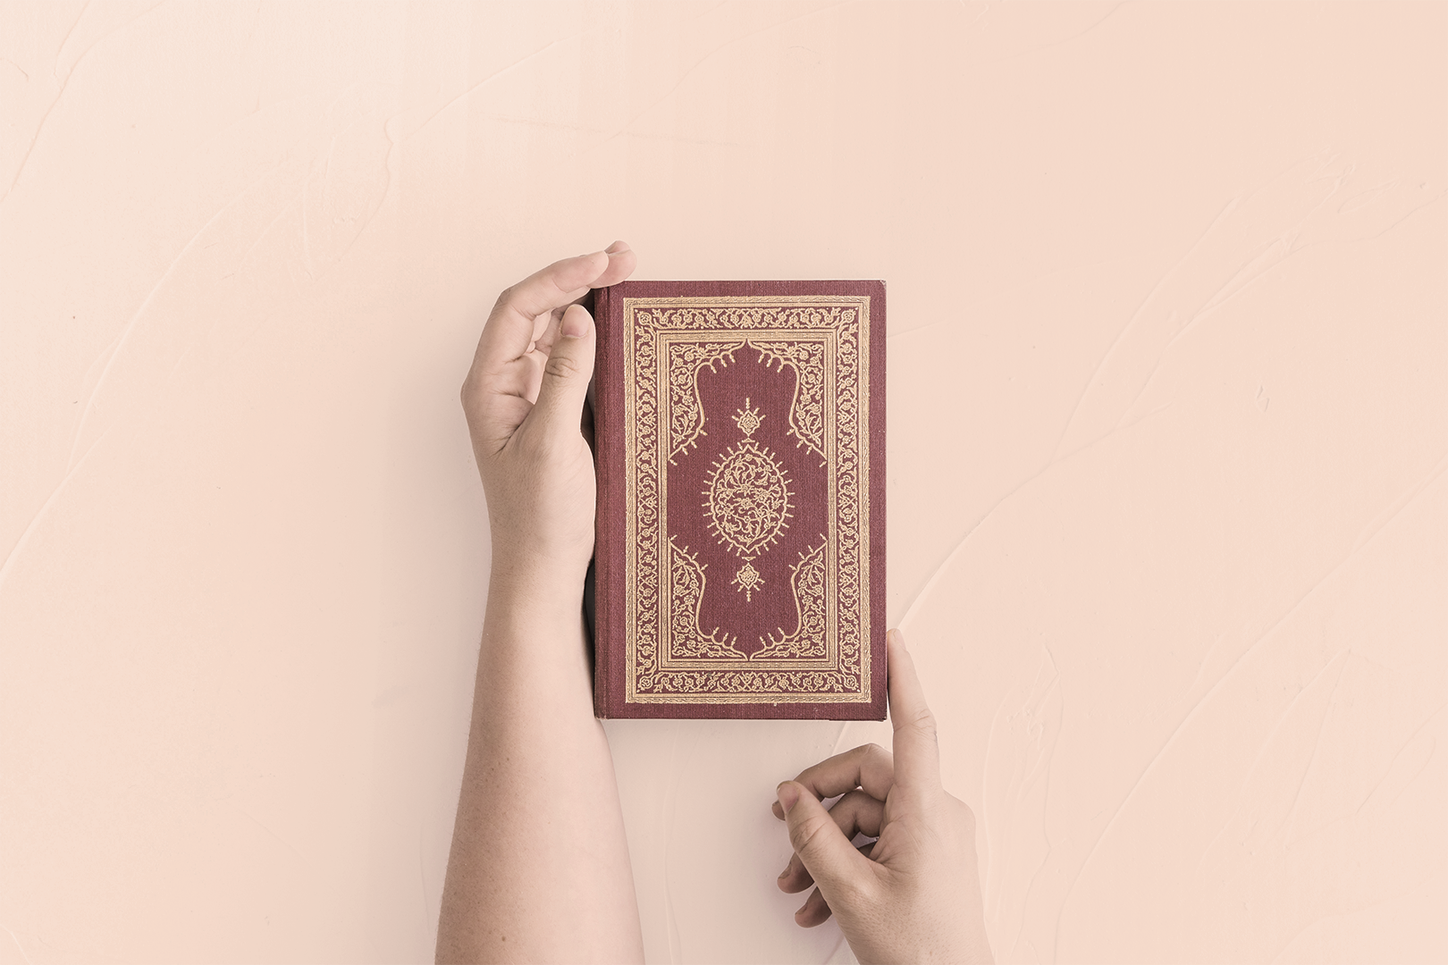
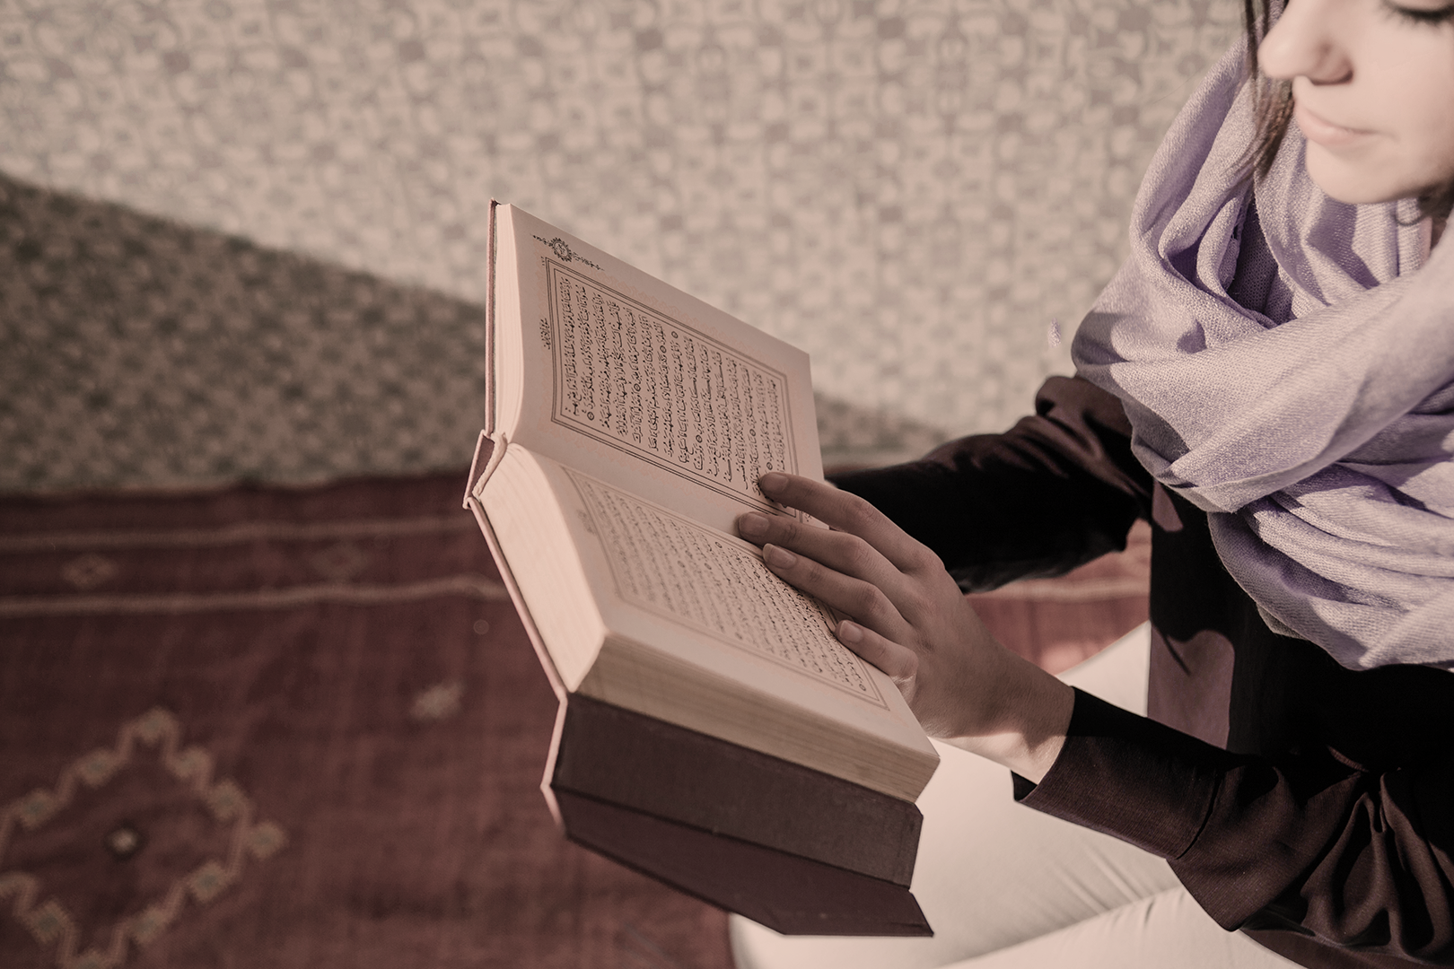
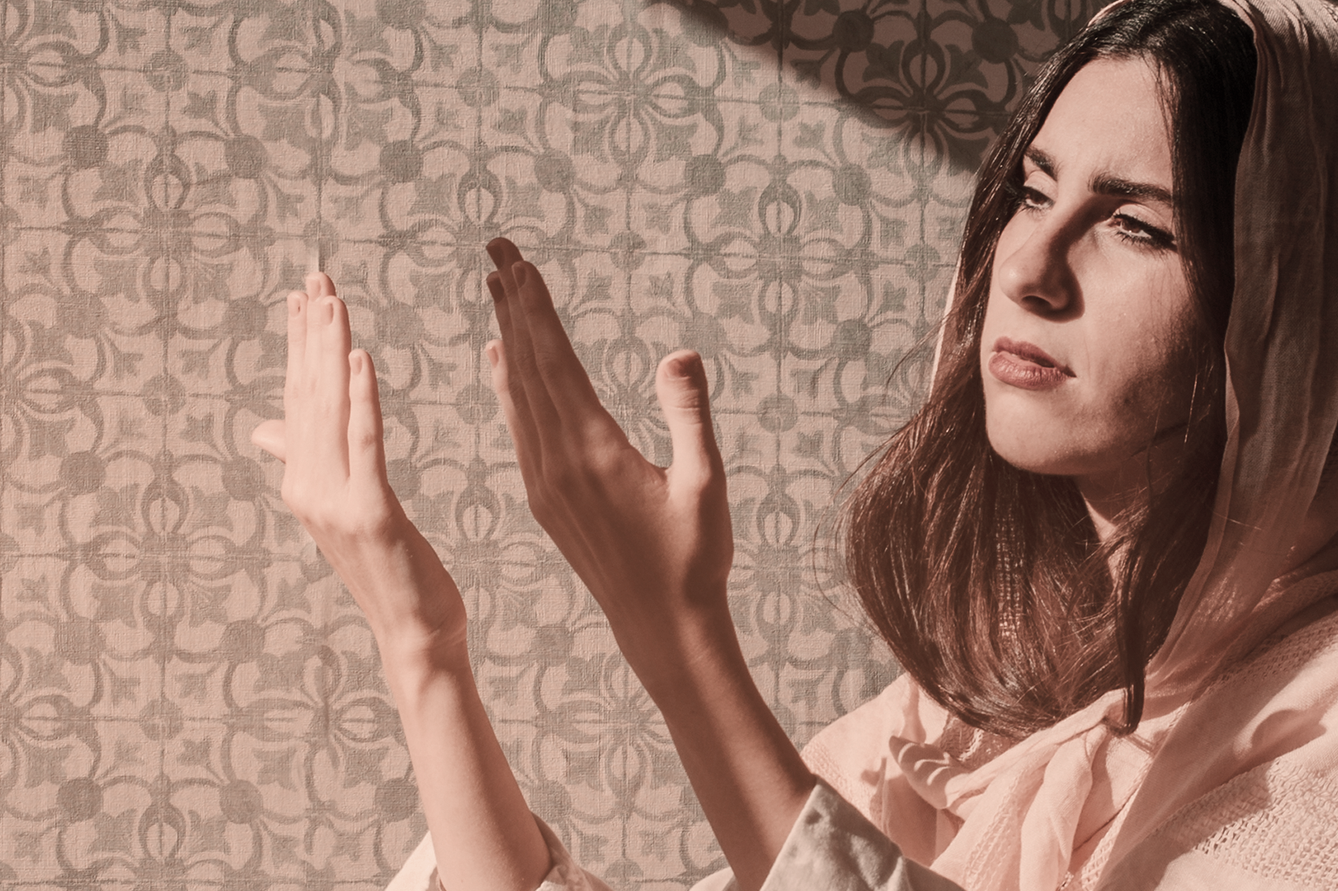
Overview Diagram
01
02
03
JUPITER
Mercury is the closest planet to the Sun and the smallest one in the Solar System
Saturn is the ringed one. It’s a gas giant, composed mostly of hydrogen and helium
Despite being red, Mars is a cold place, not hot. It’s full of iron oxide dust

Slide 15
Exercise
Mercury is the closest planet to the Sun, but does its name have anything to do with the liquid metal?
Contrary to popular belief, no. The truth is that this planet was named after the Roman messenger god, Mercury

Slide 16
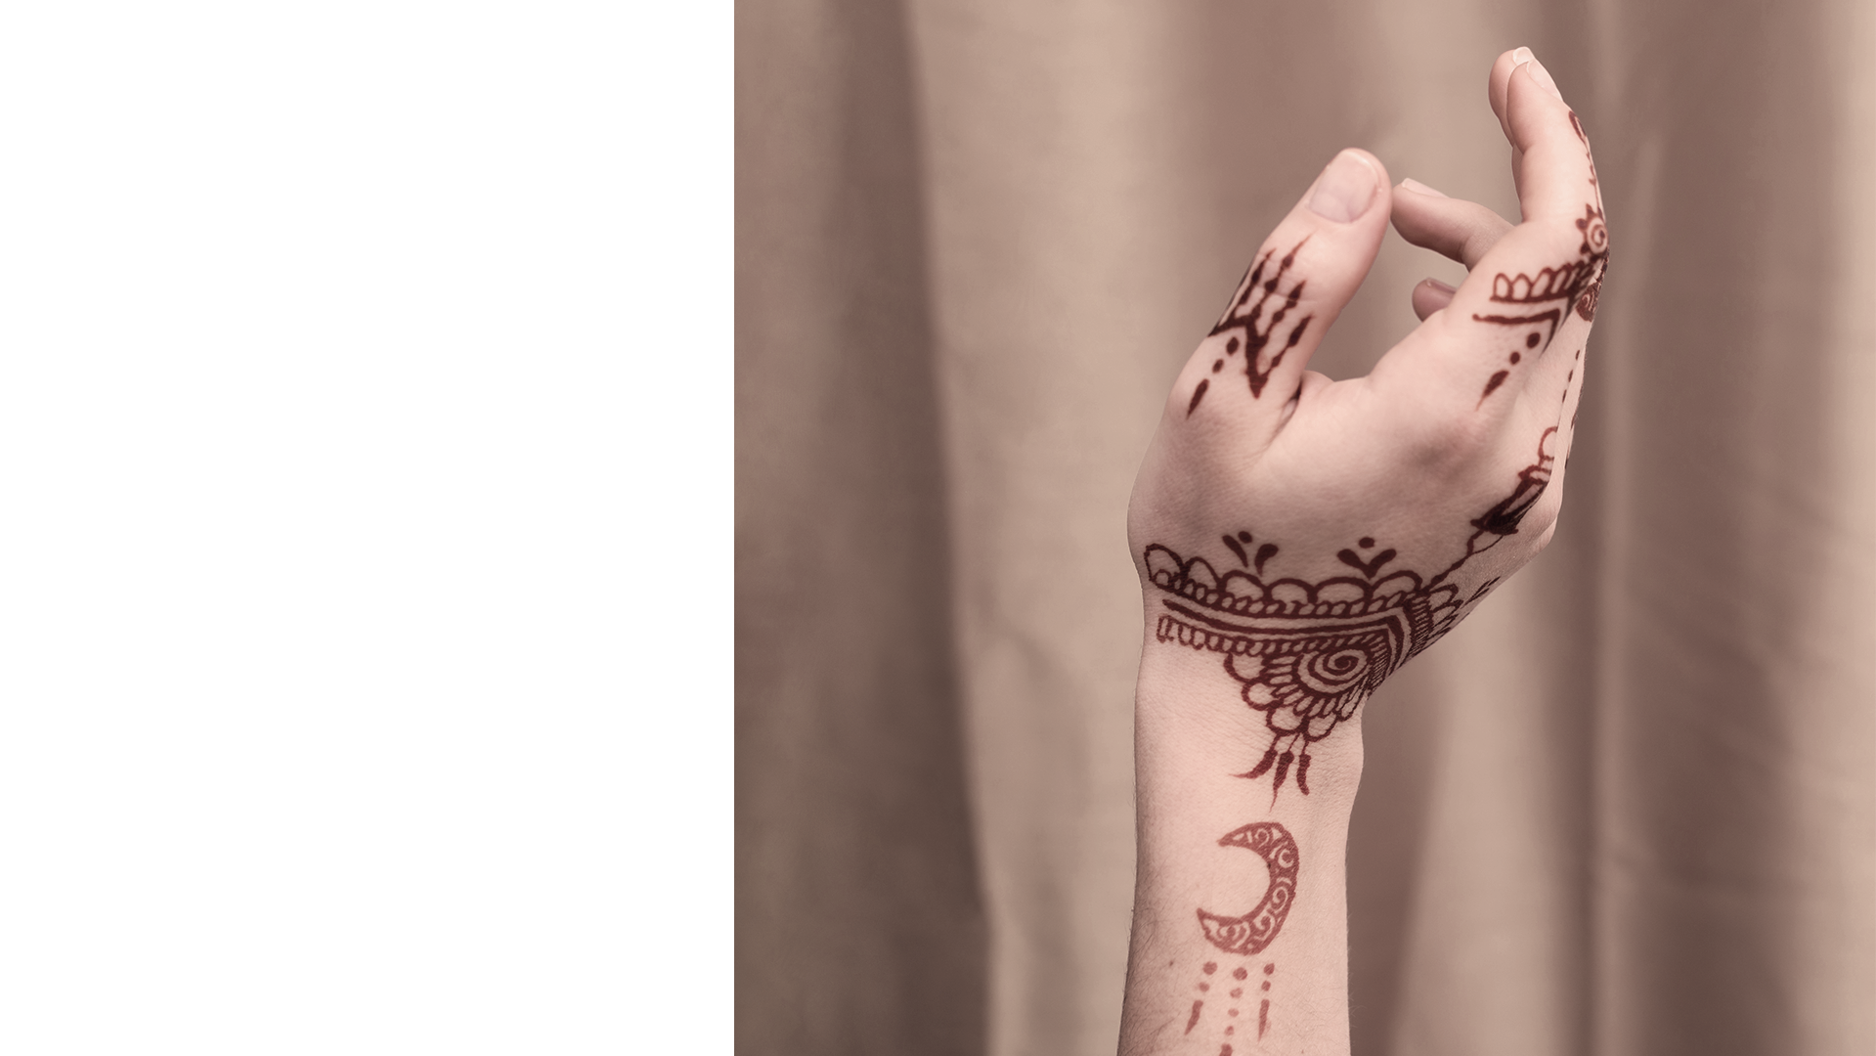
Assignment
Mercury is the closest planet to the Sun, and Neptune is the farthest one. Calculate the distance between these two planets and state your answer in kilometers and also in astronomical units

Slide 17
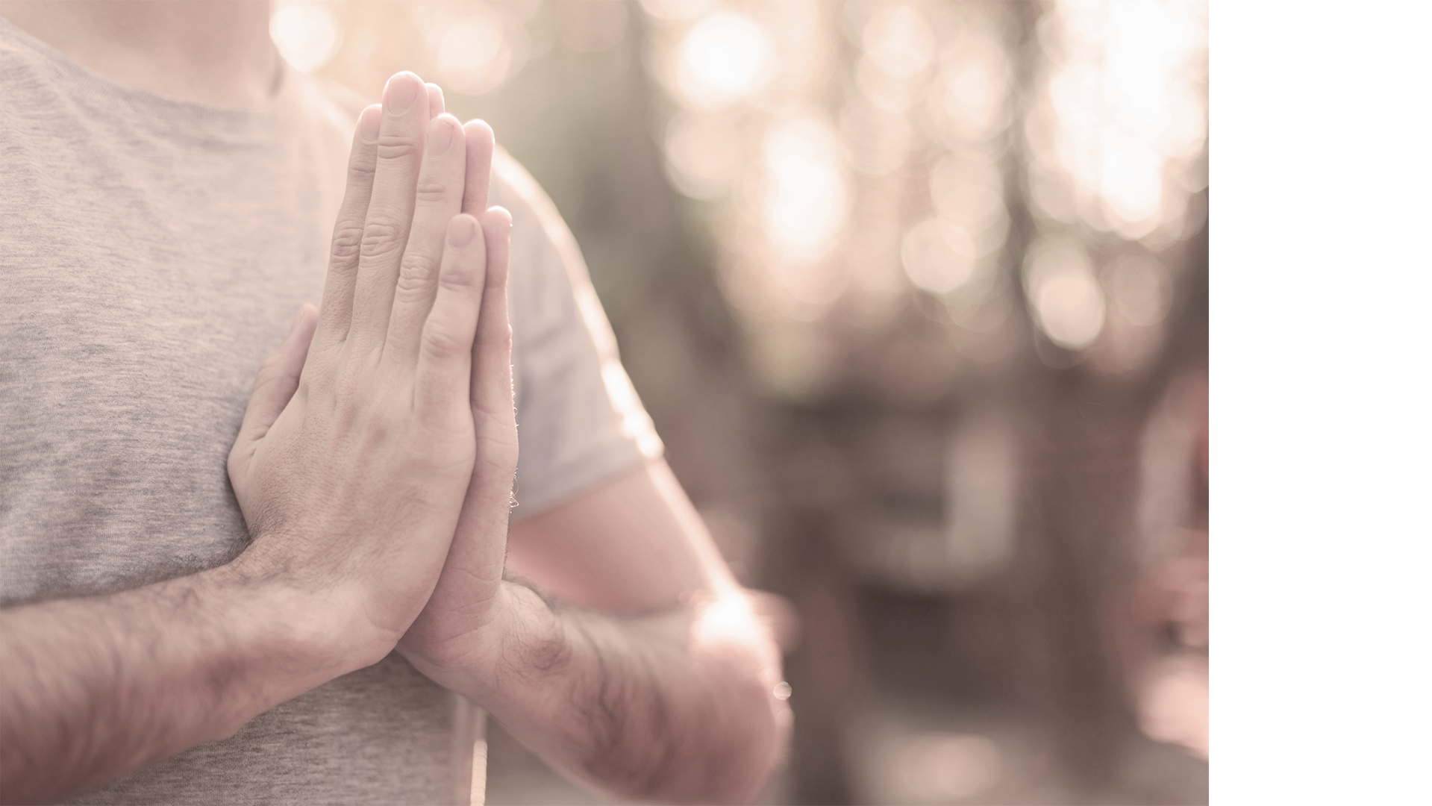
Thanks!
Does anyone have any questions?
addyouremail@freepik.com
+91 620 421 838
yourcompany.com

Slide 18
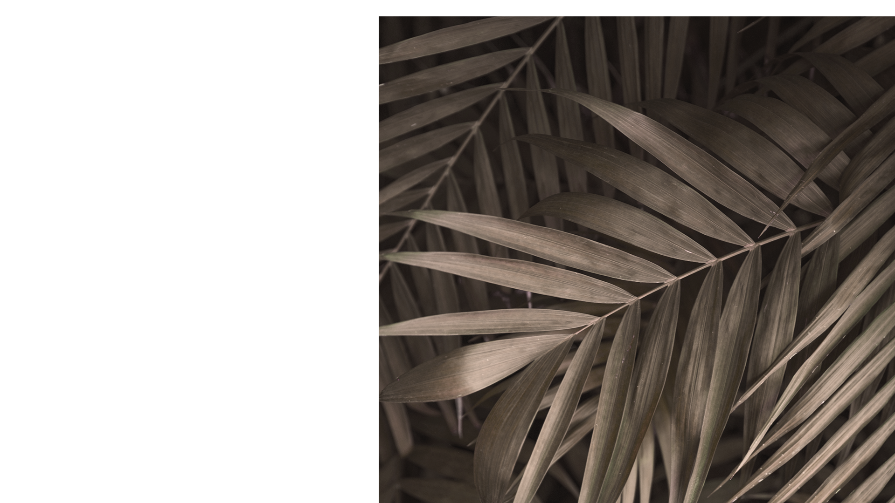
Credits
This is where you give credit to the ones who are part of this project.
Presentation template by Slidesgo
Icons by Flaticon
Infographics by Freepik
Author introduction slide photo created by Freepik
Text & Image slide photo created by Freepik.com

Slide 19
Resources
Did you like the resources on this template? Get them for free at our other websites.
PHOTOS
Sitting woman reading in quran
Olive-tree branch with dry black olives with selective focus
Hands of prayer with beads
Buda sculpture with petals
Animal habitat
Top view of a man holding quran
Dreidel and beads on cloth
Animal habitat II
Bottom view church tower
Crop man clasping hands on book
Close up view of peaceful woman
Golden branches in autumn sunlight
Long shot man walking in canyon landscape
Young woman with her closed eyes outstretching hands standing against sky
Hands holding arabic book
Muslim woman reading in quran
Muslim woman praying with sunlight effect
Woman hand with mehndi paints near textile
Close-up of guy with hands together
From above green palm leaves
VECTORS
Pack spiritual 22
Stratuscumulus
Bird

Slide 20
Instructions for use
In order to use this template, you must credit Slidesgo by keeping the Credits slide.
You are allowed to:
- Modify this template.
- Use it for both personal and commercial projects.
You are not allowed to:
- Sublicense, sell or rent any of Slidesgo Content (or a modified version of Slidesgo Content).
- Distribute Slidesgo Content unless it has been expressly authorized by Slidesgo.
- Include Slidesgo Content in an online or offline database or file.
- Offer Slidesgo templates (or modified versions of Slidesgo templates) for download.
- Acquire the copyright of Slidesgo Content.
For more information about editing slides, please read our FAQs:
https://slidesgo.com/faqs

Slide 21
Fonts & colors used
This presentation has been made using the following fonts:
Merryweather
(https://fonts.google.com/specimen/Merriweather)
Source Sans Pro
(https://fonts.google.com/specimen/Source+Sans+Pro)
#613651
#2b3627
#d8d3c3
#edebe5

Slide 23
Use our editable graphic resources...
You can easily resize these resources, keeping the quality. To change the color, just ungroup the resource and click on the object you want to change. Then, click on the paint bucket and select the color you want. Don’t forget to group the resource again when you’re done.

Slide 24
...and our set of editable icons
You can resize these icons, keeping the quality.
You can change the stroke and fill color; just select the icon and click on the paint-bucket/pen.
In Google Slides, you can also use Flaticon’s extension, allowing you to customize and add even more icons.

Slide 25
Religion Icons

Slide 26
Business Icons

Slide 27
Avatar Icons

Slide 28
Creative Process Icons

Slide 29
Educational Process Icons

Slide 30
Help & Support Icons

Slide 31
Medical Icons

Slide 32
Nature Icons

Slide 33
Performing Arts Icons

Slide 34
SEO & Marketing Icons

Slide 35
Teamwork Icons

Slide 36


