Slide 1
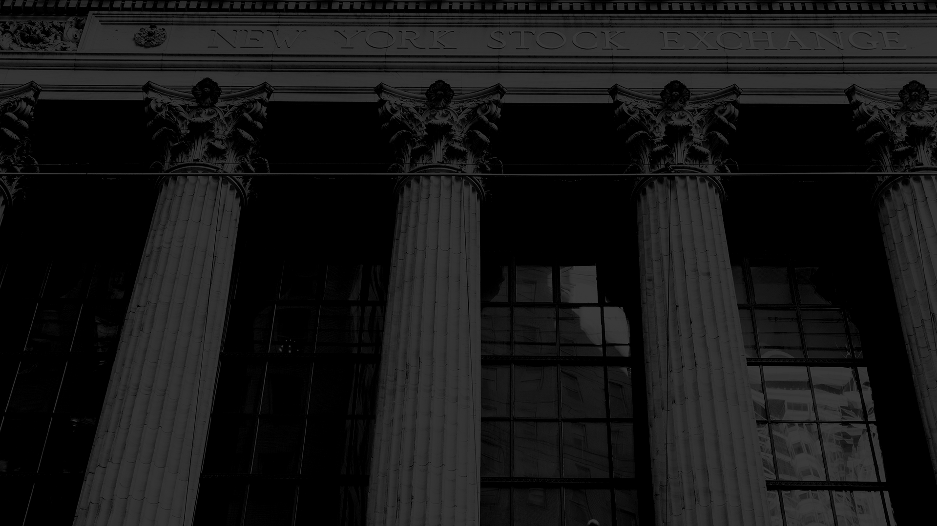
Investment Business Plan
Here is where your presentation begins

Slide 2
Table of Contents
01
02
03
Business Overview
Market Analysis and Competition
Sales and Marketing Plan
04
05
06
Management Plan
Operating Plan
Financial Plan
Here you could describe the topic of the section
Here you could describe the topic of the section
Here you could describe the topic of the section
Here you could describe the topic of the section
Here you could describe the topic of the section
Here you could describe the topic of the section

Slide 3
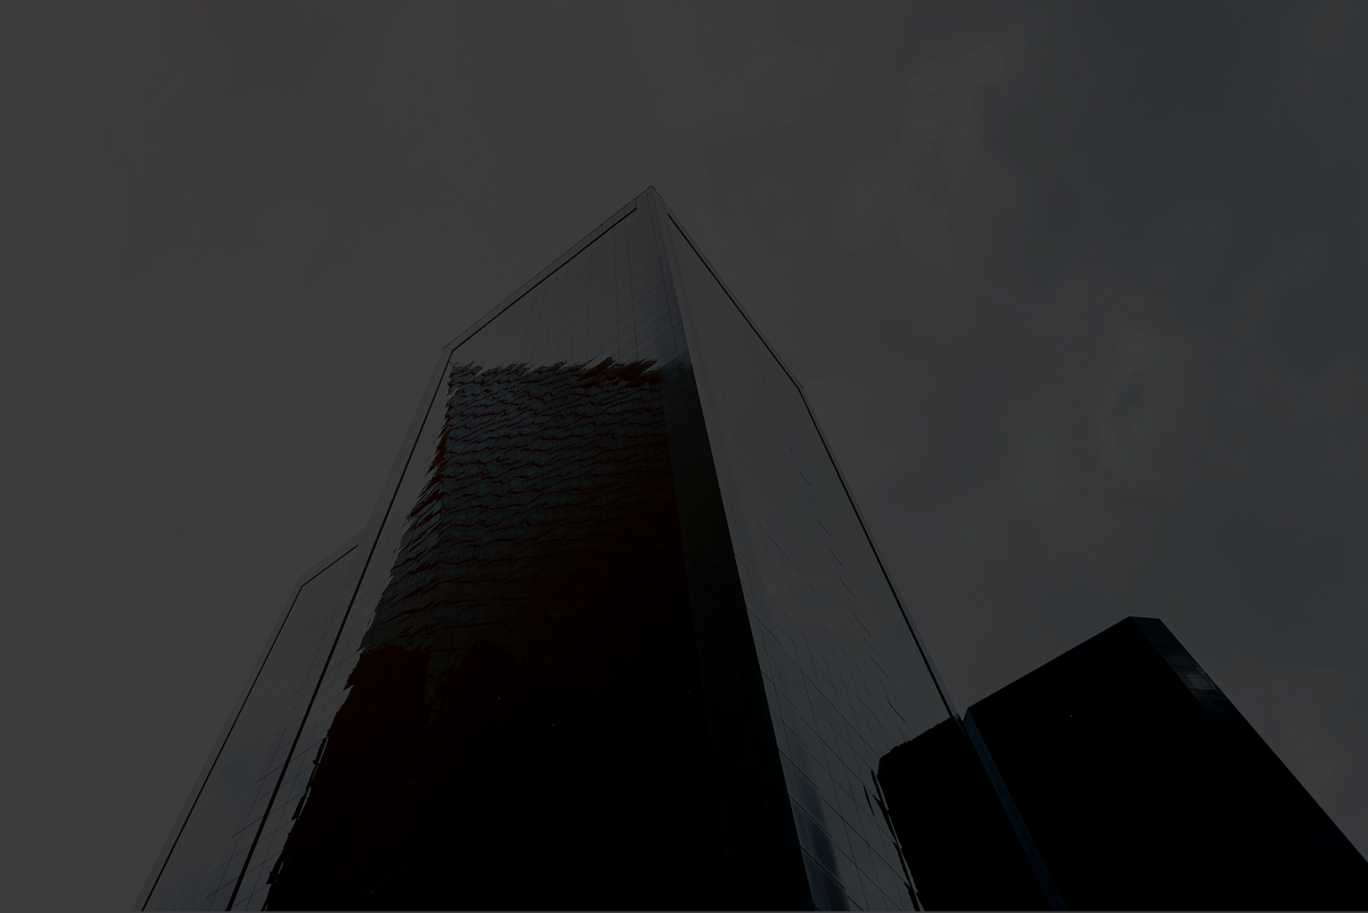
Mission Statement
Here you could describe the company’s mission. A clear message is a good way to get down to business. For example, you could say that Mercury is the closest planet to the Sun and the smallest one in our Solar System

Slide 4
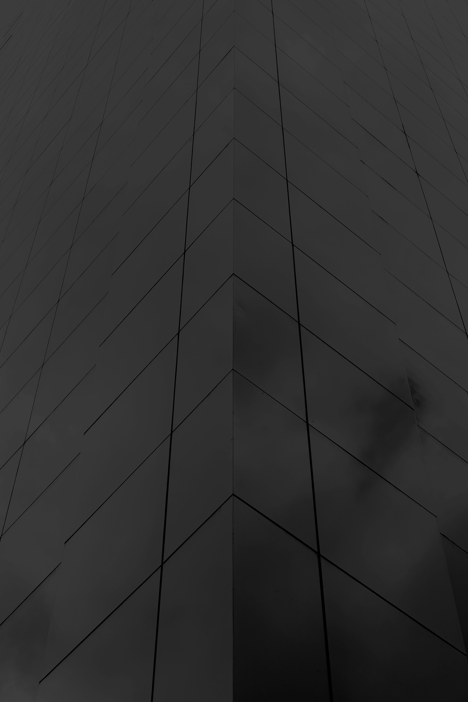
Our Company
Your Logo
Mercury is the closest planet to the Sun and the smallest one in the Solar System—it’s only a bit larger than our Moon. The planet’s name has nothing to do with the liquid metal, since it was named after the Roman messenger god

Slide 5
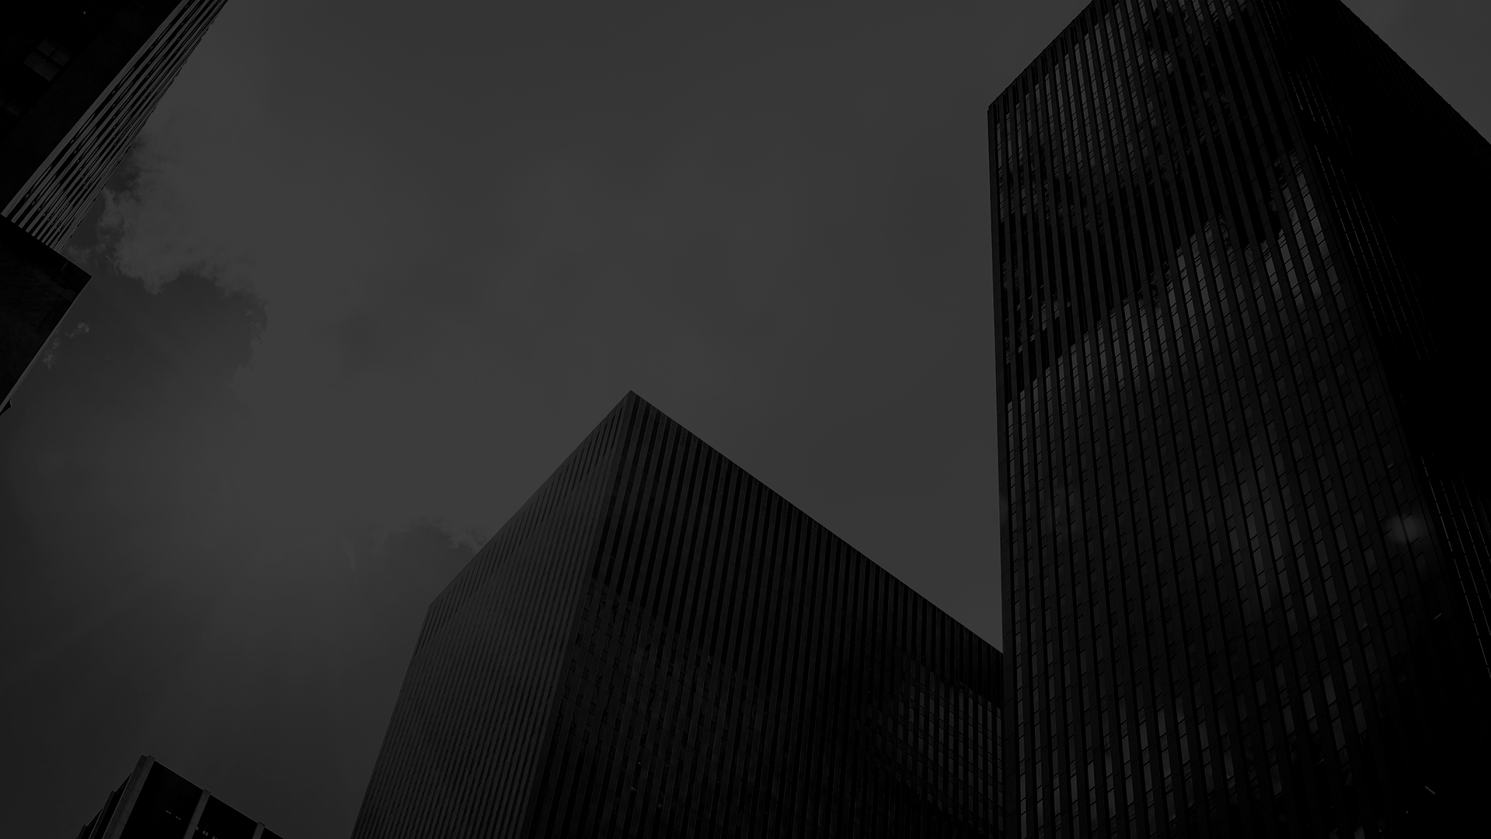
Business Overview
01

Slide 6
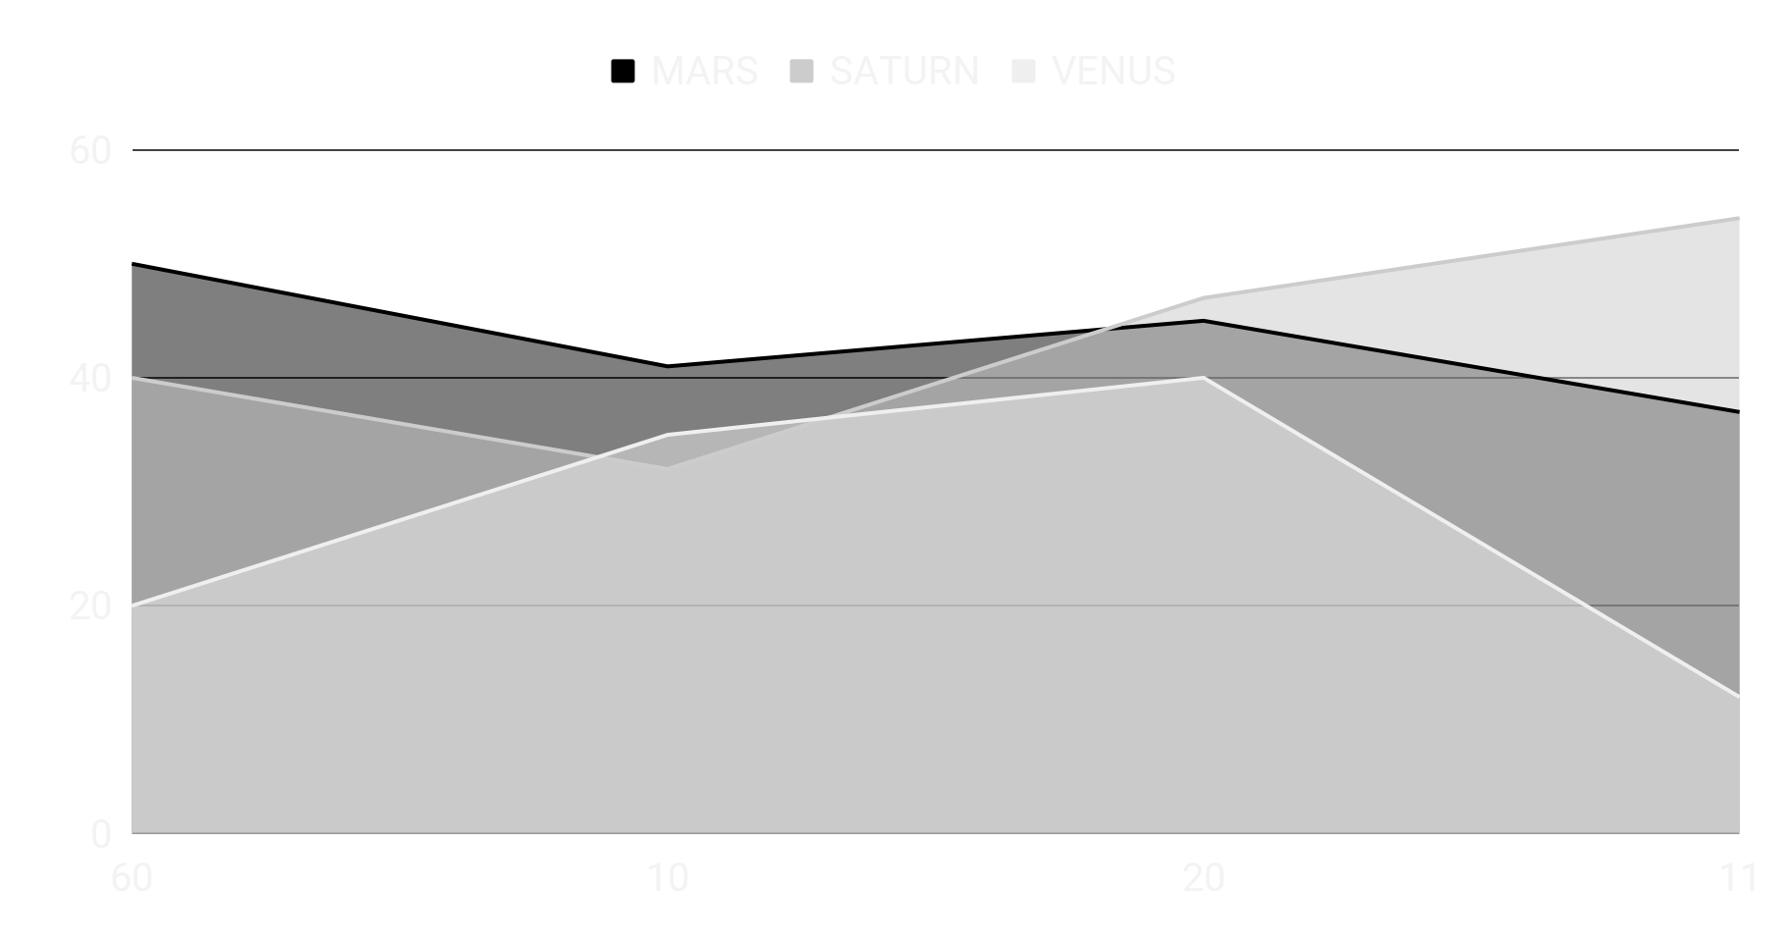
Market Trends
Mercury is the closest planet to the Sun and the smallest one in the Solar System—it’s only a bit larger than our Moon. The planet’s name has nothing to do with the liquid metal, since it was named after the Roman messenger god, Mercury
If you want to modify this graph, click on it, follow the link, change the data and replace it

Slide 7
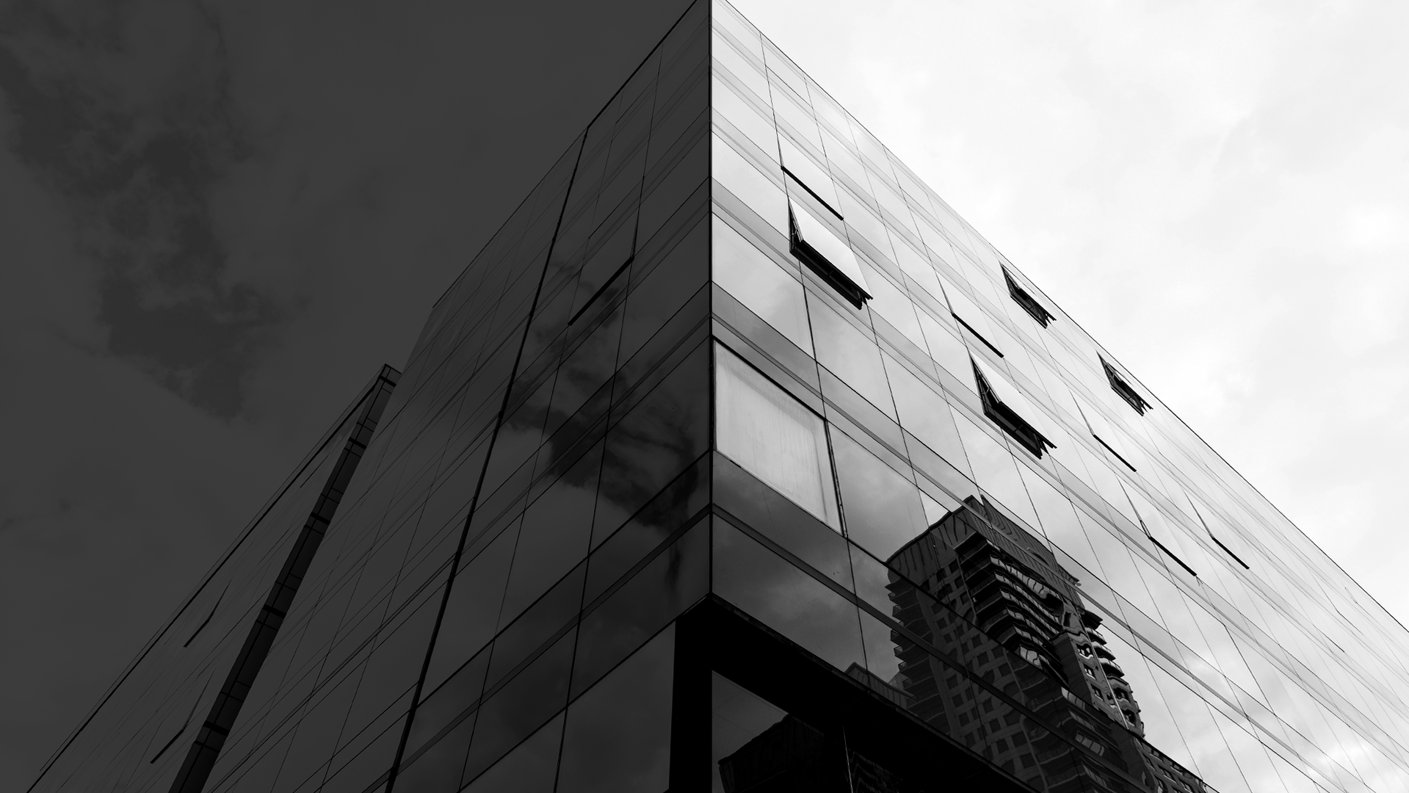
Problem
Solution
Mercury is the closest planet to the Sun and the smallest one in the Solar System—it’s only a bit larger than our Moon. The planet’s name has nothing to do with the liquid metal, since it was named after the Roman messenger god
Venus has a beautiful name and is the second planet from the Sun. It’s terribly hot—even hotter than Mercury—and its atmosphere is extremely poisonous. It’s the second-brightest natural object in the night sky after the Moon

Slide 8
Competitors
Mars
Jupiter
Venus
Saturn
Despite being red, Mars is a cold place, not hot. It’s full of iron oxide, which gives the planet its reddish cast
It’s a gas giant, the biggest planet in our Solar System and the fourth-brightest object in the sky
Venus has a beautiful name and is the second planet from the Sun. It’s terribly hot, even hotter than Mercury
Yes, this is the ringed planet. It’s a gas giant, composed mostly of hydrogen and helium

Slide 9
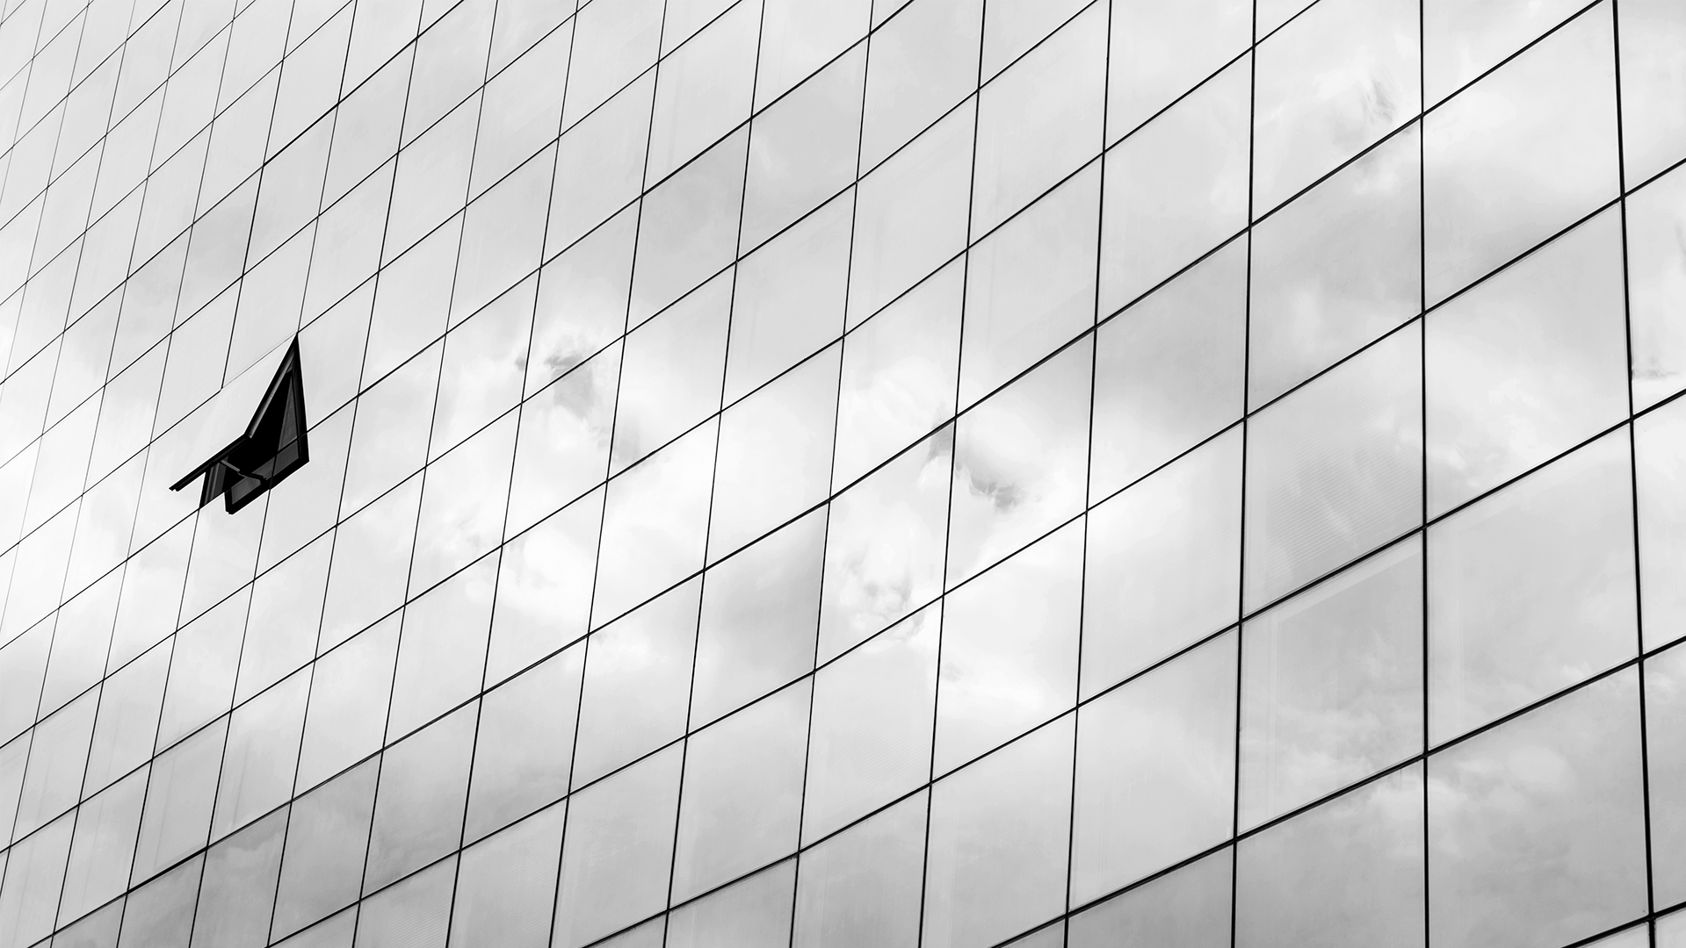
Them
Us
Mercury is the closest planet to the Sun and the smallest one in the Solar System—it’s only a bit larger than our Moon. The planet’s name has nothing to do with the liquid metal, since it was named after the Roman messenger god, Mercury
Venus has a beautiful name and is the second planet from the Sun. It’s terribly hot—even hotter than Mercury—and its atmosphere is extremely poisonous. It’s the second-brightest natural object in the night sky after the Moon

Slide 10
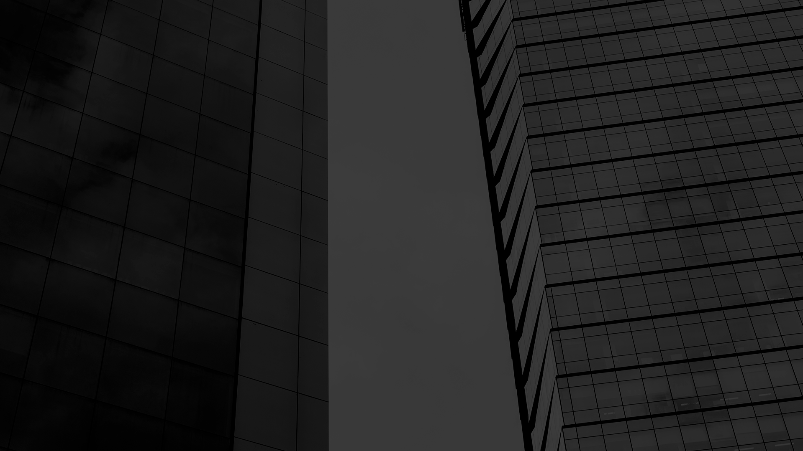
Market Analysis and Competition
02

Slide 11
Target
Average Spend per Customer
Gender
$20,000
Male
Female
Interests
Age
Interest 1
Interest 3
Interest 2
Interest 4
40%
60%
30-45
45-60

Slide 12
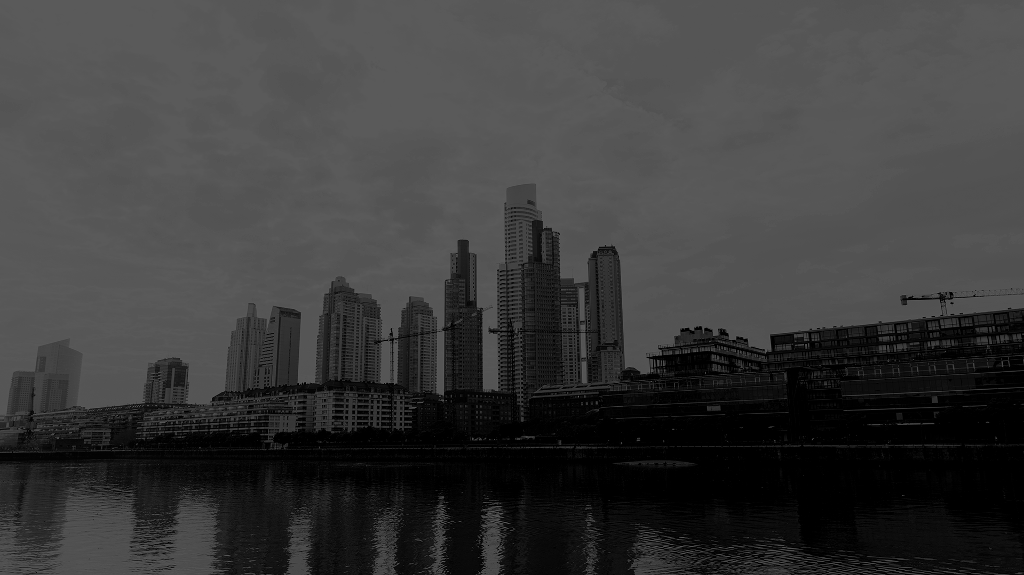
Market Size
20%
Saturn
20%
Neptune
5%
Mercury
55%
Jupiter

Slide 13
Market Share
Jupiter
Jupiter is a gas giant and also the biggest planet in our Solar System
10%
25%
Venus
Venus has a beautiful name, but it’s terribly hot, even hotter than Mercury
15%
50%
Mars
Despite being red, Mars is a cold place, not hot. It’s full of iron oxide dust
Saturn
Saturn is a gas giant, composed mostly of hydrogen and helium

Slide 14
Competition Analysis
Jupiter
Mars
Venus
Mercury
Competitor 1
Yes
Yes
Competitor 2
Yes
Competitor 3
Yes

Slide 15
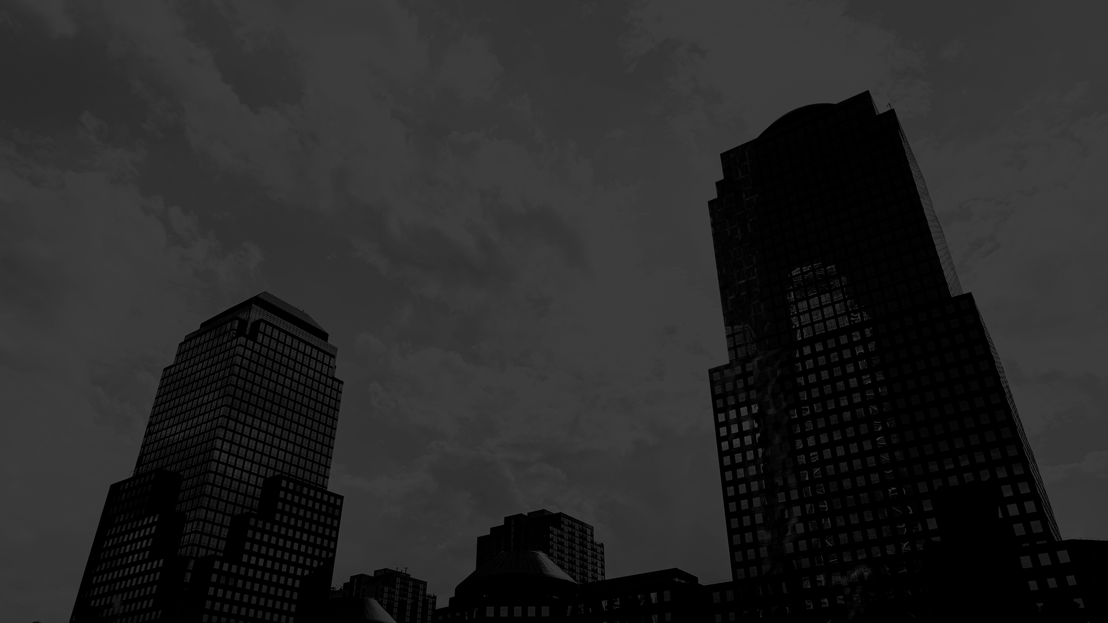
Sales and Marketing Plan
03

Slide 16
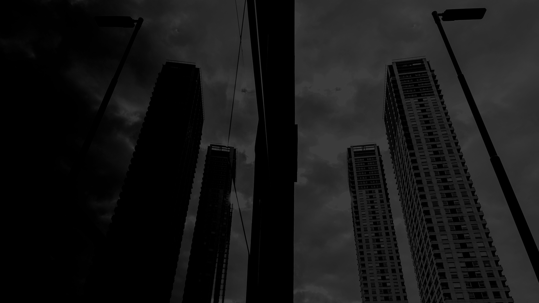
Our Services
Mercury
Venus
Jupiter
Saturn
Mercury is the closest planet to the Sun
Venus has a beautiful name, but it’s terribly hot
It’s the biggest planet in our Solar System
Saturn is the ringed one and a gas giant

Slide 17
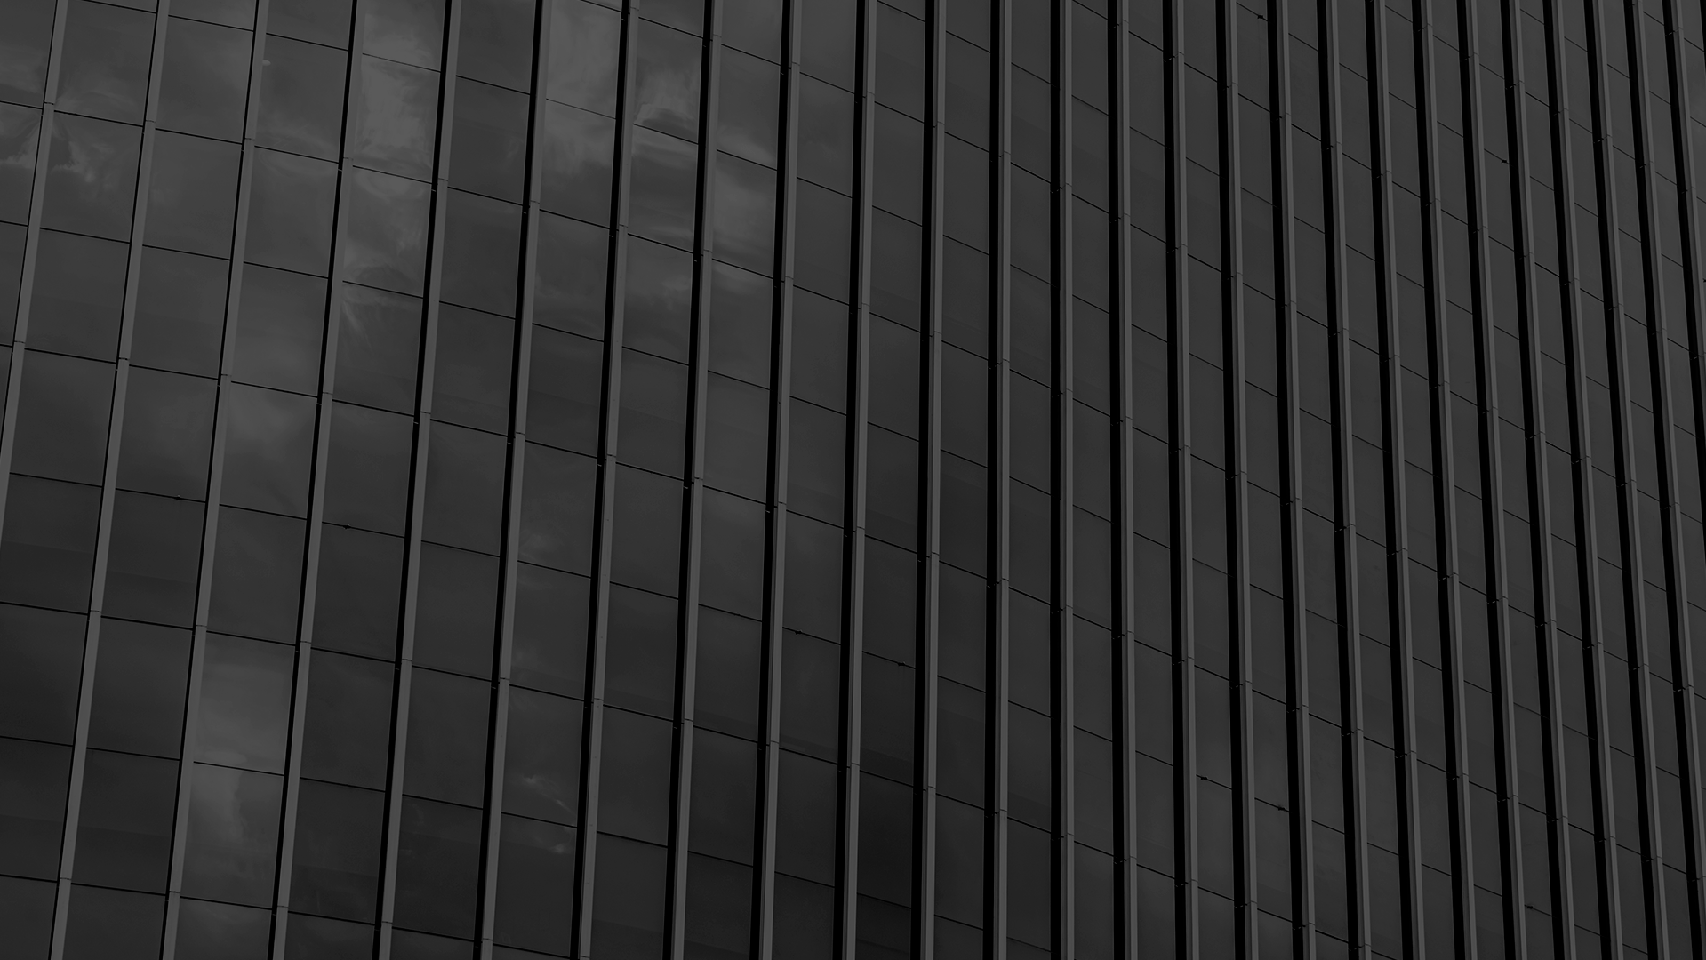
Break-even Analysis
High Profit
Neptune is the farthest planet from the Sun
Profit
Saturn is composed of hydrogen and helium
Break-even Point
Jupiter is the biggest planet in our Solar System
Loss
Despite being red, Mars is a cold place
Big Loss
Mercury is the closest planet to the Sun

Slide 18
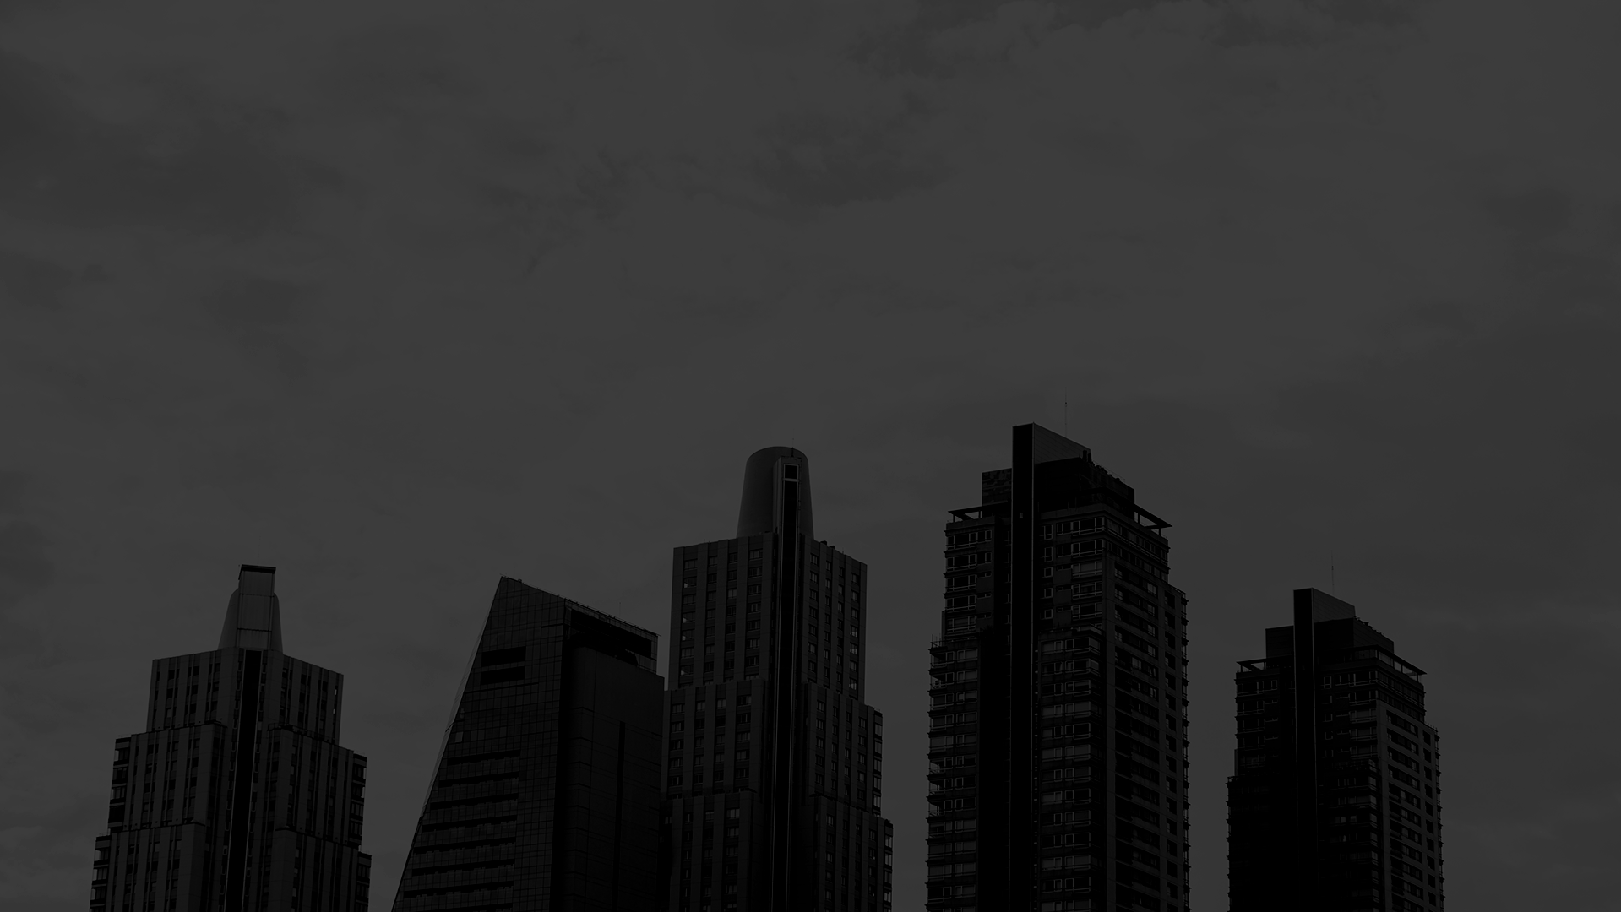
Our Plans
Basic
Pro
Premium
Despite being red, Mars is a cold place, not hot. It’s full of iron oxide dust, giving the planet its reddish cast
Yes, Saturn is the ringed one. This planet is a gas giant, composed mostly of hydrogen and helium
Jupiter is a gas giant and the biggest planet in our Solar System. It’s the fourth-brightest object in the sky

Slide 19
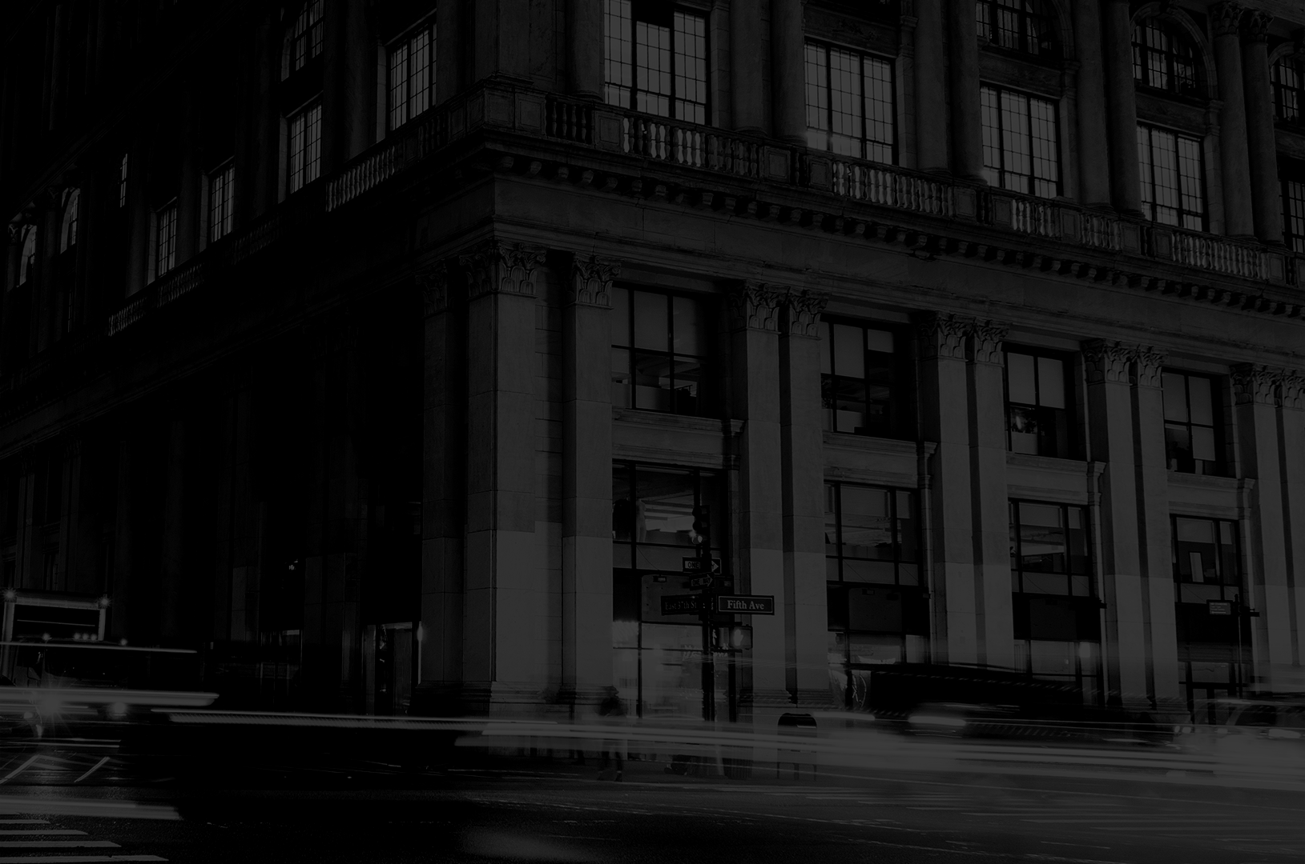
Sales and Distribution
Channel 2
Channel 4
Channel 1
Channel 3

Slide 20
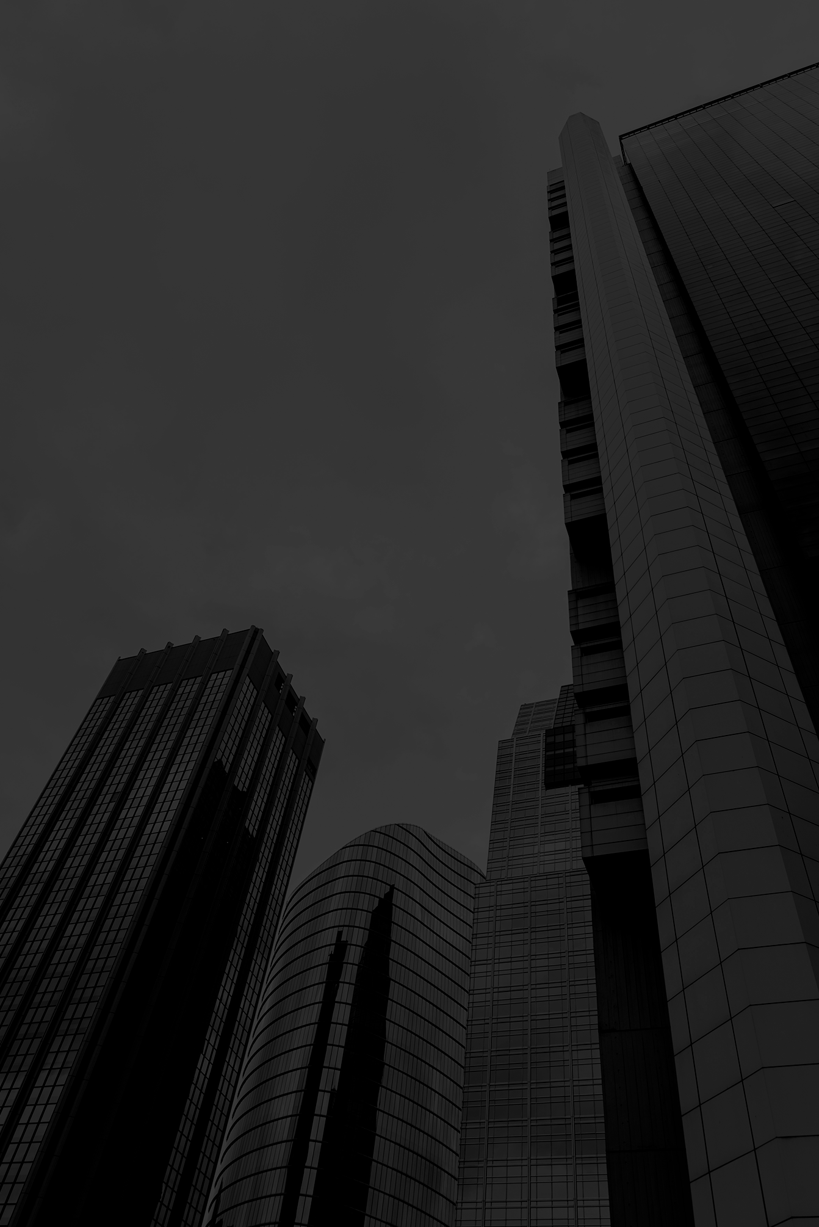
Advertising and Promotion
Advertising
PR
Online
Mercury is the closest planet to the Sun and the smallest one in the Solar System—it’s only a bit larger than our Moon
Venus has a beautiful name and is the second planet from the Sun. It’s terribly hot, even hotter than Mercury
Despite being red, Mars is a cold place, not hot. It’s full of iron oxide dust, which gives the planet its reddish cast

Slide 21
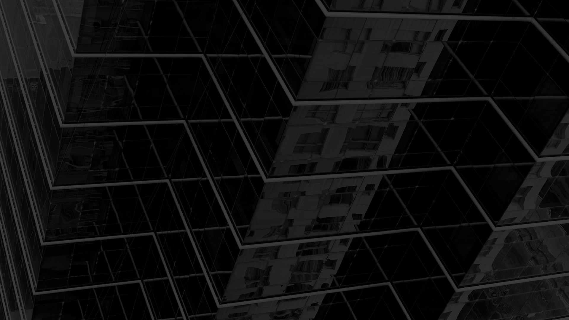
Management Plan
04

Slide 22
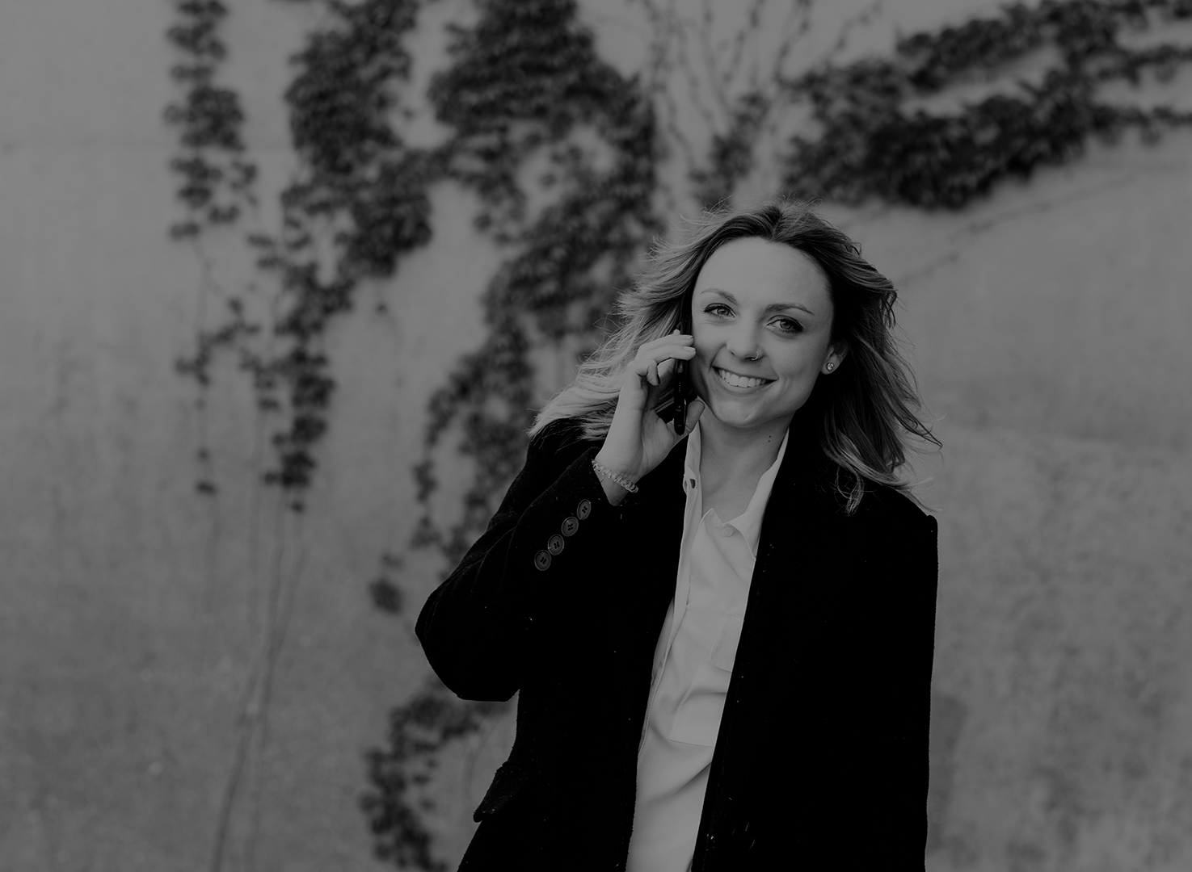

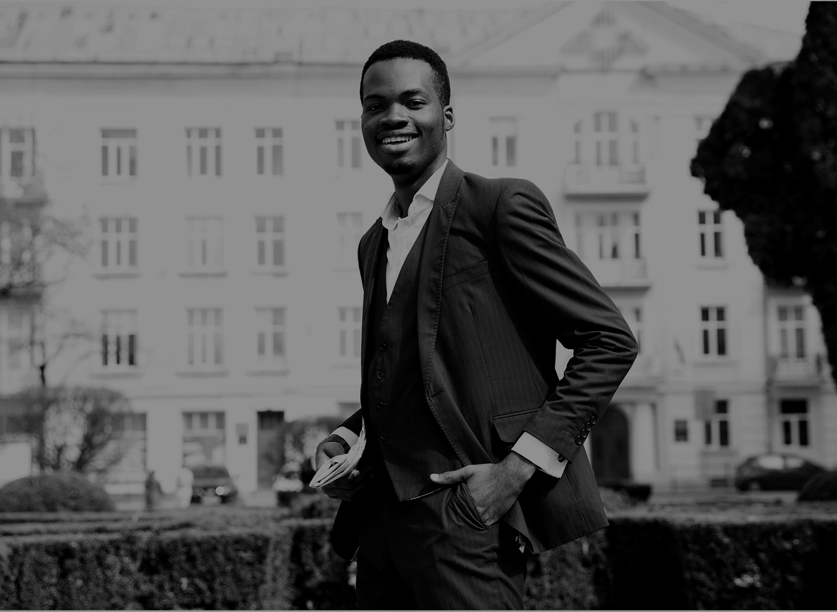
Our Team
Adelyn Keller
You can replace the image on the screen with your own
Mark Doe
Charles Jones
You can replace the image on the screen with your own
You can replace the image on the screen with your own

Slide 23
Organizational Chart
Employee 1
Employee 1
Employee 2
Team 1
Team 3
CEO
Employee 1
Employee 1
Team 2
Team 4
Employee 2

Slide 24
Our Partners
Mercury
Venus
Jupiter
Saturn
Mercury is the closest planet to the Sun
Venus has a beautiful name, but it’s terribly hot
It’s the biggest planet in our Solar System
Saturn is the ringed one and a gas giant

Slide 25
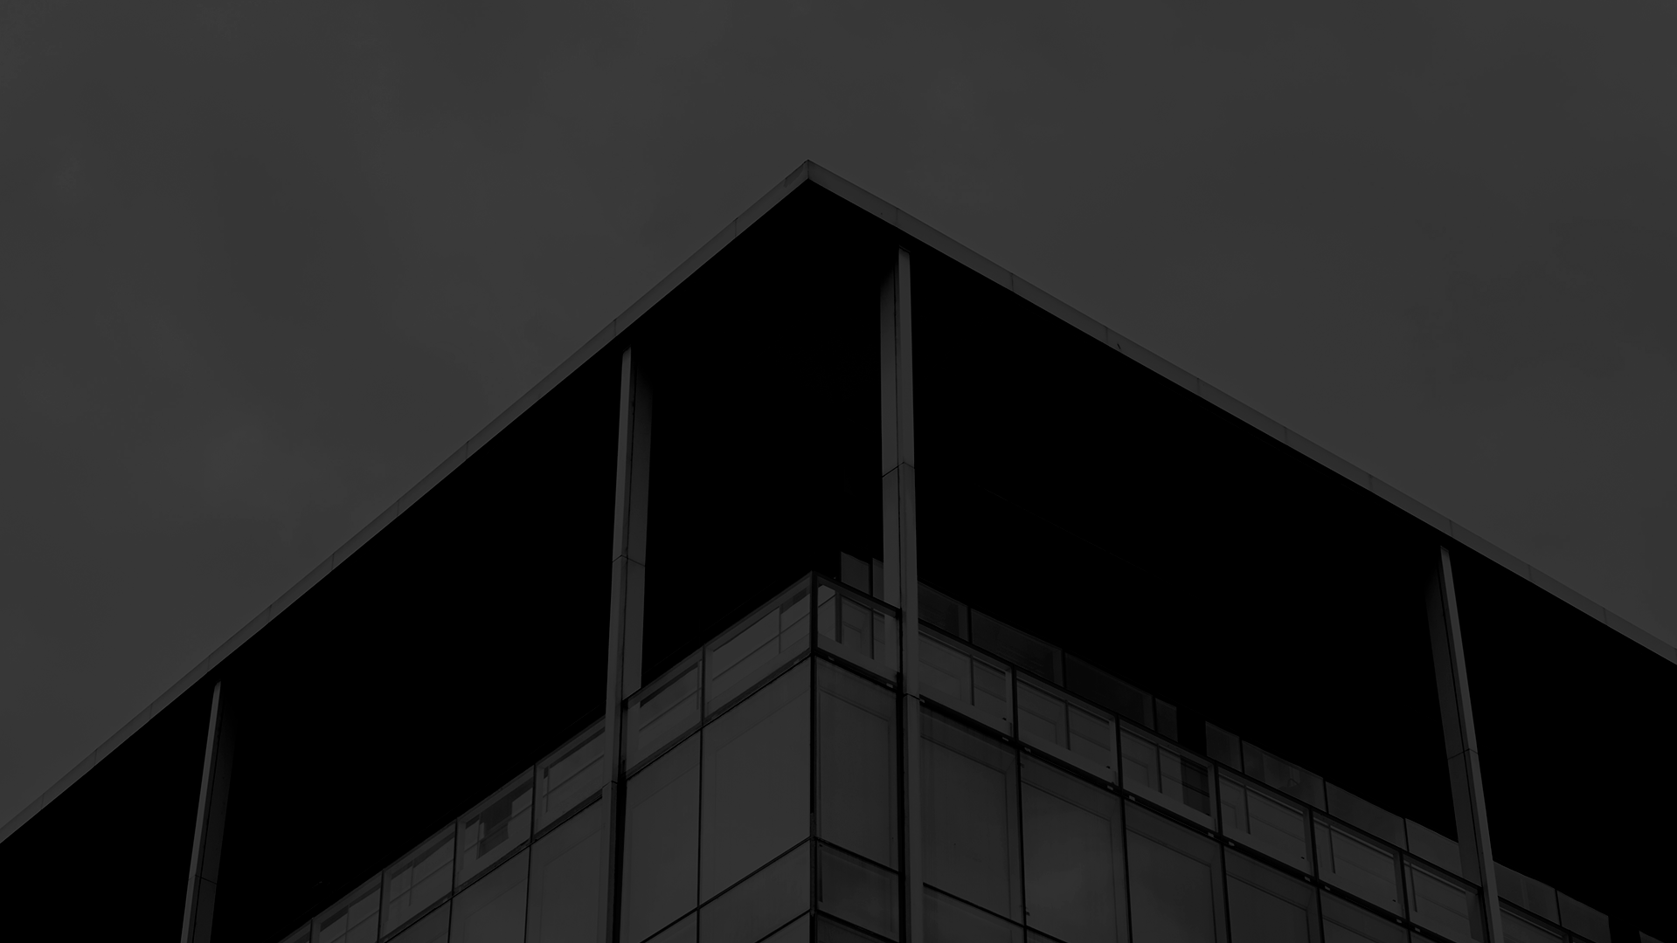
Operating Plan
05

Slide 26
Our Process
Step 1
Step 2
Step 3
Step 4
Step 5
Mercury is the closest planet to the Sun
Despite being red, Mars is a cold place, not hot
Venus has a beautiful name, but it’s terribly hot
Saturn is composed of hydrogen and helium
Neptune is the farthest planet from the Sun

Slide 27
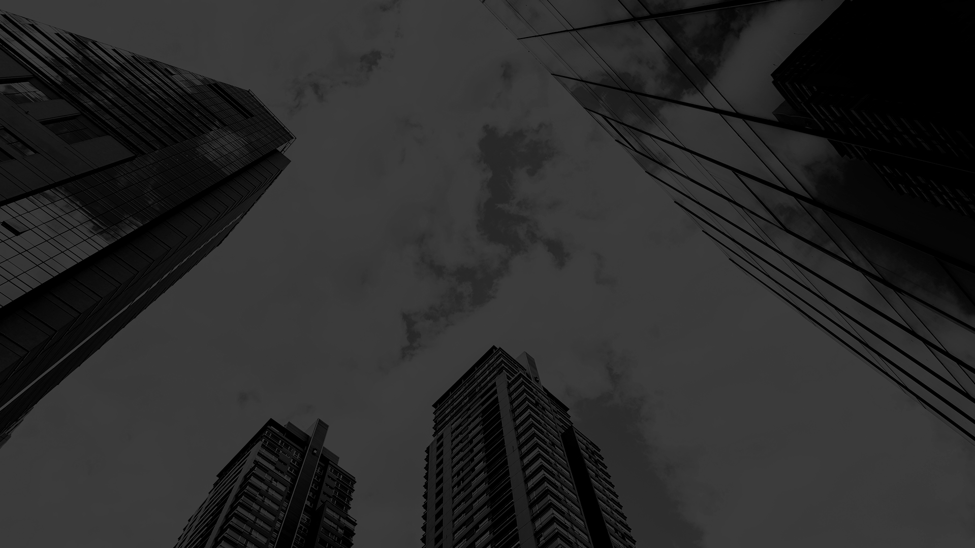
Financial Plan
06

Slide 28
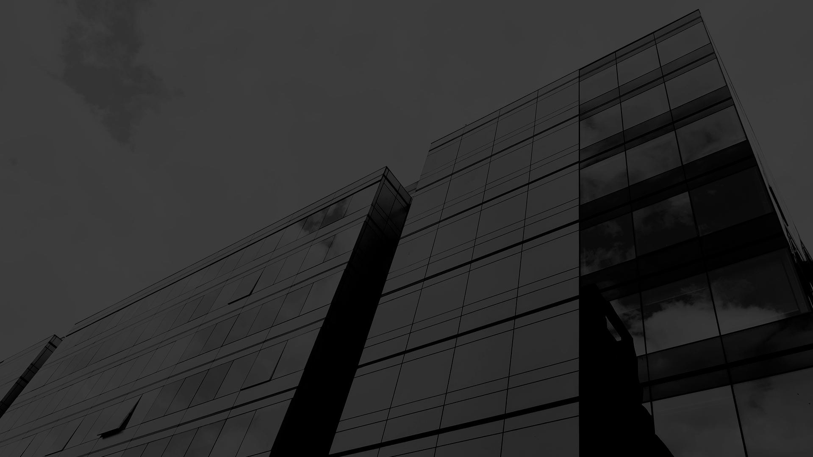
Predicted Growth
$150M
Mercury
Mercury is the smallest planet in our Solar System
$75M
Venus
Venus has a beautiful name, but it’s terribly hot
50%
Saturn
Saturn is composed mostly of hydrogen and helium
25%
Neptune
Neptune is the farthest planet from the Sun

Slide 29
Balance Sheet
Assets
Liabilities
Equity
1M
300K
700K
What the company owns
What the company owes
The difference between assets and liabilities

Slide 30
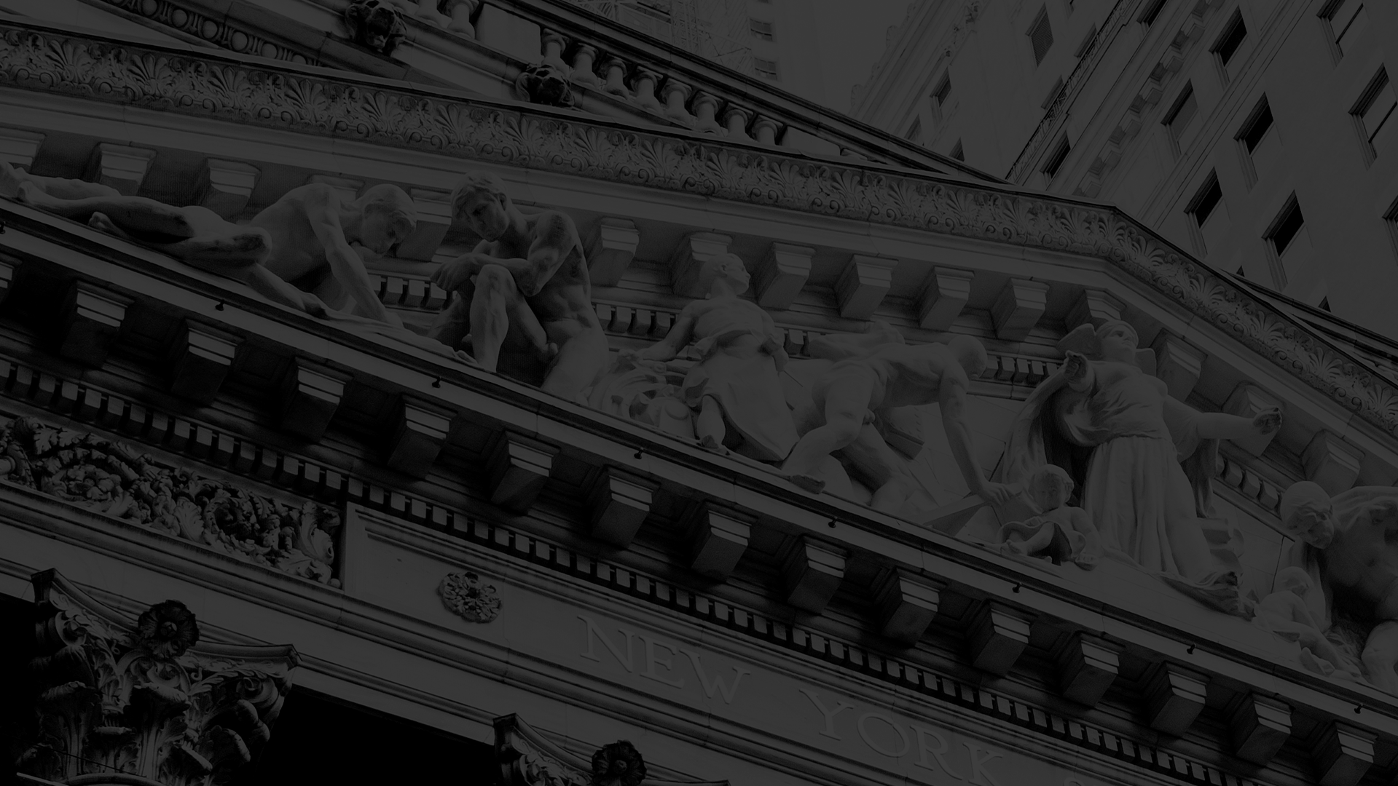
Thanks
Does anyone have any questions?
addyouremail@freepik.com
+91 620 421 838
yourcompany.com

Slide 31
Credits
This is where you give credit to the ones who are part of this project.
Presentation template by Slidesgo
Icons by Flaticon
Infographics by Freepik
Images created by Freepik
Author introduction slide photo created by Freepik
Text & Image slide photo created by Freepik

Slide 32
Resources
Did you like the resources on this template? Get them for free at our other websites.
PHOTOS
Facade of old building with columns of new york stock exchange
Low angle view with grandiose buildings
Low angle building with glass design
Skyscrapers and blue sky with clouds
Low angle view glass designed building
Close-up building with opened window
Low angle buildings with glass design
Low angle view of city skyline
Low angle modern buildings skyline
Low angle glass designed skyscrapers
Close-up glass designed building
Modern buildings skyline view
Lights from cars on background of historic building
Low angle tall buildings view
High angle tall glass building
Medium shot smiley man posing outdoors
Businesswoman making phone call outdoors
Smiling portrait of a young businessman with hands in his pocket looking at camera
Low angle tall building with many windows
Low angle view of skyscrapers
Low angle tall buildings view
New york stock exchange and buildings of wall street

Slide 33
Resources
Did you like the resources on this template? Get them for free at our other websites.
VECTORS
Icon Pack Teamwork
Megaphone Icon
Insurance Icon
Strategy Management Icon Pack

Slide 34
Instructions for use
In order to use this template, you must credit Slidesgo by keeping the Credits slide.
You are allowed to:
- Modify this template.
- Use it for both personal and commercial projects.
You are not allowed to:
- Sublicense, sell or rent any of Slidesgo Content (or a modified version of Slidesgo Content).
- Distribute Slidesgo Content unless it has been expressly authorized by Slidesgo.
- Include Slidesgo Content in an online or offline database or file.
- Offer Slidesgo templates (or modified versions of Slidesgo templates) for download.
- Acquire the copyright of Slidesgo Content.
For more information about editing slides, please read our FAQs:
https://slidesgo.com/faqs

Slide 35
Fonts & colors used
This presentation has been made using the following fonts:
DM Serif Display
(https://fonts.google.com/specimen/DM+Serif+Display)
Open Sans
(https://fonts.google.com/specimen/Open+Sans)
#434343
#f3f3f3

Slide 37
Use our editable graphic resources...
You can easily resize these resources, keeping the quality. To change the color, just ungroup the resource and click on the object you want to change. Then, click on the paint bucket and select the color you want. Don’t forget to group the resource again when you’re done.

Slide 38
...and our set of editable icons
You can resize these icons, keeping the quality.
You can change the stroke and fill color; just select the icon and click on the paint-bucket/pen.
In Google Slides, you can also use Flaticon’s extension, allowing you to customize and add even more icons.

Slide 39
Business Icons

Slide 40
Avatar Icons

Slide 41
Creative Process Icons

Slide 42
Educational Process Icons

Slide 43
Help & Support Icons

Slide 44
Medical Icons

Slide 45
Nature Icons

Slide 46
Performing Arts Icons

Slide 47
SEO & Marketing Icons

Slide 48
Teamwork Icons

Slide 49


