Slide 1
My Digital Notebook

Slide 2
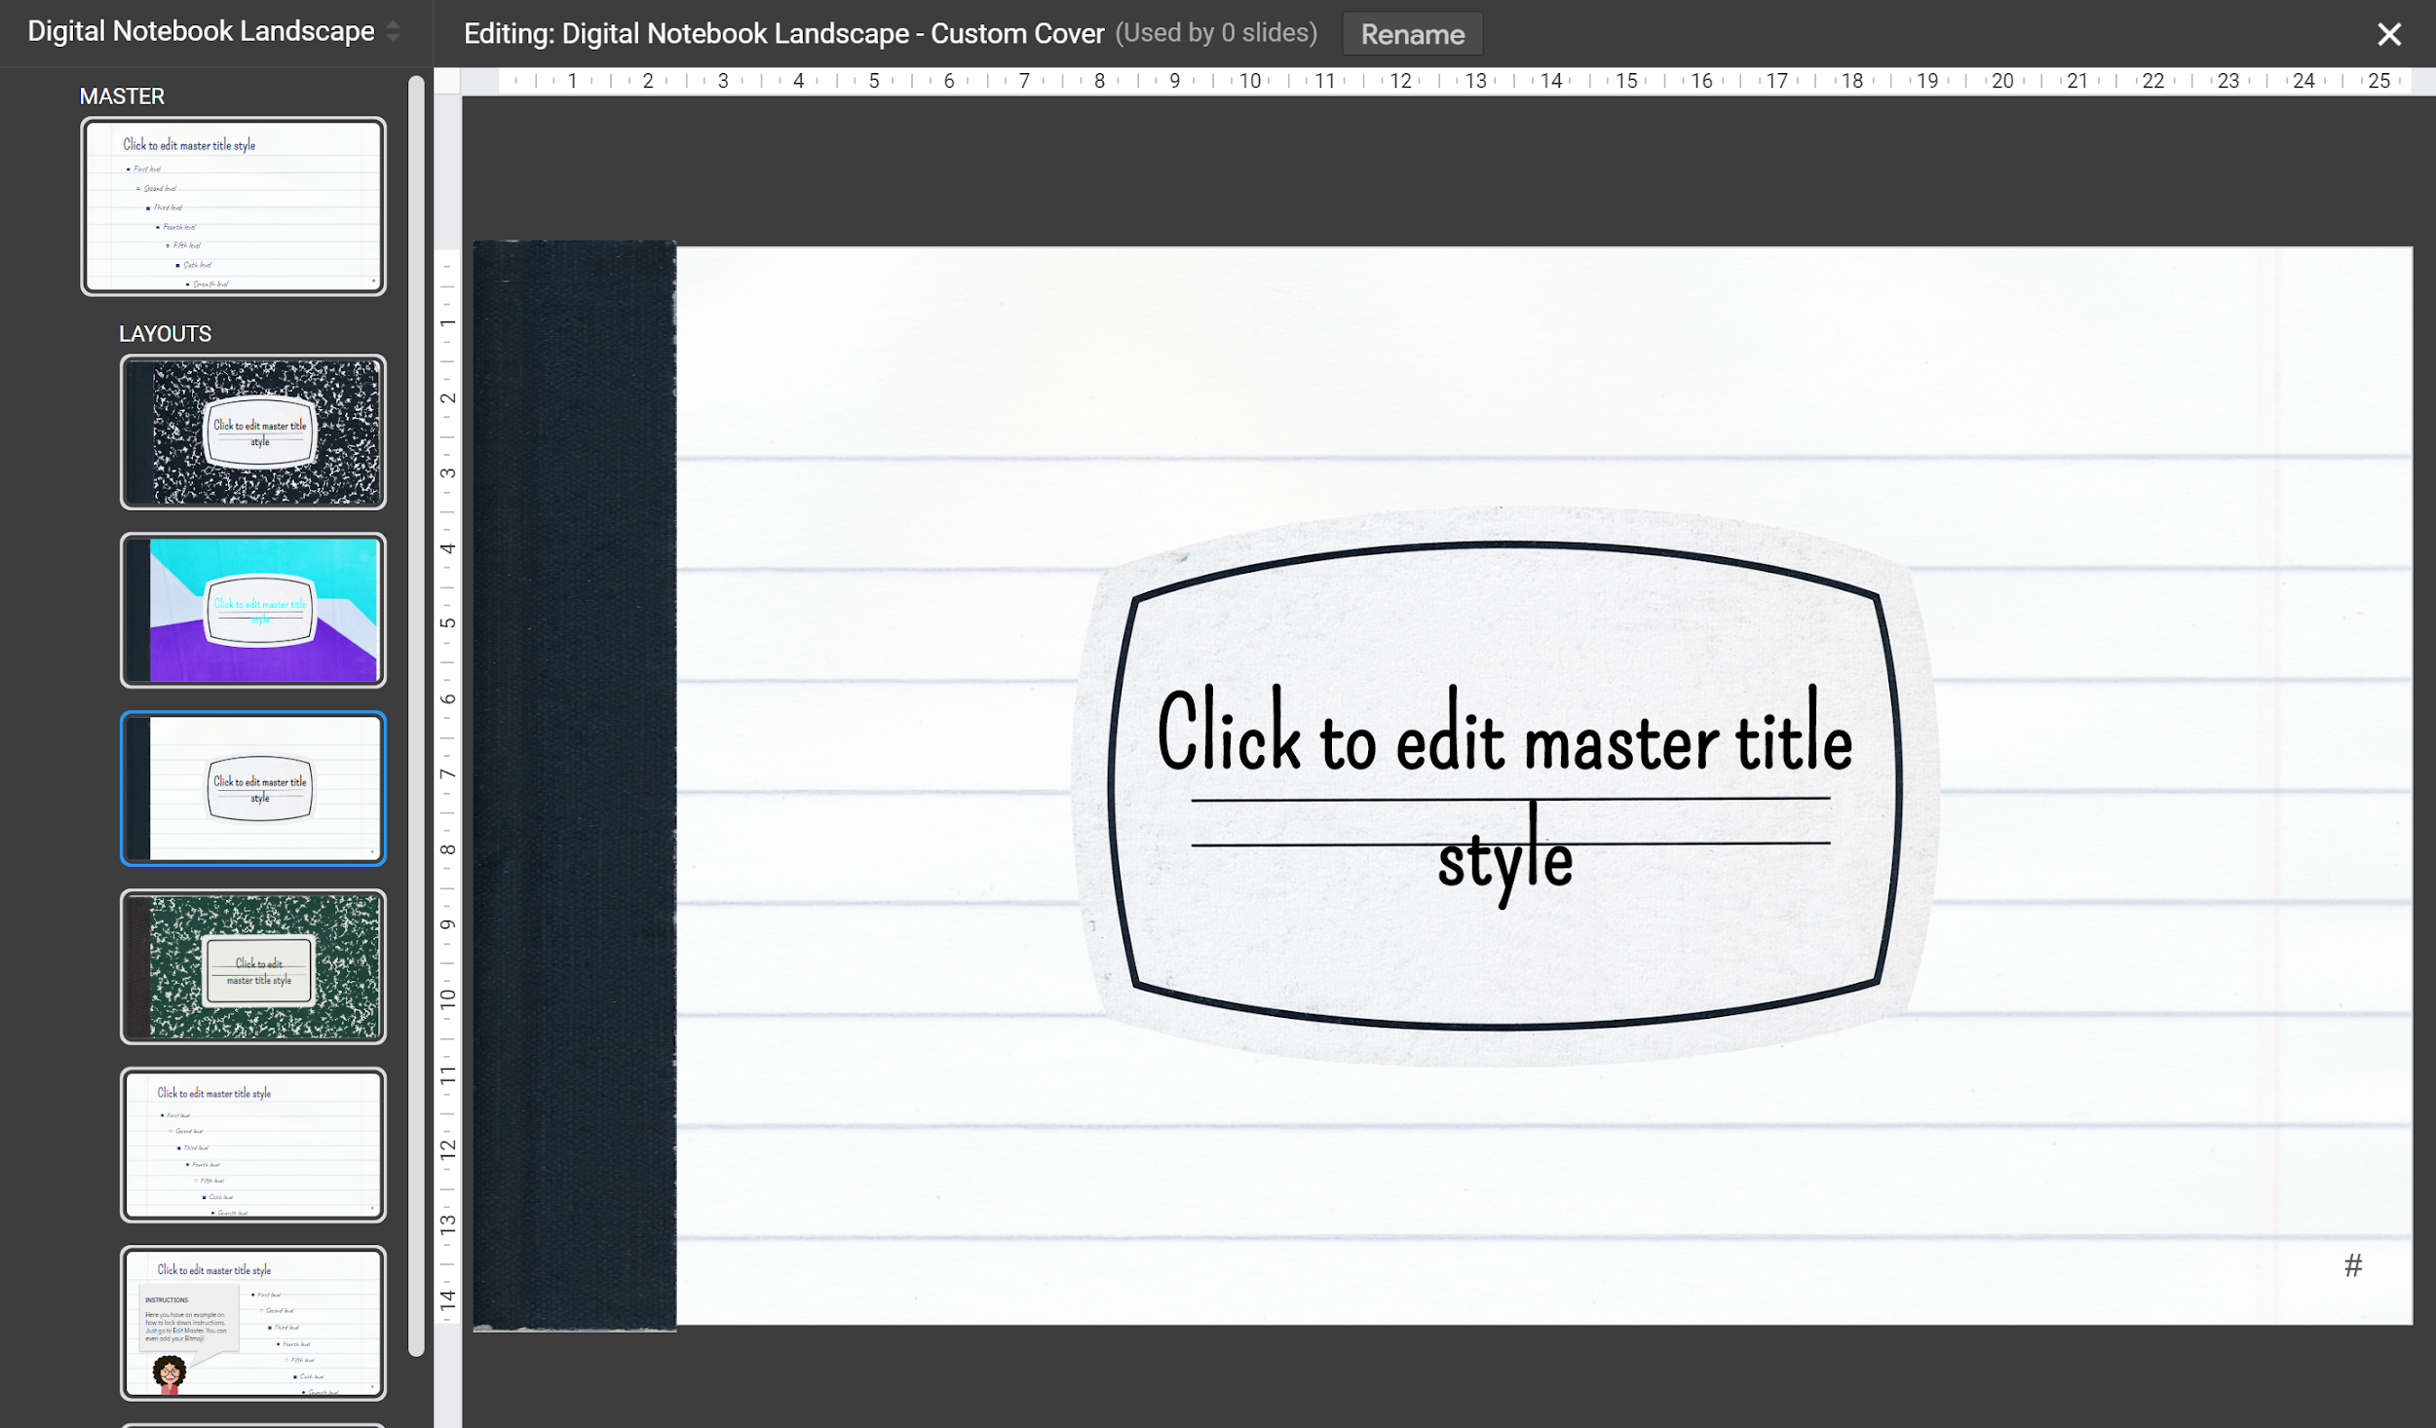
COVERS
You can choose one of the given covers or create your own:
Go to Edit Master.
Go to the “Custom Cover” Layout. Insert the desired image you want for your cover, crop it or resize it to fit the notebook and then right click on it: select Order and Send to back.

Slide 3
PAPER
You can choose between ruled paper or grid. Or edit the master and add your own!
IMPORTANT!
Remember to set your instructions on the master to avoid they get deleted or moved by accident! See next slide.

Slide 4
WRITE YOUR TITLE HERE
Did you know that dogs can smell your feelings?
Dogs can pick up on subtle changes in your scent, which can help him figure out how you are feeling, such as by smelling your perspiration when you become nervous or fearful.

Slide 5
BLANK CANVAS? No problem!
Add your awesome content here.

Slide 6
FONTS
We have chosen Caveat and Pompiere, but you can replace the fonts used on the whole template. Go to Edit Master, click on the MASTER (not the particular layout) and select the desired font for title and body

Slide 7
HIGHLIGHT YOUR TITLES
HIGHLIGHT YOUR TITLES
HIGHLIGHT YOUR TITLES
HIGHLIGHT YOUR TITLES
Select the highlight shape, copy it as many times you need, change fill color - select Custom and adapt transparency.
One you are done, select it and send it to the back.

Slide 8
MORE HIGHLIGHTS!

Slide 9
THANK YOU!
Digital Notebook made by:
SlidesMania

